Slide 1









Best Apps for Manufacturing Available on
AppExchange | AgentExchange

Slide 2







#1
Unknown App
By Unknown

Slide 3







#2
Unknown App
By Unknown

Slide 4


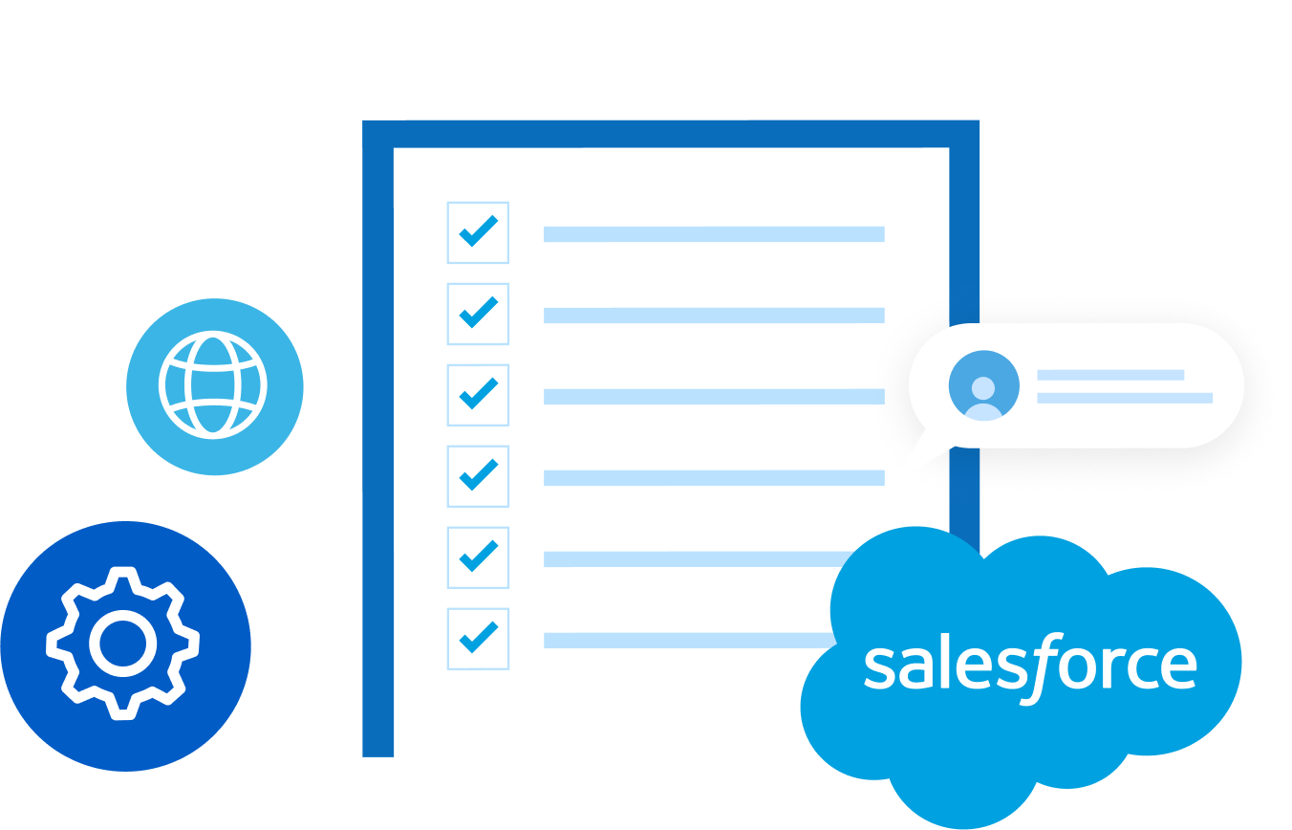


View Full List of Best Salesforce
Apps for Manufacturing at

