Slide 1
DDoS attack prediction using AI
In Fulfilment of CS258 Computer Communication System
Presented to: Prof. Navrati Saxena
Presented by: Udayan Atreya
Shreyas Bhoyar

Slide 2
Table of Contents
Introduction
Related Work
Motivation
4. Problem Statement
5. Proposed Solution
6. Results

Slide 3
Introduction
S&P market intelligence study suggests global cloud computing revenue has doubled from 50 billion to 101 billion USD from 2020 to 2025 ^{[1]} .
This drastic increase in network based technologies such as cloud computing, web services and Internet of Things (IoT) has raised security concerns as well.
IBM security reported 4.8 million USD loss due to data breaches in 2024 alone, reflecting 10% increase from 2023 ^{[2]} .
Intrusion Detection Systems require modern solutions to detect and prevent cyber attacks.
[1] Y. Peraza, M. Posey, and G. Zwakman, "Cloud computing revenue set to nearly double to $101bn by 2025," 451 Research, Market Insight Report, Aug. 20, 2021. [Online].
[2] IBM Corporation, "Cost of a Data Breach Report 2024," IBM Security, Jul. 2024. [Online]. Available: https://www.ibm.com/reports/data-breach

Slide 4
Related Work
Numerous intrusion detection solutions using machine learning have been developed:
Anis et al. ^{[3]} implemented supervised ML algorithms such as Support Vector Machine (SVM) and K-Nearest Neighbours (KNN) using labeled data and combining their results through hard voting to improve detection accuracy.
Saad et al. ^{[4]} implemented reinforcement learning based intrusion detection solution that target multiple attack types using a simple binary reward system.
[3] Anis, A., Shohrab Hossain, M. (2024). DDoS Attack Detection Using Ensemble Machine Learning. In: Pandit, M., Gaur, M.K., Kumar, S. (eds) Artificial Intelligence and Sustainable Computing. ICSISCET 2023. Algorithms for Intelligent Systems. Springer, Singapore.
[4] Saad, A.M.S.E., Yildiz, B. (2023). Reinforcement Learning for Intrusion Detection. In: García Márquez, F.P., Jamil, A., Eken, S., Hameed, A.A. (eds) Computational Intelligence, Data Analytics and Applications. ICCIDA 2022. Lecture Notes in Networks and Systems, vol 643. Springer, Cham.

Slide 5
Related Work
Sr. No. | Related Work | Comments
[1] | A. Anis and M. S. Hossain, "DDoS Attack Detection Using Ensemble Machine Learning" in *Artificial Intelligence and Sustainable Computing*, M. Pandit et al., Eds., Algorithms for Intelligent Systems, Singapore: Springer, 2024, pp. 531–545. [Online]. Available: https://doi.org/10.1007/978-981-97-0327-2_39. | Uses supervised ML with ensemble learning. Static model needs labelled dataset. Focus on DDoS.
[2] | A. M. S. E. Saad and B. Yildiz, "Reinforcement Learning for Intrusion Detection" in *Computational Intelligence, Data Analytics and Applications*, F. P. García Márquez et al., Eds., Lecture Notes in Networks and Systems, vol. 643, Springer, Cham, 2023, pp. 1–14. [Online]. Available: https://doi.org/10.1007/978-3-031-27099-4_18. | Uses Deep Q-learning (RL). Covers multiple classes of attacks. Uses simple binary reward structure.
[3] | E. Bates, V. Mavroudis, and C. Hicks, "Reward Shaping for Happier Autonomous Cyber Security Agents," in *Proceedings of the 16th ACM Workshop on Artificial Intelligence and Security (AISec ’23)*, Copenhagen, Denmark, Nov. 2023, pp. 1–12. [Online]. Available: https://doi.org/10.1145/3605764.3623916. | Study of reward tuning and curiosity in cybersecurity.
Our approach | DDoS attack prediction using AI | Used Deep Q-learning (Reinforcement Learning) on the NSL-KDD dataset. Focused exclusively on DDoS attacks. Custom reward tuning to minimize false positive and false negative. (Not binary)

Slide 6
Motivation
Distributed Denial of Service (DDoS) attacks overwhelms network system by flooding in fake traffic.
Easy to launch and hard to detect early, DDoS attacks are perfect proxy covers for hidden attacks.
Cripples services such as banking, healthcare and emergency response systems leading to loss of revenue and trust.
By predicting and detecting these attacks early, we can protect infrastructure, preserve trust, and contribute to a safer digital future.

Slide 7
Problem Statement
DDoS attacks are increasingly frequent and sophisticated, targeting essential network technology services.
Traditional machine learning detection methods struggle to keep up with these evolving attack patterns.
Supervised learning relies on labelled data, but labelling real world network data is costly.
Unsupervised learning struggles with high dimensional data producing high false positive rates, blocking legitimate traffic.

Slide 8
Proposed Solution
An adaptive intrusion detection system utilizing reinforcement learning, specialized to detect DDoS intrusions with customized reward system.
Advantages:
Can handle imbalanced data
Adaptability to new and evolving attacks
Customizable objectives via reward functions
Challenges:
Complex reward design
Exploration risk

Slide 9
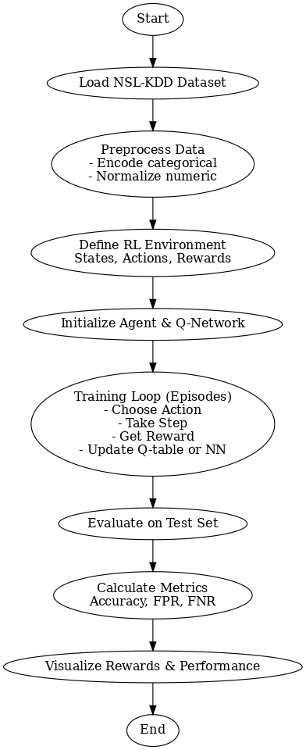
Proposed Solution - Overview
Applied Deep Q-Learning to detect DDoS attacks using the NSL-KDD dataset.
Network records are treated as states, with actions being "benign" or "attack".
Designed a reward system to reinforce correct detections and penalize false alarms.
Agent trained through episodic learning, improving with each interaction.
Final model evaluated on test data using accuracy, FPR, and FNR.

Slide 10
Proposed Solution - Dataset
Dataset:
“Network Security Laboratory” dataset
Specifically designed for evaluating anomaly-based network intrusion detection systems
Developed by the Canadian Institute for Cybersecurity (CIC)
Format: (KDDTrain+.txt), tab-separated
Instances: ~125,973 in Train and ~22,544 in Test
Features:
41 features
Label includes protocol_type, service, flag, duration, src_bytes, dst_bytes, etc.
Preprocessing:
Categorical encoding (OneHot or LabelEncoder)
Normalize numerical features Map attack types to broad categories (especially for DDoS detection)

Slide 11
Proposed Solution - Deep Q-learning
Goal:
Learn an optimal strategy (policy) to maximize long-term rewards for classifying network traffic.
How it works:
Uses a neural network to approximate the Q-function:
Q(s,a)≈Expected reward for action a in state s
Expected reward for action 𝑎 in state 𝑠
Chooses actions using an epsilon policy (balance exploration and exploitation)
Training Loop:
Observe current state (traffic features)
Pick an action (e.g., attack or benign)
Receive a reward
Store (state, action, reward, next_state) in memory
Update Q-network using sampled experiences

Slide 12
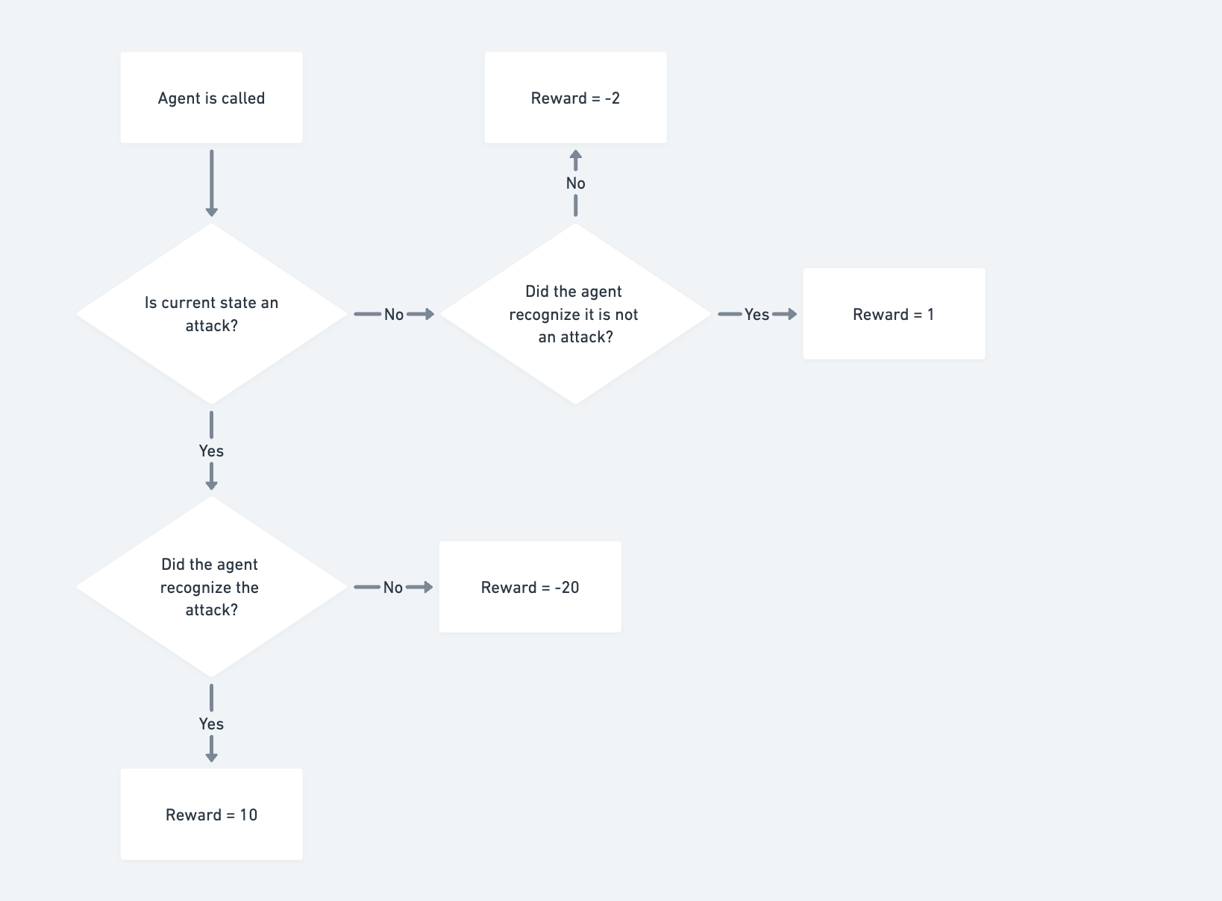
Proposed Solution - Agent Structure

Slide 13
Proposed Solution - Reward Design
Risk-Weighted Reward Design ^{[5]} :
Missing an attack can result in service downtime, data breaches, or financial loss.
It’s far worse than overblocking a benign packet, especially in mission-critical systems.
The high penalty trains the agent to favor caution: if in doubt, treat it as a threat.
[5] E. Bates, V. Mavroudis, and C. Hicks, “Reward shaping for happier autonomous cyber security agents,” in Proc. 16th ACM Workshop on Artificial Intelligence and Security (AISec '23), New York, NY, USA: ACM, 2023, pp. 221–232. [Online]. Available: https://doi.org/10.1145/3605764.3623916
Notes:
Rewarding high-value behaviors (stopping attacks) Penalizing dangerous mistakes more heavily

Slide 14
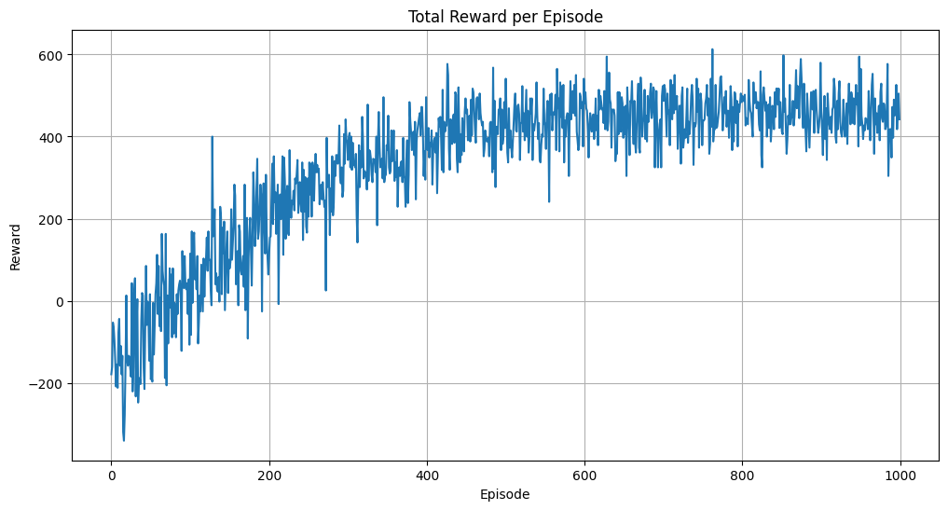
Results

Slide 15
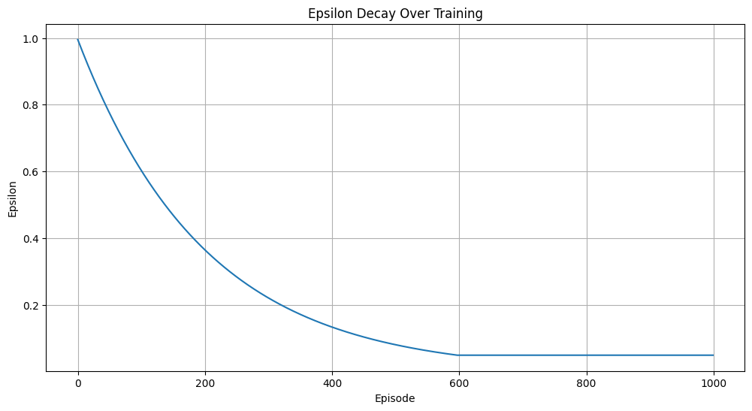
Results

Slide 16
Results
Metric | Our approach | Paper 1 | Paper 2
Model used | Reinforcement Learning with multi-award agent | Ensemble model (KNN, SVM, and Decision Tree) | Reinforcement Learning with binary award agent
Accuracy | 0.8687 ~ 87% | 98.7% | 93%
False Negatives | 0.0961 ~ 9% | Not published | Not published
False Positives | 0.1580 ~ 15% | Not published | Not published

Slide 17
Conclusion & Future Scope
Conclusion:
Devised a intrusion detection system using reinforcement learning with custom reward system.
No dependency on labelled data hence scalable to real world scenarios.
Future Scope:
This approach be extended to detect multi class intrusions.
Deploy to real-time network environments.

Slide 18
Appendix
Sr. No. | Items | Details / Link
1. | Github Code Repository | https://github.com/slowloris-98/DDoS_RL
2. | ReadMe Link | https://github.com/slowloris-98/DDoS_RL/blob/main/README.md
3. | Software Requirements | Python packages: gym, numpy, pandas, matplotlib, scikit-learn, torch
4. | Demo Video Link | https://github.com/slowloris-98/DDoS_RL/blob/main/video1197708533.mp4

Slide 19
References
Y. Peraza, M. Posey, and G. Zwakman, "Cloud computing revenue set to nearly double to $101bn by 2025," 451 Research, Market Insight Report, Aug. 20, 2021. [Online].
IBM Corporation, "Cost of a Data Breach Report 2024," IBM Security, Jul. 2024. [Online]. Available: https://www.ibm.com/reports/data-breach
Anis, A., Shohrab Hossain, M. (2024). DDoS Attack Detection Using Ensemble Machine Learning. In: Pandit, M., Gaur, M.K., Kumar, S. (eds) Artificial Intelligence and Sustainable Computing. ICSISCET 2023. Algorithms for Intelligent Systems. Springer, Singapore. https://doi.org/10.1007/978-981-97-0327-2_39
Saad, A.M.S.E., Yildiz, B. (2023). Reinforcement Learning for Intrusion Detection. In: García Márquez, F.P., Jamil, A., Eken, S., Hameed, A.A. (eds) Computational Intelligence, Data Analytics and Applications. ICCIDA 2022. Lecture Notes in Networks and Systems, vol 643. Springer, Cham. https://doi.org/10.1007/978-3-031-27099-4_18
E. Bates, V. Mavroudis, and C. Hicks, “Reward shaping for happier autonomous cyber security agents,” in Proc. 16th ACM Workshop on Artificial Intelligence and Security (AISec '23), New York, NY, USA: ACM, 2023, pp. 221–232. [Online]. Available: https://doi.org/10.1145/3605764.3623916
H. Hassan, "NSL-KDD," Kaggle, [Online]. Available: https://www.kaggle.com/datasets/hassan06/nslkdd.

Slide 20
THANK YOU!
We are open for questions!

