Slide 1
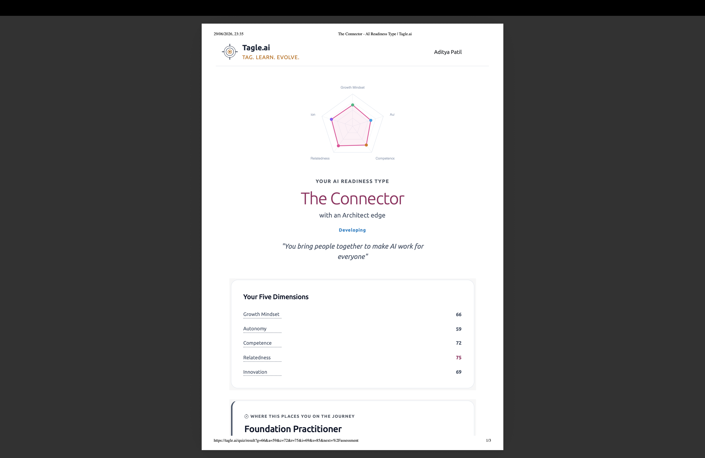
Intelligent Observability & Event Watchdog
A Python / FastAPI AI-Directed SRE Tool
Aditya Patil
The Connector · AI Readiness Type · Tagle.ai
"You bring people together to make AI work for everyone"
Zero cloud dependencies · SQLite · FastAPI · Docker-ready · Built < 3 hours

Slide 2
The Problem
Modern systems generate more logs than humans can monitor
▶ Apache HTTP Server → error.log → thousands of lines / hour
▶ BGL Supercomputer → 131,072 processors → millions of kernel events
▶ Linux syslog → SSH attacks, FTP floods → constant noise
✗ Alert fatigue — ops teams drown in undifferentiated noise
✗ Invisible spikes — real error bursts buried in background chatter
✗ Delayed response — anomalies spotted too late, after impact
✗ Fragmented tooling — parse here, detect there, alert somewhere else
✗ Cost — Datadog / Splunk / New Relic charge thousands per month
→ One self-contained Python service: ingest · detect · alert · visualise

Slide 3
Architecture
┌───────────────────── Single Process (FastAPI + Gunicorn) ─────────────────────┐ │ 9 REST Endpoints WebSocket /api/stream │ │ /api/logs Log Parser (log_parser.py) │ │ /api/analyze apache_logs.csv → unified EventCreate │ │ /api/anomalies bgl_logs.csv → unified EventCreate │ │ /api/webhooks linux_logs.csv → unified EventCreate │ │ ↓ │ │ SQLite watchdog.db (WAL mode) │ │ logs · anomalies · webhook_alerts │ │ ↓ │ │ Anomaly Detector (Z-Score · IQR · Moving Average) │ │ ↓ │ │ Webhook Handler → WH-<uuid> payload → SQLite │ │ │ │ Dashboard static/index.html · Chart.js CDN · WebSocket JS │ └─────────────────────────────────────────────────────────────────────────────────┘
One command: uvicorn main:app --reload --port 8000

Slide 4
Key Features
1. Multi-Source Log Ingest
Apache · BGL Supercomputer · Linux syslog → unified {timestamp, severity, source, message} schema
2. Three Anomaly Detection Algorithms
Z-Score (primary) · IQR · Moving Average — configurable window & threshold
3. Structured Webhook Alerting
WH-<uuid> JSON payload per anomaly: CRITICAL (z>3) PAGE_ON_CALL · WARNING NOTIFY
4. Real-time Dashboard
Health pill · 4 metric cards · Error Rate chart · Severity bar · Source doughnut · Live stream
5. Production Docker Setup
Multi-stage image · non-root user · named volume · dev hot-reload override

Slide 5
Live Demo Flow
Step 1
uvicorn main:app --reload --port 8000 → auto-ingest 160 logs → open localhost:8000
Step 2
Observe pre-loaded anomalies: Apache spike · BGL FATAL burst · Linux SSH storm
Step 3
Switch method to IQR → Run Analysis | Lower Z threshold → more alerts surface
Step 4
Click Simulate Live Feed → watch chart grow at 300 ms/log → Stop
Step 5
python synthetic_data_gen.py --rows 500 → Ingest → Run Analysis
Step 6
Expand a SPIKE badge → WH-<uuid> JSON with action: PAGE_ON_CALL
Step 7
Visit /docs → full OpenAPI UI | /api/webhooks → raw JSON history

Slide 6
Tech Stack & AI-Directed Development
▶ API: FastAPI 0.115 — async, auto-docs, WebSocket native
▶ Database: SQLite + WAL — zero-config, zero cost, ACID compliant
▶ Server: Gunicorn + uvicorn worker — production lifecycle
▶ Frontend: Vanilla JS + Chart.js CDN — no build step, single HTML
▶ Detection: Pure Python stdlib math — no NumPy dependency
▶ Containers: Docker + Compose — reproducible deploys
How the session worked:
→ Human defines requirements → AI translates to architecture
→ Human specifies CSV schemas → AI writes complete implementation
→ Human reviews screenshot → AI diagnoses bug, rewrites files
→ Human approves each phase → AI executes with zero manual edits
Full MVP · 22 files · ~1 800 lines · < 3 hours · 0 cloud services · 0 manual edits

Slide 7
Future Improvements
Near-term
Medium-term
• ML anomaly detection — Isolation Forest / LSTM for non-stationary series
• Real webhook delivery — POST to Slack / PagerDuty with retry queue
• Alert deduplication — suppress repeat alerts for same window
• Rule engine — user-defined threshold rules (error_rate > 60% for 10 min)
• JWT / API-key authentication on all endpoints
• PostgreSQL — multi-worker horizontal scaling
• Log tail mode — watch live files via inotify
• Grafana integration — Prometheus /metrics endpoint
• Email digest — daily anomaly summaries via SMTP
Vision: Any log format · LLM root cause analysis · K8s + HPA · TimescaleDB

Slide 8
Summary
Lines of code
~1 800 (Python + HTML + YAML)
Files delivered
22
Build time
< 3 hours (AI-directed session)
External paid services
0
Cloud dependencies
0
Manual edits by human
0
Bugs fixed
1 (empty dashboard → auto-ingest on startup)
Anomaly methods
3 (Z-Score · IQR · Moving Average)
Docker image size
~200 MB (multi-stage slim)
Built by Aditya Patil · The Connector (Tagle.ai) · July 2026

