Slide 1
Cisco Certified Network Associate Enterprise LAN Design with Inter-VLAN Routing and EtherChannel for High Availability
Presented by,
Md.Ishrak Khan
CCNA & MTCNA – 2504

Slide 2
CONTENTS
1. Network Topology | What topology used and the base diagram of how the network looks like.
2. Configurations | Router, Switch, Server, Device etc configuration along with commands.
3. Security protocol | SSH and other security protocols.
4. Testing | All routes testing by ping testing.
5. Conclusion | Concluding the presentation on good note.
6. Q&A | Taking questions from audience.

Slide 3
1
Network Topology

Slide 4
In our project we have used Star Network Topology. Components that have been used to create the network are: - 1 ISR Router (Integrated Service Router - 2911) - 1 Multilayer Switch (3650-24PS) - 3 Switches (2960-24TT) - 4 Servers (1 NTP Server and 1 Server for each department) - Some end devices - Copper Straight-Through Cables to connect all the components

Slide 5
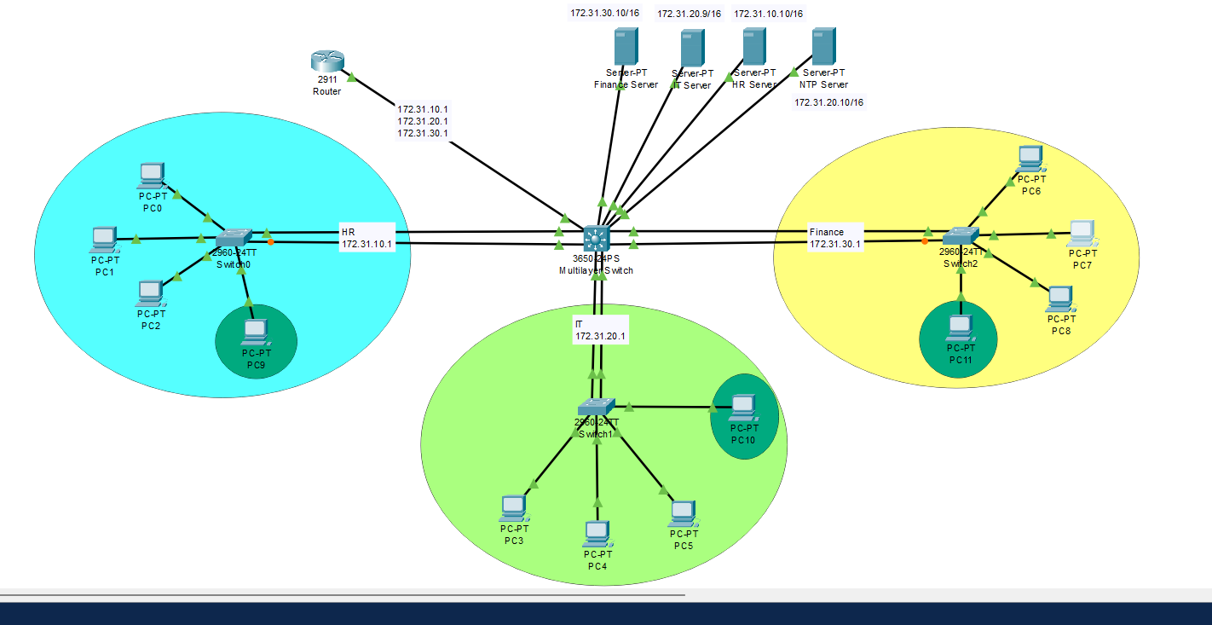
The Network Topology

Slide 6
2
Configurations

Slide 7
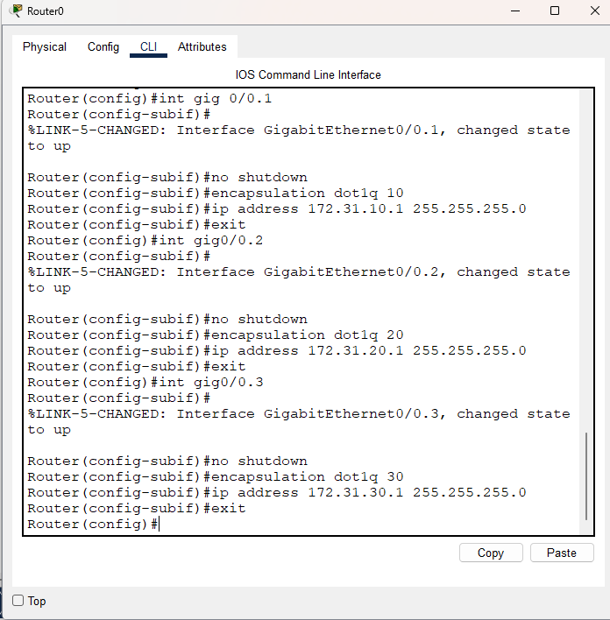
Router Sub Interface Configuration:
int gig0/0.1
no shutdown
encapsulation dot1q 10 (for HR)
ip address 172.31.10.1 255.255.255.0 (HR Gateway)
exit
int gig0/0.2
no shutdown
encapsulation dot1q 20 (for IT)
ip address 172.31.20.1 255.255.255.0 (IT Gateway)
exit
int gig0/0.3
no shutdown
encapsulation dot1q 30 (for Finance)
ip address 172.31.30.1 255.255.255.0 (Finance Gateway)
exit

Slide 8
Multilayer Switch Configuration
# Turning trunk port in Multilayer Switch for router connection:
configure terminal
int gig1/0/1
switchport mode trunk
switchport trunk allowed vlan 10,20,30
# VLAN configuration in multilayer switch:
vlan 10
name HR
exit
int gig1/0/2
switchport mode trunk
exit
vlan 20
name IT
exit
int gig1/0/3
switchport mode trunk
exit
------------------→
-----------→
vlan 30
name Finance
exit
int gig1/0/4
switchport mode trunk
exit

Slide 9
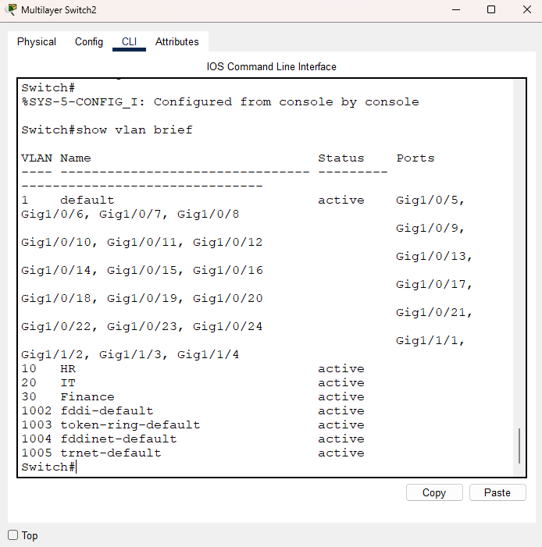

Slide 10
Switch Configuration:
# Switch configuring for pc to switch connection:
vlan 10
name HR
exit
int range fa0/1-24
switchport mode access
switchport access vlan 10
exit
vlan 20
name IT
exit
int range fa0/1-24
switchport mode access
switchport access vlan 20
exit
--------------------→
---------------→
vlan 30
name Finance
exit
int range fa0/1-24
switchport mode access
switchport access vlan 30
exit
# Turning trunk mode on in all switch connected to multilayer switch
en
configure terminal
int gig0/1
switchport mode trunk
Int gig0/2
switchport mode trunk (back up cable)

Slide 11
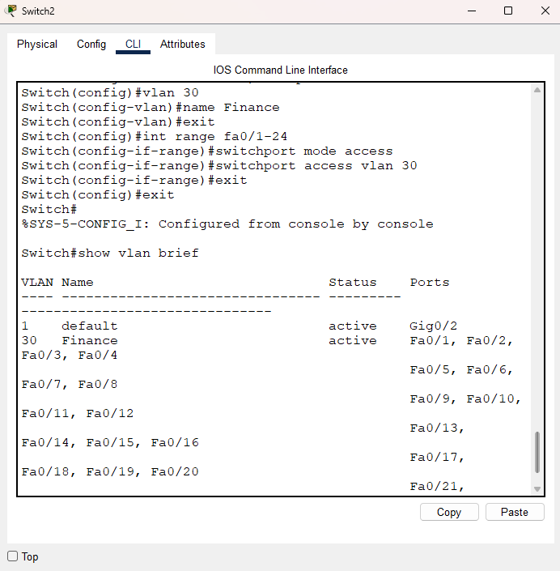
Switch of Finance Department

Slide 12
DHCP Configuration in Router:
We configured DHCP in router for external users to get access to network.
# DHCP configuration:
HR:
ip dhcp pool vlan10
network 172.31.10.0 255.255.255.0
default-router 172.31.10.1
dns-server 8.8.8.8
IT:
ip dhcp pool vlan20
network 172.31.20.0 255.255.255.0
default-router 172.31.20.1
dns-server 8.8.8.8
Finance:
ip dhcp pool vlan30
network 172.31.30.0 255.255.255.0
default-router 172.31.30.1
dns-server 8.8.8.8
Excluding reserved ip from dhcp:
ip dhcp excluded-address 172.31.10.1 172.31.10.10
ip dhcp excluded-address 172.31.20.1 172.31.20.10
ip dhcp excluded-address 172.31.30.1 172.31.30.10

Slide 13
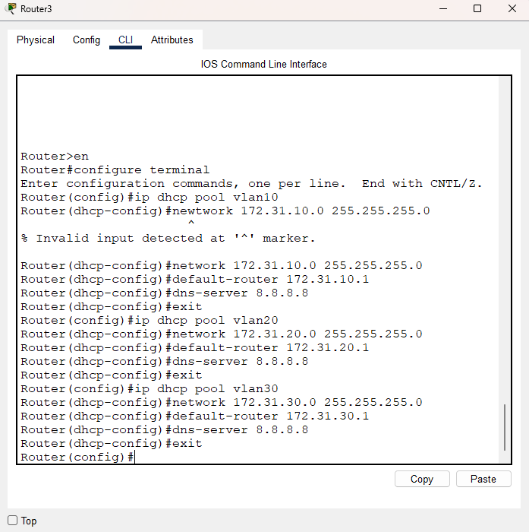
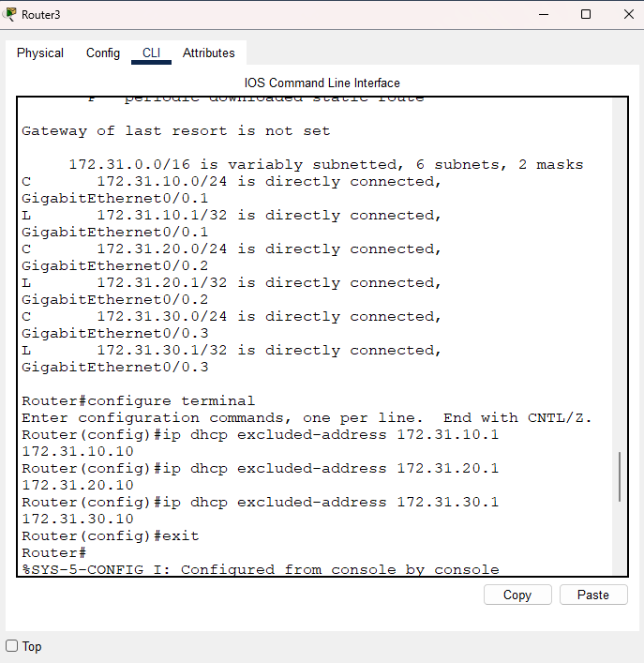

Slide 14
Server Configuration:
We have 3 departments in our network. Therefore, we added 3 dedicated servers to our network. Moreover, we added the NTP Server to synchronize time of all devices within the network. It is also important for the network security.
# HR-server:
1. putting a static ip in the HR server
2. Switch configuration:
Switch(config)#interface gig1/0/6
Switch(config-if)#switchport mode access
Switch(config-if)#switchport access vlan 10
# IT-server:
1. putting a static ip in the IT server
2. Switch configuration:
Switch(config)#interface gig1/0/7
Switch(config-if)#switchport mode access
Switch(config-if)#switchport access vlan 20

Slide 15
# Finance-server:
1. putting a static ip in the Finance server
2. Switch configuration:
Switch(config)#interface gig1/0/8
Switch(config-if)#switchport mode access
Switch(config-if)#switchport access vlan 30
# NTP-server:
1. We put static ip 172.31.20.10 in the ntp server
2. Switch configuration:
interface gig1/0/5
switchport mode access
switchport access vlan 20
3. Configuring router to connect to ntp server:
en
configure terminal
ntp server 172.31.20.10
ping 172.31.20.10 (if successful then next command)
show clock

Slide 16
Access Control List Configuration
To limit the access of servers to only the dedicated departments we have configured ACL in the network router. The configuration commands are:
# HR:
access-list 100 permit ip 172.31.10.0 0.0.0.255 host 172.31.10.10
access-list 100 deny ip any host 172.31.10.10
access-list 100 permit ip any any
int gig0/0.1
ip access-group 100 out
# IT:
access-list 101 permit ip 172.31.20.0 0.0.0.255 host 172.31.20.9
access-list 101 deny ip any host 172.31.20.9
access-list 101 permit ip any any
int gig0/0.2
ip access-group 101 out
# Finance:
access-list 102 permit ip 172.31.30.0 0.0.0.255 host 172.31.30.10
access-list 102 deny ip any host 172.31.30.10
access-list 102 permit ip any any
int gig0/0.3
ip access-group 102 out

Slide 17
3
Security Protocol

Slide 18
To establish a strong security in our network we have taken different measures. The steps that are taken:
Used Static IP addresses in user PC’s.
Configured Telnet in our Router.
Configured SSH(Secure Shell) in our Router.

Slide 19
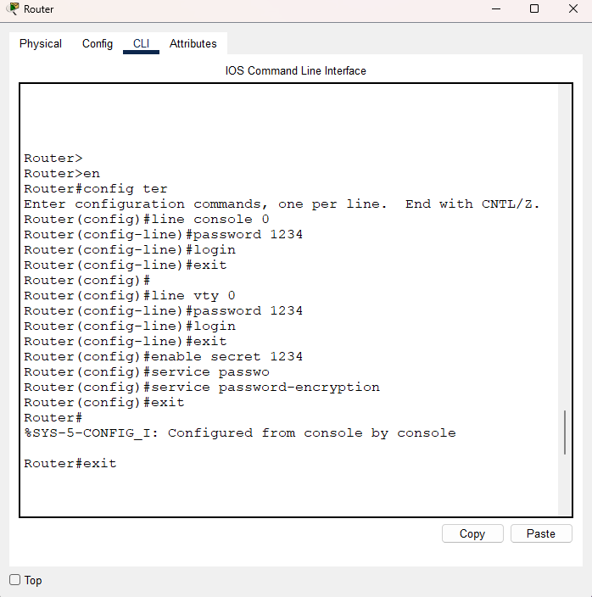
# Telnet Configuration:
For Physical Access;
line console 0
password 1234
login
exit
For Remote Access;
line vty 0
password 1234
login
exit
Enable Password;
enable secret 1234
Encrypt Password;
service password-encryption

Slide 20
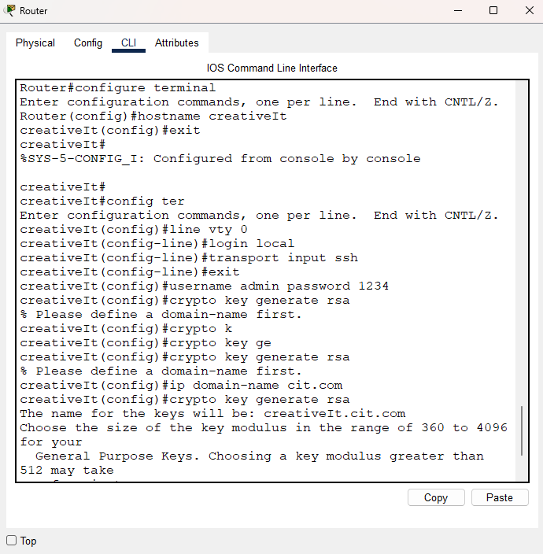
# SSH-configure:
Creating a hostname;
hostname creativeIt
ip domain-name cit.com
line vty 0
login local
transport input ssh
exit
username admin password 1234
crypto key generate rsa
1024

Slide 21
4
Testing

Slide 22
By pinging all the IP addresses from each department we have checked all our connection. We have also tested the ACL configuration and NTP Server connection. All the tests have successfully returned the expected output. Some of the results are shown in the following slides.

Slide 23
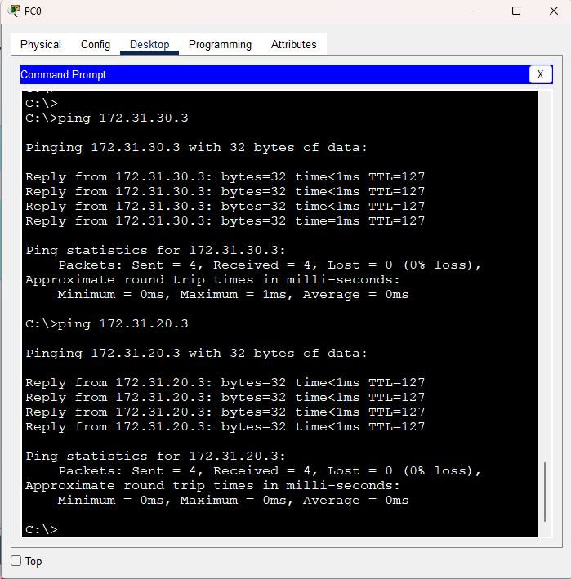
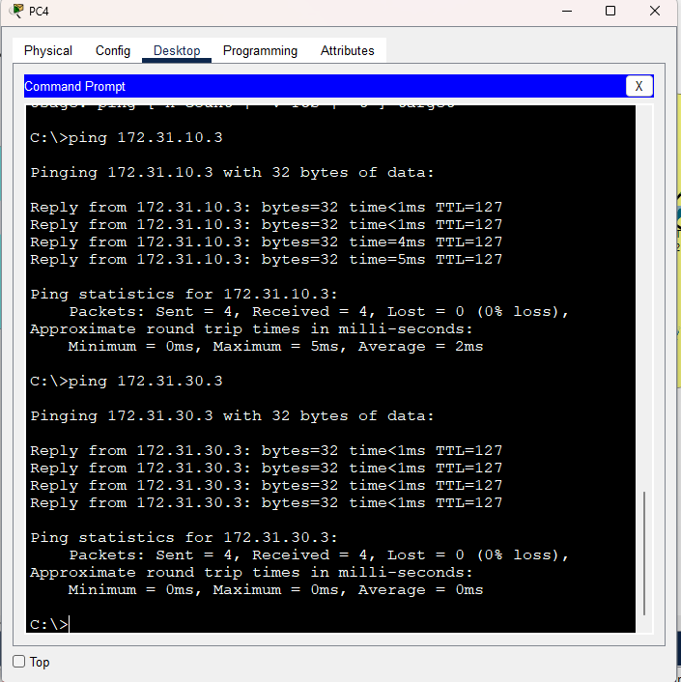
From HR department to all other departments
From IT department to all other departments

Slide 24
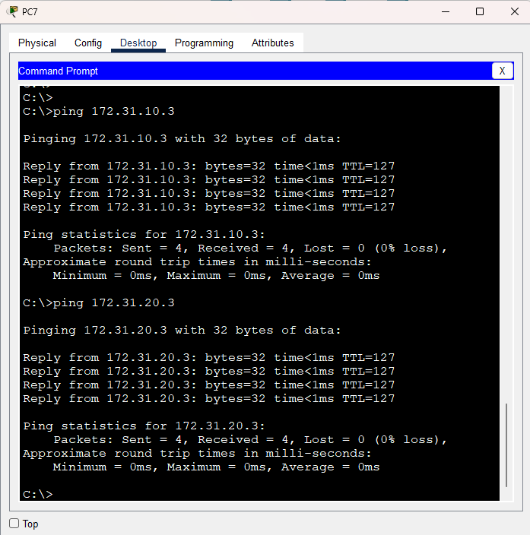
From Finance department to all other departments

Slide 25
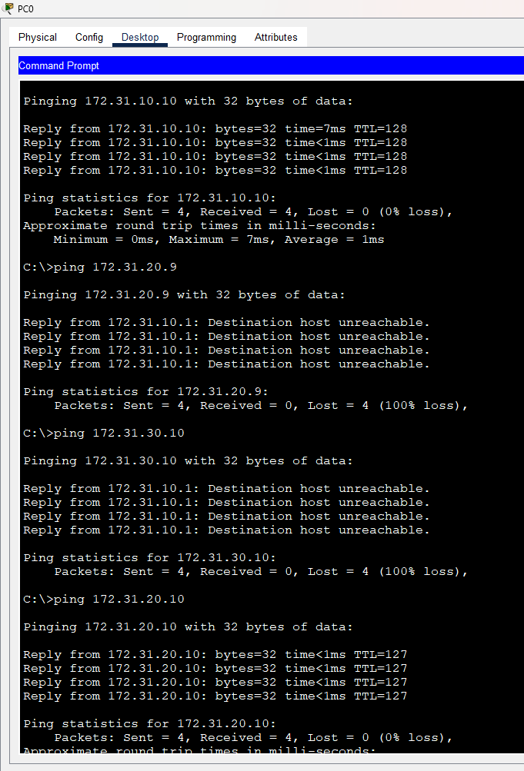
ACL testing from HR department. Here we can see that users can communicate with anyone but don’t have access to the IT and Finance department servers.

Slide 26
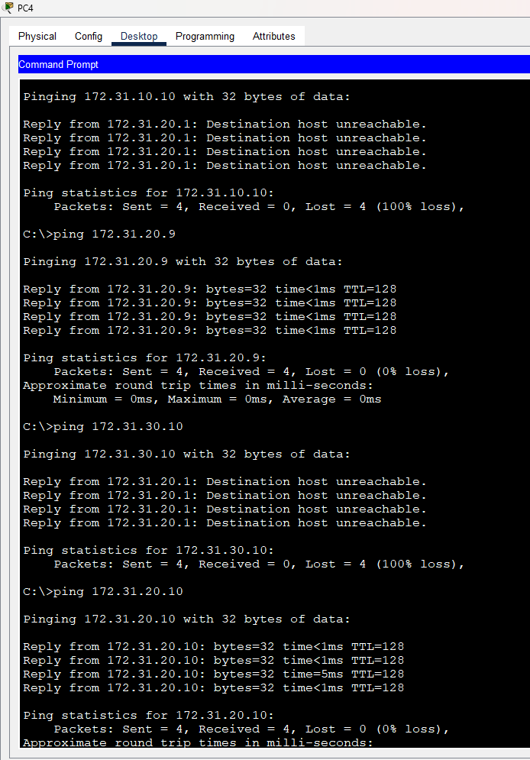
ACL testing from IT department. Here we can see that users can communicate with anyone but don’t have access to the IT and Finance department servers.

Slide 27
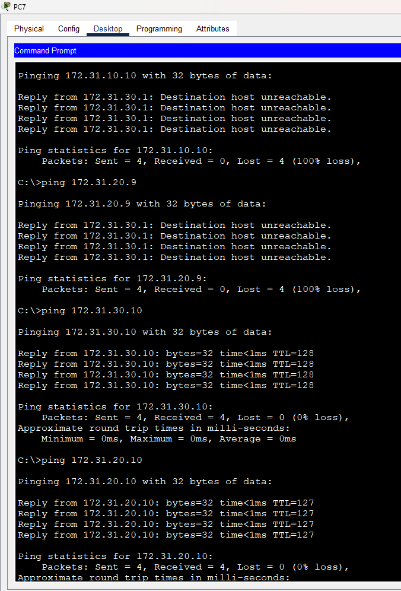
ACL testing from Finance department. Here we can see that users can communicate with anyone but don’t have access to the IT and Finance department servers.

Slide 28
5
Conclusion

Slide 29
This networking project successfully demonstrates the design and implementation of a secure, scalable, and efficient enterprise network. By integrating routers, multilayer switches, and access switches, the network ensures proper segmentation through VLANs while enabling seamless inter-VLAN communication. Security was enhanced through the configuration of Telnet and SSH for remote management and ACLs to control access between departments and servers. Dedicated servers such as NTP, DNS, and departmental servers ensured reliable services for users.
Overall, the project highlights the importance of structured network design, efficient IP addressing, and layered security to meet organizational needs. This setup not only ensures smooth communication between departments but also protects critical resources, making it a robust foundation for future scalability and enhancements.

Slide 30
6
Q&A Session
Feel free to ask us about our project.
We are more than happy to explain about our hard work.

Slide 31
Jazakallu khairan!

