Slide 1
MONRP × SlowSoup
Multi-Objective Optimization of LLM-Based Clue Generation
JERRY WU + GUANQIAO CHEN
NSGA-II · SPEA2 · Random Search

Slide 2
Problem
Lateral-thinking puzzles need clues that hint without spoiling.
LLM clue generation has many knobs: model, prompt, clue count, temperature.
Two goals pull against each other: lower API cost vs. higher clue quality.
No single best config exists — we want the Pareto front.
Question: do multi-objective evolutionary algorithms beat random search at finding it?
Dataset: lateral-thinking puzzles from Chen et al. (NeurIPS 2024).

Slide 3
Search Space & Objectives
DECISION VARIABLES
OBJECTIVES
Groq model (categorical)
Prompt template / decomposition strategy (categorical)
Number of clues — integer [3, 8]
Temperature — continuous [0.0, 1.0]
Minimize cost — Groq API $/puzzle
Maximize quality — Claude grader @ T=0
Non-revelation (0–3)
Coverage (0–3)

Slide 4
Pipeline
Each evaluation = generate → grade → aggregate → cache.
Candidate config
(model, prompt, n, T)
Groq
clue generation
Claude grader
(rubric @ T=0)
Mean cost,
Mean Quality
(Over 5 puzzles)
Cache
SHA-256
Fixed puzzle sample (PUZZLE_SEED = 42) so every config faces the same problems.
Failed evals → [cost=1.0, quality=0.0] so the optimizer learns to avoid them.
Cache keyed by SHA-256 of (config + puzzle indices) — repeat configs are free.

Slide 5
Experimental Protocol
Apples-to-apples evaluation budget per (algorithm, seed).
Algorithms: NSGA-II, SPEA2, Uniform Random Search.
Each algorithm × 5 independent seeds on the same puzzle sample.
Budget per run: POP × GENS = 10 × 5 = 50 evaluations.
Metric: 2-D hypervolume of final non-dominated front vs. a shared reference.
Statistics: pairwise two-sided Mann-Whitney U + Vargha-Delaney A12.

Slide 6
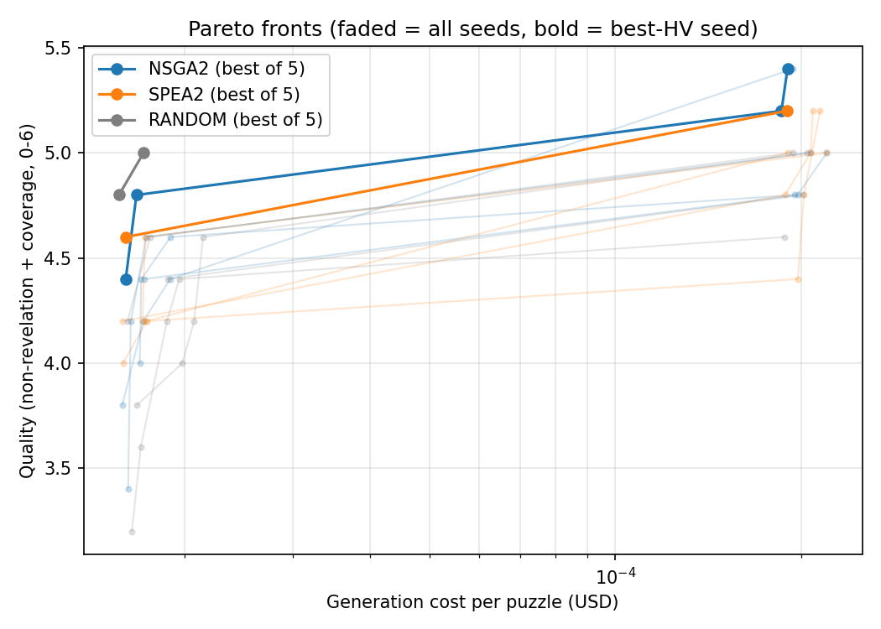
Result — Pareto Fronts
Faded = each seed; bold = best-HV seed per algorithm.

Slide 7
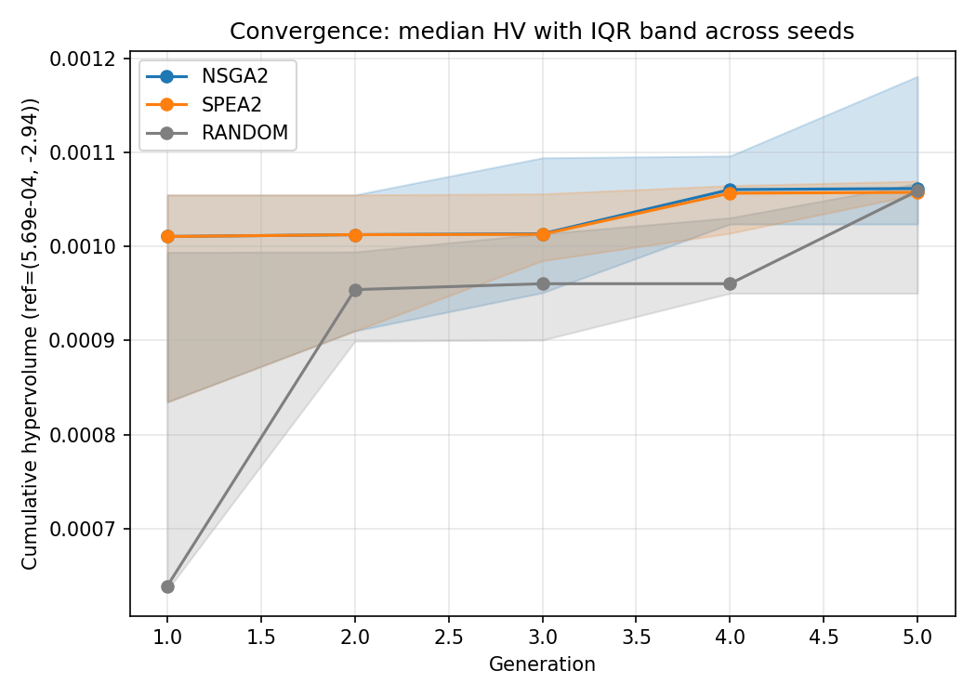
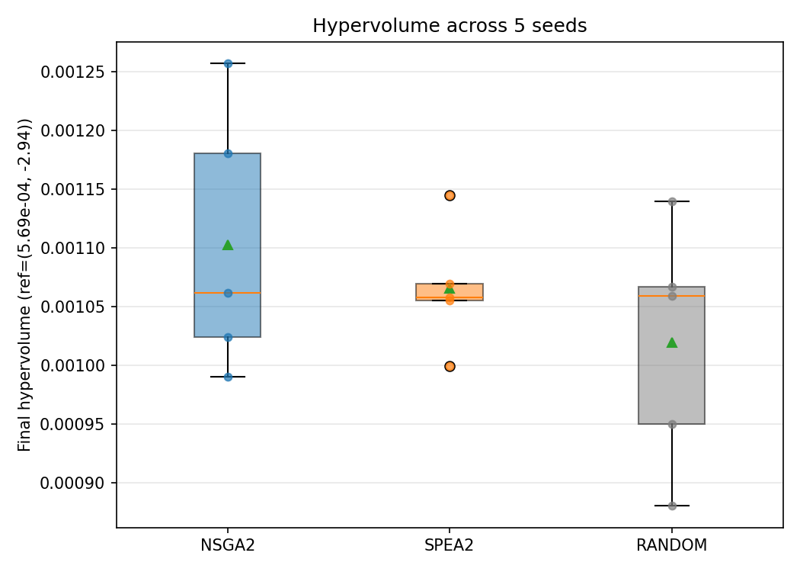
Convergence & Final-HV Distribution
Median cumulative HV (IQR band) + final-HV across seeds.

Slide 8
Statistics
Final-HV across 5 seeds per algorithm.
Algorithm | Median HV | Mean HV | Std
NSGA-II | 0.001062 | 0.001103 | 1.12e-4
SPEA2 | 0.001058 | 0.001065 | 5.23e-5
Random | 0.001059 | 0.001019 | 1.03e-4
Pair (A vs B) | U | p | A12
NSGA-II vs SPEA2 | 14.0 | 0.8413 | 0.560 (small)
NSGA-II vs Random | 17.0 | 0.4206 | 0.680 (medium)
SPEA2 vs Random | 15.0 | 0.6905 | 0.600 (small)
NSGA-II shows the largest A12 vs. Random (0.68, medium effect) but does not reach significance at n=5.
Medians are within 5e-6 of each other — budget is too small to separate the algorithms.
Direction is consistent with theory; signal strength is limited by seed count.

Slide 9
Limitations & Next Steps
Clue count is a fixed gene — ideally adapt to puzzle difficulty or let the model decide.
Grading uses 1 Claude run (T=0). Deviation across runs was minimal, but a 3-run average would be more defensible.
5 seeds per algorithm is statistically thin; scale to 10–30 seeds for tighter Mann-Whitney signal.
Budget per run (POP=10, GENS=5 → 50 evals) is modest — differences between optimizers may surface at larger budgets.
Add more categorical options (models, prompts) to widen the search space.

Slide 10
Takeaways
Framed LLM clue generation as a 2-objective optimization problem (cost ↔ quality).
Built a fully cached, resumable sweep around NSGA-II / SPEA2 / Random with a shared eval budget.
Hypervolume + Mann-Whitney + A12 gives a principled comparison protocol.
Current results: NSGA-II trends ahead of Random (A12 = 0.68), but n=5 is not enough for significance.
Next step: more seeds, larger budget, adaptive clue count.
github: clue-gen-optimization · dataset: Chen, Q., Zhang, B., Wang, G., Wu, Q. (2024). Weak-eval-Strong: Evaluating and Eliciting Lateral Thinking of LLMs with Situation Puzzles (SPLAT). NeurIPS 2024. arXiv:2410.06733.

