Slide 1


Loading..

Slide 2


120
50
100
250
500
1000

Slide 3
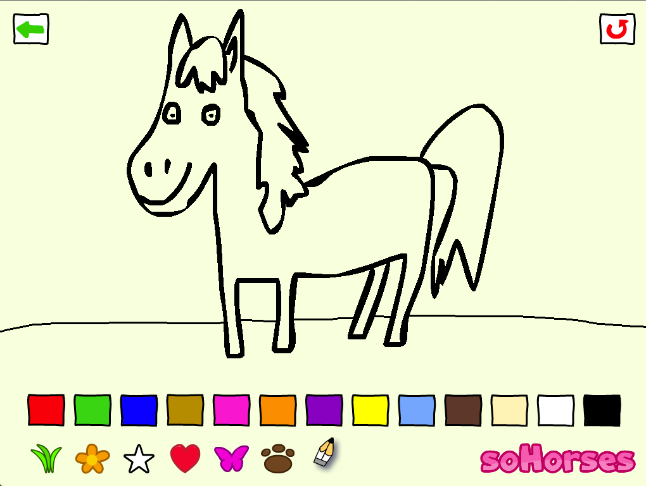
back
120
Achievement unlocked! +1 Star

Slide 4
Unlock all pictures for 0.99 EUR

