Slide 1
Airline Survey Analysis
Sammy Pardes IST687 12/15/19

Slide 2
Project Overview
Hired as a consultant for Cool&Young Airlines Inc.
Survey of over 125,000 passengers from 14 different airlines
The survey took place over 3 months, from January 1, 2014 through March 31, 2014
1,288 passengers on Young&Cool Airlines Inc. surveyed
Each passenger was asked to rate their experience on a scale from 1 to 5

Slide 3
Assumptions
Everyone survey filled out the survey honestly
Survey is an accurate sample of passenger data
We can gain valuable insight from this dataset
Enough data has been collected to make informed business decisions

Slide 4
Business Questions
Which cities/states have the largest impact on satisfaction? Do these cities have higher/lower delays?
How are airlines performing across different types of customers?
Who are the most loyal customers? Who are the least loyal? Does loyalty align with satisfaction?
What variables have the strongest impact on Satisfaction score?

Slide 5
Data Cleansing
Read .csv file into RStudio
Find missing data
NAs in Arrival Delay in Minutes -> replaced with 0s
NAs in Flight Time in Minutes -> replaced with 0s
Convert State Names to lowercase
Remove periods from column names

Slide 6
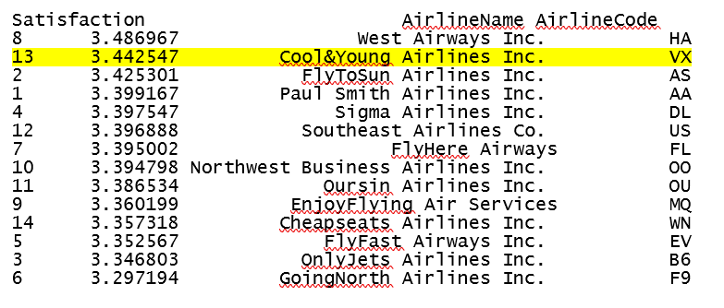
Data Analysis
How does Cool&Young Airlines Inc. rank against its competitors?
Second in average passenger satisfaction

Slide 7
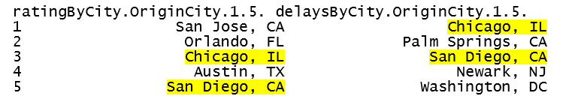
Data Analysis
Q1: Which cities/states have the largest impact on satisfaction? Do these cities have higher/lower delays?
Two cities are in the top 5 most delayed and lowest rated

Slide 8
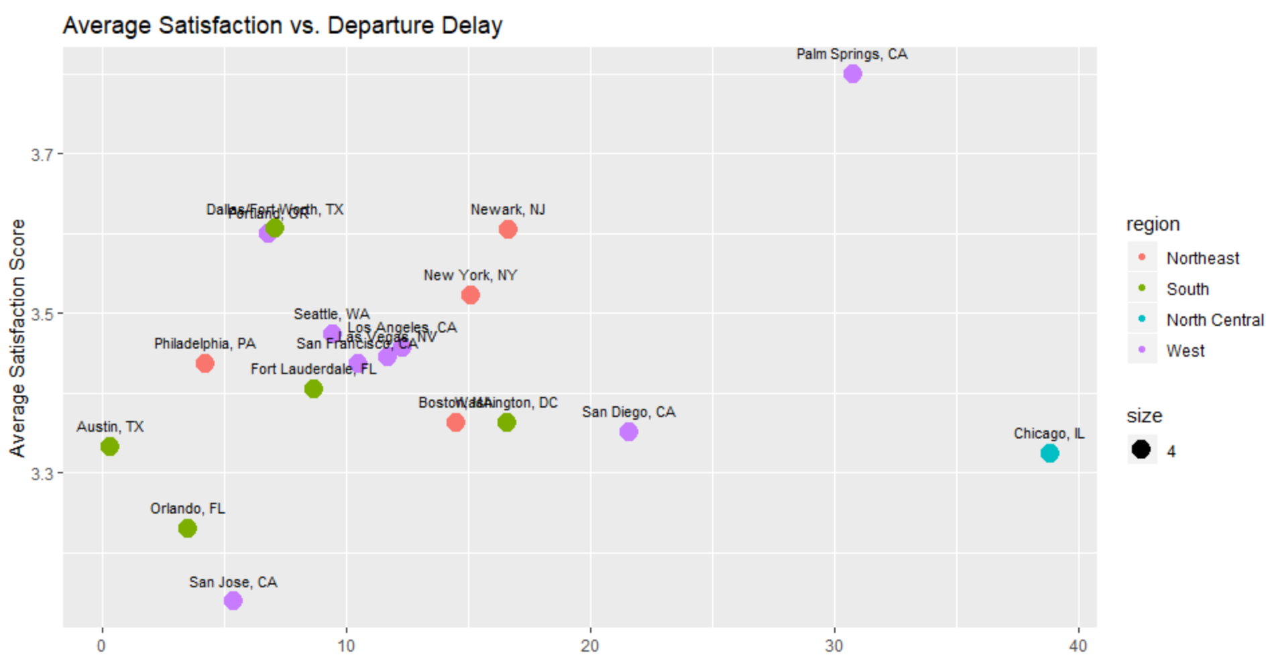
Data Analysis

Slide 9
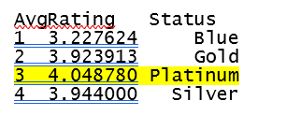
Data Analysis
Q2: How are airlines performing across different types of customers?
Airline Status
Platinum most satisfied
Blue least satisfied

Slide 10
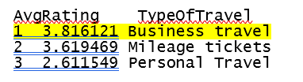
Data Analysis
Q2: How are airlines performing across different types of customers?
Type of Travel
Business Travel most satisfied
Personal Travel least satisfied

Slide 11
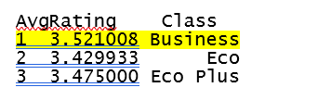
Data Analysis
Q2: How are airlines performing across different types of customers?
Airline Class
Business most satisfied
Eco least satisfied

Slide 12
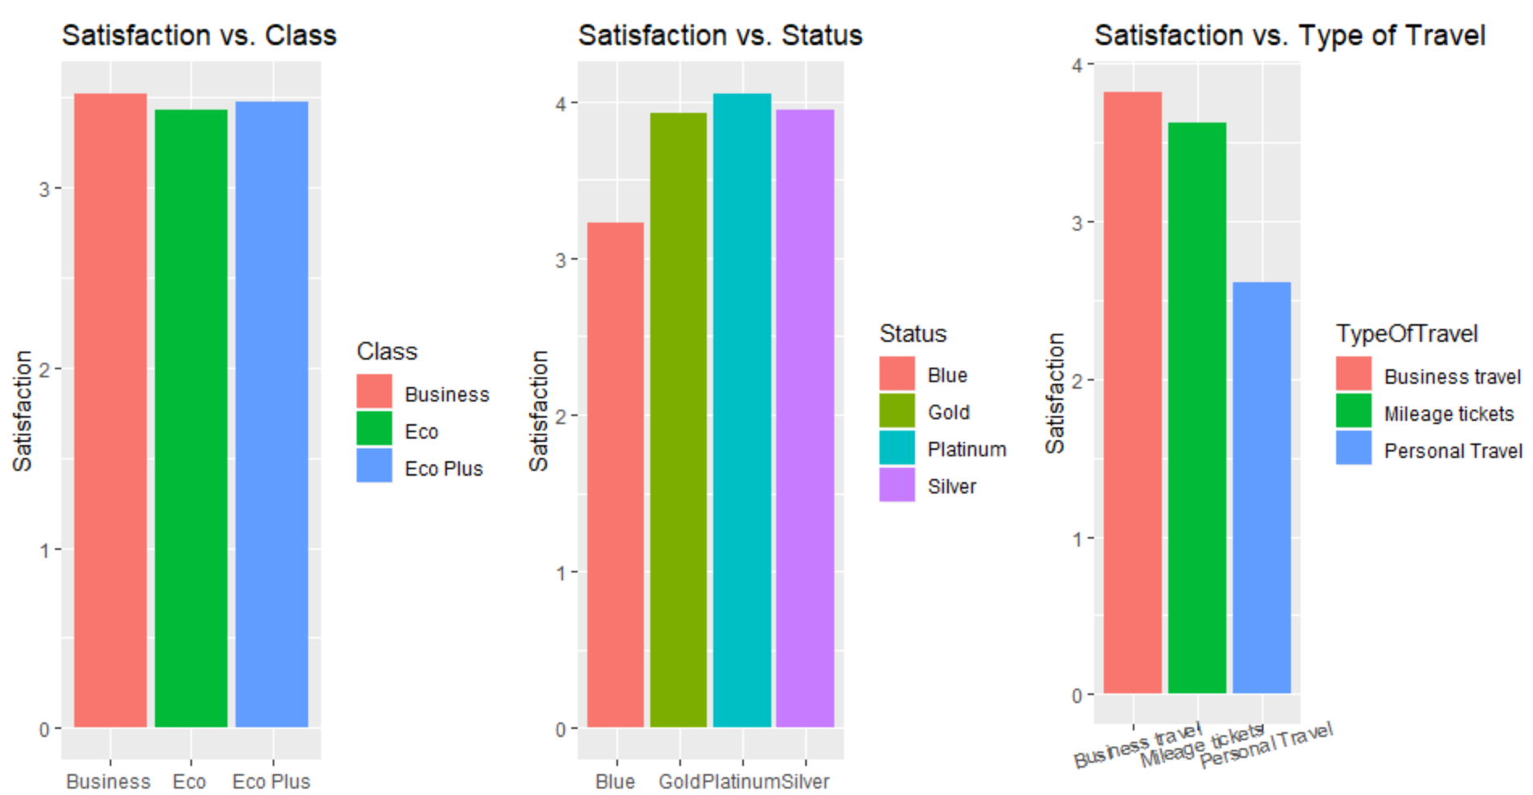
Data Analysis

Slide 13
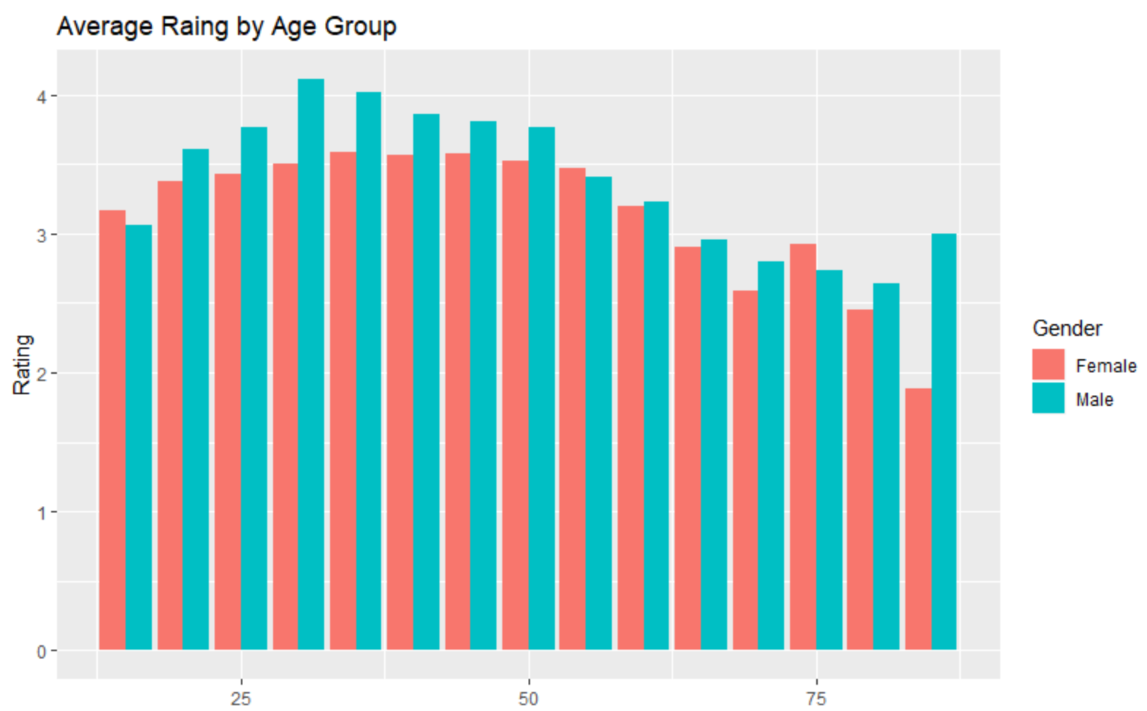
Data Analysis
Average satisfaction by Gender and Age (divided into ranges of 5 years)
Men more satisfied than women
25-50 year-olds most satisfied

Slide 14
Data Analysis
Q3: Who are the most loyal customers? Who are the least loyal? Does loyalty align with satisfaction?
Define loyalty: (flights on other airlines)/(total flights)
Lowest % = most loyal
Get rid data with of zeros for # of flights

Slide 15
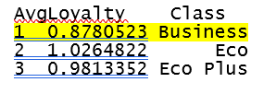

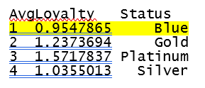
Data Analysis
Loyalty by Class
Loyalty by Gender
Loyalty by Status

Slide 16
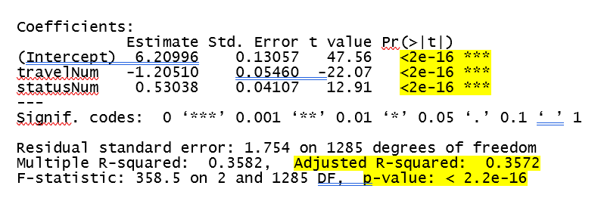
Data Analysis
Q4: What variables have the strongest impact on Satisfaction score?
Linear modeling
Best predictor: Travel Type + Status

Slide 17
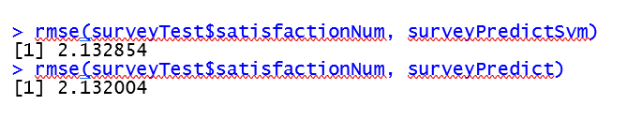
Data Analysis
Q4: What variables have the strongest impact on Satisfaction score?
KSVM and SVM models

Slide 18
Data Validation
Microsoft SQL Server
Excel

Slide 19
Recommendations
Recommendation #1: Increase accessibility
Recommendation #2: Incentivize Status upgrades
Recommendation #3: Offer discounts for non-mileage flights
Recommendation #4: Reward passenger loyalty

