Slide 1
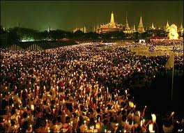
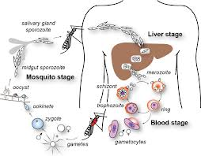
Inter-Host and Intra-Host Models
Intra-host models are for interactions within hosts
Also known as within-host models
For populations of parasites within individual hosts
Inter-host models are for interactions between hosts within populations of hosts
(example: the SIRS model)

Slide 2
Within host Models for Dynamics of Malaria Parasites
Sompob Saralamba
sompob@tropmedres.ac
MAEMOD, MORU

Slide 3
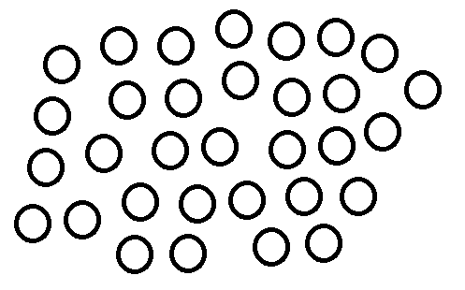
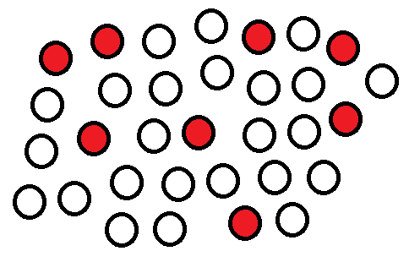
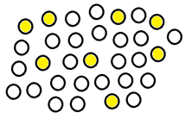
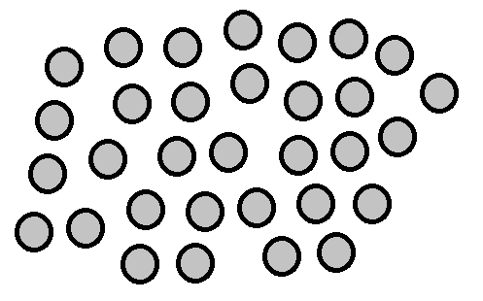
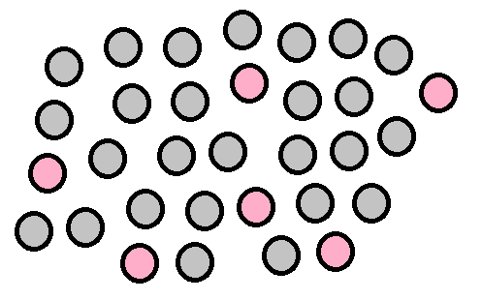
From Human Population to Malaria Parasite Population
S
I
R
H
P
S
I
S

Slide 4
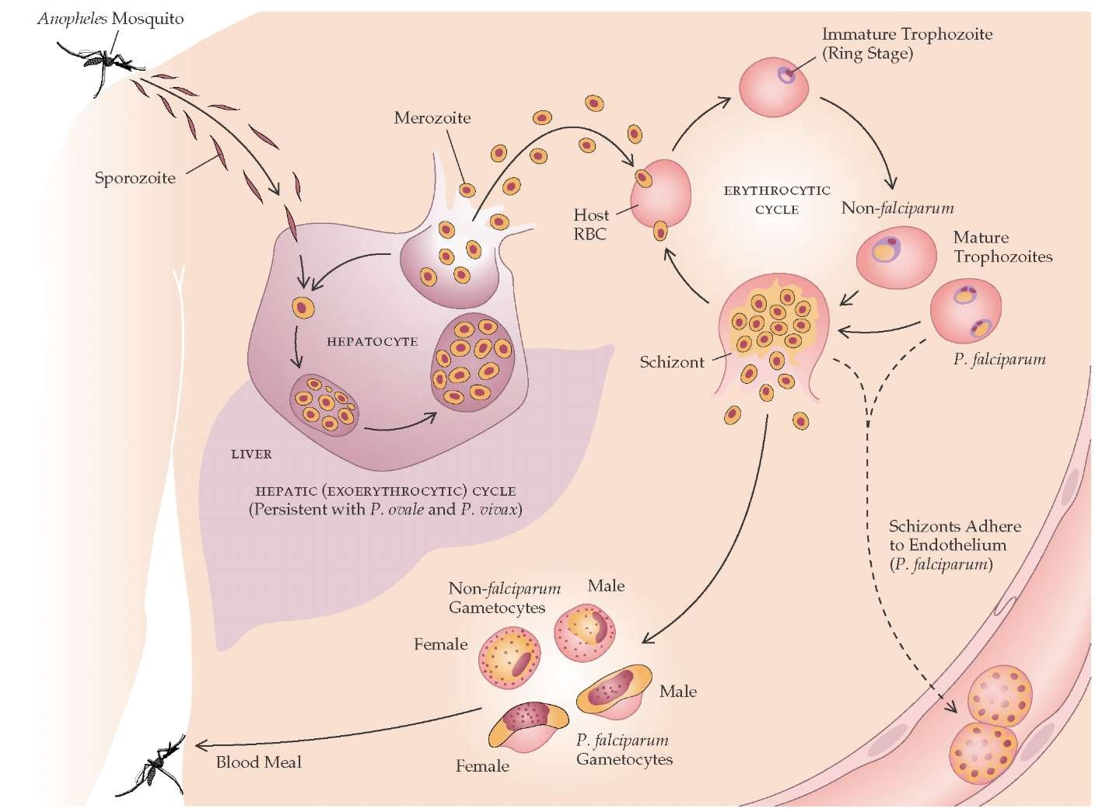
Malaria Parasite Life cycle
Main species to cause malaria in humans
P. falciparum
P. vivax
P. ovale
P. malariae
P. knowlesi
Image from http://what-when-how.com/acp-medicine/protozoan-infections-part-1/

Slide 5
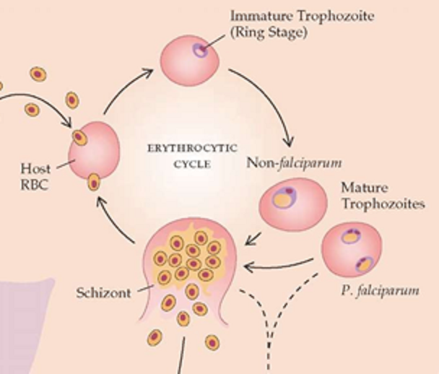
Malaria Parasite Life cycle
Image from http://what-when-how.com/acp-medicine/protozoan-infections-part-1/

Slide 6
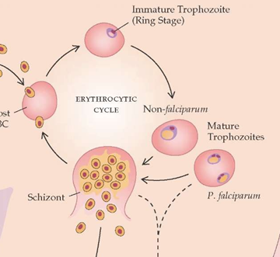
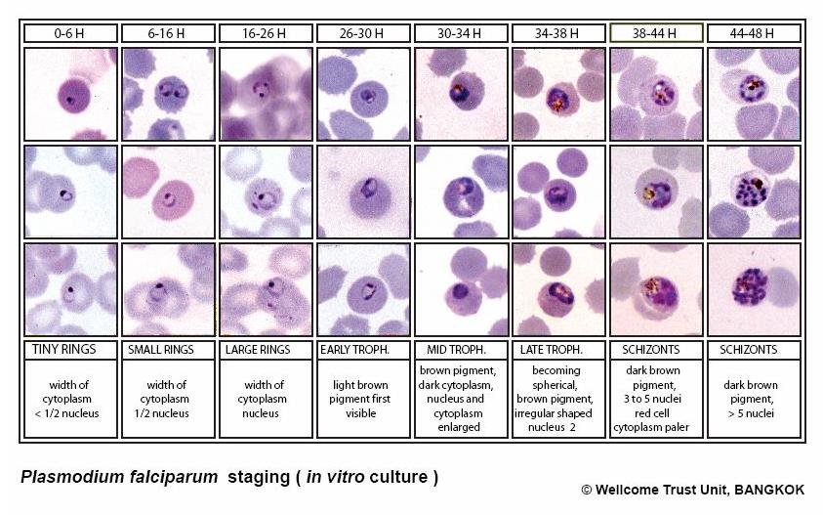
Mechanisms: Asexual development in Plasmodium falciparum
Circulating
Sequestered

Slide 7

Observation: Parasite Count Data
number of parasites per μL
Thin Film
$$\frac{count}{1000RBC}×HCT×125.6$$
Thick Film
$$\frac{count}{200WBC}×40$$
- 1 μL of blood ≈ 12,560,000 RBCs
number of parasites per μL
- average WBC per μL = 8000
Total Peripheral blood parasites = Peripheral blood parasite count × 80,000 × body weight
- assume a total blood volume of 80 mL/kg

Slide 8
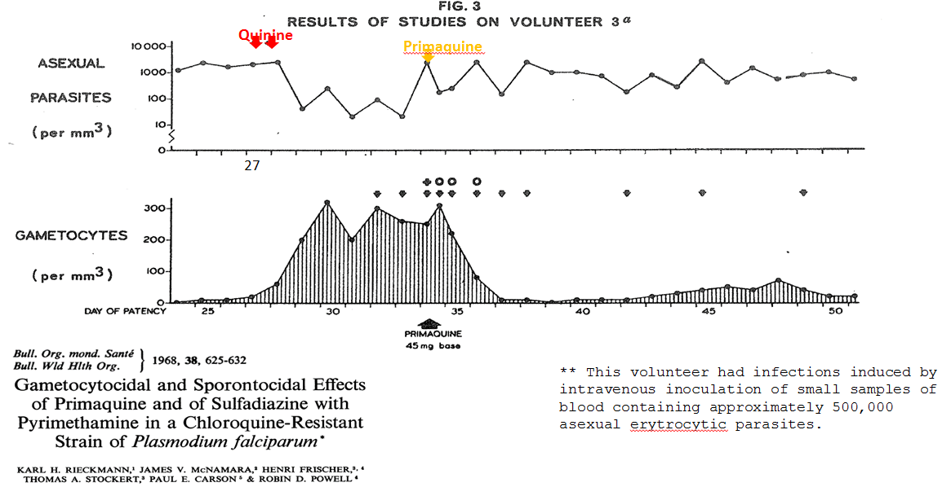
Examples of Parasite Count Data

Slide 9
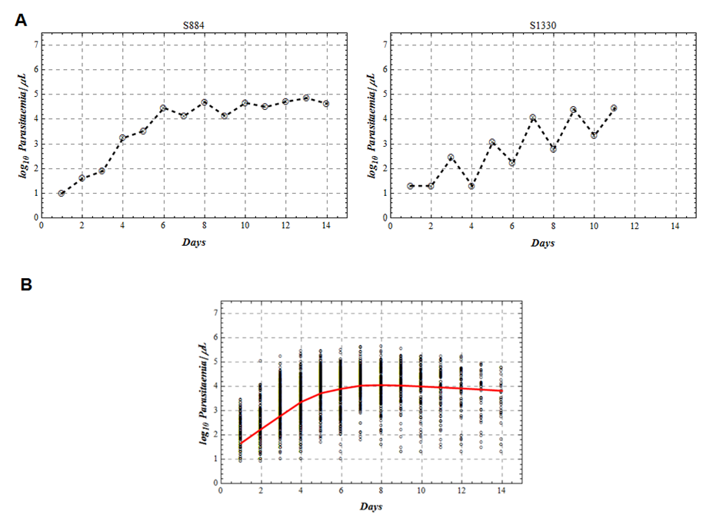
Examples of Parasite Count Data
Therapeutic malaria in man: Sporozoite and blood-induced infections with Plasmodium falciparum
William E Collins and Geoffrey M Jeffrey.
Unpublished.

Slide 10
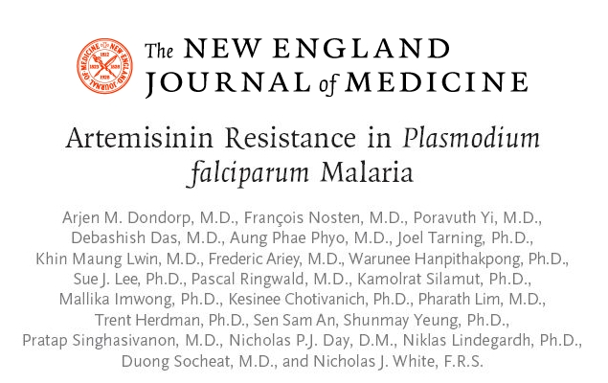
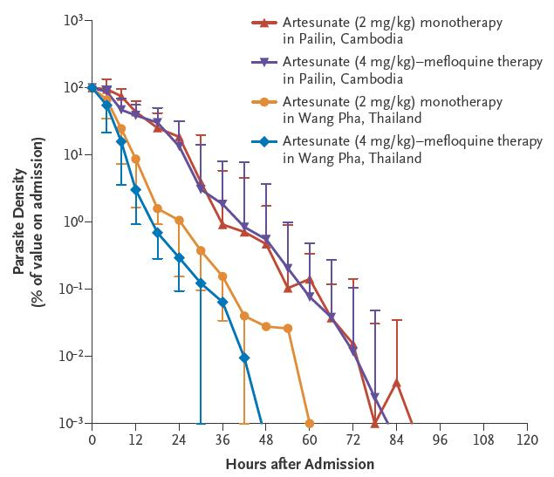
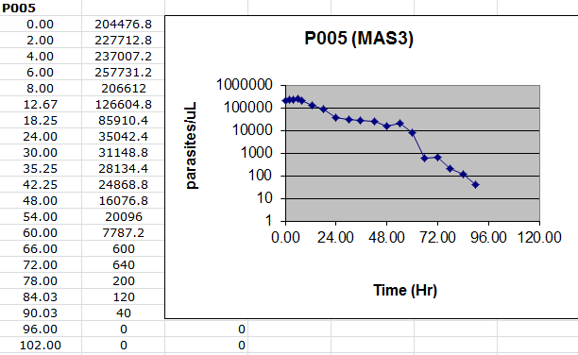
Examples of Parasite Count Data
N Engl J Med, 2009. 361(5): p. 455-67

Slide 11
Aspects of within host dynamics
Species
Sporozoites
Liver stage
Asexual stage: Rings, Trophozoites, Schizonts
Merozoites
Sexual stage: Gametocytes
Immunity
Fever
Drugs
Drug resistance
Anemia
??

Slide 12
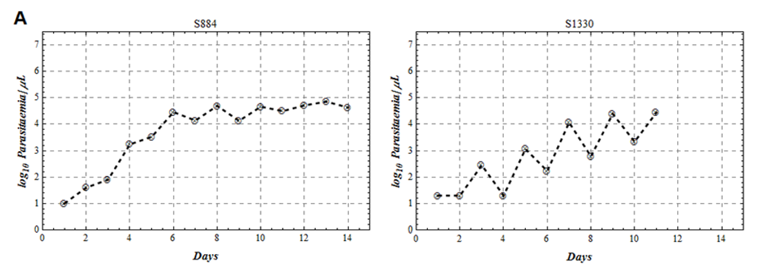
Within host models for the dynamics of malaria parasites
Simple ODE mechanistic
Statistical model
Mechanistic multi-stage

Slide 13

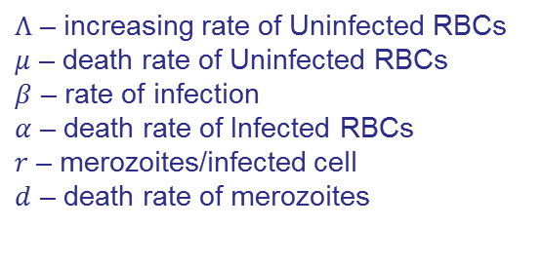
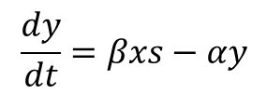
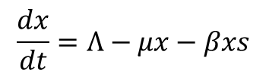
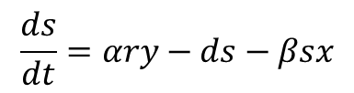
Simple ODE Mechanistic
A
Uninfected RBCs
$$\frac{dx}{dt}=Λ−μx−βxs$$
Model Parameters
$Λ$ – increasing rate of Uninfected RBCs
$μ$ – death rate of Uninfected RBCs
$β$ – rate of infection
$α$ – death rate of Infected RBCs
$r$ – merozoites/infected cell
$d$ – death rate of merozoites
Infected RBCs
$$\frac{dy}{dt}=βxs−αy$$
Merozoites
$$\frac{ds}{dt}=αry−ds−βsx$$

Slide 14
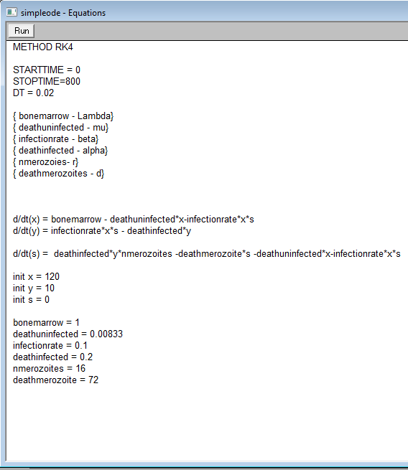
Berkeley Madonna
Simpleode.mmd

Slide 15
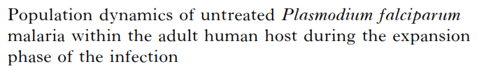


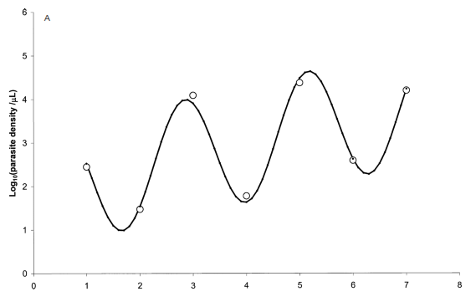
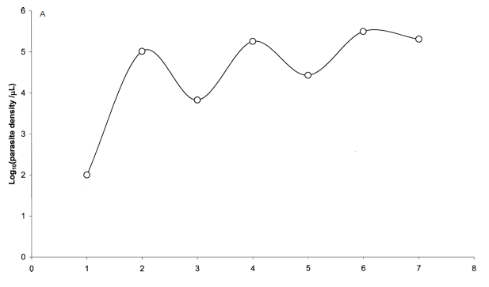
Statistical Model
B
Parameters
a - density at day 0
c - amplitude
PMR - multiplication rate/life cycle
k - phase
can be fitted
cannot be fitted

Slide 16
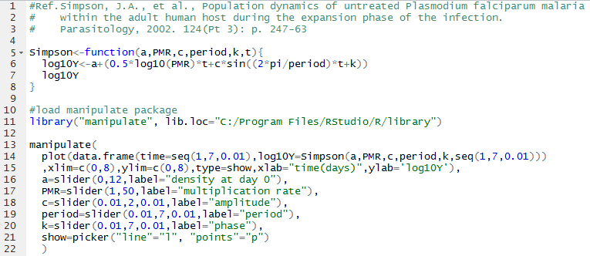
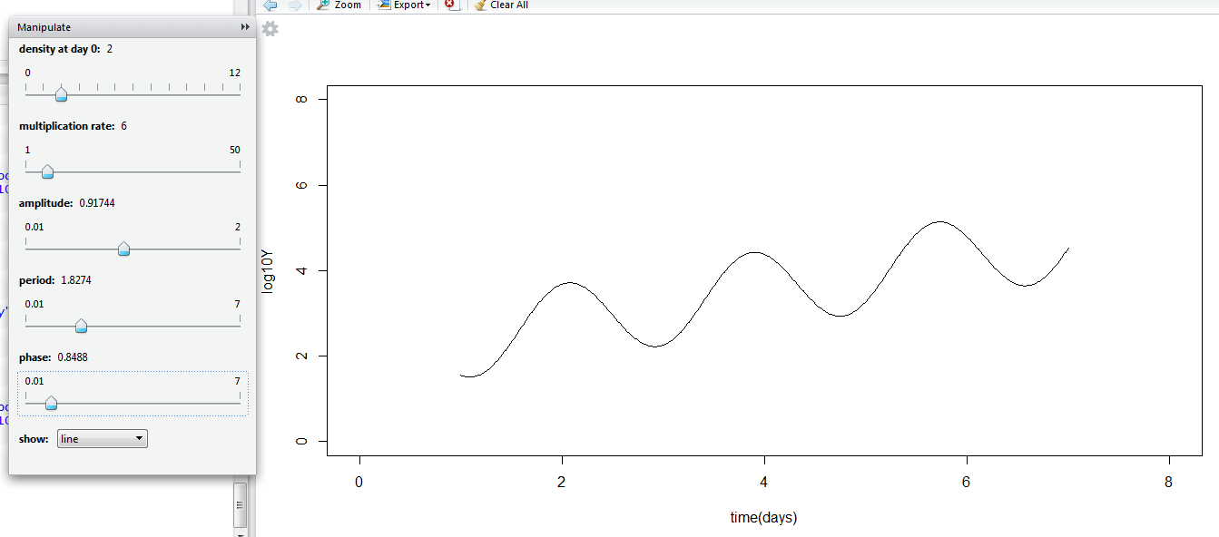
Simpson.R

Slide 17
manipulate(
output command (par1,par2,..) ,
par1=slider(begin,end,init,label=“XXX”),
par2=slider(begin,end,init,label=“XXX”),
..
)

Slide 18
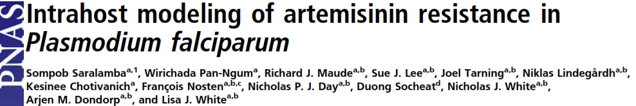
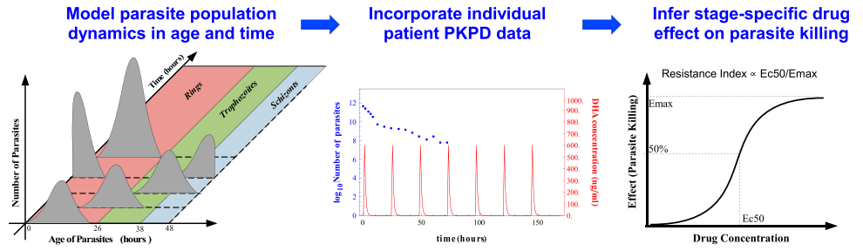
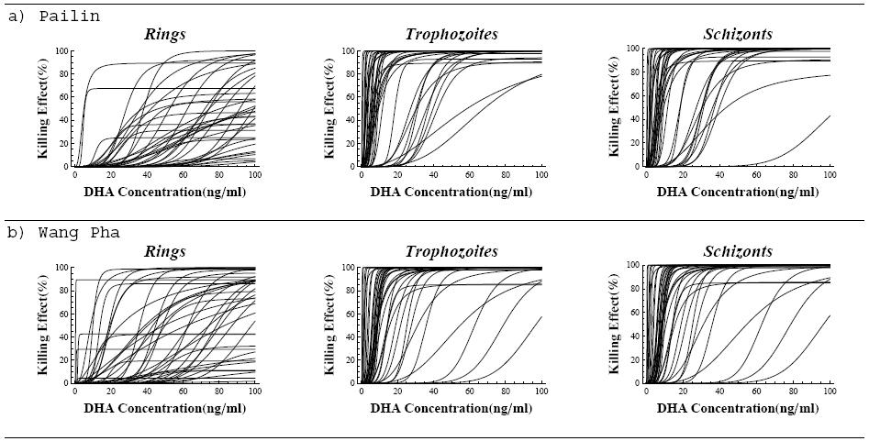
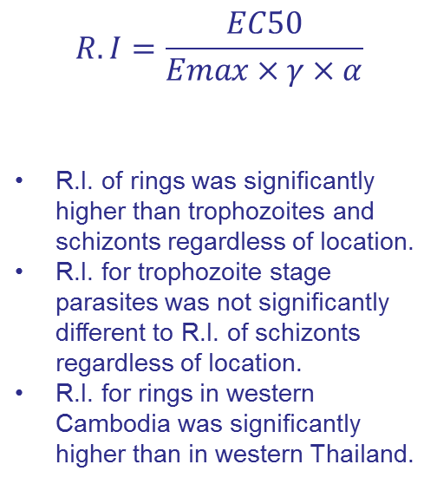
Mechanistic multi-stage
C
$$R.I=\frac{EC50}{Emax×γ×α}$$
R.I. of rings was significantly higher than trophozoites and schizonts regardless of location.
R.I. for trophozoite stage parasites was not significantly different to R.I. of schizonts regardless of location.
R.I. for rings in western Cambodia was significantly higher than in western Thailand.

Slide 19
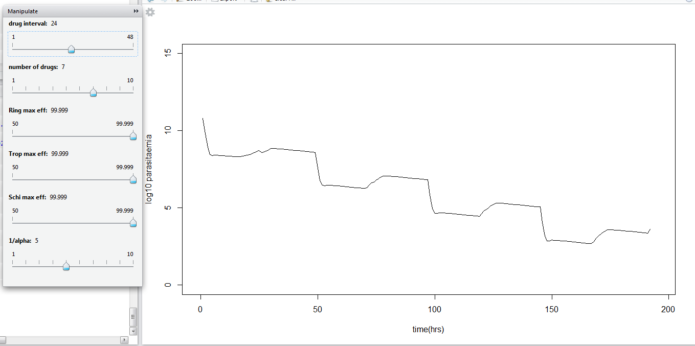
Sompob.R
adapted from: http://demonstrations.wolfram.com/AModelOfPlasmodiumFalciparumPopulationDynamicsInAPatientDuri/

