Slide 1
Project Managment

Slide 2
Project name : Tourism development application
Project sponsor: Ministry of tourism
Purpose of the project: facilitating Egyptian tourism for tourists technology sites.
Business case: designing an application through which places are booked on trips that have been previously announced in different place
Key deliverables: Tourism development application that will work both android and IOS

Slide 3
Project milestones
Requirements review: Requirements specifications are complete,
Approved and suitable 1/1/2022.
Critical design review:
Detailed designs fully implement the system architecture, are approved and are suitable for input into the development of code.
Project Resources Staff:
10 Android developers, 10 IOS developers, 10 Back-end developers Hardware: 20 Laptops, 3 Software servers: Software licenses (Editors: gava)

Slide 4
Budget:
Get allocated for this project is 150000 L.E
Constraints This project must be delivered within the specified budget.
This project must be delivered by 1/1/2023 Any ordered laptops or computers must be purchased from HP.

Slide 5
High level risks:
• An imbalance in the budget.
• Exploitation of street vendors for tourists, lack of good organization, and failure of workers to perform their duties.
• Inaccurate estimates.
• Scope creep : uncontrolled changes and continuous growth of the scope .or scope is ill defined.
• Project team misunderstand requirements.
• Loss of key personnel
• Customer will not accept the software as delivered even though it meets all specifications
• Selected technology is a poor match to the problem or customer
• Project key success criteria not clearly defined to verify the successful completion of each project phase.

Slide 6
Project scope
Project scope description :
Project acceptance criteria:
Project deliverables:
Project exclusion :
Project constraints:
Project assumptions:

Slide 7
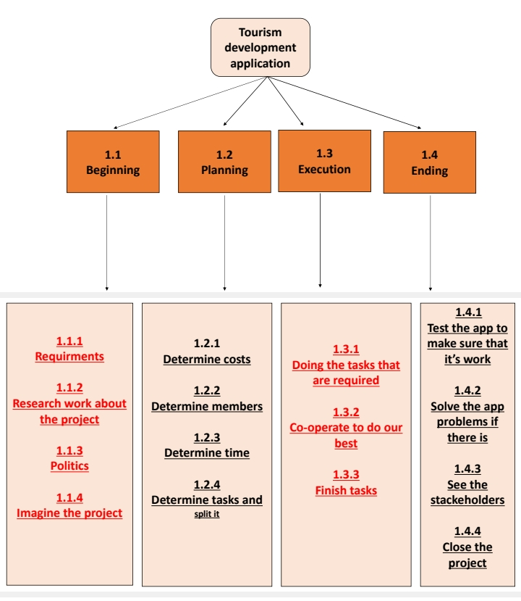

Slide 8
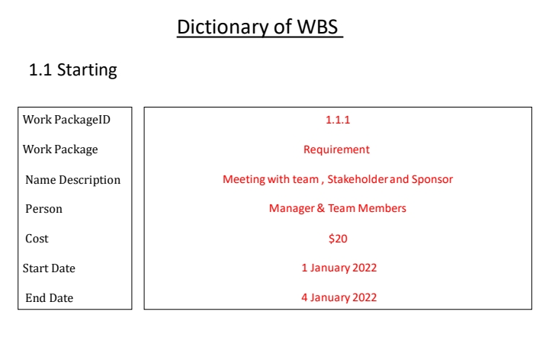
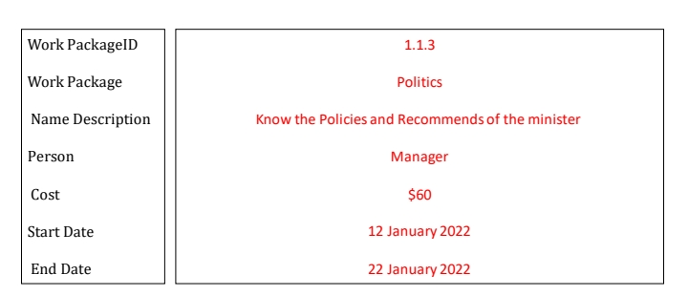
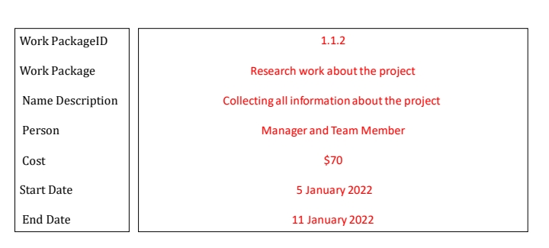

Slide 9
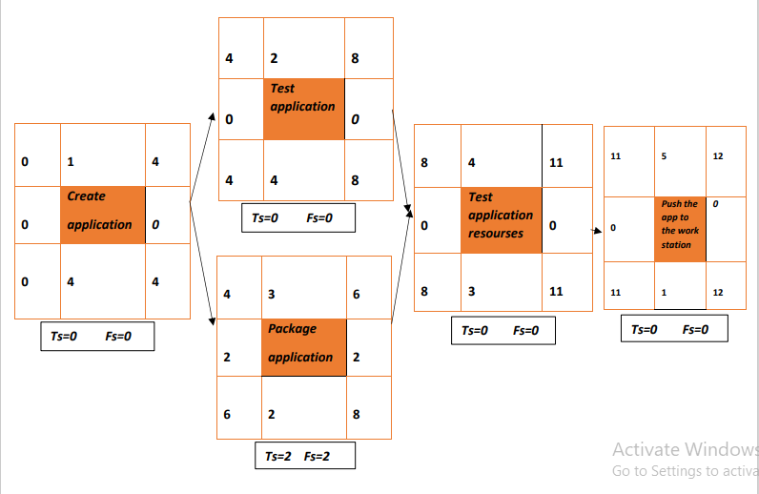

Slide 10
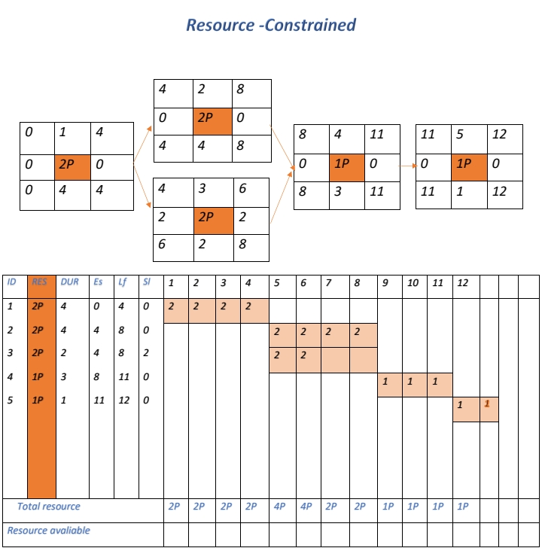

Slide 11
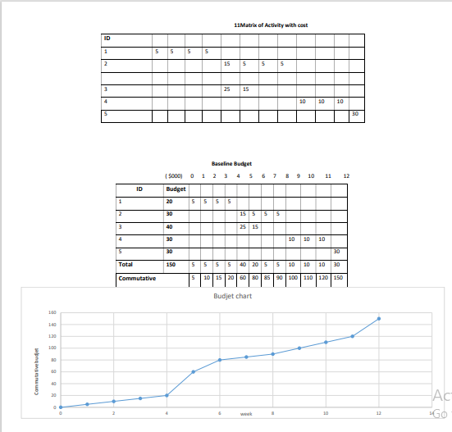

Slide 12
Risk
Negative Risk
1) Hackers that can hack the app
. 2) Insufficient budget
. 3) Inaccurate information.
4) Internet disconnection.
Positive risk
1) Make a change on the app to improve it by keeping up with technology.
2) Hirring some secret workers to ensure the safety of the employees.
3) App that can work on both ios and android.

Slide 13
Solution for risk
1)we can nomination professional programmers to protect the security of the app
. 2)We can have partner in our project to avoid insufficient budget.
3)We can test the information by professional employees to make sure that the information are correct.
4)We can make the app available without internet to avoid internet dis connection.
5)We should spread the principle of cooperation to avoid any problems between workers to do their best and that project.
we can monitor our project by seeing all the tasks that had done and seeing all the work frequently.

