Slide 1
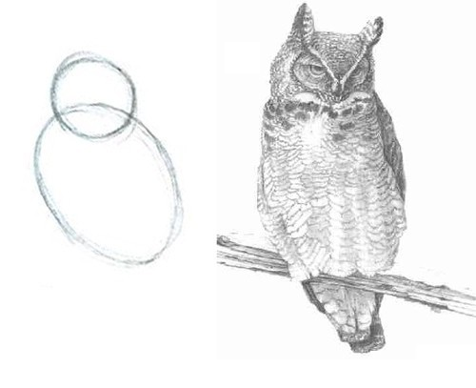
Writing a parser in Go, the C way
1. Write some
grammar rules.
2. Write the rest of the parser.

Slide 2
About me
Software Engineering Intern @ Red Hat
OpenShift Monitoring Team
Working on Prometheus and the Prometheus Language Server
Math student in Ulm

Slide 3

What is a parser?
String
parse tree
assignment
answer = 80/2 + 2
“answer”
sum
division
2
80
2

Slide 4
What is YACC?
Formal grammar
start: expr {
if !yylex.(*interpreter).evaluationFailed{
fmt.Println($1)
}}
| assignment;
expr:
NUMBER {
var err error
$$, err = strconv.ParseFloat($1, 64)
if err != nil{
yylex.Error(err.Error())
}
}
| IDENTIFIER {
var ok bool
$$, ok = yylex.(*interpreter).vars[$1]
if !ok {
yylex.Error(fmt.Sprintf("Variable undefined: %s\n", $1))
}
}
| expr '+' expr { $$ = $1 + $3 }
| expr '-' expr { $$ = $1 - $3 }
| expr '*' expr { $$ = $1 * $3 }
| expr '/' expr { $$ = $1 / $3 }
| '(' expr ')' { $$ = $2 }
| '-' expr %prec '*' { $$ = -$2 }
;
assignment:
IDENTIFIER '=' expr {
if !yylex.(*interpreter).evaluationFailed {
yylex.(*interpreter).vars[$1] = $3
}};
A parser, written in go

Slide 5
Step 1: Lexer
answer = 80/2 + 2
Identifier:
answer
Number:
80
Number:
2
Number:
2
=
/
+

Slide 6
Step 1: Lexer
answer = 80/2 + 2
Concept:
switch ... {
case <space>: // ignore.
case <is number>: return NUMBER
case <is identifer>: return IDENTIFIER
default: return <next letter>
}
Problem:
How are numbers and identifiers recognized?

Slide 7
Step 1: Lexer
answer = 80/2 + 2
Solution: Regular Expressions
var tokens = []tokenDef{
tokenDef{
regex: regexp.MustCompile(`^[0-9]*\.?[0-9]+([eE][-+]?[0-9]+)?`),
token: NUMBER,
},
tokenDef{
regex: regexp.MustCompile(`^[_a-zA-Z][_a-zA-Z0-9]*`),
token: IDENTIFIER,
},
}

Slide 8
Step 1: Lexer
answer = 80/2 + 2
Actual lexer code:
// Skip spaces.
for ; len(l.input) > 0 && isSpace(l.input[0]); l.input = l.input[1:] {
}
// Check if the input has ended.
if len(l.input) == 0 {
return EOF
}

Slide 9
Step 1: Lexer
answer = 80/2 + 2
Actual lexer code:
// Check if one of the regular expressions matches.
for _, tokDef := range tokens {
str := tokDef.regex.FindString(l.input)
if str != "" {
// Pass string content to the parser.
...
return tokDef.token
}
}
// Otherwise return the next letter.
ret := int(l.input[0])
l.input = l.input[1:]
return ret

Slide 10
Step 1: Lexer
At the end we have to implement this interface:
type yyLexer interface {
Lex(lval *yySymType) int
Error(s string)
}
yySymType is generated from the following statement in the grammar file:
%union {
String string
Number float64
}
Which is transpiled to:
type yySymType struct {
yys int
String string
Number float64
}

Slide 11
Step 2: Parsing
Identifier:
answer
Number:
80
Number:
2
Number:
2
=
/
+
assignment
“answer”
sum
division
2
80
2

Slide 12
Step 2: Parsing
2.1. Write a formal EBNF grammar:
start: expr
| assignment;
expr:
NUMBER
| IDENTIFIER
| expr '+' expr
| expr '-' expr
| expr '*' expr
| expr '/' expr
| '(' expr ')'
| '-' expr
;
assignment:
IDENTIFIER '=' expr;

Slide 13
Step 2: Parsing
2.2. Add actions to the grammar:
%token<String> NUMBER IDENTIFIER
%type <Number> expr
start: expr { fmt.Println($1) }
| assignment;
expr:
NUMBER { $$ = strconv.ParseFloat($1)// + error handling}
| IDENTIFIER { $$ = // lookup variable }
| expr '+' expr { $$ = $1 + $3 }
| expr '-' expr { $$ = $1 - $3 }
| expr '*' expr { $$ = $1 * $3 }
| expr '/' expr { $$ = $1 / $3 }
| '(' expr ')' { $$ = $2 }
| '-' expr { $$ = -$2 }
;
assignment:
IDENTIFIER '=' expr;
start: expr
| assignment;
expr:
NUMBER
| IDENTIFIER
| expr '+' expr
| expr '-' expr
| expr '*' expr
| expr '/' expr
| '(' expr ')'
| '-' expr
;
assignment:
IDENTIFIER '=' expr;

Slide 14
Step 2: Parsing
2.3. Run the interpreter:
$ goyacc grammar.y
22 shift/reduce conflicts
$ go build .
$ ./calulator
> 1 + 2 * 3
7
> 2 * 3 + 1
8

Slide 15
Step 2: Parsing
2.4. Fix the grammar:
%left '+' '-'
%left '*' '/'
...
expr:
...
| '-' expr %prec '*' { $$ = -$2 }
...

Slide 16
Step 2: Parsing
2.5. Make variable handling work:
| IDENTIFIER {
var ok bool
$$, ok = yylex.(*interpreter).vars[$1]
if !ok {
yylex.Error(fmt.Sprintf("Variable undefined: %s\n", $1))
}
}
...
IDENTIFIER '=' expr {
if !yylex.(*interpreter).evaluationFailed {
yylex.(*interpreter).vars[$1] = $3
}};

Slide 17
Step 2: Parsing
[2.6. Actually use a syntax tree:]
start: expr {yylex.(*interpreter).parseResult = &astRoot{$1}}
| assignment {yylex.(*interpreter).parseResult = $1};
expr:
NUMBER {$$ = &number{$1} }
| IDENTIFIER { $$ = &variable{$1}}
| expr '+' expr { $$ = &binaryExpr{Op: '+', lhs: $1, rhs: $3} }
| expr '-' expr { $$ = &binaryExpr{Op: '-', lhs: $1, rhs: $3} }
| expr '*' expr { $$ = &binaryExpr{Op: '*', lhs: $1, rhs: $3} }
| expr '/' expr { $$ = &binaryExpr{Op: '/', lhs: $1, rhs: $3} }
| '(' expr ')' { $$ = &parenExpr{$2}}
| '-' expr %prec '*' { $$ = &unaryExpr{$2} }
;
assignment:
IDENTIFIER '=' expr {$$ = &assignment{$1, $3}};

Slide 18
[Step 3: Evaluating]
assignment
“answer”
sum
answer = 42
division
2
80
2

Slide 19
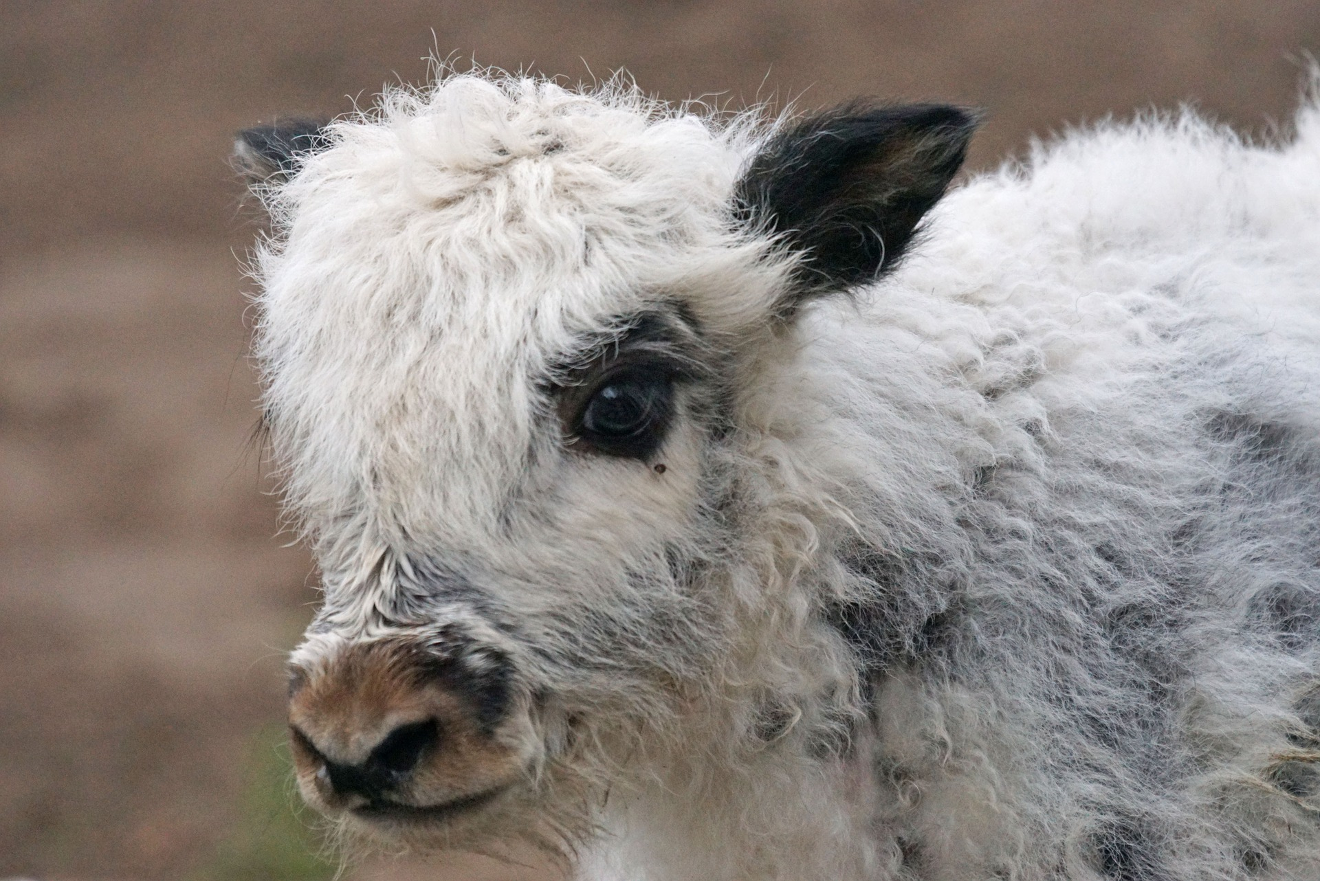
Thanks for Listening!
github.com/
slrtbtfs/goyacc-tutorial

