Slide 1
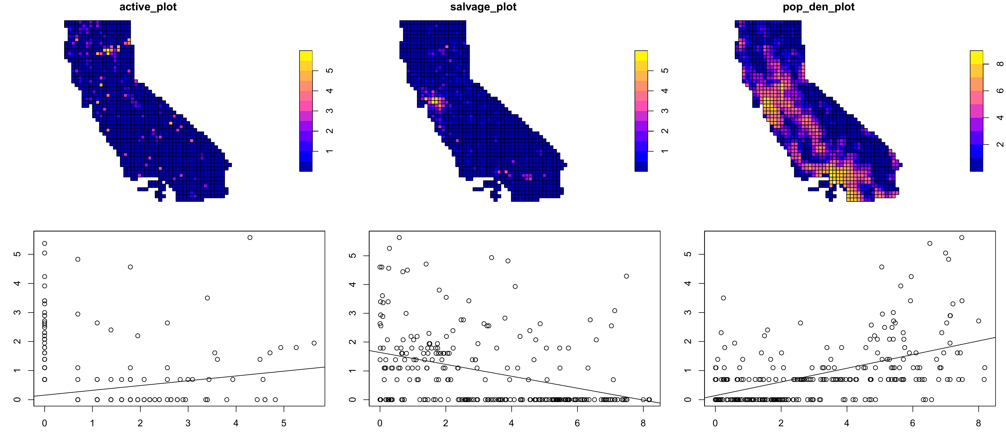
A
B
C
Log-transformed specimen count/10 km
Log-transformed specimen count/10 km
Log-transformed population count/10 km
D
E
F
Log(Actively-collected Specimen Count)
Log(population/10-km)
Log(population/10-km)
Log(Salvaged Specimen Count)
Log(Actively-collected Specimen Count)
Log(Salvaged Specimen Count)

