Slide 1
Meeting:
Testing the FORTRAN subroutine “Interpolate_Fluid_To_Particle” in 1D
May 05/29/2012

Slide 2
Outline
Testing the Interpolate_Fluid_To_Particle subroutine.
  We consider the vector Q as a 3rd order polynomial.
  We use 3rd order ENO interpolation to approximate the fluid properties at the particle position.
  Are presented plots of exact versus approximate solution and absolute error with the current version of the code and the modified version.
  To illustrate the issues with the ENO stencil in the current version, are showed the results in the 3rd order interpolation to the Heaviside function.
Are identified the subroutines that cause the problem in the ENO interpolation .
The modified version is presented in the file: Module_Particle_ENO_Interpolation_1D.F and the implementation of these subroutines are in the file Test_ENO.F .

Slide 3
Test function
Q(x) = [ ρ_{(x)} ρu_{(x)} E_{(x)} ]^{T}
ρ_{(x)} = x³ - 3*x² + 11*x - 7
ρu_{(x)} = -x³ + 2*x² - 4*x + 11
E_{(x)} = 2*x³ - 11*x² + 2

Slide 4
Domain and particle setup
Uniform grid on [-3,2] with Nx = 20 grid points: x_{i} = x_{i-1} + dx.
Uniform particles x_{i}^{p} = x_{i-1}^{p} + dx/4 on [-3,2] (Np = 77 particles in total).
Third order ENO interpolation to compute an approximation Q_{fp}(x_{i}^{p}) to Q(x_{i}^{p}) .
In theory, the error in the interpolation have to be zero due to the definition of Q as a third order polynomial.

Slide 5
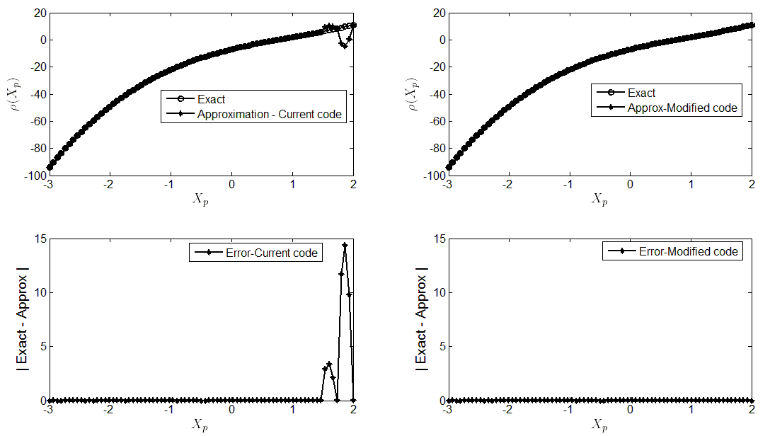
Plots for density ρ

Slide 6
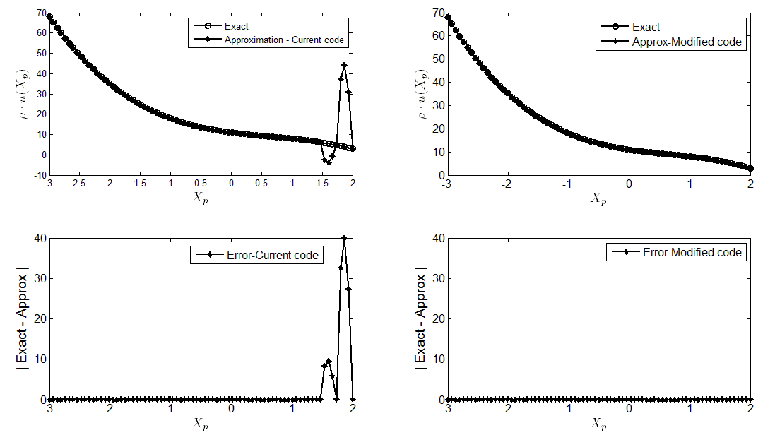
Plots for ρu

Slide 7
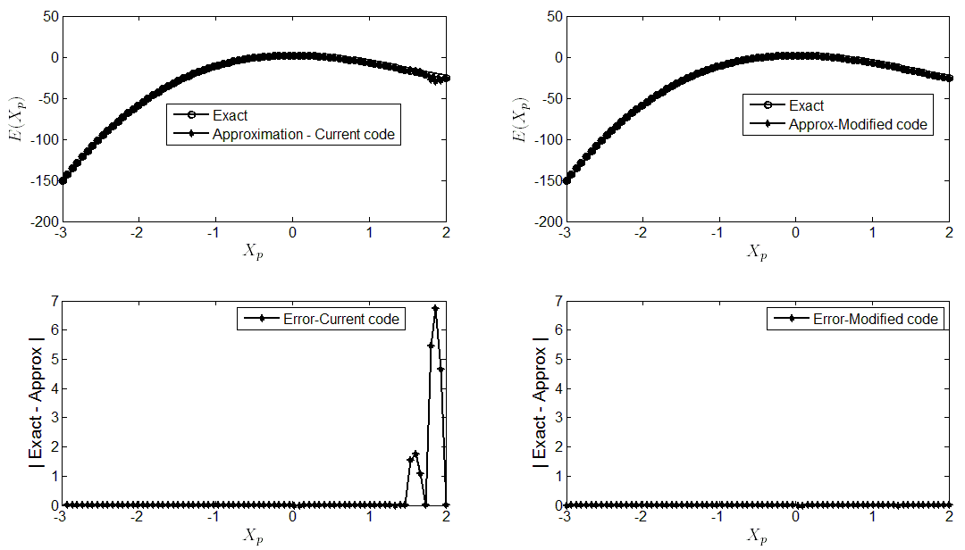
Plots for E

Slide 8
Where is the problem?
The subroutine “Divided_Differences” is computing wrong the divided differences and the dimension of the vectors c1 and c to storage these values are incorrect.
There is a bug in the subroutine “ENO_Interpolation_Stencil”. In particular, is assigned to the vector Left (index for the ENO interpolation stencil) an incorrect value to the endpoint of the interval.
An evidence of incorrect ENO stencil (vector Left in “ENO_Interpolation_Stencil”) is showed in the following slides, where is interpolated the Heaviside function with a 3rd order polynomial.

Slide 9
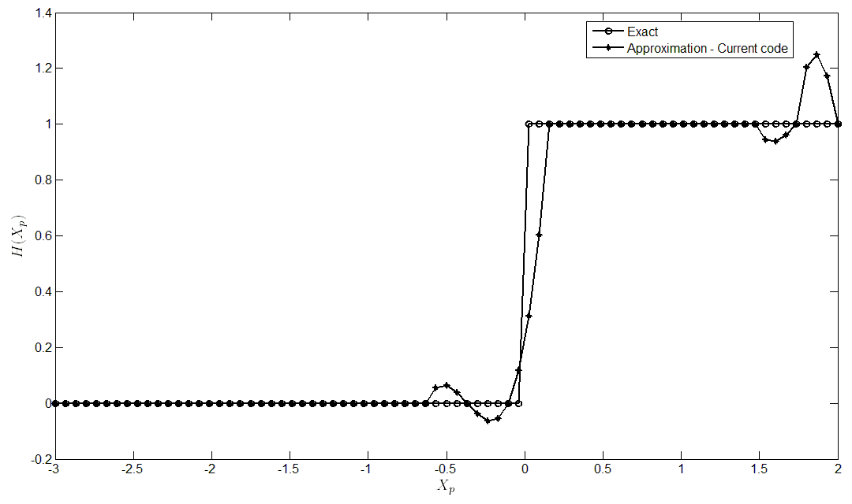
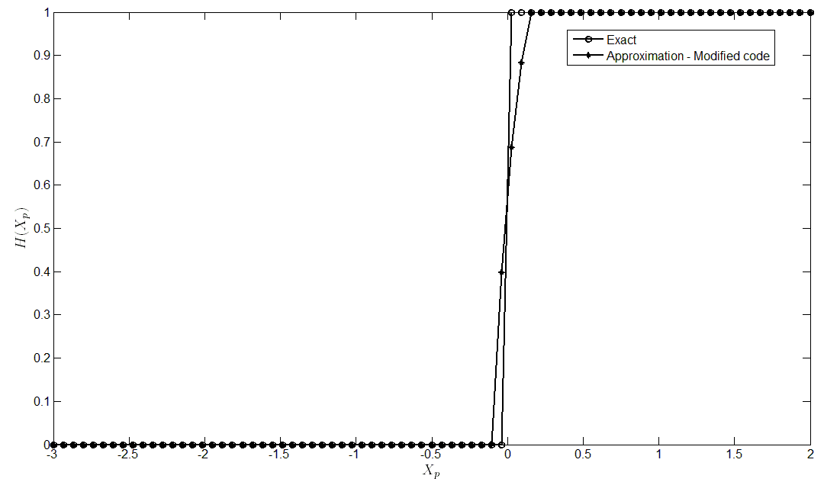
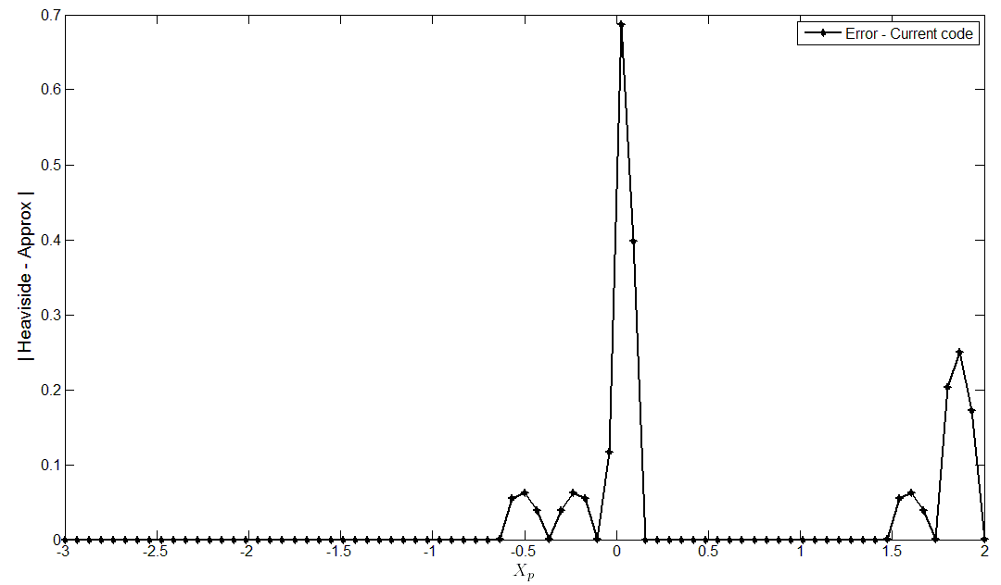
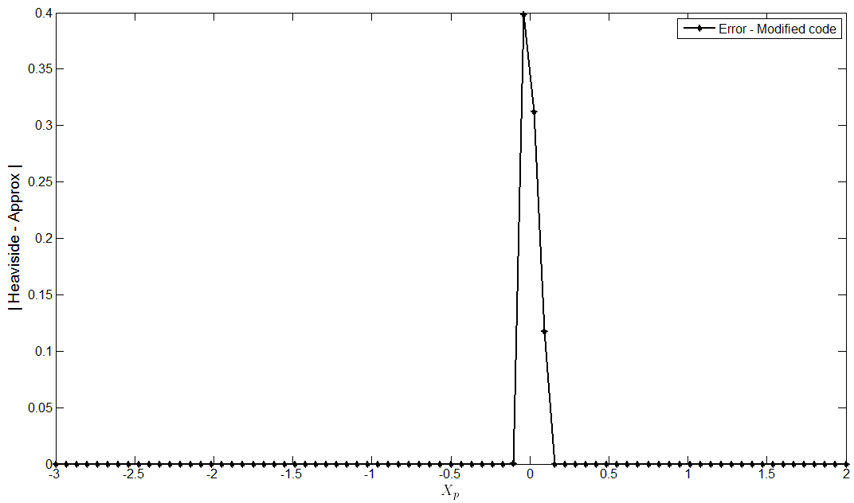
ENO Interpolation to the Heaviside function

