Slide 1
The CUDA ClusterFinder
Kernel design · hardware limits · seven optimization steps
Khalil Daniel Ferjaoui
Paul Scherrer Institut · aare
September 2026
Notes:
SAY THIS -- 52 words, about 20 s.
- Good morning. I am Khalil, and this is about making the cluster finder in aare
run on a GPU.
- It is a performance talk, so there are numbers, but the story is simple: I
expected to spend my time on the maths, and I spent it on moving data.

Slide 2
AARE · HYBRID PIXEL DETECTORS · CUDA CLUSTERFINDER
The kernel was rarely the bottleneck.
Feeding it was.
One kernel, one thread per pixel, and seven steps to keep it fed
WHERE THIS ENDS UP · THE SHIPPED f32 BUILD AFTER ALL SEVEN STEPS · ENGINE TIMES [f32 · s4] · RECONCILED IN A7
3×3
×9.1
61,312
~1 in 10⁶
CLUSTER SIZE
VS 24-THREAD CPU
FRAMES / SECOND
CLUSTER MISMATCH VS CPU
RTX 4090 (Ada, sm_89) · PCIe 4.0 ×16 · Mönch 400×400 uint16 · 3×3 clusters · 100 000 frames · Cu fluorescence, MAX IV
Notes:
SAY THIS -- 92 words, about 35 s.
- The title is the finding, and it surprised me. I expected to spend my time on
the kernel. The kernel was fast almost immediately.
- At the small cluster size the maths takes 5 microseconds per frame, and just
getting that frame across the PCIe wire takes 16. So six of my seven steps are
not about computing. They are about feeding, and about getting results back.
- Where we end up: nine times faster than 24 CPU threads, 61 thousand frames per
second, and the answers are the same to about one cluster in a million.
DETAILS: WHERE THE ~1 IN A MILLION COMES FROM, IF ASKED.
It is a bound, and a provable one, not a measurement. Three comparisons, all at
3x3 over 10 000 frames and 23 244 605 clusters:
serial CPU vs frozen CPU 8 / 11 = 19 pedestal update timing
frozen CPU vs CUDA [f64 ped] 0 / 0 = 0 the port, on its own
frozen CPU vs CUDA [f32 ped] 0 / 6 = 6 float32 ULP ties
The shipped build is CUDA [f32], and the finder a user would otherwise reach for
is the serial CPU one. That pair is never compared directly, but symmetric
difference obeys the triangle inequality, so it is at most 19 + 6 = 25. Two
independent causes, neither of them the GPU port: slide 29 has the first, slide
28 the second, and slide 26 shows the port itself contributes exactly zero.
25 / 23 244 605 = 1.08 per million. Say "about one in a million"; do NOT say
"below one in a million", which the bound does not support.
THE PARAGRAPH THAT USED TO BE ON THIS SLIDE is now only spoken: at 3x3 the
kernel needs 5.5 us per frame while getting that frame across PCIe costs 16.6,
or 13.2 uncontended. Both numbers return at full size on slide 19 and in A7.

Slide 3
CONTEXT · WHAT THE CODE DOES
The algorithm, the hardware, the limits
COMING UP
3–4
The algorithm
5–6
The two machines
No optimizations yet, only what the hardware has to do.
7–8
The CUDA kernel
9
What limits it
10
The roadmap
Notes:
SAY THIS -- 56 words, about 20 s.
- First, some context. What the algorithm does, what the two machines look
like, and what we ask the GPU to do.
- No speed numbers in this part. We only set up the problem.
- One thing to keep in mind all the way through: every frame has 160 000
pixels, and the work on each pixel is independent of the others.

Slide 4
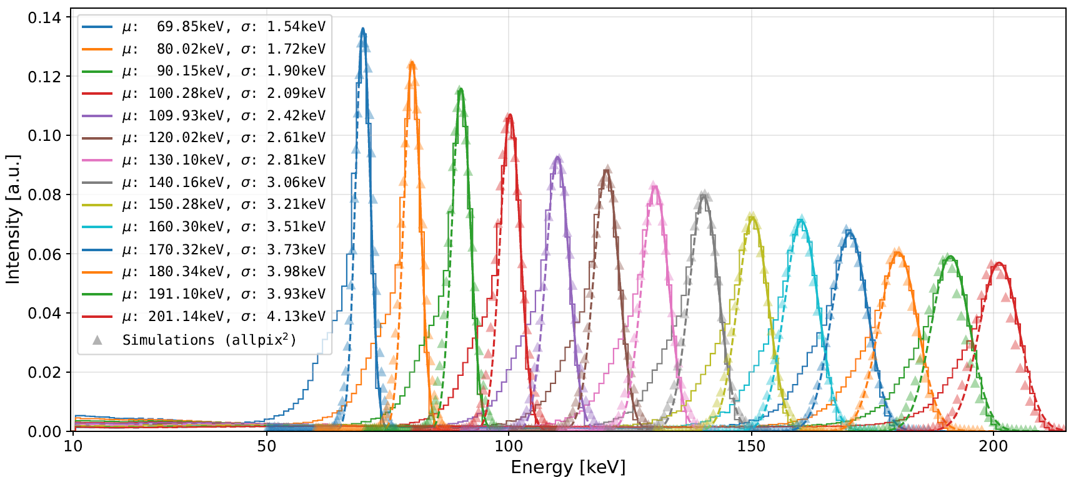
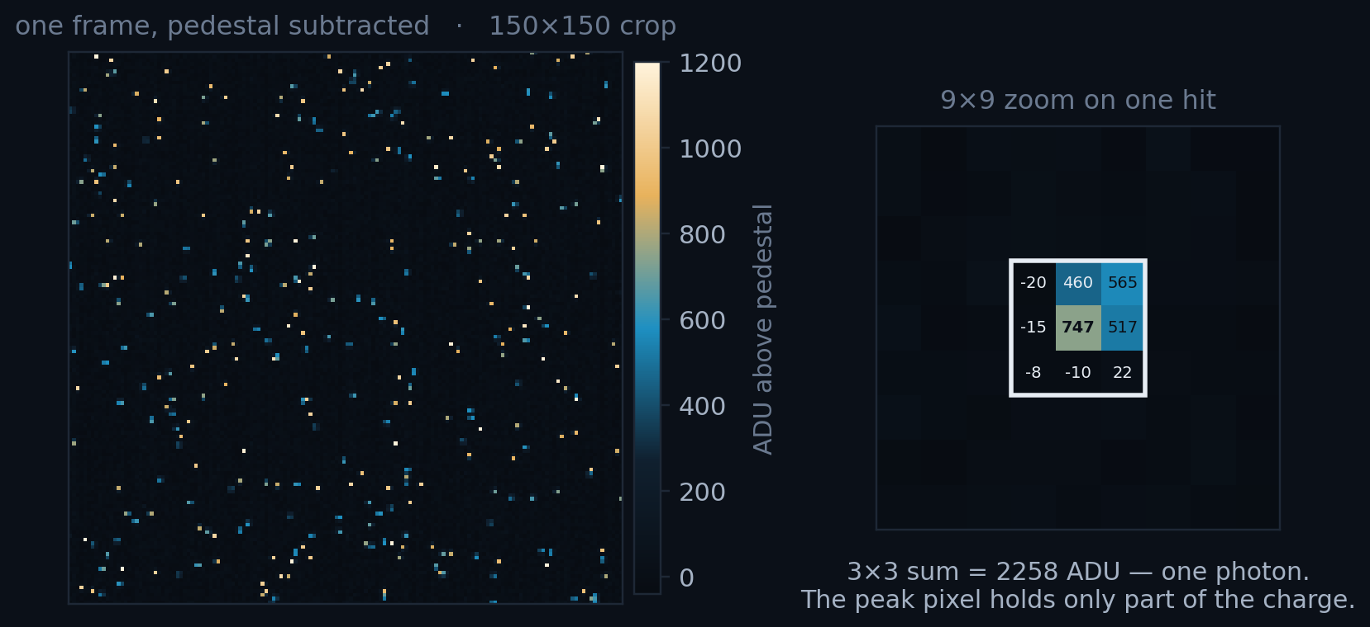
THE ALGORITHM · WHAT IT IS FOR
A photon is not a pixel: it is a cluster
• One photon's charge spreads over neighbouring pixels; summing the 3×3 patch recovers its energy.
• The histogram of those cluster energies is the measurement: peak and width give gain and energy resolution.
WHY IT MATTERS
Cluster-energy spectra from an energy scan.
MÖNCH03 · THE DETECTOR THIS FEEDS
ARRAY · PITCH · ACTIVE AREA
400 × 400 · 25 µm · 10 × 10 mm²
FRAMES PER SECOND
1.3 k standard, 3–6 k optimised
PEAK PIXELS = PHOTONS / FRAME
Real MÖNCH data, Cu fluorescence, MAX IV. One cluster per local maximum, so 2 330 counts photons.
~2 330 · 1.5 %
3 / 34
Notes:
SAY THIS -- 118 words, about 45 s.
- A photon does not land on one pixel. Its charge spreads over the pixels next
to it. So to get its energy, you have to add up a small patch -- three by
three around the brightest pixel. That patch is what we call a cluster.
- The histogram on the right is the real measurement. Where the peak sits gives
the gain, how wide it is gives the energy resolution. Finding clusters is
what makes that plot possible.
- The detector is MOENCH: 400 by 400 pixels, 1 300 frames per second today, up
to 6 000 with better readout boards. About 2 300 photons per frame -- so only
one and a half percent of the pixels have a photon.
DETAILS: The detector, and why its frame rate is the yardstick.
MOENCH03 is a hybrid silicon pixel detector: charge integration with analog
readout, 25 x 25 um^2 pitch, 400 x 400 pixels over a 10 x 10 mm^2 active area.
Its standard frame rate is 1.3 kHz; with optimised readout boards the design
reaches 3-6 kHz depending on configuration.
That is the number to hold on to. 400 x 400 = 160 000 pixels is 312.5 KiB per
frame at 16 bit, so 1.3 kHz is ~0.4 GB/s off the detector and 6 kHz is ~1.9
GB/s. The 24-thread CPU finder does 6 762 FPS at 3x3, so it already keeps up
with the standard mode and roughly matches the optimised ceiling -- with nothing
left over for anything else on the machine, and nothing left at 9x9, where it
manages 1 503 FPS. Slide 33 closes this loop.
Pixels above 5 sigma are ~5 700, about 3.6 % of the frame and 2.4 per photon;
that is the number that sets how much of the frame the 3x3 windows cover.

Slide 5
THE ALGORITHM · PER FRAME
Per pixel: subtract, threshold, update the pedestal
• Per pixel: subtract a running pedestal, keep what clears nσ · rms, cut a 3×3 cluster around each local maximum.
• The pedestal is updated by ~80 % of pixels every frame, so arithmetic and data movement are coupled.
THE SHAPE OF THE WORK
WORK ITEMS PER FRAME
160 000
THE WHOLE ALGORITHM · THREE OUTCOMES, NOT TWO
// the whole algorithm, per pixel
v = frame[i] - pedestal_mean[i]
rms = pedestal rms at i
m = max(v) over the 3x3 window at i
if (m > nSigma * rms) // a photon is within reach
if (v == m) -> emit cluster // ... and I am its peak
else -> nothing // ... I am in its shadow
else -> update pedestal // I saw nothing
OPERATIONS ON EACH
~5, identical
COMMUNICATION BETWEEN THEM
none
ORDER THEY MAY RUN IN
any, once the pedestal is fixed
Thesis of this talk: the compute was fast almost immediately. Six of the seven steps are about feeding it.
BYTES PER FRAME
312.5 KiB · ~2 330 clusters
4 / 34
Notes:
SAY THIS -- 127 words, about 46 s.
- This is the whole algorithm, for one pixel. First subtract the pedestal --
that is the dark baseline, what the pixel reads with no light. Then look at
the three by three window around you.
- Now three outcomes, not two. If the brightest value in that window is above
the threshold and it is ME, I write out a cluster. If it is a neighbour, I do
nothing -- I am in its shadow. And if nothing is above the threshold, then I
saw only noise, so I add my value to the pedestal. That last case is about
80 % of pixels, every frame.
- So: 160 000 pixels, about five operations each, and no pixel needs to talk to
another. That shape is why a GPU should work here.
DETAILS: Why order does not matter, and the one place it does.
A pixel reads what its neighbours MEASURED, never what they decided. With the
pedestal held at its frame-start value, order cannot matter, and that is what
licenses one thread per pixel.
The serial CPU finder updates the pedestal mid-scan and so gives that property
up: a pixel scanned late sees a pedestal that earlier pixels have already moved.
Slides 30-31 measure what that costs -- it is the channel behind 11 of the 19
cluster differences between the serial CPU and the frozen-pedestal reference.

Slide 6
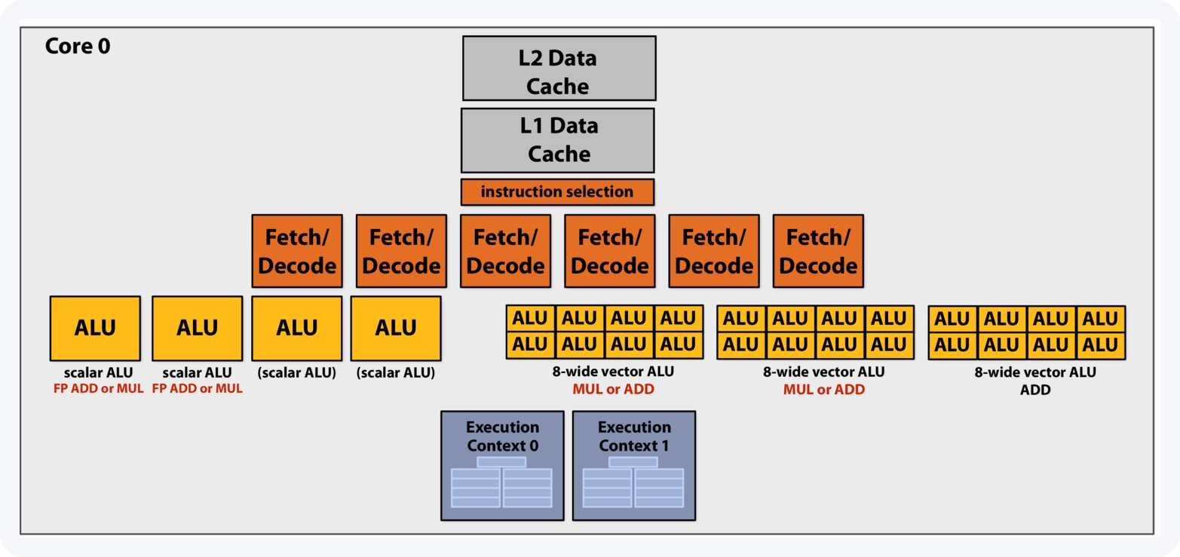
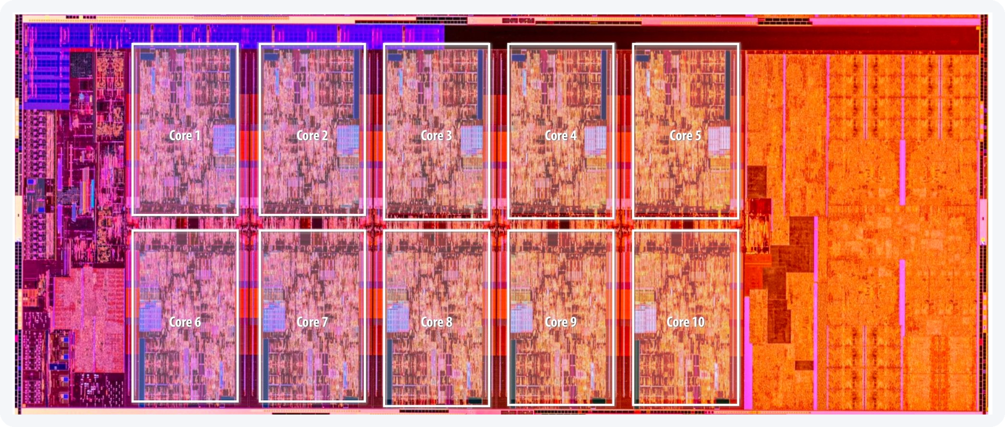
THE MACHINE WE ARE STARTING FROM
CPU: latency-oriented, built to finish one thread fast
PC-MOENCH-04 · AMD RYZEN 9 7950X
CORES × SMT
16 × 2
CPU, 1 THREAD
1.75 ms
CPU MT, 24 THREADS
148 µs
Count the boxes: 6 fetch/decode and two levels of private cache, all to keep two instruction streams fed. The ALUs are the small part.
THAT IS THE BAR
6 762 frames / s
Both diagrams after Stanford CS149, Fall 2025.
Thread count is swept per cluster size, not assumed: 24 at 3×3, 32 at 9×9.
5 / 34
Notes:
SAY THIS -- 124 words, about 45 s.
- This is the machine we start from. Look at what the chip is spent on: six
fetch and decode units, an instruction selector, two levels of private cache.
All of that keeps just two instruction streams running fast.
- The yellow boxes, the parts that actually compute, are the small ones. Most
of the chip is there to FIND independent work inside one program, and to hide
slow memory behind a cache. That is the right design when you have a few
threads and each one must finish quickly.
- Our problem is the opposite. The independent work is handed to us: 160 000
pixels. The bar to beat is here: 24 threads, 148 microseconds per frame,
6 762 frames per second.
DETAILS: The CPU slide. The point is not that CPUs are bad -- it is what the
silicon is SPENT on.
On the diagram: Intel Skylake is shown, one core, schematically. The Zen 4 core
in this machine differs in detail -- 4 FP pipes rather than 3, AVX-512
double-pumped on 256-bit datapaths -- but not in kind: ~6-wide front end, 4
scalar ALUs, 2 SMT contexts, private L1 + L2. Load/store units are not drawn.
DO NOT ADD THE BOXES UP INTO A LANE COUNT. Counting the picture gives 3 x 8-wide
vector + 4 scalar = 28 ALU boxes, and 28 is not a number to say next to the GPU's
16 384. Three reasons:
1. They are not separate hardware. The drawing gives the scalar ALUs and the
vector ALUs their own boxes, but on Skylake they sit on the SAME issue
ports (0, 1, 5). Adding 24 + 4 counts the same execution resources twice.
2. Only two of the three vector units multiply -- read the red labels: "MUL or
ADD", "MUL or ADD", and then "ADD" alone. FLOPs need FMA-capable width, so
it is 2 x 8, not 3 x 8.
3. "8-wide" is 8 x 32 bit = 256 bit = AVX2, so those ARE fp32 lanes. That part
of the reading is right.
The number to quote is 16 FP32 FMA lanes per core: on Skylake client, 2 FMA units
x 256 bit. And on the Zen 4 in this machine, also 16 -- 4 FP pipes of which 2 are
FMA-capable, 256 bit wide. 16 cores x 16 = 256, which is the figure on slide 6's
rail. Say it comes from the Zen 4, NOT from this Skylake picture: the two
microarchitectures landing on the same 16 is a coincidence, not a derivation.
Same shape of caveat as the V100 diagram on slide 6, and the same answer if the
count is challenged: the picture is there for the RATIO of control silicon to
arithmetic -- 6 fetch/decode, an instruction selector, two private caches, all
feeding 2 execution contexts -- not for its lane count.
On the die photo: Comet Lake, a 10-core Core i9, at the same scale of argument
as the AD102 die on the next slide. Ten cores, and they do not fill the die --
the orange slab on the right is L3 and the block on the left is I/O and the
memory controller. If someone asks why a 16-core Ryzen is not simply 16x a
1-core Ryzen, that picture is the answer.
Six fetch/decode units, an instruction selector, L1 + L2 private cache: all of
that machinery exists to find independent work INSIDE one instruction stream,
and to hide memory latency behind a cache. It is the right design when you have
a few threads that must each finish fast.
WHAT THE DIAGRAM DOES *NOT* SHOW, if asked. It draws exactly four things:
superscalar issue (6 fetch/decode + several ALUs + one "instruction selection"
box), SIMD (3 x 8-wide vector ALUs), 2-way SMT (the two Execution Contexts), and
a private L1/L2. There is NO out-of-order hardware on it -- no reorder buffer,
no reservation stations, no register renaming, no load/store queue, no branch
predictor, no retirement unit. The single "instruction selection" box is the only
nod to issue logic, and its label does not say out-of-order; on a diagram whose
subject is SMT it reads just as naturally as "pick which of the two threads
issues this cycle".
So do not point at this picture and say "out-of-order". The real Zen 4 in this
machine is deeply out-of-order and that fact supports the argument -- but say it
as a fact about the chip, not as a box on the slide, or someone will spend the
next minute looking for the box.
Our problem has the opposite shape: 160 000 work items that are already
independent. We do not need a machine to FIND the parallelism -- it is handed to
us. Every transistor spent looking for it is a transistor not doing arithmetic.
On the thread sweep: 6 762 FPS is the best of a measured sweep (perf/cpu_threads.py),
not a default. 48 threads on 16 cores is 24 % SLOWER than 24 -- worth saying out
loud, because an oversubscribed baseline is the easiest way to inflate a GPU
speedup without lying about anything.

Slide 7
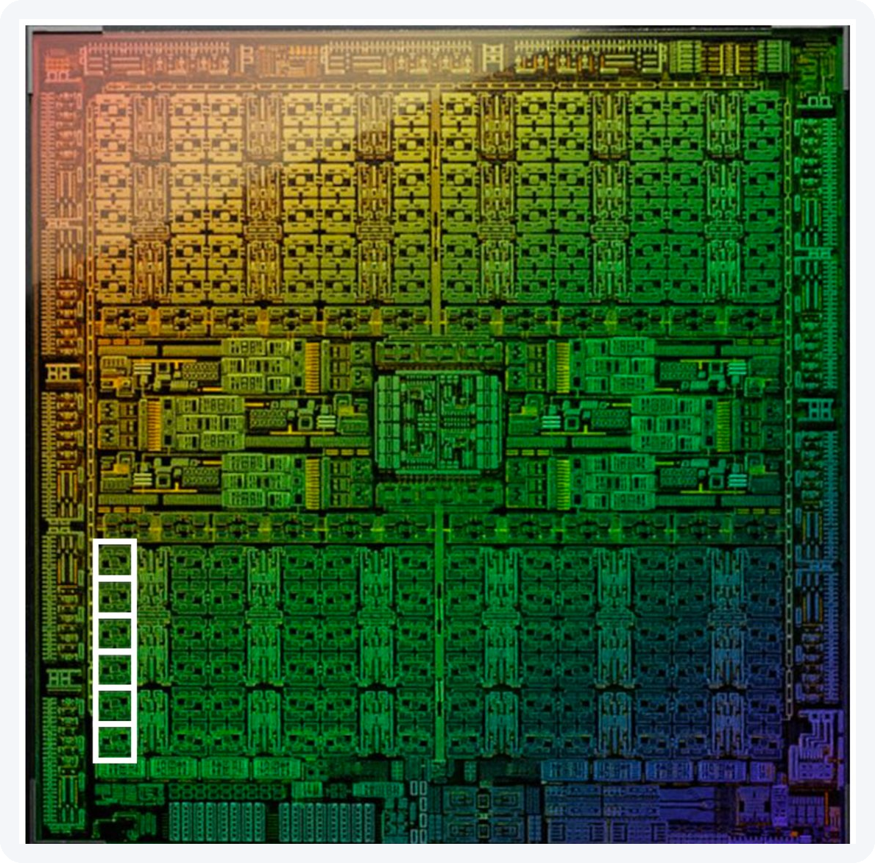
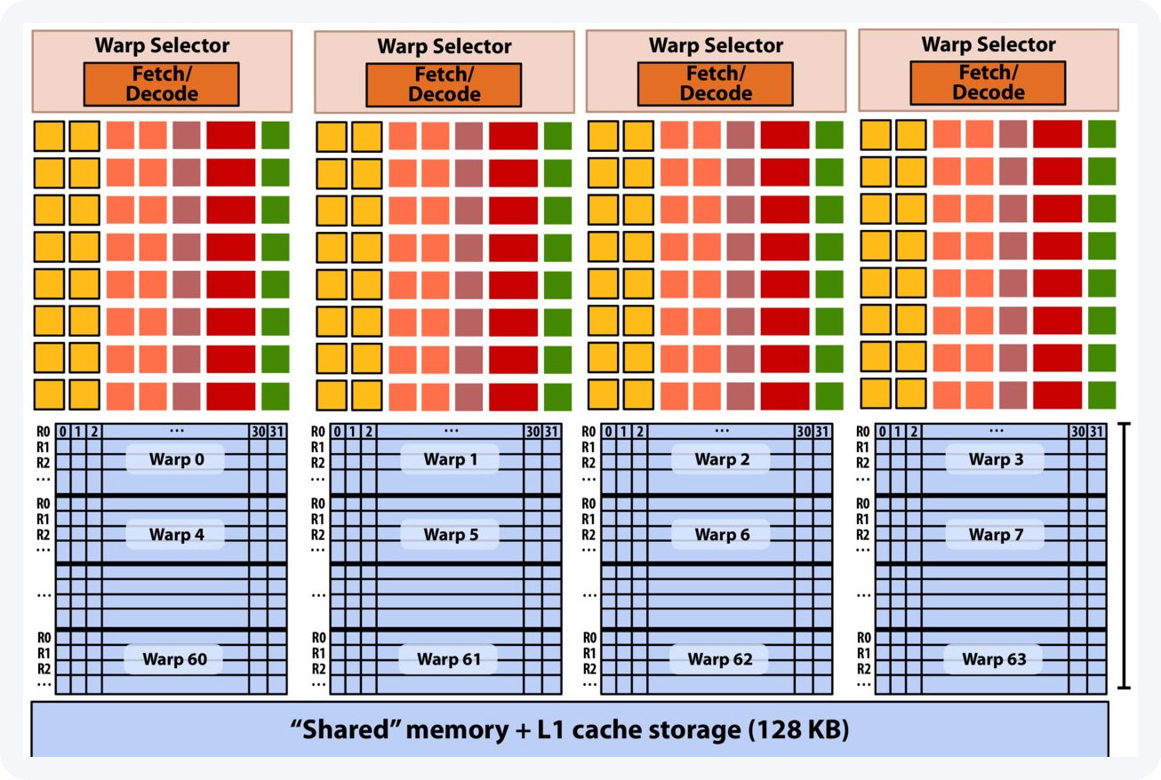
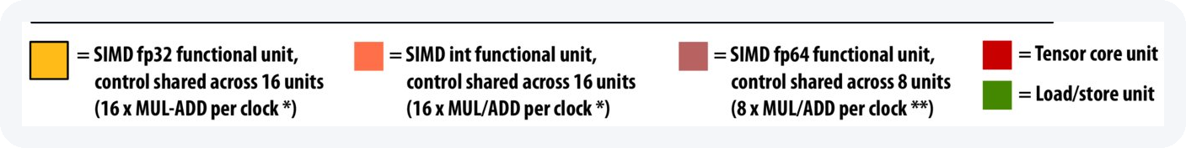
THE MACHINE WE ARE MOVING TO
GPU: throughput-oriented, the whole frame at once
NVIDIA GEFORCE RTX 4090
FP32 LANES
16 384
128 SMS × 128 LANES
vs 16 cores × 16 = 256
RESIDENT THREAD SLOTS
196 608
AD102 · 144 blocks, 128 enabled on this card. One SM boxed.
THE FRAME NEEDS
160 000 → all at once
Same grammar, inverted proportions: 4 fetch/decode for 64 warp contexts.
Device memory runs at 1 008 GB/s (384-bit, 21 Gbps); PCIe 4.0 ×16 peaks at 31.5 and measures 24. Two copy engines, so H2D and D2H run at the same time.
One SM: a V100 is shown; this card's is the same idea: 128 FP32 lanes, 48 warp slots, 100 kB shared memory. After Stanford CS149, Fall 2025.
6 / 34
Notes:
SAY THIS -- 144 words, about 52 s.
- Same drawing, opposite proportions. Four fetch and decode units, and 64 warp
contexts. Almost all the area is compute and registers.
- The GPU hides slow memory in a different way. Not with a big cache, but by
having many other threads ready to run. When one group waits, another runs.
- The number to keep: this card can hold 196 000 threads at the same time. Our
frame needs 160 000. The whole frame fits in the machine at once.
- And compare like with like: 256 float lanes on this CPU, 16 384 here. That is
64 times the width, about 32 times once you count clock speeds. We measure
nine. So we are not short of lanes -- we are short of a wire to feed them.
Device memory runs at a thousand gigabytes per second; PCIe brings us 25.
DETAILS: The GPU slide, and the number to land.
128 SMs x 1 536 threads = 196 608 thread slots that can be RESIDENT at the same
time. Our frame is 160 000 pixels. The entire frame fits in the machine at once,
one thread per pixel, with room left over -- which is why slide 7's "one thread
per pixel" is not a figure of speech, and why slide 9 can talk about occupancy
as a real quantity (3x3 achieves 100 %: 1 536 threads resident per SM).
Latency hiding, in one sentence: the CPU hides memory latency with a cache and
out-of-order execution; the GPU hides it by having 48 other warps ready to run.
That is why there is no reorder buffer on this diagram and no branch predictor.
Count the pink cells in the legend before moving on: FP64 units are a small
minority of the SM, 8 MUL/ADD per clock against 16 for fp32 and 16 for int. On
a GeForce part the ratio is far worse than this V100 diagram suggests -- 1/64.
That is half of why opt7 pays, and it is worth planting here so opt7 lands as a
consequence rather than a surprise.
THE DIAGRAM IS A V100 AND ITS LANE COUNT DOES NOT TRANSFER. Anyone who counts
squares gets 64 FP32 lanes per SM, not 128, and they are right about the picture.
Per sub-core the legend reads 16 yellow "SIMD fp32" and 16 salmon "SIMD int" --
on Volta those are SEPARATE units and the int ones cannot do float. Ada changed
exactly that: per sub-core, 16 FP32-only lanes plus 16 that do FP32 OR INT32, so
4 x 32 = 128 per SM, and 128 SMs x 128 = 16 384. Cross-check: 16 384 x 2 flop x
2.52 GHz = 82.6 TFLOP/s against NVIDIA's quoted 82.58.
Two more Volta-isms in the same picture: it draws 64 warp slots per SM where Ada
has 48 -- slide 9 divides by 48 -- and it draws FP64 at half the FP32 rate,
where a GeForce Ada part is 1/64. The caption on the slide already says a V100
is shown; this is the detail behind that sentence.
THE TRAP TO PRE-EMPT, AS A LIKE-FOR-LIKE RATIO. The old version of this line
compared 16 384 GPU lanes against 32 CPU threads and called it 512x. That is
lanes against hardware threads -- two different quantities -- and it is the kind
of thing this audience catches. The defensible comparisons:
FP32 lanes CPU 16 cores x 16 = 256 GPU 16 384 x64
peak FP32 ~2.6 TFLOP/s at ~5 GHz 82.6 TFLOP/s x32
memory BW ~71 GB/s measured 1 008 GB/s x14
MEASURED 6 762 FPS 61 312 FPS x9.1
The CPU's 16 FP32 lanes per core are 2 FMA pipes x 256 bit, and SMT adds threads,
not lanes -- 32 threads share the same 256. Quote x64 or x32. Never x512.
The point survives either way, and it is the last row: even 32x is not what we
get, because every frame crosses a 25 GB/s wire once in each direction. At 9x9,
where there is far more work per byte moved, we DO get x26.5 -- the same
neighbourhood as the compute ratio. That contrast between the two cluster sizes
is the talk.

Slide 8
THE CUDA KERNEL · EXECUTION MODEL
One thread per pixel, one block per 16×16 tile
• A 16×16 block = 256 threads; the grid tiles the frame in 625 identical blocks.
• The output is sparse, but the decision work is dense: every pixel is tested, 160 000 times per frame.
WHERE THE LOOP WENT
// CPU: one thread per FRAME, loop inside
find_clusters(frame) {
for (int iy = 0; iy < 400; iy++)
for (int ix = 0; ix < 400; ix++)
/* test pixel (iy,ix) inline */
}
// GPU: no loop. The launch is the loop:
ix = blockIdx.x*blockDim.x + threadIdx.x;
iy = blockIdx.y*blockDim.y + threadIdx.y;
LAUNCH CONFIGURATION · ClusterFinderCUDA.hpp
block = dim3(BLOCK_X, BLOCK_Y); // 16 x 16 = 256 threads
grid = dim3((ncols + BLOCK_X - 1)/BLOCK_X, // 25 x 25 = 625 blocks
(nrows + BLOCK_Y - 1)/BLOCK_Y);
find_clusters_in_single_frame<<<grid, block, shmem, stream>>>(
d_frame, d_pd_mean, /* ... 9 more ... */ d_clusters);
The loop is the launch. 625 blocks × 256 threads = 160 000, one per pixel, decided before any data is seen.
400×400 → a 25×25 grid of 16×16 blocks = 625 blocks per frame, over 128 SMs. Nothing in the launch depends on the cluster count.
A block is the 256 threads that share one tile and can wait for each other. That is the next slide.
1 load tile + halo
›
2 __syncthreads
›
3 stencil reduction
›
4 classify
›
5 append or update pedestal
7 / 34
Notes:
SAY THIS -- 89 words, about 30 s. Two differences from the CPU code.
- WHAT ONE WORKER OWNS. CPU: one thread takes one WHOLE frame -- 24 threads on
24 frames -- and walks it pixel by pixel. GPU: one thread takes ONE PIXEL,
160 000 at once on the same frame.
- WHERE THE LOOP WENT. On the CPU the loop is in the code: for y, for x. On the
GPU there is no loop -- the loop IS the launch. A 25 by 25 grid of 16 by 16
blocks, each thread finding its own pixel. And a block is 256 threads that
share one tile: the next slide.
DETAILS (if asked):
- Every thread runs the same function. The kernel is written once, for one
thread; the launch runs it 160 000 times.
- "One thread per frame" is why the CPU baseline moves with thread count:
24 threads at 3x3, 32 at 9x9.
- Each CPU thread carries its own pedestal, so neighbouring frames train
separate baselines. Act IV, not here.
Do NOT say "a chunk of the frame" for the CPU: ClusterFinderMT hands each thread
a whole frame, and ClusterFinder walks it in raster order. Slide 30 needs that
-- its whole argument is that a late pixel is judged against a pedestal this
same scan already moved.
DETAILS: what this slide used to carry, and where it went. The right column was a
copy of slide 4's three-outcome logic -- same panel title, same ~80 % figure --
so it has been replaced by the loop/launch contrast the notes above argue. The
two facts that lived only here, if either comes up:
- The branch split per frame: ~80 % of threads update the pedestal, ~18 % sit
in a peak's shadow, ~1.5 % are peaks. (Also on slide 30.)
- A shadow pixel is neither recorded NOR fed back: it is not a cluster, and it
does not update the pedestal either. That is the third outcome, and it is
why the algorithm has three and not two.
DETAILS: the launch line is elided on purpose. The real call passes 12 arguments
(ClusterFinderCUDA.hpp:715-719); nine of them are pedestal and geometry pointers
that say nothing about the execution model, and at full length they were the
widest thing on the slide. The bold is on grid and block because those two are
the subject; shmem is deliberately left plain -- it is slide 8's subject, one
slide later.

Slide 9
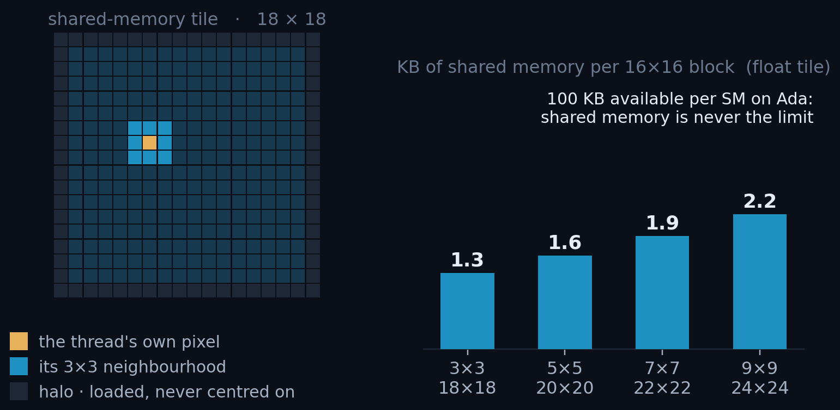
THE CUDA KERNEL · TILING AND HALOS
Shared memory: load the tile once, reuse it nine times
• Neighbouring threads need overlapping windows; without shared memory each pixel is fetched up to nine times.
• Each block stages one pedestal-subtracted tile plus its halo, loaded by the threads on the block edges.
clusterfinder_kernel.cuh
extern __shared__ unsigned char smem[];
auto *sh = (COMPUTE_TYPE*)smem;
auto stride = blockDim.x + 2*col_radius;
auto tid = (threadIdx.y + row_radius)*stride
+ (threadIdx.x + col_radius);
// pedestal subtraction fused into the load
sh[tid] = d_frame[gid] - d_pd_mean[gid];
Only odd cluster sizes are supported, so the centre pixel is unique.
8 / 34
Notes:
SAY THIS -- 123 words, about 45 s.
- Each thread needs its own 3x3 window, so it reads nine values. Which means
every pixel is read nine times, by nine different threads. At 9x9 it is
eighty-one times.
- What CUDA gives you here is control over the chip's memory. Shared memory is
the same on-chip memory as L1, except you decide what goes in it.
- So the block loads its tile once, plus a one-pixel halo, and after that every
thread reads from shared memory. One trip to VRAM instead of nine -- and the
pedestal subtraction happens on the way in, for free.
- The cost: 1.3 kilobytes at 3x3, 2.2 at 9x9, out of 100 per SM. One to two
percent. Shared memory is never what runs out. So what does?
DETAILS: shared memory is never the binding resource here. The tile is stored in
COMPUTE_TYPE (float), not in the pedestal type: 1.3 KB for 3x3 and 2.3 KB for
9x9, against 100 KB of shared memory per SM. Even the old double-precision tile
only reached 4.5 KB. What runs out first is registers -- the next slide.
DETAILS: "nine reads" is per pixel, not per thread. A thread reads 9 values (its
own window); a pixel is read by 9 threads (every window it falls in). Both are
nine at 3x3, which is why the sentence works either way -- but the WASTE is the
second one, so say it that way.
DETAILS: on Ada, shared memory and L1 are one 128 KB block of on-chip storage per
SM, split at launch, up to 100 KB of it usable as shared. So "same silicon as L1,
but user-managed" is literal, not an analogy.

Slide 10
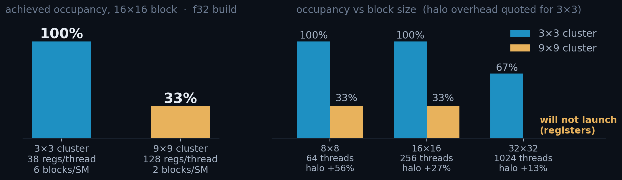
HARDWARE · OCCUPANCY
Occupancy is a latency-hiding budget
• When a warp stalls, the SM switches to another already-resident warp. Occupancy = resident warps / the maximum: how many alternatives it has to switch to.
THREADS / BLOCK
THREAD SLOTS / SM
MAX WARPS / SM
REGISTERS / SM
SHARED MEM / SM
256
1 536
48
65 536
100 kB
16×16 is the balance point. 33 % is not a failure to fix: it is what the register budget allows (annex A1), and at 9×9 one kernel nearly fills the machine on its own.
9 / 34
Notes:
SAY THIS -- 120 words, about 45 s.
- This is the last two slides in one number. Occupancy is the warps resident
on an SM over the most it could hold. It is a latency-hiding budget: when a
warp stalls, the SM switches to another one that is already there.
- At 3x3: six blocks, 48 warps, 100 percent. At 9x9: two blocks, 16 warps,
33 percent.
- And 33 is not a bug to fix. Occupancy only buys latency hiding, and hiding
only pays if there is latency left unhidden. At 9x9 each thread does a lot of
work per byte it loads, so 16 warps keep the SM fed.
- High occupancy is a means, not the goal -- and on this workload the kernel was
never the bottleneck anyway.
CAREFUL: occupancy has nothing to do with arithmetic intensity. Intensity is
FLOP per byte, a property of the ALGORITHM; occupancy cannot change it. The true
statement is "more occupancy does not mean more throughput" -- a kernel with
enough independent work per thread runs full speed at low occupancy. Saying
"highest occupancy is not highest arithmetic intensity" invites a correction
from anyone in the room who knows the roofline.
DETAILS: why "33 % occupancy" is not the alarm it looks like.
Occupancy only buys latency hiding, and latency hiding only matters if there is
latency left unhidden. At 9x9 the kernel is long and each thread does a lot of
work per byte loaded, so 16 resident warps are enough to keep the SM fed.
It is also build-dependent, and that is the honest caveat. On the shipped f32
build the 9x9 kernel overlaps across four streams by only 1.02x -- extra streams
buy nothing in kernel concurrency. On the f64 build the kernel is 3.5x longer
and DOES overlap, 1.32x, and there four streams genuinely lower the floor. So
quote the overlap factor, never "occupancy is fine" on its own.
Shared memory never binds here: 1.3 KB per block at 3x3, 2.3 KB at 9x9, against
100 kB per SM. That is 1-2 % of the budget, which is why the strip lists it as a
ceiling we never approach rather than as a number that decides anything.
ON THE 100 kB, if someone who knows sm_89 asks. The SM has 128 kB of UNIFIED
L1 + shared memory; 100 kB is the most of it that can be carved out as shared,
and 99 kB the most a single block may request. So 100 kB is the shared-memory
ceiling, not the size of the array. The three numbers on the strip are the three
things that can run out -- and on this kernel it is never this one.
Provenance for both hardware slides: shipped f32 build, measured not estimated.
cuobjdump -res-usage for registers and spills;
cudaOccupancyMaxActiveBlocksPerMultiprocessor for blocks per SM; RTX 4090
(sm_89). Reproduce with python/tests/perf/kernel_resources.py.

Slide 11
ROADMAP
Three acts, ordered by which bar is tallest
ACT I · FEED THE GPU
the host cannot submit work fast enough at 3×3 [f64]
opt1
First CUDA port
×2.34
1 stream, one launch per frame
opt2
Streams + batching
×3.66
4 streams, drained every 4 frames
opt3
Pipeline rework
×4.32
sync barriers removed
opt4
Pinned memory
×5.69
DMA-speed host transfers
ACT II · GET THE RESULTS BACK
the host copy is now the tallest bar at 3×3 [f64]
opt5
Host↔GPU overlap
×7.45
chunked submit / collect
opt6
Zero-copy collection
×8.65
read in place, never copy
ACT III · THE KERNEL
the kernel is the tallest bar, at 9×9 at 9×9 [f32]
opt7
FP32 pedestal + variance rewrite
kernel −41%
the only kernel change in the deck
Speedups are 3×3 against the best CPU configuration, 24 threads.
10 / 34
Notes:
SAY THIS -- 104 words, about 40 s.
- Here is the whole talk on one page. Seven steps, grouped in three acts, and
the acts are ordered by which part was the slowest at the time.
- Act one: the host cannot feed the GPU fast enough. Act two: getting the
results back is now the slow part. Act three: only now is the kernel itself
the slow part -- and that is the only step where I touched the maths.
- The numbers on the right are speed-ups against the CPU. We start at two and
finish at nine, for the small cluster size. Do not read every row now; we
come back to this page at the end.

Slide 12
ACT I OF III · FEED THE GPU
Bottleneck: host submission and PCIe
COMING UP
11
two memories, one wire
12
opt1 · first port
The kernel was fast almost immediately. This act is about the host, and it is told at 3×3, where PCIe is the floor.
13
opt2 · four streams, four deep
14
opt3 · the whole batch in flight
15
opt4 · pinned memory
STARTING FROM
6 762 FPS
24-thread CPU · 14.8 s for 100 000 frames
Notes:
SAY THIS -- 62 words, about 22 s.
- Act one. The kernel was already fast. The problem is getting the data to it.
- Five slides, all at the small cluster size, because that is where the PCIe
wire is the limit.
- We start from the CPU: 6 762 frames per second, about 15 seconds for a
hundred thousand frames. Everything from now on is compared to that.

Slide 13
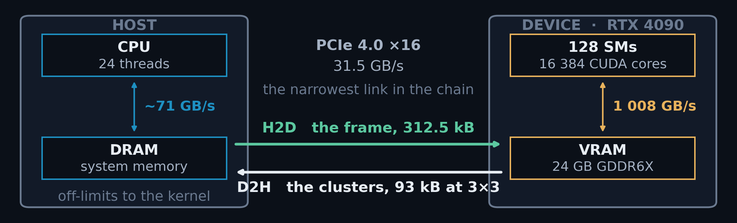
ACT I · THE TWO MEMORIES
The GPU consumes 32× faster than PCIe delivers
• A CUDA kernel addresses the GPU's own memory and nothing else. So every frame is copied in (H2D, host to device) and every result copied back out (D2H). Those two names are what the next five slides are about.
The asymmetry is the whole talk. Host DRAM runs at ~71 GB/s and VRAM at 1 008, but everything between them crawls through 31.5.
11 / 34
Notes:
SAY THIS -- 119 words, about 43 s.
- One rule of CUDA explains the next five slides. A GPU program can only read
the GPU's own memory. It cannot touch host memory. So every frame has to be
copied IN, and every result copied back OUT. Those two copies have names:
H2D, host to device, and D2H, device to host.
- Now look at the three speeds. Inside the GPU, memory runs at a thousand
gigabytes per second. Host memory runs at seventy. But the wire between them,
PCIe, gives us thirty-one.
- So the GPU can eat about thirty times faster than the wire can deliver. Our
data crosses that wire once per frame, in each direction. That is the whole
problem of the next two acts.
DETAILS: This slide is for the half of the room that has never written CUDA. If
they are all GPU people, say the two sentences on the left and move on.
The one idea: a kernel cannot dereference a host pointer. Everything it reads
must already be in VRAM, and everything it produces must be copied back. That is
not a performance detail, it is the programming model, and it is why six of the
seven optimisations are about movement rather than arithmetic.
THE THREE BANDWIDTHS, and be precise about which comparison is which. VRAM to SM
is 1 008 GB/s. Host DRAM measured ~71 GB/s on pc-moench-04 (threaded copy over a
1 GB array, counting 24 B per element: 8 read, 8 write, 8 read-for-ownership;
dual-channel DDR5, so this is in the right family). PCIe 4.0 x16 is 31.5.
So the wire is 32x below VRAM but only about 2.3x below host DRAM. The claim to
make is NOT "the wire is 32x slower than memory" -- it is that the wire is the
NARROWEST link in the chain, and that the GPU can consume about thirty times
faster than the wire delivers. Any calculation whose input crosses that wire once
per use is gated by the wire, and this one does exactly that: a frame arrives, is
touched about five times, and leaves.
If asked why not keep the data resident on the GPU: for this workload the frames
come off a detector at 100 kHz and the results go to analysis on the host, so
both ends are genuinely on the host side. Streaming is the problem, not a
choice.
The DMA engines are the reason the story is not simply "the wire is slow, the
end". There are two, one per direction, independent of the SMs, so transfer and
compute CAN overlap. Act I is getting the input arrow overlapped; Act II is the
output arrow.
Numbers on this slide, all from A1: H2D 13.2 us [s1] / 16.6 [s4], kernel 5.5 us
at 3x3 f32, D2H payload 93 kB at 3x3.

Slide 14
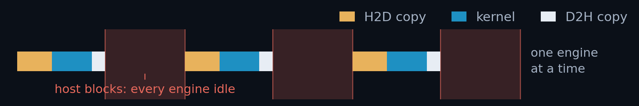
OPT1
ACT I · THE FIRST CUDA PORT
The first port runs at 26 % of the GPU's floor
• One copy in, one kernel, one copy out. The calls are async, but the clusters have to be on the host and copied out before the next frame starts, so nothing overlaps.
OPT1 · 3×3 · 100 K FRAMES · F64
THROUGHPUT
15 807 FPS
ClusterFinderCUDAOpt2.hpp · find_clusters()
cudaMemcpyAsync(d_frame, h_src, H2D, sc.stream); // 1. frame in
find_clusters_in_single_frame<<<..., sc.stream>>>(...); // 2. kernel
cudaMemcpyAsync(h_clusters, d_clusters, D2H, sc.stream); // 3. clusters out
cudaStreamSynchronize(sc.stream); // 4. host stops
for (c : found) out.push_back(c); // 5. copy out
VS 24-THREAD CPU
×2.34
PER FRAME
63.3 µs
H2D · KERNEL · D2H [S4]
16.2 · 15.2 · 7.7 µs
% OF FLOOR · 61 859 FPS
PCIe is full-duplex: H2D, kernel and D2H run on independent engines and overlap, so the floor is max(H2D, kernel, D2H), never the sum. At 3×3 that is 16.2 µs → 61 859 FPS [s4].
26 %
[s1] opt1's own, uncontended: 13.1 · 14.7 · 5.3 µs
12 / 34
Notes:
SAY THIS -- 144 words, about 53 s.
THIS PICTURE IS THE MAP FOR THE NEXT TEN SLIDES. Both ideas that drive the whole
ladder are visible as empty space in it. Point at the gaps while you say bullet 2.
- The first port is the simple one: copy a frame in, run the kernel, copy the
clusters out. The calls do not block, but the last line does -- the clusters
have to be copied into the caller's vector before the next frame starts. So
the host stops, once per frame.
- Look at the picture: it holds the whole plan. There are two kinds of empty
space in it. First: the three GPU steps run one after another, even though
they use separate hardware and could overlap. Closing that gap is Act one.
Second: the GPU waits for the host, then the host waits for the GPU. Closing
that one is Act two.
- The first gap also gives the target: if the three overlapped perfectly, a
frame would cost the longest of them, not the sum. 16 microseconds, 62 000
frames a second. We are at 26 percent of it.
DETAILS: The two-idea framing, and where Act III fits.
The mapping is exact, so it is safe to promise here and collect later:
ACT I opt1-opt4 overlap the GPU with ITSELF. H2D, kernel and D2H are
three independent engines; streams (opt2), removing the
barriers (opt3) and pinning (opt4) are all about getting
those three to run at the same time.
ACT II opt5-opt6 overlap the GPU with the HOST. Slide 18 is titled
host-GPU overlap; opt6 removes the last host copy.
Act III (opt7, the f32 kernel) is NOT a third kind of overlap, and do not
promise it as one. It makes one of the three engines cheaper rather than hiding
it behind another. That is also why it comes last: measured end to end it is
worth 1.5 %, and only once the host is off the critical path is the same change
worth 21 %. If someone asks "so what is act three?", the answer is "once nothing
is waiting any more, the only thing left is to make the work itself smaller".
DETAILS: Why the rail quotes [s4] on a slide about a ONE-STREAM build.
The floor is a property of the machine, not of opt1, and it has to be the SAME
denominator on all seven slides or "% of floor" means nothing. So every opt slide
divides by the floor derived from the s4 columns of A1: at 3x3 f64 the engines
are H2D 16.17, kernel 15.17, D2H 7.69 us, the max is H2D at 16.17, and
1/16.17 us = 61 859 FPS. That is the 16.2 in the callout.
The small [s1] line under it is opt1's own measurement -- one stream, nothing
else on the link -- and it is what the timeline figure is drawn from: 13.1 + 14.7
+ 5.3 = 33.2 us of serialized engine time inside a 63.3 us frame. Quote it if
someone asks what a single frame costs on a quiet GPU; do not divide by it. Its
max is the kernel, not H2D, and a floor built from it would move every
percentage on the next six slides.
Both conventions and the reconciliation are in annex A7.
DETAILS: What the code panel leaves out on purpose.
Two simplifications, both to avoid forward-referencing later slides. If someone
who has read the header asks, these are the honest answers:
- opt1 does not DMA from the caller's array. It std::memcpy's the frame into
sc.h_frame, a pinned buffer owned by the class, and the H2D reads from
there. That extra host-side copy of 312 kB per frame is exactly what opt4
deletes by registering the caller's buffer instead -- slide 15. Explaining
pinned memory here would spend the idea four slides before it pays.
- There are TWO D2H copies per frame, not one. The kernel writes a count, the
host fetches the 4-byte count, waits, and only then can it ask for that many
clusters -- so there is a second sync as well. That round trip is annex A3's
whole subject, so this panel shows the payload copy only.
Neither changes the claim on this slide: the calls are async, the host still
stops once per frame, and nothing overlaps.

Slide 15
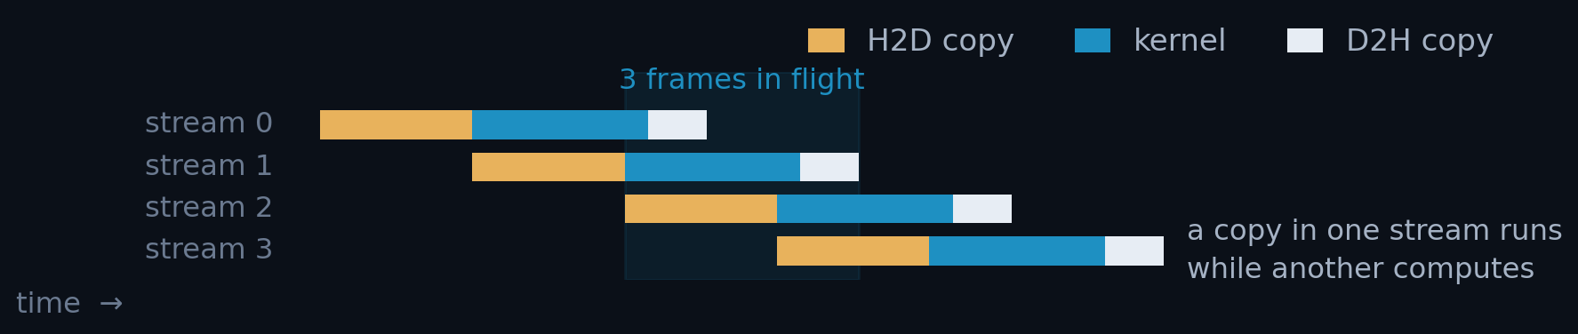
OPT2
ACT I · STREAMS
Four streams, but only four frames deep: ×1.56
• A stream is an ordered queue of GPU work. Work in different streams may overlap, so a copy can run while another stream computes.
OPT2 · 3×3 · 4 STREAMS · 4 DEEP
THROUGHPUT
24 726 FPS
VS 24-THREAD CPU
×3.66
• Each stream owns its own buffers and pedestal; frames go round-robin.
PER FRAME
40.4 µs
ClusterFinderCUDAOpt2.hpp · per-stream state
struct StreamContextOpt2 {
cudaStream_t stream; FRAME_TYPE *h_frame; // pinned
FRAME_TYPE *d_frame; ClusterType *d_clusters;
PEDESTAL_TYPE *d_pd_mean, *d_pd_sum, *d_pd_sum2;
};
auto &sc_k = v_sc[k]; // round-robin: frame = round*n_streams + k
STEP GAIN OVER OPT1
×1.56
% OF FLOOR · 61 859 FPS
40 % (was 26)
Scaffolding, not yet the payoff. The streams exist, but the host still synchronises after every round: see opt3.
13 / 34
Notes:
SAY THIS -- 116 words, about 42 s.
- A stream is just a queue of GPU work. Things inside one queue run in order.
Things in DIFFERENT queues are allowed to overlap. So with four queues, a
copy in one can run while another one computes.
- Each stream gets its own buffers and its own pedestal, and frames go to the
four streams in turn. We also stop sending one frame at a time: 2 000 frames
per call.
- This gives 1.56 times, and takes us from 26 to 40 percent of the floor. But
be honest about what it is: it is only the scaffolding. The host still stops
and waits after every round of four. Removing that is the next slide.

Slide 16
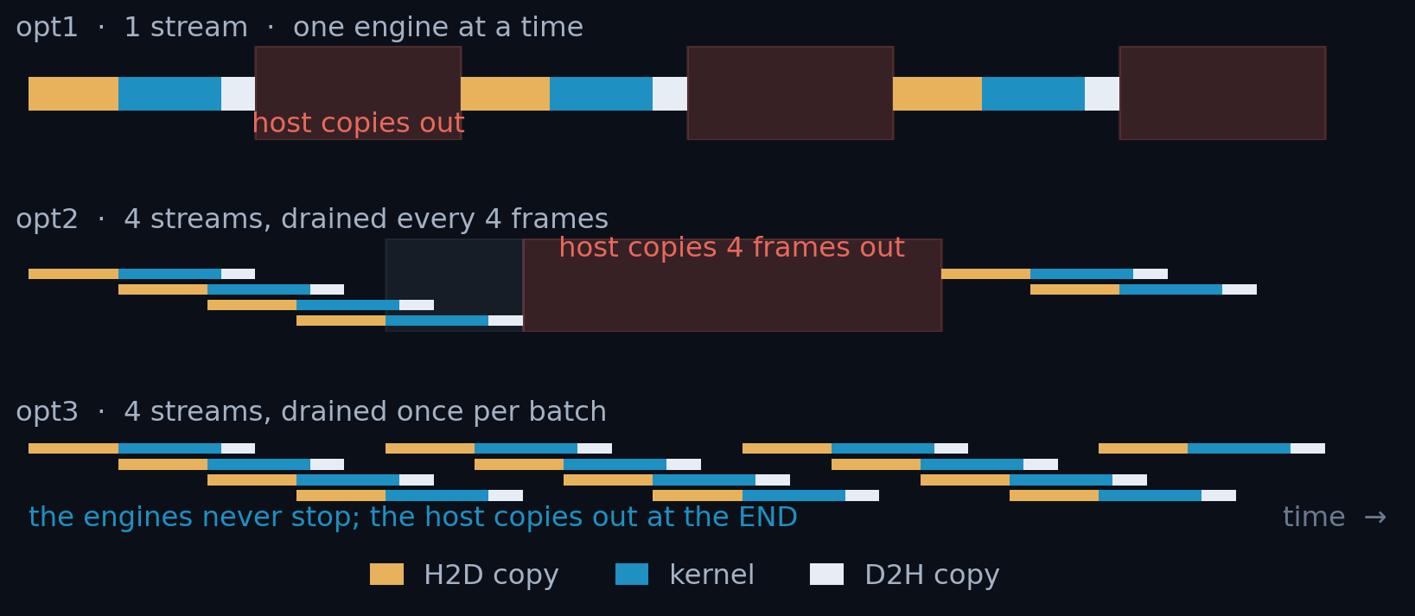
OPT3
ACT I · REMOVE THE SYNC BARRIERS
One sync per batch, not one per round: ×1.18
THE BARRIER, BEFORE AND AFTER
// opt2: a drain after EVERY round of 4
for (round) {
for (k : 4) submit(frame);
for (k : 4) cudaStreamSynchronize(sc[k]);
}
// opt3: submit the whole batch, drain once
for (frame : batch) {
cudaMemcpyAsync(..., sc.stream);
kernel<<<..., sc.stream>>>(...);
cudaMemcpyAsync(..., sc.stream);
}
for (k : 4) cudaStreamSynchronize(sc[k]);
29 188 FPS · ×4.32 34.3 µs/frame · 47 % of floor (was 40)
• opt2 drained all four streams after every round. The host then copied four frames out, with every engine idle.
• opt3 submits every frame's H2D → kernel → D2H asynchronously and synchronises once per batch.
Each lane is one stream; H2D and D2H are one FIFO engine each. The red blocks are the host: 48 % of opt1's frame, 46 % of opt2's round. opt3 removes a second, per-frame barrier as well: annex A3.
14 / 34
Notes:
SAY THIS -- 122 words, about 44 s.
- Three pictures, same time axis. Top: version one, one stream, one engine
working at a time. Middle: four streams, but the host says "wait for
everybody" after every round of four -- you can see the copy engine go idle
in the orange gaps. Bottom: the barrier is gone.
- The fix is small in the code and large on the picture. Instead of waiting
after every round, we push all the work of the whole batch into the queues,
and wait once at the end.
- 1.18 times faster, and 47 percent of the floor. The point is not the number,
it is the shape: from here on the copy engine never has to stop and wait for
the host.
CAREFUL: BOTH VERSIONS CALL THE SAME FUNCTION.
Do not say opt3 "replaced cudaDeviceSynchronize with cudaStreamSynchronize".
cudaDeviceSynchronize is not used anywhere in aare. Both sides call
cudaStreamSynchronize, once per stream. What changed is HOW OFTEN:
opt2 ClusterFinderCUDAOpt2.hpp:324-388
per round of 4: a launch loop, then a DRAIN loop that calls
cudaStreamSynchronize on each of the 4 streams. With a batch of 2 000
that is 500 rounds, so 2 000 sync calls per batch.
opt3 ClusterFinderCUDA.hpp:896-990 (kept commented, and the comment there
says these are the opt3/opt4 numbers)
one launch loop over the whole batch, then the same 4 calls ONCE.
So the honest sentence is "opt2 drained the queues 500 times per batch, opt3
drains them once" -- an argument about the loop boundary, not about which API
was called. If someone asks why not cudaDeviceSynchronize: it would be worse
here, since it waits on every stream on the device rather than the four we
own.

Slide 17
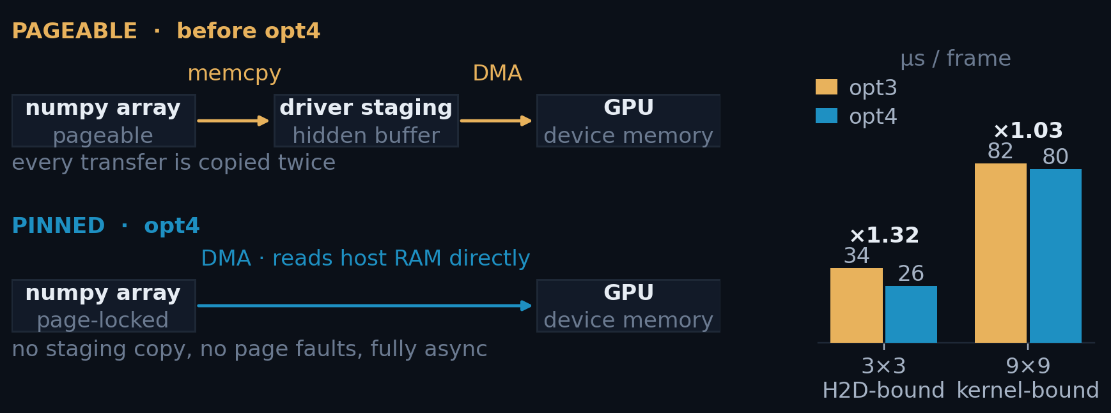
OPT4
ACT I · PINNED (PAGE-LOCKED) MEMORY
Pinning the input buys DMA-speed H2D: ×1.32
• Normal host memory is pageable, so the driver stages every transfer through a hidden pinned buffer: copied twice.
• Pinning locks the pages in RAM, so the DMA engine reads host memory directly.
ClusterFinderCUDA.hpp
// pin the whole dataset once
cudaHostRegister(ptr, bytes,
cudaHostRegisterDefault);
// ... run the whole campaign ...
cudaHostUnregister(ptr);
38 486 FPS · ×5.69 26.0 µs/frame · 62 % of floor, the largest step in Act I
Measured H2D: one 312.5 KiB frame in 13.2 µs = 24.2 GB/s, which is 77 % of PCIe 4.0 ×16: true DMA speed. Pageable staging manages ~15 GB/s for the same frame, because it is copied twice.
15 / 34
Notes:
SAY THIS -- 124 words, about 45 s.
- Normal host memory can be moved around by the operating system. The GPU
cannot copy from memory that might move, so the driver does it in two steps:
first into a hidden safe buffer, then to the GPU. Every frame is copied twice.
- Pinning tells the operating system: never move these pages. Then the GPU
reads host memory directly. One line of code, once, for the whole dataset.
- And it is the biggest single step in act one: 1.32 times, 62 percent of the
floor. The copy now runs at 24 gigabytes per second, which is about 77 percent
of what the PCIe wire can do -- the two-step version managed 15. Note this
helps because the copy IN is the tallest bar here. At 9x9 it buys almost
nothing.
DETAILS: Which H2D number, and why there are two.
13.2 us is uncontended [s1]. In the shipped pipeline H2D reads 16.6 us [s4]; the
extra 26 % is H2D<->D2H contention on the link, and the full engine grid is in
annex A7.
The rule this slide is the first sighting of: pinning attacks H2D, which is the
tallest bar at 3x3 and the shortest at 9x9. So the same change is worth x1.32 at
3x3 and only x1.03 at 9x9.

Slide 18
ACT II OF III · GET THE RESULTS BACK
Bottleneck: the result copy, host to host
COMING UP
16
opt5 · host↔GPU overlap
Both transfers are DMA already. What is slow is what happens AFTER the D2H: copying clusters out of the finder's pinned buffer into heap the caller owns. Host to host. Still 3×3, but 9×9 is where this act pays most.
17
9×9 · why overlap runs out
18
opt6 · zero-copy
ARRIVING AT
38 486 FPS
opt4 · 26.0 µs per frame · 62 % of the GPU floor
Notes:
SAY THIS -- 65 words, about 23 s.
- Act two. Both copies now run at full wire speed, so the wire is no longer the
thing to fix.
- What is slow now happens AFTER the results come back: the host copying
clusters out of our buffer into memory the caller owns. Host to host, no GPU
involved.
- Three slides. It pays a little at 3x3, and a lot at 9x9.

Slide 19
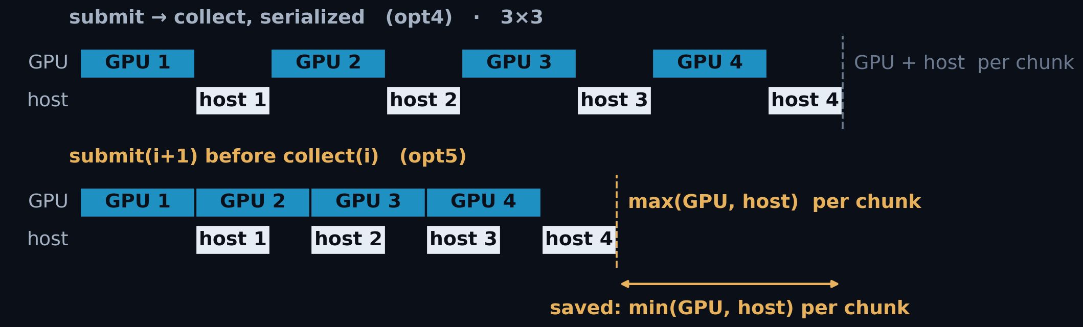
OPT5
ACT II · HOST↔GPU OVERLAP
Overlapping host and GPU hides min(host, GPU): ×1.31
• opt3 overlapped the GPU's own engines, never the host with the GPU: the batch synchronised, then built ClusterVectors with the GPU idle.
• opt5 keeps one batch in flight while materialising the previous one.
OPT5 · F64 · NO CUDA WORK AT ALL
3×3 THROUGHPUT
50 410 FPS
PER FRAME · STEP · OF FLOOR
19.8 µs · ×1.31 · 81 %
THE WHOLE CHANGE
CUDA API CALLS ADDED
none
WHAT MOVED
the host loop
you never write these: find_clusters_batched() wraps them
tok = cf.submit_batch(data[a0:b0], first_frame=a0)
for a, b in bounds[1:]:
nxt = cf.submit_batch(data[a:b], first_frame=a) // GPU starts i+1
results.extend(cf.collect(tok)) // host unpacks i
tok = nxt
9×9 · SAME CHANGE, HALF THE CEILING
66.4 µs · ×1.20 · 45 %
16 / 34
Notes:
SAY THIS -- 118 words, about 43 s.
- Up to now we overlapped the GPU with itself. We never overlapped the GPU with
the HOST. The batch finished, and then the host built its result objects while
the GPU sat and did nothing.
- The fix is to keep one batch running on the GPU while the host is still
unpacking the previous one. Send batch two, then unpack batch one, and repeat.
- Note what is NOT here: no new CUDA call, no kernel change. Only the order of
the host loop. That is 1.31 times faster, and it takes us to 81 percent of the
floor. And the user does not even see it -- it is inside the normal function
everyone already calls.
- Last line on the right, and then we move on: at the big cluster size the same
change only reaches 45 percent, not 81. That gap is the whole next slide.
DETAILS: opt5 — host<->GPU overlap. Code and chunk sizing are on annex A4.
tok = cf.submit_batch(data[a0:b0], first_frame=a0)
for a, b in bounds[1:]:
nxt = cf.submit_batch(data[a:b], first_frame=a) # GPU starts N+1 ...
results.extend(cf.collect(tok)) # ... host unpacks N
tok = nxt
results.extend(cf.collect(tok)) # drain
1. This is now INTERNAL to find_clusters_batched(), so every caller gets it for
free. submit_batch/collect stay public for anyone who wants the token by hand.
2. The chunk size is rounded to a multiple of n_streams, because the device
pedestal is per-stream: an uneven chunk would advance the four stream
pedestals by different amounts and the finders would stop being comparable.
Why the gain differs by cluster size: the saving is min(GPU, host) per chunk, so
it is largest when the two terms are comparable. At 3x3 they nearly are (GPU
16.2 us, host ~9.8) and opt5 is worth x1.31. At 9x9 the host term is roughly
twice the GPU term, so overlap hides only the smaller one and opt5 is worth
x1.20 - which is exactly the diagnosis that motivates opt6: you cannot overlap
your way out of a host term that is simply larger. Report SS8.2.
CAREFUL: THE 45 % ON THE RAIL IS NOT A STABLE NUMBER.
Both rail blocks come from the same ladder table (SS8, [f64]), but they are not
equally solid, and the difference is worth knowing before someone asks:
3x3 19.84 us spread 1.2 % clean, 30-96 k minor faults
9x9 66.39 us spread 22.4 % 151 601 minor faults, best of five reps
opt5 at 9x9 is THE ONE ROW IN THE LADDER THAT NEVER REACHES A FAULT-FREE STEADY
STATE (SS8.3). 66.39 is the best rep, not a plateau. So quote 45 % as "about 45"
and do not defend the second figure.
This does not weaken the argument -- it strengthens it. The faults are the host
allocating and first-touching a fresh ClusterVector per frame, which is exactly
the cost opt6 deletes. The instability IS the symptom. opt6 at 9x9 lands on
30.01 us, 100 % of the floor, with the fault count back to normal.

Slide 20
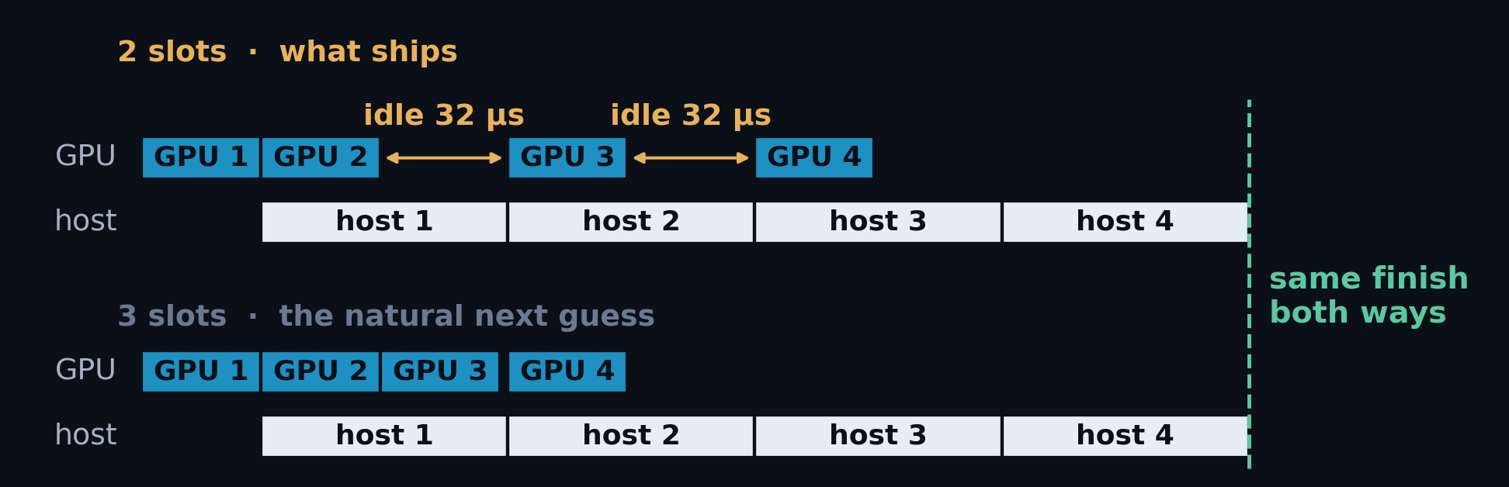
OPT5
ACT II · AT 9×9 · WHY OVERLAP RUNS OUT
Overlap runs out: the host is the taller bar
• At 3×3 the host copy is shorter than the GPU floor and hides under it. At 9×9 it is roughly twice the floor, so overlap has less to hide: opt5 is worth ×1.20 here against ×1.31 at 3×3.
A deeper buffer relocates the GPU's idle, it does not close it: the host lane is already back-to-back in both strips, so it alone sets the pace. The only way down is to make the host term smaller.
Measured proportions: GPU 30.01 µs/frame, host ~62 µs steady-state [A10].
17 / 34
Notes:
SAY THIS -- 121 words, about 44 s.
- At the small cluster size the host work is shorter than the GPU work, so it
hides underneath it completely. At 9x9 the host work is about twice the GPU
work. Now it sticks out, and overlap can only hide the smaller of the two.
- The natural idea is: use more buffers, go deeper. The lower picture is
exactly that -- three slots instead of two -- and the finish line does not
move. More buffers move the GPU's idle time somewhere else; they do not
remove it.
- The reason is simple: the host lane is already busy back to back. It sets the
pace. The only way to go faster is to make the host work itself smaller. That
is the next slide.
DETAILS: This slide exists because "add more slots" is the reliable guess here,
and it is worth letting the room say it out loud before the second strip goes up.
The queueing argument, if it is asked for: with producer period G and consumer
period H, an N-buffer pipeline has steady-state period max(G, H) for every N >= 2.
Buffers DECOUPLE two stages; they do not speed up either. Depth beyond 2 only
helps when the periods vary -- it absorbs jitter, at the cost of latency and
pinned memory. Here the work per chunk is near constant, so there is no jitter to
absorb.
The concrete version lands better: a third slot needs somebody to fill it, and
the only host thread is inside collect(). Adding slots without adding a producer
thread is adding storage to a queue that is not storage-bound.
"So would a producer thread help?" It would let submit and collect overlap, but
the host term is dominated by malloc + first touch, which is allocator-serialised
anyway. That was measured and reverted (ClusterFinderCUDA.hpp:130-136): 2.27 M
faults at 8 threads against 9.7 k at 1, a 6 % gain at best and a 33 % LOSS when
results are freed promptly. The comment there ends with the right conclusion --
stop allocating per frame, do not copy faster. That is opt6.
ON THE 62 US, if challenged. It is not measured directly; no one timed the host
loop. Two independent routes agree on it. (1) Fault-correct the five f64 reps at
0.68 us/fault -- the same rate fitted at 3x3 and applied out of sample -- and a
22 % raw spread collapses to 4.6 %, at 61-64 us. (2) f32 rep 3 happened to run
with only 10 128 faults and measured 61.85 us with no correction at all. The
"~40 us" that used to be on the opt6 slide was the memcpy alone, computed at
bandwidth; the loop is allocation-bound, not bandwidth-bound, so it under-counted
the host term by about half.

Slide 21
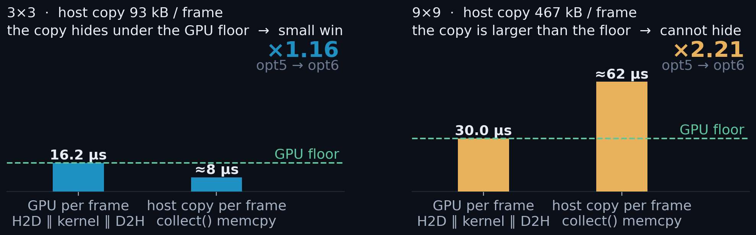
OPT6
ACT II · ZERO-COPY COLLECTION
Read the results in place: ×2.21 at 9×9
• The D2H lands in a pinned host buffer; collect() then allocates one ClusterVector per frame and memcpys into it: 467 kB per frame at 9×9.
• collect_view() returns a BatchView onto that buffer instead: it withholds ownership past the chunk, not access.
OPT6 · 3×3 AND 9×9 · COLLECT_VIEW()
3×3 THROUGHPUT
58 495 FPS
PER FRAME · STEP · OF FLOOR
17.1 µs · ×1.16 · 95 %
9×9 THROUGHPUT
33 323 FPS
PER FRAME · STEP · OF FLOOR
30.0 µs · ×2.21 · 100 %
RESULTS
The win is max(0, host copy − GPU floor). At 3×3 the copy already hid under the floor; at 9×9 it is twice the floor and cannot hide at any overlap.
bit-identical to opt5
18 / 34
Notes:
SAY THIS -- 126 words, about 46 s.
- So what IS the host doing? The results arrive in our own pinned buffer. Then,
for every frame, we allocate a new object and copy the clusters into it -- 467
kilobytes per frame at 9x9. Allocate, copy, free, sixty thousand times.
- The fix is to stop copying. We hand back a view: a small object that points
INTO the buffer that already holds the data. You can read every cluster. The
only thing you do not get is ownership past the end of your chunk.
- At 9x9 that is 2.2 times faster on its own, and we land exactly on the GPU
floor -- 100 percent. At 3x3 it is only 1.16, because there the copy was
already hidden. Same change, very different value.
DETAILS: Where 93 kB and 467 kB come from: clusters/frame x sizeof(Cluster).
sizeof — Cluster.hpp:28 is two CoordType coords then std::array<T, X*Y> data.
CoordType=uint16, T=int32, alignof 4, so the coords pack with no padding:
3x3: 2x2 B + 9x4 B = 40 B
9x9: 2x2 B + 81x4 B = 328 B
clusters/frame — report section 13, the same counts used for correctness:
3x3: 233 094 390 / 100 000 fr = 2 330.9 /fr
9x9: 28 447 962 / 20 000 fr = 1 422.4 /fr
2 330.9 x 40 B = 93.2 kB/frame
1 422.4 x 328 B = 466.5 kB/frame -> x 20 000 fr = 9.33 GB/run
NOT the D2H transfer. D2H is fixed at cap x sizeof regardless of how many clusters
were found: at the 9x9 campaign cap of 1700 that is 1700 x 328 B = 558 kB every
frame, i.e. the 467 kB of real clusters is an 84 % fill (section 4.2). The 467 kB
is the HOST memcpy inside collect(), pinned buffer -> freshly allocated
ClusterVector. That is what collect_view() removes; the wire traffic is unchanged.
Report: section 12 (payload table), section 9.4 (materialize_slot), section 13.

Slide 22
ACT III OF III · THE KERNEL
Bottleneck: the kernel itself
COMING UP
19
why the kernel, and where its time goes
The story moves to 9×9, where the kernel is finally the tallest bar, and where most of what it does is update the pedestal, not find photons.
20
opt7 · FP32 pedestal
21
why it comes last
ARRIVING AT
58 495 FPS
opt6 · 3×3, and 33 323 FPS at 9×9, where this act pays
Notes:
SAY THIS -- 64 words, about 23 s.
- Act three. Only now is the kernel itself the slowest part -- and only at the
big cluster size, 9 by 9.
- This is the one act where I change the maths instead of the plumbing.
- First, the measurement that says the kernel is now the problem -- and what it
is spending that time on, which turns out not to be photons.
- Three slides. The trap that the change brings with it -- and it is a real
one -- is annex ten.

Slide 23
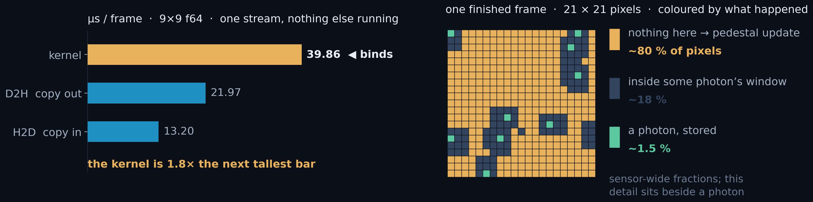
ACT III · WHY THE KERNEL, AND WHERE ITS TIME GOES
The kernel is the tallest bar, and 80 % of it is pedestal
• At 9×9, one stream with nothing else running, the kernel takes 39.9 µs against 22.0 for the copy out and 13.2 for the copy in. For the first time in the talk it is the thing to fix.
• ~80 % of pixels see only noise, and each takes the pedestal-update branch: six running values read and written. Most of the kernel is moving pedestal numbers, not finding photons.
So attack the pedestal, not the photon search. The branch that runs on four pixels in five is the one worth making cheaper.
19 / 34
Notes:
SAY THIS -- 118 words, about 43 s.
- Act three, and for the first time the GPU itself is the problem. Left picture:
one stream, nothing else running, the big cluster size. The kernel is 40
microseconds. The two copies are 22 and 13. The kernel is nearly twice the
next tallest bar.
- So what is the kernel actually doing? Right picture: one frame, finished,
coloured by what happened to each pixel. Green is a photon we stored. The dark
cells are pixels that sit inside some photon's window. And amber -- about four
pixels in five -- is "nothing here", which means: update the pedestal.
- So the kernel is mostly not finding photons. It is bookkeeping noise. That is
what act three attacks.
DETAILS: the two numbers on this slide, and where they come from.
The engine bars are the UNCONTENDED reading: one stream, nothing else on the
device, so each bar is a true duration. 9x9, cap 1 700, f64 build:
H2D 13.20, kernel 39.86, D2H 21.97 us. In the shipped four-stream pipeline the
numbers move -- copies rise, the kernel falls, because four kernels overlap each
other -- and that distinction is annex A7. It does not change this slide's
claim: the kernel binds in BOTH readings on the f64 arm.
The ~80 % is measured, not assumed: the branch map is read out of the finder
after a frame completes (branch_site_dump.py). Of a 21x21 neighbourhood, ~1.5 %
of pixels are stored photons, ~18 % sit in a photon's shadow -- inside some
window whose max clears 5 sigma -- and ~80 % clear nothing at all and push the
pedestal. The same picture returns on slide 31 to argue about Test3; here only
the amber fraction matters.
WHY THAT MAKES THE KERNEL BANDWIDTH-BOUND. The pedestal update is six values per
pixel, read and written, and almost every pixel does it. There is very little
arithmetic per byte moved. So the kernel's cost is dominated by pedestal
TRAFFIC, which is what the next slide halves.

Slide 24
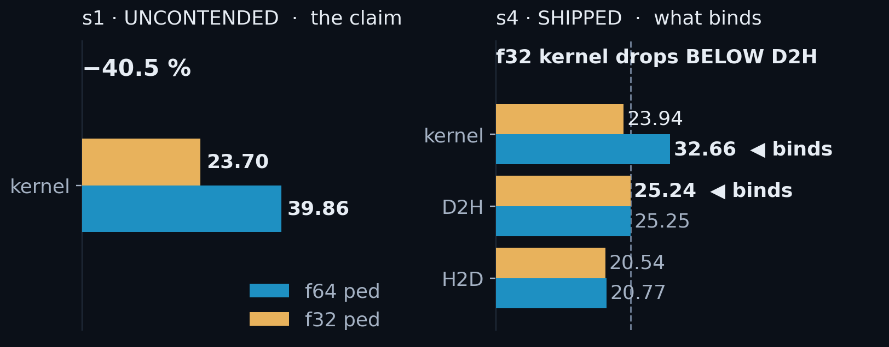
OPT7
ACT III · FP32 DEVICE PEDESTAL
One typedef: −41 % on the kernel, and the floor moves to D2H
• One typedef halves all four pedestal arrays (48 bytes per updating pixel in FP64, 24 in FP32), and the kernel is bandwidth-bound.
ONE TYPEDEF
// clusterfinder_kernel.cuh
using COMPUTE_TYPE = float;
using DEVICE_PED_TYPE = float;
// was: double
Kernel, 9×9 uncontended 39.86 → 23.70 µs (−40.5 %)
The bottleneck moves. In the shipped pipeline the kernel lands at 23.94 µs, under a 25.24 µs D2H. The limit is now the result path, not the maths.
Naive FP32 is wrong. See annex A9.
Left: one stream, nothing else running, so the bar is a true duration and carries the −40.5 % claim. Right: the shipped four-stream pipeline, where the f32 kernel falls under a D2H bar that never moved. Full engine grid: A8.
Both builds, same git rev, 20 000 frames.
20 / 34
Notes:
SAY THIS -- 120 words, about 44 s.
- Remember that four pixels in five only update the pedestal, and that update
reads and writes six running values. Those were stored as doubles, 8 bytes
each.
- Change them to floats. One typedef. 48 bytes per pixel becomes 24. The kernel
is limited by memory traffic, so half the bytes is a big win: 40 percent off
the kernel.
- Left bar pair is the honest measurement of the change: one stream, nothing
else running, 39.9 down to 23.7.
- The right picture is the ending. In the real pipeline the kernel drops to
23.9, and the copy back out -- 25.2, unchanged -- is now the tallest bar. We
optimised the kernel until it stopped being the problem.
CAREFUL: TWO DIFFERENT PERCENTAGES, AND THEY MEASURE DIFFERENT THINGS.
-40.5 % is the uncontended kernel: one stream, a true duration, and the honest
headline for what the typedef does to the arithmetic. -26.7 % is the same change
read in the shipped four-stream pipeline, where the kernel's per-frame busy time
is already shortened by overlapping itself, so part of the win was hidden before
the typedef arrived. Both are true. A7 is the rule for which to quote, and A8
has the full grid including the copy engines and the 3x3 arm.
THE 3x3 ARM, if asked: the same typedef is worth -70.6 % in the kernel there and
4.6 % end to end, because at 3x3 the kernel was never the tallest bar -- H2D
was. It also frees 9 registers, taking 3x3 from five blocks per SM to six. Neither
changes anything end to end.
WHY FP64 WAS SLOW FOR TWO REASONS, not one: the bytes are the main story, but on
a GeForce part FP64 arithmetic also runs at 1/64 of FP32. The bytes are why it
is worth 40 %; the arithmetic rate is a bonus.

Slide 25
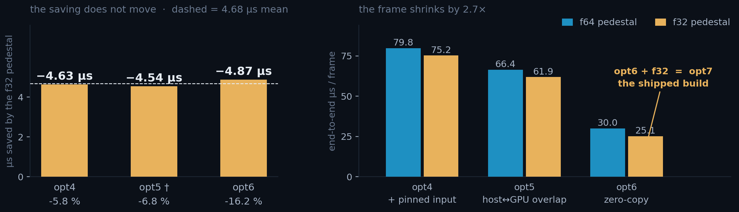
OPT7
ACT III · WHY THIS ACT COMES LAST
opt7 saves the same 4.7 µs at every step: 6 % of opt4, 16 % of opt6
opt7 ships at 25.1 µs/frame, 100 % of the 9×9 floor. And the act ends by handing that floor away: at s4 the f64 kernel bound the pipeline at 32.66 µs; the typedef puts it at 23.94, under a 25.24 µs D2H that never moved.
9×9 · 20 000 frames · 4 streams · cap 1 700 · warm · both arms at the same git rev. opt3 excluded and opt5 marked †: their arms sat in different allocator states. Worked through in annex A10.
21 / 34
Notes:
SAY THIS -- 123 words, about 45 s.
- One last question about act three: why is it last? Because its value depends
on everything before it.
- Left picture: the whole frame time shrinking, step by step, from 80
microseconds down to 25. Right picture: what the typedef itself saves at each
of those steps. It is the same 4.7 microseconds every time. The saving never
grew. What changed is the frame around it: 4.7 out of 80 is six percent; the
same 4.7 out of 30 is sixteen.
- And that is where the talk ends, because act three hands the limit away. Once
the kernel drops to 24 microseconds, the copy back out, at 25, is the tallest
bar again. There is no opt8.
DETAILS: WHY opt3 IS EXCLUDED AND opt5 IS DAGGERED. Both steps' two arms sat in
different allocator states, so the difference between them does not report the
typedef -- it reports the heap. opt3 is dropped entirely; opt5's reading agrees
with opt4 and opt6 but is not independently attributable. Annex A10 has both.
WHAT THE BARS ARE. The f32 bar at opt6 is opt7, the shipped build. The f32 bars
at opt4 and opt5 are the same typedef applied at earlier steps -- configurations
that exist only to make this comparison controlled, and that nobody ships.
WHY opt4 AND opt6 ARE THE PAIR TO QUOTE. They are the two readings whose fault
counts match, so the difference between their arms is the typedef and nothing
else. That is the whole reason the saving can be called constant.
THE HANDOVER, if asked for the numbers: [engines, slide 20 of the 33-slide
draft] f64 s4 kernel 32.66 vs D2H 25.25 -> kernel-bound; f32 s4 kernel 23.94 vs
the same 25.25 -> D2H-bound. The constraint moved from the arithmetic to the
result path, which is why Act III is last and why there is no opt8.

Slide 26
RESULTS · WHAT CAME OUT OF IT
The full ladder, both cluster sizes
COMING UP
Both cluster sizes end to end, and the audit behind the numbers.
22–23
Results, both cluster sizes
24
Where the time went
ARRIVING AT
58 495 FPS
opt6 · everything after this is the ladder seen whole
Notes:
SAY THIS -- 58 words, about 21 s.
- That is all seven steps. The rest of the talk is the ladder seen as a whole:
both cluster sizes end to end, and where the time actually went.
- No new optimisation from here. Only results -- and then whether they are the
RIGHT results, which is the last section.

Slide 27
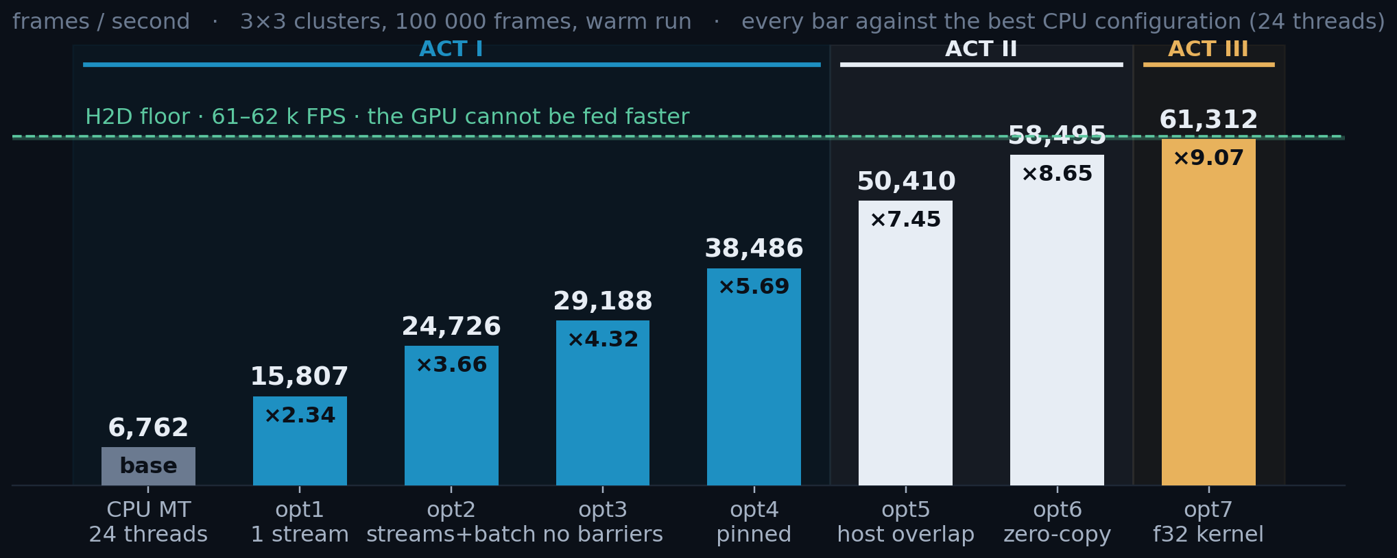
RESULTS · 3×3
×9.1 at 3×3, sitting on the H2D floor
×9.1 over 24 CPU threads, 14.8 s → 1.63 s for 100 000 frames, and at the H2D floor.
Every step is monotonic, and correctness held constant throughout: exact on the f64 pedestal, 6 clusters in 23 M on the shipped f32.
3×3 · nσ = 5 · 100 000 frames · batch 2 000 · 4 streams · warm = best of reps 1–4 · each step in its own process.
22 / 34
Notes:
SAY THIS -- 112 words, about 41 s.
- The whole ladder at the small cluster size. Every bar is a step, and every
step is an improvement -- nothing had to be undone later.
- Left to right: 6 762 frames per second on 24 CPU threads, and 58 495 at the
end. Nine times faster. For a hundred thousand frames that is 15 seconds down
to 1.6.
- The dashed line is the hardware floor, and the last bar is sitting on it. That
is the honest way to read this: we are not fast, we are FINISHED. What is left
is the wire. And the answers stayed correct the whole way -- six clusters
different out of 23 million.

Slide 28
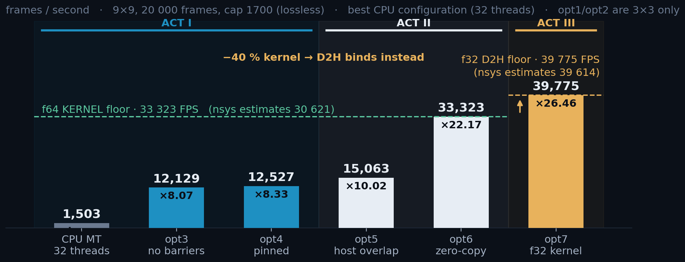
RESULTS · 9×9
×26.5 at 9×9, and opt7 hands the floor to D2H
×26.5 over 32 CPU threads; the kernel is the tallest bar for the whole f64 arm, and opt7's −40 % drops it below D2H.
9×9 · cap 1 700 · 20 000 frames · CPU baseline at 32 threads. opt1 and opt2 are 3×3-only. Why the two arms differ is in the notes.
23 / 34
Notes:
SAY THIS -- 109 words, about 40 s.
- Same ladder, big cluster size. Here the numbers are much larger: 26 times
faster than 32 CPU threads.
- Why bigger? Because the CPU suffers much more when clusters are 9 by 9 -- it
does 81 pixels of work where the GPU just uses more threads. The GPU work per
frame grows far less.
- And this is the arm where the story ends differently. For the whole f64 part
the kernel is the tallest bar. The typedef change cuts it by 40 percent, and
then it drops BELOW the copy back out. From that point the result path is the
limit, not the maths.

Slide 29
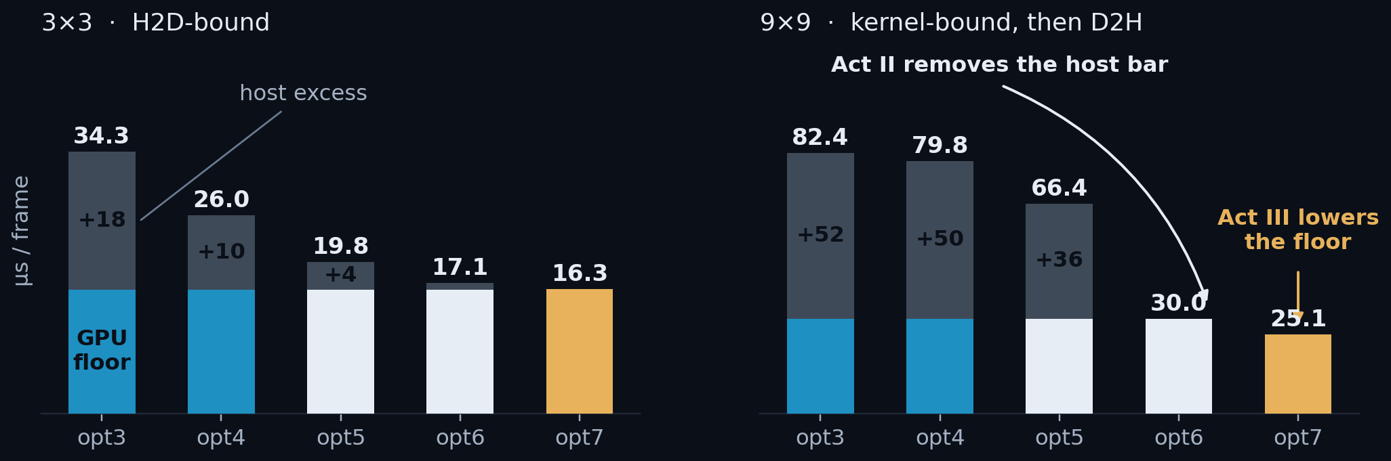
WHERE THE TIME ACTUALLY WENT
The host bar dies first, then the floor itself drops
Acts I and II never touch the arithmetic. The GPU floor is a flat 16.2 µs at 3×3 / 30.0 µs at 9×9; what collapses is everything stacked on it.
Act III is the only step that lowers the floor itself, and it could not have been seen until the stack above it was gone.
Coloured = the GPU floor for that act's build. Grey = everything the host adds on top: +50 µs at opt3, nothing at opt6.
24 / 34
Notes:
SAY THIS -- 116 words, about 42 s.
- This is the same story told as two colours. The coloured part is the hardware
floor -- what the GPU cannot go below. The grey part is everything the host
piles on top of it.
- Look at what actually happened. In acts one and two the coloured part never
moves. It is flat: 16 microseconds at 3x3. Every step is eating grey. By the
end of act two there is no grey left.
- Only act three moves the coloured part itself, and only there. That is the
reason for the order of the whole talk: you cannot see the floor, and you
certainly cannot lower it, while fifty microseconds of host work sit on top
of it.

Slide 30
VALIDATION · DOES IT FIND THE SAME PHOTONS
Does it find the same clusters?
COMING UP
25–26
The fair comparison
27–28
The f32 residual, dissected
Whether the CUDA finder returns the same clusters as the CPU.
29–31
The CPU-vs-CPU gap, named
32–33
For users
34
What is next
ESTABLISHED
×9.1 and ×26.5
on the hardware floor at both cluster sizes, if the physics holds
Notes:
SAY THIS -- 60 words, about 22 s.
- Everything so far assumed one thing: that the GPU finds the same photons as
the CPU. If it does not, none of the numbers mean anything.
- So the last part is correctness. How do you compare two finders fairly, what
is left over when you do, and what a user should actually call.

Slide 31
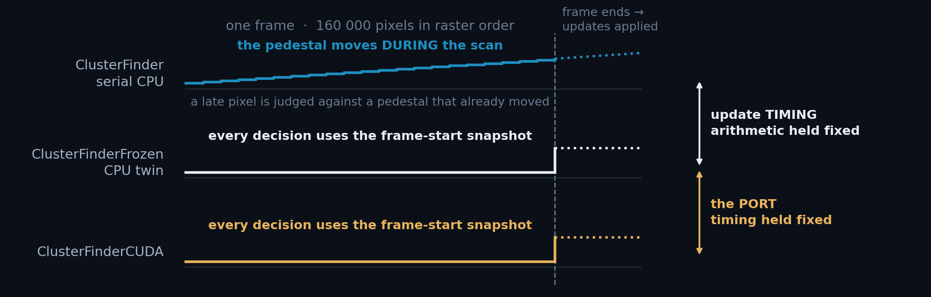
VALIDATION · WHY A CPU TWIN WAS NEEDED
CPU and CUDA update the pedestal at different moments
The CPU finder updates the pedestal as the raster reaches each pixel. 160 000 CUDA threads read it at once, so the update is applied at the frame boundary.
A straight CPU↔CUDA comparison therefore moves two things at once. ClusterFinderFrozen moves only the update: same arithmetic, same gates, same scan, all in f64.
Frozen is a diagnostic twin, not a product. Every finder trains on the same 1 000 pedestal frames and runs the same 10 000 data frames.
25 / 34
Notes:
SAY THIS -- 124 words, about 45 s.
- To compare two finders you have to change ONE thing at a time. Here is why
that is hard.
- The CPU finder updates the pedestal as it walks the frame, pixel by pixel. So
a pixel near the end of the frame is judged against a pedestal that the
earlier pixels of the SAME frame have already moved.
- The GPU cannot do that. All 160 000 threads read the pedestal at the same
moment, so the update can only be applied at the end of the frame.
- So a straight CPU-against-GPU comparison changes two things at once: the
maths, and WHEN the pedestal moves. That is why I wrote a third finder --
same CPU code, but with the update moved to the frame end.
DETAILS: Why this slide is here.
The obvious experiment - run the CPU finder and the CUDA finder over the same
frames and count the differences - cannot answer the question anyone actually
asks, which is "is the port correct?" It moves two variables at once:
1. WHEN the pedestal is updated. The serial CPU finder updates per pixel,
during the raster scan, so a pixel late in the frame is judged against a
pedestal that already contains this frame's earlier pixels. That is
scan-order dependent by construction.
2. WHAT arithmetic runs. float vs double, a different local-max expression,
a different rounding point.
ClusterFinderFrozen holds (2) fixed and changes only (1): it is the serial
finder, same decision logic line for line, with the update deferred to the frame
boundary. That is the CUDA update model, on the CPU.
So the three-way comparison factorises:
cpu vs frozen -> update timing alone (19 of 23.2 M)
frozen vs cuda -> the port alone (6 of 23.2 M)
and the second is the number that answers the question. It is also why the
headline mismatch figure in this deck is 6 / 23 M and not 25 / 23 M: the larger
number is dominated by an effect that has nothing to do with CUDA.
Frozen ships in the library as a diagnostic, not as the recommended finder.

Slide 32
VALIDATION · ISOLATING ONE VARIABLE AT A TIME
CUDA and its CPU twin agree exactly: 0 in 23 million
• ClusterFinderFrozen makes byte-for-byte the same decisions as ClusterFinder and differs in exactly one thing: when the pedestal is updated. Frozen per frame, pushed at frame end. That is the CUDA model, so comparing against it isolates everything else the port changes.
COMPARISON
THE ONE THING THAT DIFFERS
A-ONLY / B-ONLY
% OF CLUSTERS
frozen CPU [f64] vs CUDA [f64 ped]
nothing
0 / 0
0 %
frozen CPU [f64] vs CUDA [f32 ped]
the float32 pedestal EMA drifting: see next slide
0 / 6
0.000026 %
The ringed row is the port on its own. With the update timing held identical, the two finders agree on all 23 244 605 clusters. Not small: zero. The six at f32 are the next slide.
3×3 · 10 000 frames · 23.2 M clusters · exact centre-set difference at tol = 0. [f64 ped] and [f32 ped] differ only in DEVICE_PED_TYPE, on the CUDA side: both CPU finders hold the pedestal in f64 always. What is left once the timing is allowed to differ is slide 29.
26 / 34
Notes:
SAY THIS -- 121 words, about 44 s.
- Now we can change one thing at a time, and this is the headline of the whole
validation section.
- The ringed row is the port on its own -- the CPU twin against CUDA, with the
update timing held identical. Zero differences. Not "small": zero, out of 23
million clusters. The port is exact.
- The second row, six clusters, is the float pedestal, and that is the next
slide. Six out of 23 million, and I can show you all six.
- What happens when the timing is allowed to differ is slide 29, and it is a
CPU-against-CPU story.
DETAILS: WHY THE SERIAL ROWS ARE NOT ON THIS SLIDE. They carry the same 8/11 as
each other, which is a separate claim of its own -- everything CUDA changes is
worth zero -- and reading it off the top of a four-row table made it look like
the weaker half. It has slide 29 to itself.
WHICH TEST the timing moves is measured on slides 30-31, and the answer is
specific:
frozen-only 11 clusters -> ALL from Test3 (total > c3*nSigma*rms)
cpu-only 8 clusters -> ALL from the local-max gate (value == max)
Test1 threshold -> contributes ZERO clusters
Why Test3 is the exposed one: it sums all nine values, so it collects the shift
of EVERY already-scanned neighbour -- three above, one left, exactly the pixels
eligible for update -- where Test1 feels at most the one that happens to be the
argmax.
Confirmed two ways: instrumented (branch codes diffed per frame) and ablated
(Test3 compiled out, at which point the 11 go to zero exactly). Slides 30-31
have both.
Test1 flips MORE often than Test3 -- 619 of 974 divergent pixels -- and costs
nothing, because it only moves a pixel between QUIET_UPDATE and SHADOW and
neither of those stores. It is not merely downstream of Test3 either: with Test3
ablated the first divergence is still a Test1 flip, on a frame where the two
pedestals were provably identical. Test1 initiates on its own, just ~7x slower
(frame 30 vs frame 4), and can never create a cluster by itself.
The f32 row is a different mechanism entirely -- EMA drift, not timing, since
both finders freeze the pedestal there. That is the next slide.

Slide 33
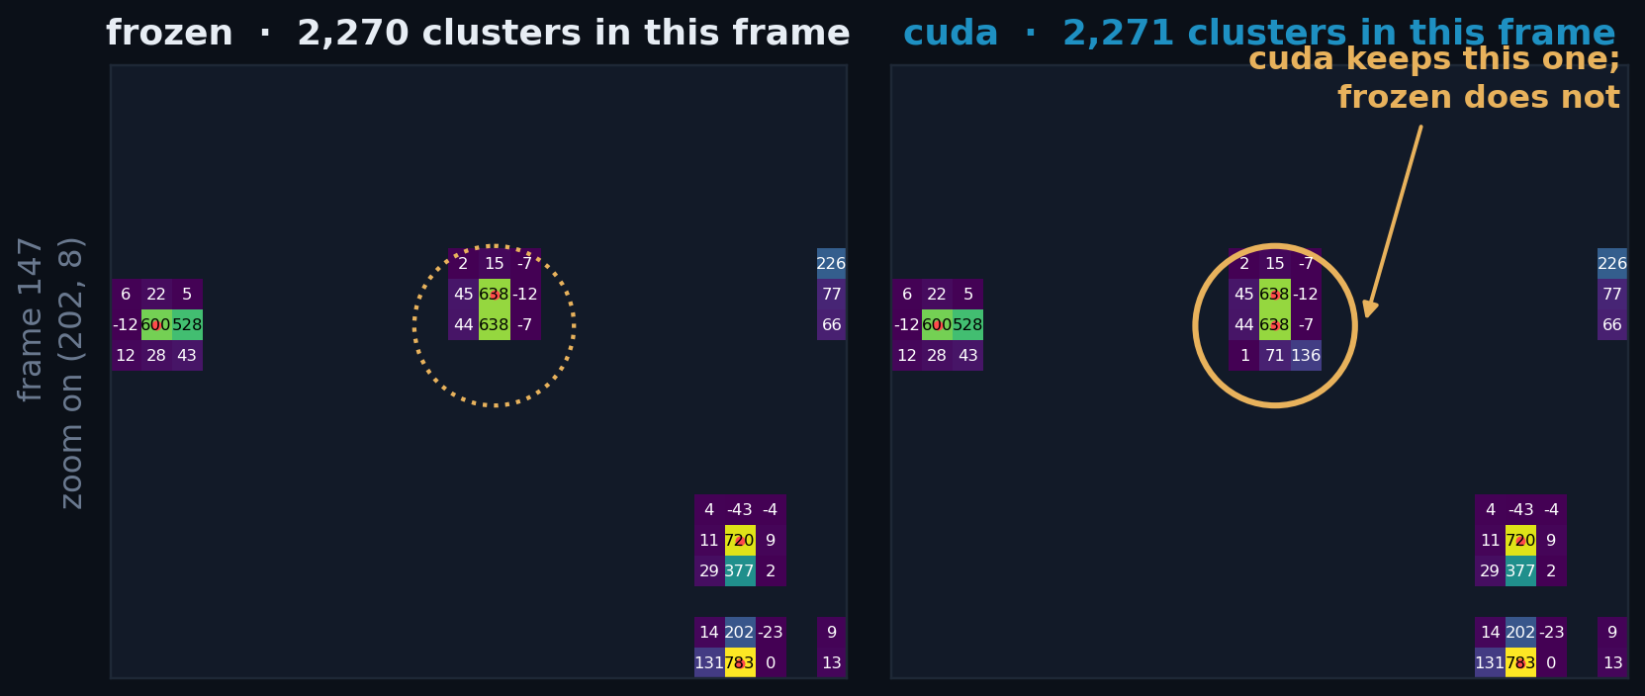
VALIDATION · THE DISAGREEMENT, SEEN
The whole disagreement is one duplicate centre
frozen CPU [f64] left, CUDA [f32] right. Only each finder's own 3×3 footprints are drawn, so the panels differ exactly where the finders do.
cuda's patch is one row taller: a second centre directly below the one both found. The charge is already counted: a duplicate, not a new photon.
27 / 34
Notes:
SAY THIS -- 116 words, about 42 s.
- This is one of those six differences, drawn. Left is the CPU twin, right is
CUDA, same frame, same region.
- Each picture only shows the pixels that THAT finder claimed. So where they
look the same, the two agreed pixel by pixel. And they mostly do.
- The one difference is ringed: CUDA keeps a second centre directly below one
that both of them keep. Its patch is one row taller.
- And this is the important part for a physicist: nothing was missed, and
nothing was invented out of noise. The charge is already counted in the
cluster next to it. The two finders are arguing about which of two touching
pixels owns the same photon.
DETAILS: Frame 147, the strongest of the six residuals, shipping f32 build.
Every other centre in the patch agrees, including the ordinary photon at bottom
right.
Each panel masks every pixel that is not inside the 3x3 footprint of one of THAT
finder's own cluster centres. So a pixel is visible on the left only if frozen
claimed it, and visible on the right only if cuda did. Where the panels look
identical, the finders agreed pixel for pixel.
The red dots are cluster centres. The amber ring is the one centre cuda keeps
that frozen does not: (202, 8), directly below (202, 7) which both finders keep.
Because the two 3x3 windows overlap, cuda's patch is four rows tall where
frozen's is three - that visible extra row IS the disagreement.
Note what is NOT happening: there is no cluster in one panel that is absent from
the other's neighbourhood entirely. Nothing was missed, and nothing was invented
out of noise. The two finders are arguing about which of two adjacent pixels owns
a photon they both found.
Same construction as helper.plot_masked_mismatch() in the notebook, so this is
reproducible from ClusterFinderFrozen_vs_CUDA.ipynb directly.

Slide 34
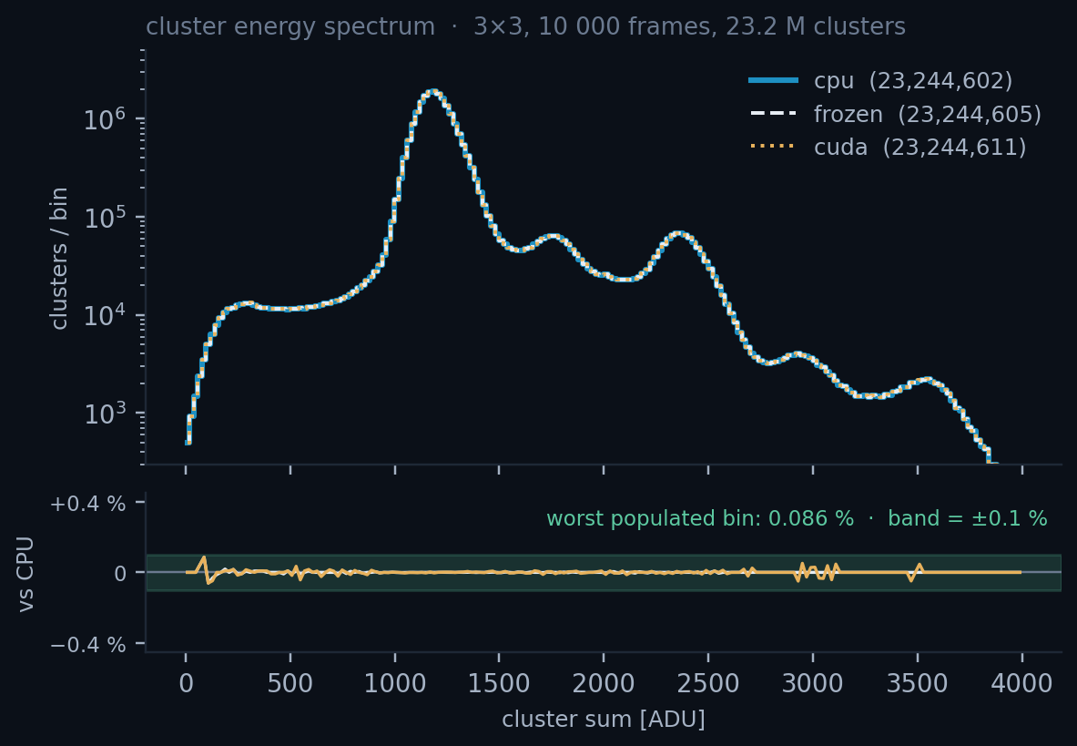
VALIDATION · THE SIX RESIDUALS, DISSECTED
float32 cannot tell these two pixels apart
frame 147 centre (x=202, y=8) 3×3 window
raw window (ADU) pedestal-subtracted, 1 decimal
[[4646 5282 4703] [[ 45.3 638.4 -12.1] frozen and cuda
[4857 5318 4950] [ 43.7 638.4 -7.5] print the SAME
[4763 4640 4858]] [ 1.1 70.7 136.4]] window
the two contenders, at full precision:
rival (dy=-1) centre
frozen [f64 ped] 638.383019956 638.382773664
cuda [f32 ped] 638.382812500 638.382812500
gate: accept if centre >= max(window)
frozen 638.382773664 >= 638.383019956 -> reject
cuda 638.382812500 >= 638.382812500 -> accept
Under the f64 pedestal the two pixels are 0.000246 ADU apart; one float32 ULP* here is 0.000488. Half a ULP: in float32, the same number.
At f64 the residual is zero.
* ULP = unit in the last place, the gap between one float32 and the next. Here it is 2⁻¹¹ = 0.000488 ADU, set by the ~5 000 ADU operands of the subtraction, not by the 638 ADU answer, whose own ULP is 8× finer.
28 / 34
Notes:
SAY THIS -- 118 words, about 43 s.
- And here is why, in numbers you can read. This is the test that decides
whether a pixel is the local maximum: is my value greater than my neighbour's?
- Look at the two sums printed there. They differ in the eleventh digit. In
float, with 32 bits, those two numbers are THE SAME number -- there is no bit
left to hold the difference.
- So the comparison goes one way on the CPU, which uses doubles, and the other
way on the GPU, which uses floats. Both answers are defensible. Neither is a
bug.
- Six clusters out of 23 million, all of this shape. If you need exactly the CPU
answer, use the double pedestal build; it is exact.
DETAILS: Frame 147, centre (x=202, y=8). The full numbers.
centre rival centre - rival
frozen (f64 host ped) 638.382773664 638.383019956 -0.000246291
cuda (f32 dev ped) 638.382812500 638.382812500 0.000000000
pedestal mean, centre: f64 4679.617226336 f32 4679.617187500
pedestal mean, rival : f64 4643.616980044 f32 4643.617187500
1 float32 ULP at 4679.6 ADU = 0.000488 ADU
the f64 separation between the two pixels = 0.50 ULP
Read that last line slowly: the two pixels differ by HALF a float32 ULP. There is
no float32 number between them, so once the pedestal is stored as float32 they
round to the identical bit pattern. The local-max gate is `value >= max`, which
accepts on equality - so CUDA keeps the centre and frozen, which can still see
the rival is 2.5e-4 ADU higher, rejects it.
This is not drift in the usual sense. It is not that the f32 EMA wandered away
from the f64 one over thousands of updates - look at the pedestal columns, they
agree to 4e-5 and 2e-4 ADU. It is that the QUESTION being asked ("which of these
two pixels is larger?") has an answer that float32 cannot represent.
Consequences worth stating out loud if asked:
- All six exist only in the shipping f32 build.
- Each of the six sits ONE PIXEL from a cluster both finders found: a duplicate
neighbour, never a spurious photon and never a missed one.
- It is one-directional. cuda-only 6, frozen-only 0. A tie can only ever ADD a
centre, never remove one, because >= accepts.
- All six are at Chebyshev distance 1 from a cluster both finders found: a
duplicate neighbour, never a spurious photon.
- With DEVICE_PED_TYPE = double the residual is 0 / 0 at both 3x3 and 9x9.
- Fixing it in f32 would mean a strict > in the gate, which changes the CPU's
documented behaviour on genuine ties. Not worth 6 clusters in 23 million.

Slide 35
VALIDATION · THE RESIDUAL THAT IS LEFT
All 19 clusters come from when the pedestal is updated
• The serial finder updates the pedestal as it scans, so a pixel can be tested against a pedestal its own neighbours already moved. Frozen and CUDA both hold the pedestal still for the whole frame.
• Slide 26 already showed frozen and CUDA agree exactly at f64, so this row reads the same 8 and 11 with frozen in CUDA's place: nothing the port does contributes anything at all.
COMPARISON
THE ONE THING THAT DIFFERS
A-ONLY / B-ONLY
% OF CLUSTERS
serial CPU [f64] vs CUDA [f64 ped]
when the pedestal is updated, and nothing else
8 / 11
0.000082 %
19 in 23 244 605, and the port is in none of them. frozen and CUDA agree exactly at f64, so the one variable left between serial and CUDA is when the pedestal moves. Which test it moves is the next two slides.
3×3 · 10 000 frames · 23.2 M clusters · exact centre-set difference at tol = 0. A-only means found by the left finder and not by the right.
29 / 34
Notes:
SAY THIS -- 112 words, about 41 s.
- So what IS left? Nineteen clusters, and they come from the one thing the CPU
twin was built to hold fixed: when the pedestal is updated.
- The serial finder updates as it scans. So by the time it reaches a pixel, some
of that pixel's neighbours have already pushed their values into the pedestal.
Frozen, and CUDA, keep the pedestal still for the whole frame.
- Now read the row. The serial finder against CUDA: 8 clusters one way, 11 the
other, out of 23 million.
- And remember slide 26: frozen and CUDA agree EXACTLY at f64. So put frozen in
CUDA's place and this row does not move. The only variable left between the
serial finder and CUDA is the one frozen was built to isolate -- when the
pedestal is updated. All nineteen clusters come from that, and none of them
from the port.
- The next two slides say which test does it.
DETAILS: the row that used to sit above this one, if someone asks for it.
serial CPU vs frozen CPU 8 / 11 = 19 update timing, CPU against CPU
It is measured, not inferred, and it is identical to the row on the slide -- that
is the point. It was dropped because slide 26 makes it derivable and two rows
carrying the same four numbers invited the audience to hunt for a difference.
DETAILS: the decomposition, in case it is asked before the next slide gets there.
frozen-only 11 clusters -> ALL from Test3 (total > c3*nSigma*rms)
cpu-only 8 clusters -> ALL from the local-max gate (value == max)
Test1 threshold -> contributes ZERO clusters
Why Test3 is the exposed one: it sums all nine values, so it collects the shift
of EVERY already-scanned neighbour -- three above, one left, exactly the pixels
eligible for update -- where Test1 feels at most the one that happens to be the
argmax.
WHY THIS IS NOT A DEFECT IN EITHER FINDER. Neither update order is more correct;
they are two defensible readings of "the pedestal at this pixel". The claim the
deck makes is narrower and provable: the CUDA port reproduces the frozen model
exactly, and the frozen model differs from the serial one by 19 clusters in 23
million, for a reason that has nothing to do with the GPU.

Slide 36
VALIDATION · THE THIRD TEST
There is a third test
• Slide 4 showed the decision with two tests, which is the right simplification for the arc. The finder has three, and the missing one is what the next slide is about.
WHAT EACH TEST ASKS
ClusterFinder.hpp:146-186 · all three branches
TEST 1 · NSIGMA · RMS
v = frame[i] - ped_mean[i]; rms = ped_rms[i]
if (v < -nSigma*rms) -> skip, no update
m = max over the 3x3 window
total = sum over the 3x3 window
if (m > nSigma*rms) // TEST 1
if (v == m) -> emit cluster // local-max gate
else -> shadow, no update
else if (total > c3*nSigma*rms) // TEST 3
if (v == m) -> emit cluster
else -> update pedestal
is any ONE pixel bright?
TEST 3 · C3 · NSIGMA · RMS
is the WINDOW bright?
LOCAL-MAX GATE
is this pixel the peak?
Test 1 reads the window's MAX; Test 3 reads its SUM. That one difference is the next slide.
c3 = √(3×3) = 3 falls out of variance addition. Variances add, standard deviations do not: nine pixels of noise σ give Var(Σ v) = 9σ², so the sum's noise is 3σ. c3·nSigma·rms is therefore the same 5σ criterion as Test 1, asked of the window instead of the pixel.
Roughly 80 % of pixels reach the last branch and push the pedestal; ~1.5 % are peaks and ~18 % sit in a peak's shadow.
30 / 34
Notes:
SAY THIS -- 84 words, about 31 s.
- Earlier I showed the decision with two tests. The finder actually has three,
and I left one out to keep that slide readable.
- The third one looks at the total of the whole cluster, not just the brightest
pixel or the brightest four. So it can accept a photon that is spread out and
has no single strong pixel.
- At the small cluster size it is a small correction. It matters here because it
is the test behind the CPU-versus-CPU difference.
DETAILS: Why slide 4 leaves Test3 out: at 3x3 it is a small correction to the
cluster count, and the arc's point there is the THREE OUTCOMES shape -- store,
shadow, update -- not completeness. This slide is where completeness belongs.
Read c3 out loud, it is the part people find satisfying. Test1 asks whether one
pixel is 5 sigma above ITS OWN noise. Test3 asks the same question of the SUM of
nine pixels -- so the only thing needed is the noise on that sum, and that is
just variance addition:
Var(v1 + ... + v9) = Var(v1) + ... + Var(v9) = 9 * sigma^2 (independent)
sigma_sum = sqrt(9 * sigma^2) = 3 * sigma
Standard deviations do NOT add; variances do. That is the whole content of the
sqrt: nine pixels give nine times the variance but only three times the rms, so
a threshold on the sum has to be 3x larger to carry the same 5-sigma meaning.
It is also why summing helps at all -- the signal adds linearly (x9) while the
noise adds in quadrature (x3), a net sqrt(9) = 3x gain in signal-to-noise for a
photon that is genuinely spread over the window.
c3 = sqrt(ClusterSizeX * ClusterSizeY) in the constructor, so it generalises: at
9x9 it is sqrt(81) = 9.
If someone challenges the independence assumption: it is the pedestal noise that
is being added, which is per-pixel readout noise and is uncorrelated between
pixels to a good approximation. Correlated noise would need covariance terms and
would make c3 larger than sqrt(N).
The negative-value skip at the top is a fourth branch but not a test in the same
sense -- it drops pixels far BELOW pedestal, which are detector artefacts rather
than photons, and it does not update either.
What matters for the next slide: Test1 reads the MAX of the window, Test3 reads
the SUM. That is the whole difference in sensitivity.

Slide 37
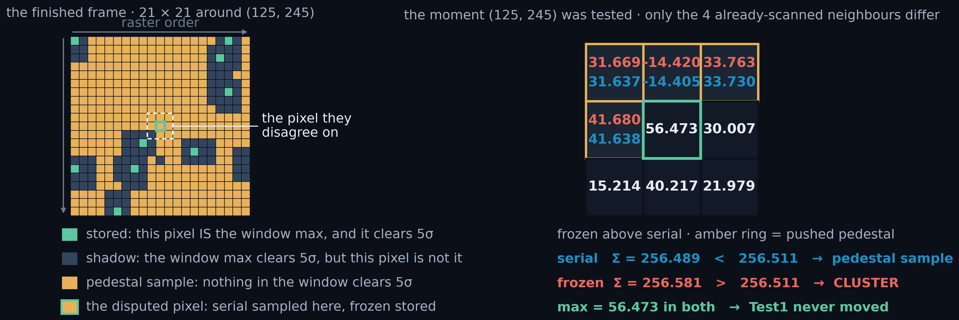
VALIDATION · WHICH TEST CAUSES THE GAP
Test3 makes the clusters; Test1 only moves the pedestal
• push_fast touches only the pixel's own accumulators and never reads the stencil, so the update is order-independent: same set of updated pixels, bit-identical pedestal. Only a differing decision can diverge.
Measured two ways. Instrumented: of the 19 disagreeing clusters, the 11 that only frozen finds are all Test 3; the 8 only serial finds are all the local-max gate. Ablated: compile Test 3 out and the 11 go to zero.
3×3 · 10 000 frames · 23 244 605 clusters · per-pixel branch codes diffed frame by frame, then re-run with Test 3 compiled out.
31 / 34
Notes:
SAY THIS -- 92 words, about 34 s.
- This is the proof that the CPU-versus-CPU difference is the third test, and it
was done two independent ways.
- First, instrumented: record which branch every pixel takes, in both finders,
and compare. All eleven clusters that only the frozen twin finds come from
that one test.
- Second, ablated: compile the test out of BOTH finders and re-run. The eleven
go to exactly zero.
- The picture shows one such pixel. The two sums differ in the eleventh digit,
and the maximum is identical in both.
DETAILS: TWO EXPERIMENTS, INDEPENDENT ROUTES.
Instrumented (both finders shipped logic, branch codes recorded): 974 pixels out
of 1.6e9 take a different branch. Only some change the cluster set, and those
decompose onto slide 29's 8/11 with no remainder:
frozen-only 11 = QUIET_UPDATE -> TEST3_STORE (all Test 3)
cpu-only 8 = TEST3_STORE -> TEST3_SKIP (5) (local-max gate)
+ TEST1_STORE -> SHADOW (3)
Ablated (Test 3 compiled out of BOTH finders):
Test3 ON Test3 OFF
clusters (cpu) 23 244 602 23 241 342
divergent pixels 974 584
first divergence frame 4 frame 30
frozen-only 11 0
cpu-only 8 4
The 11 go to zero exactly. The cpu-only 4 are all TEST1_STORE -> SHADOW, the
local-max gate, which does not need Test 3 -- the count is not preserved because
ablating changes which pixels push, so the pedestal follows a different path and
the downstream ties are a different realisation.
WHY TEST1 FLIPS MOST AND COSTS NOTHING. A Test1 flip moves a pixel between
QUIET_UPDATE and SHADOW. Neither stores, so no cluster appears or disappears; it
only changes whether that pixel pushed, which feeds forward.
TEST1 IS NOT MERELY DOWNSTREAM. With Test3 off, the first divergence is still at
frame 30, and nothing diverged before it -- so the pedestals were identical and
that Test1 flip came straight from the within-frame asymmetry. Test1 initiates
independently; it is just ~7x slower to do so (frame 30 vs frame 4) and cannot
create a cluster on its own.
THE SITE. Frame 203, pixel (125,245). Threshold c3*5*rms = 256.511. Serial sums
256.489 and calls it a pedestal sample; frozen sums 256.581 and stores. The gap
is 0.09 ADU, from four neighbours whose pedestals differ by 0.12 ADU in total.
max is 56.473 in BOTH -- printed because it is the argument: Test1 could not
have caused this.
READING THE LEFT PANEL. It is the FINISHED frame, not a scan in progress -- the
branch map is read once find_clusters() returns, so every one of the 441 cells
carries a final decision. The arrows are raster ORDER, drawn outside the grid so
they cannot be mistaken for a cursor.
If asked why a photon looks 3x4 and not 3x3: it does not. The green cells are
the stored clusters and they are single pixels, nine of them in this patch. The
dark region around them is SHADOW, and shadow is not the photon's 3x3 -- it is
every pixel whose OWN 3x3 window contains something above 5 sigma. Note the
shadow pixel need not be bright itself. Three tiers, all visible here:
810.3 ADU IS the window max -> stored
345.0 ADU above the 85.5 bar, not the peak -> shadow
17.7 ADU nowhere near the bar, but its 3x3 reaches the 345 -> shadow
Charge shared across two adjacent pixels therefore lights up the union of every
window that can see either one, which here is 3x4. In the whole patch 27 pixels
clear 5 sigma, 9 are local maxima, and 98 end up shadowed.
The marked pixel is amber with a green ring on purpose: the panel is coloured by
the SERIAL finder, and serial sampled the pedestal there. Only frozen stored. If
it were painted plain green the picture would contradict the sigma lines beside
it. Amber means one thing in BOTH panels -- a pixel that pushed the pedestal --
which is why the frozen readings on the right are red rather than amber.
WORTH POINTING AT IF THE ROOM IS ENGINEERS, four rows below the marked pixel.
(129,245) is an isolated shadow cell with pedestal samples on both sides of it.
The cause is the 85.150 ADU pixel at (130,244), one row down and one column
left, which sits in the window of BOTH (129,245) and (129,244). Their window
maxima are IDENTICAL. They take different branches anyway, because the bar is
per-pixel -- the test is m > nSigma * rms[centre], the noise of the pixel being
tested. The branch codes alone bound the two:
rms(129,245) < 17.030 <= rms(129,244)
The left neighbour is noisier, so its bar is higher, so the same 85.150 fails to
clear it. And (130,244) is itself only a pedestal sample: 85.2 does not clear its
OWN bar and its window sums to 119.5 against a ~256 Test3 threshold. So a pixel
can silence a neighbour's pedestal update without being bright enough to be
anything itself -- "bright" is not a property of a pixel, it is a relation
between a value and whose noise you measure it against.
Deliberately NOT marked on the figure. It is a statement about the algorithm,
not about serial-vs-frozen, and a second leader line would compete with the one
that carries the slide's actual argument. Full numbers in docs/deck/QA.md.
The branch_map property on both finders is diagnostic scaffolding. The ablation
is AARE_TEST3_ENABLED in the two headers, 1 by default.

Slide 38
FOR USERS · PYTHON API
The fast path in eight lines
THE RECOMMENDED PATTERN
• 3 · register_input_buffer(): opt4 in one call. Pin once, outside the loop.
• 4 · find_clusters_batched(): one ClusterVector per frame, with opt5's overlap built in.
from aare import File, ClusterFinderCUDA
cf = ClusterFinderCUDA(image_size=(400, 400), cluster_size=(3, 3),
n_sigma=5, n_streams=4,
max_clusters_per_frame=3000)
for _ in range(1000): # 1. train the pedestal
cf.push_pedestal_frame(pd.read_frame())
data = f.read_n(100_000) # 2. one contiguous array
cf.register_input_buffer(data) # 3. pin it once
for s in range(0, len(data), 2000): # 4. batch through it
clusters = cf.find_clusters_batched(data[s:s+2000], first_frame=s)
cf.unregister_input_buffer() # 5. release the pages
Zero-copy: ×1.16 at 3×3, ×2.21 at 9×9. The views expose every cluster; they only withhold ownership past the chunk.
ZERO-COPY · SAME PATTERN, STEP 4 SWAPPED
Reduce as you go and you never allocate. Hold a view past its chunk and you stall the pipeline.
for v in cf.find_cluster_views_batched_iter(data, 2000): # 4, zero-copy
hist.fill(v.sums()) # consume inside the loop:
# the view dies with its chunk
32 / 34
Notes:
SAY THIS -- 117 words, about 42 s.
- If you take one slide away for your own code, take this one. This is the fast
path, and it is eight lines.
- Two of them matter. Register the input buffer once, outside the loop -- that
is the pinning step, and you do it on the whole dataset, not per frame. And
call find_clusters_batched, which has the host-GPU overlap built in. You do
not have to think about streams at all.
- The lower panel is the zero-copy version: same code, one call swapped. You get
a view instead of your own copy. Read it inside the loop, and reduce as you
go. If you keep it past the chunk, it is gone.

Slide 39
FOR USERS · CHOOSING THE KNOBS
Five knobs, and the one that silently truncates
The single most common mistake: leaving max_clusters_per_frame too low. It does not error; it truncates, and every frame quietly returns the same count.
PARAMETER
WHAT IT DOES
GUIDANCE
n_streams
Upper bound on frames in flight.
4 at both cluster sizes. 8 buys no kernel concurrency at 9×9.
max_clusters_per_frame
Fixed size of the per-frame D2H transfer.
Must exceed the real maximum or clusters are silently dropped. At 9×9 the maximum is 1 633, and a cap of 1 700 already makes D2H the bottleneck.
batch size
Frames per find_clusters_batched call.
2 000 amortises launch overhead without a large pinned footprint.
cluster_size
Compile-time stencil geometry.
3×3 and 9×9 are registered. 9×9 moves the bottleneck off H2D.
register_input_buffer
Page-locks the host array for DMA.
Always, if the data is already in RAM.
33 / 34
Notes:
SAY THIS -- 113 words, about 41 s.
- Five settings, and only one of them can hurt you. That is the ringed one, the
maximum clusters per frame.
- It is the size of the envelope we copy back for every frame. If you set it too
low, you do not get an error. You quietly lose clusters, and every frame comes
back with the same count -- which looks like a plateau in your data, not like a
bug.
- The others are easy. Four streams is right at both cluster sizes; eight buys
nothing. Batches of two thousand. Register the input buffer whenever your data
is already in memory. Those are the defaults, and they are the ones we
measured.

Slide 40
WHERE THIS LEAVES US
The bottleneck has walked from the host, to the GPU, to PCIe
Every number in this deck is measured on one machine, one dataset, one git revision, and the annexes carry the reconciliation for each of them.
DONE
DONE
×9.1 at 3×3, ×26.5 at 9×9
FP32 pedestal, safely
16.3 and 25.1 µs/frame end to end, both on their hardware floor. At 3×3 that is 47× MÖNCH03's standard frame rate.
−40.5 % kernel time, and correct: the variance accumulates on a frozen per-pixel offset. 6 duplicate clusters in 23 million.
NEXT
NEXT
3×3: transfer granularity
9×9: the result path, not the kernel
The pipeline sustains 16.31 µs against a 13.15 µs uncontended H2D: 2 000 separate 320 kB descriptors, plus H2D↔D2H contention.
At a lossless cap D2H already binds: 25.24 µs against a 23.94 µs kernel. More kernel work buys nothing.
34 / 34
Notes:
SAY THIS -- 126 words, about 46 s.
- Where this leaves us. Nine times at 3x3, twenty-six at 9x9, and both are
sitting on their hardware floor. At the small size that is 45 times the
detector's standard frame rate, so the finder is no longer the limit.
- And the pedestal is now float, safely -- 40 percent off the kernel, with six
duplicate clusters in 23 million, all of them the same tie between two
touching pixels.
- What is left is not the maths. At 3x3 it is how we hand the wire its work --
two thousand separate small transfers. At 9x9 it is the copy back out, which
is now the tallest bar. Both of those are transfer problems. The bottleneck
has walked from the host, to the GPU, to the wire.
DETAILS: The headroom claim, stated carefully.
WHERE THE MATERIAL IS, if anyone asks for it after the talk rather than from the
floor: docs/ClusterFinderCUDA_benchmark_results.md for every number and its
provenance; python/tests/ClusterFinderCUDA_perf.ipynb for the timing protocol;
python/tests/perf/ for the campaign; python/tests/validation_tiers.py and
ClusterFinderFrozen_vs_CUDA.ipynb for the validation; python/tests/branch_trace.py
and branch_site_dump.py for slides 30-31. Paths are deliberately off the slides.
MOENCH03 runs at 1.3 kHz as standard and 3-6 kHz with optimised readout boards.
The finder does 58 495 FPS at 3x3 and 39 775 at 9x9, so it is 45x and 31x the
standard rate, and about 10x and 7x the optimised ceiling. The point is not the
multiple: it is that cluster finding has stopped being the thing that decides
how fast you can take data, on one GPU, at either cluster size.
Two honest qualifications. First, this is throughput on frames already in host
RAM -- getting them there from the detector is a separate problem and is not
measured here. Second, at 9x9 the D2H slot is cap-sized, so the margin shrinks
if max_clusters_per_frame has to grow for a busier beam.
What the 24-thread CPU finder does, for contrast: 6 762 FPS at 3x3, which
matches the standard mode with nothing to spare, and 1 503 FPS at 9x9, which
does not.

Slide 41
COMING UP
Annexes
A1
Register pressure
A2
Rejected route · CUDA graphs
A3
opt3 · the second D2H
A4
opt5 · the overlap code
A5
Rejected routes · the result copy
A6
Why not one big pinned buffer?
A7
s1, s4, and every engine number
A8
opt7 · the full engine reading
A9
Catastrophic cancellation, in full
A10
The fault model, tested
EVERYTHING SO FAR
A11
Behind the numbers · page faults
33 slides
A12
The three benchmark artefacts
the arc is finished; what follows answers questions
Notes:
SAY THIS -- 45 words, about 18 s. Only if you reach it.
- That is the talk. What follows is backup: every engine number reconciled, the
three things I tried that did not work, and the measurement traps.
- I will jump to one of these if a question needs it.

Slide 42
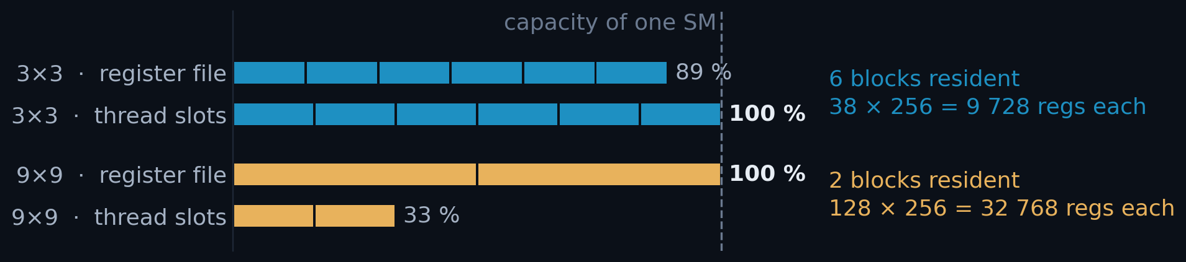
A1
ANNEX · WHAT RUNS OUT FIRST · EXPANDS SLIDE 9
Register pressure: 38 per thread at 3×3, 128 at 9×9
• An SM has 65 536 registers and 1 536 thread slots; whichever runs out first decides how many blocks fit at once.
• Every thread keeps a private clusterData[CSX × CSY], so register demand grows with the square of the cluster size. Neither build spills.
PER SM · SM_89 · F32 BUILD
3×3 · BLOCKS RESIDENT
6
9×9 · BLOCKS RESIDENT
2
SPILLS, EITHER CASE
0 bytes
9×9: the register file is exactly full at two blocks (2 × 128 × 256 = 65 536). 3×3: the slots run out first, and the registers still have room.
3×3 ON THE F64 BUILD
47 regs → 5 blocks
MEASURED, NOT ESTIMATED · READ FROM THE BUILT .SO
cuobjdump -res-usage build/aare/_aare_cuda*.so | c++filt
3x3: REG:38 STACK:0 LOCAL:0 # STACK/LOCAL 0 = no spills
9x9: REG:128 STACK:0 LOCAL:0
A1
Notes:
SAY THIS -- 117 words, about 45 s. Annex: only on a question.
- Shared memory is not the limit. Two other things are: thread slots, and
registers. An SM has 1 536 thread slots and 65 536 registers, and whichever
runs out first decides how many blocks live on that SM at once.
- Our block is 256 threads. At 3x3, 38 registers per thread: six blocks fit, and
it is the SLOTS that run out first -- six times 256 is exactly 1 536. The
registers still have room.
- At 9x9 every thread keeps a private 9-by-9 staging array, so 128 registers.
Two blocks fill the register file exactly, and two thirds of the thread slots
sit empty.
- Both numbers are read out of the built binary, and neither build spills.
CAREFUL: do not say "six versus two, because of register pressure". Registers
bind at 9x9 ONLY. At 3x3 the thread slots bind and the registers are at 89 %.
The callout on the slide says so, so the room can check you.
DETAILS: the arithmetic, and the one build-dependent caveat.
One SM holds 65 536 registers and 1 536 thread slots. A 16x16 block is 256
threads, so a block costs regs_per_thread x 256 registers. At 3x3 that is 9 728,
six blocks fit, and the THREAD SLOTS run out first. At 9x9 it is 32 768, so two
blocks exactly fill the REGISTER FILE and strand two thirds of the slots. Same
kernel, same block size, opposite binding resource.
Build dependence of the register count itself: the f64 pedestal costs 3x3 nine
extra registers (47), which loses a block per SM. 9x9 is unmoved at 128 -- there
the limiter is the clusterData[9][9] staging array, not the pedestal, which is
why opt7 helps 3x3's occupancy and not 9x9's.
Reproduce blocks/SM at runtime with python/tests/perf/kernel_resources.py, which
calls cudaOccupancyMaxActiveBlocksPerMultiprocessor on the built kernel.

Slide 43
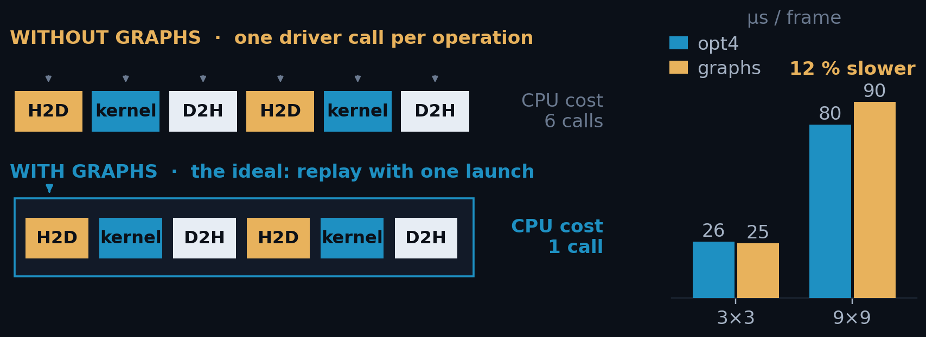
A2
ANNEX · REJECTED ROUTE · CUDA GRAPHS · EXPANDS SLIDE 10 · 1 OF 2
CUDA Graphs, a sound idea that the next act overtook
• Every cudaMemcpyAsync / kernel launch costs the CPU a few microseconds of driver work, per frame and per operation. After opt4 that looked like the budget.
• A CUDA Graph builds the whole dependency DAG once, so replay should be one cudaGraphLaunch. Ours needs three per frame, because every frame has new source and destination addresses.
ClusterFinderCUDA_graph.hpp
// setup: nodes added by hand, not captured
cudaGraphCreate(&sc.graph, 0);
cudaGraphAddMemset/Memcpy/KernelNode(...);
cudaGraphInstantiate(&sc.graphExec, ...);
// per FRAME: 3 driver calls, not 1
cudaGraphExecMemcpyNodeSetParams(...); x2
cudaGraphLaunch(sc.graphExec, sc.stream);
REJECTED 3×3: 39 752 FPS, inside noise of opt4. 9×9: 11 072 FPS, 12 % slower.
The 3×3 edge was never established: the instrumentation tax (2.8 µs) is larger than the gap (0.8 µs). Detail in the notes.
A2 · 1/2
Notes:
SAY THIS -- 88 words, about 32 s. Annex: only on a question.
- Rejected route one: CUDA graphs. The idea is sound. Every copy and every
launch costs the CPU a few microseconds of driver work. A graph is that whole
sequence built once, and then replayed.
- After step four that looked like the right target. But it did not pay: even at
3x3 the gain was inside the noise, and at 9x9 it was 12 percent SLOWER.
- And then the next act made the question go away: once host work hides under
the GPU, saving host work is worth nothing.
CAREFUL: OUR GRAPH IS NOT "ONE CALL PER BATCH".
The textbook pitch is "four driver calls per frame become one". Our
implementation does not get there, and the code on the slide now says so:
- It is built with the EXPLICIT node API, not stream capture --
cudaGraphCreate + cudaGraphAddMemsetNode / AddMemcpyNode / AddKernelNode +
cudaGraphInstantiate, all inside build_graphs(), graph.hpp 491-576.
- Every frame reads from a different place in the input array and writes to a
different output slot, so the H2D source pointer and the D2H destination
pointer have to be repointed BEFORE each launch. That is two
cudaGraphExecMemcpyNodeSetParams calls, then cudaGraphLaunch: three driver
calls per frame (graph.hpp 355-373).
So the fair sentence is "four calls per frame became three, not one". If asked
why it could not be one: a graph is a fixed set of nodes with fixed parameters,
and a streaming workload gives every frame new addresses. Only a workload that
reuses the same buffers every time gets the textbook win.

Slide 44
A2
ANNEX · REJECTED ROUTE · CUDA GRAPHS · 2 OF 2
What a CUDA Graph actually saves, in microseconds
• The stream path issues four runtime calls per frame (memset, H2D, launch, D2H) and a graph replaces all four with one cudaGraphLaunch. This is the ceiling: our own graph needs three (see part 1).
ROUTE A · MEASURED VERDICT
3×3 VS OPT4
×1.03
CALL
PER FRAME
HOST COST
µS/FRAME
cudaMemcpyAsync
2
1.98 µs
3.97
9×9 VS OPT4
cudaLaunchKernel
1
2.13 µs
2.13
×0.88
cudaMemsetAsync
1
1.57 µs
1.57
VS OPT5 AT 9×9
submission total
4
7.67
36 % behind
THE ARITHMETIC
Read from CUPTI_..._RUNTIME, the host table, so this is the one order-of-magnitude number in the deck, ±50 %. It is enough to show graphs cannot pay against a 16 µs floor, and not enough to quote to two figures.
7.67 us/frame x 3/4 = 5.75 us/frame eliminated, AS MEASURED (under nsys)
5.75 / 4 (see A12) ~ 1.4 us/frame eliminated, unprofiled estimate
~1.4 µs against a 16.17 µs floor = 8.7 %, real while the host is the critical path, and worth nothing after opt5, which hides host work under the GPU entirely.
A2 · 2/2
Notes:
SAY THIS -- 84 words, about 31 s. Annex: only on a question.
- This is the arithmetic behind that rejection, so it is not a matter of taste.
- Four driver calls per frame, about 7.7 microseconds of host time in total. A
graph removes three of the four, so about 5.7 -- but that is measured under
the profiler, which inflates host calls about four times. Unprofiled, call it
1.4 microseconds.
- Against a 16 microsecond floor that is under nine percent, and only while the
host is the critical path. After step five it is zero.
CAREFUL: THE 3/4 IN THIS TABLE IS THE BEST CASE, NOT WHAT WE BUILT.
"A graph removes three of the four calls" is the textbook ceiling. Our graph
removes ONE of the four: it still makes two cudaGraphExecMemcpyNodeSetParams
calls plus the launch, three per frame, because every frame needs new H2D and
D2H addresses (see part 1 and its note).
The 5.75 and 1.4 microsecond figures on this slide are therefore an UPPER BOUND
on what route A could ever have saved, not an estimate of what it did save. Say
"at best" when you quote them. The conclusion does not move -- it gets stronger,
since the real saving is smaller than the bound that was already too small to
matter -- but do not present the bound as the measurement. The 7.67 us and the
per-call host costs in the table ARE measured; only the 3/4 is modelled.

Slide 45
A3
ANNEX · OPT3 · THE OTHER BARRIER · EXPANDS SLIDE 14
One D2H per frame, not two
• opt2 asked the device how many clusters, blocked until the answer came back, then asked for that many. The size of the second copy was a function of data that had not arrived yet.
• opt3 gives every frame a fixed envelope (count, then room for cap clusters), so the copy's size is known at construction and can be queued with the kernel. The count is still read, but afterwards, on the host.
1 kernel
›
2 copy 4 B
›
3 BLOCK
›
4 read count
›
5 copy N B
›
6 BLOCK
opt2 · two transfers and two stalls per frame: the host must learn the count before it knows how much to fetch.
1 kernel
›
2 copy the whole envelope
›
3 → next frame, host not involved
opt3 · one transfer, no stall. Nothing in the loop waits on a value.
You can only stream a transfer whose size is known in advance. The price is bytes: the envelope is sized by the cap, not by the clusters actually found. 3×3: 120 kB shipped for 93 kB of clusters. 9×9: 558 for 467.
A3
Notes:
SAY THIS -- 128 words, about 46 s. Annex: only on a question.
- There was a second barrier, and it is less obvious. In the old version the
host asked the GPU "how many clusters did you find?", waited for the answer,
and only then asked for that many bytes. The size of the second copy depended
on data that had not arrived yet.
- You cannot queue up a copy whose size you do not know. So the host had to
stop, twice, on every single frame.
- The fix is to give every frame a fixed envelope: room for a maximum number of
clusters, decided once at the start. Now the size is known, so the copy can be
queued right behind the kernel and nobody waits. It costs about twenty percent
more bytes on an engine that had time to spare.
DETAILS: The point to say out loud: this is the one step in the ladder that is
not a setting. It changed the kernel signature, the buffer ownership and the
collection loop, and it is why the opt1/opt2 class is frozen in a separate header
(ClusterFinderCUDAOpt2.hpp) rather than being a flag on the current one.
The dependency edge is the whole argument. In opt2 the second memcpy's SIZE
argument is *sc.h_cluster_count -- host memory that only becomes valid after a
cudaStreamSynchronize (Opt2.hpp:277-294, then :442-446). So the sequence is
forced: kernel, copy 4 bytes, BLOCK, read, copy N bytes, BLOCK. Two of those six
steps are the host doing nothing, every frame.
opt3 fixes the size once in the constructor (m_output_bytes_per_frame =
m_clusters_offset + cap * sizeof(ClusterType), ClusterFinderCUDA.hpp:440-445), so
the copy is enqueued in the same loop iteration as the kernel launch (:725-728).
The kernel gets two pointers into ONE allocation (:701 and :709).
What it costs: 120 kB instead of 93 kB per frame at 3x3, 558 instead of 467 at
9x9. Roughly 20 % more bytes on an engine that had spare time, to buy back a
barrier that was stalling everything. That is also why the cap becomes a
throughput knob only from opt3 onward: under opt2 it bounded an allocation, under
opt3 it sets the D2H bar directly (report section 4.2).
If asked why opt2 did not simply copy a cap-sized buffer and skip the sync: that
IS opt3. It could not be done in opt2 because the clusters lived in their own
device allocation with no count field and no fixed per-frame stride -- there was
no single object to copy. Merging the two buffers is what created one.

Slide 46
A4
ANNEX · OPT5 · THE OVERLAP CODE · EXPANDS SLIDE 16
The overlap, in six lines, and why you never write them
THE WHOLE OF OPT5
CHUNK SIZING · THE TWO CONSTRAINTS
tok = cf.submit_batch(data[a0:b0], first_frame=a0)
for a, b in bounds[1:]:
nxt = cf.submit_batch(data[a:b], first_frame=a) # GPU starts N+1 …
results.extend(cf.collect(tok)) # … host unpacks N
tok = nxt
results.extend(cf.collect(tok)) # drain the last one
MULTIPLE OF
n_streams
CAPPED AT
MAX_SLOT_BYTES
• You do not write this. It is inside find_clusters_batched(), so opt5 arrived as a speedup, not an API change.
• submit_batch() and collect() stay public for streaming from a detector, or interleaving other work between chunks.
A multiple of n_streams, because the device pedestal is per-stream: an uneven chunk leaves the four pedestals at different ages and the finder stops being reproducible.
Two chunks in flight is enough. A third adds pinned memory and no overlap: the host is already busy for the whole time the GPU is.
Capped so the two pinned slots stay bounded: 544.5 kB per frame at 9×9, cap 1 700. chunk_size_for(n) applies both rules.
The saving is min(GPU, host) per chunk, so opt5 pays most when the two terms are comparable, ×1.31 at 3×3, and least when one dominates, ×1.20 at 9×9, where the host term is roughly twice the GPU term. That gap is the diagnosis that motivates opt6 (report §8.2).
A4
Notes:
SAY THIS -- 86 words, about 31 s. Annex: only on a question.
- This is the whole of step five, six lines. Send the next chunk, unpack the
previous one, repeat. Send, unpack, swap.
- The point is that you never write it. It is inside the normal batched call, so
everyone got the speed-up without changing a line. The two halves stay public
for people streaming from a detector.
- Two rules on chunk size: a multiple of the stream count, because each stream
owns its own pedestal, and capped so the pinned buffers stay bounded.

Slide 47
A5
ANNEX · REJECTED ROUTES · THE RESULT COPY · EXPANDS SLIDE 18
The copy is allocation-bound, not bandwidth-bound
Copying faster does not help when the cost is the OS populating pages. The only winning move is not to allocate, which is exactly what opt6 does. materialize_slot() is deliberately single-threaded and carries a comment saying so, to stop the experiment being repeated.
B′
One allocation per chunk
collect_packed()
Removes the per-frame malloc but keeps the copy, and the copy is ~80% of the cost. Worse, the replacement allocation is 1.17 GB, far above glibc's mmap threshold, so it is mmap'd and munmap'd every chunk: 606 566 faults, ~21 µs/frame.
69.3 µs · deleted from the API
B″
Parallel materialisation
8-thread copy pool
Each worker gets its own glibc arena, which destroys the cross-run heap reuse that makes the single-threaded path cheap. Faults went 9 700 → 2 270 000; MALLOC_ARENA_MAX=1 collapsed them back to 138 k, which is the proof.
+6% at best, −33% when results are freed promptly
A5
Notes:
SAY THIS -- 92 words, about 34 s. Annex: only on a question.
- The obvious answer to a slow copy is "copy faster". I tried both versions of
that, and both are here because both failed.
- One allocation per chunk instead of per frame: the copy itself is 80 percent
of the cost, so it barely helped -- and the big allocation went straight to
mmap, which the OS then has to zero every chunk.
- Eight threads copying in parallel: worse. Each thread gets its own heap arena,
which destroys the reuse that made the single-threaded version cheap. Faults
went from ten thousand to two million.

Slide 48
A6
ANNEX · THE BIG PINNED BUFFER · EXPANDS SLIDE 18
Why not pin one buffer and keep every cluster?
• The proposal. Give the finder a big pinned buffer; every frame's D2H lands in it at its own offset. No host-to-host copy, and the results outlive the finder. It works, and it is faster than opt5.
• What binds is not time, it is RAM, and the input has to stay pinned at the same time, since every frame's H2D still reads from it.
9×9 · PER FRAME
OPT5 · MEASURED
66.39 µs
OPT6 · NO HOST COPY EITHER
9×9 · PINNED AT ONCE
PER FRAME
N = 20 000
N = 100 000
30.01 µs · 100 % of floor
input frames · opt4 already does this
320 000 B
6.4 GB
32.0 GB
RESULTS KEPT, N = 100 000
output envelope · what this adds
557 568 B
11.2 GB
55.8 GB
OPT5 · PAGEABLE, COMPACTED
both, for the whole run
877 568 B
17.6 GB
87.8 GB
46.6 GB
98 GB free, no swap. At the measured size (N = 20 000) it fits easily. It is linear in N: 877 568 B per frame caps a 9×9 run at ≈112 000 frames with nothing left over.
THIS · PINNED, PADDED TO CAP
55.8 GB
Faster than opt5, and it costs 20 % more memory than opt5's own results. The envelope stores the cap (1 700), not the 1 422 clusters actually found, and all of it is page-locked.
Registration is in no timed number here: at 3×3 the whole cold–warm gap is 0.097 s, and covering the 32 GB input inside it would need 320 GB/s. Measured DRAM is 71 GB/s.
A6
Notes:
SAY THIS -- 121 words, about 44 s. Annex: only on a question.
- Fair question, and opt6 really does not answer it. The views die with their
chunk, so if you want every cluster at the end you still have to copy during
the run.
- So: one big pinned buffer, the GPU writes straight into it. It works, and it
IS faster than opt5 -- opt6 removes the same host copy and lands on thirty
microseconds against opt5's sixty-six.
- What stops it is memory, not speed. The input has to stay pinned as well,
because every frame is still copied from it. Together that is 878 kilobytes
of locked memory per frame, so a hundred thousand frames needs 88 gigabytes
of the 98 we have, and nothing may be swapped out.
DETAILS: The arithmetic. Everything below is measured or arithmetic on measured
numbers -- nothing here is an estimate.
MEASURED INPUTS
frame 400 x 400 x 2 B = 320 000 B SS1
9x9 D2H envelope, cap 1700 544.5 KiB = 557 568 B A8
9x9 clusters actually found 1422 x 328 B = 466 kB / frame SS5
host RAM 125 GiB, no swap, 98 GB free SS1/SS5
host DRAM bandwidth 71 GB/s threaded SS1
opt5 9x9 66.39 us/frame SS8
opt6 9x9 30.01 us/frame, 100 % of floor SS9
opt5 3x3 cold / warm 26.95 / 25.98 us/frame, N=100k SS5
1. SPEED. opt6 already removes exactly this host-to-host copy and measures
30.01 against opt5's 66.39, so the proposal is x2.21 at 9x9. It is faster.
The deck should say so rather than defend opt5.
2. WHY REGISTRATION DOES NOT SHOW UP IN ANY OF OUR NUMBERS. It is called once,
outside the timed region, and that is provable rather than assumed: the
entire 3x3 cold-warm gap is (26.95 - 25.98) x 100 000 = 0.097 s. Covering
the 32 GB input inside it would need 320 GB/s. Measured DRAM is 71 GB/s, so
it cannot be in there. NOTE THE CONSEQUENCE: opt4's x1.32 also excludes its
own registration. Whatever accounting we accept for opt4 we must accept
here.
3. WHAT ACTUALLY BINDS: BOTH BUFFERS ARE PINNED AT ONCE. The input cannot be
released until the last frame, because every H2D reads from it.
320 000 + 557 568 = 877 568 B per frame, page-locked
N = 20 000 -> 17.6 GB the size we actually measure: fine
N = 100 000 -> 87.8 GB of 98 GB free, no swap
98e9 / 877 568 = 111 700 frames is the ceiling with zero headroom. This is
why 9x9 is benchmarked at 20 000 frames and not 100 000 (SS5).
4. AND IT IS 20 % MORE MEMORY THAN opt5 KEEPS. opt5's results are compacted to
what was found (466 kB/frame, 46.6 GB at 100k) and live in pageable heap.
The envelope stores the cap: 557 568 / 466 000 = 1.20.
VERDICT, IF ASKED FOR ONE. For a bounded run it is the better design: faster
than opt5, and it removes the lifetime limit that opt6 has. It is not a general
replacement, because its footprint is O(N) in PAGE-LOCKED memory while opt5's
output is O(N) in ordinary heap. Pick it when N is known and bounded; pick
opt5/opt6 when it is not.

Slide 49
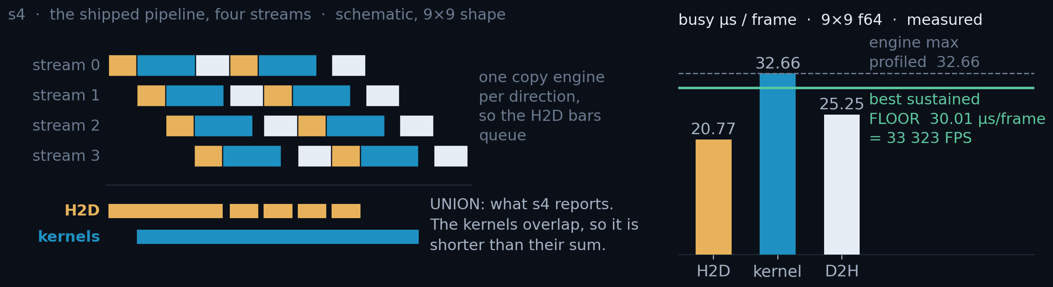
A7
ANNEX · MEASUREMENT CONVENTION · EXPANDS SLIDE 19 · 1 OF 2
Four kernels overlap, so the kernel floor is busy time, not run time
• Why it needs saying. In Act III the kernel is the tallest bar, and it is the one engine that runs four at a time. A copy engine's busy time is simply how long it runs; the kernel's is not, so what its floor means stops being obvious.
s1
s4
floor
One stream, nothing else running
The shipped pipeline, four streams
Set by the busiest engine
How long an operation actually takes.
How busy each engine is: a union, not a sum.
1 / the busiest engine, in µs/frame or FPS.
A7 · 1/2
Notes:
SAY THIS -- 120 words, about 44 s. Annex: only on a question.
- One question first: why measure engines only now? Because from here on the
KERNEL is the slowest part. There is one copy engine in each direction, so a
copy bar is just how long the copy runs. But four kernels run at the same
time, so "how long the kernel takes" and "how much kernel time a frame costs"
are two different numbers, and only one of them is the limit.
- From here on, every engine time has a label, and there are only two. "s1"
means: one stream, nothing else running. That tells you how long an operation
really takes. "s4" means: the real pipeline, four streams at once. That tells
you how BUSY each engine is per frame.
- Why two? Because under load they are different numbers. The copies get slower,
because they share one wire. The kernel gets cheaper per frame, because four
kernels overlap each other.
- And the floor is the busiest engine in the real pipeline. Not the sum of the
three -- the biggest one. If you only remember one line: s1 is how long it
takes, s4 is how busy it is, and the floor is the busiest engine.
DETAILS: Say the floor out loud, in this order.
1. There are three engines and they are independent: the H2D copy engine, the
SMs, and the D2H copy engine. PCIe is full duplex, so a frame's cost is
never the sum of the three -- it is the slowest of them.
2. There is exactly ONE copy engine per direction. So two H2D copies can never
run at the same time; they queue. That is not a modelling assumption, it is
measured: H2D_overlap and D2H_overlap are 1.000 in every row of probes.csv.
Kernels are the only row that ever overlaps.
3. That is why s4 is a UNION, not a sum. Four kernels, each 43.2 us long, but
the SMs are busy only 32.66 us per frame: overlap factor 1.32x.
4. On units, because the card says "1 / the busiest engine" and the axis says
microseconds: they are the same number. The busiest engine's busy time per
frame is in us/frame; one divided by it is frames per second. 30.01 us/frame
IS 33 323 FPS. The deck quotes whichever reads better in context -- us/frame
when comparing engines, FPS when comparing against the CPU or the detector --
and "% of floor" is the same ratio either way.
5. The floor is max(H2D, kernel, D2H) at s4. At 9x9 f64 that max is 32.66 us
= 30 618 FPS. But the unprofiled pipeline actually sustained 30.01 us/frame,
which is FASTER than the probe says is possible -- because under nsys
submission is sparser, kernels overlap less, and a less-overlapped interval
set has a LARGER union. A sustained rate is an existence proof; a probe is an
estimate. So the floor is the lower of the two, and the 1.32x is a lower
bound on the real overlap.
If time is short, say only: "s1 is how long it takes, s4 is how busy it is, and
the floor is the busiest engine." The rest is in A7.

Slide 50
A7
ANNEX · MEASUREMENT CONVENTION · EVERY ENGINE NUMBER · 2 OF 2
Uncontended, or as the pipeline runs it
• Every engine time in this deck is tagged [build · s1|s4]. s1 is one stream with nothing else running: what an engine does on its own, which is the right number for a capability claim and for the headroom that remains. s4 is the shipped four-stream pipeline: each engine's busy time per frame, the union of its intervals, the only number that can set a floor.
3×3 · µS/FRAME
S1 F64
S1 F32
S4 F64
S4 F32
9×9 · CAP 1700
S1 F64
S1 F32
S4 F64
S4 F32
H2D
13.14
13.15
16.17
16.63
H2D
13.20
13.22
20.77
20.54
kernel
14.72
4.32
15.17
5.53
kernel
39.86
23.70
32.66
23.94
D2H
5.31
5.27
7.69
7.57
D2H
21.97
21.95
25.25
25.24
engine max [s4]
—
—
16.17
16.63
engine max [s4]
—
—
32.66
25.24
FLOOR = lower of max, sustained
—
—
16.17
16.31
FLOOR = lower of max, sustained
—
—
30.01
25.14
Two traps. (1) s4 is engine *occupancy*, not duration: the 9×9 kernel row falls under load. (2) the floor is not the engine max: the max is profiled and runs 2–8 % high.
The D2H shift is an s4 phenomenon: at s1 the kernel binds in both arms. Which engine binds must be read from the s4 columns.
A7 · 2/2
Notes:
SAY THIS -- 96 words, about 35 s. Annex: only on a question.
- This is every engine number in the deck, in one grid, both cluster sizes and
both builds.
- Left columns are s1, one stream, nothing else running: how long an operation
takes. Right columns are s4, the real four-stream pipeline: how busy each
engine is per frame. Under load the copies get slower and the kernel gets
cheaper.
- Two traps at the bottom. The s4 kernel number is occupancy, not duration. And
the floor is not simply the biggest s4 number: the profiler runs a few percent
high, so we take the lower of the probe and the best real sustained rate.
DETAILS: Neither direction is faster than the other, and the bar heights say so.
At s1, H2D moves 320 000 B in 13.15 us = 24.3 GB/s; D2H moves 120 004 B in
5.27 us = 22.8 GB/s; at 9x9, D2H moves 557 604 B in 21.95 us = 25.4 GB/s. All
three sit at 72-81 % of PCIe 4.0 x16's 31.5 GB/s, the smallest transfer paying
the most fixed cost per byte. So a taller bar in this deck always means MORE
BYTES, never a slower wire -- which is exactly why raising the cap to 1 700
hands the 9x9 floor to D2H: it is 544.5 kB per frame either way the arm is
built, and it does not care about the typedef.
On the last row: the floor is the LOWER of the s4 estimate and the best
unprofiled sustained rate. 16.31 vs 16.63 at 3x3 f32; 25.14 vs 25.24 at 9x9 f32;
30.01 vs 32.66 at 9x9 f64, which is the widest gap and the reason the rule
exists. A probe roofline is an estimate, never a hard denominator.

Slide 51
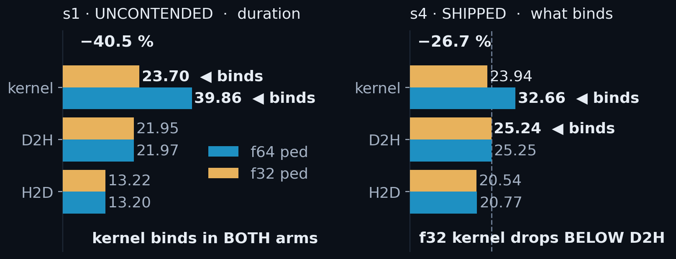
A8
ANNEX · OPT7 · THE FULL ENGINE READING · EXPANDS SLIDE 20
FP32 halves pedestal traffic: −41 % kernel time
• ~80 % of pixels take the pedestal-update branch: six accumulator values read and written.
• One typedef halves all four pedestal arrays (48 bytes per updating pixel in FP64, 24 in FP32), and the kernel is bandwidth-bound.
ONE TYPEDEF
// clusterfinder_kernel.cuh
using COMPUTE_TYPE = float;
using DEVICE_PED_TYPE = float;
// was: double
Kernel, 9×9 [s1 · cap 1700] 39.86 → 23.70 µs (−40.5 %)
At 3×3 the same typedef is worth −70.6 % in the kernel and 4.6 % end to end: there the kernel was never the tallest bar.
Naive FP32 is wrong. See annex A9.
Both builds, same git rev, 20 000 frames. Full engine grid: A7.
Two more effects, neither the reason it works: FP64 arithmetic runs at 1/64 of FP32 on a GeForce part, and the narrower accumulators free 9 registers at 3×3.
A8
Notes:
SAY THIS -- 122 words, about 44 s. Annex: only on a question.
- Remember that about 80 percent of pixels see only noise, and those all update
the pedestal. That update reads and writes six running values per pixel. So
most of what the kernel does is move pedestal numbers, not compute photons.
- Those numbers were stored as doubles, 8 bytes each. Changing them to floats,
4 bytes, halves that traffic: 48 bytes per pixel becomes 24. One typedef.
The kernel is limited by memory traffic, so half the bytes is a big win.
- 40 percent off the kernel at 9x9. Two smaller effects come for free: on a
gaming GPU double-precision maths runs at one sixty-fourth of single, and the
smaller values also free up registers. Neither is the main reason.
DETAILS: Reading the two panels, and the number to quote.
Left is s1: one stream, nothing else running, so those are true durations. The
kernel binds in BOTH arms there -- 39.86 and 23.70 against a D2H of ~21.95 -- so
s1 alone would say the kernel is the thing to optimise and stop there.
Right is s4, the shipped four-stream pipeline, and it says something different:
the f64 kernel's busy time falls to 32.66 (self-overlap, 1.32x) while every
transfer RISES under contention, and once opt7 puts the kernel at 23.94 the D2H
bar at 25.24 is above it. That is the handover slide 21 is about.
So: -40.5 % is the s1 kernel claim and is the honest headline for what the
typedef does to the arithmetic. -26.7 % is the same change measured at s4, where
self-overlap had already hidden part of the win. Both are true, they measure
different things, and A7 is the rule for which to quote.
The 3x3 occupancy effect is real but not worth stage time: 47 registers -> 38
takes 3x3 from five blocks per SM to six, 83 % -> 100 % occupancy. It changes
nothing end to end, because at 3x3 H2D is the floor.

Slide 52
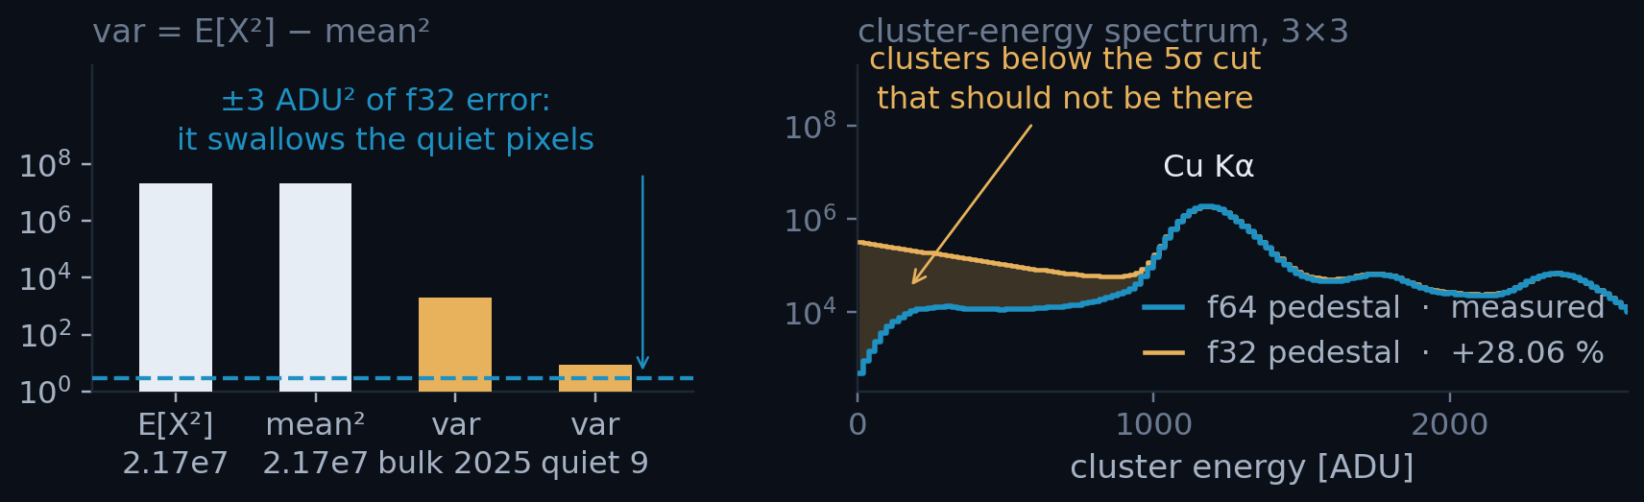
A9
ANNEX · OPT7 · CATASTROPHIC CANCELLATION · EXPANDS SLIDE 20 · 1 OF 2
Accumulate what is small, not what is large
• The trap. var = E[X²] − mean² takes two numbers near 2 × 10⁷ to get one near 2 000.
• What it cost. The rms clamps to zero, so a 5σ gate becomes a 0σ gate.
• The fix. Accumulate the centred Y = X − X₀: both operands become O(rms).
NAIVE F32 · WHAT IT DID
EXTRA CLUSTERS
+28.06 %
PIXELS AFFECTED
~1–2 % of the sensor
ERROR FLOOR
±3 ADU², absolute
AFTER THE REWRITE
F32 VS F64 COUNTS
3 × 10⁻⁷
Left: the operands and the answer against the ±3 ADU² error floor. Right: the f32 curve is reconstructed: measured area, modelled shape. The two-line patch is on the next slide.
VS THE CPU BASELINE
0.0039 %
A9 · 1/2
Notes:
SAY THIS -- 128 words, about 47 s. Annex: only on a question.
- But the naive version of that change is WRONG, and this is the most useful
slide of the talk if you ever write numerical code.
- The variance was computed as the average of X squared, minus the mean
squared. Both of those are around twenty million. The answer is around two
thousand. In float, twenty million has a step size of about two, so you
subtract two huge numbers, and the small answer drowns in the rounding.
- What it did: the noise estimate collapsed to zero for one or two percent of
pixels. A five-sigma threshold became a zero-sigma threshold, and we got 28
percent more clusters -- all fake.
- The fix is two lines: subtract a fixed offset first, so we accumulate small
numbers. Then float is fine.
DETAILS: The one sentence to leave the room with.
"Precision is relative." A float resolves small numbers finely and large numbers
coarsely, so a small answer must never be computed as the difference of two
large numbers. That is the transferable lesson; everything else on this slide is
this detector's instance of it.
Why the tail matters more than the count. +28 % is a number you might argue
about. A spectrum with a population sitting below the 5 sigma cut is not
arguable: those clusters cannot physically be there, and any gain or resolution
fit done on that spectrum is wrong.
Honesty about the right-hand panel: nobody kept the broken build around to
re-run, so the f32 curve is reconstructed. What is measured is the f64 curve and
the +28.06 % excess (CPU 116 010 113 vs CUDA 148 559 598, SS1 of the write-up).
The placement follows SS9: a correct 5 sigma gate cuts at ~225 ADU, a collapsed
gate admits the whole positive side of the pixel's distribution, so the excess
is smeared upward from zero. The write-up's TL;DR calls it a high-energy tail;
SS9 derives it from ~0 upward. Both describe the same corrupted pixels.
Welford's online variance is the other correct answer and is mentioned in the
write-up. The frozen-offset form was chosen because it is two lines and does not
change the update's arithmetic cost.

Slide 53
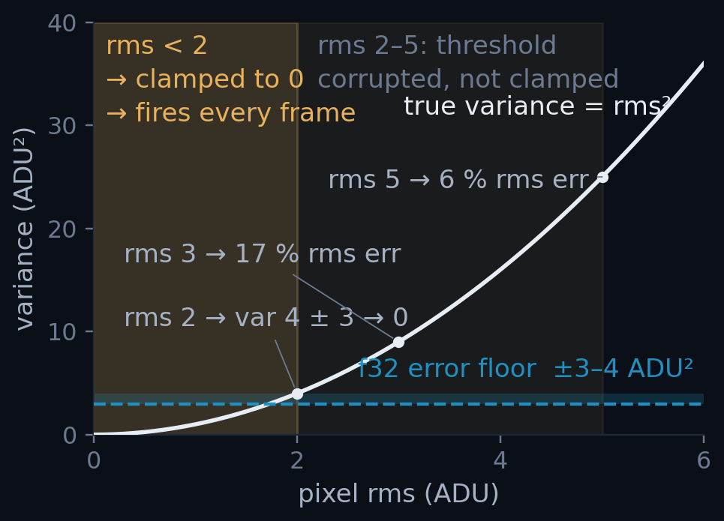
A9
ANNEX · THE VARIANCE REWRITE · 2 OF 2
The rewrite in full, and which pixels the error reached
• Freeze X₀ = round(mean) once, at the end of pedestal training, and never move it.
• Accumulate the centred Y = X − X₀; report X₀ + sum/n. Both operands are now O(rms)-sized.
clusterfinder_kernel.cuh
// before: both terms ~2.17e7, answer ~2000
var = sum2/n - mean*mean;
// after: centred on a frozen per-pixel offset X0
DEVICE_PED_TYPE resid = mean - d_pd_off[i]; // ~O(1)
DEVICE_PED_TYPE var_px = sum2[i]/n - resid*resid; // no cancellation
Result: the 100 % FP32 build matches the FP64 build to 3 × 10⁻⁷, 70 clusters out of 233 million.
Which pixels the ±3 ADU² floor actually reaches: the quiet ones, whose true variance is smallest.
X₀ must never be updated: the accumulators are defined relative to it. Welford's is the other correct answer; this one is two lines and costs nothing.
A9 · 2/2
Notes:
SAY THIS -- 95 words, about 35 s. Annex: only on a question.
- The fix in full. At the end of pedestal training we freeze one number per
pixel: the rounded mean. Call it X-zero. It never moves again.
- Then we accumulate the difference from X-zero instead of the raw value. Both
sides of the subtraction are now small, about the size of the noise, so there
is nothing left to cancel. Two lines.
- The result: the all-float build matches the double build to three parts in ten
million. And the plot shows who was hurt before -- the quietest pixels, the
ones with the smallest true noise.

Slide 54
A10
ANNEX · THE FAULT MODEL · EXPANDS SLIDE 21
The fault model, tested against every step
• The 0.68 µs per fault rate is fitted on the 3×3 f32 ladder. Every row below is 9×9, f64 vs f32, so the rate is applied out of sample, never refitted.
STEP
F64 WARM (FAULTS)
F32 WARM (FAULTS)
Δ WALL
Δ FAULTS
PREDICTED
VERDICT
opt3
82.44 µs (128 k)
95.66 µs (521 k)
+13.22
+393 k
+13.37
the allocator
opt4
79.83 µs (128 k)
75.20 µs (127 k)
−4.63
−0.5 k
−0.02
clean
opt5
66.39 µs (152 k)
61.85 µs (10 k)
−4.54
−141 k
−4.81
not separable
opt6
30.01 µs (0)
25.14 µs (0)
−4.87
0
0.00
clean
opt3 is the whole argument in one row. A 393 k fault gap predicts +13.37 µs; +13.22 was observed. The −40 % kernel is in there, invisible under 13 µs of the OS zeroing pages.
9×9 · cap 1 700 · warm = best of reps 1–4. The 0.68 µs/fault rate is carried in unchanged from the 3×3 fit: nothing here is tuned to make the columns agree.
A10
Notes:
SAY THIS -- 94 words, about 34 s. Annex: only on a question.
- This is the page-fault model tested, not asserted. The cost per fault, 0.68
microseconds, was fitted on the small cluster size. Every row here is the big
one, so the number is applied out of sample and never refitted.
- Read the opt3 row. Its two arms differ by 393 thousand faults, the model
predicts 13.4 microseconds, and 13.2 was measured. So that row tells you about
the allocator, not about the typedef.
- That is why opt3 is excluded from the earlier chart and opt5 is marked with a
dagger.

Slide 55
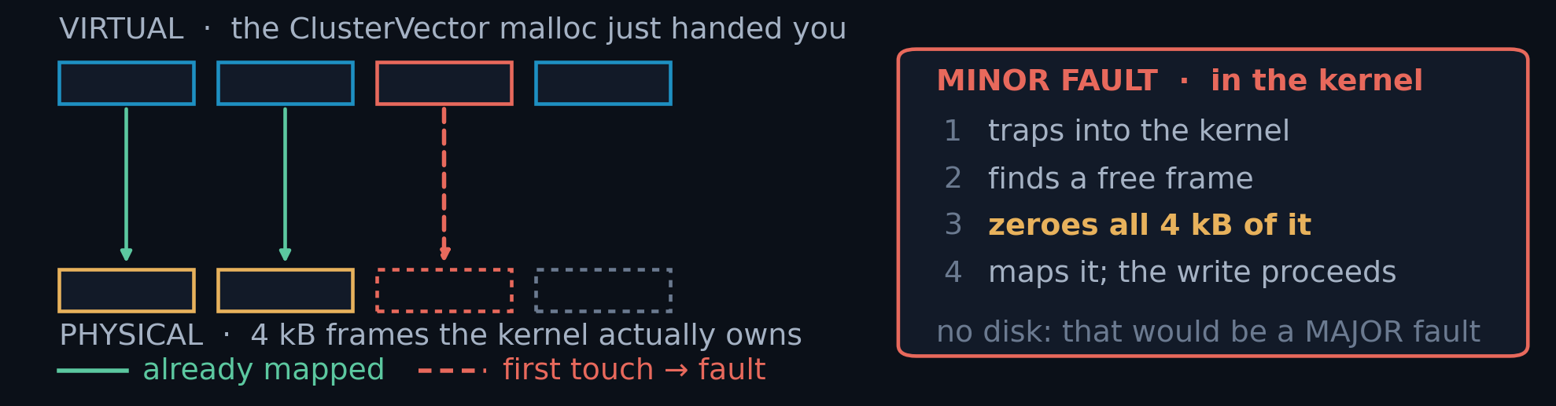
A11
ANNEX · BEHIND THE NUMBERS · EXPANDS SLIDE 24 · 1 OF 2
Materialising clusters costs 2.6 M page faults
• Every run that keeps its results allocates a fresh heap and touches it once. Linux only finds physical memory on first touch, so that pass is where the OS works, inside the timer.
ONE 100 000-FRAME PASS · 3×3
PAGES FAULTED IN
~2.6 M
COST INSIDE THE TIMER
up to 4 s
CLUSTERS MATERIALISED
~10 GB
COST PER FAULT, FITTED
Re-run until minor faults plateau (< 200 k), and quote that run.
0.68 µs
Zero major faults all campaign. Copying faster cannot avoid this; not allocating can. That is opt6.
A11 · 1/2
Notes:
SAY THIS -- 125 words, about 45 s. Annex: only on a question.
- A warning about measuring, and it cost me real time to find. When a run keeps
its results, it allocates new memory and writes to it for the first time.
Linux only gives you real physical memory when you first touch it, and that
work lands INSIDE your timer.
- For one pass here that is 2.6 million page faults, and up to 4 seconds. That
is not the GPU. That is not even our code. It is the operating system finding
pages.
- So the rule we used: count the page faults around every timed block, run it
again until that count settles, and quote that run. If you have never looked
at this, your first benchmark is probably measuring your allocator.
DETAILS: THE NUMBERS ARE 3x3, opt2, 100 000 frames, one process, results
retained: 2 625 948 minor faults on run 1 at 6.110 s / 16 366 FPS, falling to
185 885 by run 3 at 4.452 s / 22 459 FPS. 2.6 M pages x 4 kB = ~10 GB, which is
100 000 x the 93 kB 3x3 payload. Section 12 of the report has the table.
THE FIT. Correlating delta-wall against delta-faults across those three runs
gives 0.65, 0.77 and 0.68 us/fault. Reconstructing run 1 from run 3:
4.452 s + 2 439 648 x 0.68 us = 6.111 s against 6.110 measured. Kernel time was
constant (0.022 ms) across all three, so the GPU is not involved at all.
WHY IT IS ZEROING, NOT LOOKUP. The kernel must hand out a frame that last
belonged to some other process, so it has to clear it first. That is mandatory
and it is the whole cost. At 4 kB a page, 1 GB of freshly-touched memory is
262 144 faults.
TWO INSTRUMENT CAVEATS, named and set aside. (1) Under nsys, host-side CUDA API
calls read ~4x high and wall time inflates with them, so every wall time in this
deck comes from an UNPROFILED run and only GPU-side timestamps come from nsys.
(2) CUDA events measure a stream, not a kernel. Both worked through in A12.
THE FAIRNESS TRAP that follows from this: freeing a ~10 GB result heap hands it
back to the allocator and the next loop reuses it, so on a cold heap the first
loop pays the entire tax and any printed ratio is meaningless. Both loops must
be at plateau; drop stale result bindings before timing.
Synthetic confirmation, same report section: allocate ~8 GB in ClusterVector-sized
chunks, touch every page, free, repeat in one process -- 2.05 s / 2 046 594
faults cold, then 0.07 s / ~2 000 warm. 30x faster, 1000x fewer faults, same
allocations. glibc retains the arenas.

Slide 56
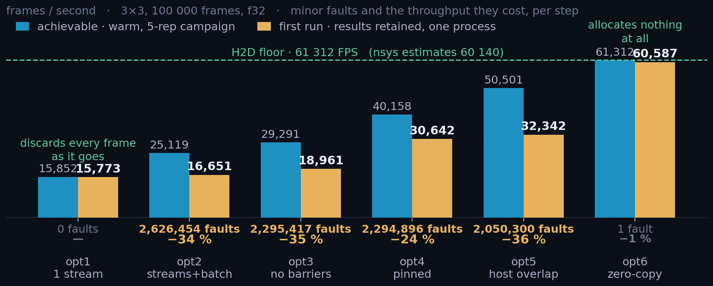
A11
ANNEX · BEHIND THE NUMBERS · WHAT A FIRST RUN COSTS · 2 OF 2
A first run loses a third of its throughput to page faults
Everything that materialises clusters loses a third of its throughput on the first run: +7 to +20 µs per frame.
Only the two ends escape, for opposite reasons. opt1 discards each frame; opt6 never grows a heap, and reaches 98 % of its peak on a cold process.
Single pass, one process, every ClusterVector retained · f32 · 100 000 frames. Repeat the run and the amber bars climb onto the blue ones.
A11 · 2/2
Notes:
SAY THIS -- 114 words, about 42 s. Annex: only on a question.
- The previous slide said "run it twice". But a real user runs it ONCE, in a
fresh process. So here is that number honestly: blue is the warm run, amber is
the very first run.
- Almost every version loses about a third of its speed on the first run. That
is the same page-fault cost, and it is real: your user pays it.
- Two versions escape, for opposite reasons. The first version throws every
frame away, so it never grows a heap. And the last one never copies the
results at all, so it does not either -- it reaches 98 percent of its warm
speed on a cold start. Zero-copy paid twice.

Slide 57
A12
ANNEX · BENCHMARK ARTEFACTS · EXPANDS A11 · 1 OF 4
Three ways a GPU benchmark lies
First-touch page faults
CUDA-event kernel timing
The profiler itself
Each run materialises ~10 GB of clusters. The first pass faults in ~2.6 M pages at 0.7 µs each, up to 4 s of pure OS work inside the timer.
avg_kernel_time_ms() measures elapsed time on a stream, including waiting for other streams. Under 8-stream load it over-reads by up to 3.5×.
Under nsys, wall time per frame inflates ~4× from API tracing.
Fix: re-run until getrusage() minor faults plateau (< 200 k).
Fix: Nsight Systems per-instance times; 1 stream for exclusive numbers.
Fix: GPU op times from nsys, wall times from unprofiled runs.
THE FAULT PROTOCOL · BRACKET EVERY TIMED CELL
# bracket every timed cell:
mf0 = resource.getrusage(resource.RUSAGE_SELF).ru_minflt
... t = time.perf_counter() - t0 ...
print(f'minor faults: {mf1-mf0:,}') # quote the run where this plateaus
Validated: wall = steady-state + faults × 0.68 µs reproduced a 6.110 s run to within 1 ms. Kernel time stayed constant throughout; the GPU was never the variable.
A12 · 1/4
Notes:
SAY THIS -- 91 words, about 33 s. Annex: only on a question.
- Three ways a GPU benchmark lies, and I hit all three.
- One: the operating system finding pages, inside your timer. Two: CUDA events
do not time a kernel, they time a stream -- so under load they include waiting
behind other streams, and over-read by up to three and a half times. Three:
the profiler itself makes host calls look about four times more expensive.
- The rule that comes out of it: GPU times from the profiler, wall times from
runs with no profiler attached. Never mix them.

Slide 58
A12
ANNEX · BENCHMARK ARTEFACTS · EXPANDS A11 · 2 OF 4
First-touch page faults: two sources, one counter
• A page exists in the address space but has no physical frame yet. First touch makes the kernel find one, zero it (mandatory), and map it. No disk: ru_majflt stays 0 all campaign. At 4 kB/page, 1 GB = 262 144 faults.
(A) RESULT HEAP
(B) PINNED D2H SLOTS
allocator
malloc → mmap, one ClusterVector per frame
cudaMallocHost, in submit_batch
cost / page
0.7 µs
1.0 µs: same fault + pin + DMA map
recurs?
yes, every alloc/free cycle above the mmap threshold
no: once per buffer, for its lifetime
removed by
collect_view(): it allocates nothing
nothing; reserve_output_slots() only moves it out of the timer
The two are exactly additive. Reserving subtracts precisely the pre-pin count from run 0 and changes nothing else.
NOT A CORRELATION, AN IDENTITY
3x3: 572 292 - 455 129 = 117 163 vs 117 192 pre-pin
9x9: 2 759 037 - 2 278 567 = 480 470 vs 480 474
closed form: 2 slots x 2000 x 120 004 B / 4 kB = 117 191
At 9×9 the heap never plateaus. ~9.3 GB per pass exceeds glibc's mmap threshold, so it is re-faulted every pass: ~10 µs/frame, permanently.
A12 · 2/4
Notes:
SAY THIS -- 90 words, about 33 s. Annex: only on a question.
- The faults come from two places, and one counter sees both. The result heap,
which we allocate and free every run, and the pinned buffers, which are
faulted once and then stay.
- They are exactly additive -- reserving the pinned slots removes precisely the
expected count and changes nothing else. That is an identity, not a
correlation.
- One warning for the big cluster size: nine gigabytes per pass is above the
threshold where the allocator gives memory back to the OS, so it never warms
up. That cost is permanent.

Slide 59
A12
ANNEX · BENCHMARK ARTEFACTS · 3 OF 4
CUDA events measure the stream, not the kernel
• avg_kernel_time_ms() brackets the launch with cudaEventRecord on the kernel's own stream, so it returns time on that stream's timeline, including time queued behind other streams.
• Honest at 1 stream, inflated up to 3.5× at 8. The tell: *PCIe + overhead* = wall/N − kernel_ms goes negative.
• It is not free either: ~3.6 µs/frame, 10–15 % of throughput at 3×3.
9×9 KERNEL · F64 · NSYS
S1 · DURATION
39.86 µs
S4 · OCCUPANCY
32.66 µs
OVERLAP FACTOR
ClusterFinderCUDA.hpp
1.32×
if (m_time_kernels) // OFF by default, all 3 finders
cudaEventRecord(start[slot][i], sc.stream);
find_clusters_in_single_frame<<<grid, block, shmem, sc.stream>>>(...);
if (m_time_kernels)
cudaEventRecord(stop[slot][i], sc.stream); // <- queue-wait lands here
Same kernel. The s4 column is the union of kernel intervals per frame, not how long one kernel takes. Quote s1 for duration; s4 feeds the floor, subject to the sustained-rate rule in A7, which has the full grid.
The flag exists for comparability, not preference: with events on for one finder and off for another, the step between them absorbs the tax.
A12 · 3/4
Notes:
SAY THIS -- 88 words, about 32 s. Annex: only on a question.
- This is the trap that cost me the most. We time kernels with CUDA events. But
an event is recorded ON A STREAM, so what you measure is when the stream got
there -- including all the time the kernel sat waiting behind other streams.
- With one stream it is honest. With eight it reads up to three and a half times
too high, and you can spot it: the leftover time goes negative.
- It is also not free. Turning it on costs about 3.6 microseconds per frame.

Slide 60
A12
ANNEX · BENCHMARK ARTEFACTS · 4 OF 4
Where nsys is sound, and where it is not
• Tracing a host call runs a callback on entry and exit, inside the interval being measured. GPU work is stamped by the hardware and read back afterwards, so nothing is injected into the execution path.
MEASUREMENT
SQLITE TABLE
9×9 [F64 · S1 · CAP 1500]
VERDICT
cudaLaunchKernel: the host call
CUPTI_..._RUNTIME
1.85 µs
inflated ~4×
the kernel executing
CUPTI_..._KERNEL
39.93 µs
sound to ~2 %
cudaMemcpyAsync: the host call
CUPTI_..._RUNTIME
1.65 µs
inflated ~4×
the H2D / D2H transfer
CUPTI_..._MEMCPY
13.25 / 19.44 µs
sound to ~2 %
Same cudaMemcpyAsync, two numbers: 1.65 µs to ask for the copy, 13.25 µs for the copy to happen. A profiler that must be present to measure,distorts; one that reads a record later does not.
Every engine number in this deck comes from GPU-side timestamps. Proof they are sound: opt7 sustains 25.14 µs unprofiled against a 25.24 µsprofiled estimate, 0.4 % apart.
A12 · 4/4
Notes:
SAY THIS -- 86 words, about 31 s. Annex: only on a question.
- The profiler is not wrong everywhere -- it is wrong in a specific place, and
the table says which.
- To trace a HOST call, the tool runs code when you enter and when you leave.
That code is inside the thing being measured, so host calls read about four
times too high. GPU work is different: the hardware writes a timestamp, and
the tool reads it later. Nothing is injected.
- Same call, two numbers: 1.6 microseconds to ASK for a copy, 13 for the copy
to happen.
DETAILS: Why this one slide is still cap 1500, and what not to read off it.
The RUNTIME column exists only inside the trace: it is the cost of the host call
itself, which does not depend on how large the output slot is. So there is
nothing to re-run -- a cap-1700 trace would report the same ~1.65 and ~1.85 us
for cudaMemcpyAsync and cudaLaunchKernel.
What you must NOT read off this slide is the 19.44 us D2H. That is the cap-1500
figure. At the shipped cap of 1 700 the same engine reads 21.95 us [s1] and
25.24 us [s4], and it is the s4 value that binds the f32 build. A8 has the
shipped grid.
The one number in the whole deck taken from _RUNTIME is the CUDA Graph launch
budget in A2, and it is quoted to a single significant figure for exactly this
reason: a ~4x inflated host-call time can support "launch cost is about 2 us,
against a 24 us floor", and nothing finer than that.

