Slide 1
The CUDA ClusterFinder
Kernel design · hardware limits · seven optimization steps
Khalil Daniel Ferjaoui
Paul Scherrer Institut · aare
August 2026

Slide 2
AARE · HYBRID PIXEL DETECTORS · CUDA CLUSTERFINDER
The kernel was never the bottleneck — feeding it was
One kernel, one thread per pixel, and seven steps to keep it fed
The stencil was fast almost immediately: at 3×3 the kernel needs 5.5 µs per frame while getting that frame across PCIe costs 16.6 — 13.2 even uncontended. The frame is gated by the wire, not the arithmetic. Six of the seven steps get data in, get results back, and measure honestly.
WHERE THIS ENDS UP — THE SHIPPED f32 BUILD AFTER ALL SEVEN STEPS · ENGINE TIMES [f32 · s4] · RECONCILED IN A1
×9.1
61,312
16.3 µs
6 / 23 M
VS 24-THREAD CPU
FRAMES / SECOND
PER FRAME, END TO END
CLUSTER MISMATCH VS CPU TWIN
RTX 4090 (Ada, sm_89) · PCIe 4.0 ×16 · Mönch 400×400 uint16 · 3×3 clusters · 100 000 frames · Cu fluorescence, MAX IV

Slide 3
CONTEXT · WHAT THE CODE DOES
What the kernel does, and what limits it
COMING UP
3–4
The algorithm
5–6
The two machines
No optimizations yet, only what the hardware has to do.
7–8
The CUDA kernel
9–10
What limits it
11
The roadmap

Slide 4
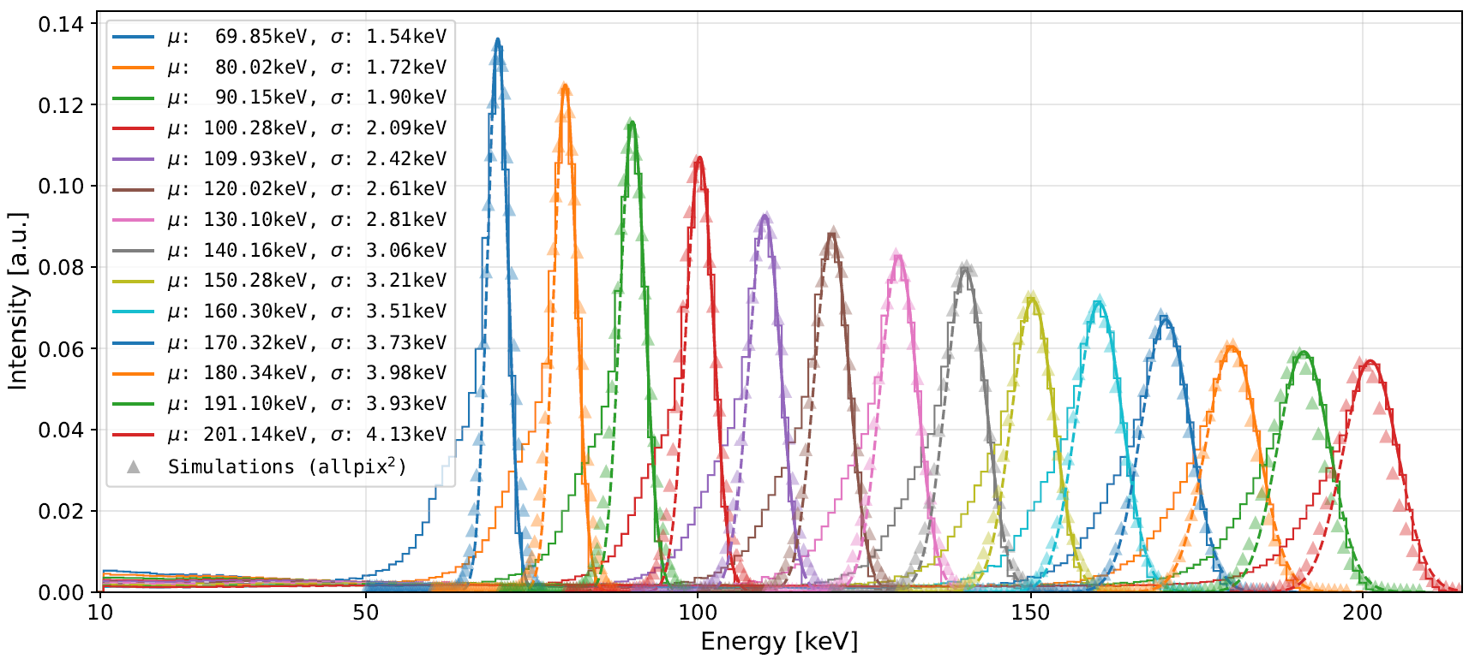
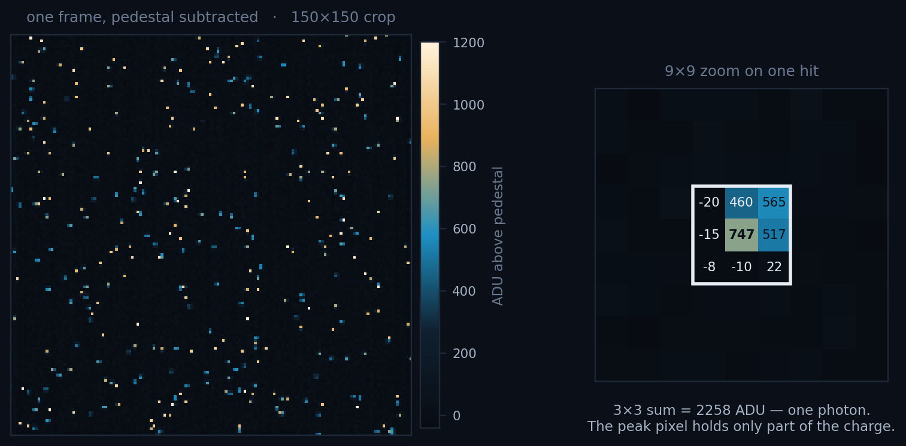
THE ALGORITHM · WHAT IT IS FOR
A photon is not a pixel — it is a cluster
• Charge from one absorbed photon spreads over neighbouring pixels. Summing that 3×3 patch recovers the photon energy; a single pixel does not.
• The histogram of those cluster energies is the measurement: peak position and width give the detector's gain and energy resolution.
WHY IT MATTERS
Cluster-energy spectra from an energy scan, against allpix² simulation. Each peak is one beam energy; its width is the resolution being measured.
MÖNCH03 · THE DETECTOR THIS FEEDS
ARRAY · PITCH · ACTIVE AREA
400 × 400 · 25 µm · 10 × 10 mm²
FRAMES PER SECOND
1.3 k standard, 3–6 k optimised
PEAK PIXELS = PHOTONS / FRAME
Real MOENCH data, Cu fluorescence, MAX IV beamtime. One cluster is emitted per local maximum, so 2 330 counts photons, not lit pixels; the recorded 3×3 windows cover 12.7 % of the frame. The detector's frame rate is the number every throughput figure in this deck should be read against.
~2 330 · 1.5 %
3 / 33
Notes:
The detector, and why its frame rate is the yardstick.
MOENCH03 is a hybrid silicon pixel detector: charge integration with analog
readout, 25 x 25 um^2 pitch, 400 x 400 pixels over a 10 x 10 mm^2 active area.
Its standard frame rate is 1.3 kHz; with optimised readout boards the design
reaches 3-6 kHz depending on configuration.
That is the number to hold on to. 400 x 400 = 160 000 pixels is 312.5 kB per
frame at 16 bit, so 1.3 kHz is ~0.4 GB/s off the detector and 6 kHz is ~1.9
GB/s. The 24-thread CPU finder does 6 762 FPS at 3x3, so it already keeps up
with the standard mode and roughly matches the optimised ceiling -- with nothing
left over for anything else on the machine, and nothing left at 9x9, where it
manages 1 503 FPS. Slide 33 closes this loop.
Pixels above 5 sigma are ~5 700, about 3.6 % of the frame and 2.4 per photon;
that is the number that sets how much of the frame the 3x3 windows cover.

Slide 5
THE ALGORITHM · PER FRAME
Per pixel: subtract, threshold, update the pedestal
• Per pixel: subtract a running pedestal (mean ± rms), keep pixels above nσ · rms, cut a 3×3 cluster around each local maximum.
• 400×400 = 160 k pixels, 312.5 kB per frame; Cu data yields ~2 330 clusters per frame at 3×3.
• The pedestal is updated by every pixel that sees no photon, about 80 % of them, every frame, so the arithmetic and the data movement are coupled.
THE SHAPE OF THE WORK
WORK ITEMS PER FRAME
160 000
OPERATIONS ON EACH
THE WHOLE ALGORITHM · THREE OUTCOMES, NOT TWO
~5, identical
// the whole algorithm, per pixel
v = frame[i] - pedestal_mean[i]
rms = pedestal rms at i
m = max(v) over the 3x3 window at i
if (m > nSigma * rms) // a photon is within reach
if (v == m) -> emit cluster // ... and I am its peak
else -> nothing // ... I am in its shadow
else -> update pedestal // I saw nothing
COMMUNICATION BETWEEN THEM
none
ORDER THEY MAY RUN IN
any
Thesis of this talk: the compute was fast almost immediately. Six of the seven steps are about feeding it.
What a pixel does never depends on what its neighbours decided, only on what they measured. That one property is what the next two slides point two very different machines at.
4 / 33

Slide 6
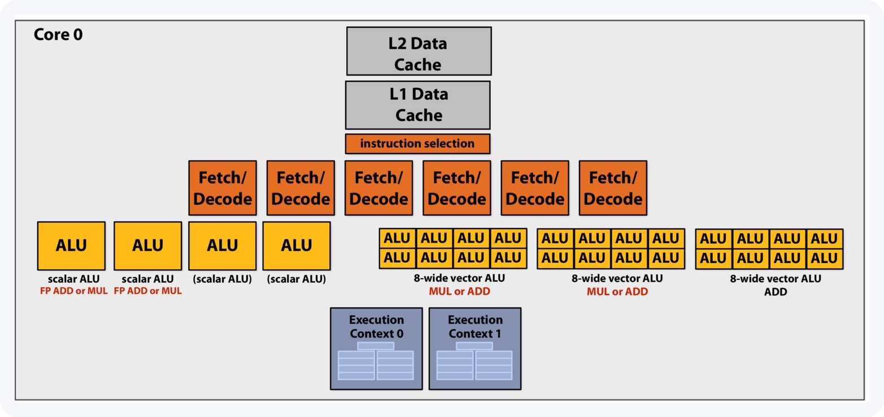
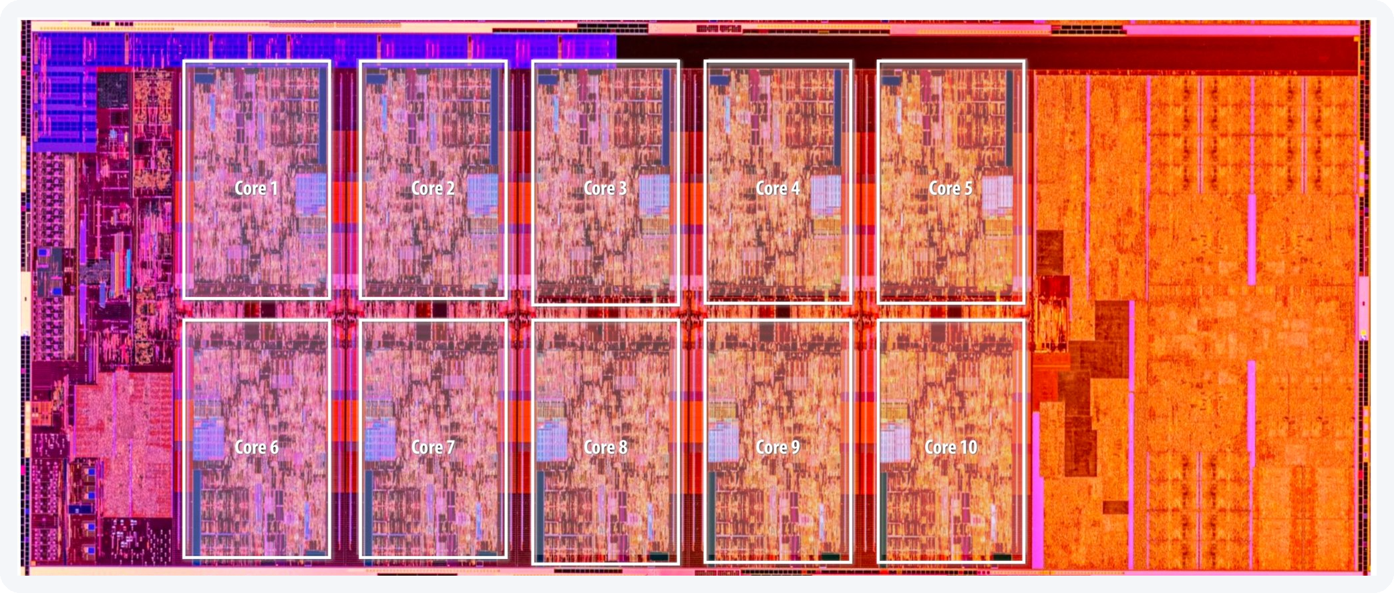
THE MACHINE WE ARE STARTING FROM
CPU: latency-oriented, built to finish one thread fast
PC-MOENCH-04 · AMD RYZEN 9 7950X
CORES × SMT
16 × 2
CPU, 1 THREAD
1.75 ms
CPU MT, 24 THREADS
148 µs
Count the boxes: 6 fetch/decode, out-of-order instruction selection, two levels of private cache, all of it to keep two instruction streams fed. The ALUs are the small part.
THAT IS THE BAR
6 762 frames / s
Thread count is swept per cluster size, not assumed: 24 at 3×3, 32 at 9×9.
Comet Lake · 10 cores boxed; nearly half the die is cache and I/O.
Both diagrams after Stanford CS149, Fall 2025.
5 / 33
Notes:
The CPU slide. The point is not that CPUs are bad -- it is what the
silicon is SPENT on.
On the diagram: Intel Skylake is shown, one core, schematically. The Zen 4 core
in this machine differs in detail -- 4 FP pipes rather than 3, AVX-512
double-pumped on 256-bit datapaths -- but not in kind: ~6-wide front end, 4
scalar ALUs, 2 SMT contexts, private L1 + L2. Load/store units are not drawn.
On the die photo: Comet Lake, a 10-core Core i9, at the same scale of argument
as the AD102 die on the next slide. Ten cores, and they do not fill the die --
the orange slab on the right is L3 and the block on the left is I/O and the
memory controller. If someone asks why a 16-core Ryzen is not simply 16x a
1-core Ryzen, that picture is the answer.
Six fetch/decode units, an out-of-order instruction selector, branch prediction
(not even drawn), L1 + L2 private cache: all of that machinery exists to find
independent work INSIDE one instruction stream, and to hide memory latency
behind a cache. It is the right design when you have a few threads that must
each finish fast.
Our problem has the opposite shape: 160 000 work items that are already
independent. We do not need a machine to FIND the parallelism -- it is handed to
us. Every transistor spent looking for it is a transistor not doing arithmetic.
On the thread sweep: 6 762 FPS is the best of a measured sweep (perf/cpu_threads.py),
not a default. 48 threads on 16 cores is 24 % SLOWER than 24 -- worth saying out
loud, because an oversubscribed baseline is the easiest way to inflate a GPU
speedup without lying about anything.

Slide 7
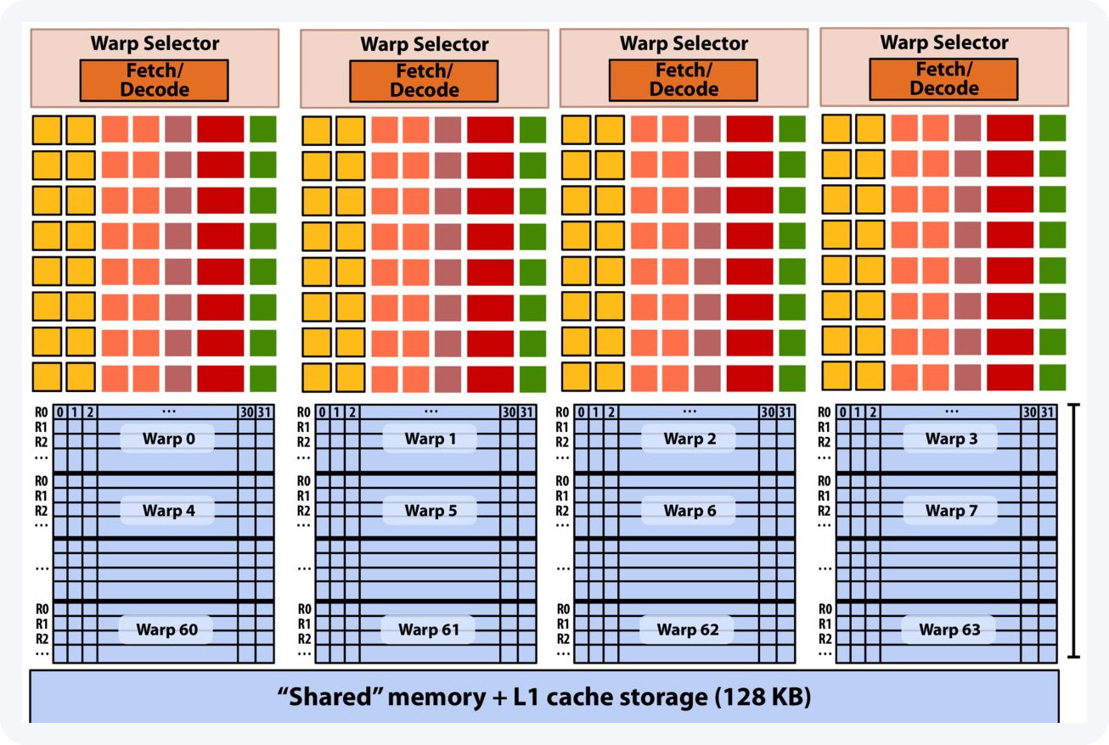
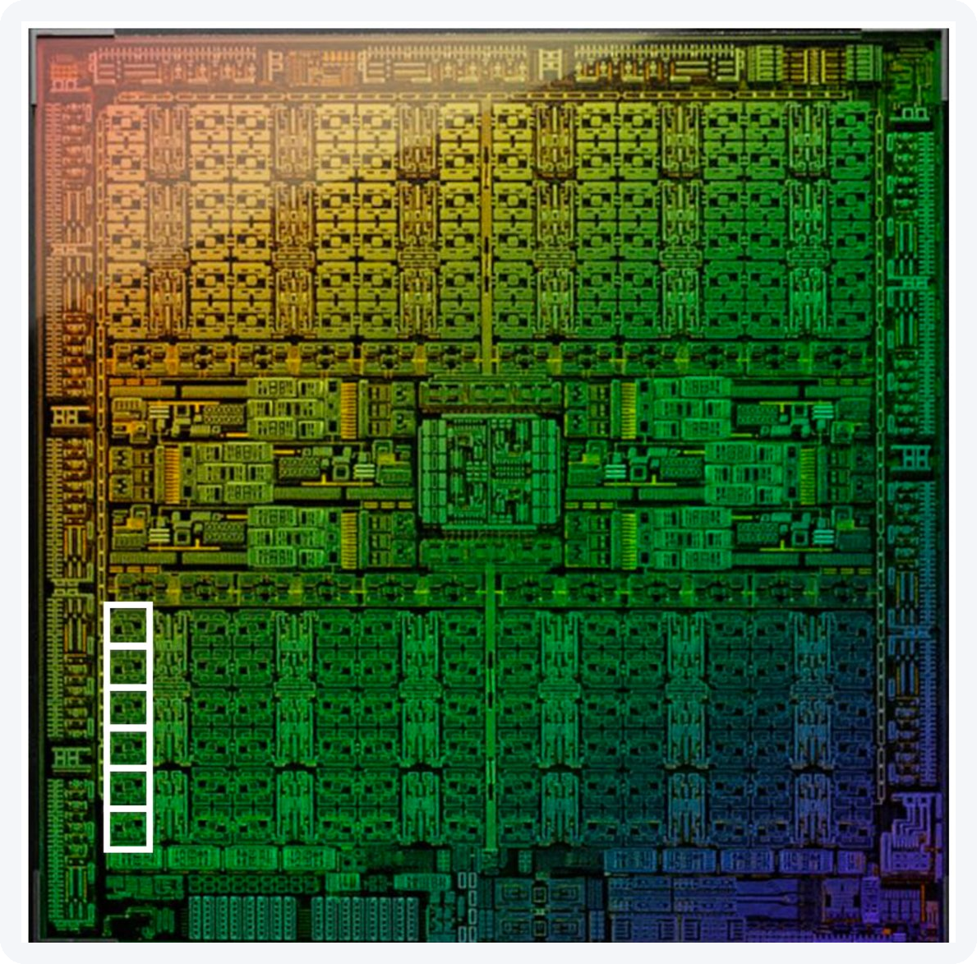
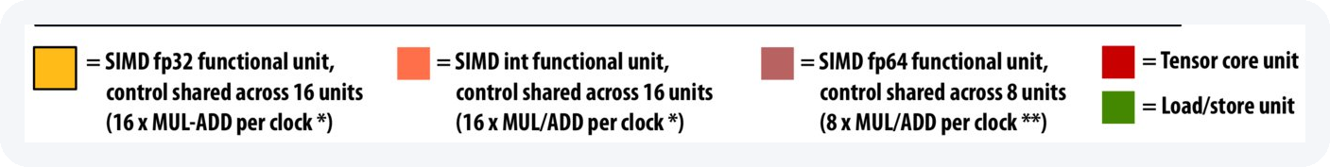
THE MACHINE WE ARE MOVING TO
GPU: throughput-oriented, the whole frame at once
NVIDIA GEFORCE RTX 4090
FP32 LANES
16 384
128 SMS × 128 LANES
vs 32 CPU streams
RESIDENT THREAD SLOTS
196 608
AD102 · 144 blocks, 128 enabled on this card. One SM boxed.
THE FRAME NEEDS
160 000 → all at once
Same grammar, inverted proportions: 4 fetch/decode for 64 warp contexts and a wall of lanes. Nothing reorders instructions: when a warp stalls on memory, the selector just runs a different one.
Device memory runs at 1 008 GB/s (384-bit, 21 Gbps); PCIe delivers 25. Two copy engines, so H2D and D2H run at the same time.
One SM: a V100 is shown; this card's is the same idea — 128 FP32 lanes, 48 warp slots, 100 kB shared memory. After Stanford CS149, Fall 2025.
6 / 33
Notes:
The GPU slide, and the number to land.
128 SMs x 1 536 threads = 196 608 thread slots that can be RESIDENT at the same
time. Our frame is 160 000 pixels. The entire frame fits in the machine at once,
one thread per pixel, with room left over -- which is why slide 7's "one thread
per pixel" is not a figure of speech, and why slide 10 can talk about occupancy
as a real quantity (3x3 achieves 100 %: 1 536 threads resident per SM).
Latency hiding, in one sentence: the CPU hides memory latency with a cache and
out-of-order execution; the GPU hides it by having 48 other warps ready to run.
That is why there is no reorder buffer on this diagram and no branch predictor.
Count the pink cells in the legend before moving on: FP64 units are a small
minority of the SM, 8 MUL/ADD per clock against 16 for fp32 and 16 for int. On
a GeForce part the ratio is far worse than this V100 diagram suggests -- 1/64.
That is half of why opt7 pays, and it is worth planting here so opt7 lands as a
consequence rather than a surprise.
The trap to pre-empt: 16 384 lanes vs 32 streams is a factor of 512, and we
measure x9.1. Say so before someone else does. We are not lane-limited; we are
BANDWIDTH-limited -- 1 TB/s of device memory, and 25 GB/s of PCIe to reach it.
That gap between 512 and 9 IS the talk.

Slide 8
THE CUDA KERNEL · EXECUTION MODEL
One thread per pixel
1 load tile + halo
›
2 __syncthreads
›
3 stencil reduction
›
4 classify
›
5 append or update pedestal
• A 16×16 block = 256 threads covers 256 pixels; the grid tiles the whole 400×400 frame. Cluster geometry is a template parameter, so the stencil is fully unrolled at compile time.
• The output is sparse: only detections touch global memory, through one atomic bump of a per-frame counter. The decision work is dense: every pixel is tested, independently and identically.
• That is exactly the shape a GPU wants: regular, independent, repeated 160 000 times per frame.
THREE OUTCOMES, NOT TWO
// ClusterFinder.hpp — the serial CPU
if (max > nSigma * rms) {
if (value < max)
continue; // Not max go to the
// next pixel — but
// also no pedestal
// update
} else {
pedestal.push_fast(iy, ix, ...);
}
LAUNCH CONFIGURATION · ClusterFinderCUDA.hpp
block = dim3(BLOCK_X, BLOCK_Y); // 16 x 16
grid = dim3((ncols + BLOCK_X - 1)/BLOCK_X,
(nrows + BLOCK_Y - 1)/BLOCK_Y);
device::find_clusters_in_single_frame<<<grid, block, shmem, stream>>>(
d_frame, d_pd_mean, d_pd_sum, d_pd_sum2, d_pd_off, n_pd_samples,
nSigma, nrows, ncols, d_clusters, d_cluster_count, max_clusters);
That comment is verbatim from the CPU source. A pixel in a photon's shadow is neither recorded nor fed back, and the CUDA kernel reproduces it exactly.
400×400 pixels → a 25×25 grid of 16×16 blocks = 625 blocks per frame, handed to 128 SMs. Nothing about the launch depends on how many clusters the frame happens to contain, which is what makes the work uniform.
~80 % of threads update the pedestal: every pixel with no photon in its window. ~1.5 % are peaks, ~18 % are shadow. The update, not the cluster write, dominates.
7 / 33

Slide 9
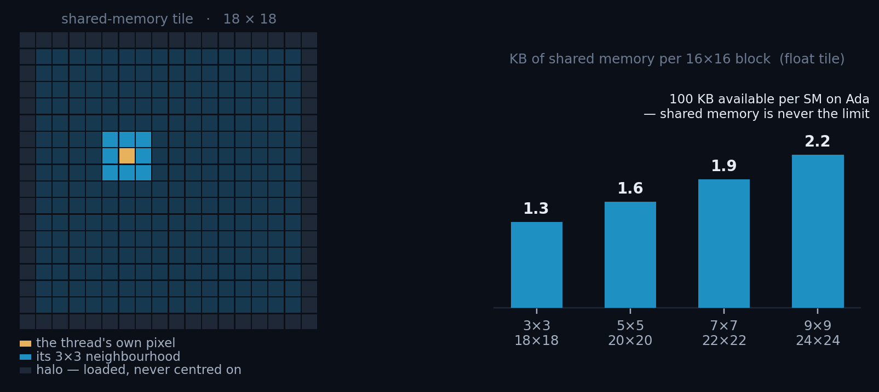
THE CUDA KERNEL · SHARED MEMORY
Load the tile once, reuse it nine times
• Neighbouring threads need overlapping 3×3 windows. Without shared memory each pixel would be fetched from global memory up to nine times.
• Each block stages a tile of (16 + 2r) × (16 + 2r) pedestal-subtracted values, the halo is the price of the stencil, and it is loaded cooperatively by the threads on the block edges.
clusterfinder_kernel.cuh
extern __shared__ unsigned char smem[];
auto *sh = (COMPUTE_TYPE*)smem;
auto stride = blockDim.x + 2*col_radius;
auto tid = (threadIdx.y + row_radius)*stride
+ (threadIdx.x + col_radius);
// pedestal subtraction fused into the load
sh[tid] = d_frame[gid] - d_pd_mean[gid];
Only odd cluster sizes are supported (3×3, 5×5, 7×7, 9×9), so that the centre pixel is unique and local-maximum suppression is well defined.
The tile is stored in COMPUTE_TYPE (float), not in the pedestal type: 1.3 KB for 3×3, 2.3 KB for 9×9, against 100 KB of shared memory per SM. Even the old double-precision tile only reached 4.5 KB.
Halo cost falls with block size: 56 % of the tile at 8×8, 27 % at 16×16, 13 % at 32×32, which is the first half of the block-size argument. The second half is registers, next slide.
8 / 33

Slide 10
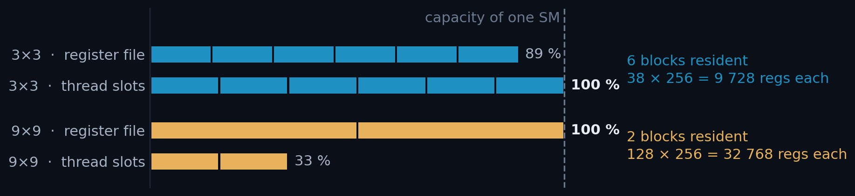
HARDWARE · WHAT RUNS OUT FIRST
38 registers per thread at 3×3, 128 at 9×9
• An SM has a fixed budget: 65 536 registers and 1 536 thread slots. A 16×16 block claims 256 slots and 256 × (registers per thread), and whichever budget runs out first decides how many blocks fit on the SM at once.
• Every thread keeps a private clusterData[CSX × CSY] staging array, so register demand grows with the square of the cluster size. Neither build spills: ptxas would rather hold fewer blocks than go to local memory.
PER SM · SM_89 · F32 BUILD
3×3 · BLOCKS RESIDENT
6
9×9 · BLOCKS RESIDENT
2
SPILLS, EITHER CASE
0 bytes
3×3 ON THE F64 BUILD
At 9×9 the register file is exactly full at two blocks (2 × 128 × 256 = 65 536), so two thirds of the thread slots are stranded. At 3×3 the slots run out first and the registers still have room.
47 regs → 5 blocks
How many blocks fit is the whole hardware story. The next slide is what that buys.
MEASURED, NOT ESTIMATED · READ FROM THE BUILT .SO
cuobjdump -res-usage build/aare/_aare_cuda*.so | c++filt
3x3: REG:38 STACK:0 LOCAL:0 # STACK/LOCAL 0 = no spills
9x9: REG:128 STACK:0 LOCAL:0
9 / 33
Notes:
The arithmetic, and the one build-dependent caveat.
One SM holds 65 536 registers and 1 536 thread slots. A 16x16 block is 256
threads, so a block costs regs_per_thread x 256 registers. At 3x3 that is 9 728,
six blocks fit, and the THREAD SLOTS run out first. At 9x9 it is 32 768, so two
blocks exactly fill the REGISTER FILE and strand two thirds of the slots. Same
kernel, same block size, opposite binding resource.
Build dependence of the register count itself: the f64 pedestal costs 3x3 nine
extra registers (47), which loses a block per SM. 9x9 is unmoved at 128 -- there
the limiter is the clusterData[9][9] staging array, not the pedestal, which is
why opt7 helps 3x3's occupancy and not 9x9's.
Reproduce blocks/SM at runtime with python/tests/perf/kernel_resources.py, which
calls cudaOccupancyMaxActiveBlocksPerMultiprocessor on the built kernel.

Slide 11
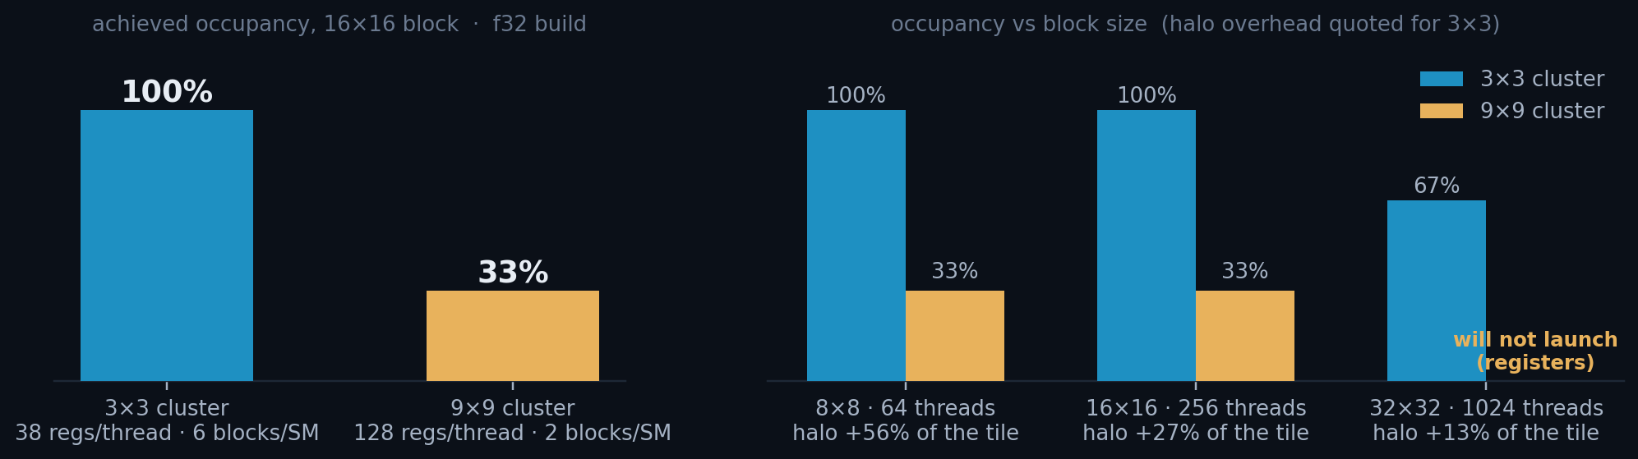
HARDWARE · OCCUPANCY
Occupancy is a latency-hiding budget
• When a warp stalls on memory the SM switches to another warp that is already resident. Occupancy = resident warps / the maximum the SM can hold: how many alternatives it has to switch to. More resident warps, more stalls hidden.
BLOCK SIZE
THREADS / BLOCK
THREAD SLOTS / SM
MAX WARPS / SM
OCCUPANCY 3×3 · 9×9
16 × 16
256
1 536
48
100 % · 33 %
16×16 is the balance point: enough threads to amortise the halo, few enough that 6 blocks still fit. But 33 % is not a failure to fix — it is what the register budget allows, and at 9×9 one kernel nearly fills the machine on its own.
10 / 33
Notes:
Why "33 % occupancy" is not the alarm it looks like.
Occupancy only buys latency hiding, and latency hiding only matters if there is
latency left unhidden. At 9x9 the kernel is long and each thread does a lot of
work per byte loaded, so 16 resident warps are enough to keep the SM fed.
It is also build-dependent, and that is the honest caveat. On the shipped f32
build the 9x9 kernel overlaps across four streams by only 1.02x -- extra streams
buy nothing in kernel concurrency. On the f64 build the kernel is 3.5x longer
and DOES overlap, 1.32x, and there four streams genuinely lower the floor. So
quote the overlap factor, never "occupancy is fine" on its own.
Shared memory never binds here: 1.3 KB per block at 3x3, 2.3 KB at 9x9, against
100 kB per SM.
Provenance for both hardware slides: shipped f32 build, measured not estimated.
cuobjdump -res-usage for registers and spills;
cudaOccupancyMaxActiveBlocksPerMultiprocessor for blocks per SM; RTX 4090
(sm_89). Reproduce with python/tests/perf/kernel_resources.py.

Slide 12
ROADMAP
Three acts, ordered by which bar is tallest
ACT I · FEED THE GPU
the host cannot submit work fast enough at 3×3 [f64]
opt1
First CUDA port
×2.34
1 stream, one launch per frame
opt2
Streams + batching
×3.66
4 streams, 2 000-frame batches
opt3
Pipeline rework
×4.32
sync barriers removed
opt4
Pinned memory
×5.69
DMA-speed host transfers
ACT II · GET THE RESULTS BACK
the host copy is now the tallest bar at 3×3 [f64]
opt5
Host↔GPU overlap
×7.45
chunked submit / collect
opt6
Zero-copy collection
×8.65
read in place, never copy
ACT III · THE KERNEL
the kernel is the tallest bar, at 9×9 at 9×9 [f32]
opt7
FP32 pedestal + variance rewrite
kernel −41%
the only kernel change in the deck
Speedups are 3×3 vs the best CPU configuration, 24 threads. Three routes were measured and rejected: CUDA Graphs, and two faster ways of copying the results. All three are in annex A2, because the rule that predicts the wins predicts the failures too.
11 / 33

Slide 13
ACT I OF III · FEED THE GPU
The host cannot submit work fast enough
COMING UP
12
opt1 · first port
The kernel was fast almost immediately. This act is about the host, and it is told at 3×3, where the wire is the floor.
13
opt2 · streams + batching
14
opt3 · no barriers
15
opt4 · pinned memory
STARTING FROM
6 762 FPS
24-thread CPU · 14.8 s for 100 000 frames

Slide 14
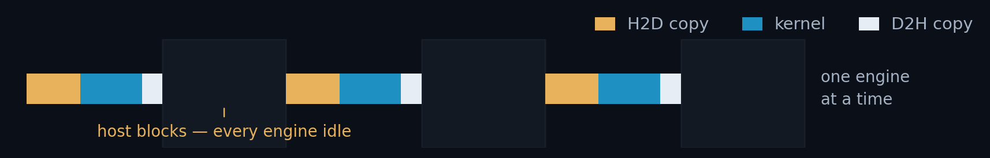
ACT I · OPT1 · THE FIRST CUDA PORT
The first port runs at 26 % of the GPU's floor
• Shared-memory tiling with halo loading for any cluster size; pedestal subtraction fused into the tile load.
• Cluster geometry is a compile-time template parameter → the 3×3 stencil is fully unrolled.
• One cudaMemcpy in, one kernel, one cudaMemcpy out; the host blocks on every frame.
OPT1 · 3×3 · 100 K FRAMES · F64
THROUGHPUT
15 807 FPS
ClusterFinderCUDAOpt2.hpp · find_clusters()
VS 24-THREAD CPU
// one frame at a time, the host waits at every step
cudaMemcpy(d_frame, h_frame, bytes, cudaMemcpyHostToDevice);
find_clusters_in_single_frame<ClusterType, FRAME_TYPE>
<<<grid, block, shmem>>>(d_frame, d_pd_mean, ...);
cudaMemcpy(h_out, d_out, out_bytes, cudaMemcpyDeviceToHost);
×2.34
PER FRAME
PCIe is full-duplex: H2D, kernel and D2H run on independent engines and overlap, so the floor — the fastest a frame can go if the host cost nothing — is max(H2D, kernel, D2H), never the sum. At 3×3 that is max(16.17, 15.17, 7.69) = 16.2 µs → 61 859 FPS. Exactly how each of those three is measured is slide 18; it does not change this one.
63.3 µs
THE GPU FLOOR
61 859 FPS
% OF FLOOR
26 %
12 / 33

Slide 15
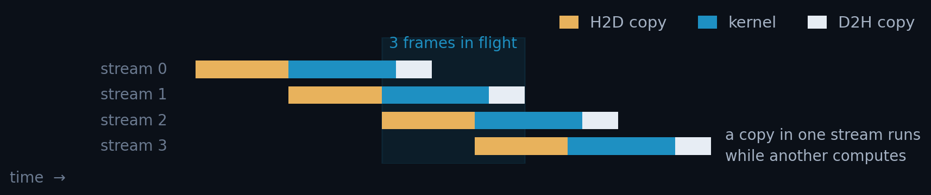
ACT I · OPT2 · STREAMS AND BATCHING
Four streams and 2 000-frame batches: ×1.56
• A stream is an ordered queue of GPU work. Work in different streams may overlap, so a copy can run while another stream computes.
• Each stream gets its own StreamContext: device frame buffer, output buffer and pedestal. Frames are handed out round-robin.
• The host now submits 2 000 frames per call instead of one.
OPT2 · 3×3 · 4 STREAMS · BATCH 2 000
THROUGHPUT
24 726 FPS
ClusterFinderCUDA.hpp · per-stream state
VS 24-THREAD CPU
struct StreamContext {
cudaStream_t stream;
FRAME_TYPE *d_frame; ClusterType *d_clusters;
PEDESTAL_TYPE *d_pd_mean, *d_pd_sum, *d_pd_sum2;
};
auto &sc = v_sc[frame_idx % n_streams]; // round-robin
×3.66
PER FRAME
40.4 µs
STEP GAIN OVER OPT1
×1.56
% OF FLOOR · 61 859 FPS
40 % (was 26)
Scaffolding, not yet the payoff. The streams exist, but the host still synchronises after every round: see opt3.
13 / 33

Slide 16
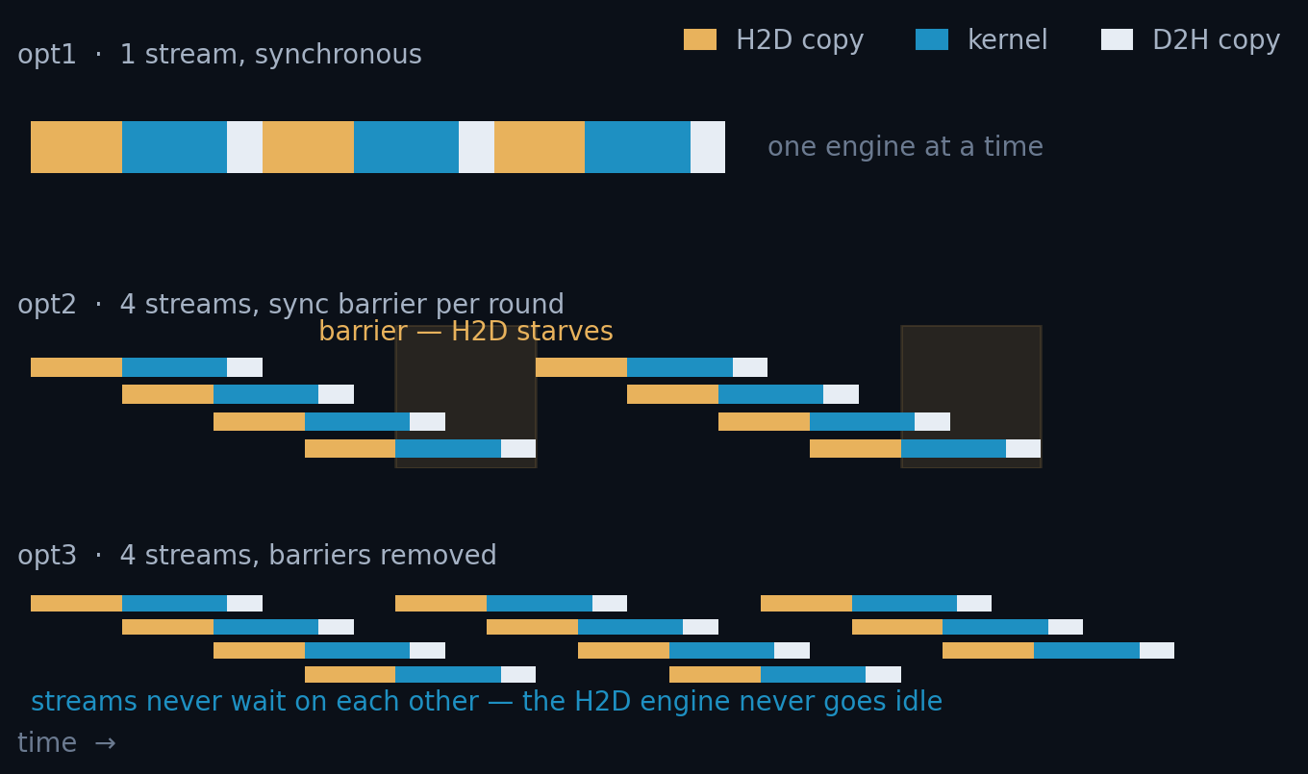
ACT I · OPT3 · REMOVE THE SYNC BARRIERS
One sync per batch, not one per round: ×1.18
• opt2 synchronised all streams after every round of n_streams frames. The GPU drained to empty each time.
• opt3 submits every frame's H2D → kernel → D2H asynchronously, then synchronises once at the end of the batch.
THE ONE-LINE IDEA
// opt2: barrier after every round
for (round) {
submit(n_streams frames);
cudaDeviceSynchronize();
}
// opt3: submit everything, sync once
for (frame : batch) {
cudaMemcpyAsync(..., sc.stream);
kernel<<<..., sc.stream>>>(...);
cudaMemcpyAsync(..., sc.stream);
}
for (sc : streams)
cudaStreamSynchronize(sc.stream);
29 188 FPS · ×4.32 34.3 µs/frame · 47 % of floor (was 40)
Each lane is one stream. Removing the barrier lets a stream start its next frame while its neighbours are still copying. The three panels are scheduled, not sketched: H2D and D2H are one FIFO engine each, so a stream waits for the copy engine, never for another stream's copy to finish overlapping it.
14 / 33

Slide 17
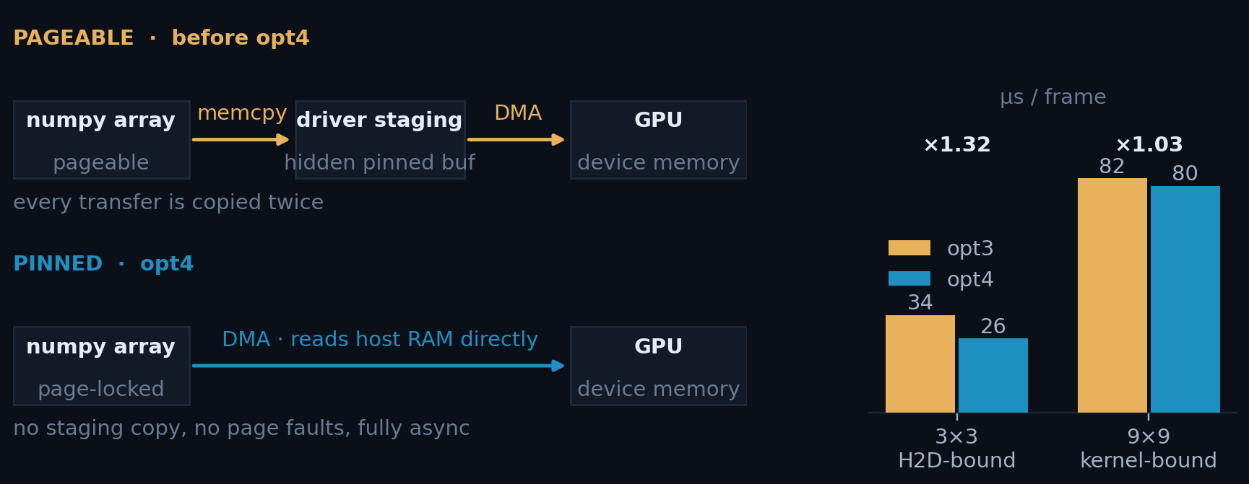
ACT I · OPT4 · PINNED (PAGE-LOCKED) MEMORY
Pinning the input buys DMA-speed H2D: ×1.32
• Normal host memory is pageable: the OS may move or swap it. A DMA engine cannot safely read that, so the driver first copies your data into a hidden pinned staging buffer. Every transfer is copied twice.
• Pinning locks the pages in physical RAM. The GPU's DMA engine then reads host memory directly, no staging copy, and the transfer can be truly asynchronous.
ClusterFinderCUDA.hpp
// pin the whole dataset once
cudaHostRegister(ptr, bytes,
cudaHostRegisterDefault);
// ... run the whole campaign ...
cudaHostUnregister(ptr);
38 486 FPS · ×5.69 26.0 µs/frame · 62 % of floor, the largest step in Act I
Measured H2D [s1, uncontended]: one 400×400 uint16 frame (312.5 KiB = 320 000 B) in 13.2 µs = 24.2 GB/s, 77 % of PCIe 4.0 ×16 theoretical, i.e. true DMA speed. In the shipped pipeline it reads 16.6 [s4], +26 % of H2D↔D2H contention (A1). Pageable staging runs ~15 GB/s.
The rule, first sighting: ×1.32 at 3×3 but only ×1.03 at 9×9. Pinning attacks H2D, the tallest bar at 3×3, the shortest at 9×9.
15 / 33

Slide 18
ACT II OF III · GET THE RESULTS BACK
The host copy is now the tallest bar
COMING UP
Frames go in at DMA speed. The results still come back slowly. Still 3×3, but 9×9 is where this act pays most.
16
opt5 · host↔GPU overlap
17
opt6 · zero-copy
ARRIVING AT
38 486 FPS
opt4 · 26.0 µs per frame · 62 % of the GPU floor

Slide 19
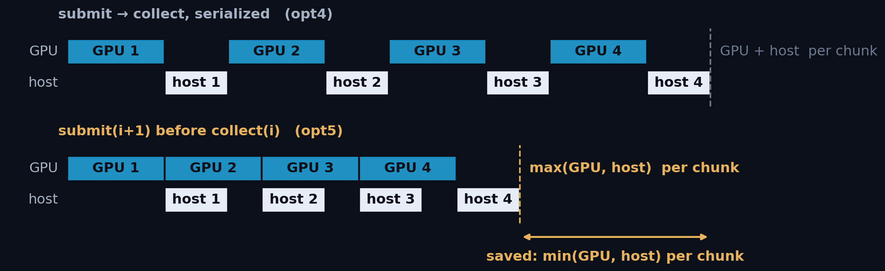
ACT II · OPT5 · HOST↔GPU OVERLAP
Overlapping host and GPU hides min(host, GPU): ×1.31
• opt3 overlapped H2D ∥ kernel ∥ D2H across streams, inside one batch, but never the host with the GPU: find_clusters_batched synchronised, then built thousands of ClusterVectors with the GPU idle.
• opt5 keeps one batch in flight while materialising the previous one: chunk i+1 is submitted before chunk i is collected.
OPT5 · 3×3 AND 9×9 · NO CUDA WORK AT ALL
3×3 THROUGHPUT
50 410 FPS
PER FRAME · STEP · OF FLOOR
19.8 µs · ×1.31 · 81 %
9×9 THROUGHPUT
15 063 FPS
PER FRAME · STEP · OF FLOOR
66.4 µs · ×1.20 · 45 %
The time hidden is min(GPU, host), so this pays most when the two are comparable, and cannot rescue a host term that is simply larger.
For clusters that must outlive the finder, this is the endpoint at 3×3: opt6 lends, it does not give.
16 / 33
Notes:
opt5 — host<->GPU overlap. Code and chunk sizing are on annex A3.
tok = cf.submit_batch(data[a0:b0], first_frame=a0)
for a, b in bounds[1:]:
nxt = cf.submit_batch(data[a:b], first_frame=a) # GPU starts N+1 ...
results.extend(cf.collect(tok)) # ... host unpacks N
tok = nxt
results.extend(cf.collect(tok)) # drain
1. This is now INTERNAL to find_clusters_batched(), so every caller gets it for
free. submit_batch/collect stay public for anyone who wants the token by hand.
2. The chunk size is rounded to a multiple of n_streams, because the device
pedestal is per-stream: an uneven chunk would advance the four stream
pedestals by different amounts and the finders would stop being comparable.
Why the gain differs by cluster size: the saving is min(GPU, host) per chunk, so
it is largest when the two terms are comparable. At 3x3 they nearly are (GPU
16.2 us, host ~9.8) and opt5 is worth x1.31. At 9x9 the host term is roughly
twice the GPU term, so overlap hides only the smaller one and opt5 is worth
x1.20 - which is exactly the diagnosis that motivates opt6: you cannot overlap
your way out of a host term that is simply larger. Report SS8.2.

Slide 20
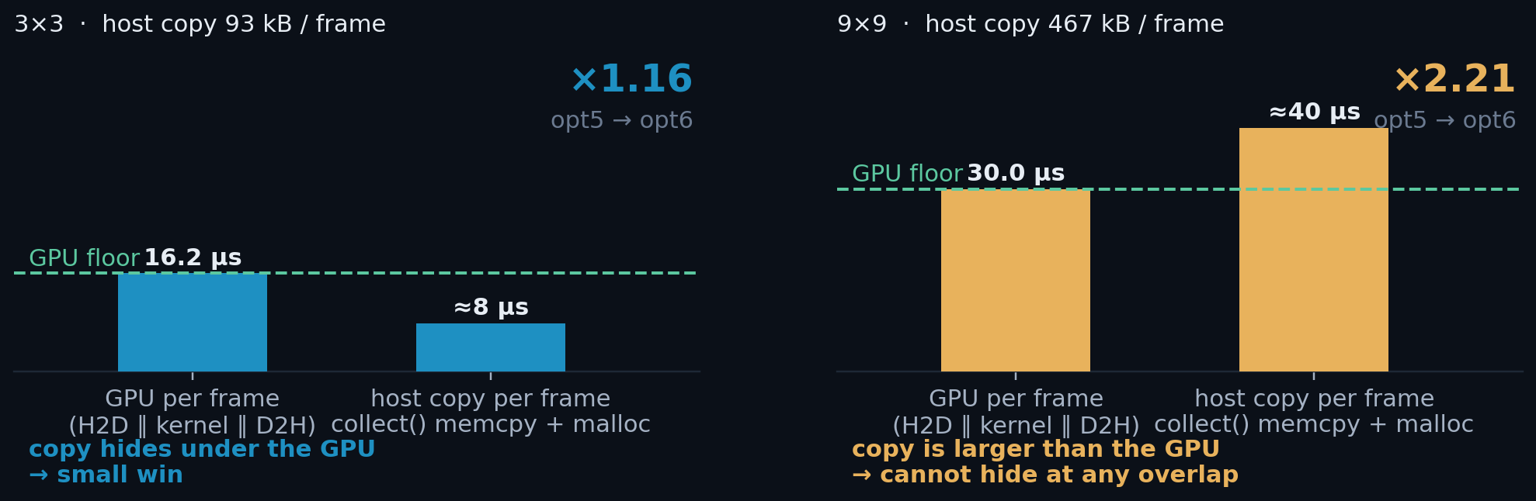
ACT II · OPT6 · ZERO-COPY COLLECTION
Read the results in place: ×2.21 at 9×9
• The D2H lands in a pinned host buffer. collect() then allocates one ClusterVector per frame and memcpys into it; at 9×9 that is 467 kB per frame, ~9.3 GB per run, single-threaded.
• collect_view() returns a BatchView: strided numpy views straight onto the pinned buffer. It withholds ownership past the chunk, not access, every cluster's payload and coordinates are readable.
OPT6 · 3×3 AND 9×9 · COLLECT_VIEW()
3×3 THROUGHPUT
58 495 FPS
PER FRAME · STEP · OF FLOOR
17.1 µs · ×1.16 · 95 %
9×9 THROUGHPUT
33 323 FPS
PER FRAME · STEP · OF FLOOR
30.0 µs · ×2.21 · 100 %
The win is max(0, host copy − GPU floor): at 3×3 the 8 µs copy hides under a 16.2 µs floor and opt5 had already absorbed most of it; at 9×9 the 40 µs copy is larger than the floor and cannot hide at any overlap.
opt5 → opt6: 19.8 → 17.1 and 66.4 → 30.0 µs, bit-identical, 0.2 % spread, zero warm faults. FLOOR = lower of the s4 engine max and the best sustained rate: at 3×3 the 16.17 µs max sets it; at 9×9 f64 the run BEATS the 32.66 µs max, so the 30.0 sustained sets it [A1].
The two bars are the competing costs, not the two steps; the step times are on the right.
17 / 33
Notes:
Where 93 kB and 467 kB come from: clusters/frame x sizeof(Cluster).
sizeof — Cluster.hpp:28 is two CoordType coords then std::array<T, X*Y> data.
CoordType=uint16, T=int32, alignof 4, so the coords pack with no padding:
3x3: 2x2 B + 9x4 B = 40 B
9x9: 2x2 B + 81x4 B = 328 B
clusters/frame — report section 13, the same counts used for correctness:
3x3: 233 094 390 / 100 000 fr = 2 330.9 /fr
9x9: 28 447 962 / 20 000 fr = 1 422.4 /fr
2 330.9 x 40 B = 93.2 kB/frame
1 422.4 x 328 B = 466.5 kB/frame -> x 20 000 fr = 9.33 GB/run
NOT the D2H transfer. D2H is fixed at cap x sizeof regardless of how many clusters
were found: at the 9x9 campaign cap of 1700 that is 1700 x 328 B = 558 kB every
frame, i.e. the 467 kB of real clusters is an 84 % fill (section 4.2). The 467 kB
is the HOST memcpy inside collect(), pinned buffer -> freshly allocated
ClusterVector. That is what collect_view() removes; the wire traffic is unchanged.
Report: section 12 (payload table), section 9.4 (materialize_slot), section 13.

Slide 21
ACT III OF III · THE KERNEL
Only now is the kernel the tallest bar
COMING UP
18
how the engine times are measured
The story moves to 9×9, where the kernel is finally the tallest bar. First, how the engine times in this act are measured.
19
opt7 · FP32 pedestal
20
catastrophic cancellation
21
why it comes last
ARRIVING AT
58 495 FPS
opt6 · 3×3, and 33 323 FPS at 9×9, where this act pays

Slide 22
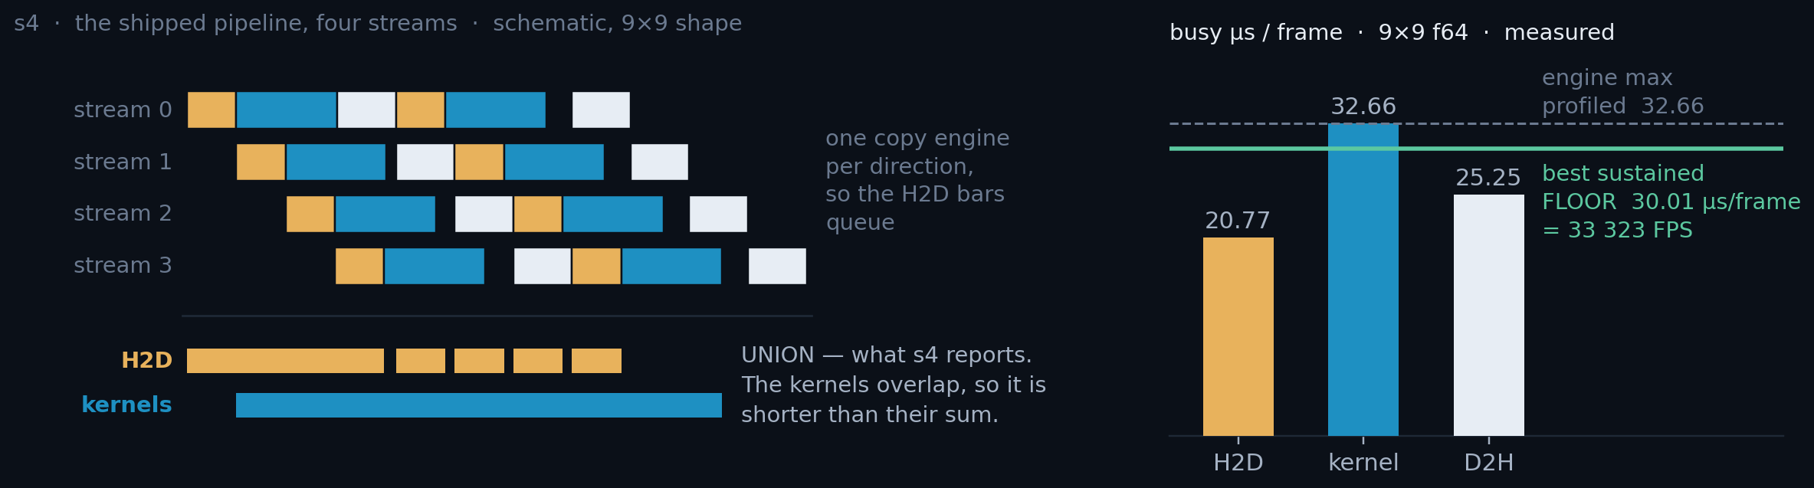
HOW THE ENGINE TIMES ARE MEASURED
Two configurations, one floor
s1
s4
floor
One stream, nothing else running
The shipped pipeline, four streams
Set by the busiest engine
How long an operation actually takes. The right number for a capability claim, and for the headroom that is left.
How BUSY each engine is per frame: the union of its intervals, which is not the sum of the durations. The only number that can set a floor.
The fastest a frame could go if the host cost nothing. In µs per frame, or its reciprocal in FPS. The LOWER of the profiled estimate and the best rate sustained.
Nothing that measures a duration falls under load — yet the 9×9 kernel row falls 39.9 → 32.7 µs from s1 to s4. That is the tell: s4 is occupancy, not duration. The floor is quoted both ways in this deck — 30.01 µs per frame is 33 323 FPS. Full engine grid: annex A1.
18 / 33
Notes:
Say the floor out loud, in this order.
1. There are three engines and they are independent: the H2D copy engine, the
SMs, and the D2H copy engine. PCIe is full duplex, so a frame's cost is
never the sum of the three -- it is the slowest of them.
2. There is exactly ONE copy engine per direction. So two H2D copies can never
run at the same time; they queue. That is not a modelling assumption, it is
measured: H2D_overlap and D2H_overlap are 1.000 in every row of probes.csv.
Kernels are the only row that ever overlaps.
3. That is why s4 is a UNION, not a sum. Four kernels, each 43.2 us long, but
the SMs are busy only 32.66 us per frame: overlap factor 1.32x.
4. On units, because the card says "1 / the busiest engine" and the axis says
microseconds: they are the same number. The busiest engine's busy time per
frame is in us/frame; one divided by it is frames per second. 30.01 us/frame
IS 33 323 FPS. The deck quotes whichever reads better in context -- us/frame
when comparing engines, FPS when comparing against the CPU or the detector --
and "% of floor" is the same ratio either way.
5. The floor is max(H2D, kernel, D2H) at s4. At 9x9 f64 that max is 32.66 us
= 30 618 FPS. But the unprofiled pipeline actually sustained 30.01 us/frame,
which is FASTER than the probe says is possible -- because under nsys
submission is sparser, kernels overlap less, and a less-overlapped interval
set has a LARGER union. A sustained rate is an existence proof; a probe is an
estimate. So the floor is the lower of the two, and the 1.32x is a lower
bound on the real overlap.
If time is short, say only: "s1 is how long it takes, s4 is how busy it is, and
the floor is the busiest engine." The rest is in A1.

Slide 23
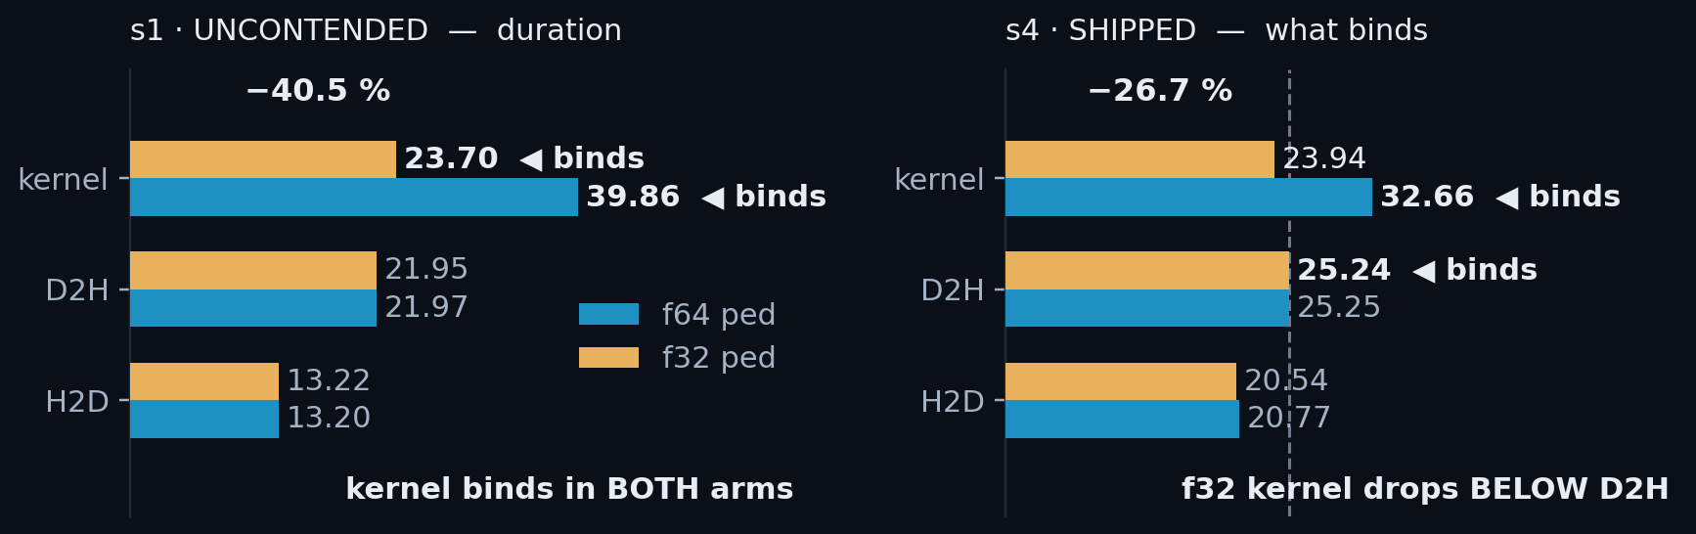
ACT III · OPT7 · FP32 DEVICE PEDESTAL
FP32 halves pedestal traffic: −41 % kernel time
• ~80 % of pixels take the pedestal-update branch: it reads off, sum and sum², and writes back sum, sum² and mean. All four pedestal arrays are DEVICE_PED_TYPE, so one typedef halves all six accesses: 48 bytes per updating pixel in FP64, 24 in FP32.
• The kernel is bandwidth-bound, so halving that traffic nearly halves the time. On a GeForce part there is a second effect: FP64 arithmetic runs at 1/64 of FP32, and the pedestal update was paying that tax on every pixel.
• Quietly, a third: the narrower accumulators free 9 registers at 3×3, 47 → 38, which buys back a block per SM.
ONE TYPEDEF
// clusterfinder_kernel.cuh
using COMPUTE_TYPE = float;
using DEVICE_PED_TYPE = float;
// was: double
Kernel, 9×9 [s1 · cap 1700] 39.86 → 23.70 µs (−40.5 %) Shipped [s4]: 30.0 → 25.1 µs end to end.
Naive FP32 is wrong (next slide), and even when correct it only pays because Act II came first.
At 3×3 the same typedef is worth −70.6 % (14.72 → 4.32 µs [s1]) yet buys only 4.6 % end to end: there the kernel was never the tallest bar.
Both builds, same git rev, 20 000 frames. Full engine grid: A1.
19 / 33
Notes:
Reading the two panels, and the number to quote.
Left is s1: one stream, nothing else running, so those are true durations. The
kernel binds in BOTH arms there -- 39.86 and 23.70 against a D2H of ~21.95 -- so
s1 alone would say the kernel is the thing to optimise and stop there.
Right is s4, the shipped four-stream pipeline, and it says something different:
the f64 kernel's busy time falls to 32.66 (self-overlap, 1.32x) while every
transfer RISES under contention, and once opt7 puts the kernel at 23.94 the D2H
bar at 25.24 is above it. That is the handover slide 21 is about.
So: -40.5 % is the s1 kernel claim and is the honest headline for what the
typedef does to the arithmetic. -26.7 % is the same change measured at s4, where
self-overlap had already hidden part of the win. Both are true, they measure
different things, and the previous slide is the rule for which to quote.
The 3x3 occupancy effect is real but not worth stage time: 47 registers -> 38
takes 3x3 from five blocks per SM to six, 83 % -> 100 % occupancy. It changes
nothing end to end, because at 3x3 H2D is the floor.

Slide 24
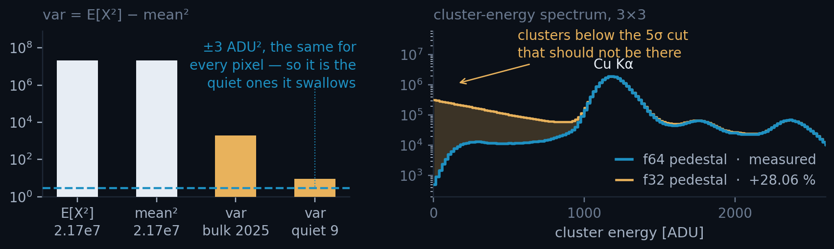
ACT III · OPT7 · CATASTROPHIC CANCELLATION
Accumulate what is small, not what is large
• The trap. The variance was computed as var = E[X²] − mean². With a pedestal at ~4 655 ADU both operands are ≈ 2.17 × 10⁷ while the answer is ≈ 2 000. FP32 carries ~7 digits, so the answer inherits an absolute error of ±3 ADU², which does not shrink as the answer does.
• What it cost. For a quiet pixel whose true variance is 9, ±3 is a third of it; below rms ≈ 2 the variance goes negative, the rms clamps to zero, and its 5σ gate becomes a 0σ gate. ~1–2 % of the sensor then fires every frame: +28.06 % clusters and a population of clusters below the physical threshold.
• The fix. Freeze X₀ = round(mean) once at the end of pedestal training and accumulate the centred value Y = X − X₀. Both operands become O(rms) and the cancellation is gone.
NAIVE F32 · WHAT IT DID
EXTRA CLUSTERS
+28.06 %
PIXELS AFFECTED
~1–2 % of the sensor
AFTER THE REWRITE
F32 VS F64 COUNTS
3 × 10⁻⁷
VS THE CPU BASELINE
0.0039 %
Left: the two operands and the answer, log scale, against the ±3 ADU² error. Right: the f64 curve is measured (23.2 M clusters); the f32 curve is reconstructed — measured area, modelled shape, method in the notes. The two-line patch itself is in annex A5.
X₀ must never be updated: the accumulators are defined relative to it.
20 / 33
Notes:
The one sentence to leave the room with.
"Precision is relative." A float resolves small numbers finely and large numbers
coarsely, so a small answer must never be computed as the difference of two
large numbers. That is the transferable lesson; everything else on this slide is
this detector's instance of it.
Why the tail matters more than the count. +28 % is a number you might argue
about. A spectrum with a population sitting below the 5 sigma cut is not
arguable: those clusters cannot physically be there, and any gain or resolution
fit done on that spectrum is wrong.
Honesty about the right-hand panel: nobody kept the broken build around to
re-run, so the f32 curve is reconstructed. What is measured is the f64 curve and
the +28.06 % excess (CPU 116 010 113 vs CUDA 148 559 598, SS1 of the write-up).
The placement follows SS9: a correct 5 sigma gate cuts at ~225 ADU, a collapsed
gate admits the whole positive side of the pixel's distribution, so the excess
is smeared upward from zero. The write-up's TL;DR calls it a high-energy tail;
SS9 derives it from ~0 upward. Both describe the same corrupted pixels.
Welford's online variance is the other correct answer and is mentioned in the
write-up. The frozen-offset form was chosen because it is two lines and does not
change the update's arithmetic cost.

Slide 25
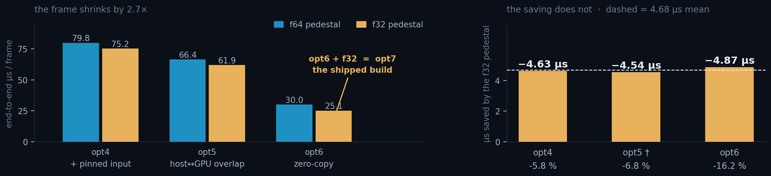
ACT III · WHY THIS ACT COMES LAST
The saving never grew — the frame around it shrank
The same typedef saves −4.63 µs at opt4 and −4.87 µs at opt6: the two readings whose fault counts match. What changes is the denominator: the frame falls 79.8 → 30.0 µs, so an identical saving reads −5.8 %, then −16.2 %. Act II did not make the kernel win bigger; it made it separable.
And the act ends by handing the floor away. At s4, the config that ships, the f64 arm is kernel-bound: 32.66 against a 25.25 µs D2H. The typedef puts the kernel at 23.94, below a D2H that never moved. The constraint is now the result path, not the arithmetic. [engines: 19/33]
9×9 · 20 000 frames · 4 streams · cap 1 700 · warm · both arms at the same git rev. opt3 is excluded: its two arms sat in different allocator states, so that comparison does not report the typedef at all. † opt5's arms differ the same way; its reading agrees with the other two but is not independently attributable. Both are worked through in annex A4. The f32 bar at opt6 is opt7, the shipped build; the f32 bars at opt4 and opt5 are the same typedef applied at earlier steps, configurations that exist only to make this comparison controlled.
21 / 33

Slide 26
RESULTS · WHAT CAME OUT OF IT
The whole ladder, and how to use it
COMING UP
22–23
Results, both cluster sizes
Both cluster sizes end to end, and the audit behind the numbers.
24
Where the time went
25–26
What the numbers survived
ARRIVING AT
58 495 FPS
opt6 · everything after this is the ladder seen whole

Slide 27
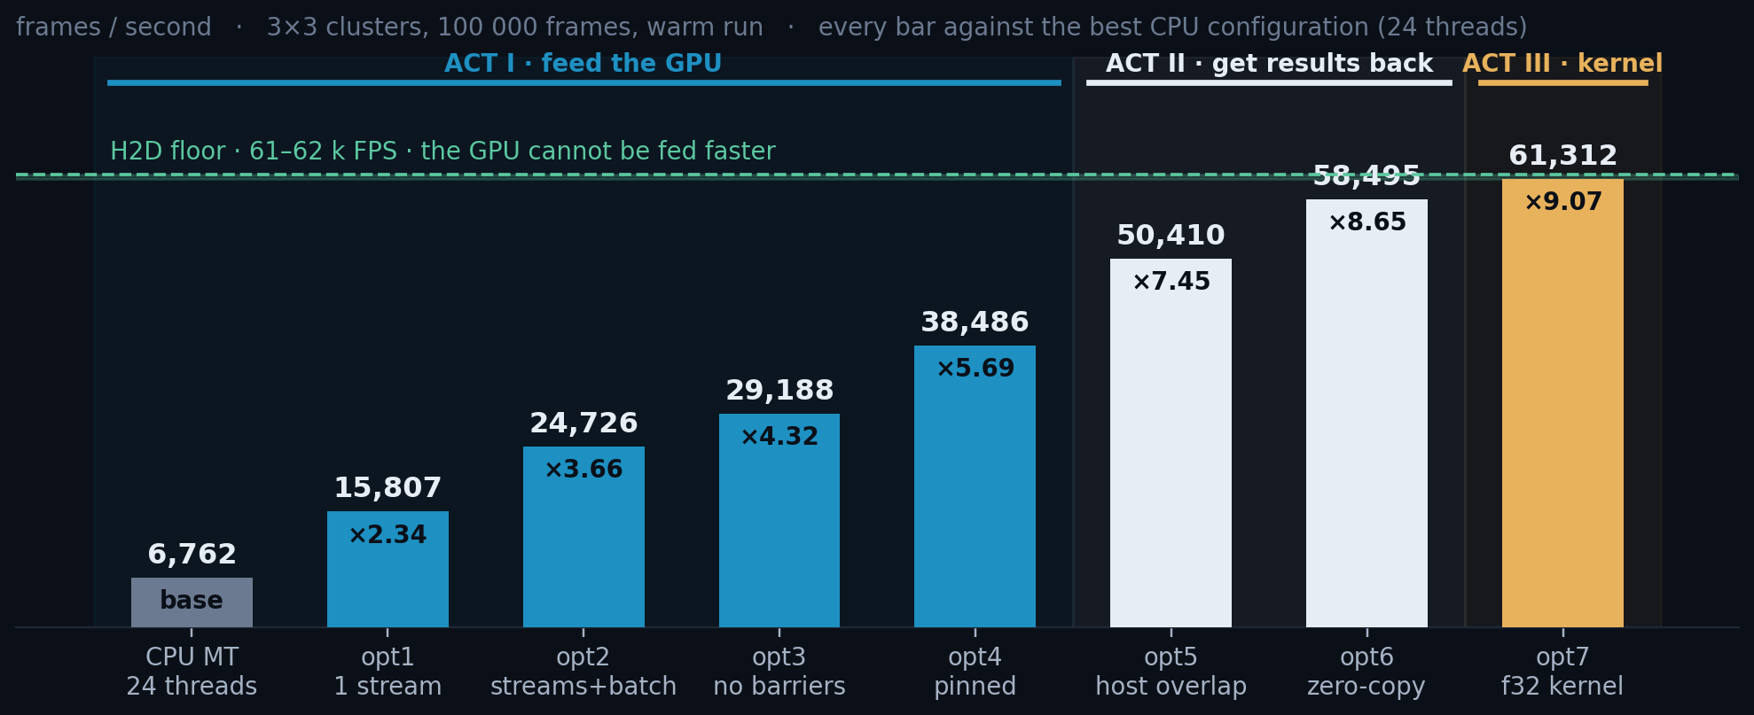
RESULTS · 3×3
×9.1 at 3×3, sitting on the H2D floor
×9.1 over 24 CPU threads, 14.8 s → 1.63 s for 100 000 frames, and at the H2D floor.
Every step is monotonic, and correctness is held constant throughout: 0.004 % against the CPU baseline; against the CPU twin that isolates the port, exact on the f64 pedestal and 6 clusters in 23 M on the shipped f32 (slides 27–30).
3×3 clusters · nσ = 5 · 100 000 frames · batch 2 000 · 4 streams · 5 reps · warm = best of reps 1–4 (collect() does not converge, it oscillates between allocator states) · each step in its own process · CPU baseline = ClusterFinderMT at its best thread count, 24 here, first pass only.
22 / 33

Slide 28
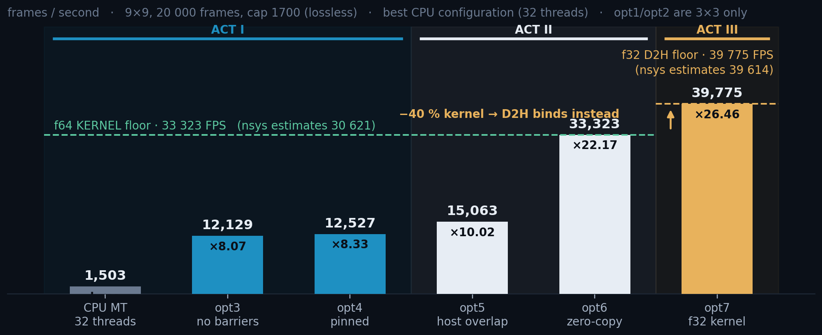
RESULTS · 9×9
×26.5 at 9×9, and opt7 hands the floor to D2H
×26.5 over 32 CPU threads; the kernel is the tallest bar for the whole f64 arm, and opt7's −40 % drops it below D2H.
opt4 buys ×1.03 here and ×1.32 at 3×3. Same code, opposite regimes, the rule, twice.
9×9 · cap 1 700 (lossless; 1 500 truncated 0.0095 % of clusters) · 20 000 frames · opt1/opt2 are 3×3-only · CPU baseline ClusterFinderMT at 32 threads. The floor is the lower of the nsys estimate and the best sustained rate; both arms are sustained-bound, corroborated to 8.8 % (f64) and 0.4 % (f32). Why the arms differ: 544.5 kB of D2H costs 25.2 µs on both [s4], hidden under the 32.7 µs f64 kernel, not under the 23.9 µs f32 one.
23 / 33

Slide 29
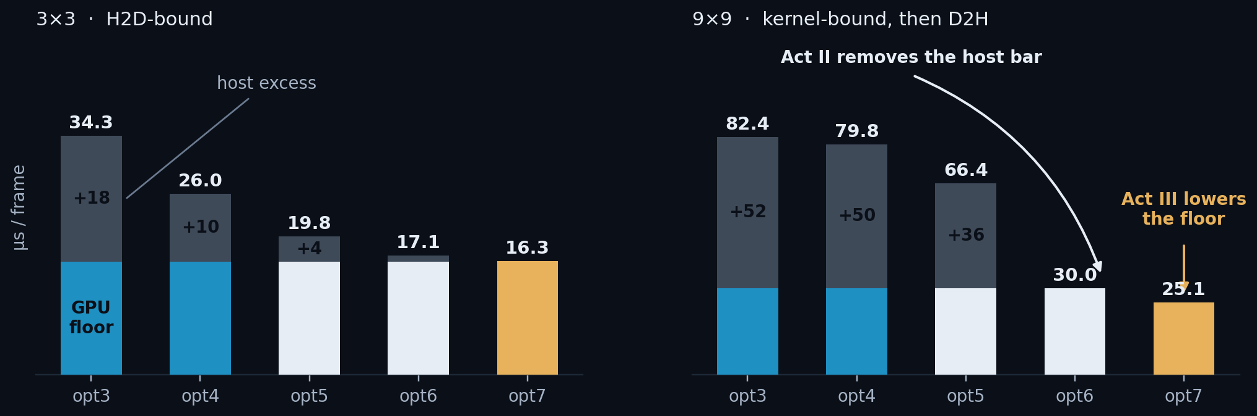
WHERE THE TIME ACTUALLY WENT
The host bar dies first, then the floor itself drops
Acts I and II never touch the arithmetic. The GPU floor is a flat 16.2 µs at 3×3 / 30.0 µs at 9×9; what collapses is everything stacked on it.
Act III is the only step that lowers the floor itself, and it could not have been seen until the stack above it was gone.
Blue/white/amber = the GPU floor for that act's build: the LOWER of the s4 engine max (max of H2D, kernel, D2H; PCIe is full duplex, so never the sum) and the best sustained rate. At 3×3 the engine max sets it, 16.17 µs; at 9×9 f64 the sustained rate does, 30.01 against a 32.66 µs max. Grey = everything the host adds on top. At 9×9 the host contributes +50 µs at opt3 and nothing at opt6.
24 / 33

Slide 30
BEHIND THE NUMBERS · THE ARTEFACT THAT DOMINATES
A GPU benchmark mostly measures the operating system
• Every run that keeps its results materialises ~10 GB of clusters. The first pass faults in ~2.6 M pages, and each fault costs the kernel a page it must find and zero before the write can proceed.
• At 0.7 µs a fault, that is up to 4 seconds of pure OS work inside the timer — on a run whose GPU work is under 2 seconds. Nothing about the GPU changed; kernel time is constant across every one of these runs. Nor is it a warm-up you can wave away: it is what a user's first run looks like, which is the next slide.
ONE 100 000-FRAME PASS · 9×9
PAGES FAULTED IN
~2.6 M
COST INSIDE THE TIMER
up to 4 s
THE PROTOCOL · python/tests/ClusterFinderCUDA_perf.ipynb
# every timed cell in the benchmark notebook is bracketed with:
mf0 = resource.getrusage(resource.RUSAGE_SELF).ru_minflt
... t = time.perf_counter() - t0 ...
print(f'minor faults: {mf1-mf0:,}') # quote the run where this plateaus
COST PER FAULT, FITTED
0.68 µs
The protocol: re-run until getrusage() minor faults plateau (< 200 k), and quote that run. Validated: wall = steady-state + faults × 0.68 µs reproduced a 6.110 s run to within 1 ms.
MAJOR FAULTS, ALL CAMPAIGN
0
No disk is involved. A minor fault is the kernel finding a physical page and zeroing it, which is mandatory and cannot be avoided by copying faster. Only by not allocating, which is opt6.
Two instrument caveats, named and then set aside. Under nsys, host-side CUDA API calls read ~4× high and wall time inflates with them, so every wall time in this deck comes from an unprofiled run and only GPU-side timestamps come from nsys. CUDA events measure a stream, not a kernel. Both worked through in A6.
25 / 33

Slide 31
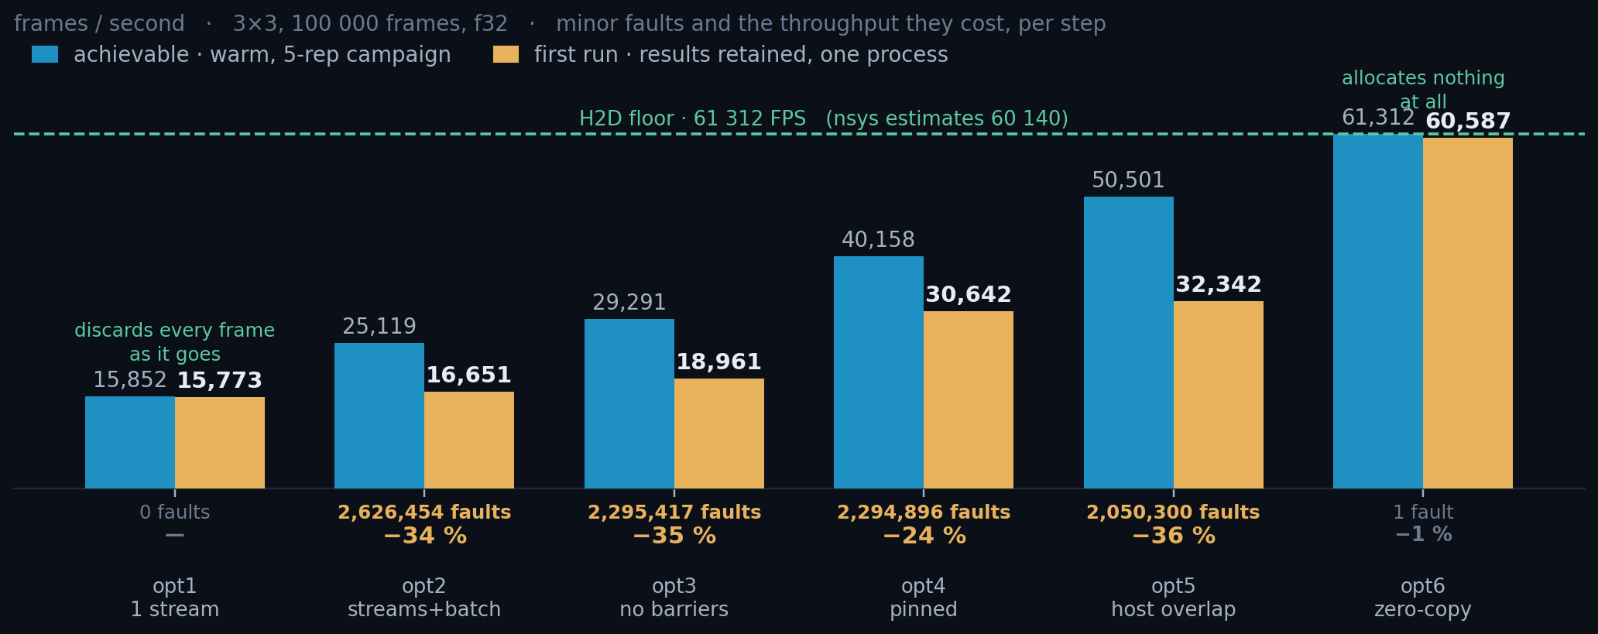
BEHIND THE NUMBERS · WHAT A USER ACTUALLY GETS
A first run loses a third of its throughput to page faults
Everything that materialises clusters loses a third of its throughput on the first run, +7 to +20 µs per frame, depending on how much of it the GPU can hide behind its own work.
Only the two ends escape, for opposite reasons. opt1 never grows the heap: it discards each frame. opt6 never needs one, and reaches 98 % of its peak on a cold process.
Single pass, one process, every ClusterVector retained, python/tests/ClusterFinderCUDA_perf.ipynb, f32, the same 100 000 frames. Not the campaign's "cold" rep, which discards results and so never grows the heap. Repeat the run and the amber bars climb onto the blue ones; opt1 and opt6 never move, because neither ever paid.
26 / 33

Slide 32
VALIDATION · DOES IT FIND THE SAME PHOTONS
Every number so far assumed the answers are identical
COMING UP
27–28
The fair comparison
Whether the CUDA finder returns the same clusters as the CPU.
29–30
The residual, dissected
31–32
For users
33
What is next
ESTABLISHED
×9.1 and ×26.5
on the hardware floor at both cluster sizes, if the physics holds

Slide 33
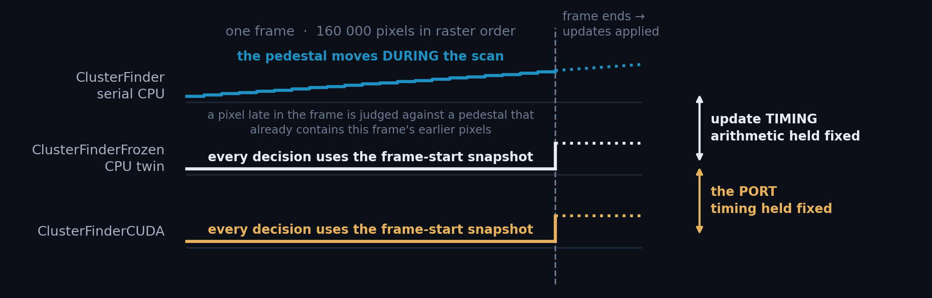
VALIDATION · WHY A CPU TWIN WAS NEEDED
CPU and CUDA update the pedestal at different moments
The serial CPU finder updates the pedestal as the raster scan reaches each pixel. A CUDA thread cannot: 160 000 of them read the pedestal at once, so the update is applied at the frame boundary.
So a straight CPU↔CUDA comparison moves two things at once. ClusterFinderFrozen is the serial finder with only the update moved to the frame end: same arithmetic, same gates, same scan.
Frozen is a diagnostic twin, not a product: it exists so the next two slides can attribute each disagreement to exactly one cause. cpu vs frozen = update timing; frozen vs cuda = the port. Every finder on these slides is trained on the same 1 000 pedestal frames and run over the same 10 000 data frames.
27 / 33
Notes:
Why this slide is here.
The obvious experiment - run the CPU finder and the CUDA finder over the same
frames and count the differences - cannot answer the question anyone actually
asks, which is "is the port correct?" It moves two variables at once:
1. WHEN the pedestal is updated. The serial CPU finder updates per pixel,
during the raster scan, so a pixel late in the frame is judged against a
pedestal that already contains this frame's earlier pixels. That is
scan-order dependent by construction.
2. WHAT arithmetic runs. float vs double, a different local-max expression,
a different rounding point.
ClusterFinderFrozen holds (2) fixed and changes only (1): it is the serial
finder, same decision logic line for line, with the update deferred to the frame
boundary. That is the CUDA update model, on the CPU.
So the three-way comparison factorises:
cpu vs frozen -> update timing alone (19 of 23.2 M)
frozen vs cuda -> the port alone (6 of 23.2 M)
and the second is the number that answers the question. It is also why the
headline mismatch figure in this deck is 6 / 23 M and not 25 / 23 M: the larger
number is dominated by an effect that has nothing to do with CUDA.
Frozen ships in the library as a diagnostic, not as the recommended finder.

Slide 34
VALIDATION · ISOLATING ONE VARIABLE AT A TIME
CUDA and its CPU twin agree exactly: 0 in 23 million
• ClusterFinderFrozen makes byte-for-byte the same decisions as ClusterFinder and differs in exactly one thing: when the pedestal is updated. Frozen per frame, pushed at frame end. That is the CUDA model, so comparing against it isolates everything else the port changes.
COMPARISON
THE ONE THING THAT DIFFERS
A-ONLY / B-ONLY
% OF CLUSTERS
serial CPU vs frozen CPU
update timing alone: a CPU-only effect
8 / 11
0.000082 %
serial CPU vs CUDA [f64 ped]
the same thing, and nothing else
8 / 11
0.000082 %
frozen CPU vs CUDA [f64 ped]
nothing
0 / 0
0 %
frozen CPU vs CUDA [f32 ped]
the float32 pedestal EMA drifting: see next slide
0 / 6
0.000026 %
Identical, frame by frame. 23 244 605 clusters, not one disagreement, and cpu vs cuda equals cpu vs frozen exactly, so the port adds nothing of its own. Payloads: 99.9941 % bit-identical, worst case 1 ADU on one pixel.
The 0.004 % headline is the baseline disagreeing with itself. ClusterFinderMT builds 48 ClusterFinders, each with its own Pedestal, after 100 k frames each has ~2 083 updates, not 100 000. It measures the baseline, not the port.
3×3 · 10 000 frames · 23.2 M clusters · same pedestal, same frames · exact centre-set difference at tol = 0 · python/tests/validation_tiers.py. [f64 ped] and [f32 ped] are the same source built with DEVICE_PED_TYPE double / float; COMPUTE_TYPE is float in both, so the stencil arithmetic is identical across the two rows. Either row is reproduced by rebuilding with that typedef and re-running python/tests/ClusterFinderFrozen_vs_CUDA.ipynb, which counts and localises every disagreement rather than only totalling them.
28 / 33

Slide 35
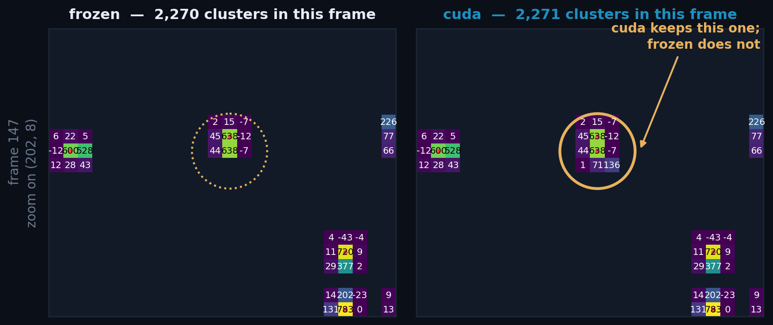
VALIDATION · THE DISAGREEMENT, SEEN
The whole disagreement is one duplicate centre
Only the 3×3 footprints of each finder's own centres are drawn, so the panels differ exactly where the finders do. Cell values are pedestal-subtracted ADU.
cuda's patch is one row taller: a second centre directly below the one both found. The charge is already counted — a duplicate, not a new photon.
29 / 33
Notes:
Frame 147, the strongest of the six residuals, shipping f32 build.
Every other centre in the patch agrees, including the ordinary photon at bottom
right.
Each panel masks every pixel that is not inside the 3x3 footprint of one of THAT
finder's own cluster centres. So a pixel is visible on the left only if frozen
claimed it, and visible on the right only if cuda did. Where the panels look
identical, the finders agreed pixel for pixel.
The red dots are cluster centres. The amber ring is the one centre cuda keeps
that frozen does not: (202, 8), directly below (202, 7) which both finders keep.
Because the two 3x3 windows overlap, cuda's patch is four rows tall where
frozen's is three - that visible extra row IS the disagreement.
Note what is NOT happening: there is no cluster in one panel that is absent from
the other's neighbourhood entirely. Nothing was missed, and nothing was invented
out of noise. The two finders are arguing about which of two adjacent pixels owns
a photon they both found.
Same construction as helper.plot_masked_mismatch() in the notebook, so this is
reproducible from ClusterFinderFrozen_vs_CUDA.ipynb directly.

Slide 36
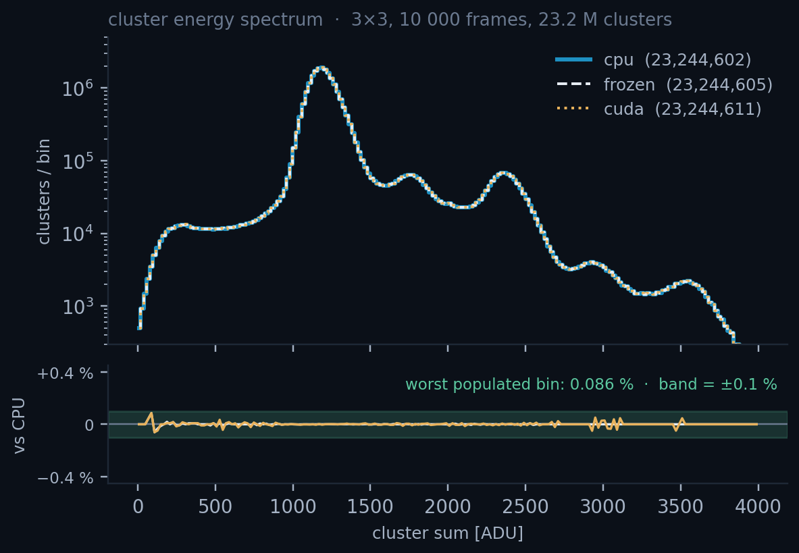
VALIDATION · THE SIX RESIDUALS, DISSECTED
float32 cannot tell these two pixels apart
THE ONLY TEST THAT FLIPS, AND WHY
frame 147 centre (x=202, y=8) 3×3 window
raw window (ADU) pedestal-subtracted, 1 decimal
[[4646 5282 4703] [[ 45.3 638.4 -12.1] frozen and cuda
[4857 5318 4950] [ 43.7 638.4 -7.5] print the SAME
[4763 4640 4858]] [ 1.1 70.7 136.4]] window
the two contenders, at full precision:
rival (dy=-1) centre
frozen [f64 ped] 638.383019956 638.382773664
cuda [f32 ped] 638.382812500 638.382812500
gate: accept if centre >= max(window)
frozen 638.382773664 >= 638.383019956 -> reject
cuda 638.382812500 >= 638.382812500 -> ACCEPT
Separation under the f64 pedestal: 0.000246 ADU. One float32 ULP at 4 679.6 ADU is 0.000488. The two pixels are half a ULP apart; in float32 they are *the same number*, and the gate accepts on a tie.
With the f64 pedestal there are none at all. In the shipping f32 build each of the six sits one pixel from a cluster both finders found, a duplicate neighbour, never a spurious photon and never a missed one.
The same frame 147 as the previous slide, recomputed under each finder's decision-time pedestal. Both finders run the same gate (CPU value == max, CUDA !(val < max)), so the tie separates them, not the expression.
30 / 33
Notes:
Frame 147, centre (x=202, y=8). The full numbers.
centre rival centre - rival
frozen (f64 host ped) 638.382773664 638.383019956 -0.000246291
cuda (f32 dev ped) 638.382812500 638.382812500 0.000000000
pedestal mean, centre: f64 4679.617226336 f32 4679.617187500
pedestal mean, rival : f64 4643.616980044 f32 4643.617187500
1 float32 ULP at 4679.6 ADU = 0.000488 ADU
the f64 separation between the two pixels = 0.50 ULP
Read that last line slowly: the two pixels differ by HALF a float32 ULP. There is
no float32 number between them, so once the pedestal is stored as float32 they
round to the identical bit pattern. The local-max gate is `value >= max`, which
accepts on equality - so CUDA keeps the centre and frozen, which can still see
the rival is 2.5e-4 ADU higher, rejects it.
This is not drift in the usual sense. It is not that the f32 EMA wandered away
from the f64 one over thousands of updates - look at the pedestal columns, they
agree to 4e-5 and 2e-4 ADU. It is that the QUESTION being asked ("which of these
two pixels is larger?") has an answer that float32 cannot represent.
Consequences worth stating out loud if asked:
- It is one-directional. cuda-only 6, frozen-only 0. A tie can only ever ADD a
centre, never remove one, because >= accepts.
- All six are at Chebyshev distance 1 from a cluster both finders found: a
duplicate neighbour, never a spurious photon.
- With DEVICE_PED_TYPE = double the residual is 0 / 0 at both 3x3 and 9x9.
- Fixing it in f32 would mean a strict > in the gate, which changes the CPU's
documented behaviour on genuine ties. Not worth 6 clusters in 23 million.

Slide 37
FOR USERS · PYTHON API
The fast path in eight lines
THE RECOMMENDED PATTERN
• find_clusters_batched returns one ClusterVector per frame, in order, and does opt5's chunked overlap internally, so you get it for free.
• register_input_buffer is what turns opt3 into opt4: one call.
from aare import File, ClusterFinderCUDA
cf = ClusterFinderCUDA(image_size=(400, 400), cluster_size=(3, 3),
n_sigma=5, n_streams=4,
max_clusters_per_frame=3000)
for _ in range(1000): # 1. train the pedestal
cf.push_pedestal_frame(pd.read_frame())
data = f.read_n(100_000) # 2. one contiguous array
cf.register_input_buffer(data) # 3. pin it once
for s in range(0, N, 2000): # 4. batch through it
clusters = cf.find_clusters_batched(data[s:s+2000], first_frame=s)
cf.unregister_input_buffer() # 5. release the pages
IF YOU REDUCE AS YOU GO
# opt6: never copy
for v in cf.find_cluster_views_
batched_iter(data, 2000):
hist.fill(v.sums())
# views die with the chunk
×1.16 at 3×3, ×2.21 at 9×9. The views expose every cluster; they only withhold ownership past the chunk.
Pin once, outside the loop. Slices of a registered array inherit the pinning.
31 / 33

Slide 38
FOR USERS · CHOOSING THE KNOBS
Five knobs, and the one that silently truncates
PARAMETER
WHAT IT DOES
GUIDANCE
n_streams
How many frames may be in flight at once: an upper bound, not a count: the copy engines cap the real number below it.
4 at both sizes. 8 buys no kernel concurrency at 9×9 (+1% instance time) and inflates the CUDA-event timer 3.5×.
max_clusters_per_frame
Fixed size of the per-frame D2H transfer.
Must exceed the real maximum or clusters are silently dropped, and it sets the D2H bar directly. Measured at 9×9: the maximum is 1 633, and the lossless cap of 1 700 already makes D2H the bottleneck on the f32 build.
batch size
Frames per find_clusters_batched call.
2 000 amortises launch overhead without a large pinned footprint.
cluster_size
Compile-time stencil geometry.
3×3 and 9×9 are registered; 9×9 moves the bottleneck off H2D and onto the kernel on f64, and onto D2H once opt7 shortens it.
register_input_buffer
Page-locks the host array for DMA.
Always, if the data is already in RAM. Check the pinning budget first.
The single most common mistake: leaving max_clusters_per_frame too low. It does not error; it truncates, and every frame quietly returns the same count.
32 / 33

Slide 39
WHERE THIS LEAVES US
The bottleneck has walked from the host, to the GPU, to the wire
DONE
DONE
×9.1 at 3×3, ×26.5 at 9×9
FP32 pedestal, safely
16.3 and 25.1 µs/frame end to end, both sitting on their hardware floor. At 3×3 that is 58 495 FPS against MÖNCH03's 1.3 kHz standard frame rate: 45× the detector, and ~10× its optimised 3–6 kHz ceiling.
−40.5 % kernel, and correct, because the variance is accumulated on a frozen per-pixel offset instead of a raw second moment. Against the CPU twin that isolates the port the decisions are identical; the shipped f32 pedestal adds 6 duplicates in 23 million.
NEXT
NEXT
3×3: transfer granularity
9×9: the result path, not the kernel
The 16.31 µs sustained sits 3.16 µs above the uncontended 13.15 µs H2D rate [f32: s4 vs s1]: 2 000 separate 320 kB descriptors, plus 26% of H2D↔D2H contention.
At a lossless cap D2H already binds [f32 · s4]: 25.24 µs against a 23.94 µs kernel. More kernel work buys nothing until the D2H slot stops being cap-sized.
Full numbers, methodology and reproduction steps: docs/ClusterFinderCUDA_benchmark_results.md · notebook python/tests/ClusterFinderCUDA_perf.ipynb · measurement campaign python/tests/perf/
33 / 33
Notes:
The headroom claim, stated carefully.
MOENCH03 runs at 1.3 kHz as standard and 3-6 kHz with optimised readout boards.
The finder does 58 495 FPS at 3x3 and 39 775 at 9x9, so it is 45x and 31x the
standard rate, and about 10x and 7x the optimised ceiling. The point is not the
multiple: it is that cluster finding has stopped being the thing that decides
how fast you can take data, on one GPU, at either cluster size.
Two honest qualifications. First, this is throughput on frames already in host
RAM -- getting them there from the detector is a separate problem and is not
measured here. Second, at 9x9 the D2H slot is cap-sized, so the margin shrinks
if max_clusters_per_frame has to grow for a busier beam.
What the 24-thread CPU finder does, for contrast: 6 762 FPS at 3x3, which
matches the standard mode with nothing to spare, and 1 503 FPS at 9x9, which
does not.

Slide 40
Annexes
COMING UP
A1
Every engine number, reconciled
A2
The three rejected routes
A3
opt5 · the overlap code
A4
The fault model, tested
A5
The variance rewrite in full
A6
The three benchmark artefacts
EVERYTHING SO FAR
33 slides
the arc is finished; what follows answers questions

Slide 41
A1
ANNEX · MEASUREMENT CONVENTION · EXPANDS SLIDE 18
Uncontended, or as the pipeline runs it
• Every engine time in this deck is tagged [build · s1|s4]. s1 is one stream with nothing else running: what an engine does on its own, which is the right number for a capability claim and for the headroom that remains. s4 is the shipped four-stream pipeline: each engine's busy time per frame, the union of its intervals, the only number that can set a floor.
3×3 · µS/FRAME
S1 F64
S1 F32
S4 F64
S4 F32
9×9 · CAP 1700
S1 F64
S1 F32
S4 F64
S4 F32
H2D
13.14
13.15
16.17
16.63
H2D
13.20
13.22
20.77
20.54
kernel
14.72
4.32
15.17
5.53
kernel
39.86
23.70
32.66
23.94
D2H
5.31
5.27
7.69
7.57
D2H
21.97
21.95
25.25
25.24
engine max [s4]
—
—
16.17
16.63
engine max [s4]
—
—
32.66
25.24
FLOOR = lower of max, sustained
—
—
16.17
16.31
FLOOR = lower of max, sustained
—
—
30.01
25.14
Two traps this table closes. (1) s4 is engine *occupancy*, not duration: the 9×9 kernel row falls 39.86 → 32.66 while every transfer rises, and nothing that measures a duration falls under load. (2) the FLOOR is not the engine max: the max is profiled and runs 2–8 % high, so the floor is whichever is lower, it or the best unprofiled sustained rate, which is why opt6 reports 30.01 µs against a 32.66 max.
THE D2H SHIFT IS AN s4 PHENOMENON: at s1 the kernel binds in both arms (39.86 and 23.70 against a 21.97 / 21.95 D2H); only under four-stream contention does D2H climb to 25.24 and overtake the 23.94 f32 kernel, so any claim about which engine binds must be read from the s4 columns. Source: probes.csv in perf/results/2026-08-18_{f64,f32}/ (3×3) and 2026-08-20_{f64,f32}_capAB/ (9×9). Bandwidth arithmetic in the notes.
A1
Notes:
Neither direction is faster than the other, and the bar heights say so.
At s1, H2D moves 320 000 B in 13.15 us = 24.3 GB/s; D2H moves 120 004 B in
5.27 us = 22.8 GB/s; at 9x9, D2H moves 557 604 B in 21.95 us = 25.4 GB/s. All
three sit at 72-81 % of PCIe 4.0 x16's 31.5 GB/s, the smallest transfer paying
the most fixed cost per byte. So a taller bar in this deck always means MORE
BYTES, never a slower wire -- which is exactly why raising the cap to 1 700
hands the 9x9 floor to D2H: it is 544.5 kB per frame either way the arm is
built, and it does not care about the typedef.
On the last row: the floor is the LOWER of the s4 estimate and the best
unprofiled sustained rate. 16.31 vs 16.63 at 3x3 f32; 25.14 vs 25.24 at 9x9 f32;
30.01 vs 32.66 at 9x9 f64, which is the widest gap and the reason the rule
exists. A probe roofline is an estimate, never a hard denominator.

Slide 42
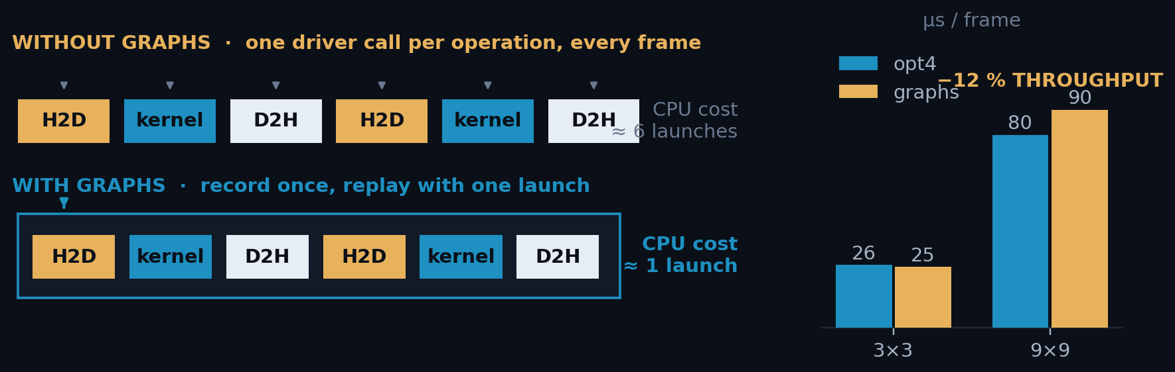
A2
ANNEX · REJECTED ROUTE · CUDA GRAPHS · EXPANDS SLIDE 11 · 1 OF 3
CUDA Graphs, a sound idea that the next act overtook
• Every cudaMemcpyAsync / kernel launch costs the CPU a few microseconds of driver work, per frame and per operation. After opt4 that looked like the budget.
• A CUDA Graph captures the whole dependency DAG once. Replaying it is a single cudaGraphLaunch: the driver already knows every node and edge.
ClusterFinderCUDA_graph.hpp
// record once, at setup
cudaStreamBeginCapture(sc.stream, ...);
submit_h2d_kernel_d2h(sc);
cudaStreamEndCapture(sc.stream, &sc.graph);
cudaGraphInstantiate(&sc.graphExec, ...);
// per batch: one call
cudaGraphLaunch(sc.graphExec, sc.stream);
REJECTED 3×3: 39 752 FPS, inside noise of opt4. 9×9: 11 072 FPS, 12 % slower.
Its 3×3 edge was never established: the graph finder recorded no CUDA events while the stream finder did, and that instrumentation tax (2.8 µs) is larger than the gap (0.8 µs). More decisively, it never received the chunked pipeline of opt5, so it is competing on ~2 µs of launch cost against a 24 µs floor. Launch overhead stops binding one step later; the technique aimed at it can no longer pay.
A2 · 1/3

Slide 43
A2
ANNEX · REJECTED ROUTE · CUDA GRAPHS · 2 OF 3
What a CUDA Graph actually saves, in microseconds
• The stream path issues four runtime calls per frame, a memset to clear the cluster counter, H2D, the launch, D2H. A graph replaces all four with one cudaGraphLaunch, so the ceiling on what it can save is ¾ of the submission cost.
ROUTE A · MEASURED VERDICT
3×3 VS OPT4
×1.03
CALL
PER FRAME
HOST COST
µS/FRAME
cudaMemcpyAsync
2
1.98 µs
3.97
9×9 VS OPT4
cudaLaunchKernel
1
2.13 µs
2.13
×0.88
cudaMemsetAsync
1
1.57 µs
1.57
VS OPT5 AT 9×9
submission total
4
7.67
36 % behind
Read from CUPTI_..._RUNTIME, the host table, so this is the one order-of-magnitude number in the deck, ±50 %. It is enough to show graphs cannot pay against a 16 µs floor, and not enough to quote to two figures.
THE ARITHMETIC
7.67 us/frame x 3/4 = 5.75 us/frame eliminated, AS MEASURED (under nsys)
5.75 / 4 (see A5) ~ 1.4 us/frame eliminated, unprofiled estimate
~1.4 µs against a 16.17 µs floor = 8.7 %, real while the host is the critical path, and worth nothing after opt5, which hides host work under the GPU entirely.
A2 · 2/3

Slide 44
A2
ANNEX · REJECTED ROUTES · THE RESULT COPY · EXPANDS SLIDE 18 · 3 OF 3
The copy is allocation-bound, not bandwidth-bound
B′
One allocation per chunk
collect_packed()
Removes the per-frame malloc but keeps the copy, and the copy is ~80% of the cost. Worse, the replacement allocation is 1.17 GB, far above glibc's mmap threshold, so it is mmap'd and munmap'd every chunk: 606 566 faults, ~21 µs/frame.
69.3 µs · deleted from the API
B″
Parallel materialisation
8-thread copy pool
Each worker gets its own glibc arena, which destroys the cross-run heap reuse that makes the single-threaded path cheap. Faults went 9 700 → 2 270 000; MALLOC_ARENA_MAX=1 collapsed them back to 138 k, which is the proof.
+6% at best, −33% when results are freed promptly
Copying faster does not help when the cost is the OS populating pages. The only winning move is not to allocate — which is exactly what opt6 does. materialize_slot() is deliberately single-threaded and carries a comment saying so, to stop the experiment being repeated.
A2 · 3/3

Slide 45
A3
ANNEX · OPT5 · THE OVERLAP CODE · EXPANDS SLIDE 17
The overlap, in six lines, and why you never write them
THE WHOLE OF OPT5
CHUNK SIZING · THE TWO CONSTRAINTS
tok = cf.submit_batch(data[a0:b0], first_frame=a0)
for a, b in bounds[1:]:
nxt = cf.submit_batch(data[a:b], first_frame=a) # GPU starts N+1 …
results.extend(cf.collect(tok)) # … host unpacks N
tok = nxt
results.extend(cf.collect(tok)) # drain the last one
MULTIPLE OF
n_streams
CAPPED AT
MAX_SLOT_BYTES
• You do not write this. It is inside find_clusters_batched(), which chunks the batch and runs the loop for you, opt5 arrived as a speedup, not an API change, and every existing caller got it without editing a line.
• submit_batch() and collect() stay public for anyone who wants the token by hand, streaming from a detector, interleaving other work between chunks.
The chunk MUST be a multiple of n_streams. The device pedestal is per-stream and advances once per frame the stream sees, so an uneven chunk leaves the four pedestals at different ages, the finder would stop being reproducible, and two runs of the same data would not agree.
It is also capped so the two pinned output slots stay bounded: the slot is chunk × (4 + cap × sizeof(Cluster)), which at 9×9 and cap 1 700 is 544.5 kB per frame. chunk_size_for(n) applies both rules; pass the result to reserve_output_slots() to pre-pay the page-locking outside any timed region.
Two chunks in flight is enough. A third adds pinned memory and no overlap: the host is already busy for the whole time the GPU is.
The saving is min(GPU, host) per chunk, so opt5 pays most when the two terms are comparable, ×1.31 at 3×3, and least when one dominates, ×1.20 at 9×9, where the host term is roughly twice the GPU term. That gap is the diagnosis that motivates opt6 (report §8.2).
A3

Slide 46
A4
ANNEX · THE FAULT MODEL · EXPANDS SLIDE 21
The fault model, tested against every step
• Slide 26 fits 0.68 µs per first-touch fault on the 3×3 f32 ladder, where wall = steady-state + faults × 0.68 µs reproduced a 6.110 s run to 1 ms. Every row below is 9×9, and an f64-vs-f32 gap: a different cluster size and a different comparison, so the rate is applied out of sample, never refitted.
STEP
F64 WARM (FAULTS)
F32 WARM (FAULTS)
Δ WALL
Δ FAULTS
PREDICTED
VERDICT
opt3
82.44 µs (128 k)
95.66 µs (521 k)
+13.22
+393 k
+13.37
the allocator
opt4
79.83 µs (128 k)
75.20 µs (127 k)
−4.63
−0.5 k
−0.02
clean
opt5
66.39 µs (152 k)
61.85 µs (10 k)
−4.54
−141 k
−4.81
not separable
opt6
30.01 µs (0)
25.14 µs (0)
−4.87
0
0.00
clean
opt3 is the whole argument in one row. A 393 k fault gap predicts +13.37 µs; +13.22 was observed, agreement to 1 %. The −40 % kernel is in there somewhere, invisible under 13 µs of the OS zeroing pages. Only opt4 and opt6, where the fault term is ~0, report the typedef at all.
ladder_9x9.csv in results/2026-08-20_{f64,f32}_cap1700/, warm = best of reps 1–4, faults are that rep's own getrusage minor-fault count. Predicted = Δfaults × 0.68 µs ÷ 20 000 frames, with 0.68 carried in unchanged from the 3×3 fit (slide 25): nothing on this slide is tuned to make the columns agree. Observed vs predicted: +13.22 / +13.37, −4.63 / −0.02, −4.54 / −4.81, −4.87 / 0.00. This table replaces an earlier figure that quoted opt3's +16 % as a measurement of the result path; it is a measurement of two allocator states.
A4

Slide 47
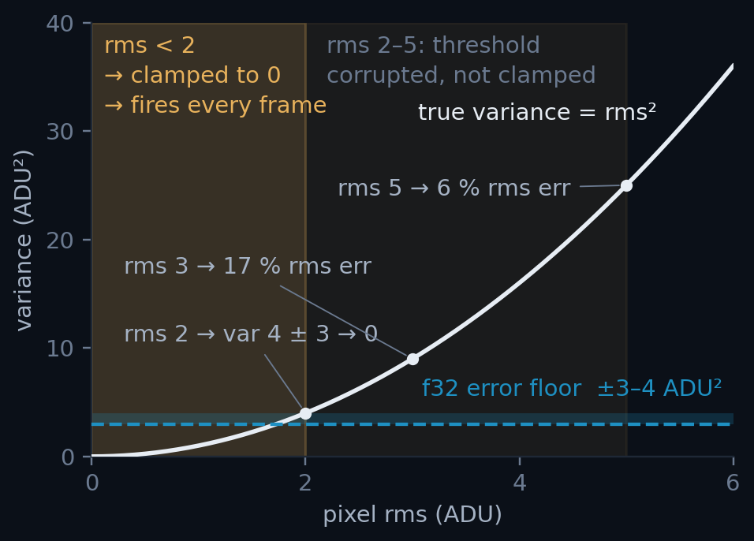
A5
ANNEX · THE VARIANCE REWRITE · EXPANDS SLIDE 20
The rewrite in full, and which pixels the error reached
• Freeze a per-pixel baseline X₀ = round(mean) once, at the end of pedestal training, and never move it again.
• Accumulate the centred value Y = X − X₀ instead of X, and report the mean as X₀ + sum/n, so nothing downstream changes.
• Both operands of the subtraction are now O(rms)-sized: the huge common term is gone before the subtraction rather than after it.
clusterfinder_kernel.cuh
// before: both terms ~2.17e7, answer ~2000
var = sum2/n - mean*mean;
// after: centred on a frozen per-pixel offset X0
DEVICE_PED_TYPE resid = mean - d_pd_off[i]; // ~O(1)
DEVICE_PED_TYPE var_px = sum2[i]/n - resid*resid; // no cancellation
Which pixels the ±3 ADU² floor actually reaches. Below rms ≈ 2 the variance is lost outright; from 2 to 5 the threshold is corrupted but not clamped. Source: §5–§6 of docs/pedestal_precision_f32_cancellation.md. The naive f32 build's +28.06 % excess is this shaded band, integrated over the sensor.
Result: the 100 % FP32 build matches the FP64 build to 3 × 10⁻⁷, 70 clusters out of 233 million.
X₀ must never be updated. The accumulators are defined relative to it, so moving it invalidates every sum already collected. Welford's online variance is the other correct answer; this one was chosen because it is two lines and does not change the update's arithmetic cost.
A5

Slide 48
A6
ANNEX · BENCHMARK ARTEFACTS · EXPANDS SLIDE 25 · 1 OF 4
Three ways a GPU benchmark lies
First-touch page faults
CUDA-event kernel timing
The profiler itself
Each run materialises ~10 GB of clusters. The first pass faults in ~2.6 M pages at 0.7 µs each, up to 4 s of pure OS work inside the timer.
avg_kernel_time_ms() measures elapsed time on a stream, including waiting for other streams. Under 8-stream load it over-reads by up to 3.5×.
Under nsys, wall time per frame inflates ~4× from API tracing.
Fix: re-run until getrusage() minor faults plateau (< 200 k).
Fix: Nsight Systems per-instance times; 1 stream for exclusive numbers.
Fix: GPU op times from nsys, wall times from unprofiled runs.
THE FAULT PROTOCOL · python/tests/ClusterFinderCUDA_perf.ipynb
# every timed cell in the benchmark notebook is bracketed with:
mf0 = resource.getrusage(resource.RUSAGE_SELF).ru_minflt
... t = time.perf_counter() - t0 ...
print(f'minor faults: {mf1-mf0:,}') # quote the run where this plateaus
Validated: wall = steady-state + faults × 0.68 µs reproduced a 6.110 s run to within 1 ms. Kernel time stayed constant throughout; the GPU was never the variable.
A6 · 1/4

Slide 49
A6
ANNEX · BENCHMARK ARTEFACTS · EXPANDS SLIDE 25 · 2 OF 4
First-touch page faults: two sources, one counter
• A page exists in the process's address space but has no physical frame yet. On first touch the kernel finds one, zeroes it (mandatory), and maps it. No disk I/O: ru_majflt stays 0 all campaign. At 4 kB/page, 1 GB = 262 144 faults.
(A) RESULT HEAP
(B) PINNED D2H SLOTS
allocator
malloc → mmap, one ClusterVector per frame
cudaMallocHost, in submit_batch
cost / page
0.7 µs
1.0 µs: same fault + pin + DMA map
recurs?
yes, every alloc/free cycle above the mmap threshold
no: once per buffer, for its lifetime
removed by
collect_view(): it allocates nothing
nothing; reserve_output_slots() only moves it out of the timer
NOT A CORRELATION, AN IDENTITY
The two are exactly additive. Reserving subtracts precisely the pre-pin count from run 0 and changes nothing else.
3x3: 572 292 - 455 129 = 117 163 vs 117 192 pre-pin
9x9: 2 759 037 - 2 278 567 = 480 470 vs 480 474
closed form: 2 slots x 2000 x 120 004 B / 4 kB = 117 191
At 9×9 the heap never plateaus. ~9.3 GB per pass is above glibc's mmap threshold, so it is munmap'd and re-faulted every pass: ~292 k faults ≈ 10 µs/frame, permanently. No number of re-runs removes it, which is an independent argument for opt6.
A6 · 2/4

Slide 50
A6
ANNEX · BENCHMARK ARTEFACTS · 3 OF 4
CUDA events measure the stream, not the kernel
• avg_kernel_time_ms() brackets the launch with cudaEventRecord on the kernel's own stream. What it returns is elapsed time on that stream's timeline, which includes time spent queued behind other streams.
• So it is honest at 1 stream and inflates under saturation: up to 3.5× at 8 streams. The tell is that the derived *PCIe + overhead* = wall/N − kernel_ms goes negative: kernels overlap, so wall/frame < kernel/frame.
• It is also not free: ~3.6 µs/frame, i.e. 10–15 % of end-to-end throughput at 3×3, to produce a number that is unusable exactly when it matters.
9×9 KERNEL · F64 · NSYS
S1 · DURATION
39.86 µs
S4 · OCCUPANCY
32.66 µs
OVERLAP FACTOR
1.32×
ClusterFinderCUDA.hpp
if (m_time_kernels) // OFF by default, all 3 finders
cudaEventRecord(start[slot][i], sc.stream);
find_clusters_in_single_frame<<<grid, block, shmem, sc.stream>>>(...);
if (m_time_kernels)
cudaEventRecord(stop[slot][i], sc.stream); // <- queue-wait lands here
Same kernel. The s4 column is the union of kernel intervals per frame, not how long one kernel takes. Quote s1 for duration; s4 feeds the floor, subject to the sustained-rate rule on slide 18. Full grid: A1.
The flag exists for comparability, not preference: with events on for one finder and off for another, the step between them absorbs the tax.
A6 · 3/4

Slide 51
A6
ANNEX · BENCHMARK ARTEFACTS · 4 OF 4
Where nsys is sound, and where it is not
• Tracing a host call means running a callback on entry and on exit, inside the interval being measured. GPU work is different: the hardware stamps its own start/end and the host reads those records afterwards, so nothing is injected into the execution path.
MEASUREMENT
SQLITE TABLE
9×9 [F64 · S1 · CAP 1500]
VERDICT
cudaLaunchKernel: the host call
CUPTI_..._RUNTIME
1.85 µs
inflated ~4×
the kernel executing
CUPTI_..._KERNEL
39.93 µs
sound to ~2 %
cudaMemcpyAsync: the host call
CUPTI_..._RUNTIME
1.65 µs
inflated ~4×
the H2D / D2H transfer
CUPTI_..._MEMCPY
13.25 / 19.44 µs
sound to ~2 %
Same cudaMemcpyAsync, two numbers: 1.65 µs to ask for the copy, 13.25 µs for the copy to happen. If the profiler must be present at the moment to measure it, it distorts it; if the hardware records it anyway and the profiler reads it later, it does not.
Every headline number in this deck (kernel times, transfer times, duty cycles, overlap and every engine floor) comes from the _KERNEL and _MEMCPY tables (see gpu_span.py). Proof that side is sound: opt7 sustains 25.14 µs unprofiled against a 25.24 µs estimate measured under the profiler, 0.4 % apart, which a 4× distortion could not survive. ⚠ Cap 1500: the only such numbers left in the deck. Why, and what the shipped bar is, in the notes.
A6 · 4/4
Notes:
Why this one slide is still cap 1500, and what not to read off it.
The RUNTIME column exists only inside the trace: it is the cost of the host call
itself, which does not depend on how large the output slot is. So there is
nothing to re-run -- a cap-1700 trace would report the same ~1.65 and ~1.85 us
for cudaMemcpyAsync and cudaLaunchKernel.
What you must NOT read off this slide is the 19.44 us D2H. That is the cap-1500
figure. At the shipped cap of 1 700 the same engine reads 21.95 us [s1] and
25.24 us [s4], and it is the s4 value that binds the f32 build. A1 has the
shipped grid.
The one number in the whole deck taken from _RUNTIME is the CUDA Graph launch
budget in A2, and it is quoted to a single significant figure for exactly this
reason: a ~4x inflated host-call time can support "launch cost is about 2 us,
against a 24 us floor", and nothing finer than that.

