Slide 1
AARE · PSI HYBRID PIXEL DETECTORS · CUDA CLUSTERFINDER
Feeding the GPU
Six optimization steps of the CUDA ClusterFinder
Five of the six steps never touch the arithmetic. They are about keeping a 24 µs kernel supplied with data — and about learning to measure honestly.
×8.29
39,472
25.3 µs
0.004%
VS 48-THREAD CPU
FRAMES / SECOND
PER FRAME, END TO END
CLUSTER-COUNT DRIFT
RTX 4090 (Ada, sm_89) · PCIe 4.0 ×16 · Mönch 400×400 uint16 · 3×3 clusters · 100 000 frames · Cu fluorescence, MAX IV
Khalil Ferjaoui · Paul Scherrer Institut

Slide 2
THE PROBLEM & THE BASELINE
What has to happen to every frame
• Per pixel: subtract a running pedestal (mean ± rms), keep pixels above nσ · rms, cut a 3×3 cluster around each local maximum.
• 400×400 = 160 k pixels, 312.5 kB per frame; Cu data yields ~2 330 clusters per frame at 3×3.
• The pedestal is updated by every non-photon pixel, every frame — so the arithmetic and the data movement are coupled.
BASELINE · SAME DATA, SAME THRESHOLD
CPU, 1 THREAD
1.75 ms
CPU MT, 48 THREADS
THE KERNEL IN FIVE LINES
210 µs
// the whole algorithm, per pixel
v = frame[i] - pedestal_mean[i]
rms = sqrt(pedestal_sum2[i]/n - pedestal_mean[i]^2)
if (v > nSigma * rms && v == max(3x3 window)) -> emit cluster
else -> update pedestal
THAT IS THE BAR
4 761 frames / s
Every CUDA number in this deck is measured against the 48-thread CPU on the same 100 000 frames.
Thesis of this talk: the compute was fast almost immediately. Five of six steps are about feeding it.
2 / 19

Slide 3
ROADMAP
Two acts: feed the GPU, then speed up the kernel
opt1
First CUDA port
×3.14
1 stream, one launch per frame
opt2
Streams + batching
×4.86
4 streams, 2 000-frame batches
opt3
Pipeline rework
×5.58
sync barriers removed
opt4
Pinned memory
×7.73
DMA-speed host transfers
opt5
CUDA Graphs
×8.29
one launch replaces six
opt6
FP32 pedestal + variance rewrite
kernel −40%
the first kernel change
opt1–opt5 change only how work is scheduled and moved — the arithmetic is byte-identical. opt6 is the first step that changes the kernel itself.
3 / 19

Slide 4
BEFORE ANY NUMBER IS BELIEVED
Three ways a GPU benchmark lies
First-touch page faults
CUDA-event kernel timing
The profiler itself
Each run materialises ~10 GB of clusters. The first pass faults in ~2.6 M pages at 0.7 µs each — up to 4 s of pure OS work inside the timer.
avg_kernel_time_ms() measures elapsed time on a stream — including waiting for other streams. Under 8-stream load it over-reads by up to 3.5×.
Under nsys, wall time per frame inflates ~4× from API tracing.
Fix: re-run until getrusage() minor faults plateau (< 200 k).
Fix: Nsight Systems per-instance times; 1 stream for exclusive numbers.
Fix: GPU op times from nsys, wall times from unprofiled runs.
THE FAULT PROTOCOL — python/tests/ClusterFinderCUDA_perf.ipynb
# every timed cell in the benchmark notebook is bracketed with:
mf0 = resource.getrusage(resource.RUSAGE_SELF).ru_minflt
... t = time.perf_counter() - t0 ...
print(f'minor faults: {mf1-mf0:,}') # quote the run where this plateaus
Validated: wall = steady-state + faults × 0.68 µs reproduced a 6.110 s run to within 1 ms. Kernel time stayed constant throughout — the GPU was never the variable.
4 / 19

Slide 5
OPT1 · THE FIRST CUDA PORT
One frame, one stream, fully synchronous
• Shared-memory tiling with halo loading for any cluster size; pedestal subtraction fused into the tile load.
• Cluster geometry is a compile-time template parameter → the 3×3 stencil is fully unrolled.
• One cudaMemcpy in, one kernel, one cudaMemcpy out — the host blocks on every frame.
OPT1 · 3×3 · 100 K FRAMES
END TO END
66.8 µs
VS 48-THREAD CPU
ClusterFinderCUDAOpt2.hpp · find_clusters()
×3.14
// one frame at a time — the host waits at every step
cudaMemcpy(d_frame, h_frame, bytes, cudaMemcpyHostToDevice);
find_clusters_in_single_frame<ClusterType, FRAME_TYPE>
<<<grid, block, shmem>>>(d_frame, d_pd_mean, ...);
cudaMemcpy(h_out, d_out, out_bytes, cudaMemcpyDeviceToHost);
KERNEL (GPU)
23 µs
HOST + PCIE
44 µs
The stencil was already fast: 23 µs of kernel inside a 67 µs frame. The other 44 µs is the host standing still.
Two thirds of the frame is spent not computing.
5 / 19

Slide 6
OPT2 · STREAMS AND BATCHING
A CUDA stream is a queue the GPU can overlap
• A stream is an ordered queue of GPU work. Work in different streams may overlap — so a copy can run while another stream computes.
• Each stream gets its own StreamContext: device frame buffer, output buffer and pedestal. Frames are handed out round-robin.
• The host now submits 2 000 frames per call instead of one.
OPT2 · 4 STREAMS · BATCH 2 000
END TO END
43.2 µs
VS CPU
ClusterFinderCUDA.hpp · per-stream state
×4.86
struct StreamContext {
cudaStream_t stream;
FRAME_TYPE *d_frame; ClusterType *d_clusters;
PEDESTAL_TYPE *d_pd_mean, *d_pd_sum, *d_pd_sum2;
};
auto &sc = v_sc[frame_idx % n_streams]; // round-robin
STEP GAIN OVER OPT1
×1.55
HOST + PCIE
21 µs (was 44)
Scaffolding, not yet the payoff. The streams exist, but the host still synchronises after every round — see opt3.
6 / 19

Slide 7
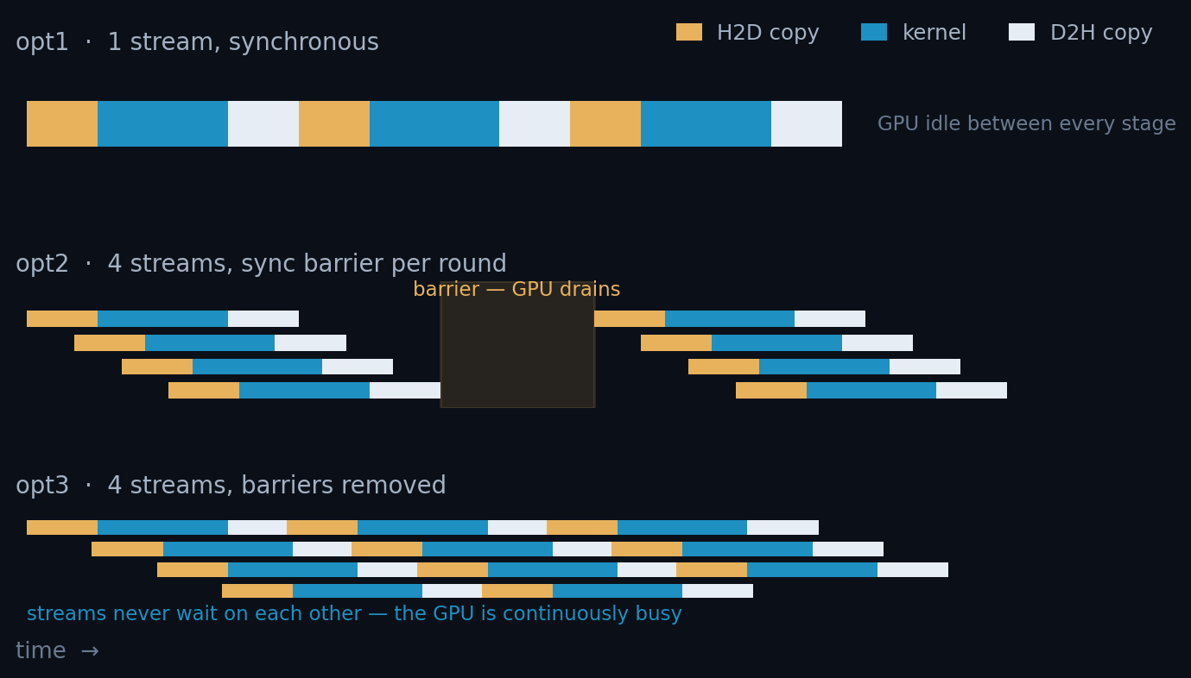
OPT3 · REMOVE THE SYNC BARRIERS
Stop draining the GPU between rounds
• opt2 synchronised all streams after every round of n_streams frames. The GPU drained to empty each time.
• opt3 submits every frame's H2D → kernel → D2H asynchronously, then synchronises once at the end of the batch.
THE ONE-LINE IDEA
// opt2: barrier after every round
for (round) {
submit(n_streams frames);
cudaDeviceSynchronize();
}
// opt3: submit everything, sync once
for (frame : batch) {
cudaMemcpyAsync(..., sc.stream);
kernel<<<..., sc.stream>>>(...);
cudaMemcpyAsync(..., sc.stream);
}
for (sc : streams)
cudaStreamSynchronize(sc.stream);
37.6 µs/frame · ×5.58 Host overhead 21 → 14 µs
Each lane is one stream. Removing the barrier lets a stream start its next frame while its neighbours are still copying.
7 / 19

Slide 8
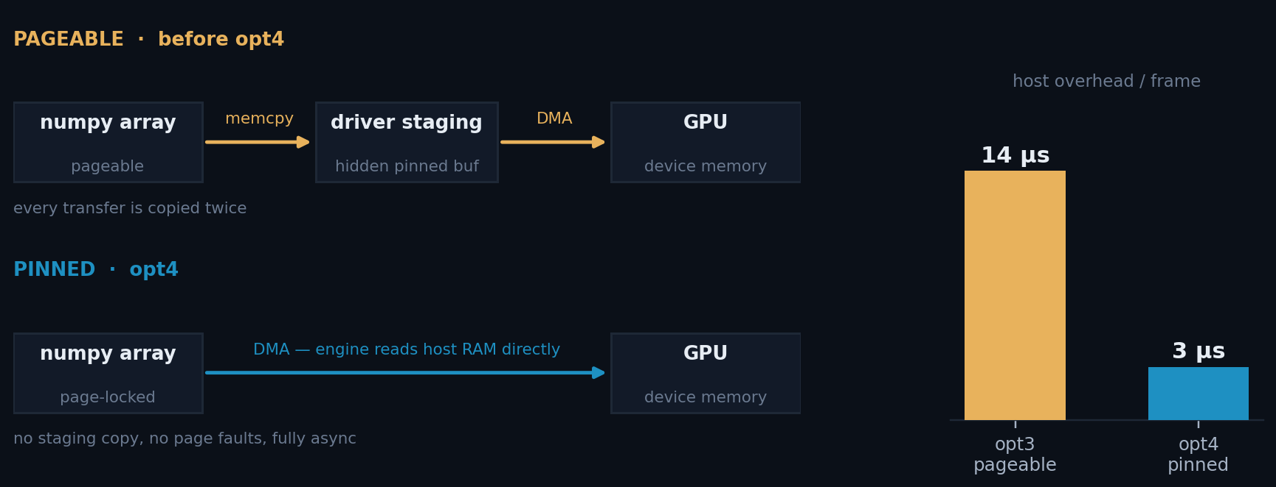
OPT4 · PINNED (PAGE-LOCKED) MEMORY
What pinning is, and why the GPU cares
• Normal host memory is pageable — the OS may move or swap it. A DMA engine cannot safely read that, so the driver first copies your data into a hidden pinned staging buffer. Every transfer is copied twice.
• Pinning locks the pages in physical RAM. The GPU's DMA engine then reads host memory directly — no staging copy, and the transfer can be truly asynchronous.
ClusterFinderCUDA.hpp
// pin the whole dataset once
cudaHostRegister(ptr, bytes,
cudaHostRegisterDefault);
// ... run the whole campaign ...
cudaHostUnregister(ptr);
27.2 µs/frame · ×7.73 Host overhead 14 → 3 µs
Measured H2D: one 400×400 uint16 frame (312.5 KiB = 320 000 B) in 13.2 µs = 24.2 GB/s — 77% of PCIe 4.0 ×16 theoretical, i.e. true DMA speed. Pageable staging runs ~15 GB/s.
Caveat: pinned memory is a finite system resource — it cannot be swapped. aare exposes a budget helper (print_pinning_budget) before you pin 31 GB.
8 / 19

Slide 9
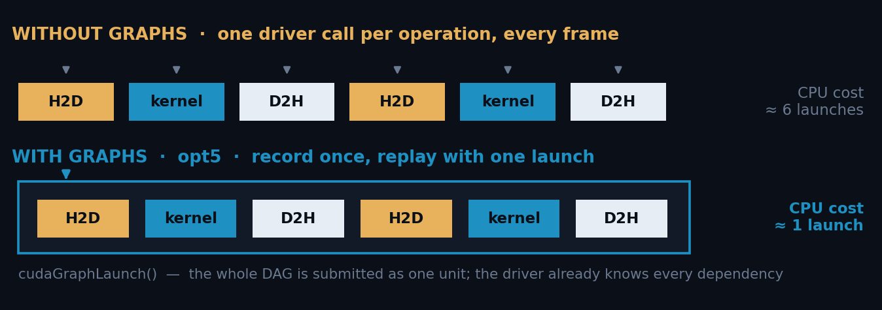
OPT5 · CUDA GRAPHS
Record the pipeline once, replay it with one call
• Every cudaMemcpyAsync / kernel launch costs the CPU a few microseconds of driver work — per frame, per operation. At 39 k frames/s that is the budget.
• A CUDA Graph captures the whole dependency DAG once. Replaying it is a single cudaGraphLaunch — the driver already knows every node and edge.
ClusterFinderCUDA_graph.hpp
// record once, at setup
cudaStreamBeginCapture(sc.stream, ...);
submit_h2d_kernel_d2h(sc);
cudaStreamEndCapture(sc.stream, &sc.graph);
cudaGraphInstantiate(&sc.graphExec, ...);
// per batch — one call
cudaGraphLaunch(sc.graphExec, sc.stream);
25.3 µs/frame · ×8.29 Best end-to-end result
Worth 7% here because opt4 already removed the transfer cost — what remains is CPU launch overhead, which is exactly what graphs eliminate. Trade-off: shapes are frozen at record time, so the batch geometry must be fixed.
9 / 19

Slide 10
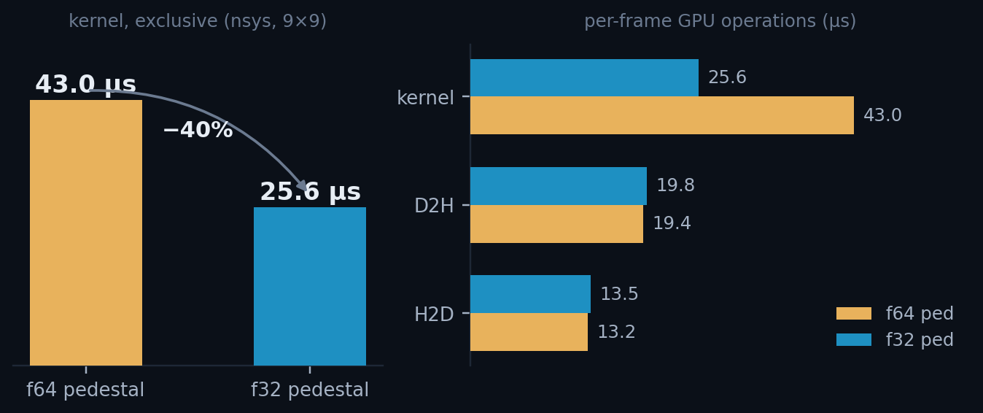
OPT6 · FP32 DEVICE PEDESTAL
The first change to the kernel itself
• ~99.9% of pixels take the pedestal-update branch, which reads and writes mean, sum and sum². In FP64 that is 32 bytes per pixel; in FP32, 16.
• The kernel is bandwidth-bound, so halving that traffic nearly halves the time.
• Second effect: on a GeForce part, FP64 arithmetic runs at 1/64 of FP32. The pedestal update was paying that tax on every pixel.
ONE TYPEDEF
// clusterfinder_kernel.cuh
using COMPUTE_TYPE = float;
using DEVICE_PED_TYPE = float;
// was: double
Kernel, 9×9, measured with Nsight Systems 43.0 µs → 25.6 µs (−40%)
Exclusive per-instance kernel time, 2 000 instances, 1 stream. σ = 0.4 µs. Transfers are unchanged, as they must be.
But a faster kernel is not automatically a faster frame — and naive FP32 is wrong. Both on the next slides.
10 / 19

Slide 11
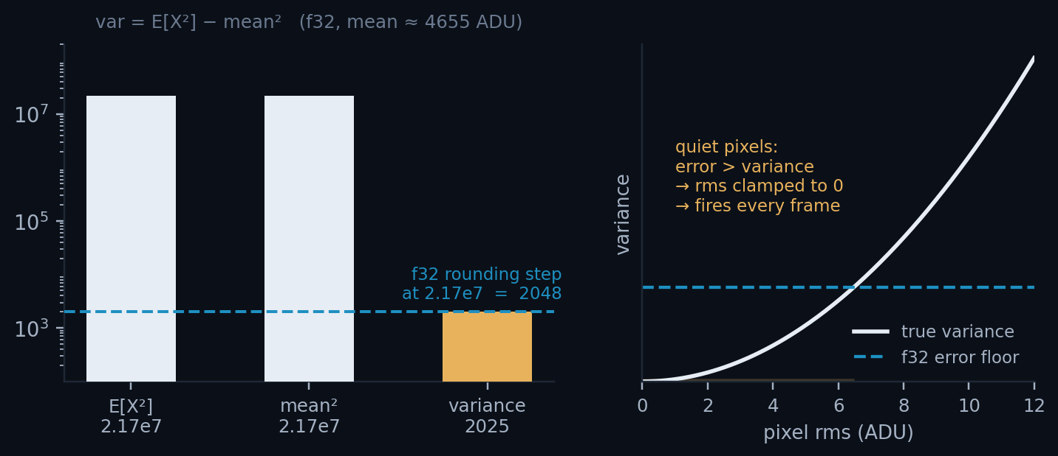
OPT6 · THE CORRECTNESS TRAP
Why the obvious FP32 pedestal is broken
• The running variance was computed as var = E[X²] − mean². With a pedestal mean of ~4 655 ADU, both terms are ≈ 2.17 × 10⁷ while the answer is ≈ 2 000.
• In FP32 the spacing between representable numbers at 2.17 × 10⁷ is 2 048 — larger than the variance itself. This is catastrophic cancellation.
WHAT IT LOOKED LIKE
EXTRA CLUSTERS
+28.06%
Quiet pixels got rms → 0, so their threshold became 0 and they fired on every single frame — producing a large unphysical high-energy tail in the spectrum.
AFFECTED PIXELS
~1–2% of the sensor
WRITTEN UP IN
docs/pedestal_precision_…
11 / 19

Slide 12
OPT6 · THE VARIANCE REWRITE
Accumulate what is small, not what is large
• Freeze a per-pixel baseline X₀ = round(mean) once, at the end of pedestal training, and never move it again.
• Accumulate the centred value Y = X − X₀ instead of X. Now both sums are O(rms)-sized — the huge common term is gone before the subtraction.
• The reported pedestal mean is still the full value, X₀ + sum/n, so nothing downstream changes.
WHY IT WORKS
Precision is relative. Floats resolve small numbers finely and large numbers coarsely — so never let a small answer be the difference of two large numbers.
F32 VS F64 COUNTS
clusterfinder_kernel.cuh
3 × 10⁻⁷
// before — both terms ~2.17e7, answer ~2000
var = sum2/n - mean*mean;
// after — centred on a frozen per-pixel offset X0
DEVICE_PED_TYPE resid = mean - d_pd_off[i]; // ~O(1)
DEVICE_PED_TYPE var_px = sum2[i]/n - resid*resid; // no cancellation
VS CPU
0.0039%
X₀ must never be updated — the accumulators are defined relative to it.
Result: the 100% FP32 build now matches the FP64 build to 3 × 10⁻⁷ — 70 clusters out of 233 million.
12 / 19

Slide 13
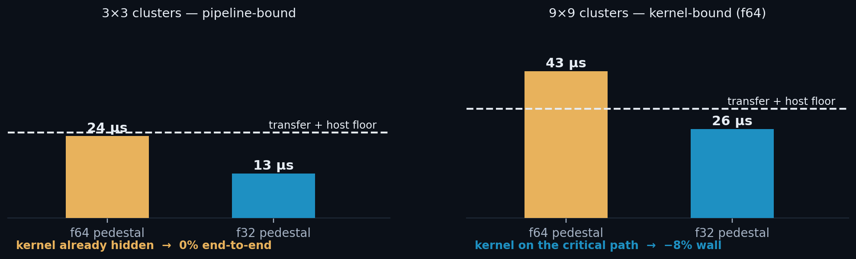
OPT6 · WHEN DOES A FASTER KERNEL HELP?
Only if the kernel was the tallest bar
f32 buys exactly the distance between the kernel and the next-tallest bar. At 3×3 the kernel already hides inside the transfers, so end-to-end throughput does not move at all. At 9×9 the kernel is on the critical path, and the same change is worth 8% of the frame.
9×9, 20 000 frames, 8 streams, cap 1 500 (all CPU clusters recorded): 1.540 s → 1.423 s batched, 1.482 s → 1.372 s with graphs. The FP64 build shows the classic kernel-bound signature — per-frame wall time shorter than per-frame kernel time, because kernels from different streams queue.
13 / 19

Slide 14
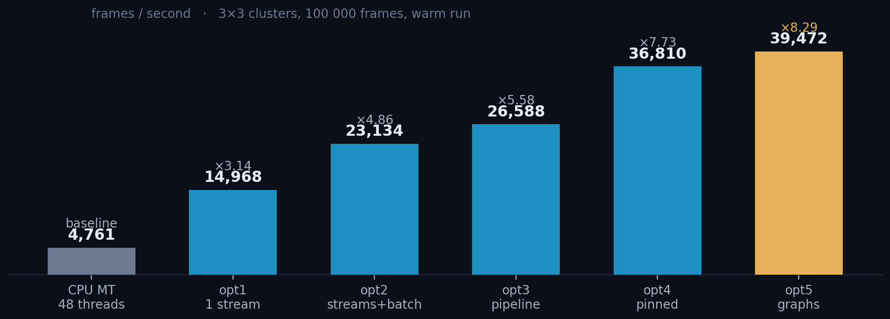
RESULTS
The whole ladder, one dataset, one baseline
×8.29 over 48 CPU threads — 21.0 s → 2.53 s for 100 000 frames.
Every step is monotonic, and correctness is held constant at 0.004% throughout.
3×3 clusters · nσ = 5 · 100 000 frames · batch 2 000 · 4 streams · warm run (page faults plateaued) · CPU baseline = ClusterFinderMT with 48 threads.
14 / 19

Slide 15
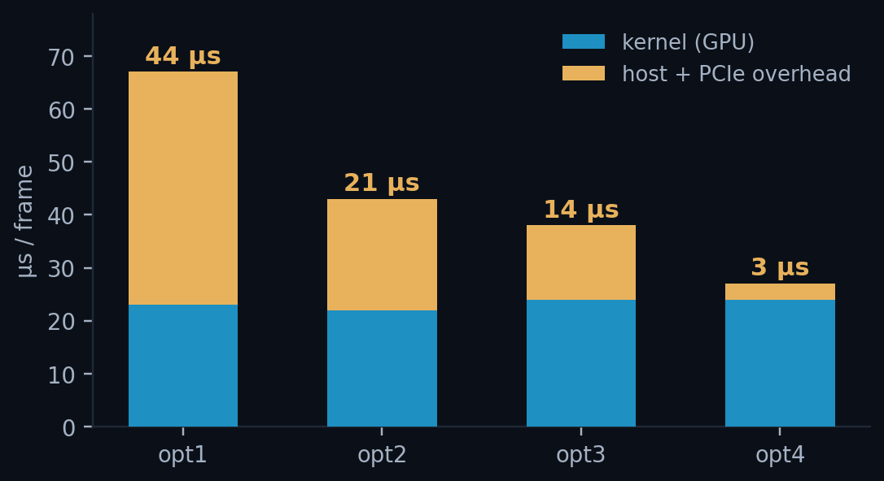
WHERE THE TIME ACTUALLY WENT
The kernel never changed — the overhead collapsed
• The GPU kernel is a flat ~23 µs across opt1–opt5. Not one of those steps made the arithmetic faster.
• What changed is everything around it: 44 → 21 → 14 → 3 µs of host and PCIe time per frame.
• By opt4 the pipeline is fed almost perfectly — which is precisely why opt5 (launch overhead) is the only lever left, and why opt6 shows nothing at 3×3.
The bottleneck moved from the host, to PCIe, and finally — only for large cluster windows — to the kernel.
Per-frame GPU operation profile at 9×9 (Nsight Systems): kernel 43 µs · D2H 19.4 µs · H2D 13.2 µs. At 3×3 the kernel is 13–24 µs against a ~25 µs transfer-and-host floor — which is the entire story of this deck in three numbers.
15 / 19

Slide 16
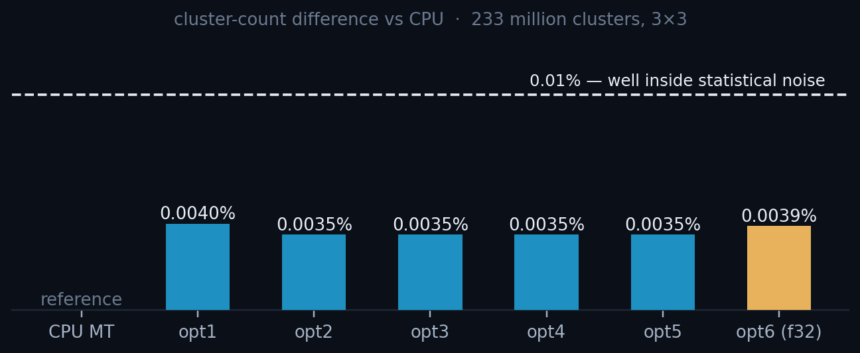
VALIDATION
Same physics out of every variant
• 233 million clusters over 100 000 frames.
• All CUDA variants agree with the CPU to 0.004%.
• The residual is not precision: it is the CUDA finder updating the pedestal once per frame vs the CPU's per-pixel update.
CLUSTER COUNTS · 3×3 · 100 000 FRAMES
A local-maximum gate had to be back-ported into the opt1/opt2 snapshot so the whole ladder is compared at identical correctness.
CPU (ClusterFinderMT) 233 085 343 2330.85 / frame reference
opt1 .. opt5 (f64 ped) 233 093 484 2330.93 / frame 0.0035 %
opt6 (f32 ped) 233 094 465 2330.94 / frame 0.0039 %
Cross-checks: ClusterFinderFrozen (a CPU finder with the CUDA pedestal-update timing) isolates that residual; energy spectra overlay within statistics.
16 / 19

Slide 17
FOR USERS · PYTHON API
The fast path in eight lines
THE RECOMMENDED PATTERN
• find_clusters_batched returns one ClusterVector per frame, in order.
• register_input_buffer is what turns opt3 into opt4 — one call.
• Swap in ClusterFinderCUDAGraph for opt5; the API is identical.
from aare import File, ClusterFinderCUDA
cf = ClusterFinderCUDA(image_size=(400, 400), cluster_size=(3, 3),
n_sigma=5, n_streams=4,
max_clusters_per_frame=3000)
for _ in range(1000): # 1. train the pedestal
cf.push_pedestal_frame(pd.read_frame())
data = f.read_n(100_000) # 2. one contiguous array
cf.register_input_buffer(data) # 3. pin it once
for s in range(0, N, 2000): # 4. batch through it
clusters = cf.find_clusters_batched(data[s:s+2000], first_frame=s)
cf.unregister_input_buffer() # 5. release the pages
GIL is released for both find_clusters and find_clusters_batched, so reading the next file can overlap with the GPU.
Pin once, outside the loop. Slices of a registered array inherit the pinning.
17 / 19

Slide 18
FOR USERS · CHOOSING THE KNOBS
What to set, and what it costs you
PARAMETER
WHAT IT DOES
GUIDANCE
n_streams
How many frames are in flight at once.
4 is right for 3×3. Larger windows saturate the GPU — 8 helps at 9×9.
max_clusters_per_frame
Fixed size of the per-frame D2H transfer.
Must exceed the real maximum or clusters are silently dropped. Too high wastes PCIe.
batch size
Frames per find_clusters_batched call.
2 000 amortises launch overhead without a large pinned footprint.
cluster_size
Compile-time stencil geometry.
3×3 and 9×9 are registered; 9×9 shifts the bottleneck onto the kernel.
register_input_buffer
Page-locks the host array for DMA.
Always, if the data is already in RAM. Check the pinning budget first.
The single most common mistake: leaving max_clusters_per_frame too low. It does not error — it truncates, and every frame quietly returns the same count.
18 / 19

Slide 19
WHERE THIS LEAVES US
The bottleneck has moved — twice
DONE
DONE
×8.29 over 48 CPU threads
FP32 pedestal, safely
25.3 µs/frame end to end, at 0.004% cluster agreement. Five pipeline steps and one kernel step.
−40% kernel, and correct — because the variance is now accumulated on a frozen per-pixel offset instead of a raw second moment.
NEXT
NEXT
Attack the transfers, not the kernel
Keep results on the device
At 3×3 the kernel is already hidden. The remaining per-frame cost is PCIe: 492 kB of clusters out, 312 kB of frame in.
On-GPU reduction, eta/interpolation on device, or compressed cluster formats — so the D2H bar stops setting the floor.
Full numbers, methodology and reproduction steps: docs/benchmark_opt1_opt6_results.md · notebook python/tests/ClusterFinderCUDA_perf.ipynb · profiler probe python/tests/nsys_kernel_probe.py
19 / 19

