Slide 1
Software engineering for scientific detectors
Python UI design • C++ backend APIs • CUDA acceleration
Khalil Daniel Ferjaoui
IT’IS Interview
05/05/2026

Slide 2
Outline Three projects, three parts of the stack
1. Python UI design
2. C++ backend APIs
3. CUDA ClusterFinder
GPU acceleration for frame processing
<number>
Notes:
The third project is about the CUDA implementation of a cluster finder algorithm on Nvidia GPUs.
<number>

Slide 3
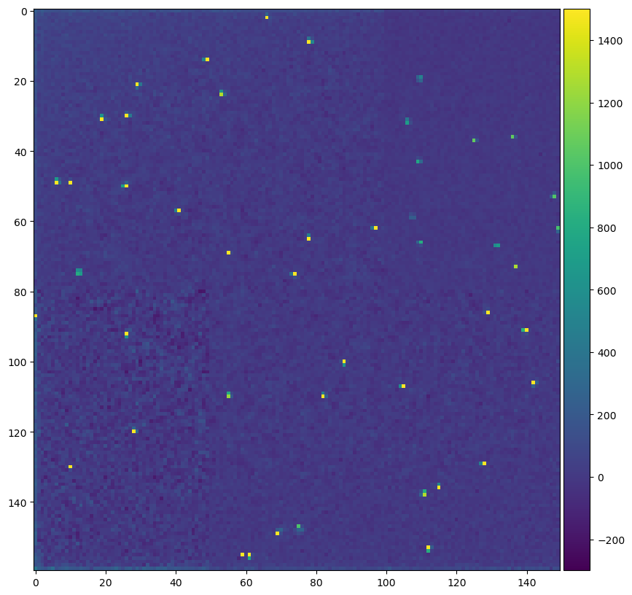
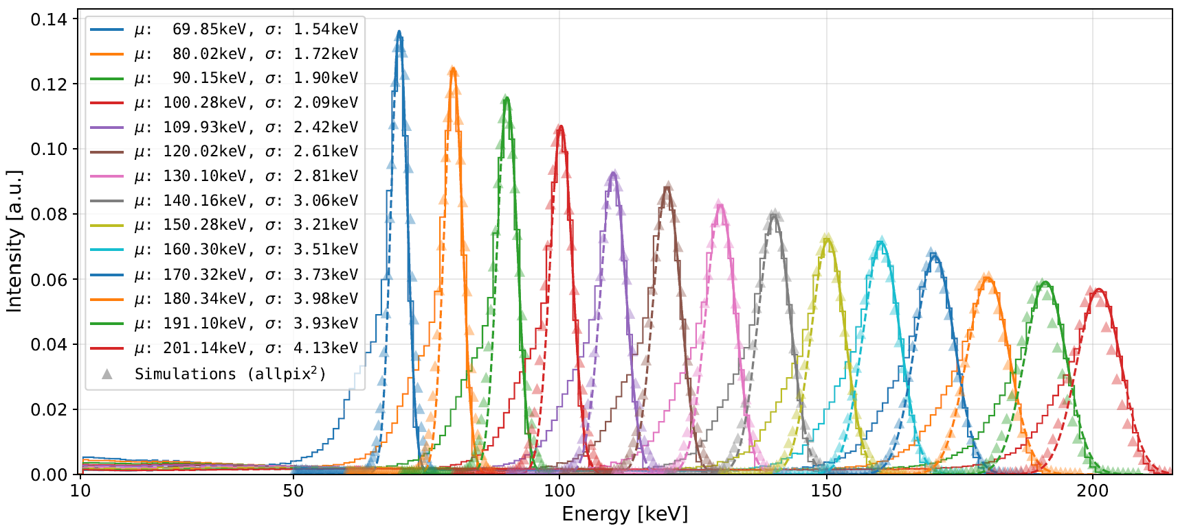
CUDA cluster finder Parallelize CPU solution on GPU
The problem
Find clusters which total energies trace back to the particle’s nature
Characterization of the chip (detector) in terms of energy resolution
<number>
Notes:
The cluster finder is an event reconstruction algorithm.
Typical data looks like the frame on the right where you would have sparse elctron/photon hits (yellow dots)
These clusters spread on a few pixels.
The cluster finder would identify these clusters, compute back their total energy which would trace back to the energy of your particle, anyway if the energy resolution of your detector is good...
Below curves are histograms of the clusters distribution over a range of energies, you's expect then to be Gaussian like and centered around the particle's energy
<number>

Slide 4
CUDA cluster finder Parallelize CPU solution on GPU
The problem
Find clusters which total energies trace back to the particle’s nature
Core idea
Map one thread to one pixel, use shared memory for neighborhood reuse, and emit only sparse detections.
Hardware
NVIDIA RTX 4090*
100,000 frames of size 400×400
Headline result
CPU: 548 FPS
GPU: 24,996 FPS
Speedup: ~45×
*NVIDIA RTX 4090 (Ada, compute capability 8.9).
<number>
Notes:
The CPU version already existed. My task was to parallelize this computation on the GPU.
The core idea is to map one CUDA thread to one pixel. Each thread checks a local neighborhood around that pixel, uses shared memory for neighborhood reuse, and only emits a result if a cluster is detected.
On an RTX 4090, for 100,000 frames of size 400 by 400, I measured roughly 45 times speedup compared with the CPU version.
<number>

Slide 5
Single frame kernel one thread per pixel
Kernel flow
Per-thread work
Execution model
A 16×16 block = 256 threads → 256 pixels processed together.
1. load tile + halo
3. local stencil reduction
2. sync
4. classify
5. update or append
kernel launch
// Grid/Block dimensions
block = dim3(BLOCK_X, BLOCK_Y);
grid = dim3((static_cast<unsigned int>(ncols) + BLOCK_X - 1) / BLOCK_X,
(static_cast<unsigned int>(nrows) + BLOCK_Y - 1) / BLOCK_Y);
device::find_clusters_in_single_frame<<<grid, block, shmem_bytes, stream>>>(
d_frame, d_pd_mean, d_pd_sum, d_pd_sum2,
n_pd_samples, nSigma, nrows, ncols,
d_clusters, d_cluster_count, max_clusters);
critical branch
if (!is_cluster) {
// update running background stats for next frame
} else {
uint32_t idx = atomicAdd(d_cluster_count, 1u);
if (idx < max_clusters) d_clusters[idx] = cluster;
}
<number>
Notes:
This slide shows the kernel flow.
The ThreadBlock size was set at 16 x 16 threads i.e. the kernel will process 256 pixels at once.
1. First, a block loads a tile of the frame into shared memory, including the halo needed for neighborhood checks. Then the threads synchronize.
2. Each thread performs a local stencil reduction over its neighborhood, classifies whether the pixel corresponds to a cluster, and then updates the cluster vector.
<number>

Slide 6

Single frame kernel one thread per pixel
Kernel flow
Per-thread work
Execution model
A 16×16 block = 256 threads → 256 pixels processed together.
1. load tile + halo
3. local stencil reduction
2. sync
4. classify
5. update or append
Sparse output
Most threads produce no output.
Only detections perform an atomic append.
kernel launch
// Grid/Block dimensions
block = dim3(BLOCK_X, BLOCK_Y);
grid = dim3((static_cast<unsigned int>(ncols) + BLOCK_X - 1) / BLOCK_X,
(static_cast<unsigned int>(nrows) + BLOCK_Y - 1) / BLOCK_Y);
device::find_clusters_in_single_frame<<<grid, block, shmem_bytes, stream>>>(
d_frame, d_pd_mean, d_pd_sum, d_pd_sum2,
n_pd_samples, nSigma, nrows, ncols,
d_clusters, d_cluster_count, max_clusters);
The output is sparse, but the per-pixel decision work is dense and highly parallel.
Why this maps well to GPU?
The work per pixel is regular, independent, and repeated across the full frame.
critical branch
if (!is_cluster) {
// update running background stats for next frame
} else {
uint32_t idx = atomicAdd(d_cluster_count, 1u);
if (idx < max_clusters) d_clusters[idx] = cluster;
}
5
Notes:
As you saw the previous frame, the output is sparse and in this algorithm it is actually a good thing as only threads mapping to cluster need to operate atomic operation to update the counter of the cluster.
The work however is not sparse as each thread needs to process its pixel so the work is independent and regular.
<number>

Slide 7
Shared memory tiling
Tile layout for 3x3 cluster
Idea
Neighboring threads need overlapping neighborhoods.
Shared memory lets a block load once and reuse many times.
green = 3×3 neighborhood
blue = 16×16 block interior
Odd cluster sizes only
Bindings support 3×3, 5×5, 7×7, and 9×9 clusters.
The center is always unique.
gray = halo
shared-memory mapping
Shared memory is cheap (~100kB for Ada SM)
For doubles and 16×16 blocks:
3×3 → 18×18 = 2.5 KB
9×9 → 24×24 = 4.5 KB
Shared memory is not the occupancy bottleneck here.
extern __shared__ unsigned char smem[];
PEDESTAL_TYPE* shmem = reinterpret_cast<PEDESTAL_TYPE*>(smem);
auto shmem_stride = blockDim.x + 2 * col_radius;
auto shmem_tid = (threadIdx.y + row_radius) * shmem_stride + (threadIdx.x + col_radius);
shmem[shmem_tid] = d_frame[gid] - d_pd_mean[gid];
<number>
Notes:
The use of the on-chip shared memory is important.
Shared memory is used to reduce redundant global-memory loads through tiling.
But as any stencil-like problem, special care needs to be given when compting the halo (or the boundary) that needs to be loads for further computations.
Only odd cluster sizes are supported for now --> Unique center.
Computation show that for different cluster sizes, shared memory stays cheap is likely not the occupancy bottleneck here.
<number>

Slide 8
Block size and occupancy reasoning
block size
threads / block
max threads / SM
ideal blocks / SM
shared mem / block
16 × 16
256
1536
6
2.5–4.5 KB
Why 16 x 16?
enough threads to amortize halo loading.
modest shared memory.
Small enough to avoid extreme register pressure.
below the 1024-thread/block hardware limit.
Tradeoffs in one view
8×8 blocks
lighter per block
more halo overhead / less work per block
16×16 blocks
balanced choice
what was used
resource sizing
32×32 blocks
maxes out block threads
riskier for registers and scheduling
constexpr int BLOCK_X = 16;
constexpr int BLOCK_Y = 16;
size_t shmem_bytes = (BLOCK_X + 2*col_radius)
* (BLOCK_Y + 2*row_radius)
* sizeof(PEDESTAL_TYPE);
<number>
Notes:
Let's us talk a bit about occupancy.
It is usually one metric used to define the siye of the blocks in order to fit a maximum of resident blocks in order to hide latency.
The block size I used is 16 by 16, so 256 threads per block. On the RTX 4090, this maps well to the hardware because it can in principle allow several blocks resident per SM.
<number>

Slide 9
Block size and occupancy reasoning
block size
threads / block
max threads / SM
ideal blocks / SM
shared mem / block
16 × 16
256
1536
6
2.5–4.5 KB
Why 16 x 16?
enough threads to amortize halo loading.
modest shared memory.
Small enough to avoid extreme register pressure.
below the 1024-thread/block hardware limit.
Register pressure (ptxas -v)
The limiter is registers, because each thread keeps a local clusterData[CSX*CSY] array.
3×3 is fine (43 rgs/thread) i.e. ~87.5% occupancy
9×9 is the case where register spills and occupancy drops (128 rgs/thread) → 33% occupancy
resource sizing
constexpr int BLOCK_X = 16;
constexpr int BLOCK_Y = 16;
size_t shmem_bytes = (BLOCK_X + 2*col_radius)
* (BLOCK_Y + 2*row_radius)
* sizeof(PEDESTAL_TYPE);
BUT…
Occupancy is a means, not the goal!
The real goal is high throughput without spills or excessive overhead.
<number>
Notes:
But occupancy is not just about block size.
In this kernel, shared memory is small, so the more important limiter is register pressure. Each thread keeps local cluster data, and that grows with the cluster size.
For 3 by 3 clusters, register usage is comfortable and occupancy is high. For 9 by 9 clusters, register usage is much higher, and occupancy drops.
<number>

