Slide 1
Next Generation Sequencing
Samantha Sevilla
Spring 2018

Slide 2

Outline
Introduction
Study Design
Experiment
Bioinformatics
Quality Control
Findings
Conclusions

Slide 3
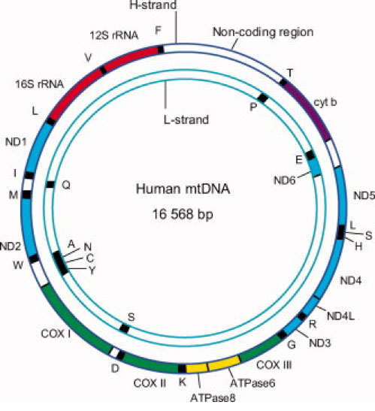

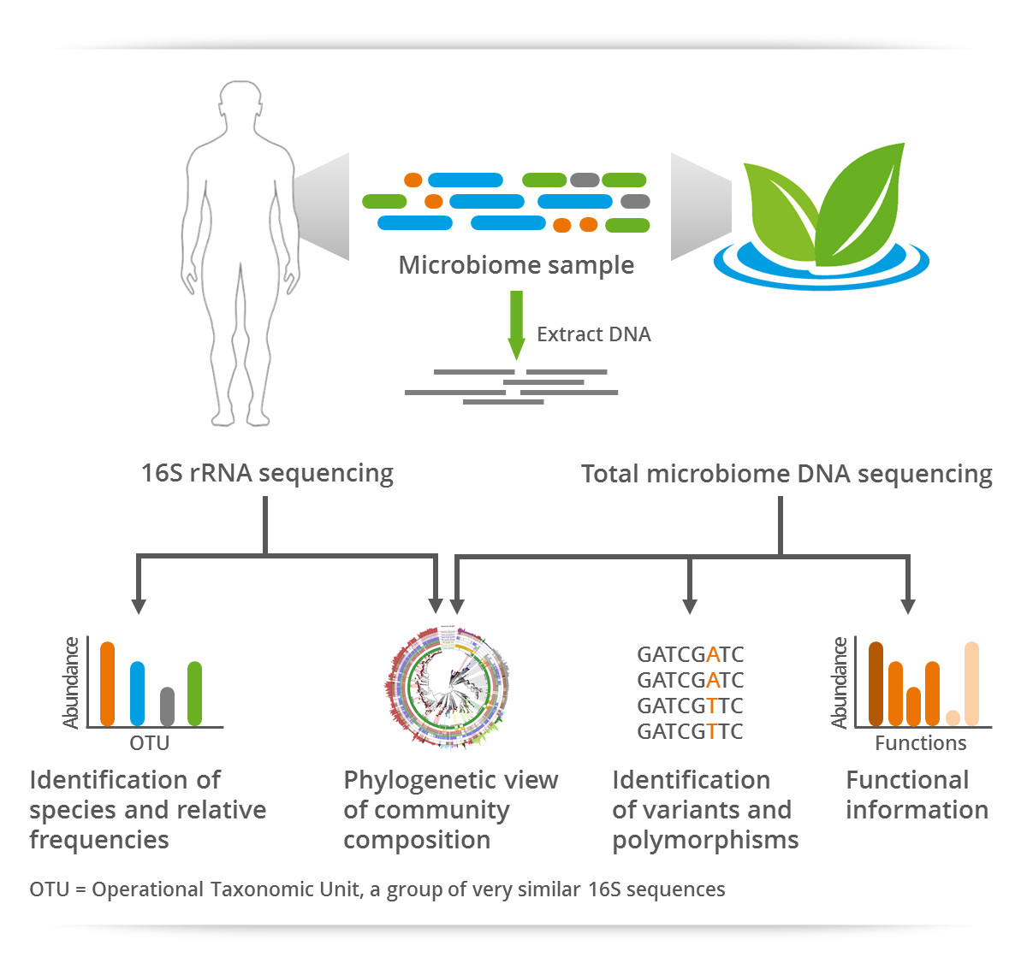
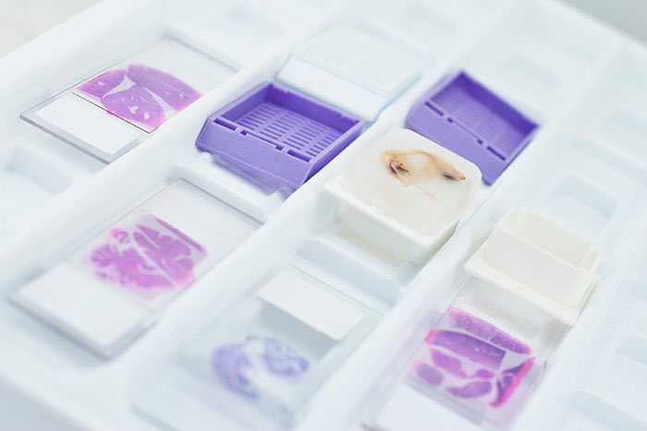


Introduction
Contractor for NCI
Development and Optimization
Microbiome 16S Sequencing
mtDNA
FFPE Library Prep

Slide 4


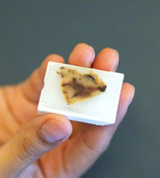
Fresh Frozen, Paraffin Embedded
FFPE samples are commonly used in research and clinical settings
Stored in a fixative
Embedded in paraffin
Complications to extraction and sequencing
Degraded and damaged samples
Highly fragmented
Artifacts from fixation
Notes:
FFPE is a technique that allows tissue samples to be stored at room temperature for extended periods of time, and are helpful in both research and clinics
Biopsy’s are stored in a fixative, commonly formaldehyde for a set period of time

Slide 5
Outline
Introduction
Study Design
Experiment
Bioinformatics
Quality Control
Findings
Conclusions

Slide 6
Study design
Library Method | Extraction Method | # Samples
A | 1 | 2
A | 2 | 2
B | 1 | 2
B | 2 | 2
2 samples
Paired tumor/normal kidney samples
2 library prep methods – paired end
A* - Mechanical Shearing Method
B* - Enzymatic Shearing Method; Contain Midi’s
2 extraction Methods
1*- Bead based extraction method
2*
* Due to the preliminary nature of the findings, names have been redacted

Slide 7
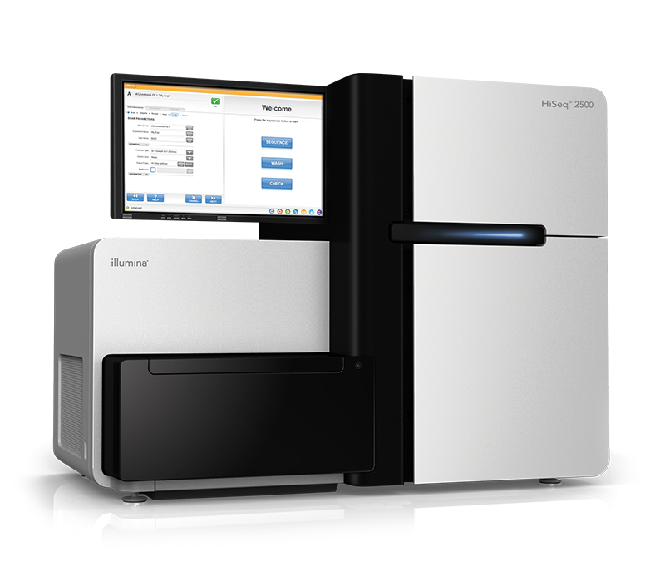
Study design
Sequencing
HiSeq 2500
Custom Capture Kit – Nimblegen
Paired-ends

Slide 8
Study Design
FastQ Joiner

Slide 9
Outline
Introduction
Study Design
Experiment
Bioinformatics
Quality Control
Findings
Conclusions

Slide 10
Outline
Introduction
Study Design
Experiment
Bioinformatics
Quality Control
Findings
Conclusions

Slide 11
Outline
Introduction
Study Design
Experiment
Bioinformatics
Quality Control
Findings
Conclusions

Slide 12
Outline
Introduction
Study Design
Experiment
Bioinformatics
Quality Control
Findings
Conclusions

Slide 13
references

