Slide 1
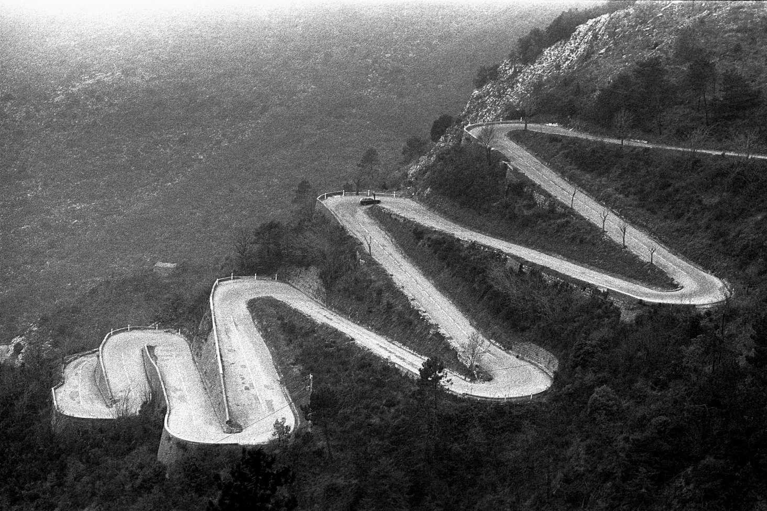
Valentina / Open Fashion
Notes:
Project status for Valentina open source pattern design software.
This project status is not just about the past two weeks, but about the past two years.
This update quickly covers progress since my previous workshop for Interactivos?'13 at MediaLab-Prado.
This project has had many twists and turns, but we've always gone forward and always gone up.

Slide 2
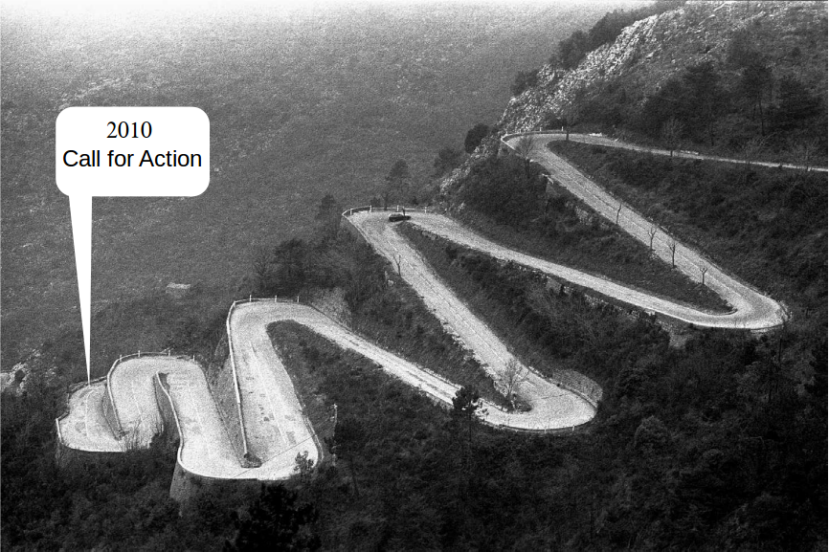
Valentina / Open Fashion
Notes:
Project status for Valentina open source pattern design software.
This project status is not just about the past two weeks, but about the past two years.
This update quickly covers progress since my previous workshop for Interactivos?'13 at MediaLab-Prado.
This project has had many twists and turns, but we've always gone forward and always gone up.

Slide 3
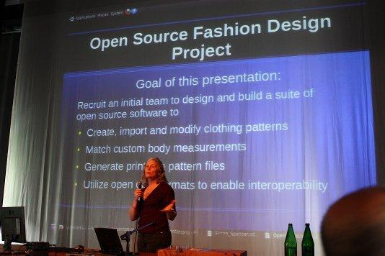
Valentina / Open Fashion
Notes:
This project began as a presentation at 2010 Libre Graphics, calling for an open source community to build tools for the fashion industry.

Slide 4
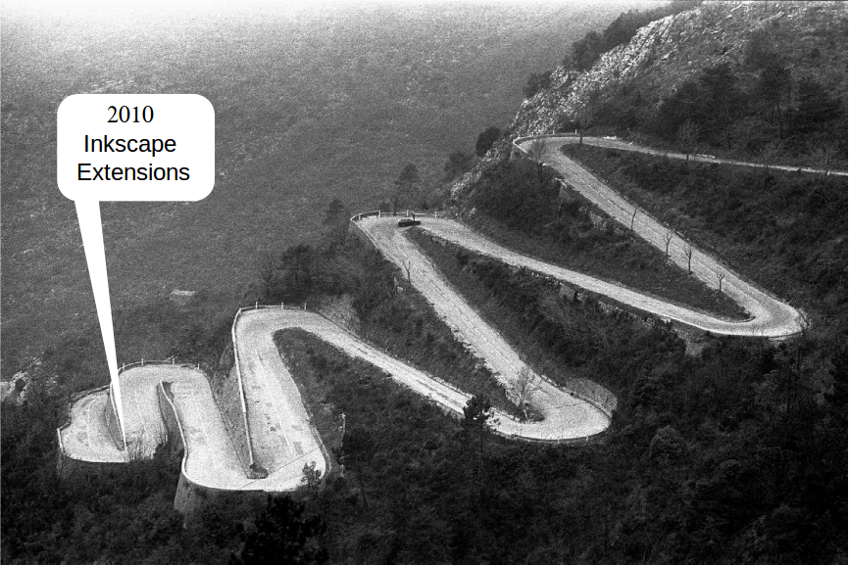
Valentina / Open Fashion
Notes:
Then there was a long exploration phase, for translating manual patternmaking methods into math, for translating SVG element tree functionality into usable functions, for finding the best data structures to hold pattern objects and data, for finding how to formulate the pattern templates, for finding the right body measurements to use, for studying pattern making methods, for finding best ways to arrange pattern pieces on paper, for finding best ways to label pattern pieces, and more.
The first iteration n 2011 was as an Inkscape extension.

Slide 5
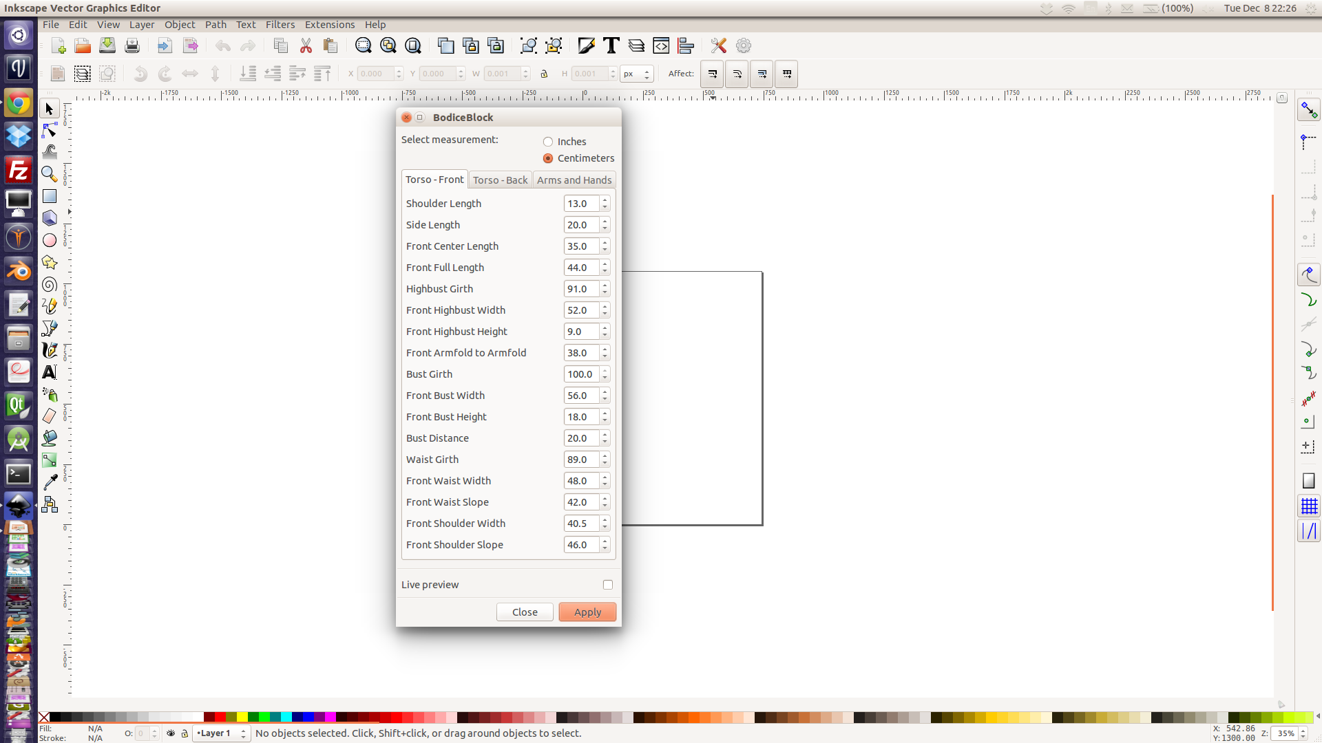
Valentina / Open Fashion
Notes:
Then there was a long exploration phase, for translating manual patternmaking methods into math, for translating SVG element tree functionality into usable functions, for finding the best data structures to hold pattern objects and data, for finding how to formulate the pattern templates, for finding the right body measurements to use, for studying pattern making methods, for finding best ways to arrange pattern pieces on paper, for finding best ways to label pattern pieces, and more.
The first iteration n 2011 was as an Inkscape extension.

Slide 6
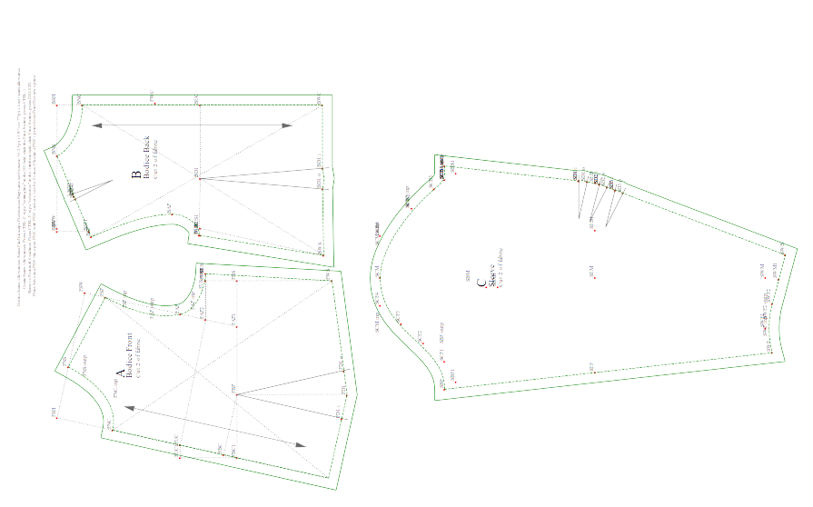
Valentina / Open Fashion
Pattern from Inkscape Extension
Notes:
This is the output from the Inkscape extension

Slide 7
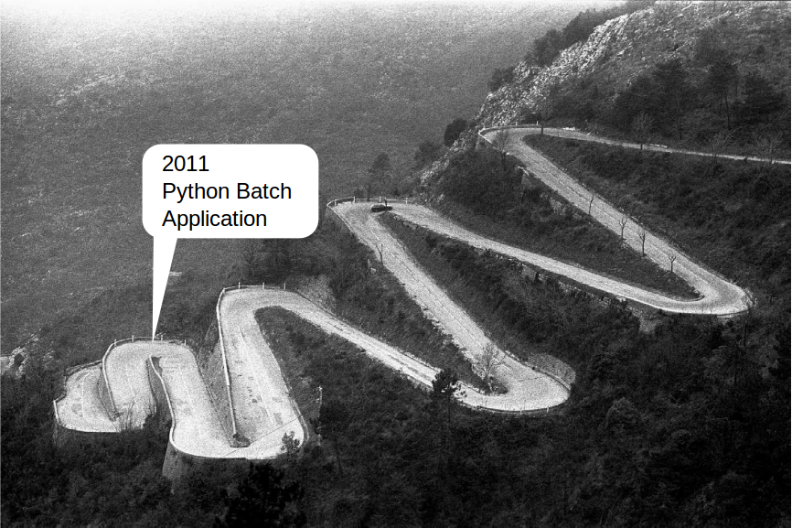
Valentina / Open Fashion
Notes:
The second iteration was a batch file processor written in Python.

Slide 8
Valentina / Open Fashion
Tau Meta Tau Physica batch file processor
Notes:
Then there was a long exploration phase, for translating manual patternmaking methods into math, for translating SVG element tree functionality into usable functions, for finding the best data structures to hold pattern objects and data, for finding how to formulate the pattern templates, for finding the right body measurements to use, for studying pattern making methods, for finding best ways to arrange pattern pieces on paper, for finding best ways to label pattern pieces, and more.
The first iteration n 2011 was as an Inkscape extension.

Slide 9
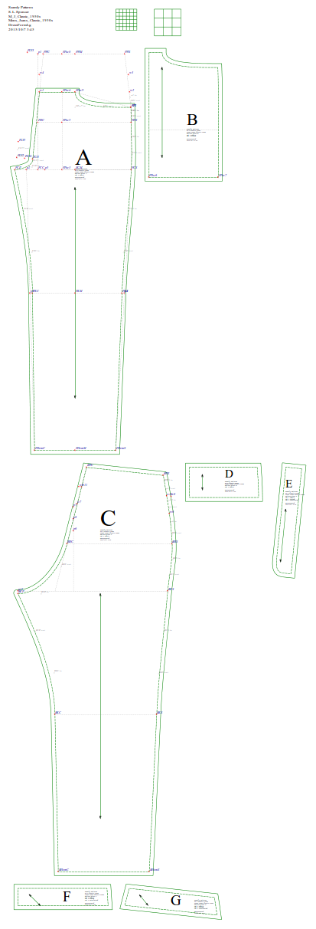
Valentina / Open Fashion
Pattern from TMTP

Slide 10
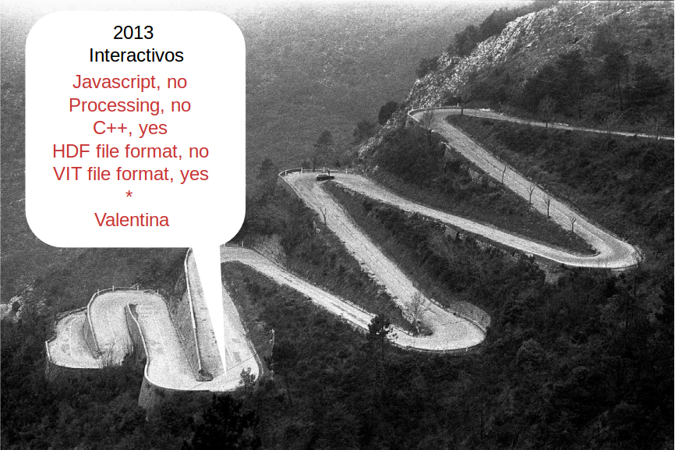
Valentina / Open Fashion
Notes:
The second iteration was a batch file processor written in Python.

Slide 11
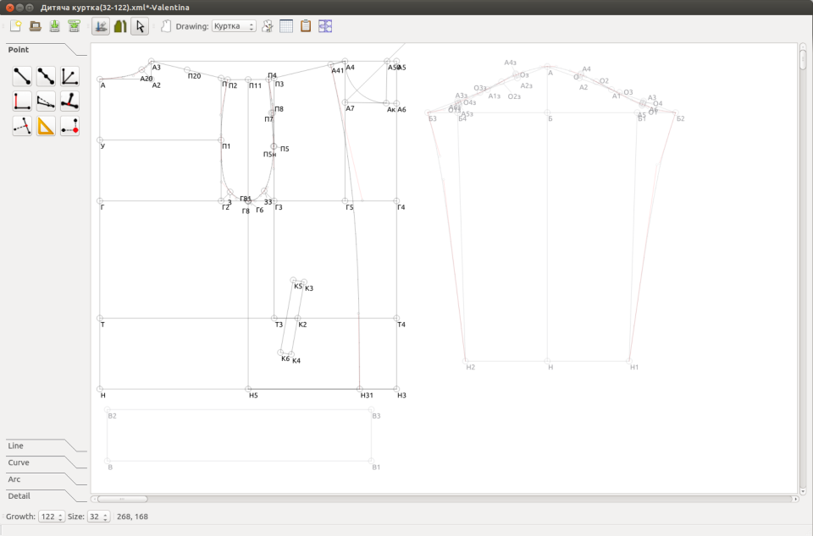
Valentina / Open Fashion
Valentina 0.2.0
Notes:
The second iteration was a batch file processor written in Python.

Slide 12
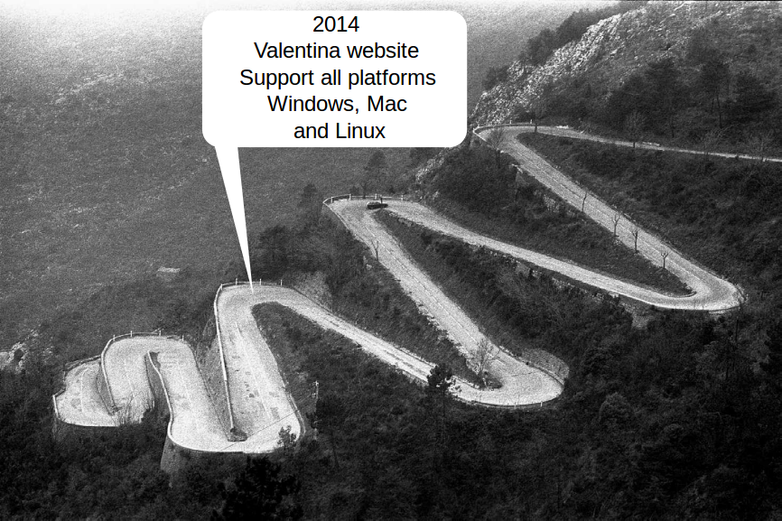
Valentina / Open Fashion
Notes:
The second iteration was a batch file processor written in Python.

Slide 13
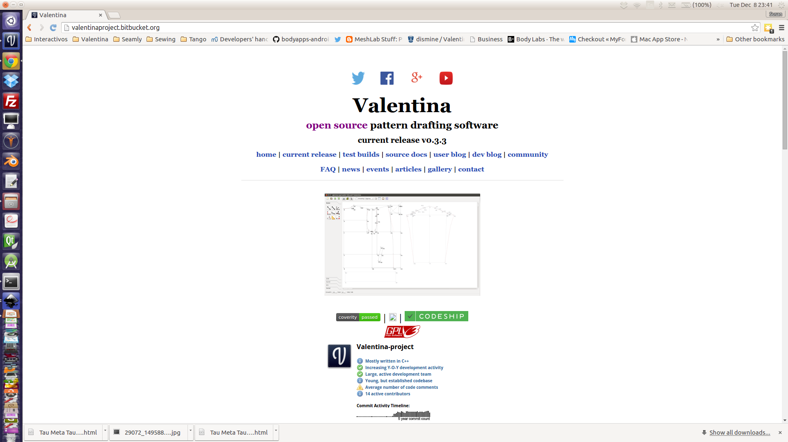
Valentina / Open Fashion
Notes:
The second iteration was a batch file processor written in Python.

Slide 14
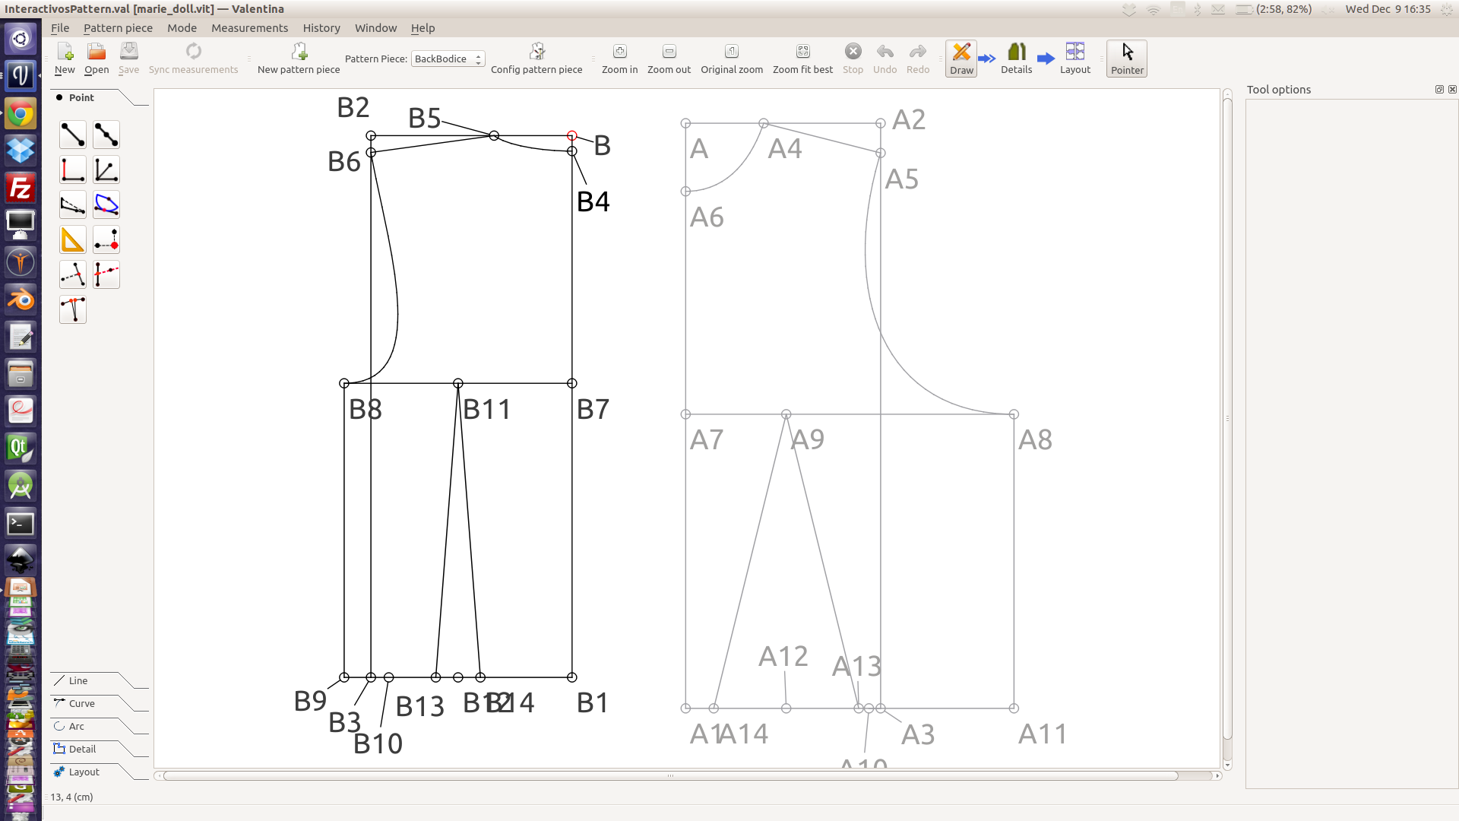
Valentina / Open Fashion
Valentina 0.4.0
Notes:
The second iteration was a batch file processor written in Python.

Slide 15
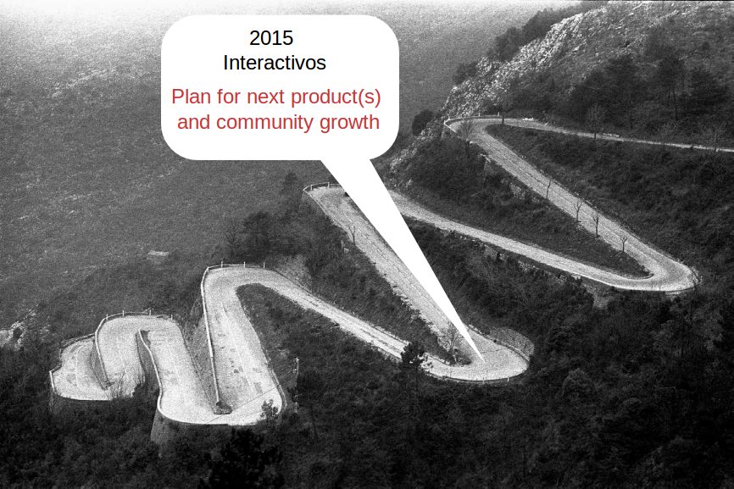
Valentina / Open Fashion
Notes:
The second iteration was a batch file processor written in Python.

Slide 16
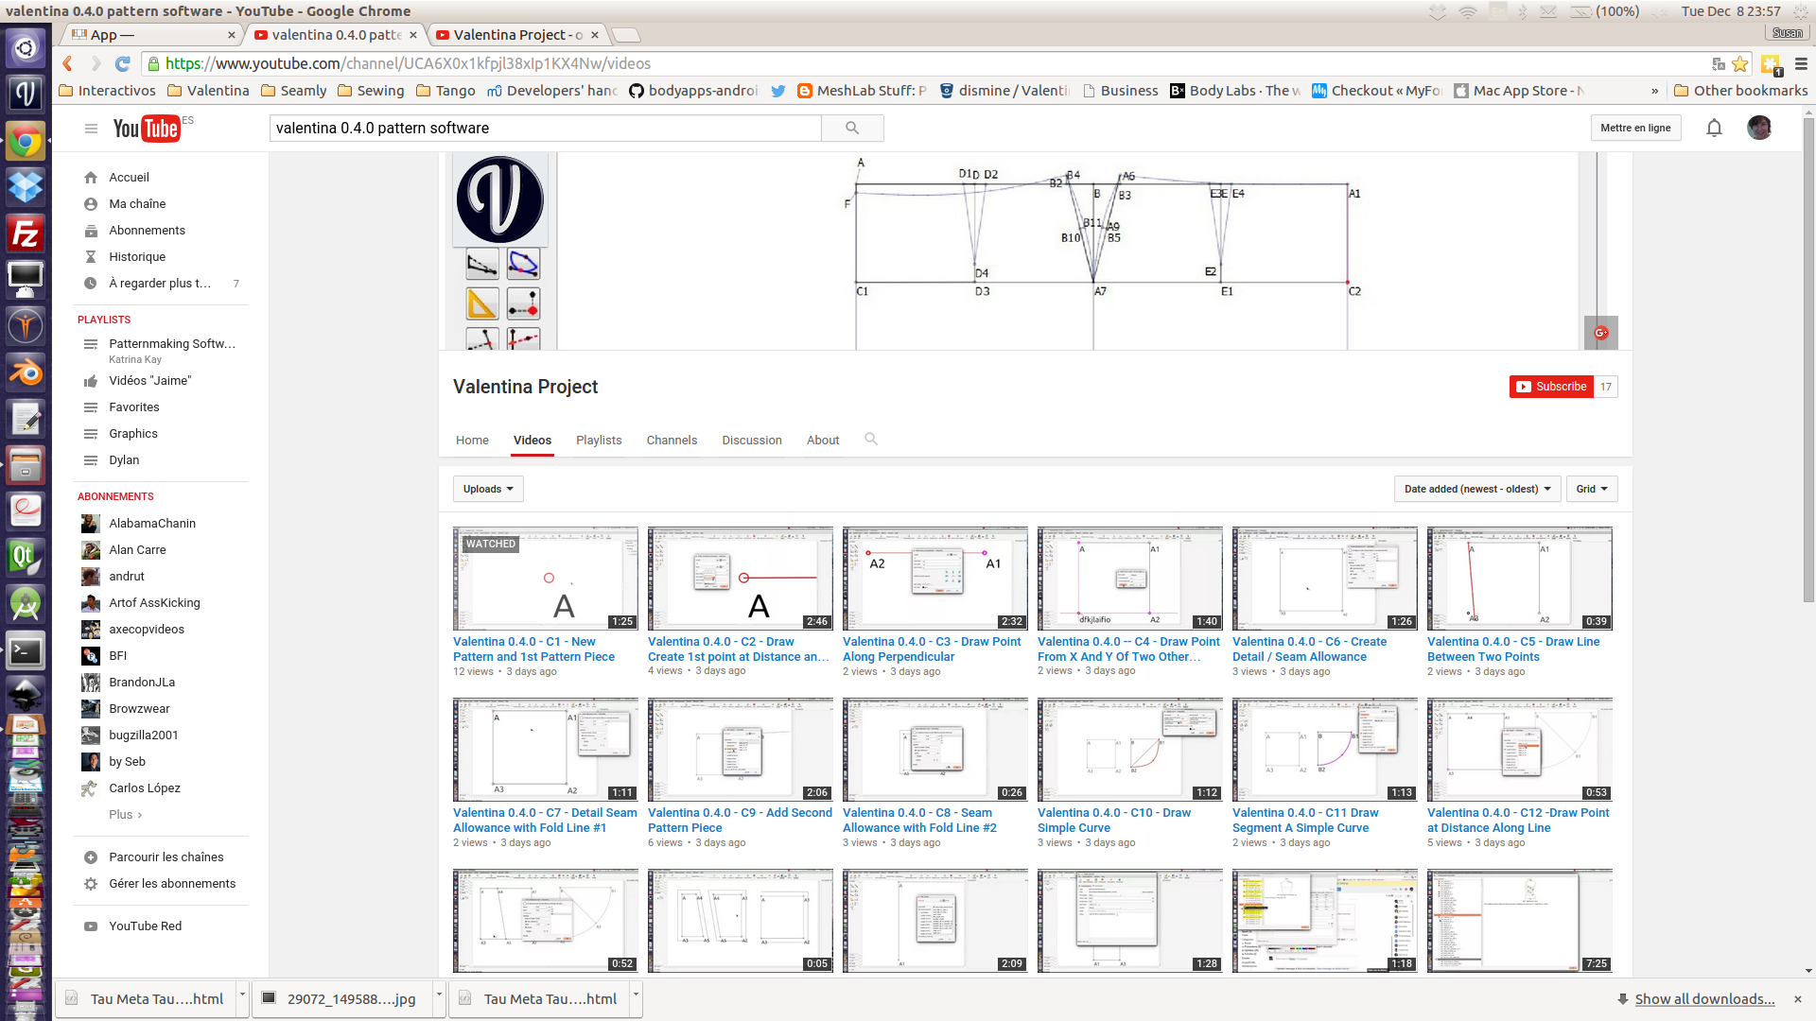
Valentina / Open Fashion
Build Community with Valentina Training
Notes:
The second iteration was a batch file processor written in Python.

Slide 17
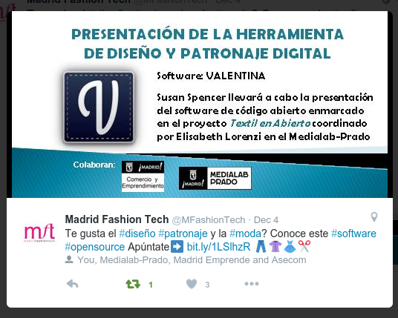
Valentina / Open Fashion
Build Community with Open Source Outreach
Notes:
The second iteration was a batch file processor written in Python.

Slide 18
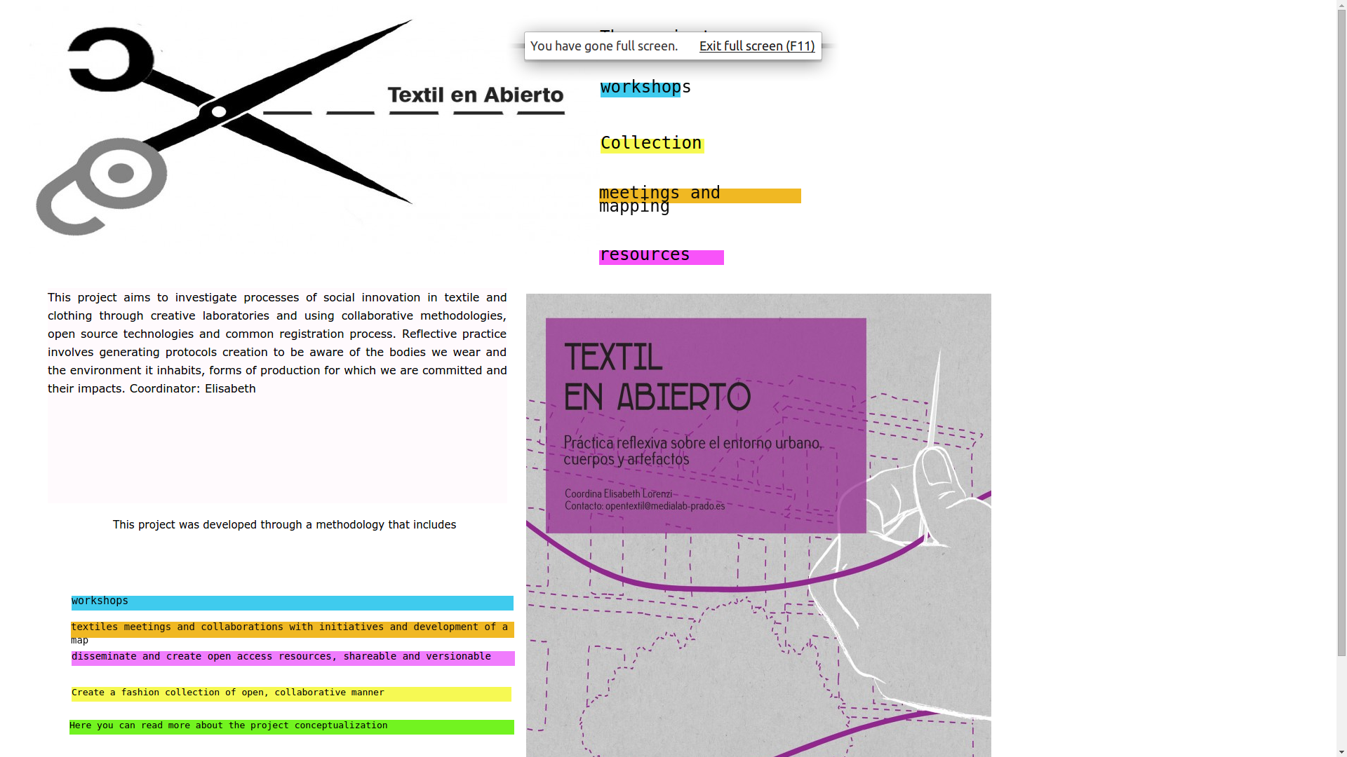
Valentina / Open Fashion
Build Community with Valentina Pattern Drafting
Notes:
The second iteration was a batch file processor written in Python.

Slide 19
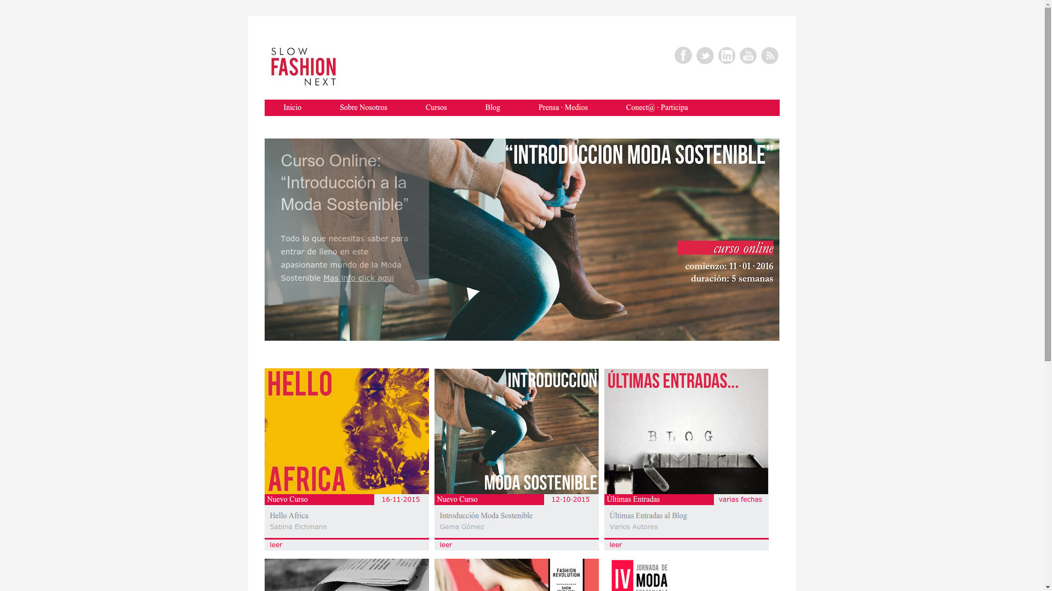
Valentina / Open Fashion
Build Community with Social Media Outreach
Notes:
The second iteration was a batch file processor written in Python.

Slide 20
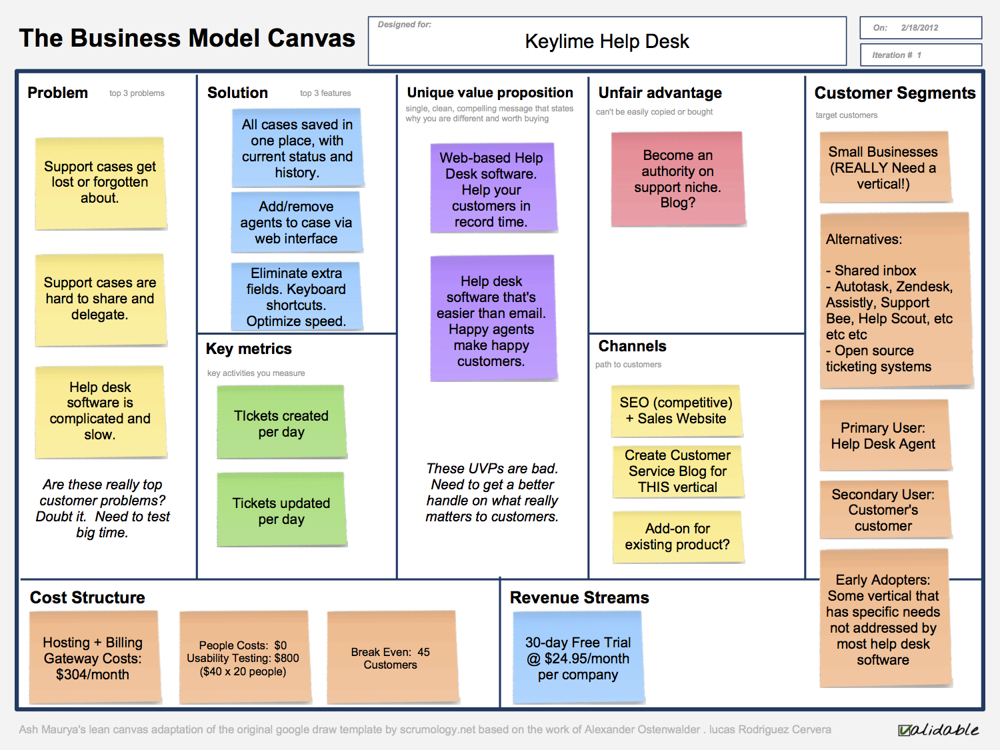
Valentina / Open Fashion
Product and Business Development
Notes:
The second iteration was a batch file processor written in Python.

Slide 21
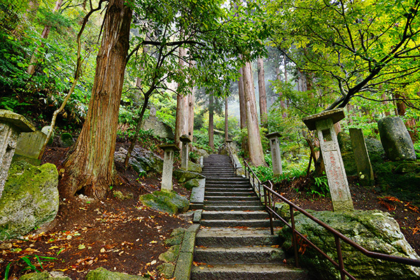
Valentina / Open Fashion
Future Road Map
Notes:
The second iteration was a batch file processor written in Python.

Slide 22
Valentina / Open Fashion
Interactivos Deliverables
Digitized patterns for Textil En Abierto
'Open Source Concepts for Fashion Design' Slide Deck
'Introduction to Valentina' Slide Deck
Valentina YouTube Training Videos
Fashion Designer Interview Protocol
Community Building with Empresas de Vivas (event)
Community Building with Slow Fashion Next (event)
Community Building with Independent Fashion Tour (event)
Valentina Training with Textil En Abierto
Valentina Future Road Map
Notes:
The second iteration was a batch file processor written in Python.

