Slide 1
Valentina
open-source pattern design tool
traditional patternmaking formulas
custom body measurements

Slide 2
Valentina's primary goal:
make made-to-measure and boutique-sized garments and patterns
more profitable and scalable

Slide 3
Valentina's additional goals:
Reduces barriers-to-entry
into the fashion industry
Reduces lead time for small batch and single unit garment production
Removes inter-operability problems of using proprietary tools

Slide 4
Problems with Measurements
Body Proportions are a Victorian construct - “Kenyan vs vs Korean”
Data gathered from primarily European-descent populations
Produced in 'nested sizes'
Methods of taking body measurements varies – “Ease vs No Ease”
No standardized measurement sets or names

Slide 5
Valentina's Solution
Measurements
Measurement Chart:
Measurements from all patternmaking systems are available
https://bitbucket.org/dismine/valentina/wiki/Measurements#markdown-header-measurement-image-and-download
Measurement names:
Consistent naming convention
Uses 'Body Points'
Measurement methodology:
No Ease

Slide 6
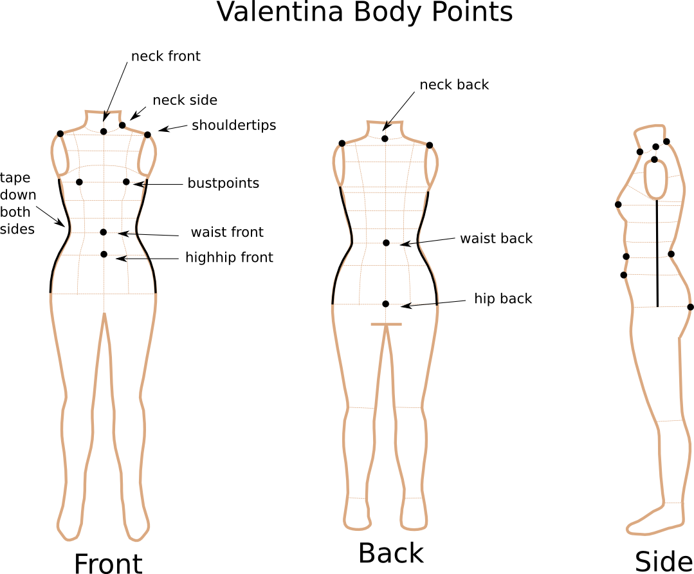

Slide 7
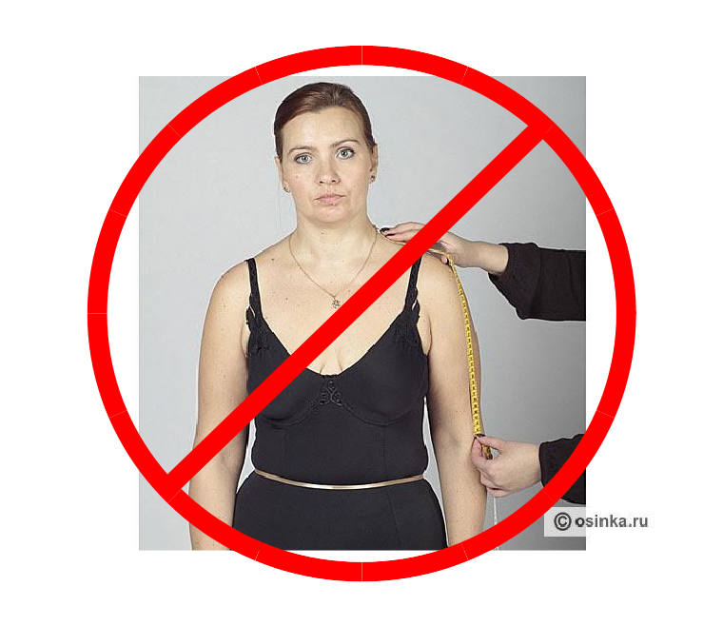
No Ease!

Slide 8
Measurements Files
– Classification –
Customizable:
Individual (*.vit)
Blank Templates (*.vit)
Government Standards:
Standard (*.vst, readonly)

Slide 9
Measurements Files
– Usage –
Individual:
Customize your own set of measurements
Template:
Quick, Copy template of your favorite patternmaking system
Can create your own templates
* Boutique Sizing is possible
Create multiple files from your customized template,
one for each size *

Slide 10
Exercise:
Measurements Files

Slide 11
Problems with Patterns
No embedded product information
Not human readable
Proprietary, non-interoperable
Few pattern systems make patterns that fit,
base size is not a real person
Notes:
Not a fully engineered product - No notes – No embedded product information – No communication between designer and manufacturer
Proprietary pattern file format – Inscrutable, Not human readable – Special drivers required to print image, $$ pay American garment association for rights to driver
Produced in 'nested sizes'- How is this easy to use, this is simply easy to store

Slide 12
Exercise:
Create Simple Pattern
Notes:
Not a fully engineered product - No notes – No embedded product information – No communication between designer and manufacturer
Proprietary pattern file format – Inscrutable, Not human readable – Special drivers required to print image, $$ pay American garment association for rights to driver
Produced in 'nested sizes'- How is this easy to use, this is simply easy to store

Slide 13
Exercise:
Create Bodice Pattern
Notes:
Not a fully engineered product - No notes – No embedded product information – No communication between designer and manufacturer
Proprietary pattern file format – Inscrutable, Not human readable – Special drivers required to print image, $$ pay American garment association for rights to driver
Produced in 'nested sizes'- How is this easy to use, this is simply easy to store

Slide 14
Learn Patternmaking
Winifred Aldrich
Metric Pattern Cutting for Women's Wear
Metric Pattern Cutting for Menswear
Metric Pattern Cutting for Children's Wear and Babywear
Natalie Bray
Dress Pattern Designing: The Basic Principles of Cut and Fit
More Dress Pattern Designing
Dress Fitting: Basic Principles and Practice
Bunka Fashion College
Textbook 1: Fundamentals of Garment Design
Textbook 2: Skirts and Pants (Japanese and English translation)
Textbook 3: Blouses and Dresses (Japanese and English translation)
Textbook 4: Jackets and Vests (Japanese and English translation)
Helen Joseph-Armstrong - Patternmaking for Fashion Design
Notes:
Not a fully engineered product - No notes – No embedded product information – No communication between designer and manufacturer
Proprietary pattern file format – Inscrutable, Not human readable – Special drivers required to print image, $$ pay American garment association for rights to driver
Produced in 'nested sizes'- How is this easy to use, this is simply easy to store

Slide 15
Learn Patternmaking
Lori A. Knowles
Practical Guide to Patternmaking for Fashion Designers: Juniors, Misses and Women
Practical Guide to Patternmaking for Fashion Designers: Men
Lucia Mors de Castro
Patternmaking in Fashion
Patternmaking in Practice
M. Muller & Sohn
Schnittkonstruktionen fuer Kleider und Blusen (Dresses and Blouses)
Schnittkonstruktionen fuer Roecke und Hosen (Skirts and Trousers)
Schnittkonstruktionen fuer Jacken und Maentel (Jackets and Coats)
HAKA Schnittkonstruktionen 1 Sakkos und Westen (Jackets and Vests)
HAKA Schnittkonstruktionen 2 Sakkos (Jackets)
HEMDEN Schnitttechnik (Shirts)
HAKA Schnittkonstruktionen Hosen (Trousers)
Vittorina Rolfo, et. al. --Designing Apparel Through the Flat Pattern
Teresa Gilewska
Pattern-Drafting for Fashion (series)
Notes:
Not a fully engineered product - No notes – No embedded product information – No communication between designer and manufacturer
Proprietary pattern file format – Inscrutable, Not human readable – Special drivers required to print image, $$ pay American garment association for rights to driver
Produced in 'nested sizes'- How is this easy to use, this is simply easy to store

Slide 16
Valentina's Solution
Patterns
Split into Two parts:
Pattern and Image of Pattern
Open data format, Human readable
(XML standard)
Formulas are saved in pattern (*.val)
Image exportable to standard file formats (.png, .jpg, .svg, .pdf, .dxf)
Notes:
Not a fully engineered product - No notes – No embedded product information – No communication between designer and manufacturer
Proprietary pattern file format – Inscrutable, Not human readable – Special drivers required to print image, $$ pay American garment association for rights to driver
Produced in 'nested sizes'- How is this easy to use, this is simply easy to store

