Slide 1
Data Reference Guide 5/29/26

Slide 2
Storage

Slide 3
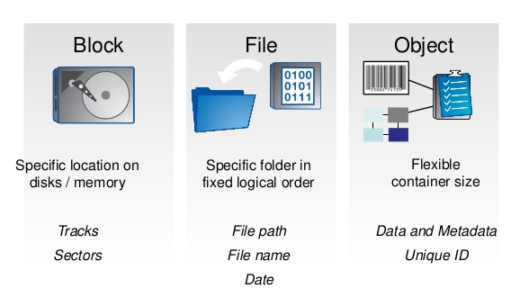
Types of Storage
Notes:
https://apachebooster.com/blog/different-types-of-storage-object-vs-file-vs-block-storage/

Slide 4
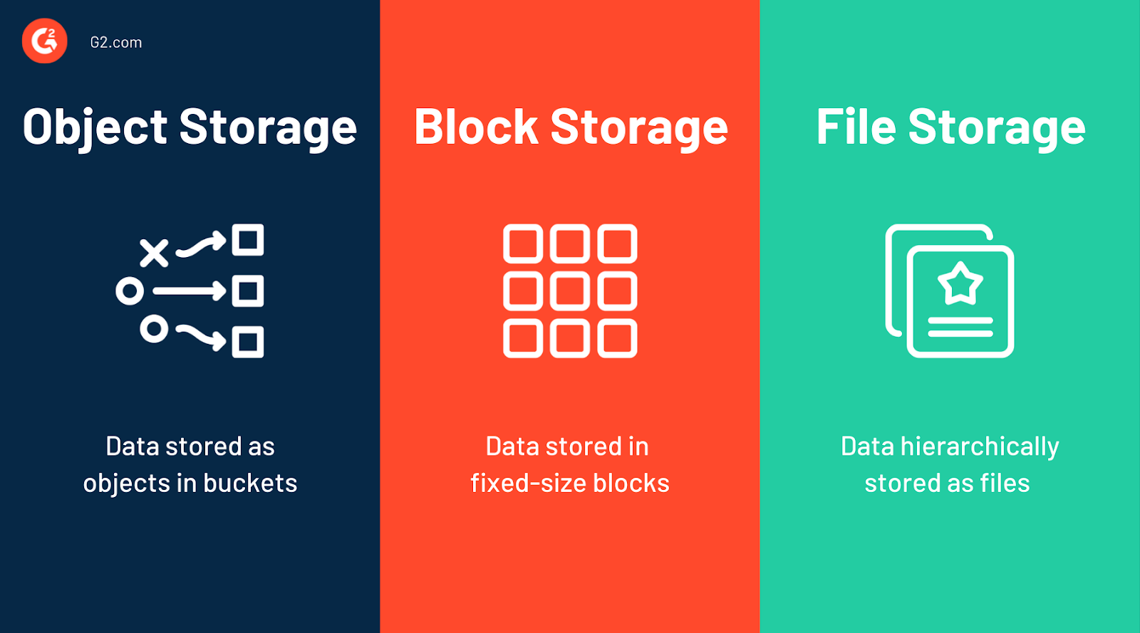
Notes:
https://blog.internxt.com/object-vs-file-vs-block-storage/

Slide 5
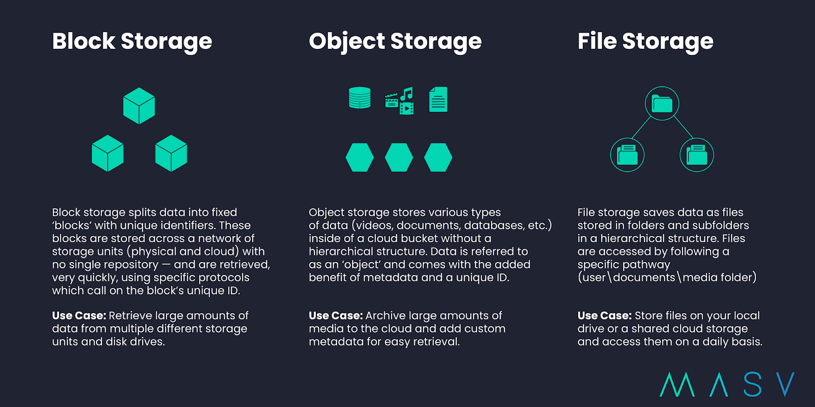
Notes:
https://blog.internxt.com/object-vs-file-vs-block-storage/

Slide 6
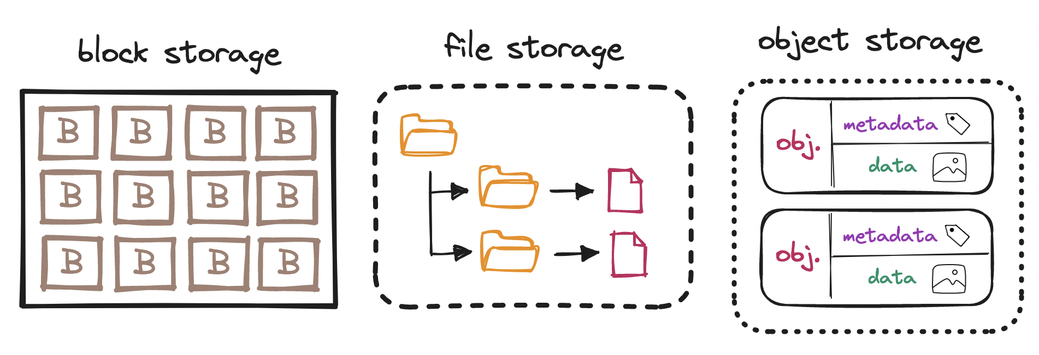
Notes:
https://ivov.dev/notes/s3-object-storage

Slide 7
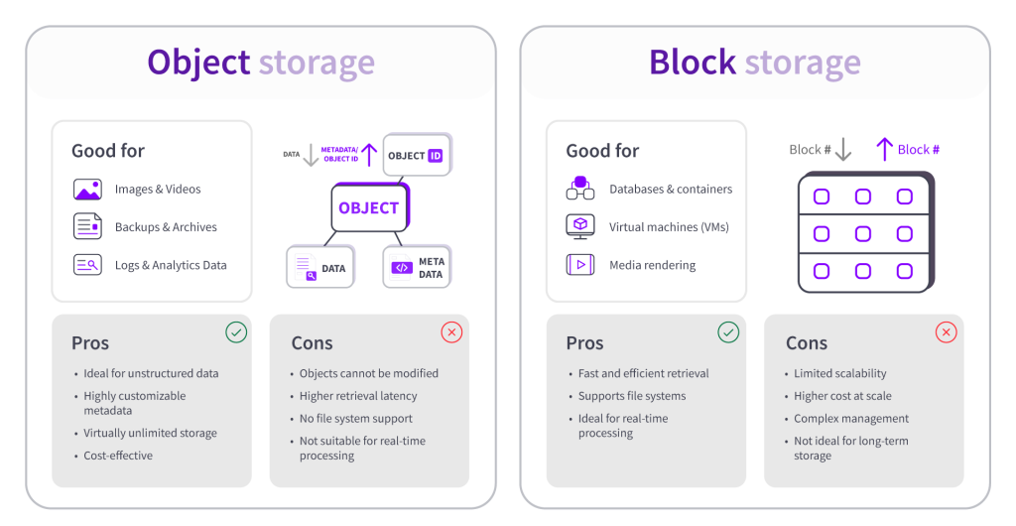
Notes:
https://upcloud.com/global/blog/comparison-guide-object-storage-vs-block-storage/

Slide 8
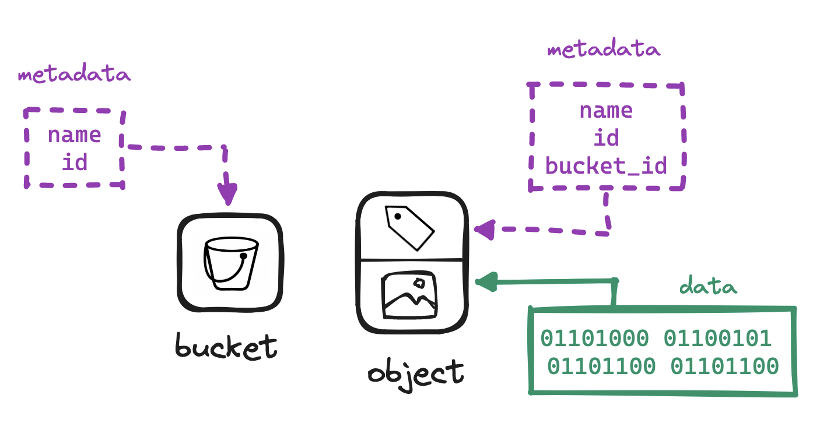
In AWS

Slide 9
Data Architecture
Notes:
https://docs.aws.amazon.com/architecture-diagrams/latest/modern-data-analytics-on-aws/modern-data-analytics-on-aws.html

Slide 10
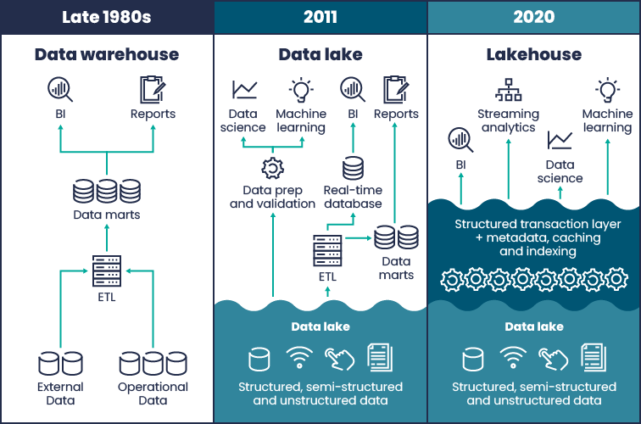
Evolution of Data Architecture
Notes:
https://nearshore-it.eu/articles/unveiling-data-mesh-architecture-principles/

Slide 11
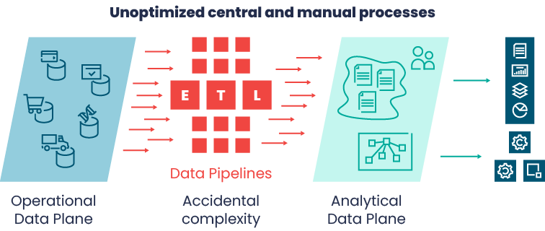
Data Warehouse Challenges

Slide 12
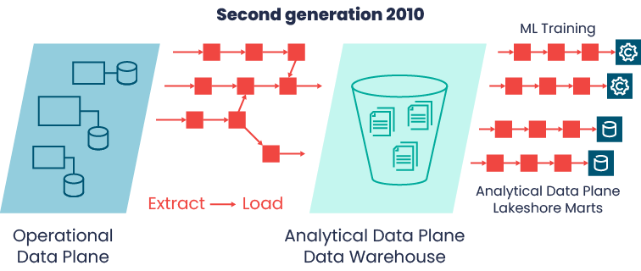
Data Lake Challenges

Slide 13
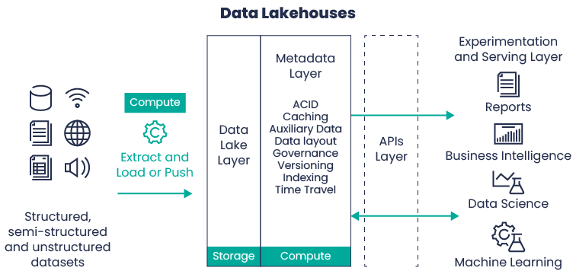
Data Lakehouse

Slide 14
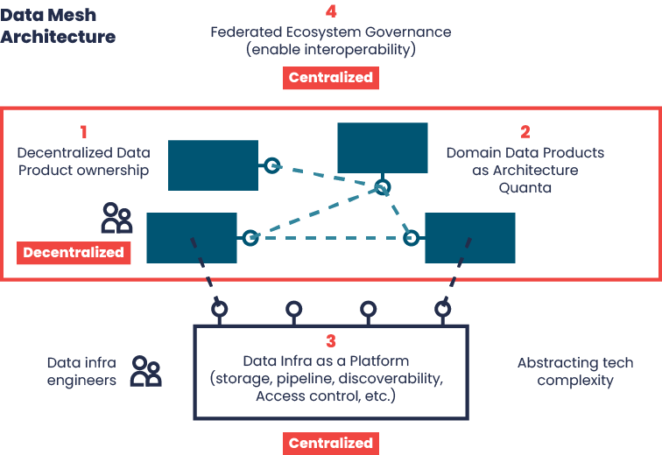
Data Mesh

Slide 15
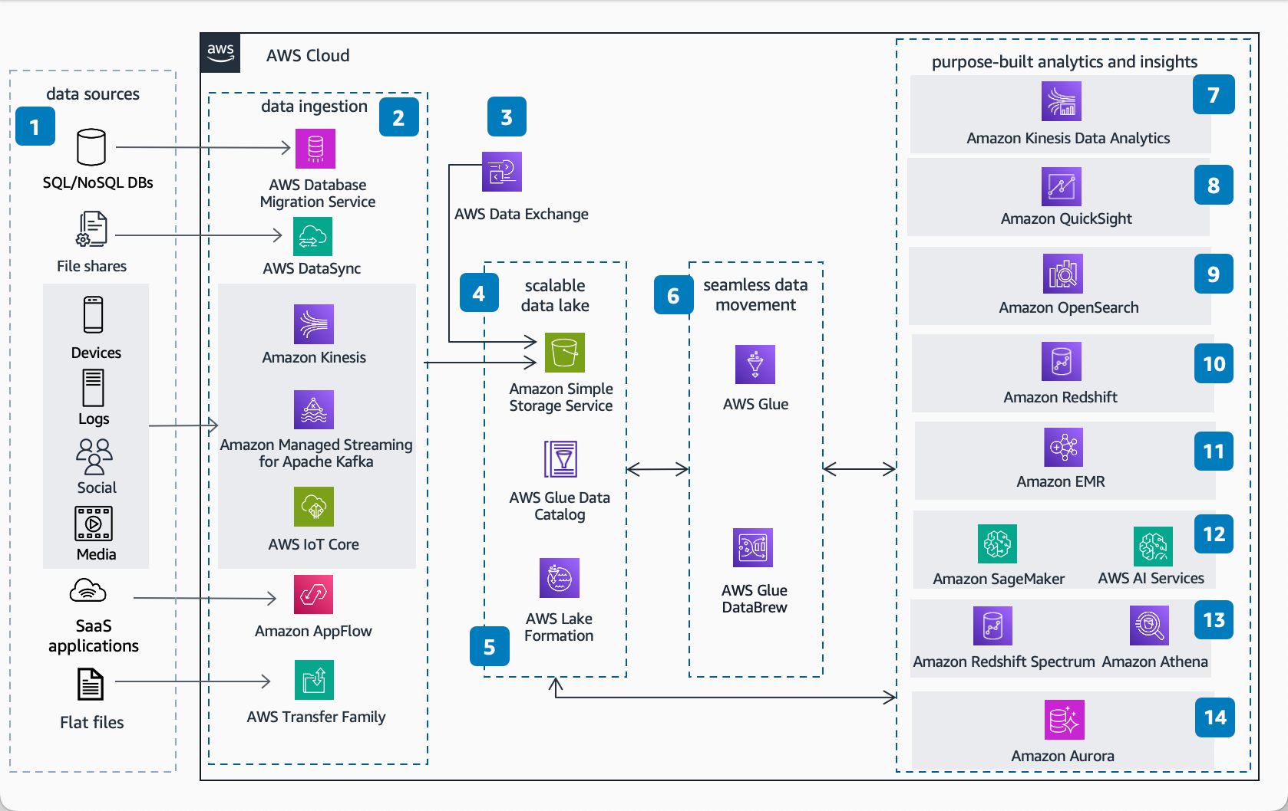
In AWS

