Slide 1
AI Architecture Patterns Reference Guide 5/27/26

Slide 2
RAG
Notes:
https://medium.com/@vi.ha.engr/bridging-natural-language-and-databases-best-practices-for-llm-generated-sql-fcba0449d4e5

Slide 3
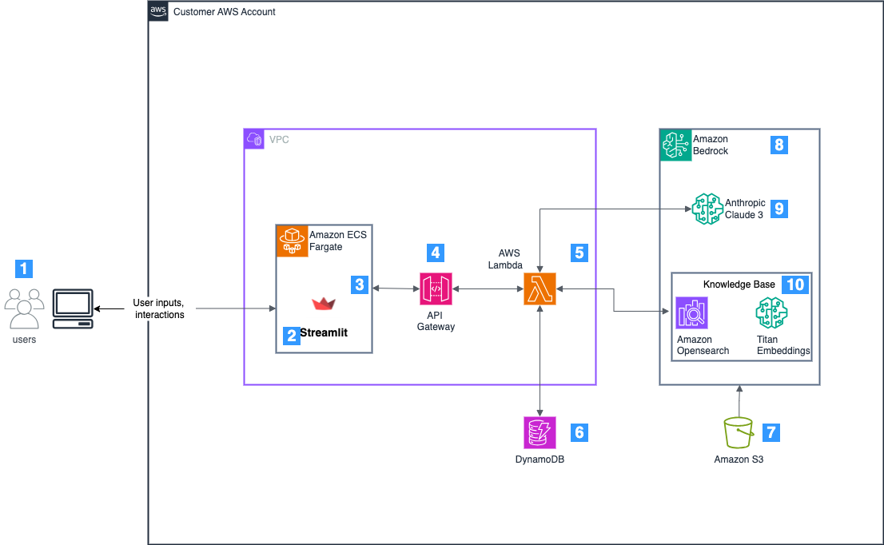
Baseline
Notes:
https://aws.amazon.com/blogs/security/hardening-the-rag-chatbot-architecture-powered-by-amazon-bedrock-blueprint-for-secure-design-and-anti-pattern-migration/

Slide 4
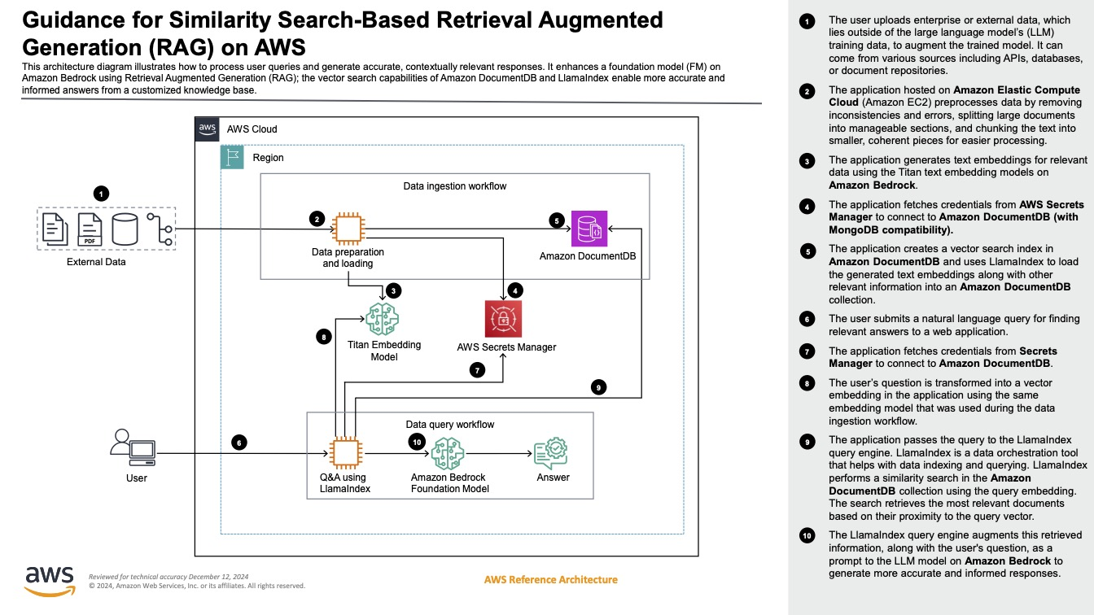
Notes:
https://docs.aws.amazon.com/solutions/similarity-search-based-retrieval-augmented-generation-rag-on-aws/

Slide 5
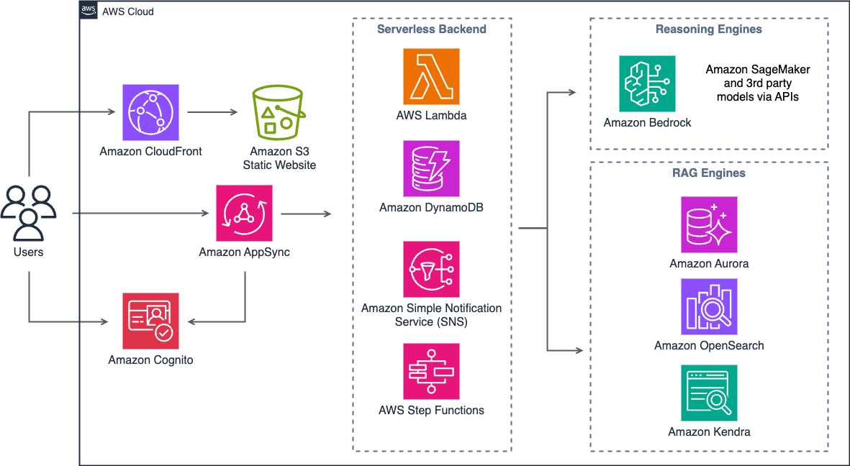
Notes:
https://aws-samples.github.io/aws-genai-llm-chatbot/about/architecture.html

Slide 6
LLM Text-to-SQL
Notes:
https://medium.com/@vi.ha.engr/bridging-natural-language-and-databases-best-practices-for-llm-generated-sql-fcba0449d4e5

Slide 7
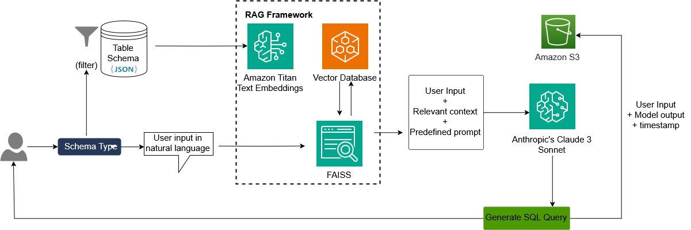
LLM with RAG (AWS Bedrock)
Notes:
https://aws.amazon.com/blogs/machine-learning/build-your-gen-ai-based-text-to-sql-application-using-rag-powered-by-amazon-bedrock-claude-3-sonnet-and-amazon-titan-for-embedding/

Slide 8
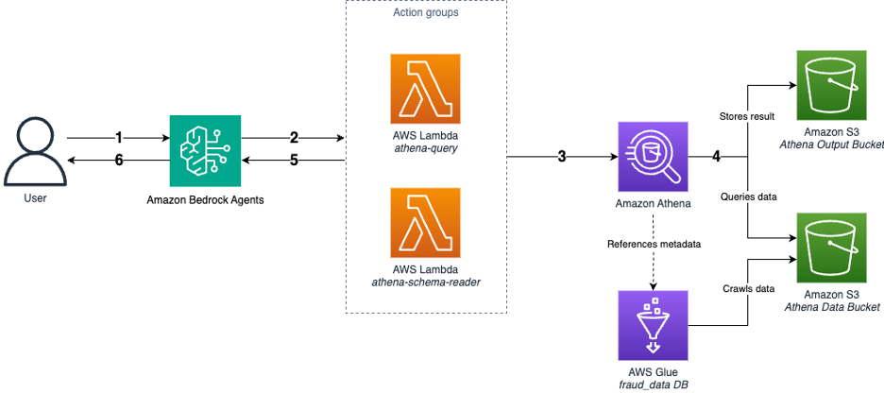
Agentic Text-to-SQL
Notes:
https://aws.amazon.com/blogs/machine-learning/dynamic-text-to-sql-for-enterprise-workloads-with-amazon-bedrock-agents/

Slide 9
RAG

Slide 10
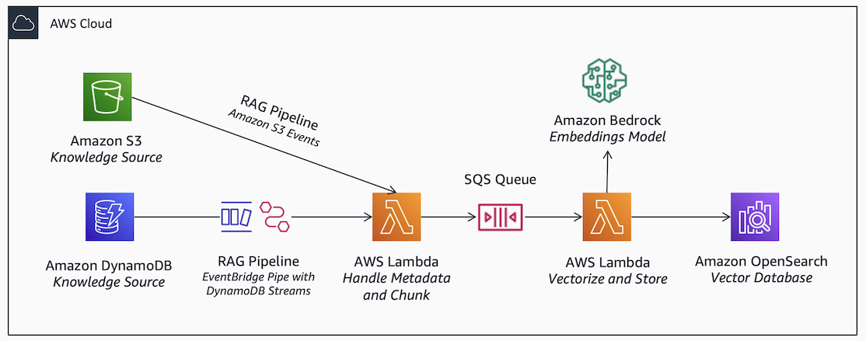
RAG Pipeline

Slide 11
Enterprise-level
Notes:
https://builder.aws.com/content/2f2d59922DQNz3iH1pCTeudpmhv/aws-bedrock-generative-ai-application-architecture

Slide 12
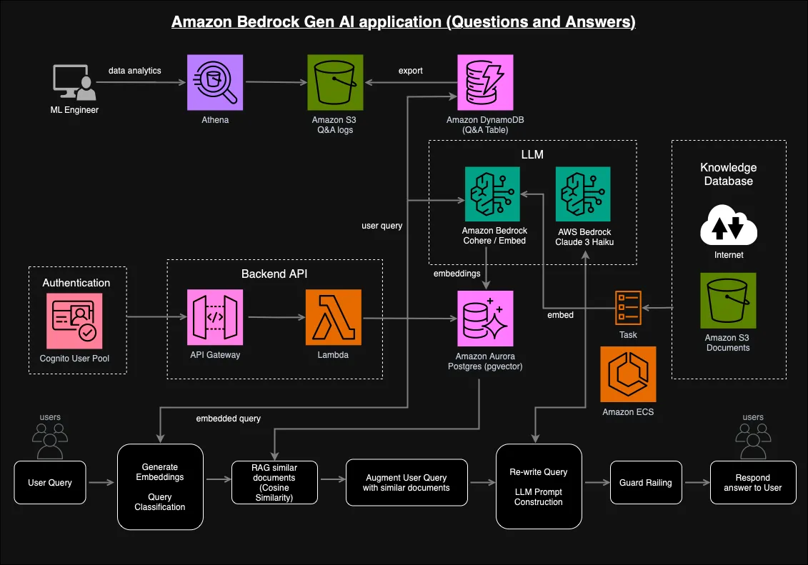

Slide 13
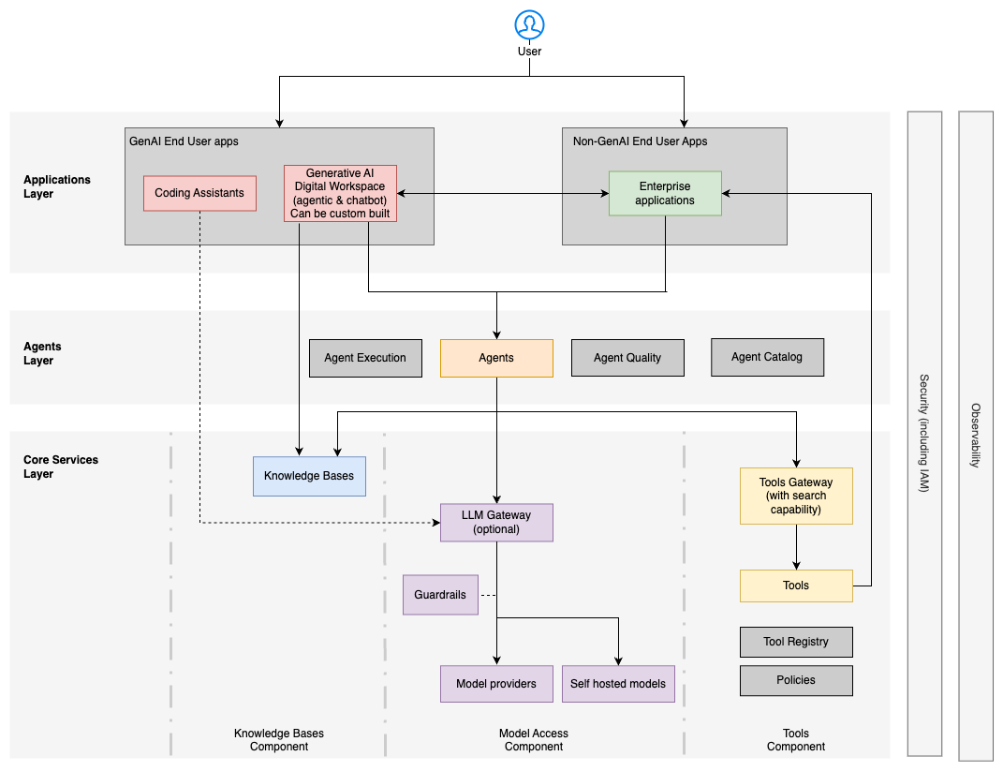
Notes:
https://docs.aws.amazon.com/prescriptive-guidance/latest/govern-architect-agentic-ai/enterprise-architecture.html

Slide 14
Traditional ML

Slide 15
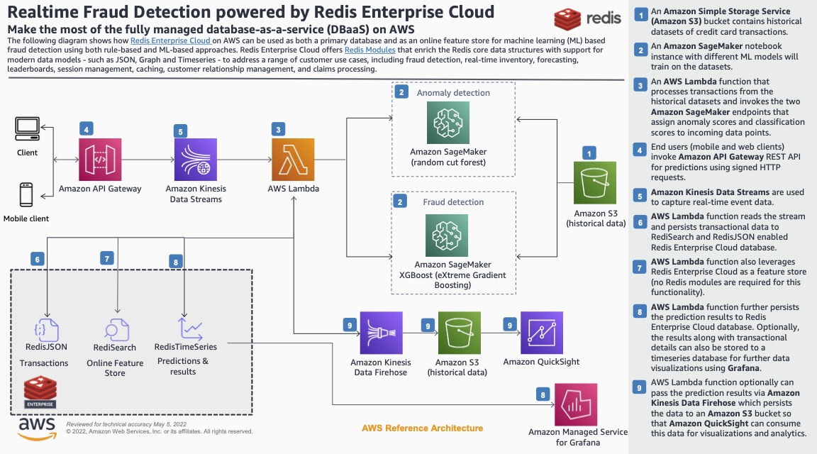
Notes:
https://d1.awsstatic.com/architecture-diagrams/ArchitectureDiagrams/aws_redis_realtime_fraud_detection_ra.pdf?did=wp_card&trk=wp_card

Slide 16
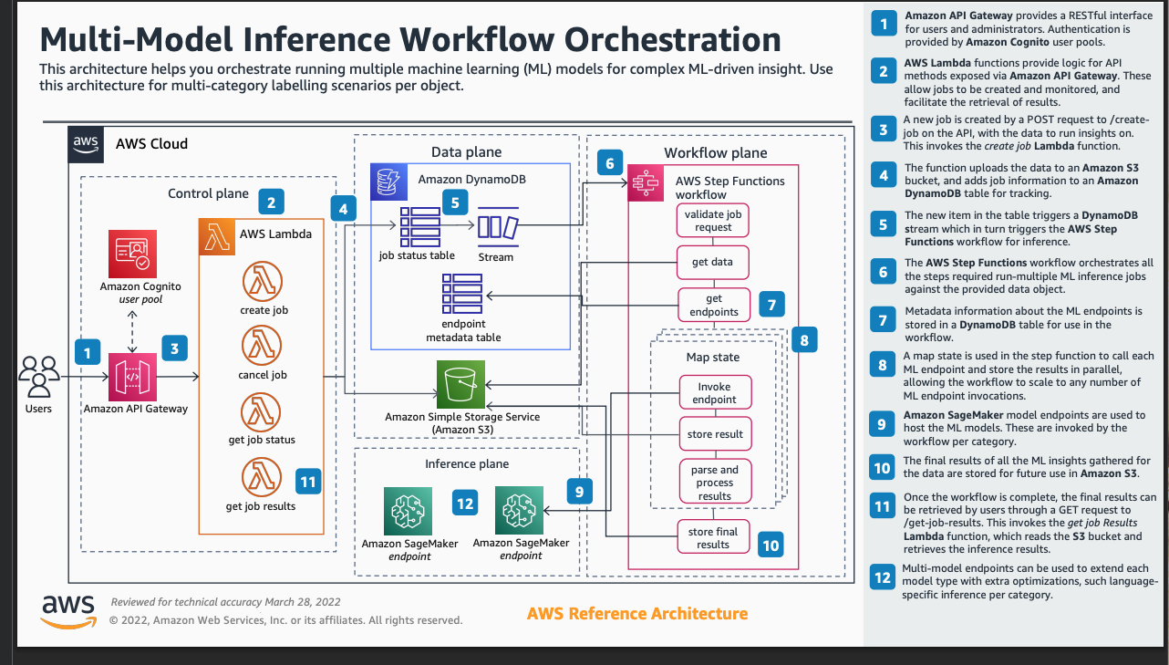
Notes:
https://d1.awsstatic.com/architecture-diagrams/ArchitectureDiagrams/multi-model-inference-workflow-orchestration-ra.pdf?did=wp_card&trk=wp_card

Slide 17
MLOps

Slide 18
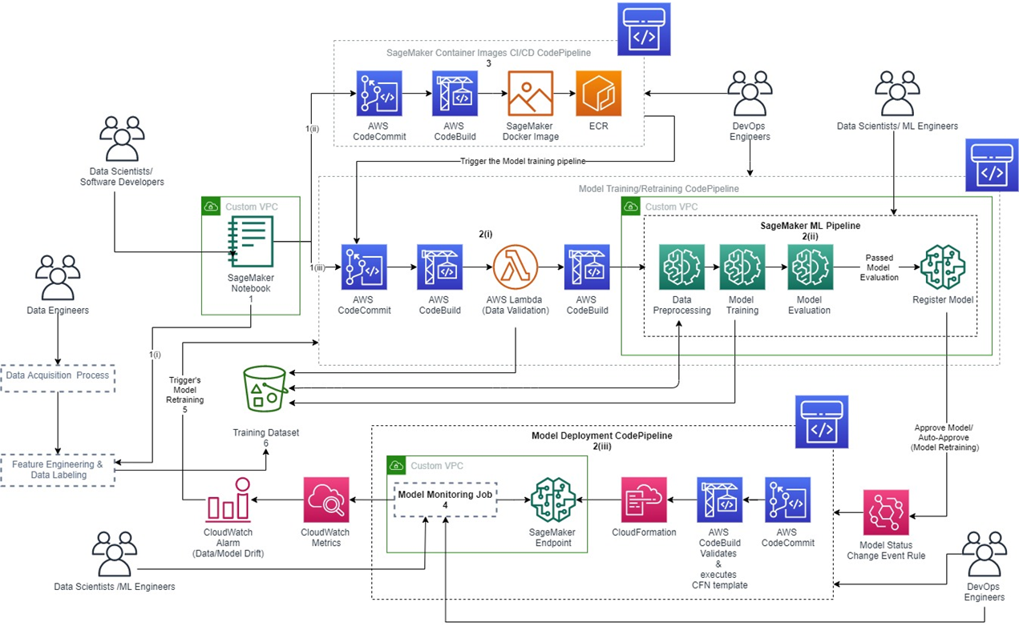
Notes:
https://aws.amazon.com/blogs/apn/taming-machine-learning-on-aws-with-mlops-a-reference-architecture/

Slide 19
Landing Zone

Slide 20
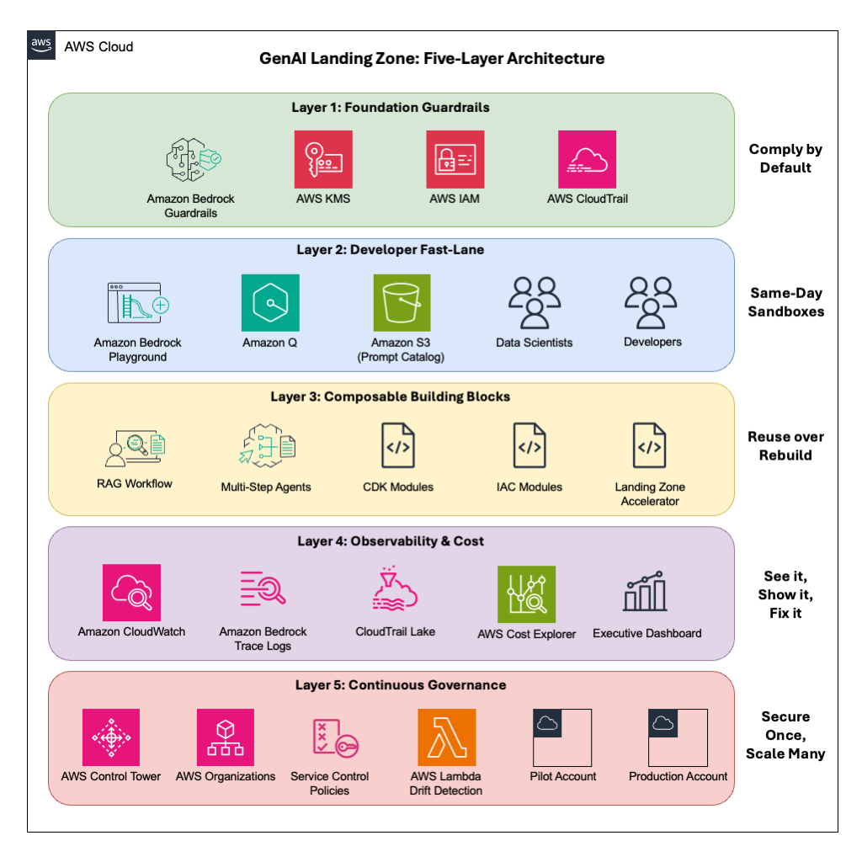
Notes:
https://aws.amazon.com/blogs/apn/rapidly-build-a-generative-ai-landing-zone-on-aws/

