Slide 1

REGIONAL TRAINING COURSE MUTATION BREEDING AND MOLECULAR TECHNIQUE FOR CROP IMPROVEMENT
Promoting Sustainable Agricultural and Food Productivity
in the Association of Southeast Asian Nations Region
Improving the Resilience of Crops to Climate Change
through Mutation Breeding — Phase II (SAPI)
29/04/2024 ~ 03/05/2024

Slide 2




Situation:
Cultivar A shows green leaf , mutation changes leaf color
ex) EMS mutagenesis
Cultivar A
Green leaf
mutation
Brown leaf
Cultivar A
Green leaf
Brown leaf
DNA
vs
Cultivar A
Green leaf
Brown leaf
DNA
vs
Reference genome
Sequencing
ATGCATGCATGCATGCATGC…
vs
??????…
Green leaf
Orange leaf
Cultivar A
Cultivar B

Slide 3
DNA fragment
Sequencing
Sequencing
ATGCATGCATGCATGC…ATGCATCCA
ATC…AGC
CAT…GAC
Whole chromosome
GCA…TGA
…
100~300bp
GCA…TGA
TTA…CTG
Cultivar A
Green leaf
Brown leaf
DNA
vs
Reference genome
Sequencing
ATGCATGCATGCATGC…ATGCATCCA
ATC…AGC
CAT…GAC
GCA…TGA
GCA…TGA
…
100~300bp
TTA…CTG
Short read alignment
Reference genome
ATGCATGCATGCATGC…………ATGCATCCA
ATGCAG
…
ATGCAT
Short reads
AGGCAT
GCATCC
AGGCAT
CATCCA
CATGCA
Cultivar A
Green leaf
mutation
Brown leaf
ATGCATGCATGCATGC…ATGCATCCA
ATGCAGGCATGCATGC…ATGCATCCA

Slide 4

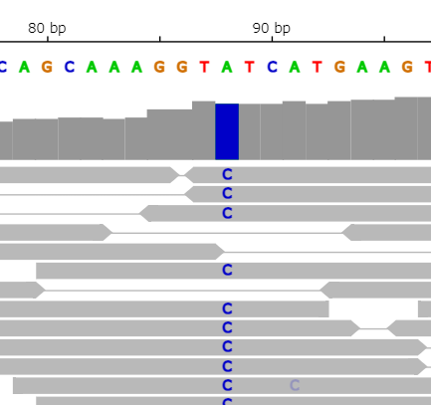
Cultivar A
Find
Database
Reference
Genome
Alignment results
Alignment
BWA
SAM file
(text format)
samtools
BAM file
(binary format)
Extract
DNA
Sequencing
Short reads
Cultivar A
Find
Database
Reference
Genome
Alignment results
Alignment
BWA
samtools
BAM file
(binary format)
Extract
DNA
Sequencing
Short reads
igv
Visualization

Slide 5
Cultivar A
Find
Database
Reference
Genome
Alignment results
Genetic variants
Alignment
BWA
samtools
BAM file
bcftools
VCF file
Extract
DNA
Sequencing
Short reads
igv
CultivarA.fasta
ATGCATGCATGCATGC…ATGCATCCA
ATGCATGCATGCATGC…………ATGCATCCA
Mutated_Cultivar_read.fastq
Alignment
ATGCAG
…
ATGCAT
ATC…AGC
AGGCAT
GCATCC
CAT…GAC
AGGCAT
CATCCA
GCA…TGA
GCA…TGA
…
CATGCA
TTA…CTG

Slide 6

Cultivar A
Green leaf
…CATGAAGTCTTACCAAAGT…
mutation
Brown leaf
…CATGAAGTCTCACCAAAGT…
ex) EMS mutagenesis
Green leaf
mutation
Black leaf
Cultivar A
Green leaf
…AATGGATAG……CATTACAA……TGAAGTCA…
Black leaf
…AACGGATAG……CAGTACAA……TGATGTCA…
Which is causal mutation…?

Slide 7
Green leaf
…AATGGATAG……CATTACAA……TGAAGTCA…
Black leaf
…AACGGATAG……CAGTACAA……TGATGTCA…
Which is causal mutation…?
…AATGGATAG……CATTACAA……TGAAGTCA…
×
…AACGGATAG……CAGTACAA……TGATGTCA…
F1
F2 population
Extract DNA
Sequencing
…AACGGATAG……CAGTACAA……TGAAGTCA...
…AATGGATAG……CAGTACAA……TGAAGTCA…
…AACGGATAG……CATTACAA……TGAAGTCA…
…AACGGATAG……CATTACAA……TGATGTCA…
…AATGGATAG……CAGTACAA……TGATGTCA…
…AATGGATAG……CAGTACAA……TGATGTCA…
Causal mutation!

Slide 8

Sequencing
Extract DNA
…AACGGATAG……CAGTACAA……TGAAGTCA...
…AATGGATAG……CAGTACAA……TGAAGTCA…
…AACGGATAG……CATTACAA……TGAAGTCA…
Extract DNA
Reference genome
mixed
DNA
…AATGGATAG……CATTACAA……TGAAGTCA…
…AACGGATAG……CATTACAA……TGATGTCA…
Sequencing
AACGGA
CATTAC
TGATGT
…AATGGATAG……CAGTACAA……TGATGTCA…
ATGGAT
AGTACA
GATGTC
CGGATA
TTACAA
ATGTCA
…AATGGATAG……CAGTACAA……TGATGTCA…
TGGATA
Causal mutation!
Causal mutation!

Slide 9
×
78,101 SNPs in the genome
…ACG…TGA…CGT………TGA…CTG…TCA…
F1
F2 population
…
Sequencing (x Population size)

Slide 10
ex) EMS mutagenesis
Green leaf
mutation
Black leaf
Cultivar B
Reference genome
…TGCATGCATGCATGC…ATGCATCC…
F2 population
…
…
…
…
…
×
F1
F2 population
…
…
…
Extract DNA
mixed
DNA
Sequencing

Slide 11
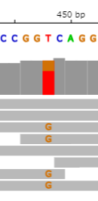
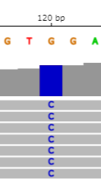
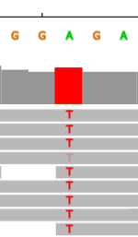
Bulked sequencing
c.f.) Sequencing 1 sample
Sample1
…GGTCA…
Sample2
…GGGCA…
Sample3
…GGTCA…
Sample
Sample4
…GTCGA…
…GGGCA…
…
…
…
CultivarB
…GGAGA…
Sample1
…GGTGA…
Sample2
…GGTGA…
Sample3
…GGTGA…
Sample4
…GGTGA…
…
…
…
Causal mutation!

Slide 12


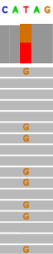
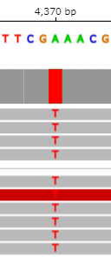
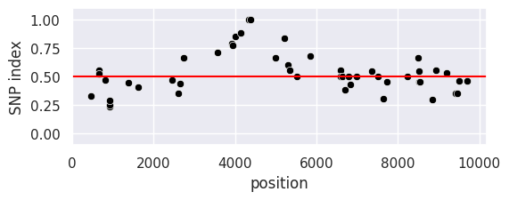

ex)
SNP1
SNP2
SNP3
$$SNP index=\frac{Mutant base}{Total reads}$$
…
…
 | Mutant base | Total reads | SNP index
SNP1 | 4 | 10 | 0.4
SNP2 | 15 | 15 | 1
SNP3 | 8 | 17 | 0.47
Causal mutation!
Green leaf
…TTCGAAACG…
Black leaf
…TTCGTAACG…

Slide 13
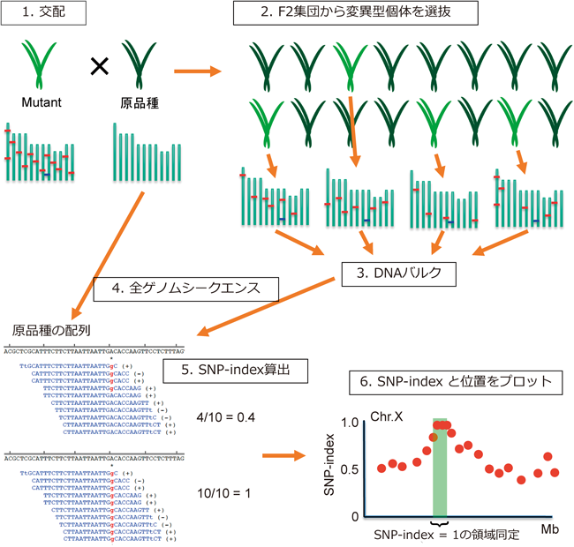
1. Segregating population
2. Select mutated samples
Mutant
Reference
4. Alignment
3. Bulked sequencing
Reference
5. Calculate SNP index
6. Visualize SNP-index plot
Region with SNP index = 1

Slide 14
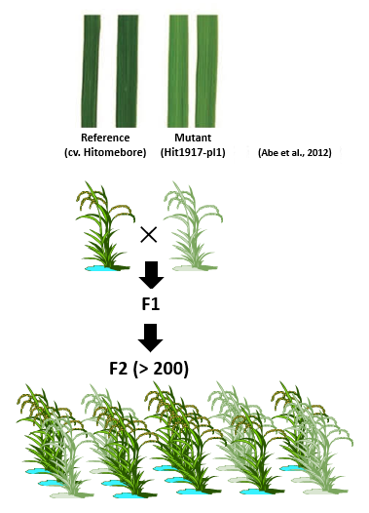
mixed
DNA
Bulked Sequencing

Slide 15




F2 population
Leaf color
(Qualitative)
…
…
…
Mut-map
×
Bulk
Sequencing
…
…
…
Leaf color
(Quantitative)
Mut-map
×
×
Plant height
(Quantitative)
Mut-map
×
×

Slide 16
ex) EMS mutagenesis
Cultivar B
mutation
Reference genome
…TGCATGCATGCATGC…ATGCATCC…
F2 population
…
…
…
…
…
×
F1

Slide 17
Cultivar B
100
…ATGCAT…CTATCA…TGAATG…GATAGT…AGCTAC…CGATCA…
mutation
+5
+30
-10
+3
-5
+7
130
…ATGTAT…CTGTCA…TGAAAG…GACAGT…AGGTAC…CGTTCA…
-10
-5
F2 population
85
…ATGCAT…CTATCA…TGAAAG…GATAGT…AGGTAC…CGATCA…
+5
+7
112
…ATGTAT …CTATCA…TGAATG…GATAGT…AGCTAC… CGTTCA…
+30
-5
125
…ATGCAT…CTGTCA…TGAATG…GATAGT…AGGTAC…CGATCA…
+30
+3
+7
140
…ATGCAT…CTGTCA…TGAATG…GACAGT…AGCTAC…CGTTCA…
…
…

Slide 18
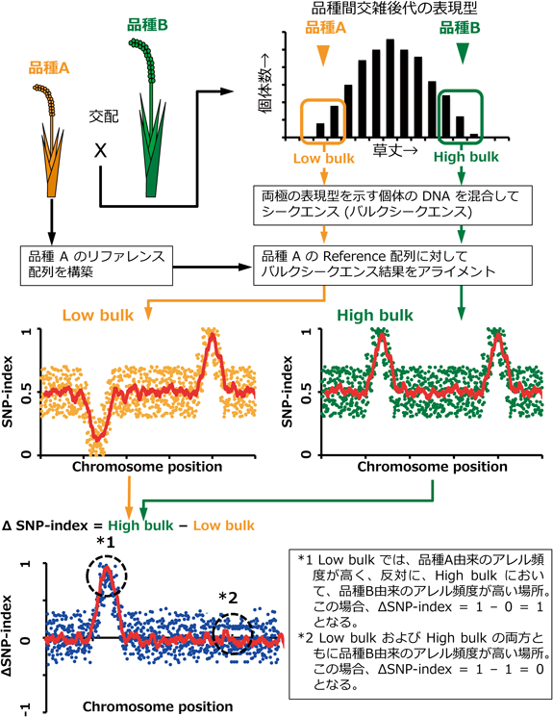
F2 population
…
…
…
…
…
The distribution of phenotype values
Number of sample
Height
Extract DNA
Bulked sequence
Bulked sequence

Slide 19



High bulk
$$SNP index=\frac{Mutant base}{Total reads}$$
SNP index = 13/13 = 1
…
…
High bulk
SNP index
= 1
SNP index
= 1
Low bulk
SNP index
= 0.86
SNP index
= 0
All High bulk
But most Low bulk
All High bulk
No Low bulk

Slide 20
High bulk
SNP index
= 1
SNP index
= 1
Low bulk
SNP index
= 0.86
SNP index
= 0
ΔSNP index = 1 – 0.86
= 0.14
ΔSNP index = 1 – 0
= 1

Slide 21
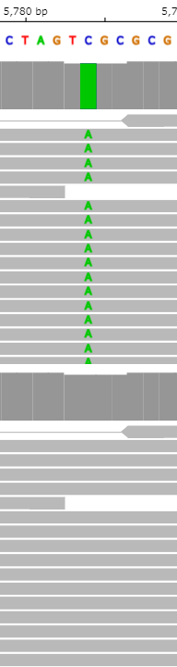
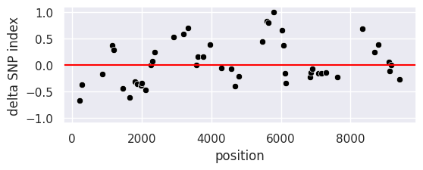
Causal mutation!
High bulk
5,784 bp
…CTAGTCGCGCG…
Low bulk
…CTAGTAGCGCG…

Slide 22
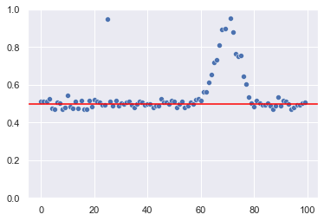
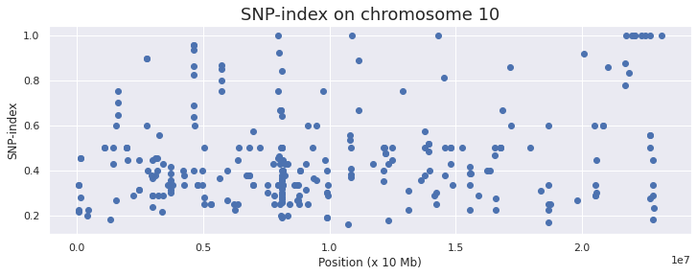
Sequence error
or low read depth
SNP index
…
Window size
0.35
Average SNP index
0.48
0.47
0.41
0.40
…
Step size

Slide 23
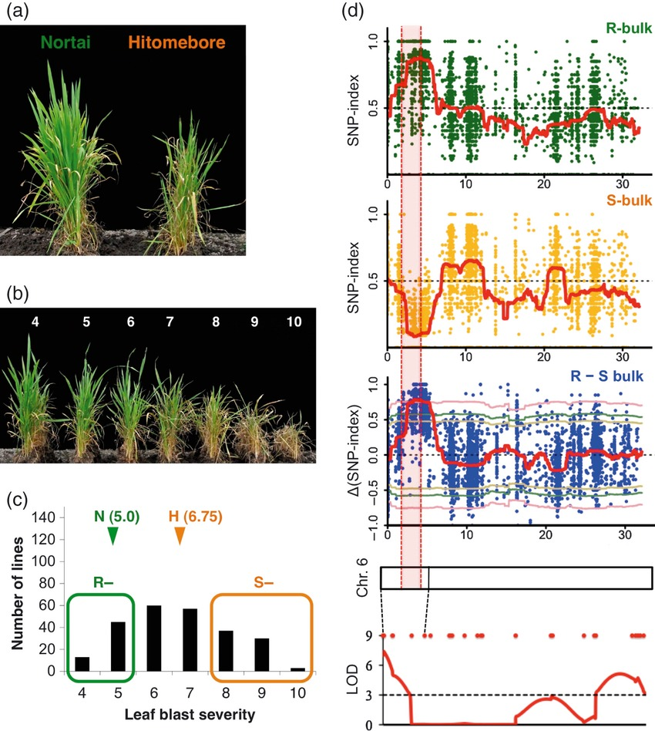
Resistance
Susceptible
Segregating population

Slide 24
← QTL
← QTL
?
?
?
?

Slide 25

+3
+20
+4
+15
…
Phenotype
126
78
97
115
Genomic prediction model:
Genotype
…
Phenotype = SNP1 x 24 + SNP2 x -16…
Statistical methods
ex) machine learning

Slide 26
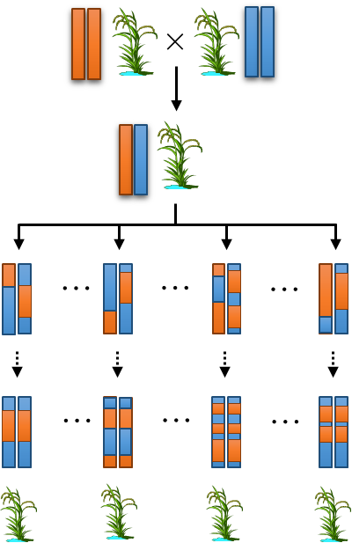
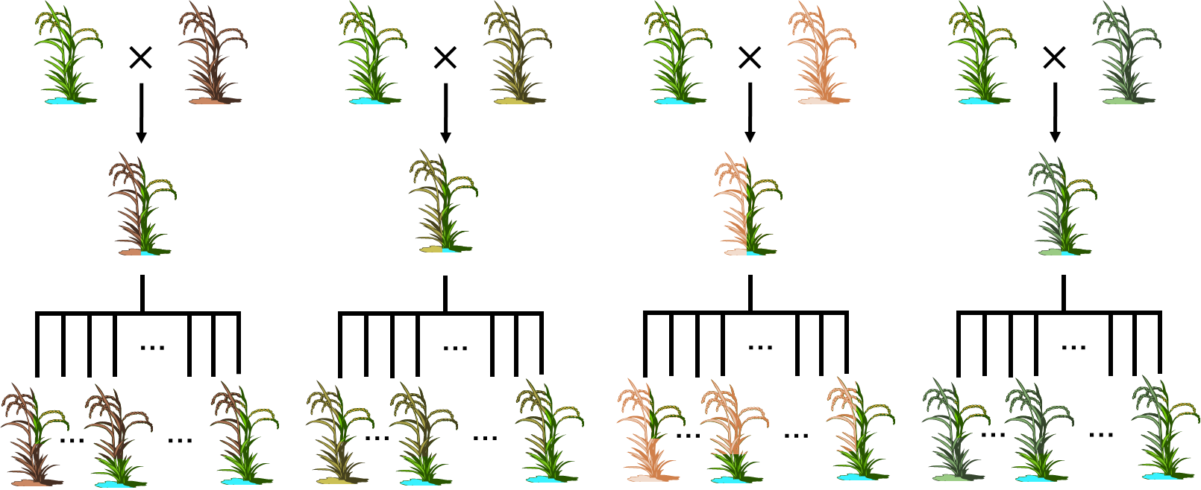
Recombinant inbred line (RIL)
×
Cultivar A
Cultivar B
F1
F2
…
…
…
F7
…
…
…
Recombinant inbred line (RIL)
Cultivar A × Cultivar B
〃 × Cultivar C
〃 × Cultivar D
…
〃 × Cultivar D
F1
…
F9
NAM population

Slide 27
Extract DNA
Identify SNPs
NAM1
Sequencing
Alignment
NAM2
Sequencing
Alignment
NAM3
Sequencing
Alignment
…
…
…
…
NAM747
Sequencing
Alignment
SNP1
NAM1
SNP3
 | NAM1 | NAM2 | NAM3
SNP1 | 2 | 2 | 0
SNP2 | 0 | 0 | 1
SNP3 | 2 | 0 | 0
SNP4 | 2 | 0 | 2
SNP4
SNP1
NAM2
NAM3
SNP2
SNP4

Slide 28
Phenotype
Genotype
SNP1
Genomic prediction model:
Phenotype = 100 + SNP1 x 20 + SNP2 x 30
NAM1 = 100 + 20 + 30 = 150
NAM2 = 100 + 20 + 0 = 120
NAM3 = 100 + 0 + 30 = 130
NAM1
150
SNP2
SNP1
NAM2
120
NAM3
130
SNP2
ex) Grain number = 85 + SNP15 x 19.2 - SNP45 x 4.3 + … + SNP₆₂₇₈ x 12.3

Slide 29
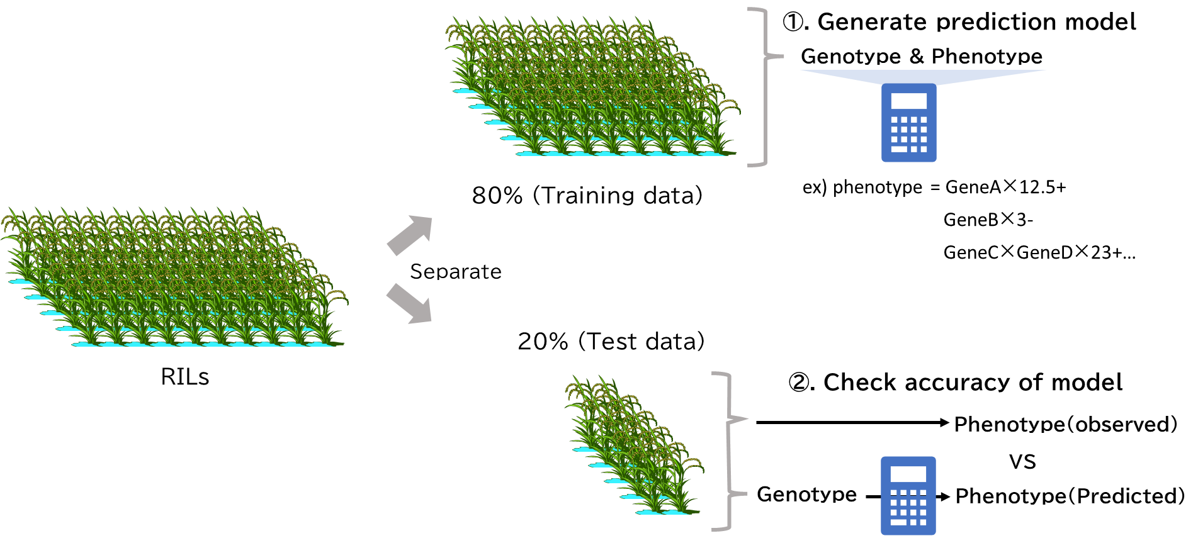
Genomic prediction model:
Genotype
&
Phenotype
Phenotype = SNP1 x 24 + SNP2 x -16…
NAM
… Is this accurate model?
NAM

Slide 30
NAM

Slide 31
NAM

Slide 32
NAM

Slide 33
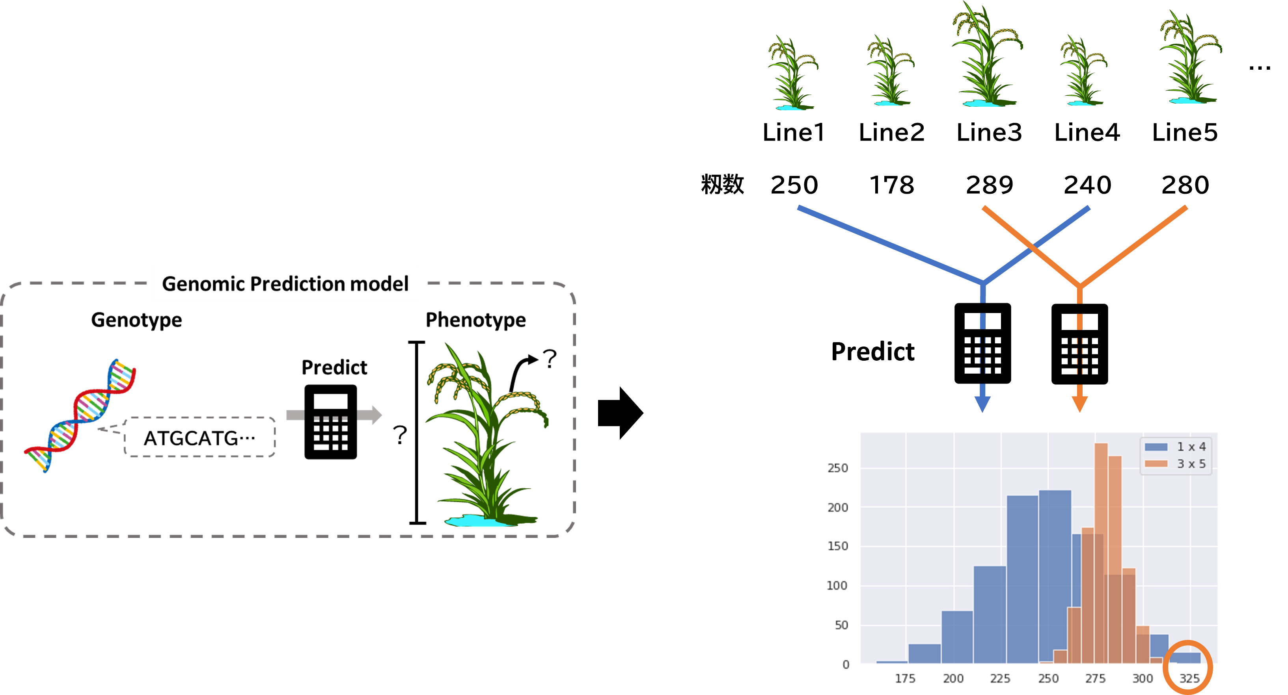
Grain number

Slide 34
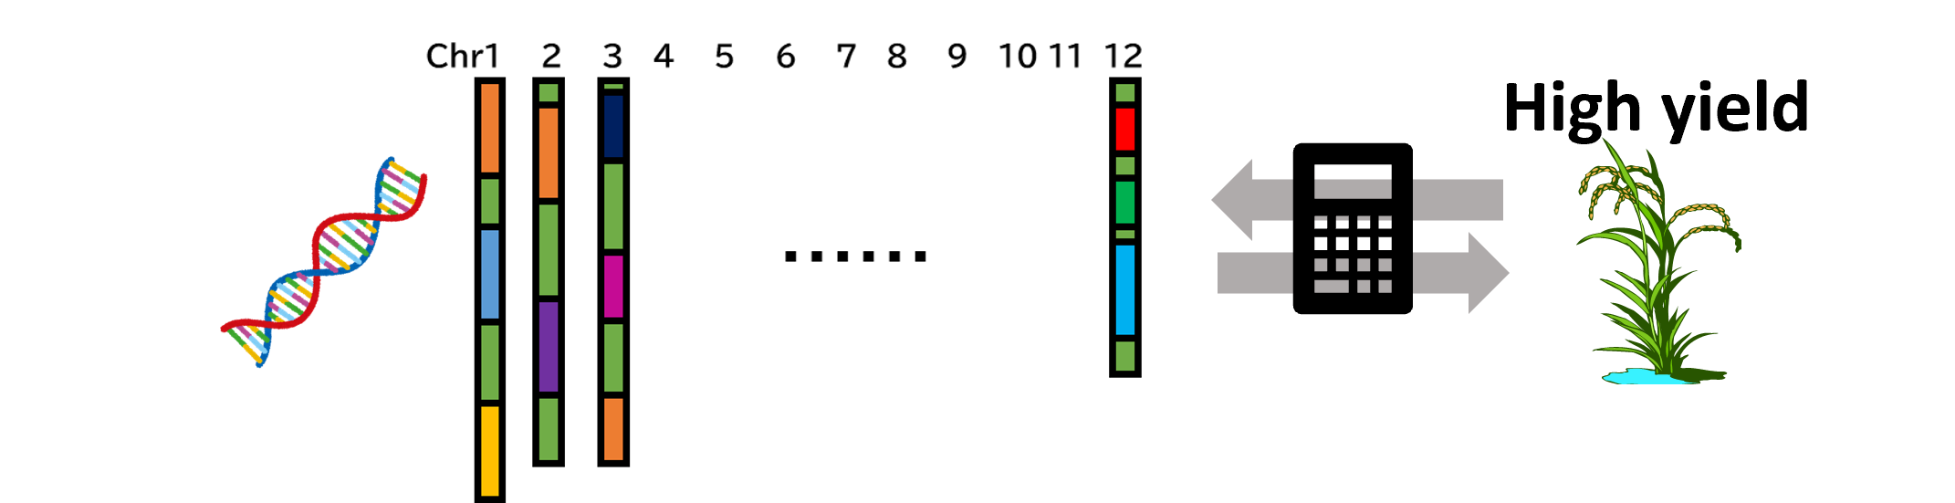
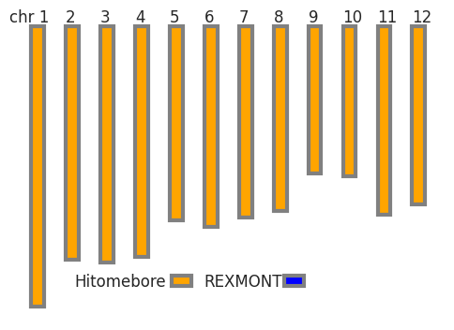
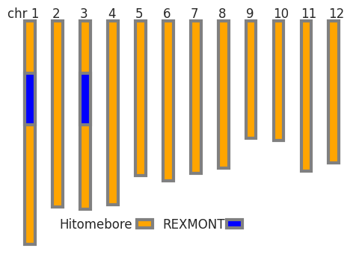
Original cultivar genotype
Another cultivar genotype
?
Original cultivar
Grain number: 110
New cultivar
Grain number: ???

Slide 35
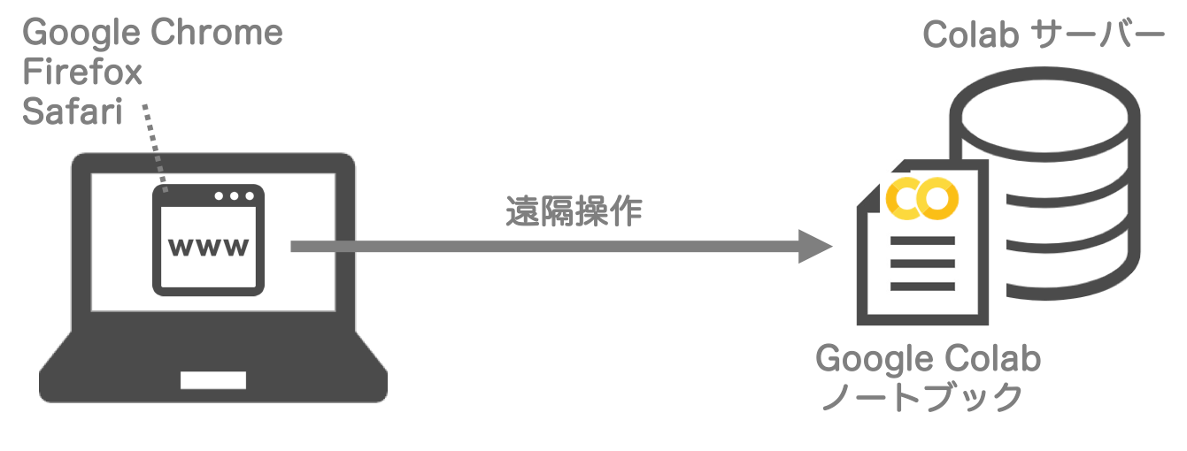
Google Chrome
Firefox
Safari
Colab Server
Remote access
Google Colab
Notebook

Slide 36
1. Crossing
2. Select mutated samples
Mutant
Reference
3. Whole genome sequence
3. DNA bulk
Reference
4. Calculate SNP index
5. Visualize SNP-index plot
Region with SNP index = 1

Slide 37
Make simulation data
Apply MutMap analysis
Sequencing
Alignment
Calculate SNP-index
…
Make simulation data
Apply QTL-seq analysis
Sequencing
Alignment
Calculate SNP-index
Calculate ΔSNP-index
…

Slide 38

1 chromosome & 100bp
ATGCATGCATGCATGCATGC…
EMS mutagenesis
GTGCAAGCATACATGTTTGC…
Reference
Mutant
×
…
…
GTGCAAGCATGCATGTTTGC…
ATGCAAGCATACATGCTTGC…
…
…
Bulk sequence

Slide 39

Bulked sequence
Reference
>read0
CATGCTTGCA
>read1
GCATGCTTGC
>read2
ATGCATGCTT
……
ATGCATGCATGCATGCATGC…
Alignment
CATGCTTGCA
GCATGCTTGC
ATGCATGCTT
……

Slide 40
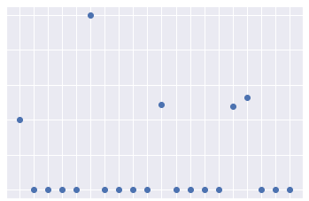

Reference
$$SNP index=\frac{The number of mutant base}{Total base}$$
ATGCATGCATGCATGCATGC…
CATGCTTGCA
Position | The number of reference base | The number of mutant base | SNP index
3 | 2 | 1 | 1/(2+1) = 0.333
9 | 0 | 4 | 4/(0+4) = 1
… | … | … | …
GCATGCTTGC
ATGCATGCTT
ATCCATGCTT
2
0
…
2
0
1
0
2
1
4
0
0
4
4
0
Reference
Mutant
2
0
4
0
2
0
4
0
4
0
4
0
ATGCATGCATGCATGCATGC
Causative position (SNP-index = 1 !!)
ATGCAAGCATGCATGCATGC
ATGCATGCATGCATGCATGC
Causative mutation
ATGCAAGCATGCATGCATGC
1.0
0.8
0.6
0.4
0.2
0
SNP index
1 2 3 4 5 6 7 8 9 1011 121314 151617 1819 20
Position

Slide 41
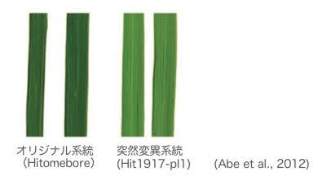
Reference
(cv. Hitomebore)
Mutant
(Hit1917-pl1)
(Abe et al., 2012)
×
F1
F2 (> 200)
…

Slide 42
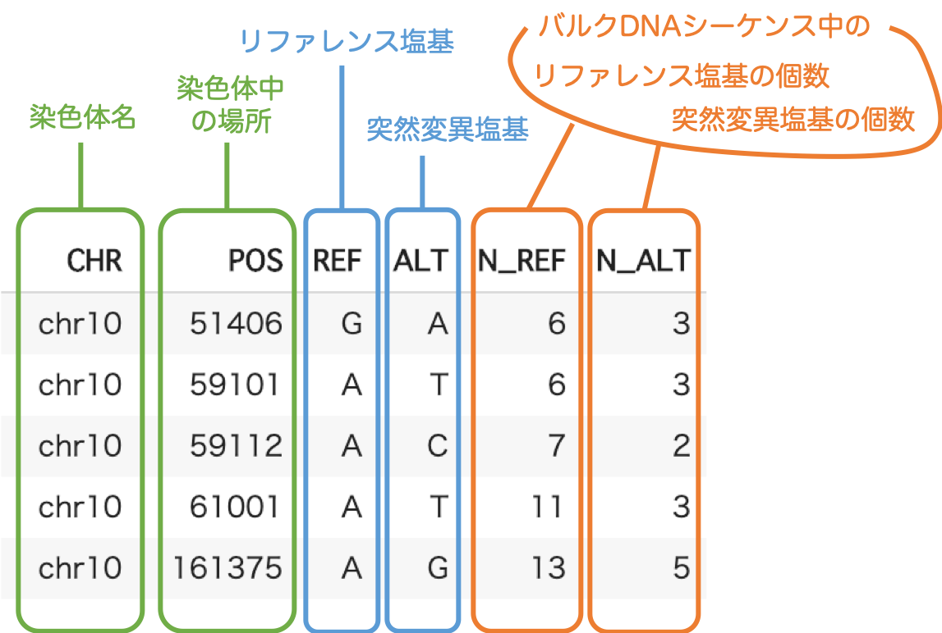
(In the bulked sequences)
The number of
Reference base
Base(reference)
Chromosome
number
Base(mutant)
The number of
Mutant base
Position

Slide 43
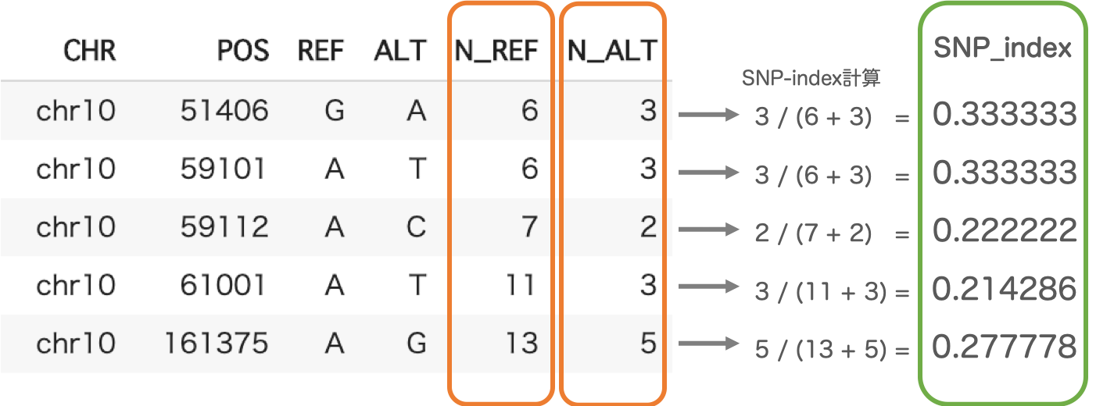
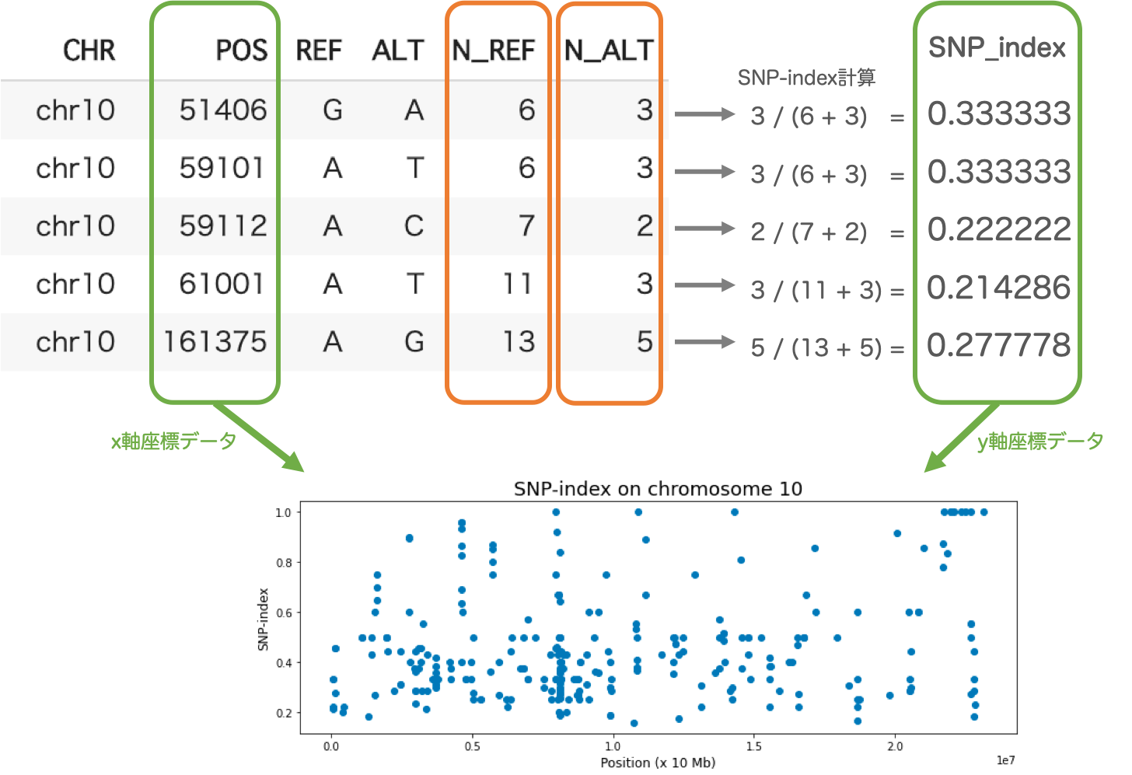
Calculate
SNP index
Calculate
SNP index
X-axis
(Position)
Y-axis

Slide 44
The distribution of phenotype of progeny
Cultivar B
Cultivar A
Cultivar B
Cultivar A
Progenies
Height
Bulked sequence for low phenotype samples and high phenotype samples
Reference genome
of cultivar A
Alignment of bulked sequences to
the reference genome of cultivar A
*1
In low bulk, allele frequency of cultivar A type is high. But, in high bulk, allele frequency of cultivar B type is high.
*2
In both low bulk and high bulk, allele frequency of cultivar B type is high.
(This position is not different between high and low bulk.)

Slide 45
1 chromosome & 100bp
Cultivar A
ATGCATGCAT……GCATGCATGC
40 SNPs are different from cultivar A
Cultivar B
ATGGATGCAT……GCATGCAAGC
Cultivar A
Cultivar B
×
F1
F2
…

Slide 46
Cultivar A
Cultivar B
Height
Bulked sequence
Bulked sequence
Cultivar A
GTGCAAGTTTGC…
GTACAAGTTTGC…
GTGCATGTTTCC…
GTGCAAGTTTGC…
GTGCATGTTTGC…
GTGCAAGTATGC…
GTGCATGTTTGC…
…
…

Slide 47
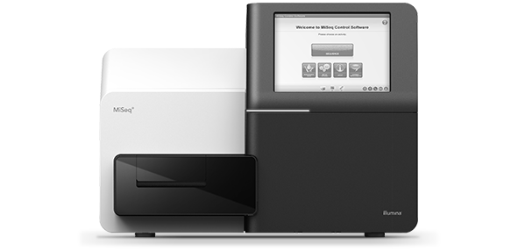
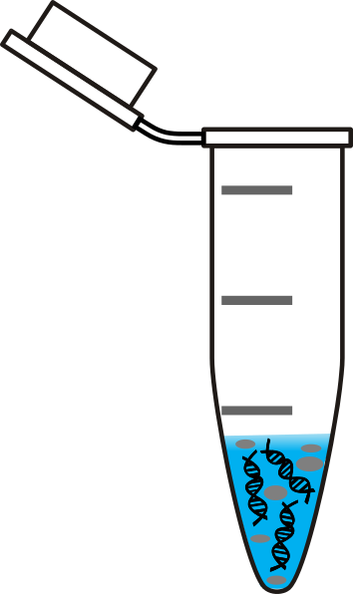
Bulk DNA sequencing
Cultivar A
Cultivar B
Extract DNA
Sequencing
Height
Output: Fastq file
>read0
ATGCATGCATGC…
+
?JA9BJA99?A&9…
>read1
…
…
Bulked sequence
Bulked sequence

Slide 48
Low bulked sequence
Cultivar A
>read0
CATGCATGCA
>read1
GCATGCATGC
>read2
ATGCATGCAT
……
ATGCATGCATGCATGCATGC
Alignment
CATGCATGCA
GCATGCATGC
ATGCATGCAT
……
High bulked sequence
Cultivar A
>read0
CATGCTTGCA
>read1
GCATGCTTGC
>read2
ATGCATGCTT
……
ATGCATGCATGCATGCATGC
Alignment
CATGCTTGCA
GCATGCTTGC
ATGCATGCTT
……

Slide 49

Cultivar A
$$SNP index=\frac{The number of different base}{Total base}$$
ATGCATGCATGCATGCATGC
CATGCTTGCA
SNP Position | The number of cultivar A bases | The number of cultivar B bases | SNP index
3 | 2 | 1 | 1/(2+1) = 0.333
9 | 0 | 4 | 4/(0+4) = 1
… | … | … | …
GCATGCTTGC
ATGCATGCTT
ATCCATGCTT
Cultivar A type
Cultivar B type
2
1
0
4
…

Slide 50
Only high bulk
Both bulk

Slide 52
…
Window size
0.35
0.48
0.47
0.41
0.40
…
Step size

Slide 53
Genomic Prediction model
Genotype
Phenotype
Predict
?
ATGCATG…
?
ex) Grain number = SNP15 x 19.2 - SNP45 x 4.3 + …

Slide 54
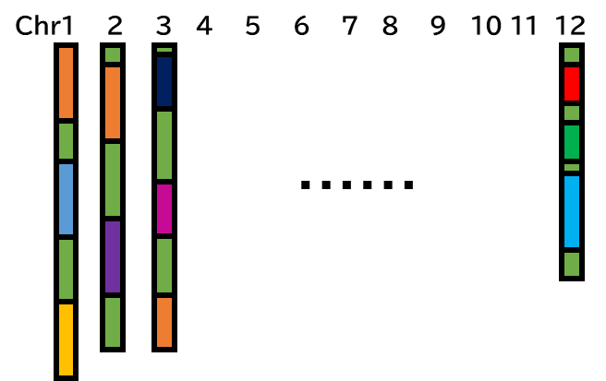
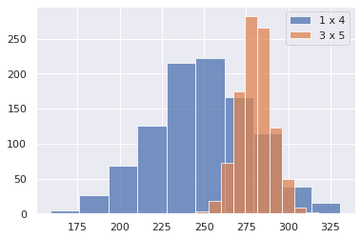
Elucidate genetic architecture of higher yield plant
High yield
Plan the most efficient breeding way
…
Line1 | Line2 | Line3 | Line4 | Line5
250 | 178 | 289 | 240 | 280
Grain
number
Predict
ex) GN = GeneA×12.5+
GeneB×3-
GeneC×23+…

Slide 55
Cultivar A × Cultivar B
Cultivar A × Cultivar C
Cultivar A × Cultivar F
…
Hitomebore × Cultivar X
RILs

Slide 56
Which combination is best ?
…
Line1 | Line2 | Line3 | Line4 | Line5
250 | 178 | 289 | 240 | 280
Grain
number
Predict
ex) GN = GeneA×12.5+
GeneB×3-
GeneC×23+…

Slide 57
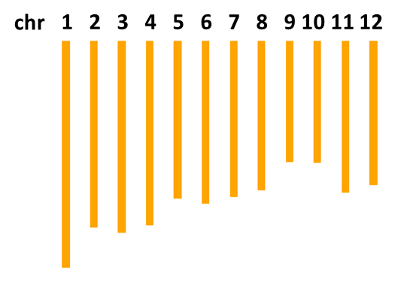
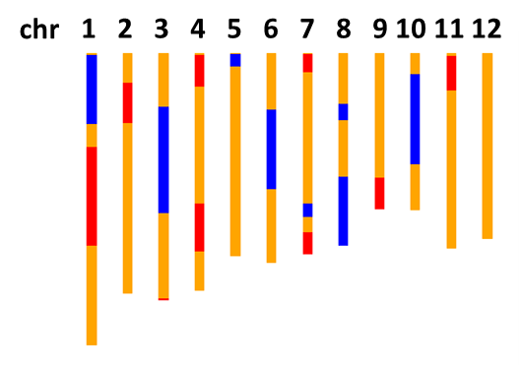

Slide 58
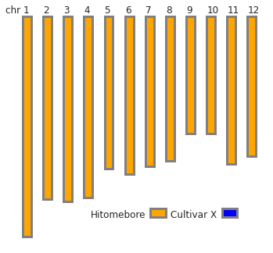
?
Original cultivar
Grain number: 110
New cultivar
Grain number: ???

