Slide 1

REGIONAL TRAINING COURSE MOLECULAR TECHNIQUES FOR CROP IMPROVEMENT OF MUTANT POPULATIONS
Enhancing Productivity and Resilience
to Climate Change of Major Food Crops in Europe and Central Asia
01/08/2022 ~ 05/08/2022

Slide 2
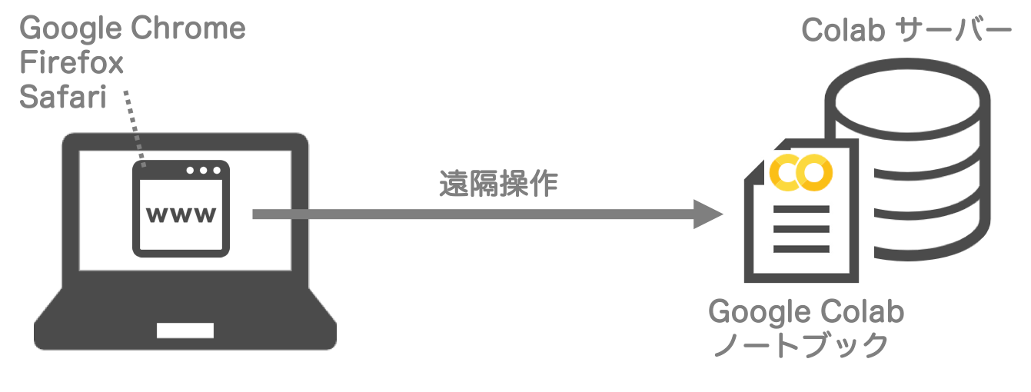
Google Chrome
Firefox
Safari
Colab Server
Remote access
Google Colab
Notebook

Slide 3
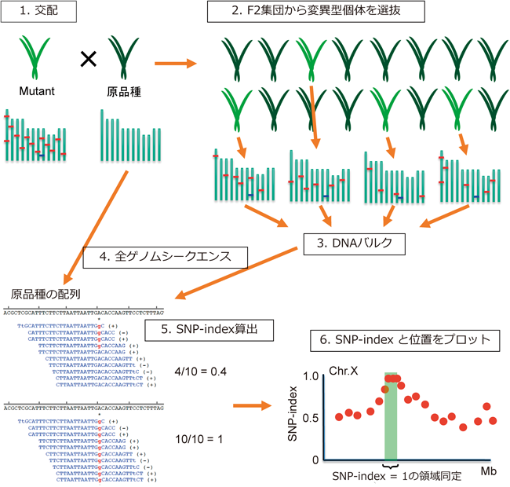
1. Crossing
2. Select mutated samples
Mutant
Reference
3. Whole genome sequence
3. DNA bulk
Reference
4. Calculate SNP index
5. Visualize SNP-index plot
Region with SNP index = 1

Slide 4

1 chromosome & 20bp
ATGCATGCATGCATGCATGC
EMS mutagenesis
GTGCAAGCATACATGTTTGC
Reference
Mutant
×
…
…
GTGCAAGCATGCATGTTTGC
ATGCAAGCATACATGCTTGC
…
…
Bulk sequence

Slide 6
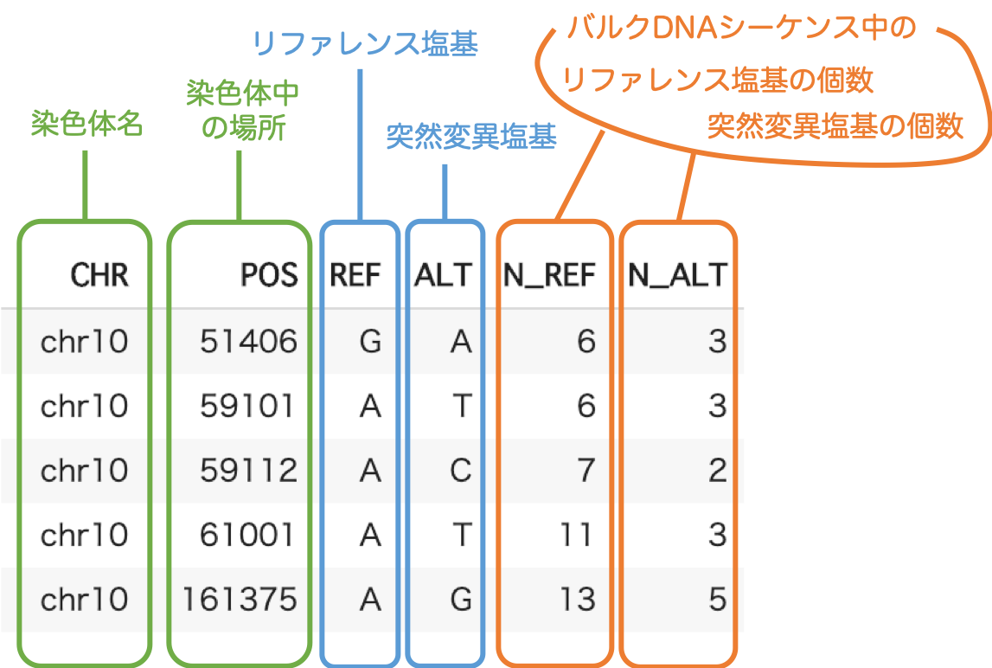
(In the bulked sequences)
The number of
Reference base
Base(reference)
Chromosome
number
Base(mutant)
The number of
Mutant base
Position

