Slide 1

Training Diag Stack
www.continental-corporation.com
Division Autosar Center

Slide 2
Training goals AUTOSAR BSW – DiagStack 4.x
Understanding of the architecture and general functions of the DiagStack
Learn about the different features and how to configure the AUTOSAR DiagStack
Diagnosis Communication Manager (DCM)
Diagnosis Event Manager (DEM)
Practice on the Tank Flap example how to configure Events, Diagnosis Messages
Important:
In order to obtain the Module Completion certificate - please complete the section Feedback Form for Receiving the Certificate at the end of this module

Slide 3
Agenda
Basics
Diagnostic Communication Manager (DCM)
Diagnostic Event Manager (DEM)
Function Inhibition Manager (FiM)
Universal Calibration Protocol (Xcp)

Slide 4
Agenda Basics
Basics
Introduction
Introduction of Tankflap Example
Methodology
Architecture
Diagnosis Protocol overview
Diagnostic Communication Manager (DCM)
Diagnostic Event Manager (DEM)
Function Inhibition Manager (FiM)
Universal Calibration Protocol (Xcp)

Slide 5
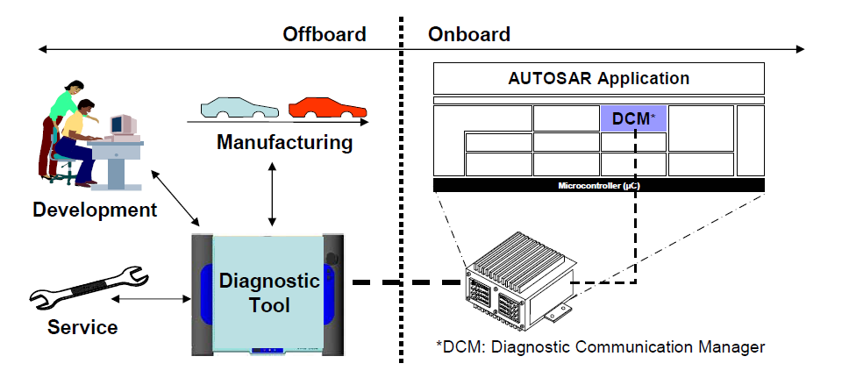
DiagStack General Features
Diagnostic in the car is split into the parts that are Offboard and parts that are on the ECU. AUTOSAR specifies the parts on the ECU and the protocols for communication with the Offboard environment
DiagStack

Slide 6
Agenda Basics
Basics
Introduction
Introduction of Tankflap Example
Methodology
Architecture
Diagnosis Protocol overview
Diagnostic Communication Manager (DCM)
Diagnostic Event Manager (DEM)
Function Inhibition Manager (FiM)
Universal Calibration Protocol (Xcp)

Slide 7
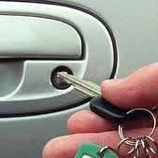

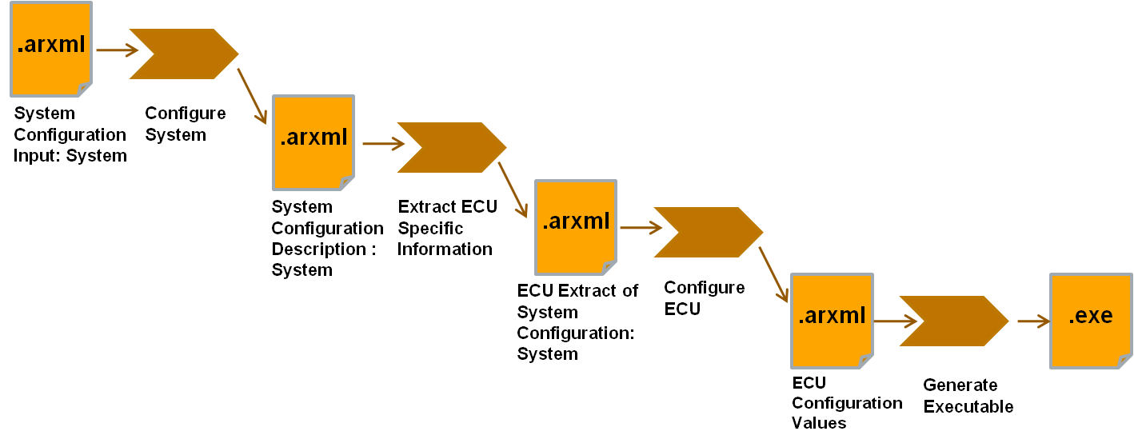
Description of Tank Flap project
Control the locking of the tank flap with the car key.
The car key is the sensor interface
The tank flap lock is the actuator
Usage of two ECUs
Communication between the ECUs over CAN

Slide 8
Intorduction Tankflap
ECU1
Swc
SensorLock
Swc
CentralLockingMaster
ECU2
Swc
TankFlap
Swc
ActuatorTankLock
RTE
RTE
BSW
BSW
MICROCONTROLLER A
MICROCONTROLLER B
Sensor
DoorLock
Actuator
TankFlap
CAN

Slide 9
Introduction Tankflap Diagnostic Modules
SW-C
SensorLock
SW-C CentralLockingMaster
Application Layer
RTE
System Services
Dem
Dcm
ComM
NvM
PduR
CanTp
ECU Abstraction
CanIf
Microcontroller Drivers
Can

Slide 10
Agenda Basics
Basics
Introduction
Introduction of Tankflap Example
Methodology
Architecture
Diagnosis Protocol overview
Diagnostic Communication Manager (DCM)
Diagnostic Event Manager (DEM)
Function Inhibition Manager (FiM)
Universal Calibration Protocol (Xcp)

Slide 11
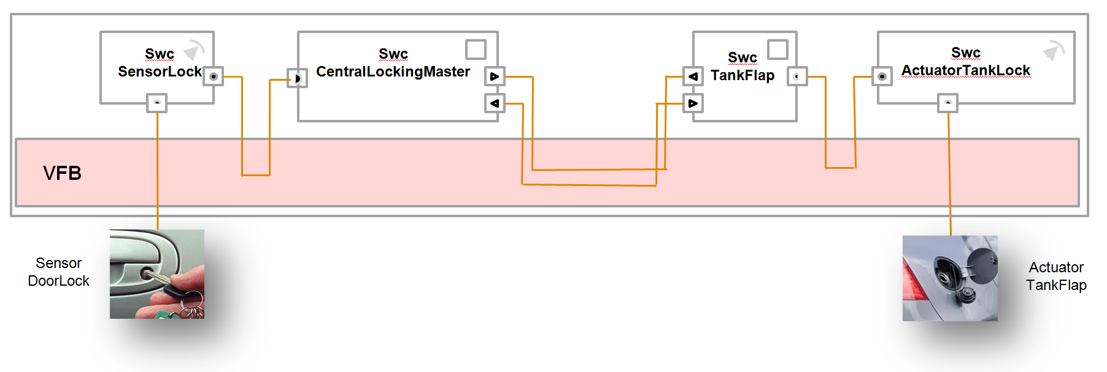

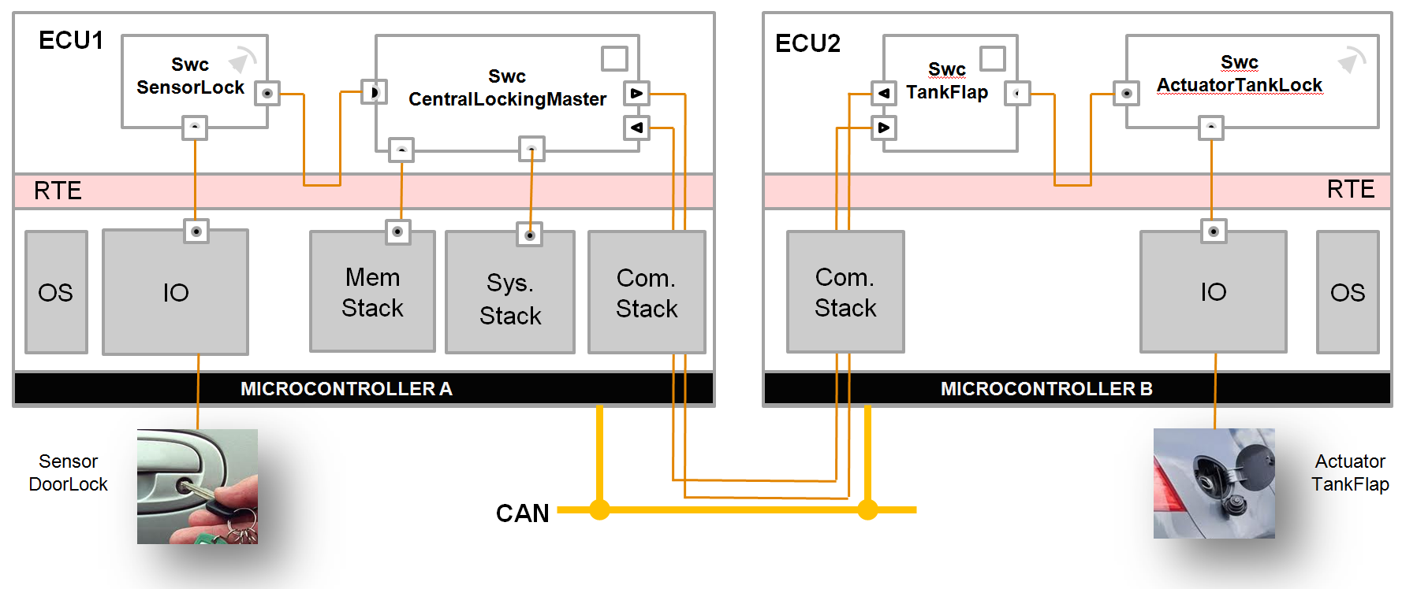
Methodology overview
1
1
Description of Application SW Components
2
Integration of SWC into Virtual Functional Bus
2
3
Description of ECU resources
4
Define System Constraints: e.g. Topology, Mapping Constraints, Predefined Communication
.arxml
.arxml
.arxml
.arxml
System Contraint Description
.ar
xml
Tool supporting deployment
of SW components
.ar
xml
5
Mapping of ASW Components on ECUs
3
ECU Description
4
6
Definition of System Communication
5
7
Configuration of Basic Software per ECU
8
8
Generation of Run Time Environment (RTE) per ECU
7
9
Integration of ECU
9
10
10
Integration of ECUs into System
6

Slide 12
Methodology overview Basic SW module configuration
1
1
Description of Application SW Components
2
Integration of SWC into Virtual Functional Bus
2
3
Description of ECU resources
4
Define System Constraints: e.g. Topology, Mapping Constraints, Predefined Communication
.arxml
.arxml
.arxml
.arxml
System Contraint Description
.ar
xml
Tool supporting deployment
of SW components
.ar
xml
5
Mapping of ASW Components on ECUs
3
ECU Description
4
6
Definition of System Communication
5
7
Configuration of Basic Software per ECU
8
8
Generation of Run Time Environment (RTE) per ECU
7
9
Integration of ECU
9
10
10
Integration of ECUs into System
6

Slide 13
Agenda Basics
Basics
Introduction
Introduction of Tankflap Example
Methodology
Architecture
Diagnosis Protocol overview
Diagnostic Communication Manager (DCM)
Diagnostic Event Manager (DEM)
Function Inhibition Manager (FiM)
Universal Calibration Protocol (Xcp)

Slide 14
Overview Architecture
Not all modules are shown here
Application Layer
AUTOSAR Runtime Environment (RTE)
System Services
Memory Services
Communication Services
I/O Hardware Abstraction
Complex
Drivers
AUTOSAR OS
Dem
FiM
Det
Dlt
Csm
StbM
Tm
WdgM
ComM
BswM
Com
Dcm
Dbg
Nm If
NvM
SM
I/O Signal Interface
XCP
IpduM
PduR
Nm
WdgIf
Tp
Driver for ext.
ADC ASIC
Driver for ext.
I/O ASIC
EcuM
Onboard Device Abstraction
Memory Hardware Abstraction
Communication Hardware Abstraction
MemIf
xxx Interface
Ea
Fee
Trcv.
ext. Drv
Microcontroller Drivers
Memory Drivers
Communication Drivers
I/O Drivers
Gpt
Wdg
Mcu
CorTst
FlsTst
RamTst
Fls
Eep
Spi
Lin
Can
Fr
Eth
Ocu
Icu
Pwm
Adc
Dio
Port
Microcontroller

Slide 15
Overview Architecture
Not all modules are shown here
Application Layer
AUTOSAR Runtime Environment (RTE)
System Services
Memory Services
Communication Services
I/O Hardware Abstraction
Complex
Drivers
AUTOSAR OS
Dem
FiM
Det
Dlt
Csm
StbM
Tm
WdgM
ComM
BswM
Com
Dcm
Dbg
Nm If
NvM
SM
I/O Signal Interface
XCP
IpduM
PduR
Nm
WdgIf
Tp
Driver for ext.
ADC ASIC
Driver for ext.
I/O ASIC
EcuM
Onboard Device Abstraction
Memory Hardware Abstraction
Communication Hardware Abstraction
MemIf
xxx Interface
Ea
Fee
Trcv.
ext. Drv
Microcontroller Drivers
Memory Drivers
Communication Drivers
I/O Drivers
Gpt
Wdg
Mcu
CorTst
FlsTst
RamTst
Fls
Eep
Spi
Lin
Can
Fr
Eth
Ocu
Icu
Pwm
Adc
Dio
Port
Microcontroller

Slide 16
Overview Architecture DCM
Application Layer
Swc
Swc Providing Data
Swc
Diagnostic Routines
Arbitration of services
Monitor
AUTOSAR Runtime Environment (RTE)
BSW
Complex
Drivers
System Services
Communication Services
Dem
Cd Providing Data
Dcm
Cd
Diagnostic Routines
Arbitration of services
PduR

Slide 17
Overview Architecture DEM
Application Layer
Swc
Swc Providing Data
Swc
Diagnostic Routines
Arbitration of DTC processing/Access DTC Information
Monitor
AUTOSAR Runtime Environment (RTE)
BSW
BSW-Module
Monitor
System Services
Communication Services
Memory Services
Fim
Dem
Dcm
Nvm

Slide 18
Agenda Basics
Basics
Introduction
Introduction of Tankflap Example
Methodology
Architecture
Diagnosis Protocol overview
Diagnostic Communication Manager (DCM)
Diagnostic Event Manager (DEM)
Function Inhibition Manager (FiM)
Universal Calibration Protocol (Xcp)

Slide 19
Diagnosis Protocol overview
Unified Diagnosis Service (UDS):
ISO 14229
OnBoardsDiagnosis (OBD):
ISO 15031
Serial Control and Communications Heavy Duty Vehicle Network:
SAE J1939

Slide 20
Diag Overview UDS Message
Sid
Data1
SubFunctionID
Data2..n
UDS Message
If a Service supports sub function, then contains Data1 a 7bit SubFunctionID.
The Bit 7 is used to signal suppression of Positive Response.

Slide 21
Message Flow Example UDS
Tester
ECU
DiagRequest
Positive Response:
SID + 0x40
e.g. 0x10 → 0x50
Diag pos. Response
For some functions the positive response could be suppressed:
MSB of the sub function byte is set.
e.g. TesterPresent
0x3E 0x00 → positive response expected → response code 0x7E 0x00
0x3E 0x80 → positive response suppressed
Tester
ECU
Negative Response:
0x7F, RSID NegResponseCode
DiagRequest (0x10 0x30)
e.g. SessionControl
0x10 0x30 → 0x7F 0x10 0x12 (Subfunction not supported)
Neg. Response ( 0x7F 0x10 0x12)
Note: OBD and J1939 work with a similar principle

Slide 22
Thank you
for your attention!

