Slide 1
POLITECNICO DI BARI
DIPARTIMENTO DI INGEGNERIA ELETTRICA E DELL’INFORMAZIONE
LAUREA MAGISTRALE IN INGEGNERIA DELL’AUTOMAZIONE
ROBOTICS 1° MODULE : INDUSTRIAL HANDLING
Prof. Eng. Paolo Lino
MOTION CONTROL WITH TWO-LAYER NEURAL NETWORK
Students:
Nicola Saltarelli
Francesco Di Chio

Slide 2




OVERVIEW
PERFORMANCE EVALUATION
STATE OF THE ART
Creation of the NN-based controllers in Simulink , with two different weight tuning rules.
Key advantages and disadvantages of the NN-based control strategy and future works.
Brief overview on classical control strategies and neural networks.
Performance evaluation of the controllers in presence and in absence of disturbances and compared to other control strategies.
SIMULINK IMPLEMENTATION
CONCLUSIONS

Slide 3
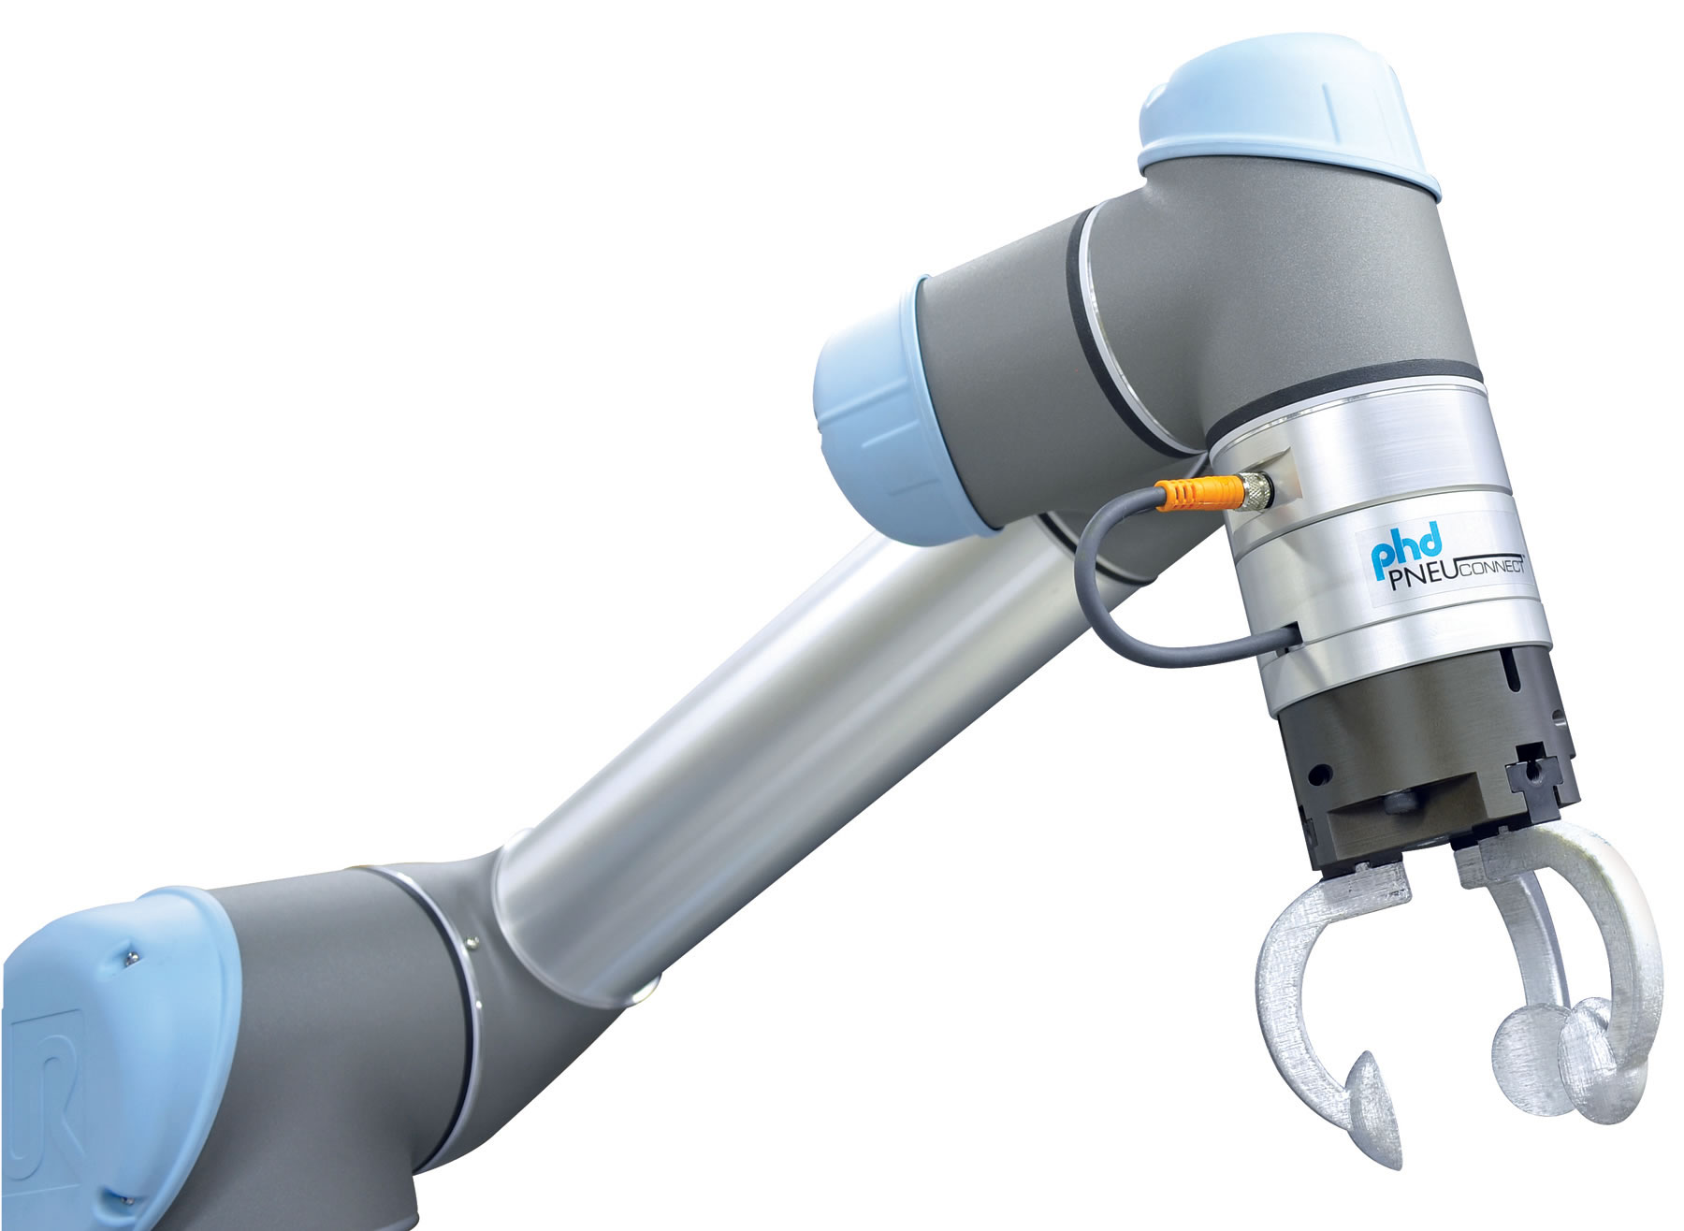
STATE OF THE ART
SIMULINK IMPLEMENTATION
PERFORMANCE EVALUATION
CONCLUSIONS
Why choose a Neural Network-based approach
PID control algorithms are implemented in most of commercially available controllers, but they not allow accurate dynamic trajectory following. Adaptive and inverse dynamic control techniques can provide good tracking performance, but are strongly limited by the need of the exact knowledge of the system to be controlled.
NN-based control techniques can overcome this limitations.

Slide 4
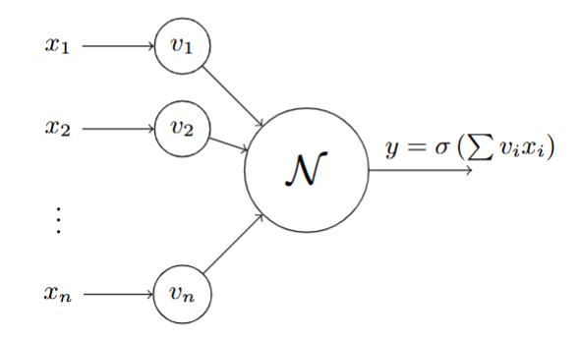
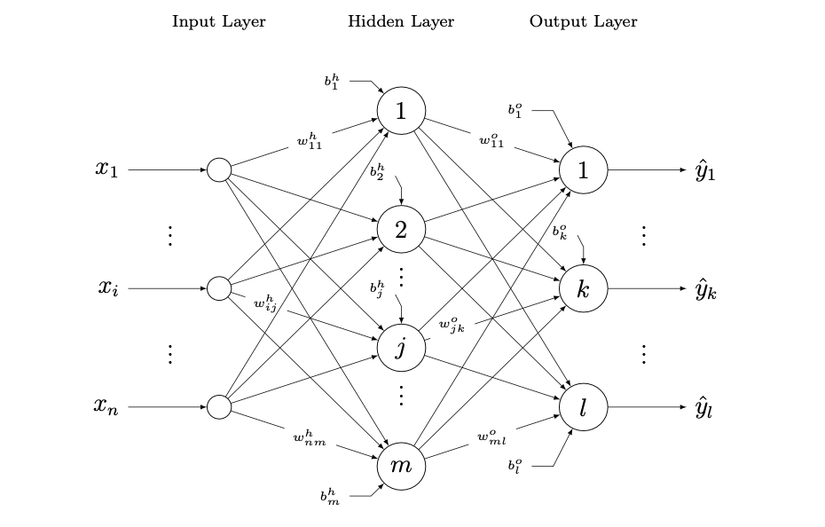
STATE OF THE ART
SIMULINK IMPLEMENTATION
PERFORMANCE EVALUATION
CONCLUSIONS
Background on Neural Network
The NN base element is the neuron, a MISO system where the inputs are connected to the neuron through synaptic weights.
Each neuron contains a basic mathematical function (typically a sigmoid function) that processes the weighted inputs and provides the output as the activation function applicated to weighted sum of the inputs, plus a bias.
A neural network (NN) is thus a system composed of interconnected neurons, arranged as an directed graph. Generally the NN are organized into layers : input, output and hidden ones.
The NN architecture allows neural networks to learn complex relationships between inputs and outputs, by changing the values of synaptic weights according to precise techniques for updating weights.
One of the most relevent and used multilayer perceptron in the control applications is the Two Layers NN thanks to the universal function approximation property

Slide 5
STATE OF THE ART
SIMULINK IMPLEMENTATION
PERFORMANCE EVALUATION
CONCLUSIONS
Background on Neural Network
A neural network (NN) is thus a system composed of interconnected neurons, arranged as an directed graph. Generally the NN are organized into layers : input, output and hidden ones.
The NN architecture allows neural networks to learn complex relationships between inputs and outputs, by changing the values of synaptic weights according to precise techniques for updating weights.
One of the most relevent and used multilayer perceptron in the control applications is the Two Layers NN thanks to the universal function approximation property.
The NN base element is the neuron, a MISO system where the inputs are connected to the neuron through synaptic weights.
Each neuron contains a basic mathematical function (typically a sigmoid function) that processes the weighted inputs and provides the output as the activation function applicated to weighted sum of the inputs, plus a bias.

Slide 6
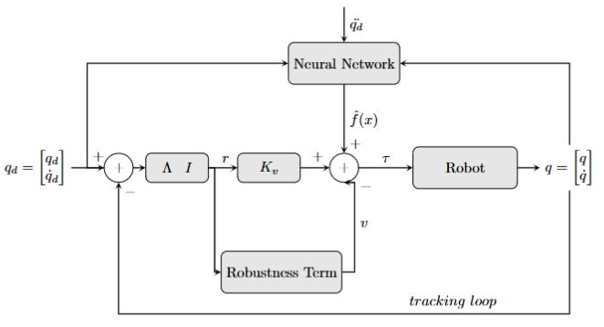

STATE OF THE ART
SIMULINK IMPLEMENTATION
PERFORMANCE EVALUATION
CONCLUSIONS
Dynamics equations and controller structure
$$M\left(q\right)\ddot{q}+V_{m}\left(q,\dot{q}\right)\dot{q}+F\left(\dot{q}\right)+G\left(q\right)+τ_{d}=τ$$
$$τ= \hat{f}\left(x\right)+ K_{v}r −v$$

Slide 7



STATE OF THE ART
SIMULINK IMPLEMENTATION
PERFORMANCE EVALUATION
CONCLUSIONS
Dynamics equations and controller structure
$$M\left(q\right)\ddot{q}+V_{m}\left(q,\dot{q}\right)\dot{q}+F\left(\dot{q}\right)+G\left(q\right)+τ_{d}=τ$$
$$\left\{\begin{aligned}e= q_{d}−q \\ r= \dot{e}+λe\end{aligned}\right.$$
$$M\dot{r}=−V_{m}r+f\left(x\right)+ τ_{d} −τ$$
$$f\left(x\right)=M\left(q\right)\left({\ddot{q}}_{d}+λe\right)+V_{m}\left(q,\dot{q}\right)\left({\dot{q}}_{d}+λe\right)+F\left(\dot{q}\right)+G(q)$$
$$x ≡{[e^{T}, {\dot{e}}^{T}, { q}_{d}^{T}, {\dot{ q}}_{d}^{T}, { \ddot{q}}_{d}^{T}]}^{T}$$
$$τ= \hat{f}\left(x\right)+ K_{v}r −v$$

Slide 8

STATE OF THE ART
SIMULINK IMPLEMENTATION
PERFORMANCE EVALUATION
CONCLUSIONS
Dynamics equations and controller structure
$$M\left(q\right)\ddot{q}+V_{m}\left(q,\dot{q}\right)\dot{q}+F\left(\dot{q}\right)+G\left(q\right)+τ_{d}=τ$$
$$\left\{\begin{aligned}e= q_{d}−q \\ r= \dot{e}+λe\end{aligned}\right.$$
$$M\dot{r}=−V_{m}r+f\left(x\right)+ τ_{d} −τ$$
$$f\left(x\right)=M\left(q\right)\left({\ddot{q}}_{d}+λe\right)+V_{m}\left(q,\dot{q}\right)\left({\dot{q}}_{d}+λe\right)+F\left(\dot{q}\right)+G(q)$$
$$x ≡{[e^{T}, {\dot{e}}^{T}, { q}_{d}^{T}, {\dot{ q}}_{d}^{T}, { \ddot{q}}_{d}^{T}]}^{T}$$
$$τ= \hat{f}\left(x\right)+ K_{v}r −v$$

Slide 9
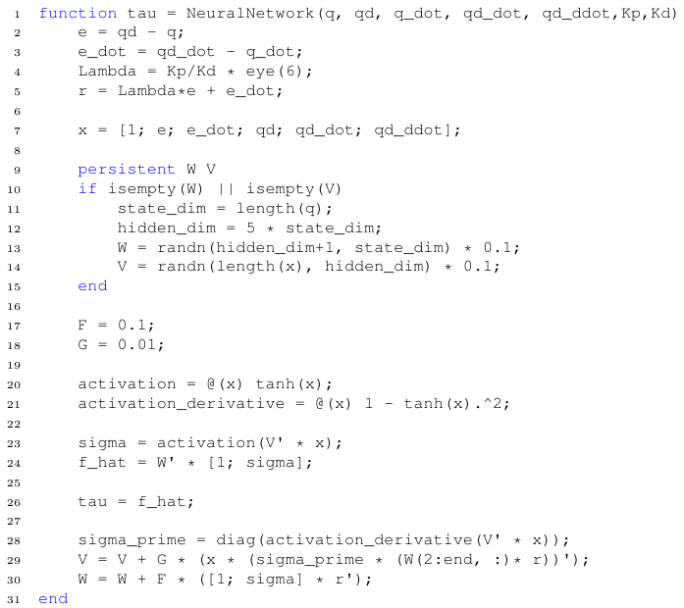
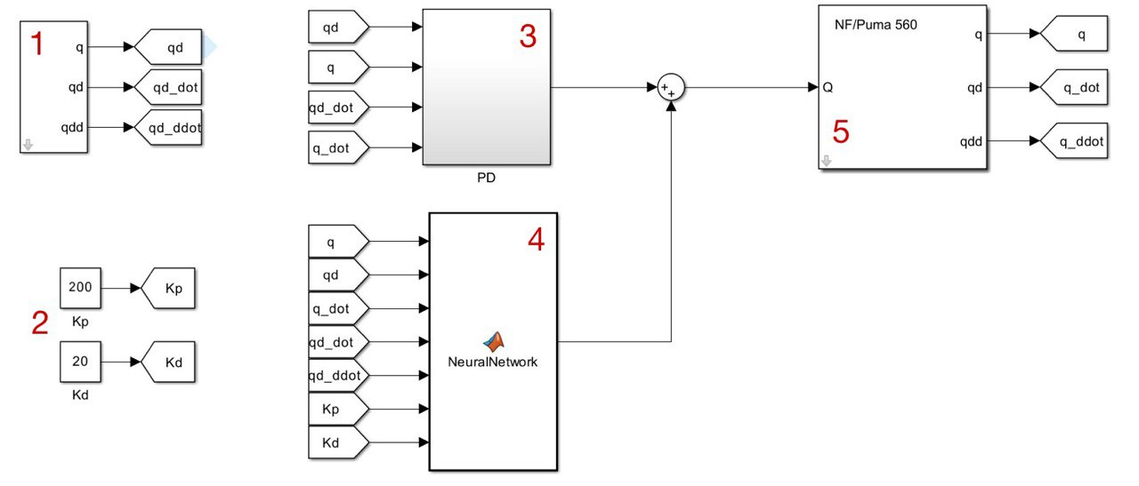
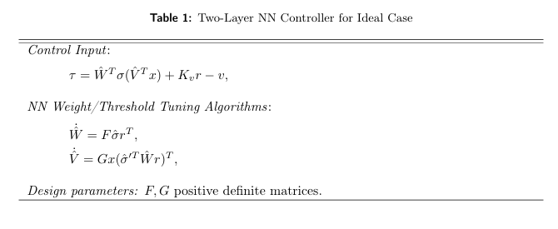
STATE OF THE ART
SIMULINK IMPLEMENTATION
PERFORMANCE EVALUATION
CONCLUSIONS
Neural Network with usupervided backpropagation tuning of weights
The simulink model implemented the first NN-based control technique is presented below.

Slide 10
STATE OF THE ART
SIMULINK IMPLEMENTATION
PERFORMANCE EVALUATION
CONCLUSIONS
Neural Network with Unsupervided Backpropagation Tuning for the Ideal Case
The Simulink model implementing the first NN-based control technique is presented below.

Slide 11
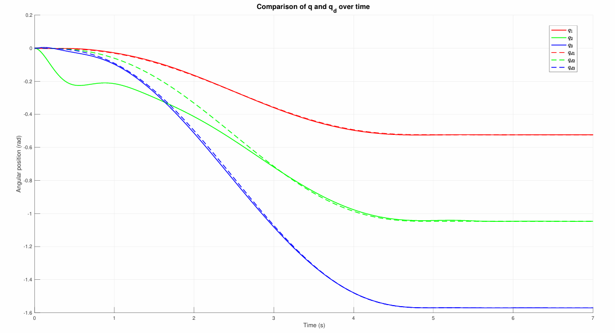
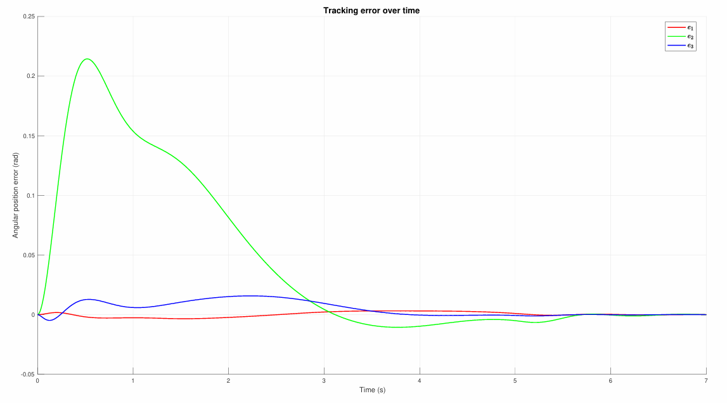
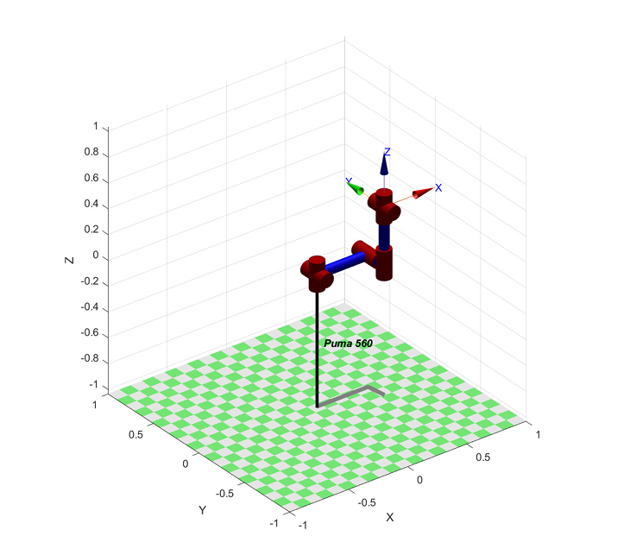
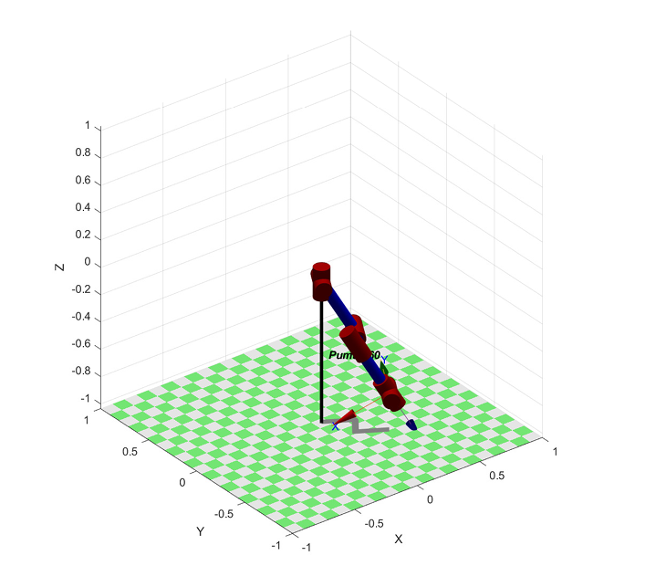

STATE OF THE ART
SIMULINK IMPLEMENTATION
PERFORMANCE EVALUATION
CONCLUSIONS
Neural Network with Unsupervided Backpropagation Tuning for the Ideal Case
The aim of NN- based controller is fot the robot manipulator to follow a prescribed trajecotry that carry
the manipulator from an upward elbow initial configuration to a fully extended arm downward configuration
downward configuration, as shown below.
Figure 1
Figure 2
Initial configuration: $q_{0}=[0 0 0 0 0 0]$.
final configuration: $q_{f}=[−\frac{π}{6} −\frac{π}{3} −\frac{π}{2} 0 0 0]$.

Slide 12
STATE OF THE ART
SIMULINK IMPLEMENTATION
PERFORMANCE EVALUATION
CONCLUSIONS
Neural Network with Unsupervided Backpropagation Tuning for the Ideal Case
Firsts evaluations on the tracking performance can be done observing the following figures, where the desired
and actual joints trajectories evolution (Figure 1) and the tracking error evolution (Figure 2) are plotted.
Figure 1 : Desired and actual joint trajectories evolution.
Figure 2 : Tracking error evolution.

Slide 13
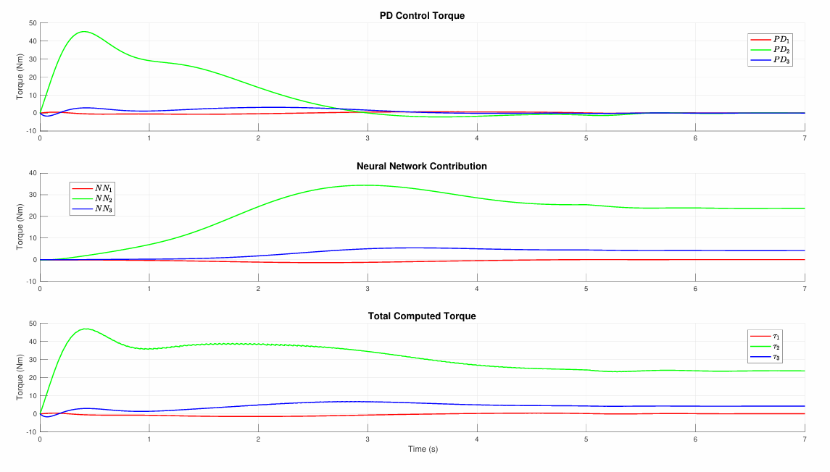
STATE OF THE ART
SIMULINK IMPLEMENTATION
PERFORMANCE EVALUATION
CONCLUSIONS
Neural Network with Unsupervided Backpropagation Tuning for the Ideal Case
For a deeper and complete understanding of the control technique, an evaluation of the evolution of the control
actions is necessary. Referring to the below, one can focus on the PD controller and Neural Network
contributions on the total torque computed, that is simply their sum.
Figure 3: Control actions evolution.

Slide 14
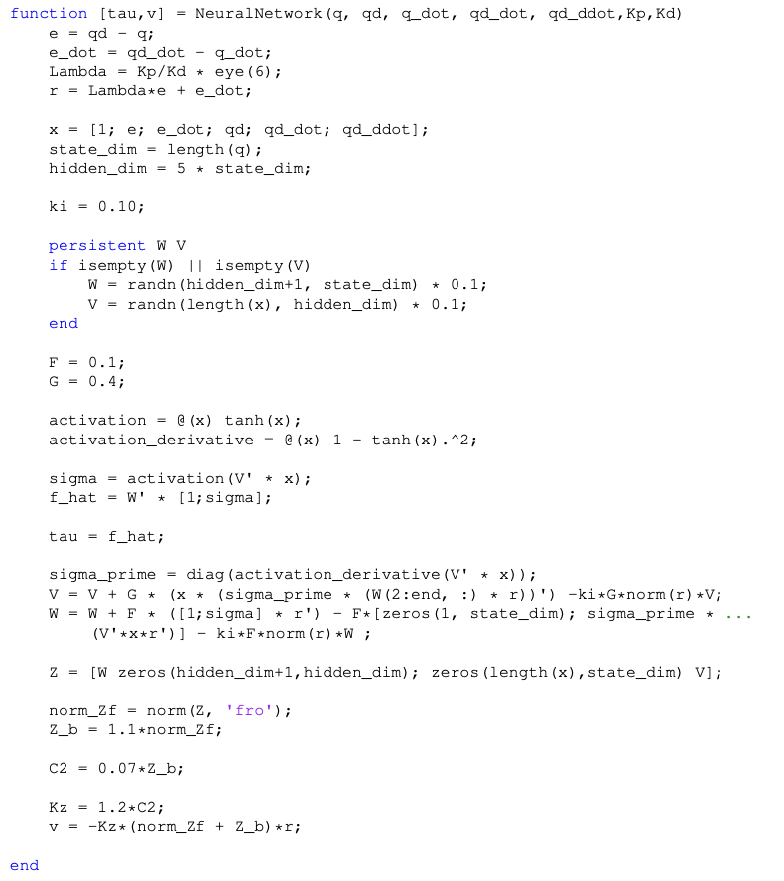
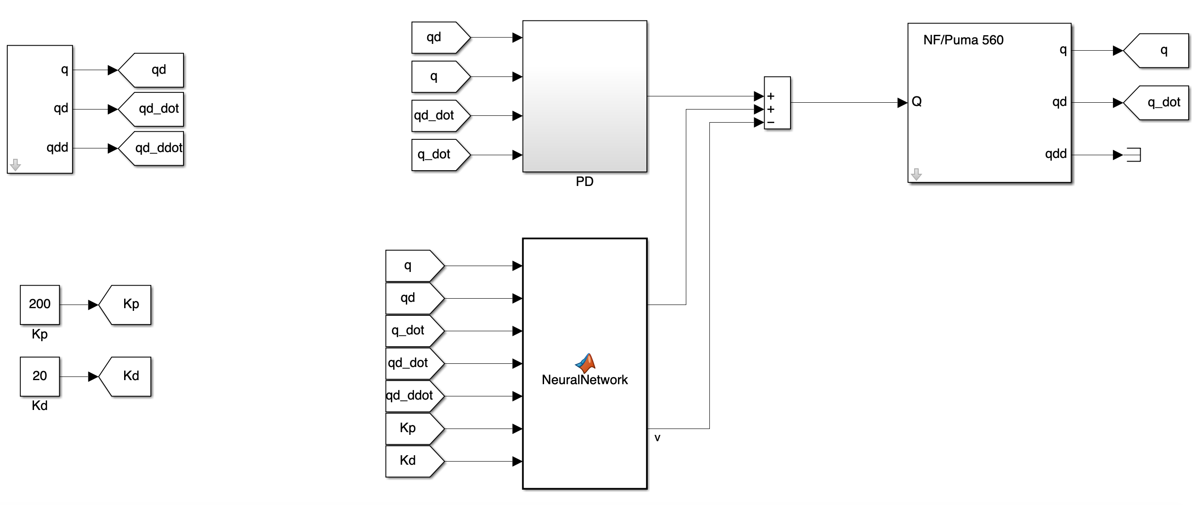
STATE OF THE ART
SIMULINK IMPLEMENTATION
PERFORMANCE EVALUATION
CONCLUSIONS
Neural Network with Augmented Backprop Tuning for the General Case
The Simulink model used to implement the control based on Neural Network with Augmented
Backprop Tuning for the General Case is depicted in Figure 4. The MATLAB code that implements the neural network and the calculation of the robustifying term is shown in Figure 5.
Figure 4: Control scheme with Neural Network with Augmented Backprop Tuning.
Figure 5: Code of the Matlab Function.

Slide 15
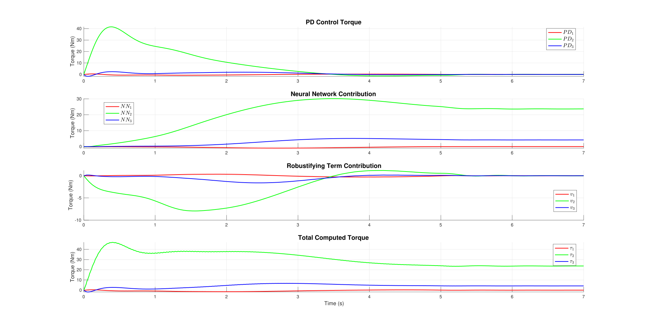
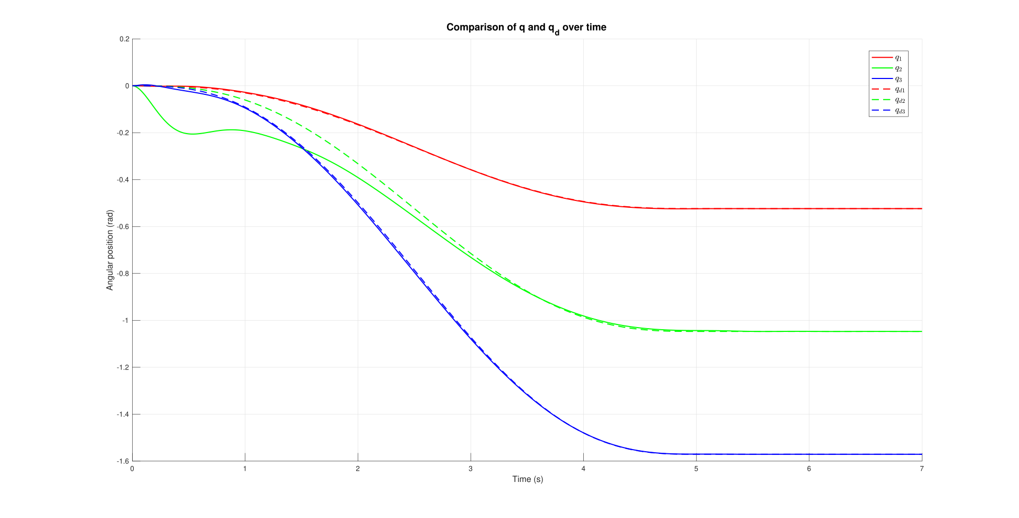
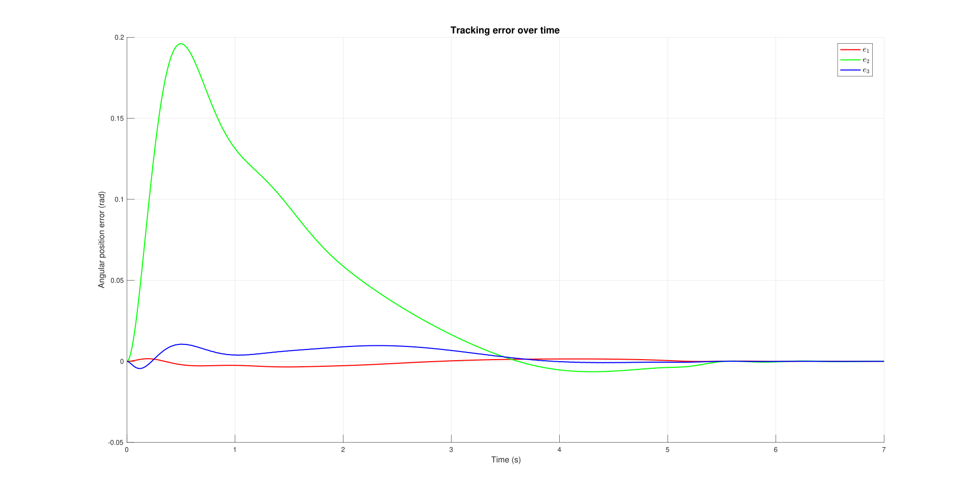
STATE OF THE ART
SIMULINK IMPLEMENTATION
PERFORMANCE EVALUATION
CONCLUSIONS
Neural Network with Augmented Backprop Tuning for the General Case
Tracking trajectory
Even with the neural network implemented using the second backpropagation methodology, the
performance in terms of tracking capability proves to be very good.
Figure 6: Desired and actual joint trajectories evolution.
Figure 7: Tracking error evolution.

Slide 16
STATE OF THE ART
SIMULINK IMPLEMENTATION
PERFORMANCE EVALUATION
CONCLUSIONS
Neural Network with Augmented Backprop Tuning for the General Case
Control action
The control action computed by the neural network-based controller using the second backpropagation methodology consists of three components: the PD control action, the neural network control action, and the control action resulting from the robustifying term, as shown in Figure 8.
Figure 8: Control actions evolution.

Slide 17
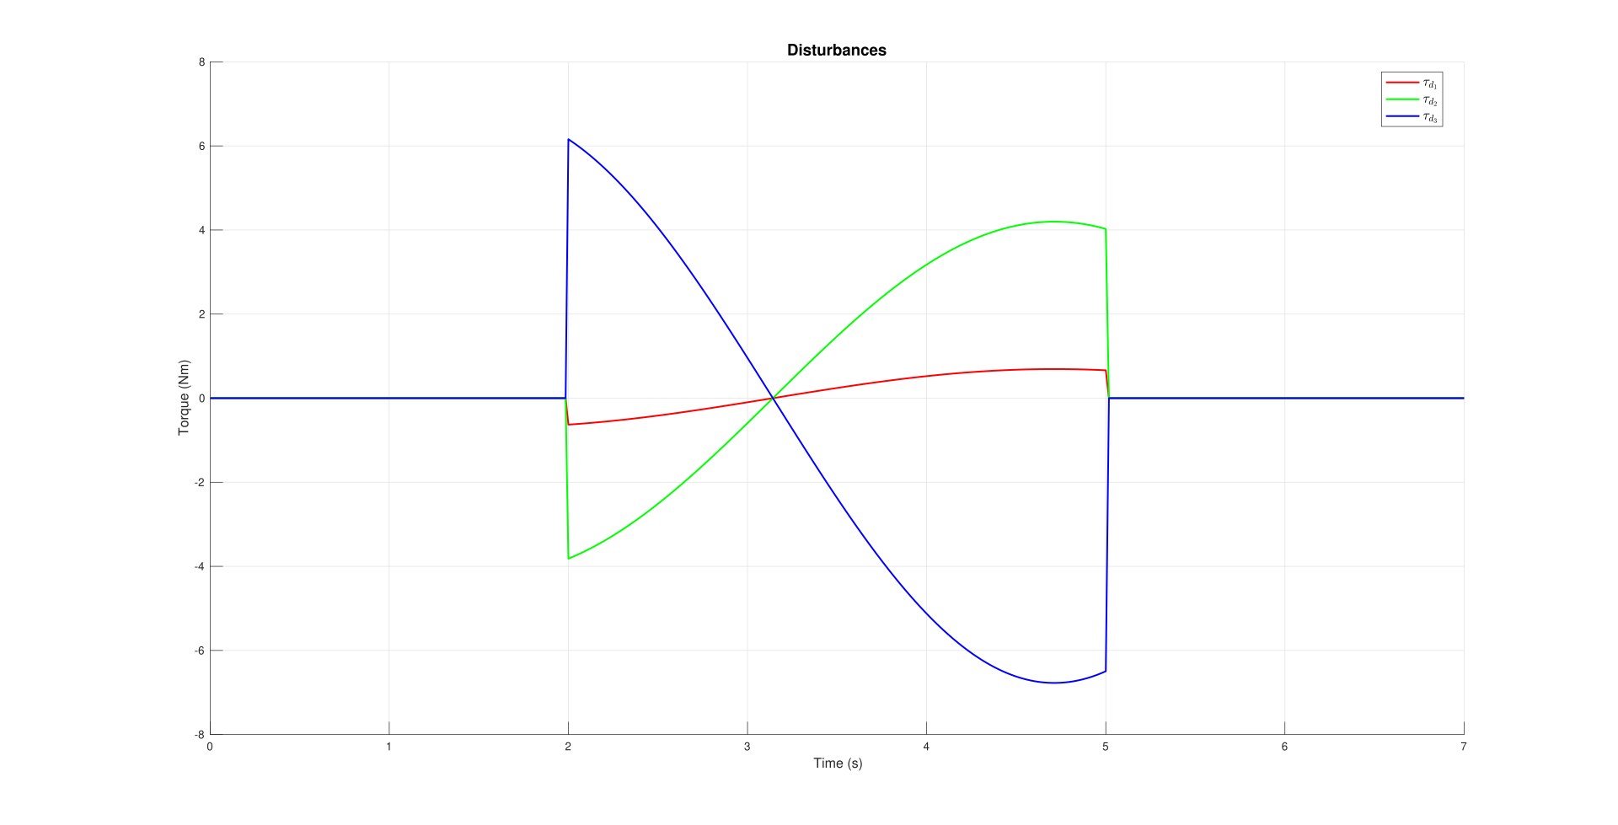
STATE OF THE ART
SIMULINK IMPLEMENTATION
PERFORMANCE EVALUATION
CONCLUSIONS
Simulation in the Presence of Disturbances
To compare the robustness of the two neural network-based controllers, tests were conducted in the presence of a sinusoidal disturbance with an amplitude of [-0.692 -4.198 6.773 0 0 0] and a frequency of 1 rad/s.
The results will be presented in terms of:
Tracking error
Control action
Figure 9: Applied Disturbances.

Slide 18
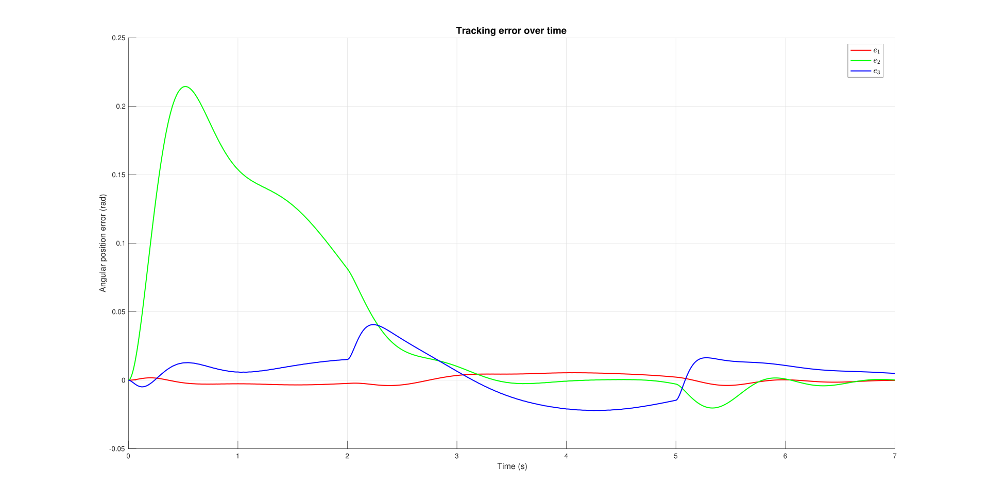
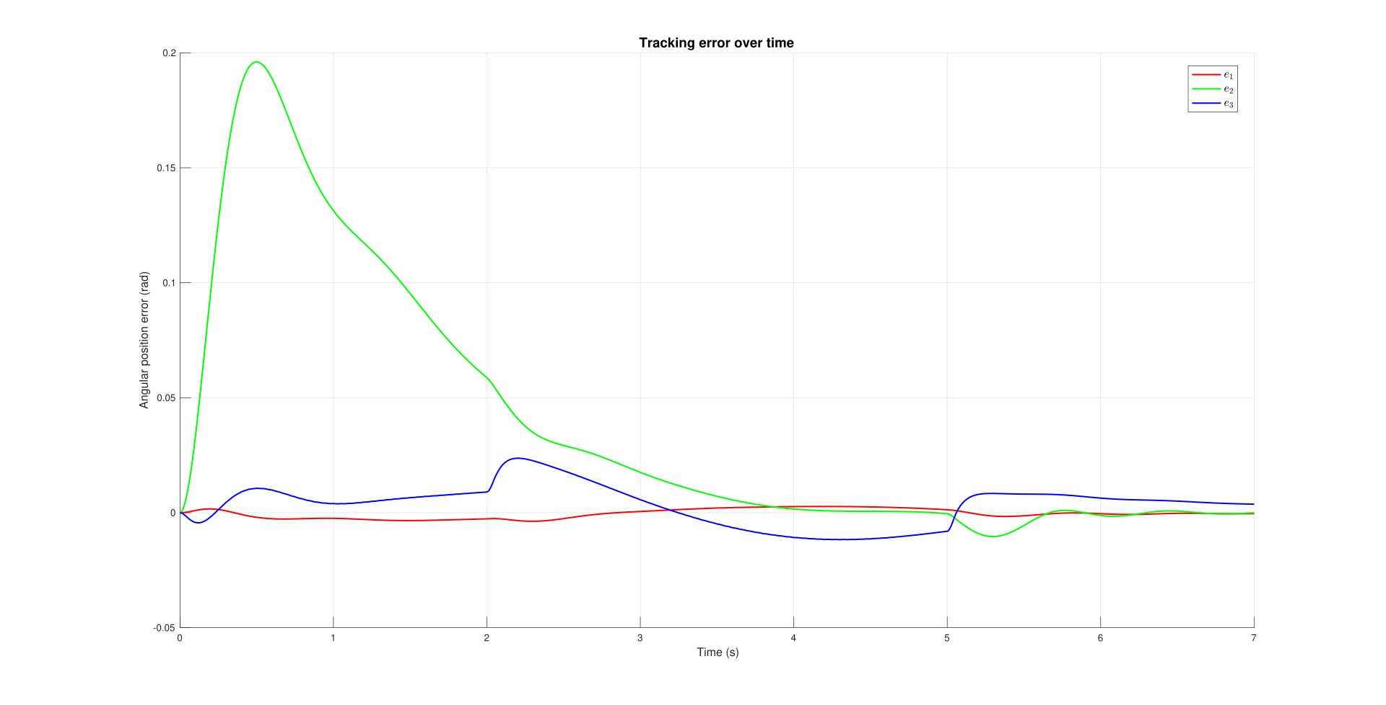
STATE OF THE ART
SIMULINK IMPLEMENTATION
PERFORMANCE EVALUATION
CONCLUSIONS
Simulation in the Presence of Disturbances
Tracking error
NN with the 1st backprop methodology
NN with the 2nd backprop methodology
Figure 10: Tracking error with the first NN in the presence of disturbance.
Figure 11: Tracking error with the second NN in the presence of disturbance.

Slide 19
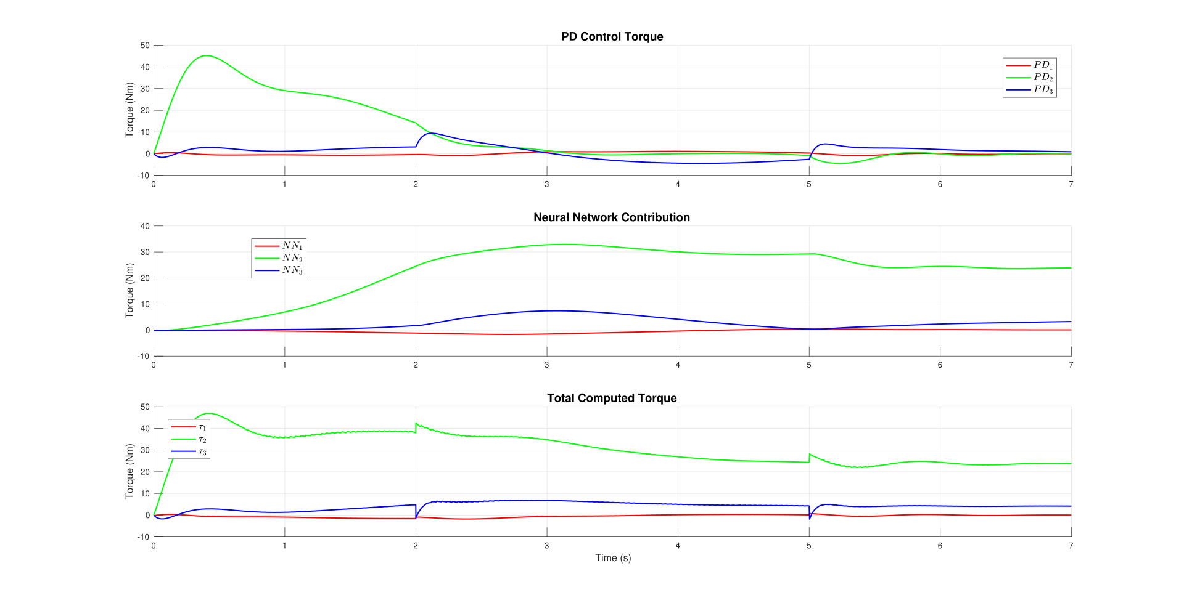
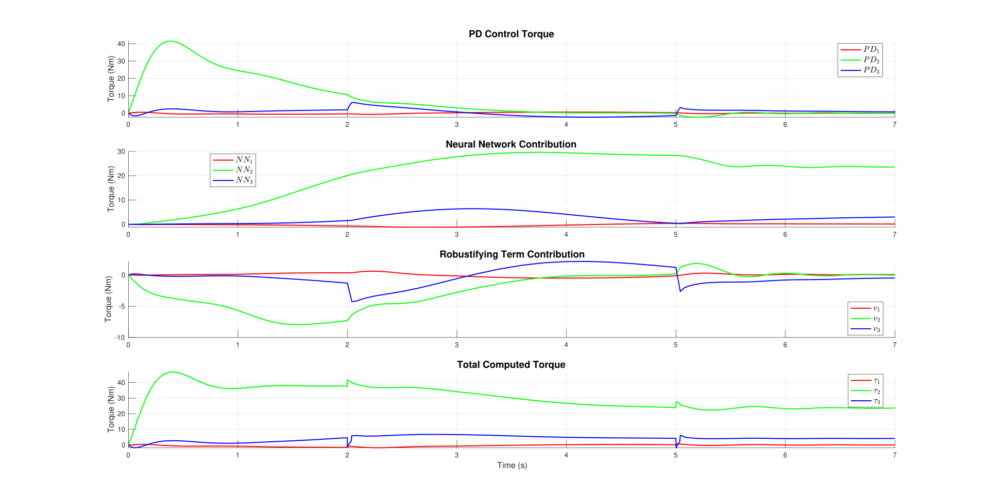
STATE OF THE ART
SIMULINK IMPLEMENTATION
PERFORMANCE EVALUATION
CONCLUSIONS
Simulation in the Presence of Disturbances
Control action
NN with the 1st backprop methodology
NN with the 2nd backprop methodology
Figure 12: Control actions with the first NN in the presence of disturbance.
Figure 13: Control actions with the second NN in the presence of disturbance.

Slide 20
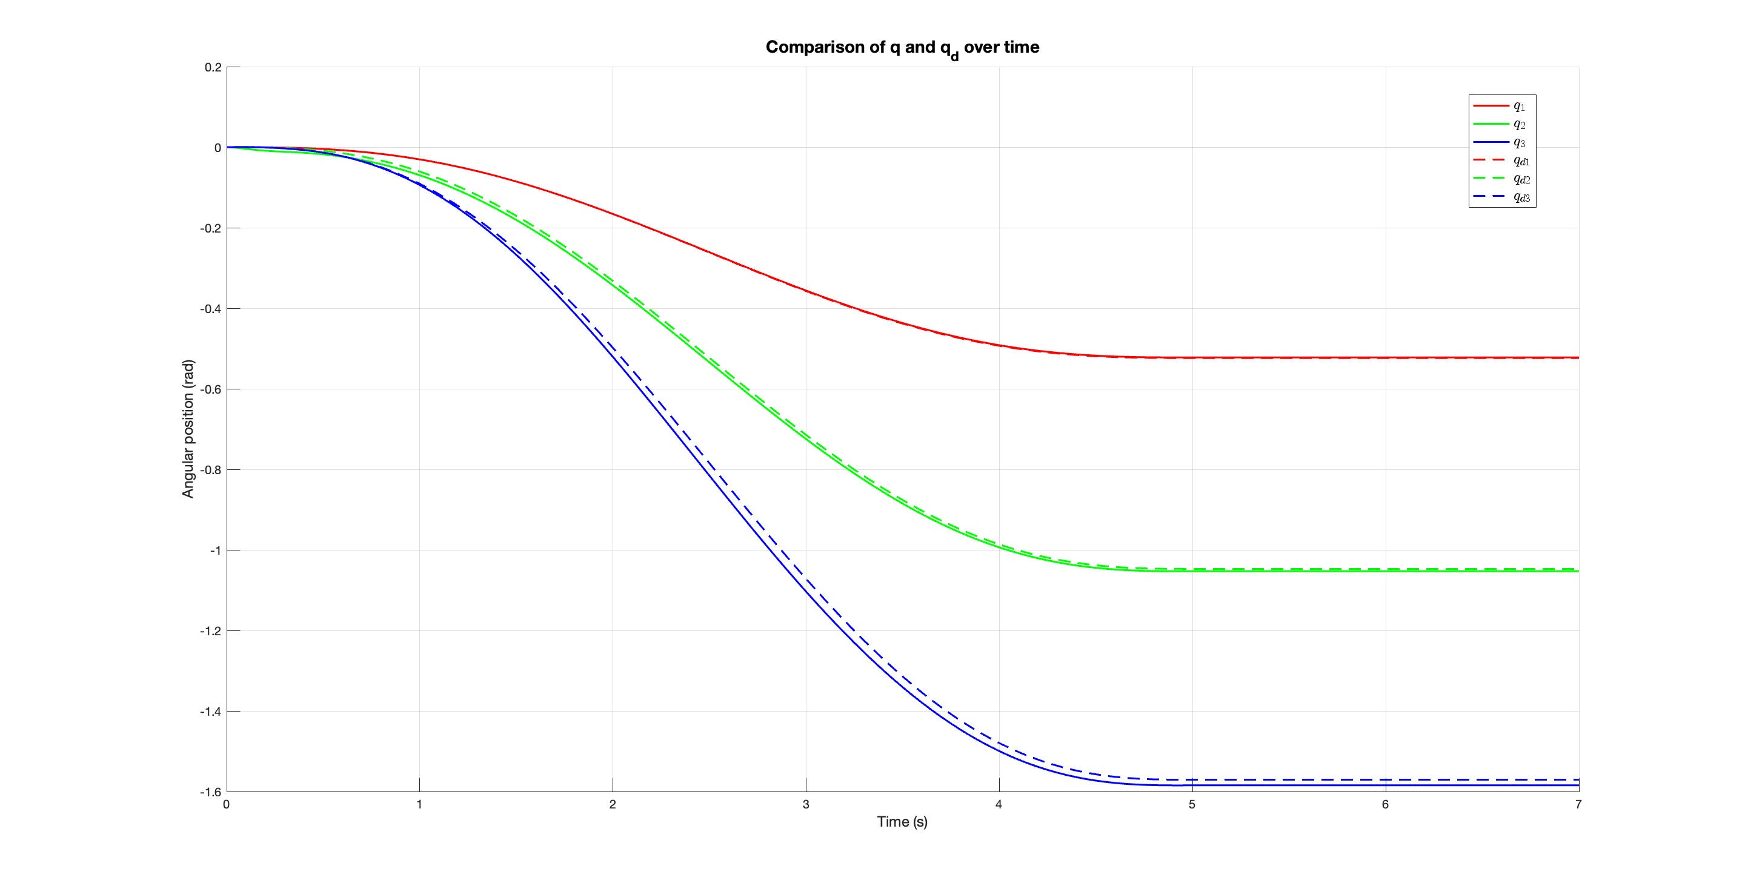
STATE OF THE ART
SIMULINK IMPLEMENTATION
PERFORMANCE EVALUATION
CONCLUSIONS
Inverse Dynamics Control
The final test conducted concerns motion control using inverse dynamics.
Since inverse dynamics control is a theoretical approach, as it requires exact knowledge
of all the matrices that define the manipulator’s dynamics, a simulation was performed in which
the masses of the manipulator’s links were modified:
The mass of link 1 was decreased by 0.2 kg,
The mass of link 2 was decreased by 0.1 kg,
The mass of link 3 was increased by 0.5 kg,
The mass of link 4 was increased by 0.1 kg,
The mass of link 5 was increased by 0.6 kg,
The mass of link 6 was increased by 0.4 kg.
Figure 14: Desired and actual joint trajectories with inverse dynamics control.

Slide 21
CONCLUSIONS
In this study, a centralized motion control technique based on a PD controller with a neural network was implemented. Two different neural networks were developed, each employing a distinct weight update methodology.
ADVANTAGES OF THE NEURAL NETWORK | DISADVANTAGES OF THE NEURAL NETWORK
No prior knowledge of the manipulator dynamics | Requires case-by-case parameter tuning
Robustness to disturbances and uncertainties | High computational cost
Online tuning without pre-training | Dependence on PD parameters
As future developments for this project, the following objectives are planned:
New tuning weights strategies
Tests on a Real System

Slide 22

Thanks for your attention

