Slide 1
IMDB Sentiment
Deep Learning Comparison
DEEP LEARNING PROJECT · ICT-4442
A controlled comparison of MLP, TextCNN, BiLSTM and fine-tuned DistilBERT for movie-review sentiment classification.
Hasil Haroon · T Rama Mohan Aniketh · Madhavan K · Ayrton Pulikottil
Manipal Institute of Technology
230953019 · 230911224 · 230953298 · 230953448
School of Computer Engineering · November 2026

Slide 2
One Dataset. Four Model Families.
PROJECT AT A GLANCE
DATASET
TASK
IMDB Large Movie Review Dataset · 50,000 labelled reviews
Binary sentiment classification: positive vs negative
COMMON PROTOCOL
QUESTION
22,500 train · 2,500 validation · 25,000 held-out test
How much accuracy is worth the extra model complexity and training cost?
IMDB Sentiment DL Comparison · ICT-4442
02 / 12

Slide 3
Two Ideas Behind the Comparison
WHY THIS PROBLEM
Sentiment is contextual
Fair comparison matters
Review language is informal and mixed. Word order changes meaning: “not good” and “not bad” contain similar tokens but express opposite sentiment.
Every model sees the same cleaned data, fixed split and metrics. Validation F1 selects a configuration; the official test set is used only once.
IMDB Sentiment DL Comparison · ICT-4442
03 / 12

Slide 4
A Reproducible, Leakage-Free Study
OBJECTIVES & SCOPE
We complete the scope proposed in the synopsis and interim report: implement four architectures, tune each on validation data, compare their test performance and cost, and inspect failures of the strongest model.
DATA SOURCE
Official IMDB mirror
CLEANING
HTML removal + whitespace normalization
MODEL SELECTION
Validation F1 only
REPRODUCIBILITY
Seed 42 · JSON results · GitHub repository
IMDB Sentiment DL Comparison · ICT-4442
04 / 12

Slide 5
What Makes the Comparison Trustworthy
EVALUATION DESIGN
01
The official 25,000-review test partition is never used for tuning.
02
TF--IDF vocabularies and neural token vocabularies are fitted on training text only.
03
Each family uses a small validation-based configuration search, not a test-set search.
04
Accuracy, precision, recall, F1, ROC--AUC and confusion matrices are reported together.
05
Saved result JSON files, plots and scripts make the experiment reproducible.
IMDB Sentiment DL Comparison · ICT-4442
05 / 12

Slide 6

One Shared Experimental Workflow
METHOD
IMDB reviews → clean & split
Train split
Validation split
Test split
22,500 reviews · vocabularies fitted here
2,500 reviews · choose highest F1 configuration
25,000 untouched reviews · final evaluation only
MLP · TextCNN · BiLSTM · DistilBERT → selected model scores are directly comparable
IMDB Sentiment DL Comparison · ICT-4442
06 / 12

Slide 7
Four Architectures, One Protocol
MODELS & TUNING
Model | Representation | Selected configuration | Test performance
MLP | 20k TF--IDF uni/bi-grams | 128 hidden · L2=1e-3 | Acc 0.8774 · F1 0.8773
TextCNN | Random embeddings | 200 tokens · 100 filters | Acc 0.8408 · F1 0.8529
TextCNN | Fine-tuned GloVe | 300 tokens · 128 filters | Acc 0.8718 · F1 0.8753
BiLSTM | Fine-tuned GloVe | 128 hidden · 256 tokens | Acc 0.8668 · F1 0.8698
DistilBERT | Pretrained transformer | 256 tokens · lr 2e-5 | Acc 0.9141 · F1 0.9138
Selection | Validation F1 | Seed 42 · held-out test | AUC best: 0.9723
IMDB Sentiment DL Comparison · ICT-4442
07 / 12

Slide 8
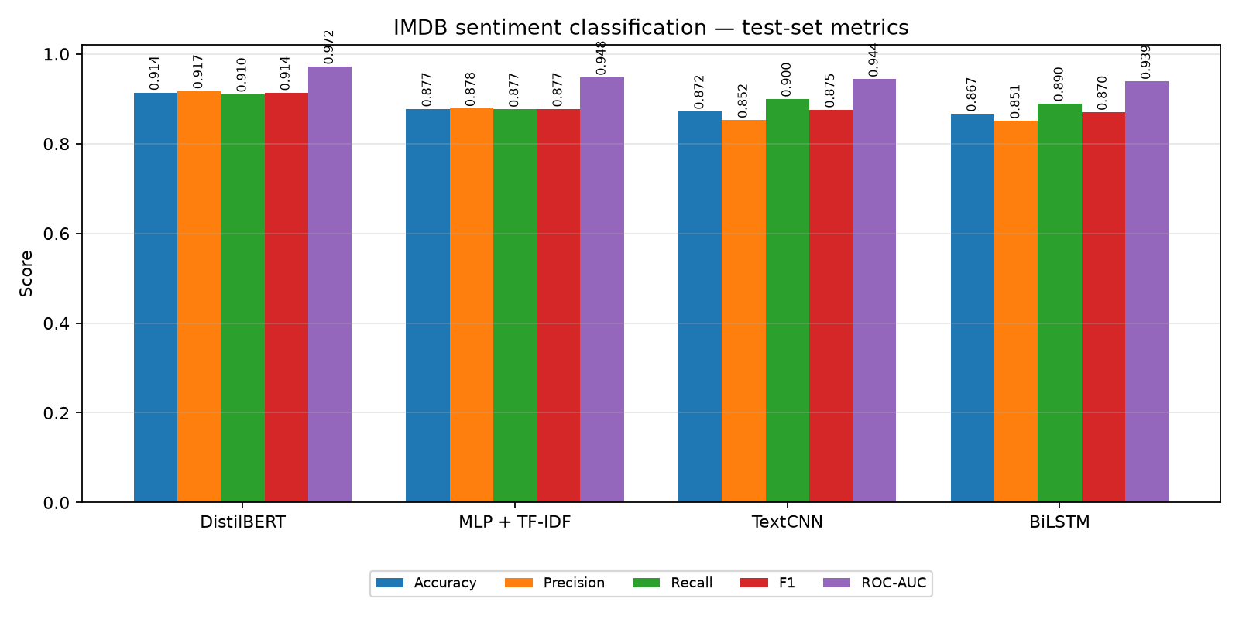
DistilBERT Leads the Comparison
RESULTS
Best overall result
Fine-tuned DistilBERT: 0.9141 accuracy, 0.9138 F1 and 0.9723 ROC--AUC. It improves accuracy by 3.7 percentage points over the strongest non-transformer.
Strong lightweight baseline
The TF--IDF MLP reaches 0.8774 accuracy. It demonstrates that sparse lexical features remain highly competitive on IMDB.
GloVe matters
TextCNN improves from 0.8408 with random embeddings to 0.8718 with GloVe and 300-token inputs.
Trade-off
TextCNN trains in 24 s; DistilBERT takes 643 s on the selected run. Higher accuracy has a clear compute cost.
IMDB Sentiment DL Comparison · ICT-4442
08 / 12

Slide 9
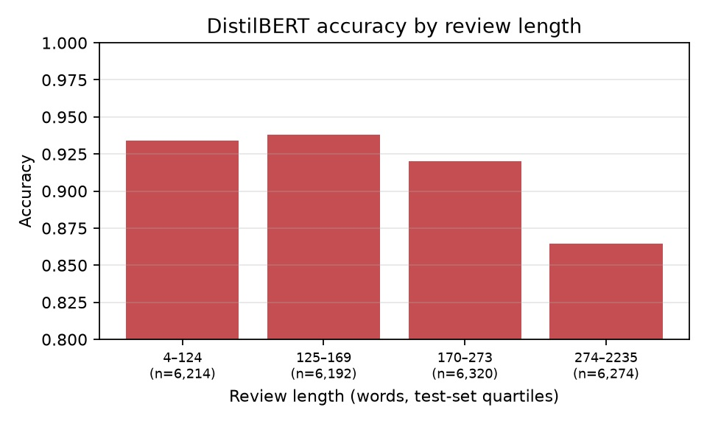
Where Does the Best Model Struggle?
ERROR ANALYSIS
Review length
Accuracy is 0.9340 for the shortest quartile, but falls to 0.8647 for reviews of 274–2,235 words.
Negation cues
Reviews with “not”, “never”, “no” or similar cues: 0.9081 accuracy; without them: 0.9322.
Why?
Long, mixed reviews are harder and evidence late in a review can be lost after the 256-token limit.
Qualitative cases
Several high-confidence apparent errors contain language that conflicts with the assigned label, suggesting noisy or mixed reviews.
IMDB Sentiment DL Comparison · ICT-4442
09 / 12

Slide 10
What the Experiment Shows
KEY TAKEAWAYS
Pretraining wins
Simple baselines matter
Embeddings help
DistilBERT is the strongest across accuracy, F1 and ROC--AUC because it begins with contextual language knowledge.
The MLP is only 3.7 percentage points behind DistilBERT while requiring far less tuning time and capacity.
GloVe substantially lifts TextCNN and fine-tuned GloVe gives the best BiLSTM configuration.
Result selection is validation-only; final figures, tables, scripts and results JSON are committed to GitHub.
IMDB Sentiment DL Comparison · ICT-4442
10 / 12

Slide 11
CONCLUSION
On one fixed IMDB protocol, fine-tuned DistilBERT delivers the best sentiment classification result — while the MLP and GloVe TextCNN remain strong, lower-cost choices.
The project turns an architectural choice into an evidence-based trade-off: 0.9141 accuracy for DistilBERT versus 0.8774 for MLP, with reproducible code, plots and error analysis.

Slide 12
Thank You
Questions & discussion
Hasil Haroon · T Rama Mohan Aniketh · Madhavan K · Ayrton Pulikottil
GitHub: github.com/sltrtn/imdb-sentiment-dl-comparison · MIT Manipal

