Slide 1
High Pressure Water Jetting
Basic Operator Training
(Awareness & Field Verification)
Day 1 – Safety Foundation, Hazards, Medical Response & Controls
Anabeeb HSE & Training | NEBOSH Verified Programme

Slide 2
NEBOSH Verified Programme
This programme is delivered to NEBOSH Verified standards.
It follows industry best practices and international standards for high pressure water jetting operations.
You will receive an Anabeeb certificate and personal Medical Alert Card upon successful completion of the full 3-day programme and assessments.
Anabeeb High Pressure Water Jetting Basic Operator Training | Day 1
2

Slide 3
Day 1 Learning Outcomes
By the end of today you will be able to:
• Understand why high pressure water jetting injuries are different and serious
• Explain the Medical Alert Card and when to use it
• Apply the hierarchy of controls and key site safety rules
• Understand how the system creates pressure and why control of relief is critical
• Recognise Stop Work Authority and when to use it
Anabeeb High Pressure Water Jetting Basic Operator Training | Day 1
3

Slide 4
What is High Pressure Water Jetting?
High pressure water jetting uses a pump to move large volumes of water through a small nozzle.
The nozzle creates the cutting or cleaning force.
Pressures commonly reach 10,000 to 20,000 psi on Anabeeb work.
It is used for surface cleaning, tube cleaning, pipe cleaning and more during shutdowns and maintenance.
Key Principle: The pump moves the water. The nozzle turns that flow into extreme force. This is a controlled cutting tool – not just cleaning equipment.
Anabeeb High Pressure Water Jetting Basic Operator Training | Day 1
4

Slide 5
Where HPWJ is Used on Our Sites
Common applications on Anabeeb and client sites:
• Heat exchanger and bundle cleaning
• Pipe and line cleaning
• Surface preparation before coating
• Vessel and tank cleaning
This work is always part of shutdown and turnaround activities. Strict controls are required every time.
Anabeeb High Pressure Water Jetting Basic Operator Training | Day 1
5

Slide 6
Why Waterjet Injuries Are Different
Waterjet injuries are different from normal cuts or bruises.
Even a small external wound can hide severe internal damage.
Medical attention is required for ALL suspected waterjet injuries – no exceptions.
The Medical Alert Card tells medical staff exactly what to look for and what treatment is needed. It can save your life.
Anabeeb High Pressure Water Jetting Basic Operator Training | Day 1
6

Slide 7
Types of Waterjet Injury
1. Water-Cut – direct injection of water into the body
2. Water-Burst – sudden high-velocity burst penetrating tissue
3. Struck-By – hose, tool or debris hitting the body
All three must be treated seriously. The Medical Alert Card covers all types. Never assume an injury is minor.
Anabeeb High Pressure Water Jetting Basic Operator Training | Day 1
7

Slide 8
Real Incident Examples – Never Again
Real incidents have happened in the industry:
• Hose failure causing struck-by injury
• Jet cutting through PPE and causing internal damage
• Delayed medical treatment because the injury looked minor
Lesson: Proper controls, pre-use inspection and immediate medical response save lives. We study these incidents so we never repeat them.
Anabeeb High Pressure Water Jetting Basic Operator Training | Day 1
8

Slide 9
The Medical Alert Card – Your Lifeline
Issued today – you must carry it on every high pressure water jetting job.
Waterproof and easy to access.
Tells medical staff exactly what treatment is needed.
This is a mandatory safety requirement – not optional. From this moment you are never allowed on a HPWJ job without this card in your possession.
Anabeeb High Pressure Water Jetting Basic Operator Training | Day 1
9

Slide 10
Activity – Issue Medical Alert Cards
Trainer will now issue one Medical Alert Card to each participant.
• Sign the training roster to confirm receipt and understanding
• Read the card aloud together
• Photograph each participant holding their card for records
From this moment the card must be with you on every HPWJ job. It is your responsibility.
Anabeeb High Pressure Water Jetting Basic Operator Training | Day 1
10

Slide 11
Hierarchy of Controls – Industry Best Practice
We always apply the hierarchy of controls:
1. Elimination / Substitution – remove the hazard where possible
2. Engineering Controls – automation, mechanised systems, guards
3. Administrative Controls – permits, JSA, procedures, training
4. PPE – last line of defence, never the only control
Safer automated or mechanised methods are always preferred where reasonably practicable.
Anabeeb High Pressure Water Jetting Basic Operator Training | Day 1
11

Slide 12
Key Site Safety Requirements
On Anabeeb and client sites we require:
• Valid permit-to-work before any pressurised work
• Job Safety Analysis (JSA) completed and reviewed by the team
• Buddy system – no lone working allowed
• Proper barricading and exclusion zones (minimum safe distance)
• Heat stress controls and work-rest rotation
These are mandatory requirements – not optional.
Anabeeb High Pressure Water Jetting Basic Operator Training | Day 1
12

Slide 13
Barricading and Exclusion Zones
Temporary barricades must be erected before any pressurised work.
Minimum safe distance follows industry best practice (typically 6 metres in all directions).
Use red barricade tape with clear “DANGER – HIGH PRESSURE WATER JETTING IN PROGRESS” signage.
Only authorised personnel inside the barricaded area.
If full distance cannot be achieved, additional controls (shrouds, shielding) must be used. Never start work without proper barricading.
Anabeeb High Pressure Water Jetting Basic Operator Training | Day 1
13

Slide 14
Heat Stress & Work Rotation
KSA weather can be extremely hot. Heat stress is a real hazard during HPWJ work.
Mandatory work-rest regimen and rotation of duties.
Watch each other for early signs of heat exhaustion.
Use hydration stations and shaded rest areas.
On practical days we rotate frequently to keep everyone safe. Safety includes looking after each other in the heat.
Anabeeb High Pressure Water Jetting Basic Operator Training | Day 1
14

Slide 15
System Fundamentals – Pressure vs Flow
The pump moves (displaces) water – it does not create pressure by itself.
Pressure is created only when the flow is restricted at the nozzle.
Higher pressure with a smaller orifice gives greater cutting power but also greater reaction force on the operator.
Key Rule: The nozzle operator must always have control of the pressure relief. Know exactly where the water is going at all times.
Anabeeb High Pressure Water Jetting Basic Operator Training | Day 1
15

Slide 16
Pressure Relief Control & Operator Responsibility
Different pressure relief control styles exist on site (standard dump, pneumatic, electrical).
The nozzle operator must always have positive control of the pressure relief method.
Different styles may add extra steps but never change the safety sequence.
Never start work if you do not fully understand and control the relief system on the equipment you are using.
Anabeeb High Pressure Water Jetting Basic Operator Training | Day 1
16

Slide 17
Stop Work Authority (SWA)
You have the authority and the duty to stop work if conditions are unsafe.
Stop work if:
• Equipment is not properly inspected or barricaded
• You are unsure about any control or procedure
• Heat stress or fatigue is affecting the team
• Any team member raises a concern
There is no penalty for stopping work for safety reasons. Use your SWA – it protects you and your team.
Anabeeb High Pressure Water Jetting Basic Operator Training | Day 1
17

Slide 18
Day 1 Summary & Key Takeaways
Key points from today:
• Waterjet injuries can be severe even when they look minor – always use the Medical Alert Card
• Follow the hierarchy of controls – safer methods first
• Mandatory controls: PTW, JSA, buddy system, barricading, heat stress rotation
• The nozzle operator must control pressure relief
• You have Stop Work Authority – use it
Tomorrow: Equipment, Pre-Use Inspection, PPE and Job Planning
Anabeeb High Pressure Water Jetting Basic Operator Training | Day 1
18

Slide 19
Day 1 Introduction of HP pump
High-Pressure (HP) Pump Training Module
(Applicable to 10K, and 20K,High-Pressure
Introduction to a High-Pressure (HP) Pump
A High-Pressure (HP) Pump is a positive displacement pump designed to convert mechanical energy from a diesel engine into high-pressure water.
The pump delivers water at pressures ranging from 0-10,000 psi (690 bar) 0-20,000 psi (1,379 bar) or higher for industrial cleaning applications.
Main Functions
Generate high-pressure water
Supply constant water flow
Maintain operating pressure
Deliver water safely to the jetting tool
Anabeeb High Pressure Water Jetting Basic Operator Training | Day 1
14

Slide 20
Day 1 Introduction of HP pump
Main Parts of an HP Pump
Part | Function
Power Unit Diesel Engine
Drives the pump
Triplex Plunger Pump
Produces high-pressure water
Plungers
Compress water to high pressure
Suction Valves
Allow water into pump
Discharge Valves
Deliver pressurized water
Pressure Regulator/Unloader Valve
Controls pressure
Pressure Relief Valve
Prevents over-pressure
Anabeeb High Pressure Water Jetting Basic Operator Training | Day 1
14

Slide 21
Day 1 Introduction of HP pump
Pressure Gauge
Displays operating pressure
Water Filter (Inlet Strainer)
Prevents debris entering pump
Water Supply Connection
Supplies clean water
HP Outlet Connection
Connects HP hose
Emergency Stop Button
Immediately shuts down system
Fuel Tank
Stores diesel fuel
Engine Control Panel
Controls engine functions
Battery
Starts engine
Oil Reservoir
Lubricates pump
Cooling System
Maintains operating temperature
Anabeeb High Pressure Water Jetting Basic Operator Training | Day 1
14

Slide 22
Day 1 Pre-Start up of HP pump
Before operating the HP pump, perform the following inspections.
Barricades installed
Sign Board in place
Pump Inspection
Engine oil level
No water leaks
Pump oil level
Pressure gauge calibrated
Fuel level
Emergency stop functional
Cooling water
Safety relief valve installed
Battery condition
No oil leaks
Belts and couplings
Anabeeb High Pressure Water Jetting Basic Operator Training | Day 1
14

Slide 23
Day 1 Pre-Start up of HP pump
HP Hose Inspection
Gun / Tool Inspection
Correct pressure rating
Trigger functioning
No cuts
Trigger guard
No bulges
Safety latch
No damaged fittings
Correct nozzle
Safety whip checks installed
Lance straight
Hose restraints installed
Hose routed safely
Anabeeb High Pressure Water Jetting Basic Operator Training | Day 1
14

Slide 24
Day 1 HPWJ PPE
Safety helmet
Face shield
Safety goggles
Hearing protection
Water jetting suit
Cut-resistant gloves
Steel-toe boots
Waterproof clothing
Anabeeb High Pressure Water Jetting Basic Operator Training | Day 1
14

Slide 25
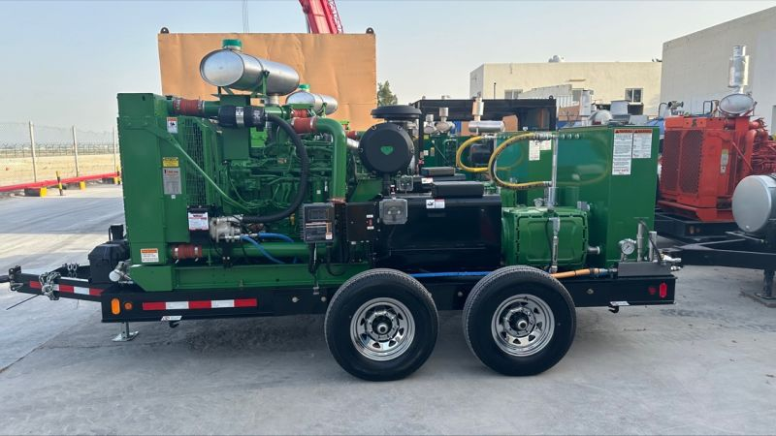
Day 2 HPWJ Line-Up Procedure
Park on stable ground.
Chock wheels.
Connect suction hose.
Connect to HP outlet.
Install whip checks.
Tighten fittings.
Long barrel gun
Select correct nozzle.
Verify nozzle orientation.
Tighten securely.
Anabeeb High Pressure Water Jetting Basic Operator Training | Day 1
14

Slide 26
Day 2 HP Pump Start-Up and Air Bleeding
Air Bleeding
Open dump valve.
Start water supply.
Allow water to flow until air is removed.
Close dump valve.
Start Engine
Start engine at idle.
Check oil pressure.
Listen for abnormal noise.
Check for leaks.
Anabeeb High Pressure Water Jetting Basic Operator Training | Day 1
14

Slide 27
Day 2 HP Pump Start-Up and Air Bleeding
Increase RPM
Increase engine speed gradually.
Observe pressure gauge.
Confirm stable operating pressure.
Functional Test
Before beginning work:
Test the trigger
Test dump valve
Anabeeb High Pressure Water Jetting Basic Operator Training | Day 1
14

Slide 28
Day 2 HP Pump Start-Up and Air Bleeding
Practical Learning Objectives
Identify all HPWJ equipment and accessories.
Perform pre-use inspection.
Complete proper line-up of the HP pump.
Operate the HP pump safely.
Use a long barrel gun correctly.
Maintain correct body position and reaction force control.
Communicate effectively with the pump operator.
Complete post-job shutdown and equipment inspection.
Use of Foot Valve, Creeping Hose and Catcher
Anabeeb High Pressure Water Jetting Basic Operator Training | Day 1
14

Slide 29
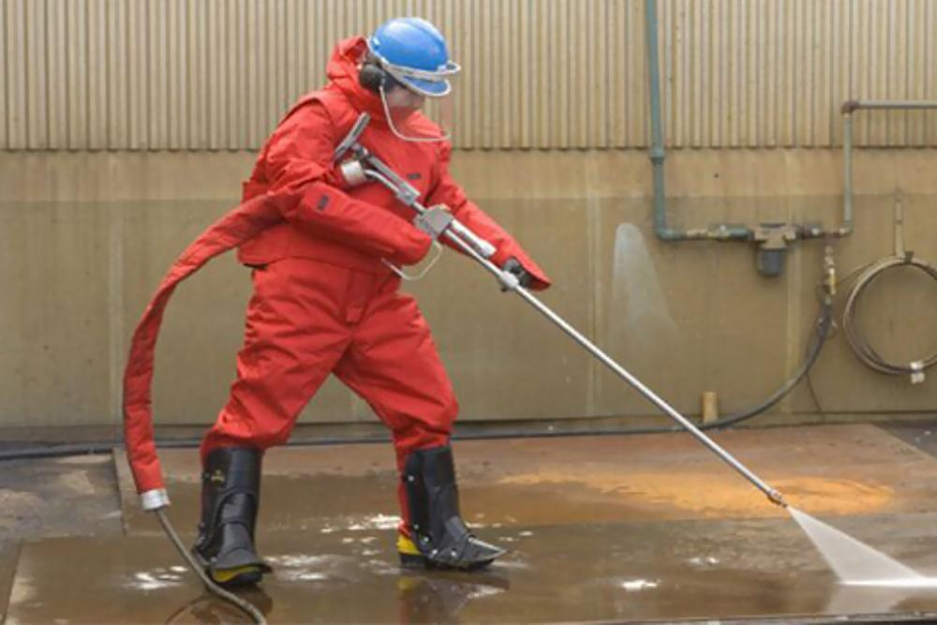
Day 2 HP Practical Training using 10k & 20k Long Barrel Gun
Long Barrel Gun Operation
Trainer demonstrates the Correct Stance:
Feet shoulder-width apart
Knees slightly bent
Both hands holds on the gun
Maintain stable footing
Keep hose behind operator
Never point gun toward people
Anabeeb High Pressure Water Jetting Basic Operator Training | Day 1
14

Slide 30
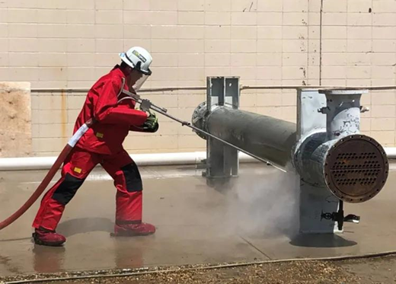
Day 2 HP Practical Training using 10k & 20k Long Barrel Gun
Practice:
Trigger control
Smooth movement
Reaction force control
Surface cleaning
Correct distance
Correct nozzle angle
Anabeeb High Pressure Water Jetting Basic Operator Training | Day 1
14

Slide 31
Day 2 HP Practical Training using 10k & 20k Long Barrel Gun
Communication
HP Jetter Commands:
Pump Operator Action
Ready?
Ready?
Start Pressure
Pressure On
Stop Pressure
Pressure Off
Every Hand Signal communication is important and must be acknowledged.
Anabeeb High Pressure Water Jetting Basic Operator Training | Day 1
14

Slide 32
Day 2 HP Practical Training using 10k & 20k Long Barrel Gun
In Case of Emergency
Slowly Reduce pressure
Release the trigger
Stop engine and Switch Off
Close water supply
Report incident
Anabeeb High Pressure Water Jetting Basic Operator Training | Day 1
14

Slide 33
Day 2 HP Practical Training using 10k & 20k Long Barrel Gun
Sequence in Pump Shutdown
Slowly Release the trigger.
Reduce RPM.
Stop the engine.
Close the water.
Disconnect hoses.
Drain the water.
Inspect damage.
Clean equipment.
Anabeeb High Pressure Water Jetting Basic Operator Training | Day 1
14

Slide 34
Day 2 HP Practical Training using 10k & 20k Long Barrel Gun
Critical Safety Rules
Never point the gun at any person.
Never bypass safety devices.
Always use the correct PPE.
Keep all personnel outside barricaded zone.
Never disconnect hoses under pressure.
Always use whip checks and hose restraints.
Maintain clear communication between the pump operator and gun operator.
Stop work immediately if any leak, hose movement, or equipment malfunction is detected.
Anabeeb High Pressure Water Jetting Basic Operator Training | Day 1
14

Slide 35
Day 2 HP Practical Training using 10k & 20k Long Barrel Gun
Practical Competency Assessment
Trainees are evaluated to the below Task
1. PPE Inspection
2. Equipment Identification
Practical Assessment Result
Trainee Name: ____________ Date: ____________
Practical Assessment: PASS / FAIL
Trainer Name & Signature: ____________
3. Pump Inspection
4. Hose Line-up
5. Pump Start-up
6. Pressure Adjustment
7. Long Barrel Gun Handling
8. Body Position
9. Communication
10. Pump Shutdown
Anabeeb High Pressure Water Jetting Basic Operator Training | Day 1
14

Slide 36
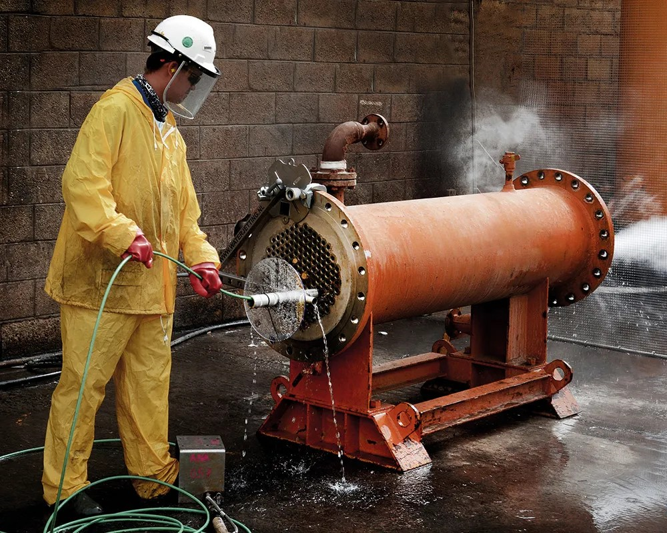
Day 3 HP Practical Training using Creeping Hose & AWD
Training Objective
At the end of the practical session, trainees shall be able to:
Identify creeping hose and AWD accessories.
Perform correct HPWJ equipment inspection.
Complete safe line-up of HP hoses and accessories.
Demonstrate correct hand signaling communication.
Operate HP pump safely
Perform creeping hose insertion and withdrawal safely.
Apply emergency shutdown procedure.
Anabeeb High Pressure Water Jetting Basic Operator Training | Day 1
14

Slide 37
Day 3 HP Practical Training using Creeping Hose & AWD
Creeping Hose Accessories (Name & Function)
Accessories Name’s
Function
Creeping Hose
Flexible hose inserted inside tubes/pipes for cleaning
AWD (Anti-Withdrawal Device)
Prevents hose from whipping or uncontrolled withdrawal
Nozzle
Produces water jet cleaning action
Nozzle Holder
Secures nozzle to hose end
Foot Valve
Controls pressure release
Barriers & Warning Signs
Establish exclusion zone
Communication
Hand Signal communication
Anabeeb High Pressure Water Jetting Basic Operator Training | Day 1
14

Slide 38
Day 3 HP Practical Training using Creeping Hose & AWD
Steps for Creeping Hose Line-Up
Pump → HP Hose → Foot Valve → Creeping Hose → Nozzle → AWD
AWD Installation Procedure
Select correct AWD size according to creeping hose diameter.
Install AWD close to tube entry point.
Confirm AWD locking function.
Test hose movement manually.
Ensure AWD prevents uncontrolled hose withdrawal.
Anabeeb High Pressure Water Jetting Basic Operator Training | Day 1
14

Slide 39
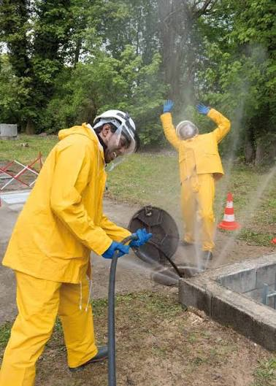
Day 3 HP Practical Training using Creeping Hose & AWD
Purpose of AWD:
Prevent Creeping hose pull-out
Reduce whipping hazard
Protect the Hydro Jetter
Creeping Hose Operation
Never hold hose close to nozzle end.
Never point hose toward people.
Maintain communication.
Monitor hose condition.
Stop immediately if abnormal movement occurs.
Anabeeb High Pressure Water Jetting Basic Operator Training | Day 1
14

Slide 40
Day 3 HP Practical Training using Creeping Hose & AWD
Practical Assessment
Correct PPE worn
Identifies creeping hose accessories
Practical Assessment Result
Trainee Name: ____________ Date: ____________
Practical Assessment: PASS / FAIL
Trainer Name & Signature: ____________
Installs AWD correctly
Performs hose inspection
Completes line-up correctly
Uses correct hand signals
Communicates with pump operator
Starts pump safely
Controls creeping hose safely
Performs shutdown procedure
Anabeeb High Pressure Water Jetting Basic Operator Training | Day 1
14

