Slide 1
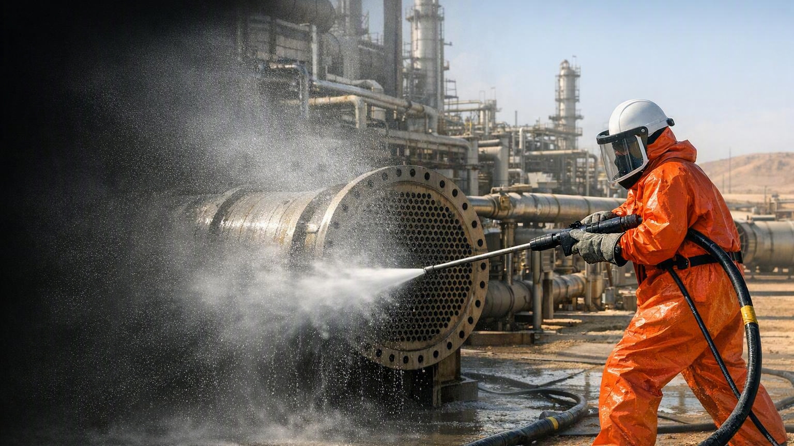
HPWJ FUNDAMENTALS
DAY 1 OF 3 — FOUNDATIONS, HAZARDS & CONTROLS
Anabeeb ATC-HPWJ-OP-001 | Level 2 Operator Pathway
Notes:
[Session 1, 07:00-07:15] Welcome the group, introduce yourself and your field background, run the round-the-room introductions, and cover house rules (next slide). See Trainer Script Session 1.

Slide 2
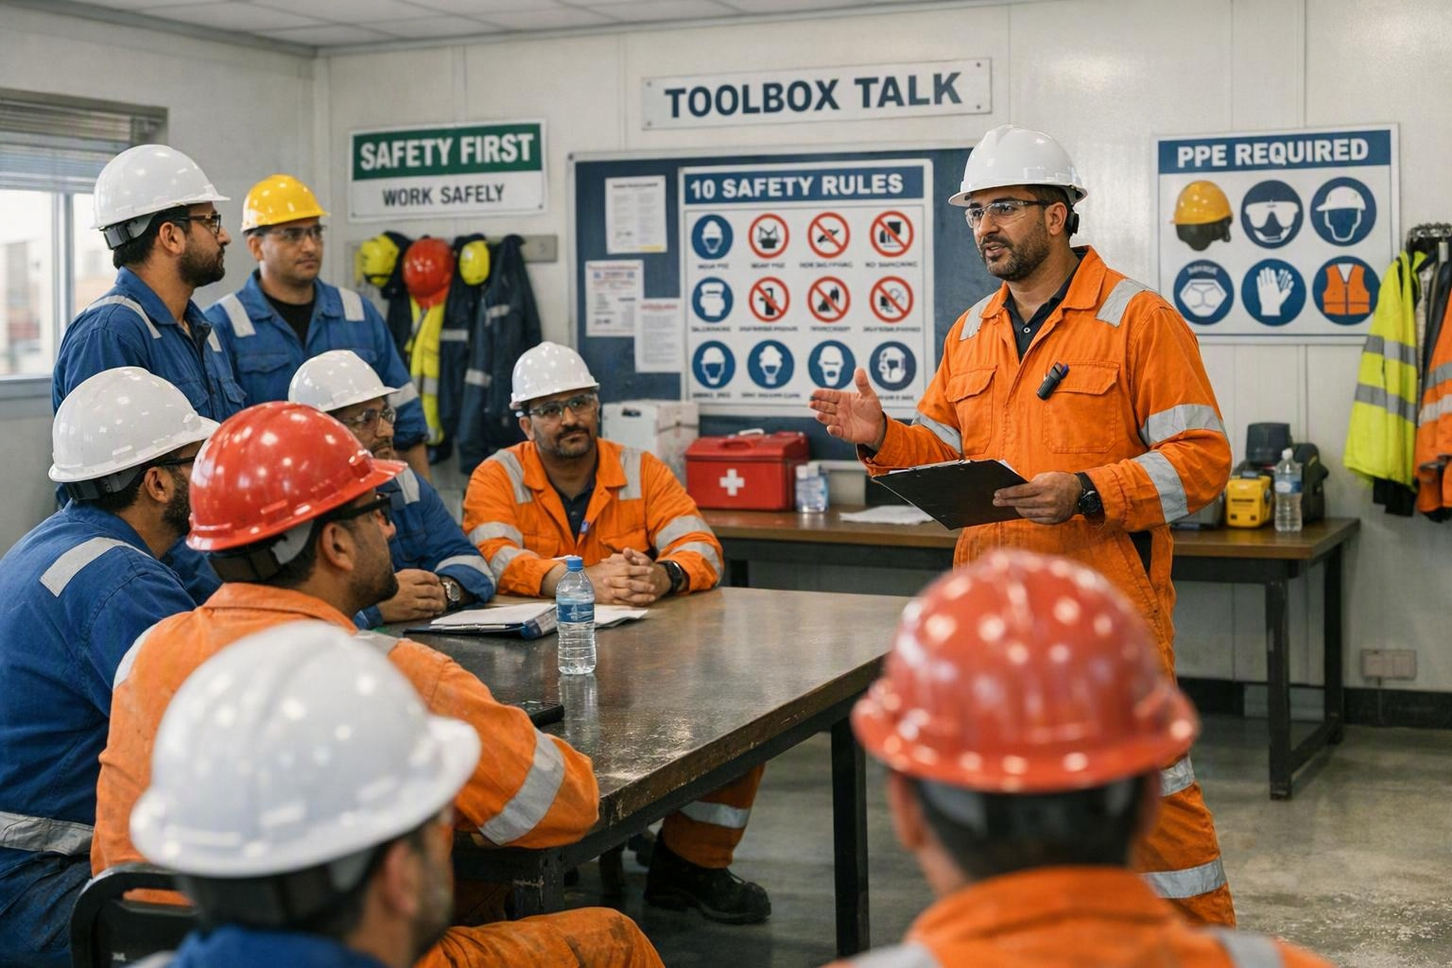
HPWJ FUNDAMENTALS – DAY 1
WELCOME & HOUSE RULES
This session is interactive, not just a lecture
You are welcome to ask questions at any time
Please share your own site experiences during discussions
Respect others when they are speaking
Mobile phones on silent during the session
This is Day 1 of 3 — everything you learn this week builds toward your certification
Notes:
[Session 1 continued, within 07:00-07:15] Part of the welcome block. See Trainer Script Session 1.

Slide 3

HPWJ FUNDAMENTALS – DAY 1
NEBOSH VERIFIED PROGRAM
NEBOSH, formed in 1979, is a globally recognised awarding organisation
It provides high-quality health, safety, and environmental qualifications
Anabeeb partners with NEBOSH to ensure high-quality HPWJ Operator training
The NEBOSH Verified logo signifies training quality
Successful completion earns a recognised e-certificate
This training enhances safety in oil and gas plants
Notes:
[Session 2, 07:15-07:20] Credibility statement — keep brief. See Trainer Script Session 2.

Slide 4

HPWJ FUNDAMENTALS – DAY 1
COURSE STRUCTURE AT A GLANCE
Day 1 (today): Foundations, hazards, equipment basics, and the core safety rules that govern every task
Day 2: Full hands-on equipment mastery — pump operation, flex lance, shotgun setup
Day 3: Integration, live Field Verification, and written assessment
Pass criteria: theory score of at least 80% + a practical pass on every critical item + a Medical Alert Card issued
Certificate validity: 24 months, then a refresher assessment (Verification of Competency)
Notes:
[Session 3, 07:20-07:30] Emphasise Field Verification is a real pass/fail event. See Trainer Script Session 3.

Slide 5
HPWJ FUNDAMENTALS – DAY 1
DAY 1 LEARNING OUTCOMES
Explain the physics of high-pressure jets and why injection injuries are catastrophic
Identify the core safety rules that govern every HPWJ task and understand why each one exists
Name the main parts of the pump, hose, and nozzle system and recognise correct PPE
Perform a complete pre-use inspection to standard
Calculate reaction force and apply the three additive controls
Demonstrate correct Medical Alert Card use and emergency communication script
Apply stop-work authority correctly
Notes:
[Session 4, 07:30-07:35] Read aloud — these are exactly what Day 3 tests. See Trainer Script Session 4.

Slide 6
HPWJ FUNDAMENTALS – DAY 1
WHY THIS MATTERS — A REAL INJECTION INJURY
Image / video: incident case study
A UK regulator investigated a fatality involving a flexible lance operated without a correctly installed and verified anti-withdrawal device
The missing device, combined with inadequate training and supervision, led to loss of control and a fatal injection injury
Source: UK Health and Safety Executive investigation, reported via SAFETY4SEA (Dec 2020) and an IMCA Safety Flash
Every control taught this week exists because of a failure exactly like this one
Notes:
[Session 5, 07:35-07:50] Ask 'what could have prevented this?' before revealing. Internal ref: Lesson LL-001. See Trainer Script Session 5.

Slide 7
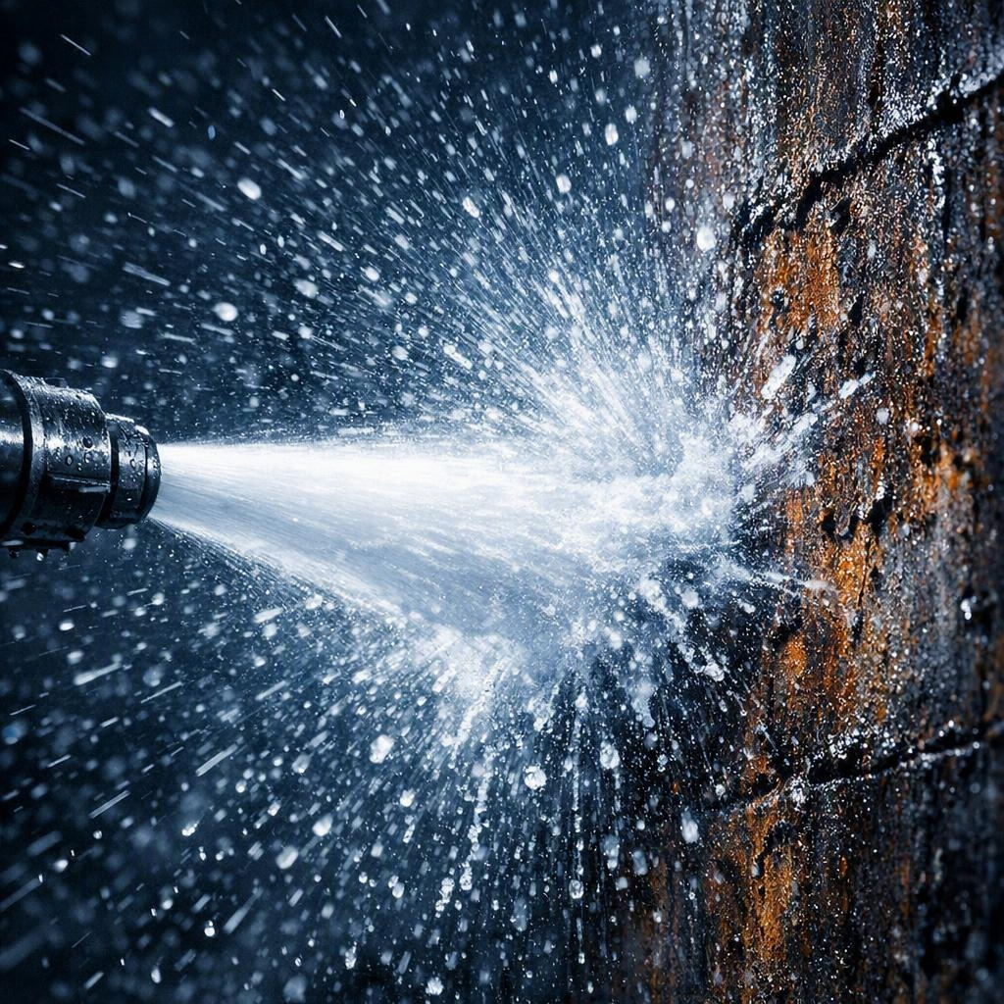
HPWJ FUNDAMENTALS – DAY 1
THE PHYSICS OF THE JET
Jet exit velocity can exceed 700 m/s at ultra-high pressure (approximately 743 m/s at 40,000 psi)
A water jet can penetrate skin and inject fluid deep into tissue in a fraction of a second
The entry wound often looks minor — internal damage is frequently severe and worsens rapidly
Any suspected injection injury is a medical emergency until proven otherwise — never 'wait and see'
Notes:
[Session 6, 07:50-08:20, then BREAK 08:20-08:35] Check understanding before moving on. See Trainer Script Session 6.

Slide 8
HPWJ FUNDAMENTALS – DAY 1
KEY SAFETY RULES EVERY OPERATOR MUST KNOW
A minimum of three competent people is required for every task, with one person dedicated solely to the emergency stop
Maximum working pressure is capped at 40,000 psi — there is no exception to this ceiling
The rupture disc must always be rated no higher than 1.2 times the weakest-rated part in the system
No unauthorised person may come within 10 metres of equipment while it is running
Most serious incidents trace back to one of three causes: a skipped pre-use inspection, loss of control of a flexible lance, or poor coordination between activities happening at the same time
Notes:
[Session 7, 08:35-09:15] Run as call-and-response: rule first, then 'why does this rule exist?'. Internal ref: MCR-046/047/048/051 + top FMEA items. See Trainer Script Session 7.

Slide 9
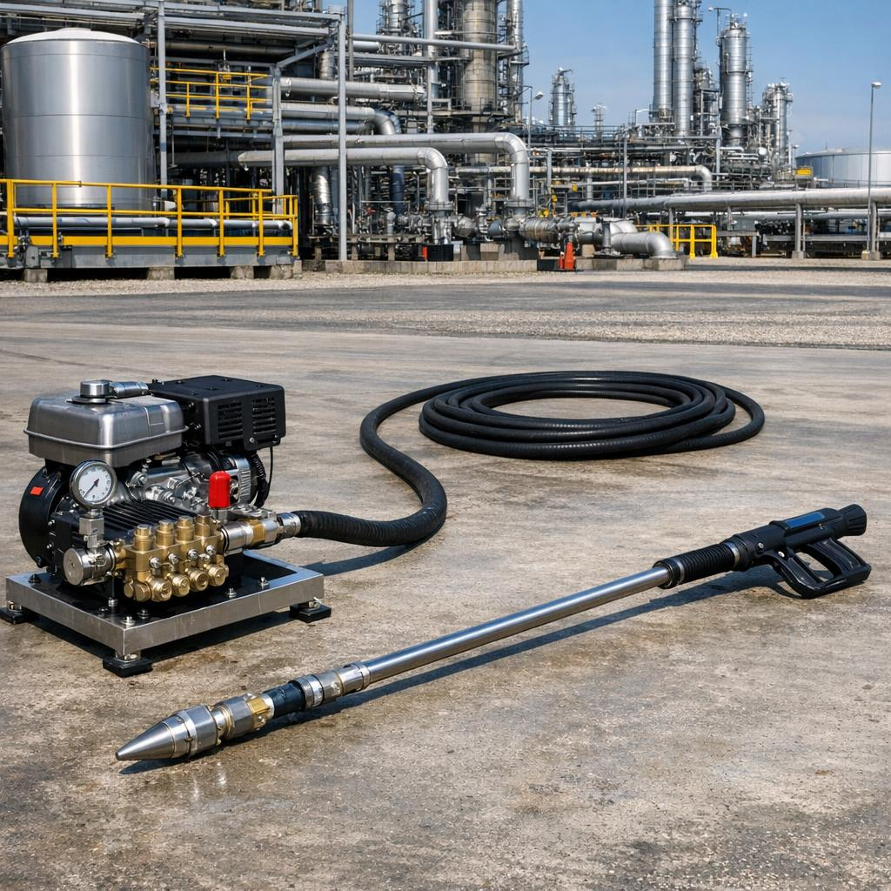
HPWJ FUNDAMENTALS – DAY 1
MEET THE EQUIPMENT — PUMP, HOSE & NOZZLE BASICS
The pump pressurises water; flow is measured in GPM or L/min, pressure in psi or bar
High-pressure hose carries water from the pump to the gun or lance — always rated above the system's working pressure
The nozzle (or lance tip) is where water exits at high speed — its orifice size controls flow and force
A whip check is a safety restraint fitted at every hose connection to stop violent movement if a coupling fails
Personal protective equipment for HPWJ includes a full-face visor, cut-resistant suit, and reinforced gloves and boots rated for the pressure class in use
Notes:
[Session 8, 09:15-10:00, then BREAK 10:00-10:15] Vocabulary session — hands-on begins Day 2. See Trainer Script Session 8.

Slide 10
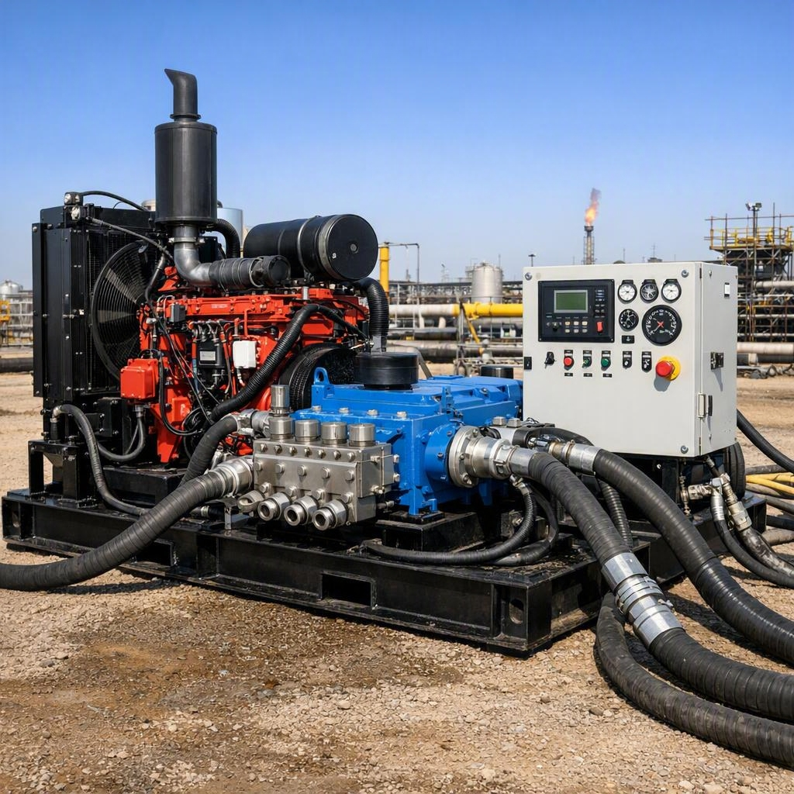
HPWJ FUNDAMENTALS – DAY 1
EQUIPMENT & PPE WALK-THROUGH
We'll now go to the equipment yard to see a real pump unit, hoses, nozzles, and PPE up close
Look for: the rupture disc, the whip checks, the nozzle tip marking, and the dump/trigger mechanism
This is an orientation visit, not hands-on operation — that begins Day 2
Bring your notepad — what you see here comes up again in this afternoon's pre-use inspection session
Notes:
[Session 9, 10:15-11:00] Flex block: trim here first if the day runs long, never the practical stations or safety rules. See Trainer Script Session 9.

Slide 11

HPWJ FUNDAMENTALS – DAY 1
PRE-USE INSPECTION — THE HIGHEST-RISK CONTROL
Starting work without a complete, supervisor-verified pre-use inspection is the single most frequent preventable cause of serious incidents
A full documented inspection is required before every use and every shift — it is a pre-requisite for the work permit
No permit is issued without a completed and verified pre-use inspection checklist
This afternoon's practical stations build this habit on the equipment you just saw in the yard
Notes:
[Session 10, 11:00-11:30, then LUNCH 11:30-12:15] Reference yard components by name. Internal ref: Lesson LL-002. See Trainer Script Session 10.

Slide 12
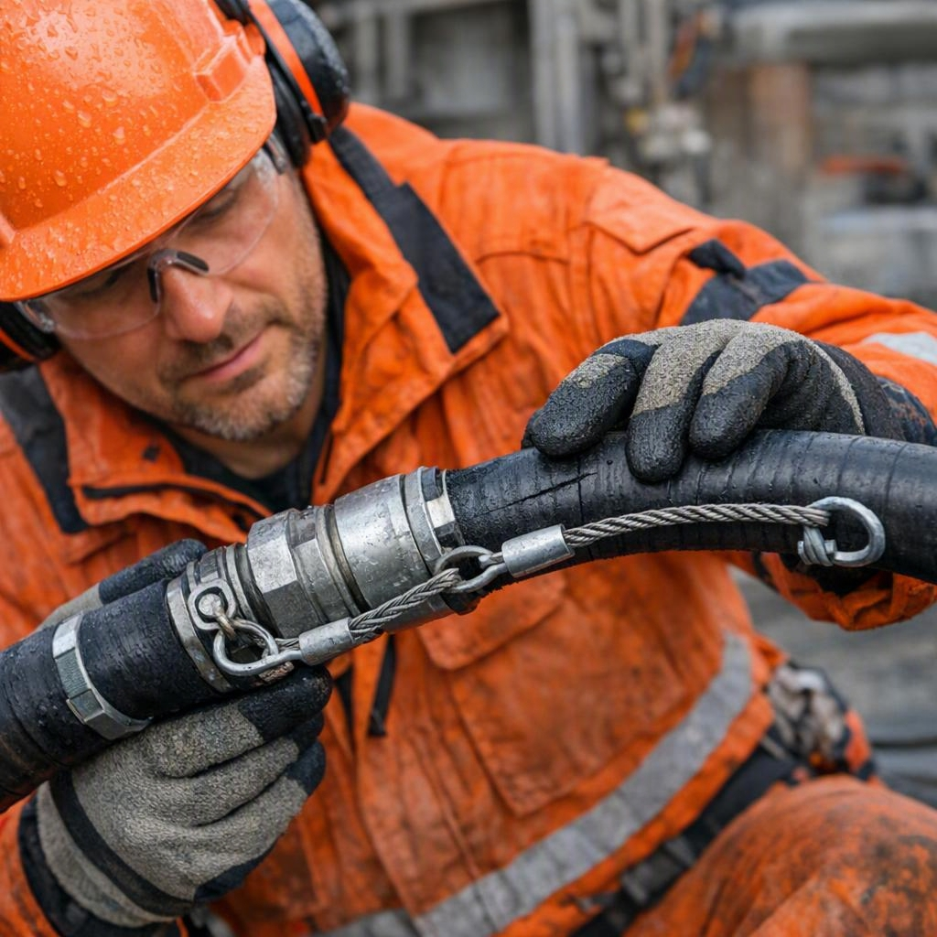
HPWJ FUNDAMENTALS – DAY 1
PRE-USE INSPECTION — PRACTICAL STATIONS
Small teams rotate through hands-on stations: hose condition, rupture disc, whip check, nozzle condition, and dump/trigger function
You work through the printed pre-use inspection checklist yourself — the station supervisor observes and corrects
By the end of the rotation, every learner will have personally performed every check at least once
This exact skill is assessed, pass/fail, during Day 3 Field Verification — treat every rotation as the real thing
Notes:
[Session 11, 12:15-13:45, 90 min] Rotate on a visible timer, ~15-20 min per station. Brief all station supervisors on checklist items and common mistakes beforehand for consistency. See Trainer Script Session 11.

Slide 13
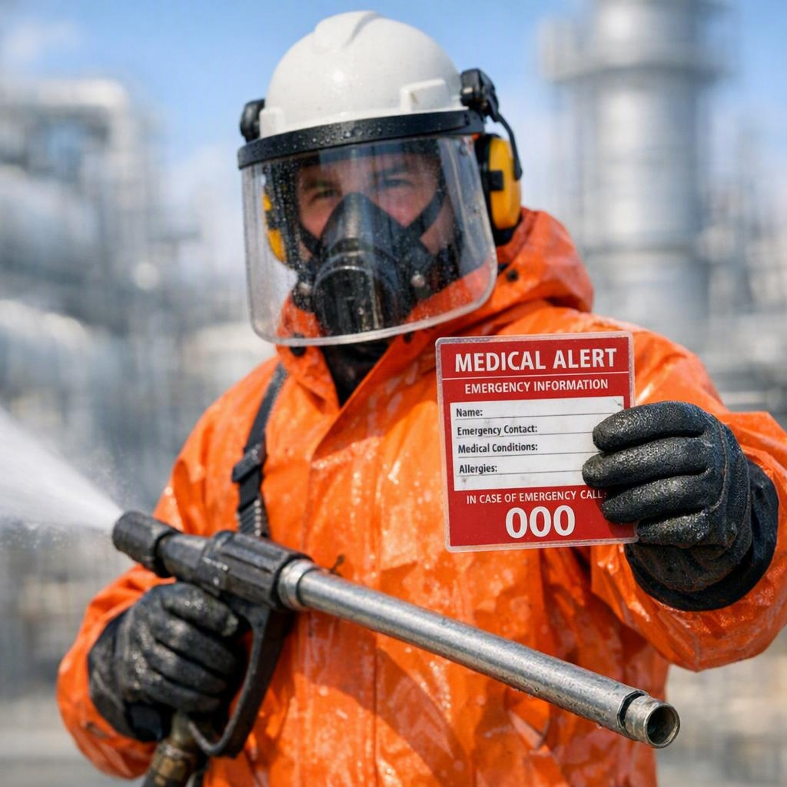
HPWJ FUNDAMENTALS – DAY 1
REACTION FORCE — WHY IT MATTERS
When water leaves the nozzle at high speed, it pushes back on the person holding the equipment — this push-back is called reaction force
Left unmanaged, this force can throw an operator off balance or drag the jet across their own body
Three checks must ALL pass before anyone can hold this equipment by hand: the force must stay under a strict limit, it must stay under a set fraction of the operator's own body weight, and the equipment must be held so the jet can never cross the operator's own feet or legs
If any one check fails: do not use handheld — switch to mechanical support, a longer barrel, a different nozzle, or automation
Notes:
[Session 12, 13:45-14:05] Concept portion — move directly into the calculation next. See Trainer Script Session 12.

Slide 14
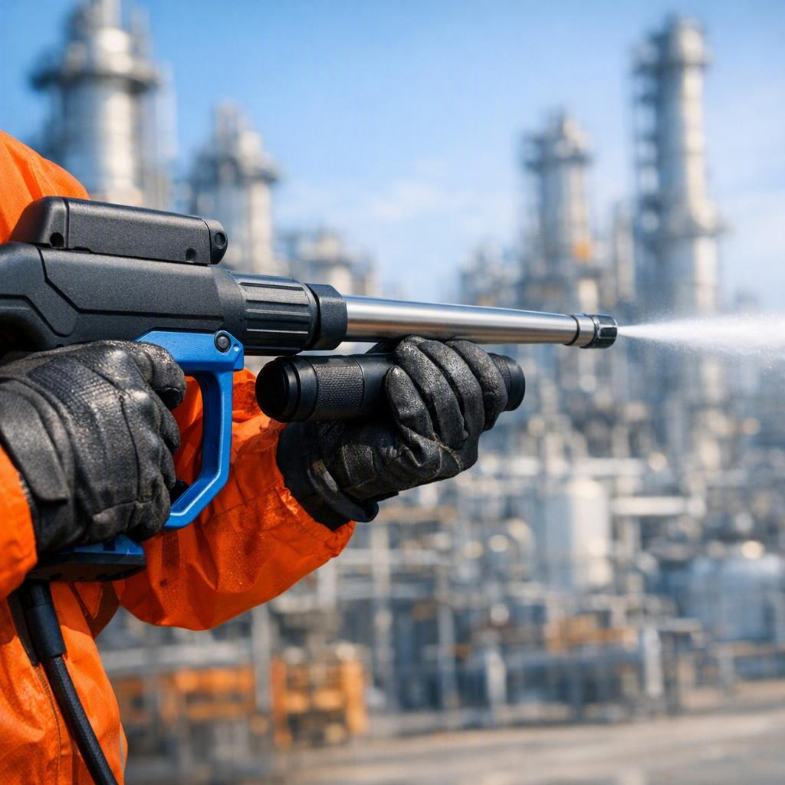
HPWJ FUNDAMENTALS – DAY 1
REACTION FORCE — CALCULATING IT
Now that you know flow and pressure, here is how we calculate reaction force before any handheld job
Imperial: force (lbf) is approximately 0.052 times flow in GPM times the square root of pressure in psi
Metric: force (N) is approximately 0.233 times flow in L/min times the square root of pressure in bar
Worked example: we'll calculate this together live for a typical field setup
If the result is above 250 N, or exceeds one third of the operator's body weight, handheld operation is not permitted
Notes:
[Session 13, 14:05-14:25] Use a worked example that FAILS the check (10 GPM at 15,000 psi ≈ 283 N > 250 N limit). Internal ref: MCR-016/017 — metric constant 0.233, corrected 16 July 2026; pull fresh from the register when rebuilding this slide. See Trainer Script Session 13.

Slide 15

HPWJ FUNDAMENTALS – DAY 1
MEDICAL ALERT CARD & EMERGENCY COMMUNICATION
Every operator carries an immediately accessible, waterproof Medical Alert Card at all times
Any jetting injury, however minor it appears, is a medical emergency until proven otherwise
Emergency communication script: state 'high-pressure water injection injury', give the location, and hand the Medical Alert Card to first responders
Delay in correct treatment is the single biggest driver of poor outcomes in injection injuries
Notes:
[Session 14, 14:25-14:40] Pass the sample card around; run the script as repeat-after-me at least twice. Full physical drill is deliberately on Day 2/3. See Trainer Script Session 14.

Slide 16
HPWJ FUNDAMENTALS – DAY 1
STOP-WORK AUTHORITY
Any team member can call stop-work — the call is absolute, with no exceptions
Supervisors must support the call, never override it for schedule or production pressure
Common triggers: any safety rule breach, unauthorised entry to the exclusion zone, loss of communication, or equipment doubt
Speaking up is expected, not optional — this is a cultural control as much as a procedural one
Notes:
[Session 15, 14:40-14:55] Discussion format — ask for a volunteer story about hesitating to speak up. See Trainer Script Session 15.

Slide 17
HPWJ FUNDAMENTALS – DAY 1
DAY 1 RECAP & BRIDGE TO DAY 2
Today: physics and injury mechanism, key safety rules, equipment basics, pre-use inspection in theory and practice, reaction force, Medical Alert Card, stop-work authority
Tomorrow (Day 2): full hands-on pump, hose and nozzle operation, flexible lance with its anti-withdrawal device (AWD), shotgun setup, hands-on practical stations
Reminder: Day 3 Field Verification is a pass/fail practical assessment covering everything from Day 1 and Day 2
Notes:
[Session 16, 14:55-15:00] Ask 2-3 volunteers for one thing they'll remember. Confirm Day 2 start time and PPE expectations. See Trainer Script Session 16.

Slide 18

HPWJ FUNDAMENTALS
DAY 2 OF 3 — EQUIPMENT MASTERY & HANDS-ON SKILLS
Anabeeb ATC-HPWJ-OP-001 | Level 2 Operator Pathway
Notes:
[Session 1, 07:00-07:15] Welcome back. Run the Day 1 recap quiz (verbal, rapid-fire): the three reaction-force checks, the 10 m exclusion rule, why a small entry wound is still an emergency, the three most common incident causes. See Trainer Script Session 1.

Slide 19
HPWJ FUNDAMENTALS – DAY 2
WELCOME BACK & DAY 2 LEARNING OUTCOMES
Quick recap quiz from Day 1 — reaction force checks, exclusion distance, emergency response
Today you will: explain how the pump creates pressure and what flow and pressure mean in practice
Inspect hoses, fittings, and whip checks against the rejection rules, and explain hose life limits
Select and check nozzles, and verify lance length and tip marking requirements
Correctly don and check the full HPWJ PPE set
Demonstrate team communication signals, and set up a shotgun lance and a flex lance with its anti-withdrawal device under supervision
Notes:
[Sessions 1-2, 07:00-07:20] Quiz first (10 min), then read outcomes. Everything listed is assessed on Day 3. See Trainer Script Sessions 1-2.

Slide 20

HPWJ FUNDAMENTALS – DAY 2
THE PUMP — HOW PRESSURE IS ACTUALLY MADE
HPWJ pumps are positive displacement pumps: each stroke pushes a fixed volume of water, so the pump sets the flow
Pressure is created by resistance at the nozzle: the pump pushes water, and the small nozzle orifice resists it
Same pump, smaller plungers: less flow but higher available pressure; larger plungers: more flow at lower pressure
This is why the nozzle choice matters so much — the wrong orifice changes the pressure of the whole system
The rupture disc and the operator dump system are the two protections if pressure runs away — both are checked in every pre-use inspection
Notes:
[Session 3, 07:20-08:00] Core concept: pump makes FLOW, nozzle resistance makes PRESSURE. If learners get this one idea, everything else on Day 2 follows. Internal ref: Section 16/17 physics, verified. See Trainer Script Session 3.

Slide 21
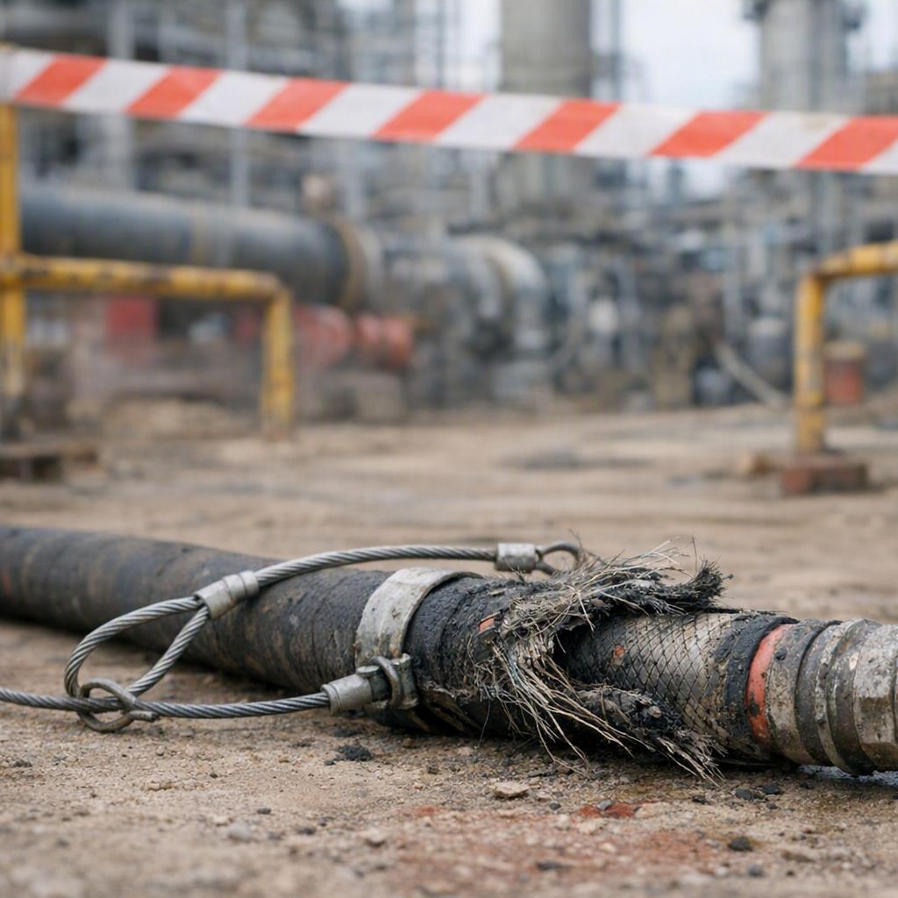
HPWJ FUNDAMENTALS – DAY 2
HOSES, FITTINGS & WHIP CHECKS
Hose life is limited: flexible lances and shotgun whip hoses have a maximum life of 2 years; all other high-pressure hoses, 4 years
Every hose also needs an annual pressure test by a third party — visual inspection alone misses internal damage
Reject any hose with exposed or rusted braid, bulging, cuts, kinks, leaks, damaged fittings, expired life, or missing pressure markings
Whip checks go on BOTH sides of every high-pressure connection, and are inspected every use
Quick-connect couplings are not used on high-pressure hoses — they can rotate and release under pressure
Notes:
[Session 4, 08:00-08:35, then BREAK 08:35-08:50] Bring real reject-condition hose samples if available — handling a bulged or braid-exposed hose beats any slide. Internal ref: MCR-001/002/004/006/007. See Trainer Script Session 4.

Slide 22
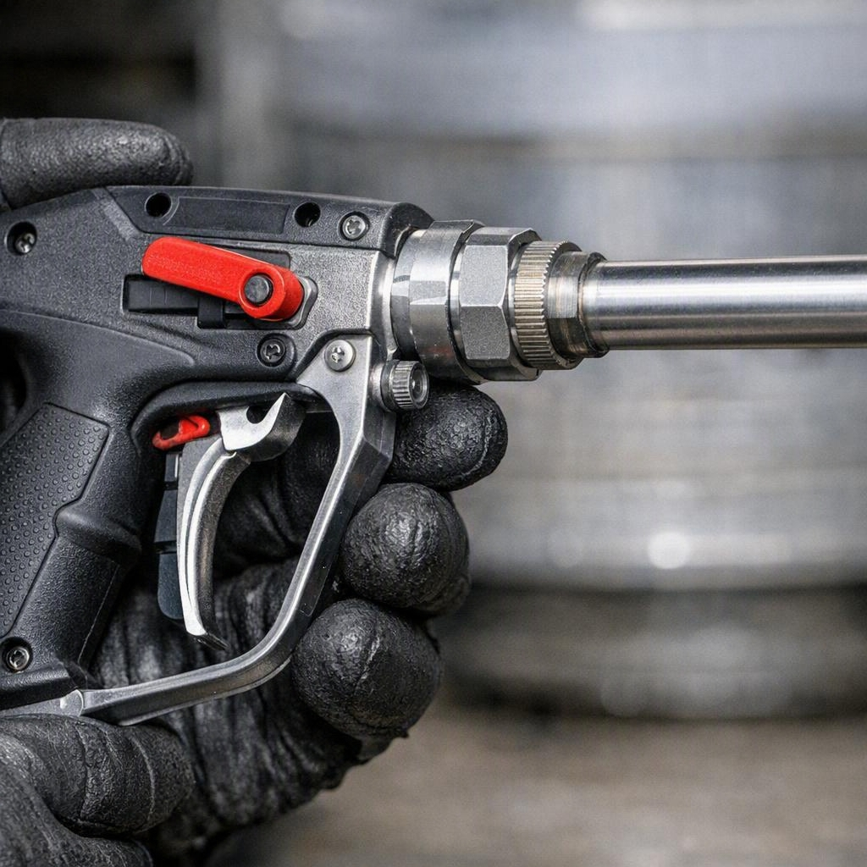
HPWJ FUNDAMENTALS – DAY 2
NOZZLES, LANCES & TIP MARKING
Nozzles wear out in service — typically within 20 to 60 hours of use; a worn nozzle loses cleaning power and wastes pump energy
Check nozzles with a pin gauge and reject any nozzle with pitting or a worn orifice
Rigid lances must be at least 1.2 metres from trigger to tip — shorter lances need special approval and extra controls
The lance or hose must carry a visible mark no closer than 600 mm from the nozzle tip — this warns you the tip is about to exit the pipe
For tube work: the nozzle's thrust direction must be verified before insertion, and the rigid leader (stinger) must be longer than the pipe's internal diameter
Notes:
[Session 5, 08:50-09:20] The 600 mm tip mark and back-out risk links directly to Day 1's fatality case study — make that connection explicitly. Internal ref: MCR-018/022/044/052. See Trainer Script Session 5.

Slide 23
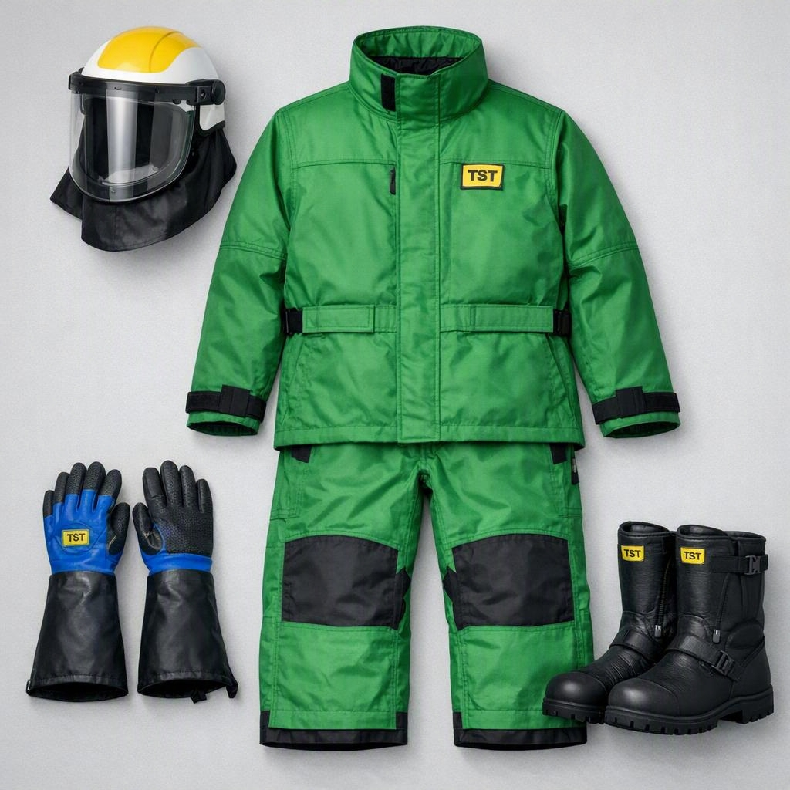
HPWJ FUNDAMENTALS – DAY 2
PPE — DONNING & CHECKING
Full HPWJ PPE: full-face visor or helmet with face protection, cut-resistant suit rated for the pressure class, reinforced gloves, and metatarsal-protected boots
PPE is rated by pressure class — equipment rated for 10,000 psi work does not protect you at 40,000 psi
In this session everyone dons the full PPE set, and we check each other in pairs
Heat matters in our climate: hydration and work-rest rotation are part of the PPE plan, not separate from it
Notes:
[Session 6, 09:20-10:00, then BREAK 10:00-10:15] Practical session — every learner dons full kit and is buddy-checked. Cover heat stress management (rotation, hydration, shade) as part of this block. Internal ref: MCR-033 + Safetech data. See Trainer Script Session 6.

Slide 24

HPWJ FUNDAMENTALS – DAY 2
TEAM COMMUNICATION & ROLES
Every job has three roles minimum: lance operator, pump operator, and a dedicated emergency-stop person
Before any job, the team agrees hand signals and the emergency dump signal — and tests them
The pump operator never leaves the running pump unattended, and never starts or stops pressure without a clear signal
If line of sight between lance and pump is lost, the dedicated emergency-stop person becomes the link — communication must be continuous
Any loss of communication means: dump pressure and stop, immediately
Notes:
[Session 7, 10:15-10:45] Practice the signals physically in this session — don't just show the chart. Internal ref: MCR-011/025/047. See Trainer Script Session 7.

Slide 25
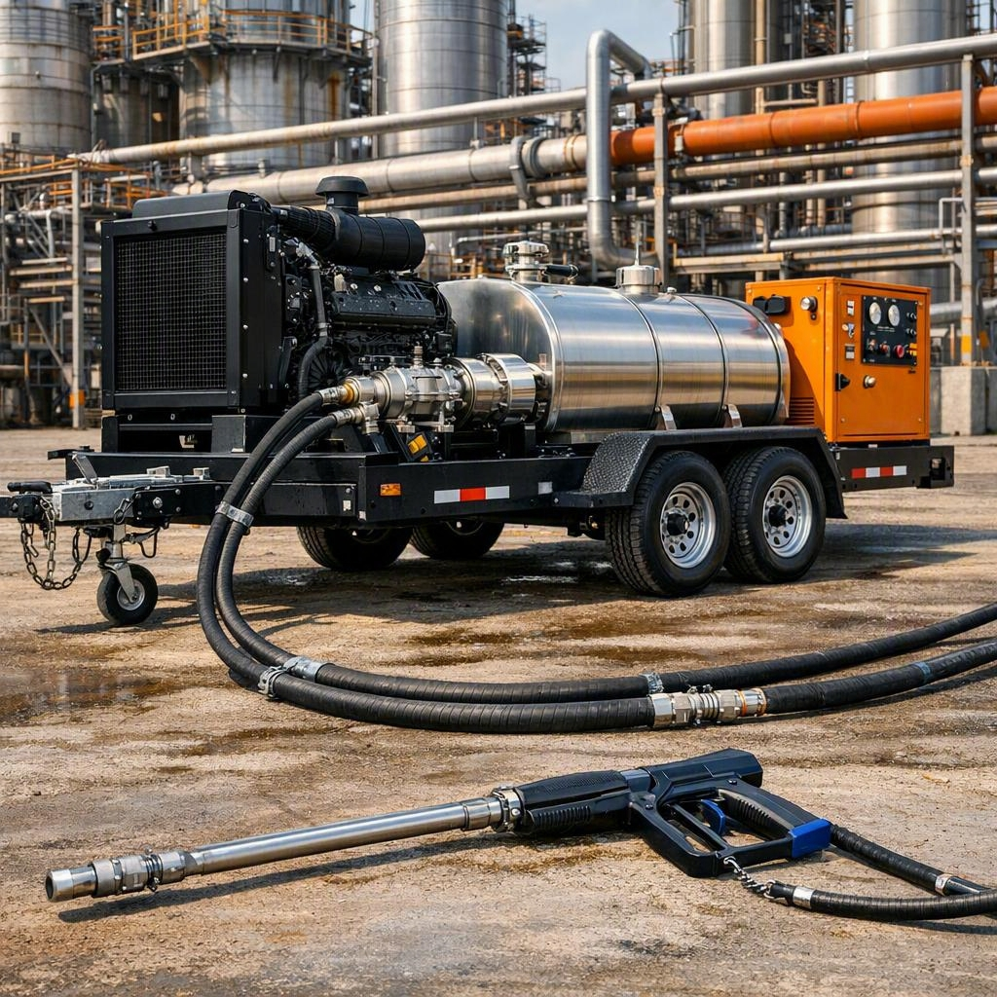
HPWJ FUNDAMENTALS – DAY 2
SAFE SYSTEM SETUP — FULL DEMONSTRATION
Trainer-led, complete rig assembly from bare pump to ready-to-work: watch first, do this afternoon
Sequence: pump checks, hose routing and connection, whip checks both sides, safety shroud at the gun connection, nozzle selection and fitting, dump test
Every step maps to a line on the pre-use inspection checklist you practised on Day 1
Nothing is pressurised until the full checklist is complete and verified
Notes:
[Session 8, 10:45-11:30, then LUNCH 11:30-12:15] Narrate every step and have learners call out the matching checklist line. The 6 ft safety shroud / burst sleeve at the hose-to-gun connection is part of this demo. Internal ref: MCR-045. See Trainer Script Session 8.

Slide 26
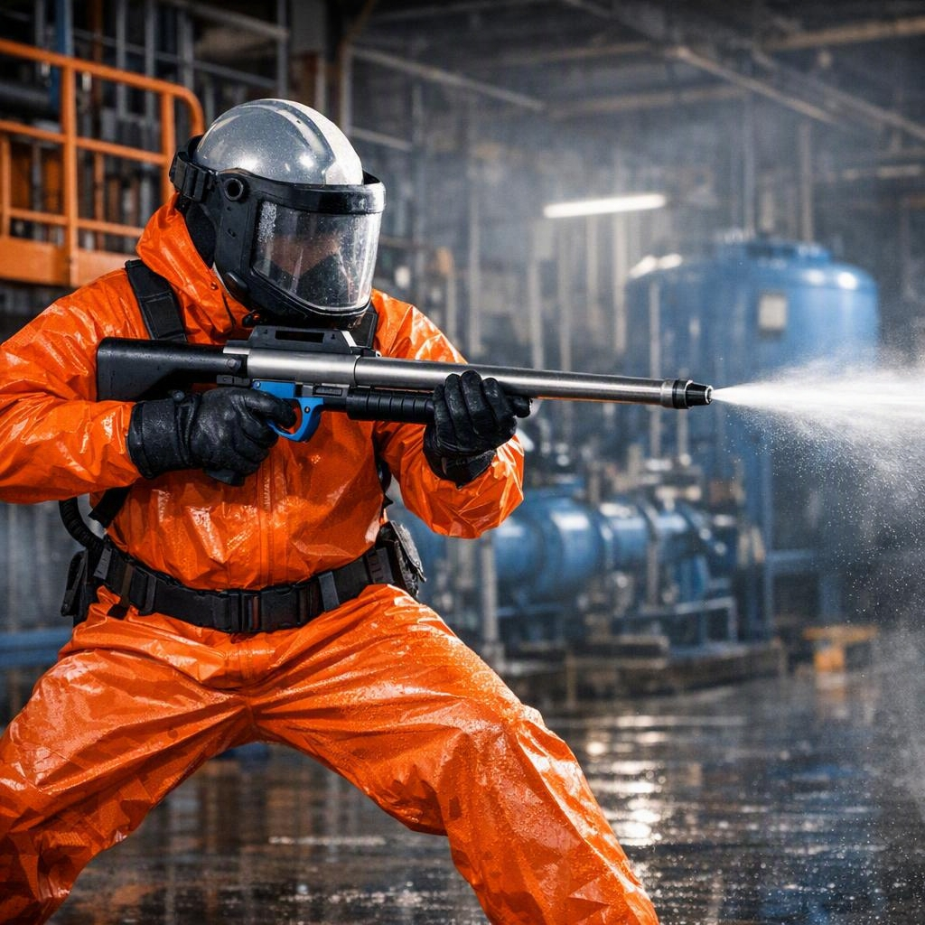
HPWJ FUNDAMENTALS – DAY 2
HANDS-ON — SHOTGUN LANCE STATION
Shotgunning is handheld jetting with a gun-style lance — the highest reaction-force exposure of any manual method
Hard limits for handheld shotgunning: never above 10,000 psi, never with a nozzle orifice larger than 1.6 mm, and reaction force always within the limits you calculated on Day 1
At this station you set up the shotgun rig, verify the limits, calculate the reaction force, and run supervised dry drills for stance and dump response
Two-person minimum on the lance position rotation — nobody operates fatigued
Notes:
[Session 9, 12:15-13:15] Dry drills first; live water only if the site setup allows and only under direct supervision, one learner at a time. The 10,000 psi / 1.6 mm shotgun limits are hard rules. Internal ref: MCR-050. See Trainer Script Session 9.

Slide 27
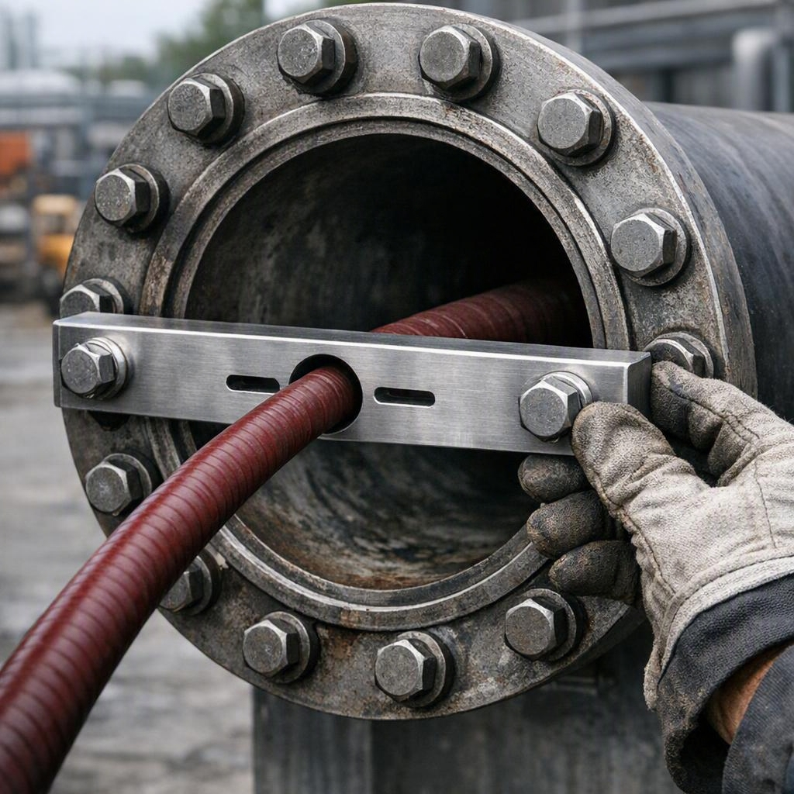
HPWJ FUNDAMENTALS – DAY 2
HANDS-ON — FLEX LANCE & ANTI-WITHDRAWAL DEVICE
The flexible lance is the equipment type from Day 1's fatality case — this station exists because of that failure mode
The anti-withdrawal device (AWD) physically prevents the lance from shooting backward out of the tube — it is mandatory, with no exceptions
A flexible lance without a correctly installed and verified AWD is not permitted to operate — full stop
At this station you install the AWD, verify it, insert and work the lance in a practice tube, and practise the communication loop with the pump operator
Notes:
[Session 10, 13:15-14:15] Direct callback to the Day 1 case study — this is the control that would have saved that operator's life. Every learner personally installs and verifies the AWD at least once. Internal ref: MCR-019/020. See Trainer Script Session 10.

Slide 28
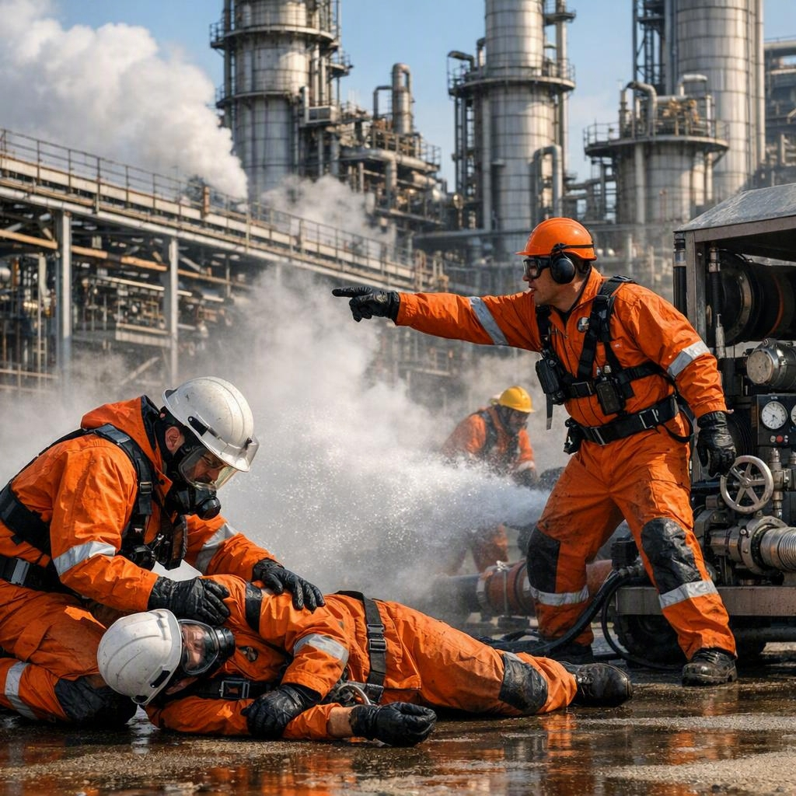
HPWJ FUNDAMENTALS – DAY 2
EMERGENCY RESPONSE DRILL
Scenario: a simulated injection injury during jetting work — the team must respond in real time
Expected response: dump pressure, stop work, deliver the emergency communication script, present the Medical Alert Card, direct first responders
This is the full physical drill of what you practised verbally on Day 1
We run it at least twice, so different learners take the lead role
Notes:
[Session 11, 14:15-14:45] This is the physical drill deferred from Day 1. Assess: pressure dumped first, script delivered correctly ('high-pressure water injection injury' + location), card presented. Rotate the lead role between runs. See Trainer Script Session 11.

Slide 29
HPWJ FUNDAMENTALS – DAY 2
DAY 2 RECAP & BRIDGE TO DAY 3
Today: how the pump makes pressure, hose life and rejection rules, nozzles and tip marking, PPE, team communication, full rig setup, shotgun and flex lance stations, and the emergency drill
Tomorrow (Day 3): morning consolidation and practice, then the written exam and the pass/fail Field Verification practical assessment
Field Verification covers everything from Day 1 and Day 2 — tonight, review your checklist and the three reaction-force checks
Notes:
[Session 12, 14:45-15:00] Preview Day 3 structure honestly: exam + practical, both must be passed. Confirm start time. See Trainer Script Session 12.

Slide 30
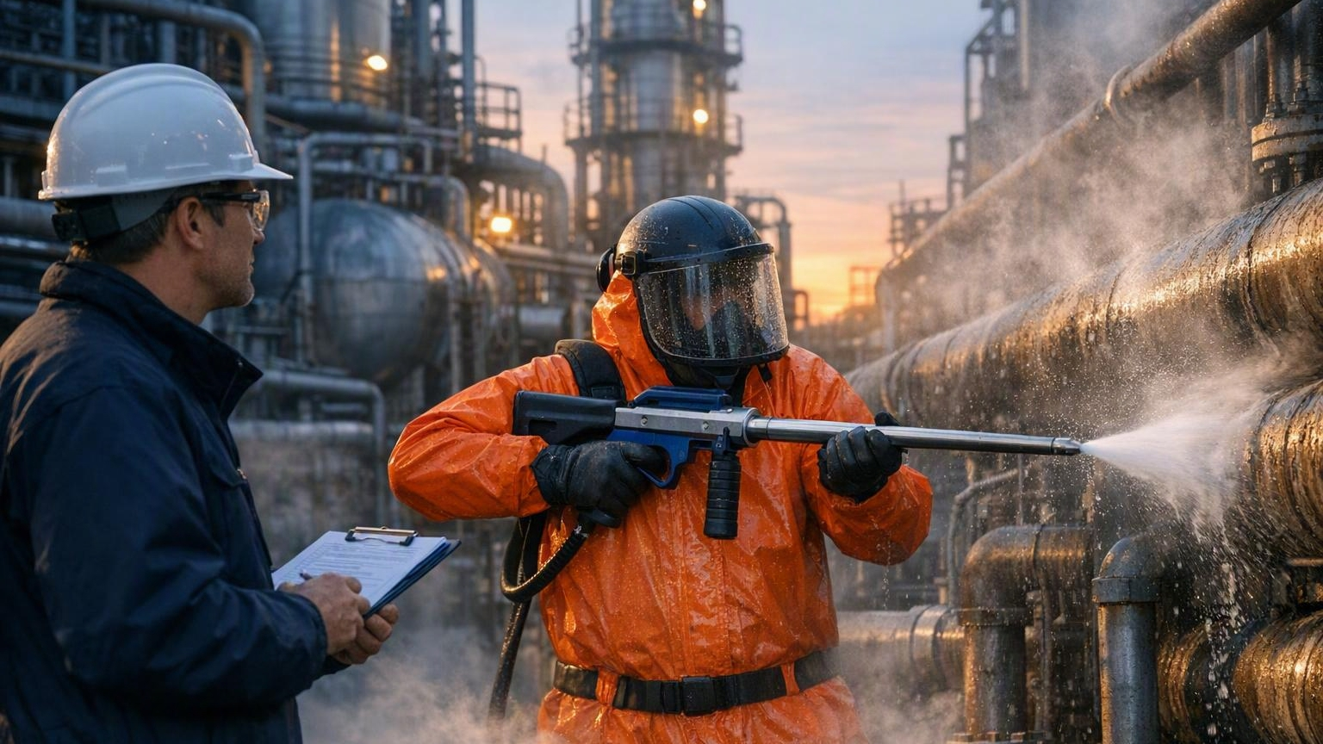
HPWJ FUNDAMENTALS
DAY 3 OF 3 — ASSESSMENT & FIELD VERIFICATION
Anabeeb ATC-HPWJ-OP-001 | Level 2 Operator Pathway
Notes:
[Session 1, 07:00-07:15] Welcome. Set an encouraging but honest tone: today is assessment day, and everything needed to pass has been taught over the last two days. See Trainer Script Session 1.

Slide 31
HPWJ FUNDAMENTALS – DAY 3
HOW ASSESSMENT DAY WORKS
Morning: one final teaching block, then open consolidation practice with trainer support
Mid-morning: the written examination — at least 80% required to pass
Afternoon: Field Verification — a live, individual practical assessment on real equipment
To be certified you must pass BOTH the written exam and every critical item in Field Verification
If you fall short today, you will get clear feedback and a re-assessment path — the standard does not bend, but the door does not close
Notes:
[Session 1 continued, within 07:00-07:15] Explain the day's shape and the pass rules before anything else — uncertainty about the process creates more anxiety than the assessment itself. See Trainer Script Session 1.

Slide 32
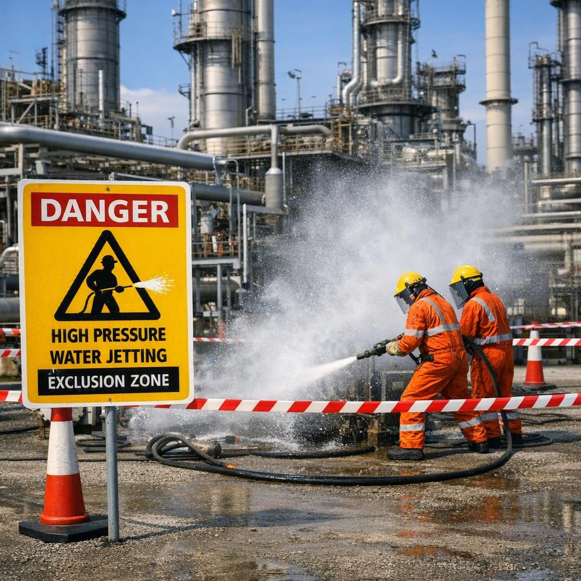
HPWJ FUNDAMENTALS – DAY 3
WORKING AROUND OTHER ACTIVITIES (SIMOPS)
On Day 1 you learned that poor coordination between activities happening at the same time is one of the three most common causes of serious incidents
SIMOPS means simultaneous operations: jetting while other work — lifting, hot work, other crews — happens nearby
The controls: a daily coordination meeting between the supervisors of every active job, agreed physical zoning between activities, and clear boundaries marked before work starts
Water jetting creates mist that can hide people, travel into other work areas, and reach further than the visible spray
You are never authorised to resolve a work-area conflict yourself — stop, and raise it with your supervisor
Notes:
[Session 2, 07:15-07:45] This is the final teaching block of the course — it completes the third of the 'three causes' named on Day 1. Keep it practical: a jetting crew and a crane crew wanting the same ground is the everyday version. See Trainer Script Session 2.

Slide 33
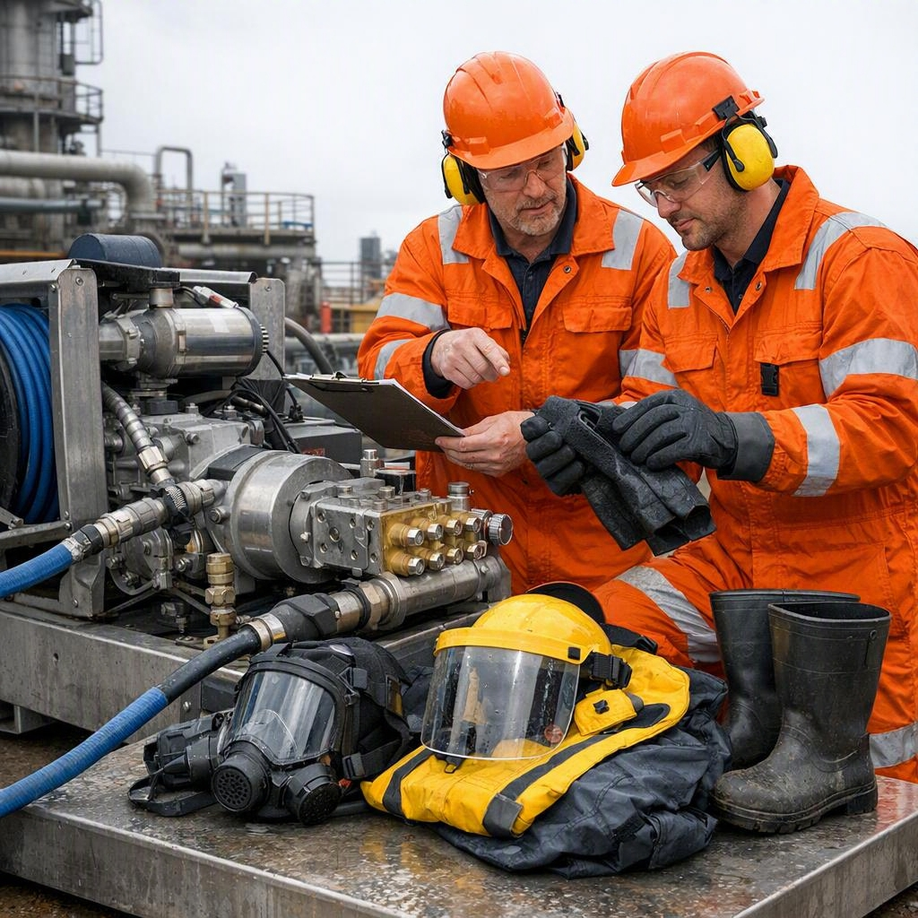
HPWJ FUNDAMENTALS – DAY 3
CONSOLIDATION PRACTICE — YOUR TIME
The equipment and stations from Day 2 are open, with trainers available
Recommended priorities: the full pre-use inspection sequence, the reaction-force calculation, AWD installation and verification, and the emergency communication script
Ask about anything still unclear — this is the last opportunity before assessment
Use your team: practising in threes with real roles is better preparation than practising alone
Notes:
[Session 3, 07:45-08:45, then BREAK 08:45-09:00] Circulate actively — this hour is for closing individual gaps spotted over the last two days, not standing back. Steer weaker learners to their specific weak areas. See Trainer Script Session 3.

Slide 34
HPWJ FUNDAMENTALS – DAY 3
WRITTEN EXAMINATION
40 to 50 questions: multiple choice, short answer, and scenario-based
Covers everything from Day 1 and Day 2 — rules, calculations, equipment, and emergency response
Pass mark: at least 80%
Individual work, closed notes, one hour
Read scenario questions twice before answering — most lost marks come from answering a different question than the one asked
Notes:
[Session 4, 09:00-10:00, then BREAK 10:00-10:15] Exam conditions: spaced seating, no notes, no phones. Mark during the Field Verification rounds so results are ready for the afternoon debrief. See Trainer Script Session 4.

Slide 35
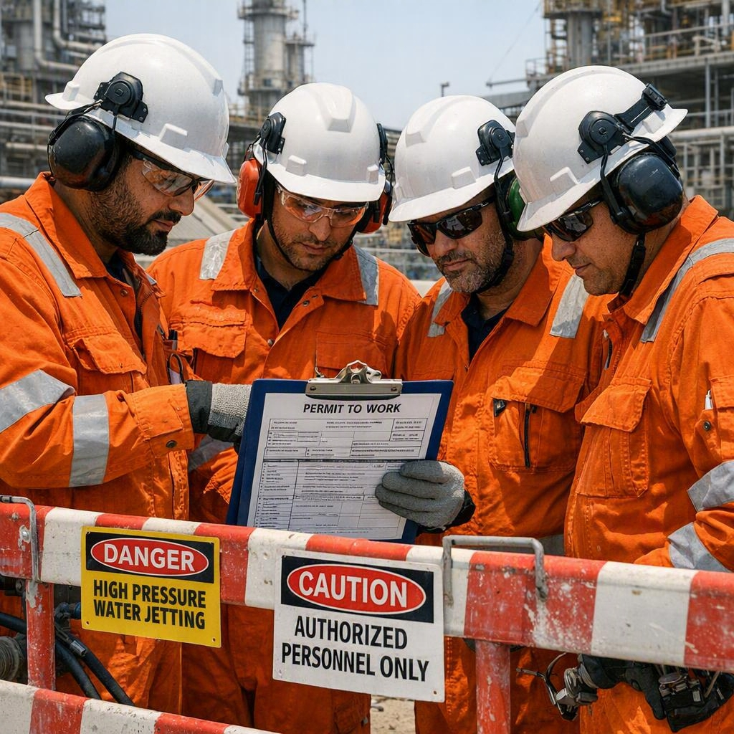
HPWJ FUNDAMENTALS – DAY 3
FIELD VERIFICATION — WHAT YOU MUST DEMONSTRATE
Complete pre-use inspection of pump, hoses, fittings, nozzles, and relief systems — documented on the checklist
Correct whip check installation, and correct AWD installation and verification on the flexible lance
Reaction-force calculation for a given setup, and the correct decision when a limit is exceeded
Emergency dump response under time pressure, and clear team communication signals
Medical Alert Card presentation with the emergency communication script, delivered word-perfect
A stop-work exercise: you must recognise the unsafe condition we stage, and call it
Every one of these is a critical item — all must be passed
Notes:
[Sessions 5-6, 10:15-11:30 and 12:15-14:00, LUNCH between] Run two rounds: half the group is assessed individually while the other half does supervised practice, then swap. One assessor per candidate, scoring against the printed checklist. The staged stop-work condition must differ between rounds so the second group gets no advantage. See Trainer Script Sessions 5-6.

Slide 36
HPWJ FUNDAMENTALS – DAY 3
RESULTS & DEBRIEF
Results are given individually and in private — exam score and Field Verification outcome together
Everyone receives specific feedback: what was strong, what to keep practising
If you did not pass today: you will get a clear written note of exactly which items to close, and a re-assessment will be scheduled
A not-yet result today is not a career verdict — the standard exists to protect you and your team
Notes:
[Session 7, 14:00-14:30] Private, individual conversations — never announce results to the room. For unsuccessful candidates, agree the re-assessment plan on the spot so they leave with a path, not just a result. See Trainer Script Session 7.

Slide 37

HPWJ FUNDAMENTALS – DAY 3
CERTIFICATION & CLOSE
Successful candidates receive: the Level 2 HPWJ Operator certificate, the operator photo card, and your personal Medical Alert Card
Your certificate is valid for 24 months — after that, a Verification of Competency refresher keeps it current
Your Medical Alert Card goes with you on every job from now on — it is part of your PPE
What you do next matters most: the habits from these three days — inspect, calculate, communicate, stop when in doubt — are what keep you and your team safe
Congratulations, and welcome to the community of certified HPWJ operators
Notes:
[Session 8, 14:30-15:00] Hand over certificates and cards individually. Close on the safety culture message, not the paperwork: the course ends, the habits do not. Remind everyone of the 24-month refresher cycle. See Trainer Script Session 8.

