Slide 1
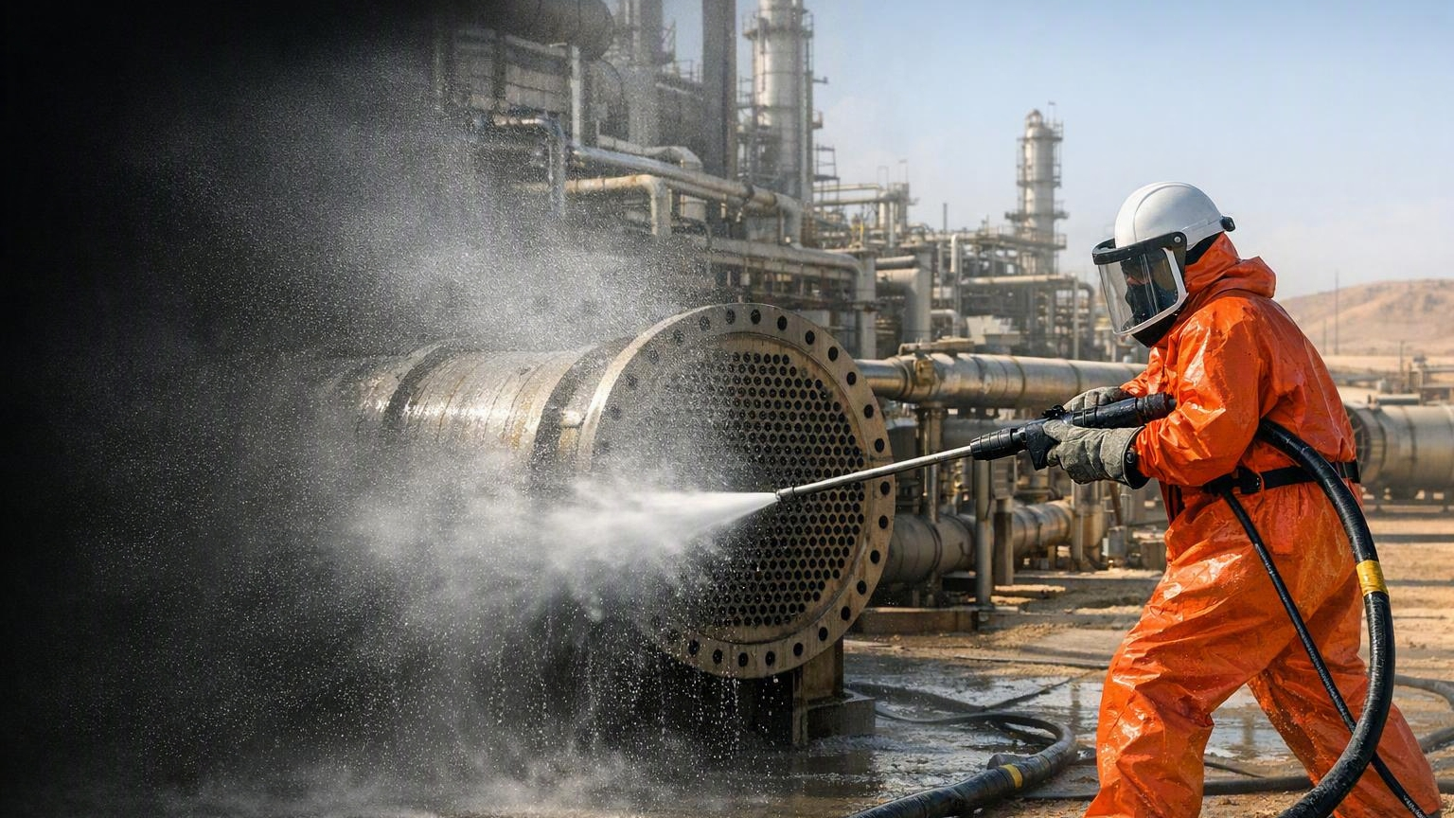
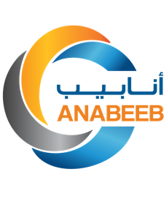
High Pressure Water Jetting
Basic Operator Training
(Awareness & Field Verification)
Day 1 – Safety Foundation, Hazards, Medical Response & Controls
Anabeeb HSE & Training | NEBOSH Verified Programme
END-TO-END SOLUTIONS

Slide 2
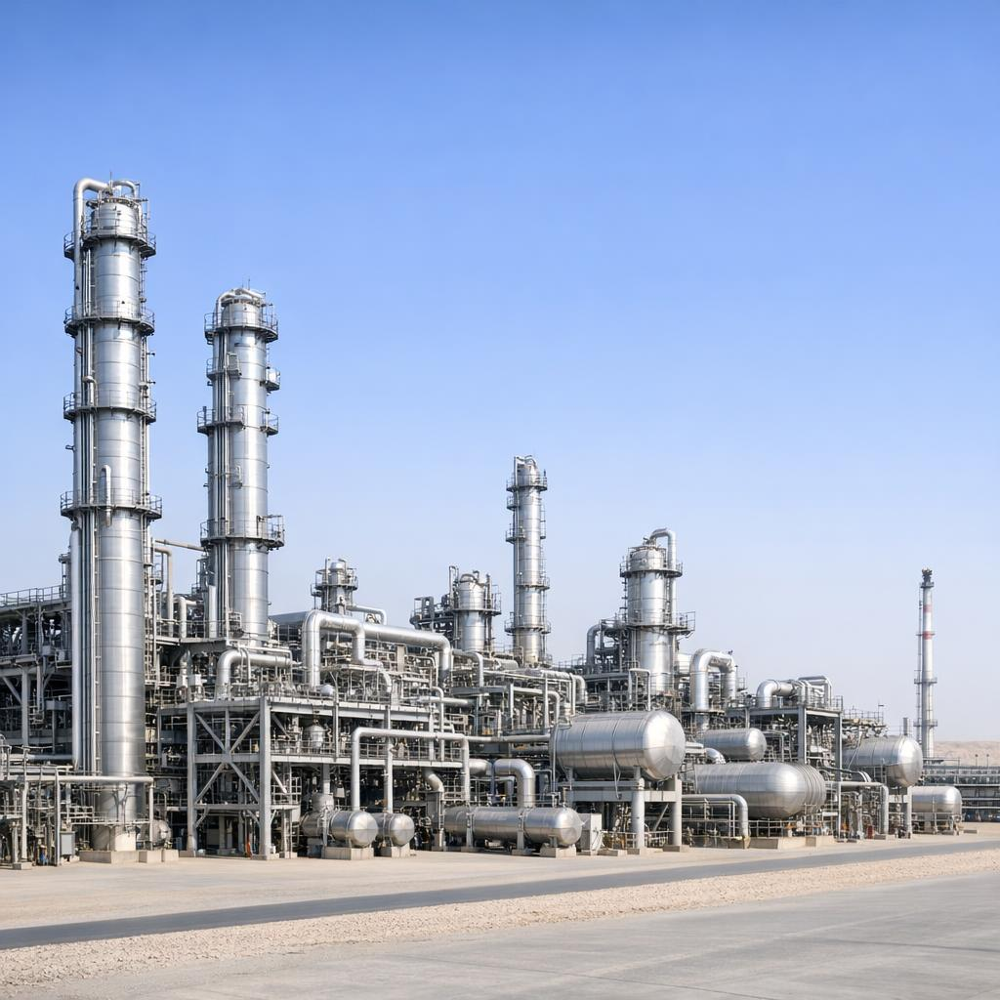

HPWJ – WATER JETTING
NEBOSH VERIFIED PROGRAMME
This programme is delivered to NEBOSH Verified standards.
It follows industry best practices and international standards for high pressure water jetting operations.
You will receive an Anabeeb certificate and personal Medical Alert Card upon successful completion of the full 3-day programme and assessments.
The NEBOSH Verified logo signifies training quality that meets recognised standards.
This training enhances safety during shutdown and turnaround operations on oil and gas sites.

Slide 3
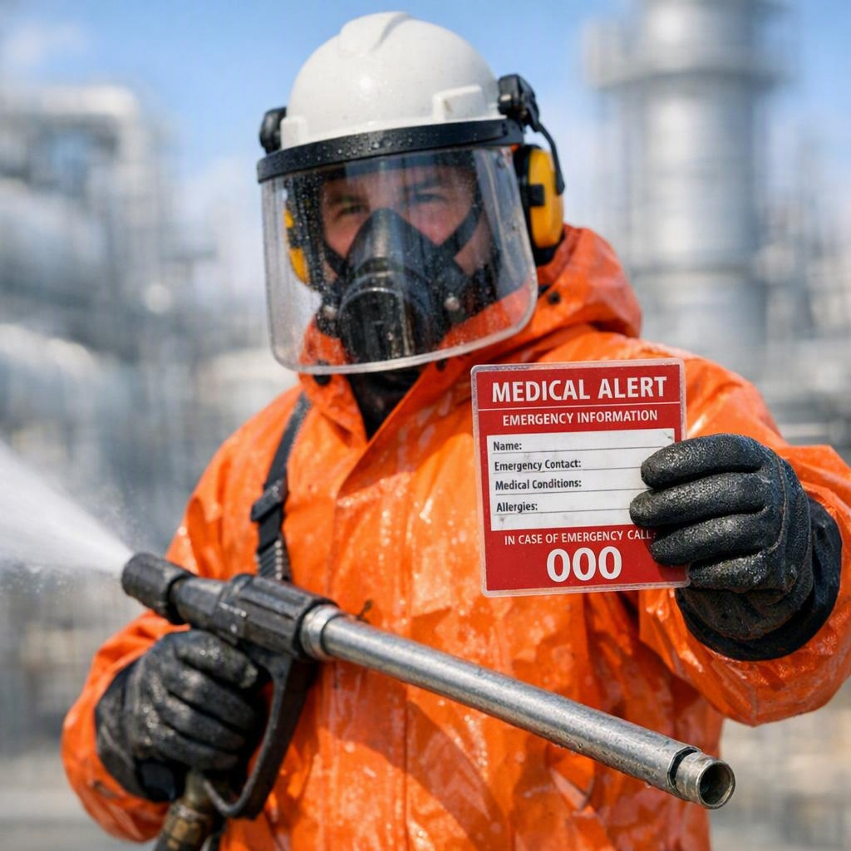
HPWJ – WATER JETTING
DAY 1 LEARNING OUTCOMES
By the end of today you will be able to:
Understand why high pressure water jetting injuries are different and serious
Explain the Medical Alert Card and when to use it
Apply the hierarchy of controls and key site safety rules
Understand how the system creates pressure and why control of relief is critical
Recognise Stop Work Authority and when to use it

Slide 4
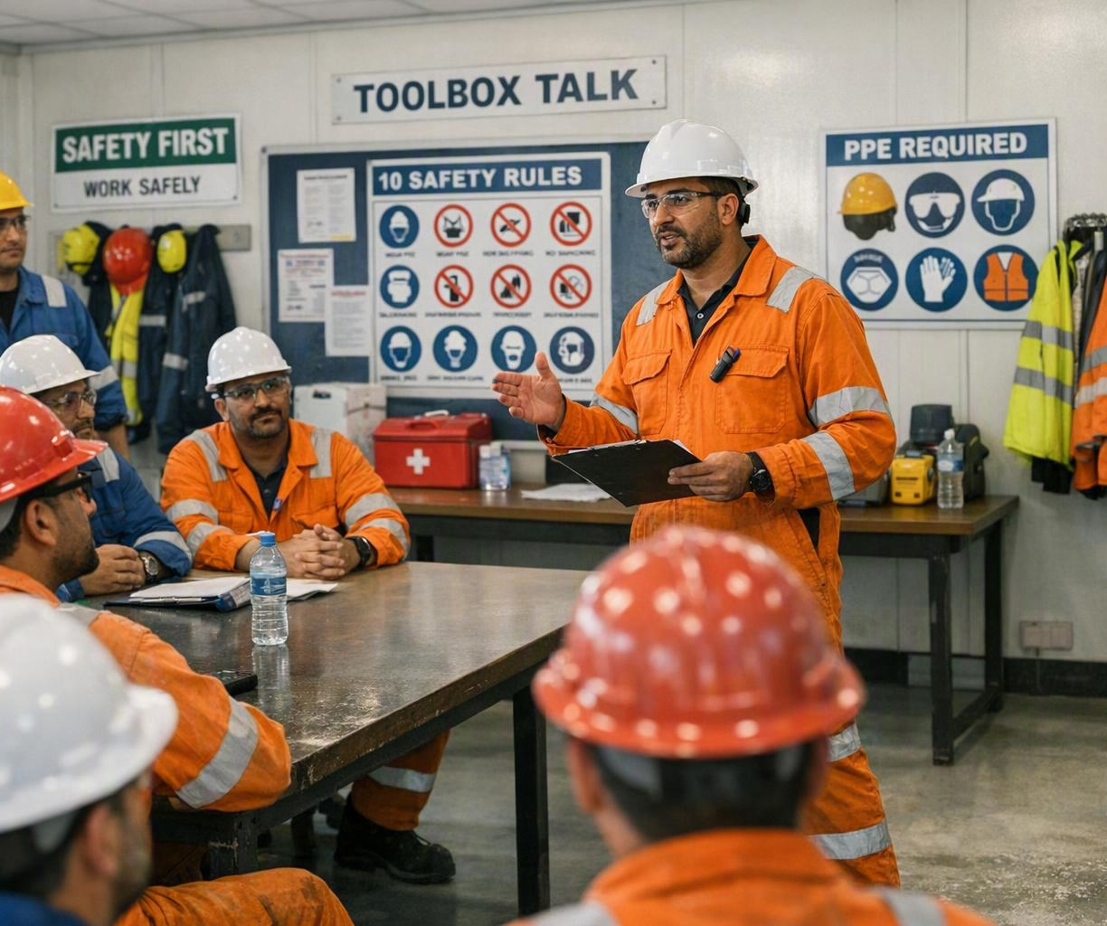
HPWJ – WATER JETTING
TRAINER INTRODUCTION & HOUSE RULES
This session is interactive, not just a lecture
You are welcome to ask questions at any time
Please share your site experiences during discussions
Respect others when they are speaking
Mobile phones on silent during the session

Slide 5
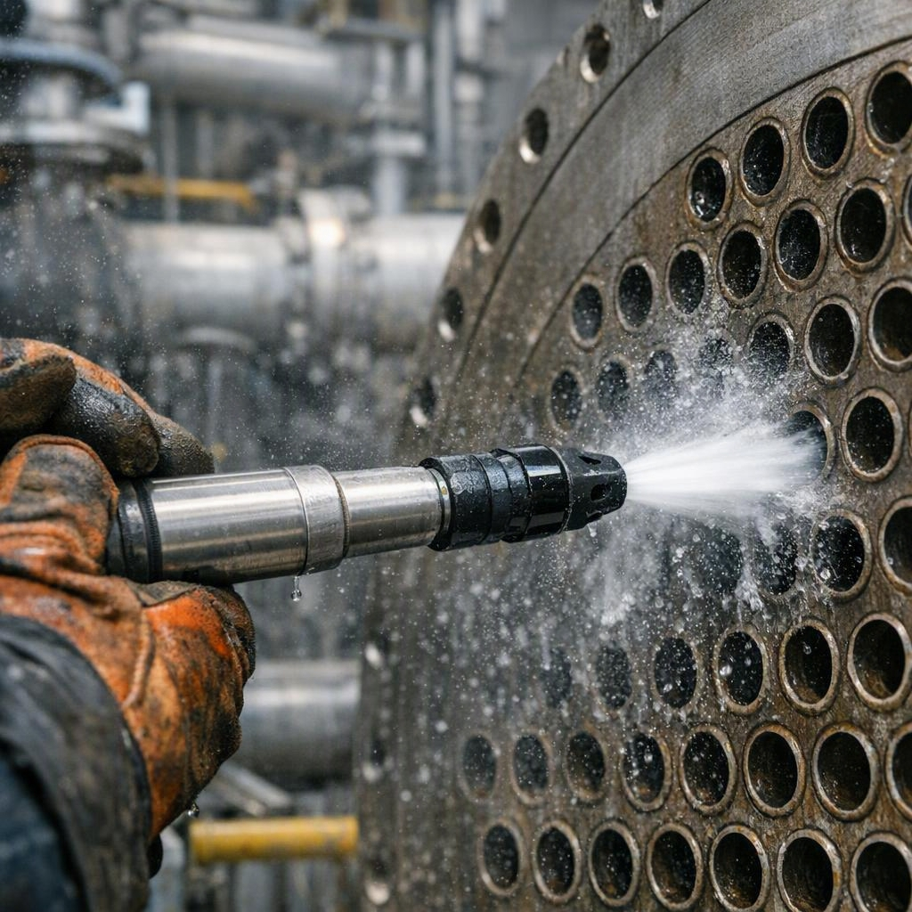
HPWJ – WATER JETTING
WHAT IS HIGH PRESSURE WATER JETTING?
High pressure water jetting uses a pump to move large volumes of water through a small nozzle.
The nozzle creates the cutting or cleaning force.
Pressures commonly reach 10,000 to 20,000 psi on Anabeeb work.
It is used for surface cleaning, tube cleaning, pipe cleaning and more during shutdowns and maintenance.
KEY PRINCIPLE
The pump moves the water. The nozzle turns that flow into extreme force. This is a controlled cutting tool – not just cleaning equipment.

Slide 6
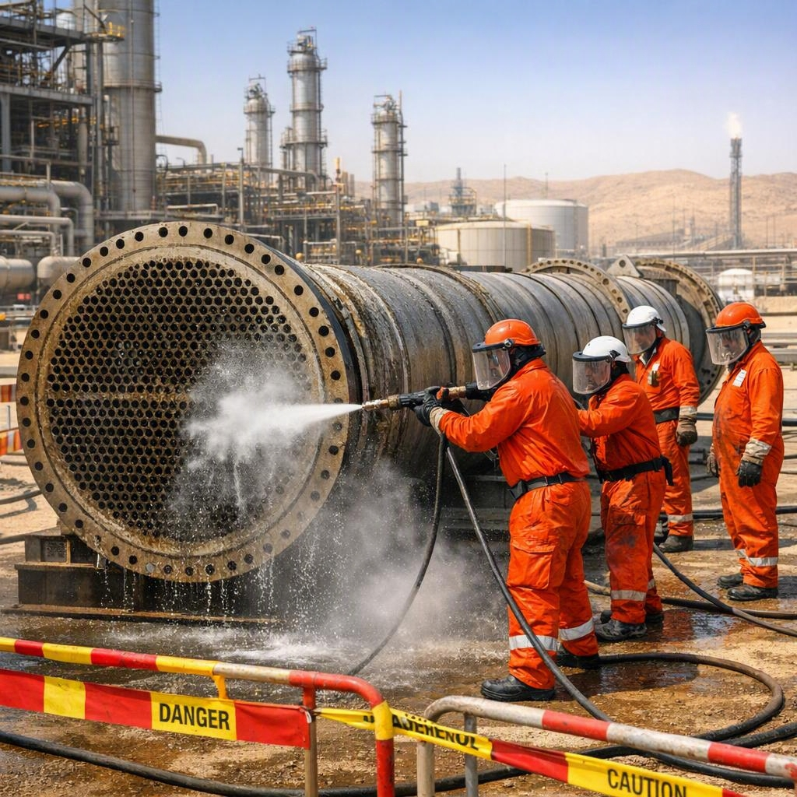
HPWJ – WATER JETTING
WHERE HPWJ IS USED ON OUR SITES
Common applications on Anabeeb and client sites:
Heat exchanger and bundle cleaning
Pipe and line cleaning
Surface preparation before coating
Vessel and tank cleaning
This work is always part of shutdown and turnaround activities. Strict controls are required every time.

Slide 7
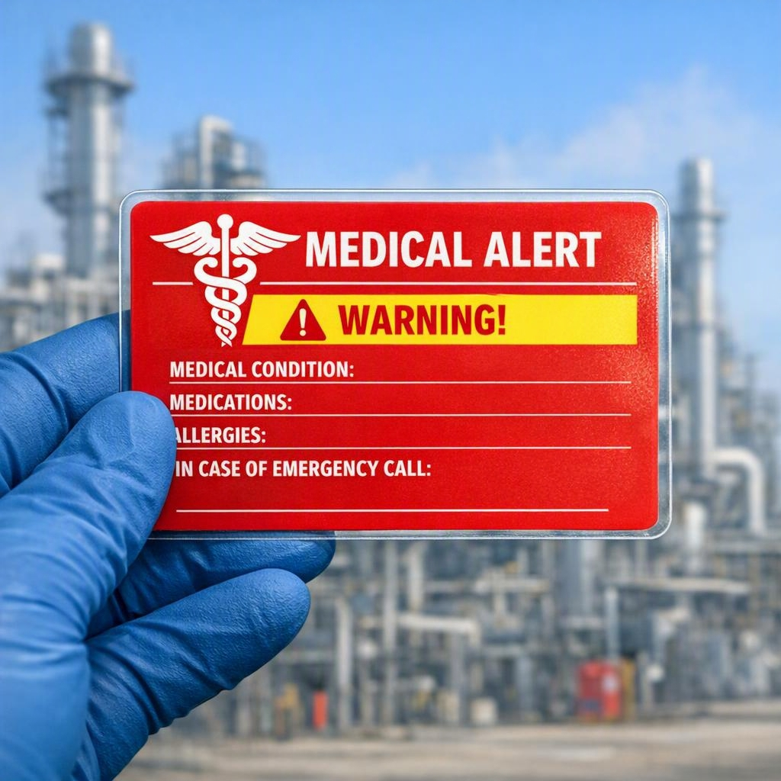
HPWJ – WATER JETTING
WHY WATERJET INJURIES ARE DIFFERENT
Waterjet injuries are different from normal cuts or bruises.
Even a small external wound can hide severe internal damage.
Medical attention is required for ALL suspected waterjet injuries – no exceptions.
The Medical Alert Card tells medical staff exactly what to look for and what treatment is needed.
It can save your life.
NEVER assume an injury is minor. Always treat every suspected waterjet injury as serious.

Slide 8
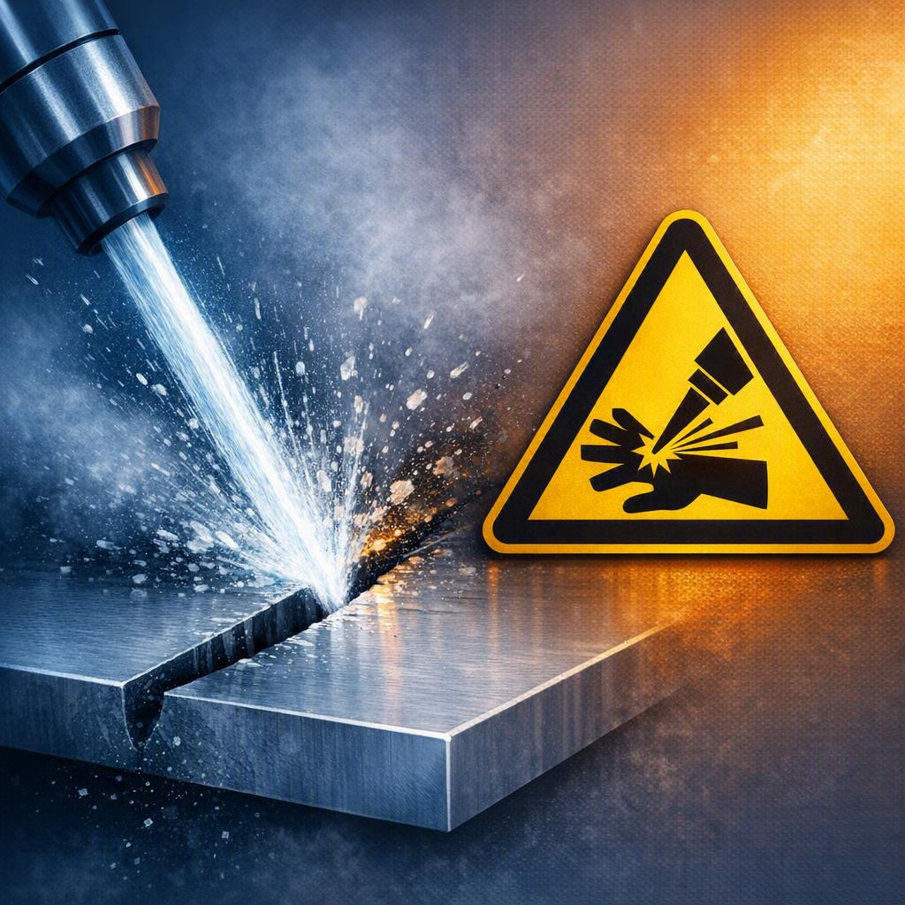
HPWJ – WATER JETTING
TYPES OF WATERJET INJURY
Water-Cut – direct injection of water into the body
Water-Burst – sudden high-velocity burst penetrating tissue
Struck-By – hose, tool or debris hitting the body
All three must be treated seriously – the Medical Alert Card covers all types.

Slide 9
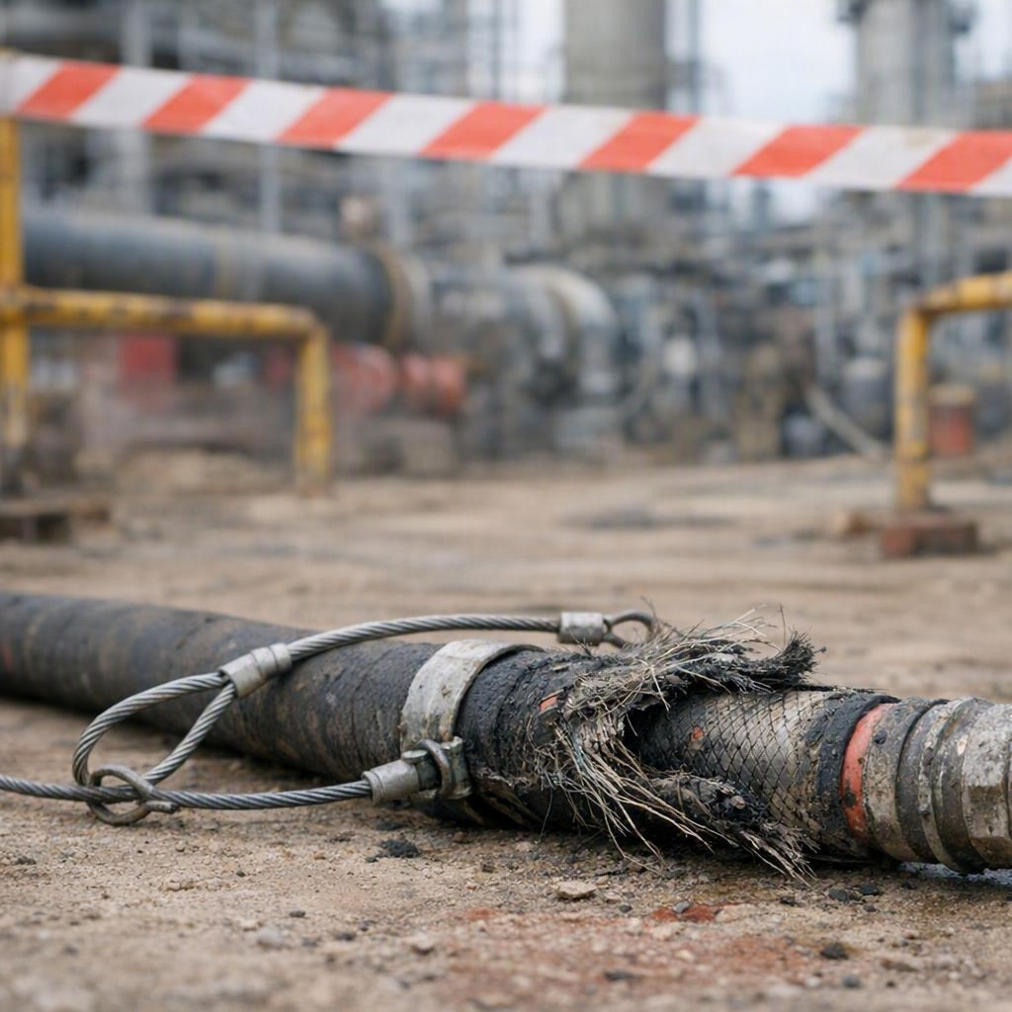
HPWJ – WATER JETTING
REAL INCIDENT EXAMPLES – NEVER AGAIN
Real incidents have happened in the industry:
Hose failure causing struck-by injury
Jet cutting through PPE and causing internal damage
Delayed medical treatment because the injury looked minor
LESSON
Proper controls, pre-use inspection and immediate medical response save lives. We study these incidents so we never repeat them.

Slide 10
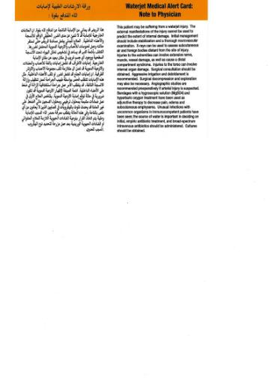
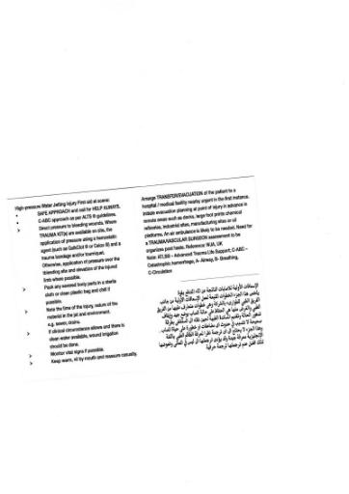
HPWJ – WATER JETTING
THE MEDICAL ALERT CARD – YOUR LIFELINE
Issued today – you must carry it on every high pressure water jetting job.
Waterproof and easy to access.
Tells medical staff exactly what treatment is needed.
External appearance cannot predict internal damage.
This is a mandatory safety requirement – not optional.
From this moment you are never allowed on a HPWJ job without this card in your possession.
Waterjet Medical Alert Card – physician note (English & Arabic)

Slide 11
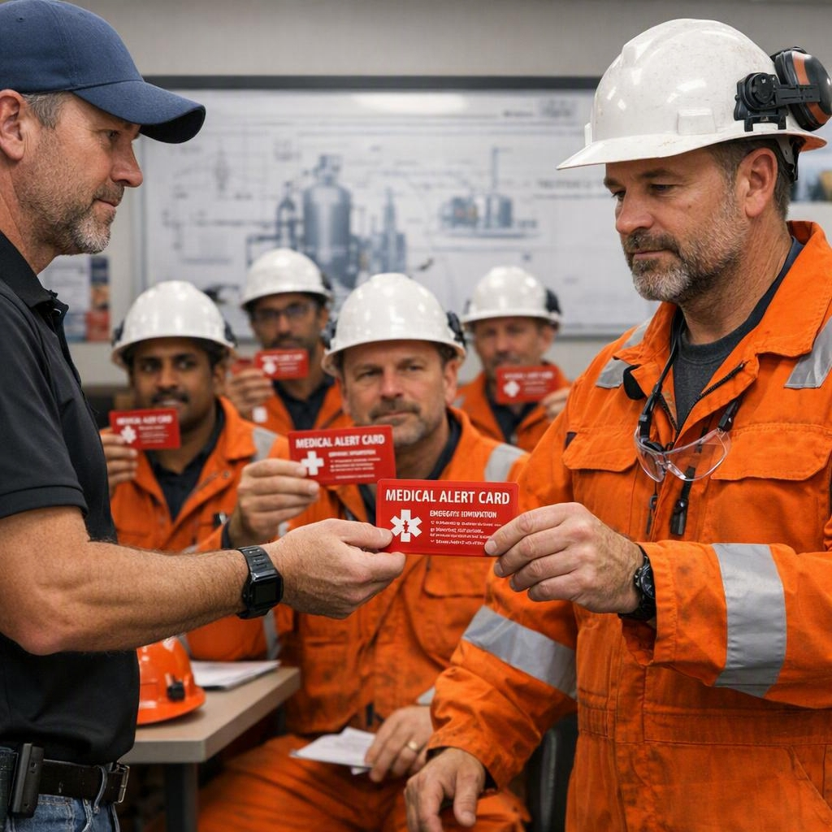
HPWJ – WATER JETTING
ACTIVITY – ISSUE MEDICAL ALERT CARDS
Trainer will now issue one Medical Alert Card to each participant.
Sign the training roster to confirm receipt and understanding
Read the card aloud together
Photograph each participant holding their card for records
From this moment the card must be with you on every HPWJ job. It is your responsibility.

Slide 12
HPWJ – WATER JETTING
HIERARCHY OF CONTROLS
We always apply the hierarchy of controls:
Elimination / Substitution – remove the hazard where possible
Engineering Controls – automation, mechanised systems, guards
Administrative Controls – permits, JSA, procedures, training
PPE – last line of defence, never the only control
Safer automated or mechanised methods are always preferred where reasonably practicable.
1 · Elimination / Substitution
2 · Engineering Controls
3 · Administrative Controls
4 · PPE
Most effective at the top – PPE is the last line of defence

Slide 13
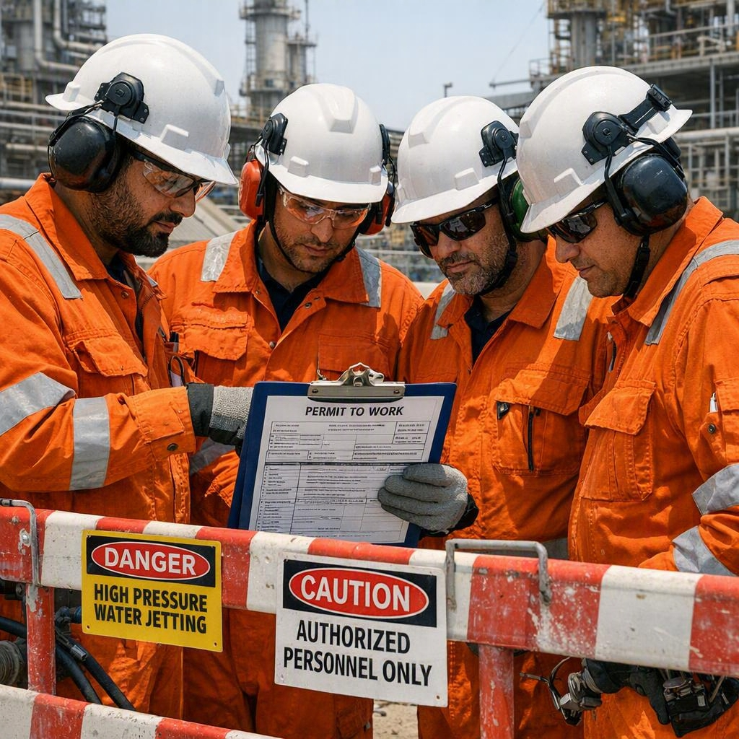
HPWJ – WATER JETTING
KEY SITE SAFETY REQUIREMENTS
On Anabeeb and client sites we require:
Valid permit-to-work before any pressurised work
Job Safety Analysis (JSA) completed and reviewed by the team
Buddy system – no lone working allowed
Proper barricading and exclusion zones (minimum safe distance)
Heat stress controls and work-rest rotation
These are mandatory requirements – not optional.

Slide 14
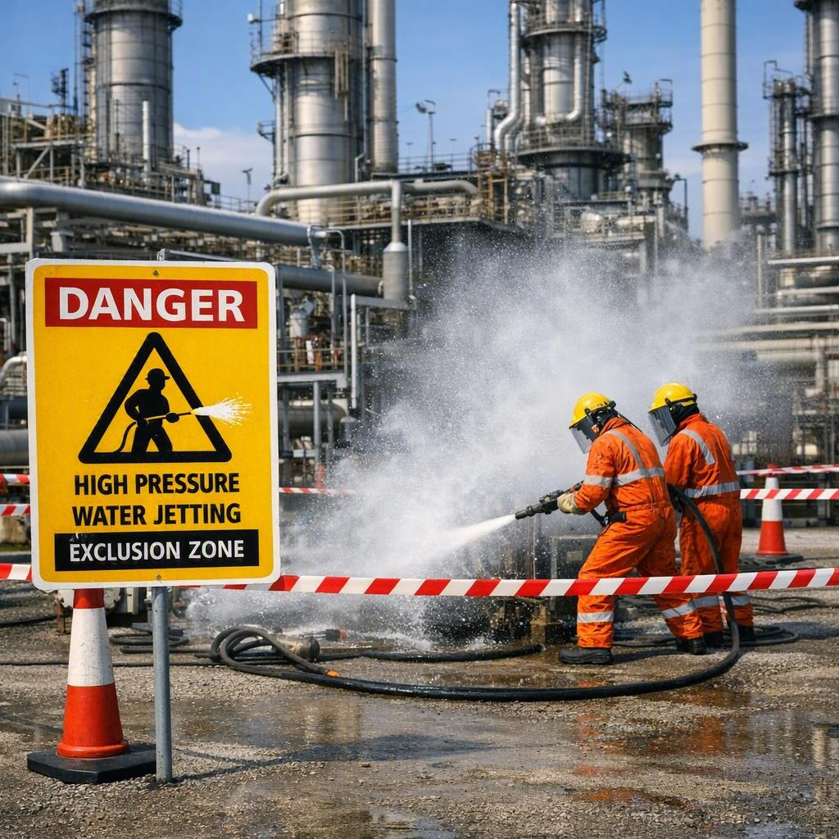
HPWJ – WATER JETTING
BARRICADING AND EXCLUSION ZONES
Temporary barricades must be erected before any pressurised work.
Minimum safe distance follows industry best practice (typically 6 metres in all directions).
Use red barricade tape with clear “DANGER – HIGH PRESSURE WATER JETTING IN PROGRESS” signage.
Only authorised personnel inside the barricaded area.
If full distance cannot be achieved, additional controls (shrouds, shielding) must be used.
Never start work without proper barricading.

Slide 15
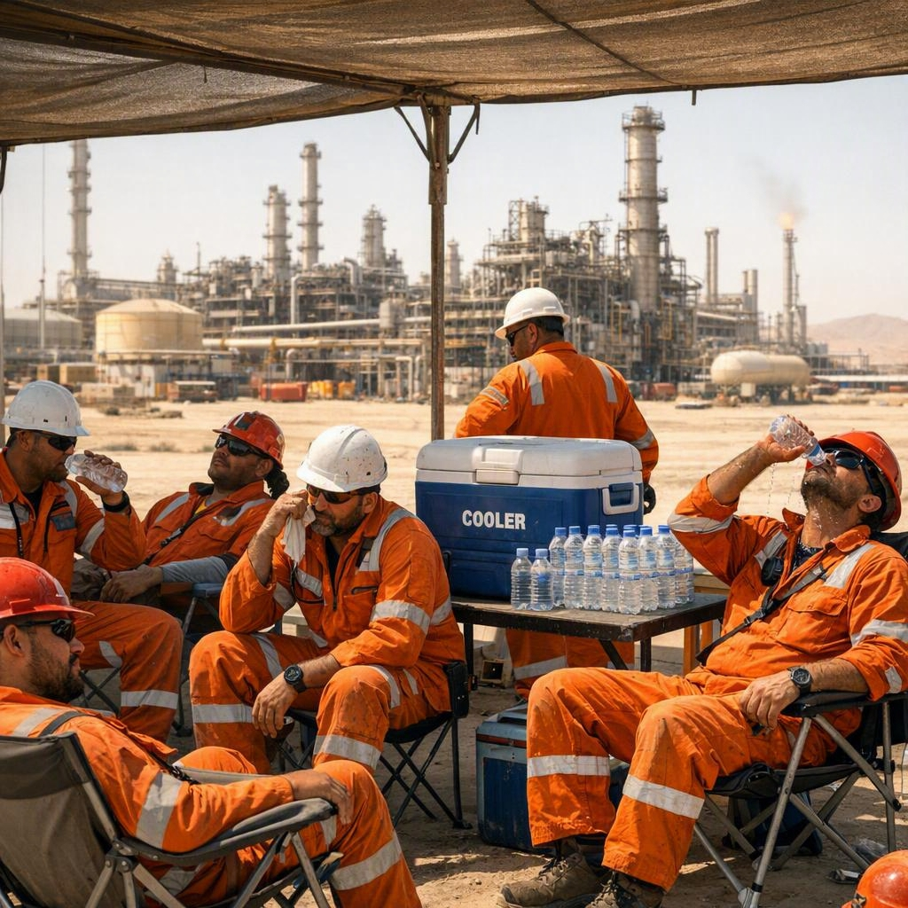
HPWJ – WATER JETTING
HEAT STRESS & WORK ROTATION
KSA weather can be extremely hot. Heat stress is a real hazard during HPWJ work.
Mandatory work-rest regimen and rotation of duties.
Watch each other for early signs of heat exhaustion.
Use hydration stations and shaded rest areas.
On practical days we rotate frequently to keep everyone safe.
Safety includes looking after each other in the heat.

Slide 16
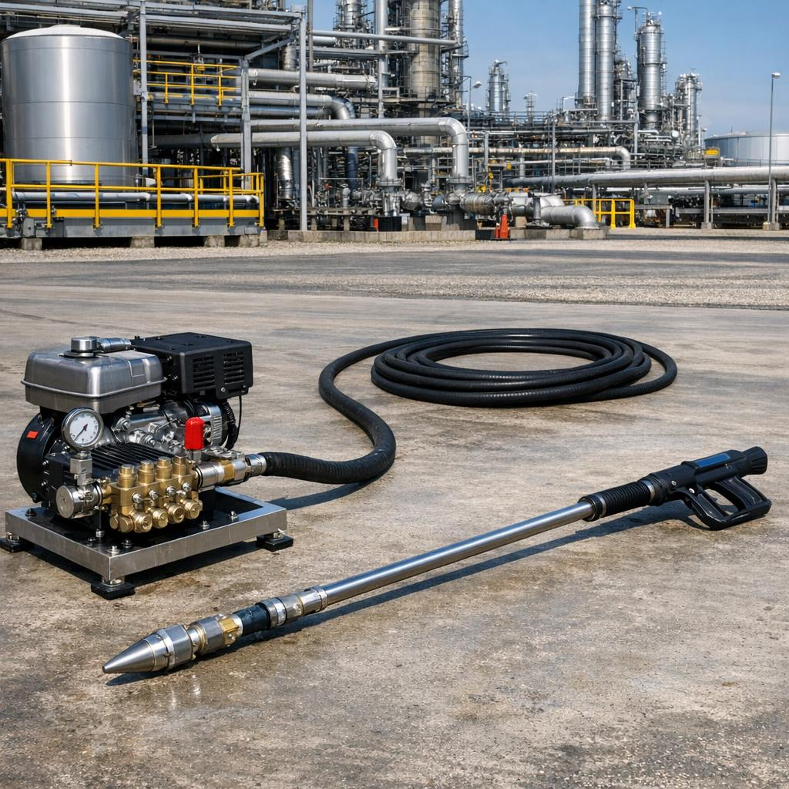
HPWJ – WATER JETTING
SYSTEM FUNDAMENTALS – PRESSURE VS FLOW
The pump moves (displaces) water – it does not create pressure by itself.
Pressure is created only when the flow is restricted at the nozzle.
Higher pressure with a smaller orifice gives greater cutting power but also greater reaction force on the operator.
KEY RULE
The nozzle operator must always have control of the pressure relief. Know exactly where the water is going at all times.

Slide 17
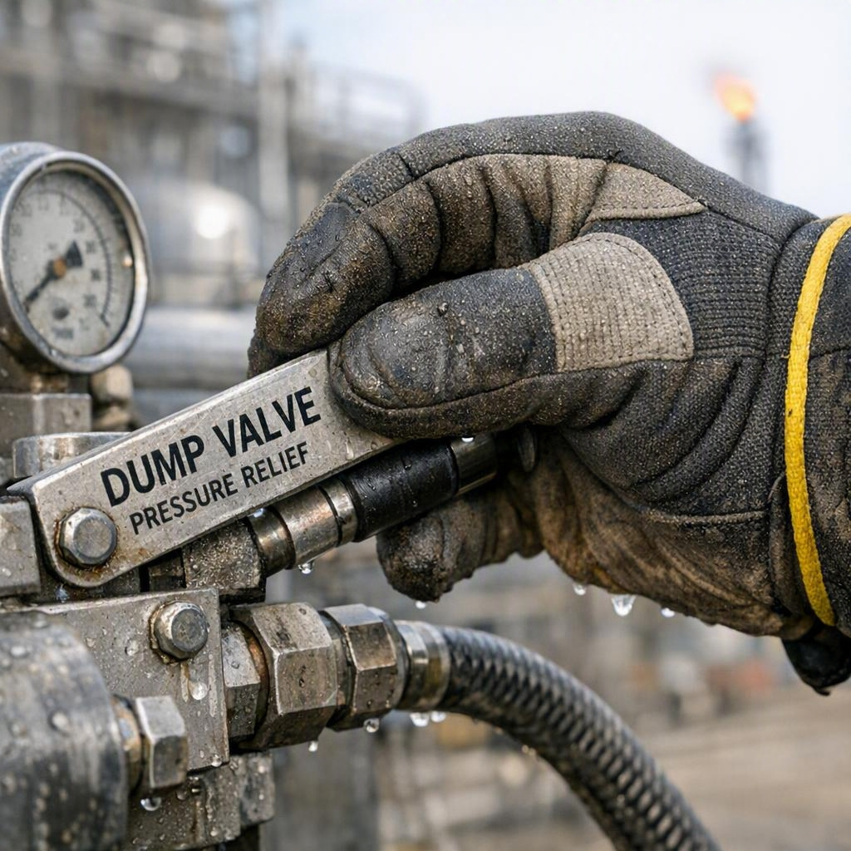
HPWJ – WATER JETTING
PRESSURE RELIEF CONTROL & OPERATOR RESPONSIBILITY
Different pressure relief control styles exist on site (standard dump, pneumatic, electrical).
The nozzle operator must always have positive control of the pressure relief method.
Different styles may add extra steps but never change the safety sequence.
Never start work if you do not fully understand and control the relief system on the equipment you are using.

Slide 18
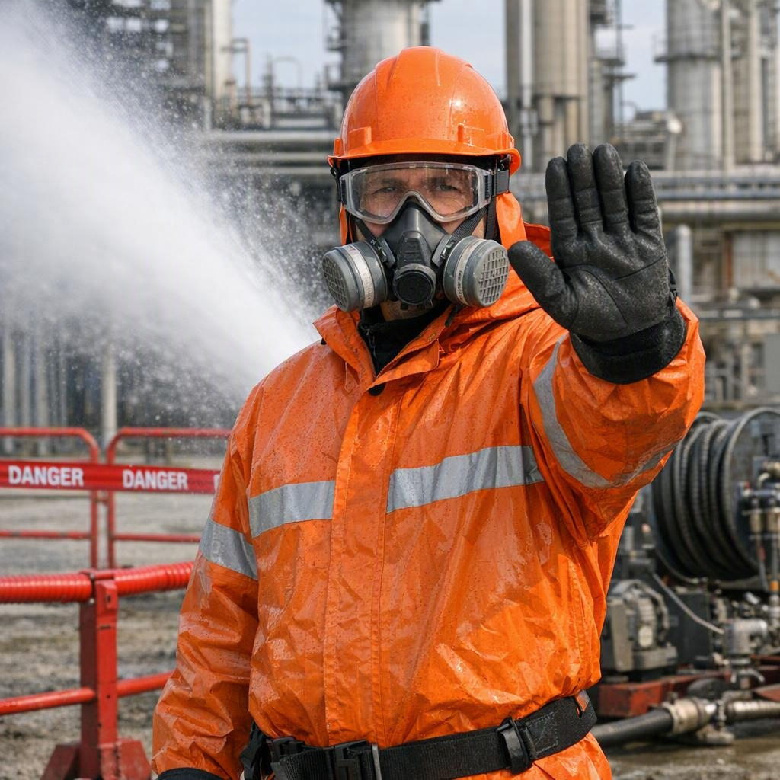
HPWJ – WATER JETTING
STOP WORK AUTHORITY (SWA)
You have the authority and the duty to stop work if conditions are unsafe.
Stop work if:
Equipment is not properly inspected or barricaded
You are unsure about any control or procedure
Heat stress or fatigue is affecting the team
Any team member raises a concern
There is no penalty for stopping work for safety reasons. Use your SWA – it protects you and your team.

Slide 19

HPWJ – WATER JETTING
DAY 1 SUMMARY & KEY TAKEAWAYS
Key points from today:
Waterjet injuries can be severe even when they look minor – always use the Medical Alert Card
Follow the hierarchy of controls – safer methods first
Mandatory controls: PTW, JSA, buddy system, barricading, heat stress rotation
The nozzle operator must control pressure relief
You have Stop Work Authority – use it
Tomorrow: Equipment, Pre-Use Inspection, PPE and Job Planning + practical work with the long-barrel gun.

Slide 20
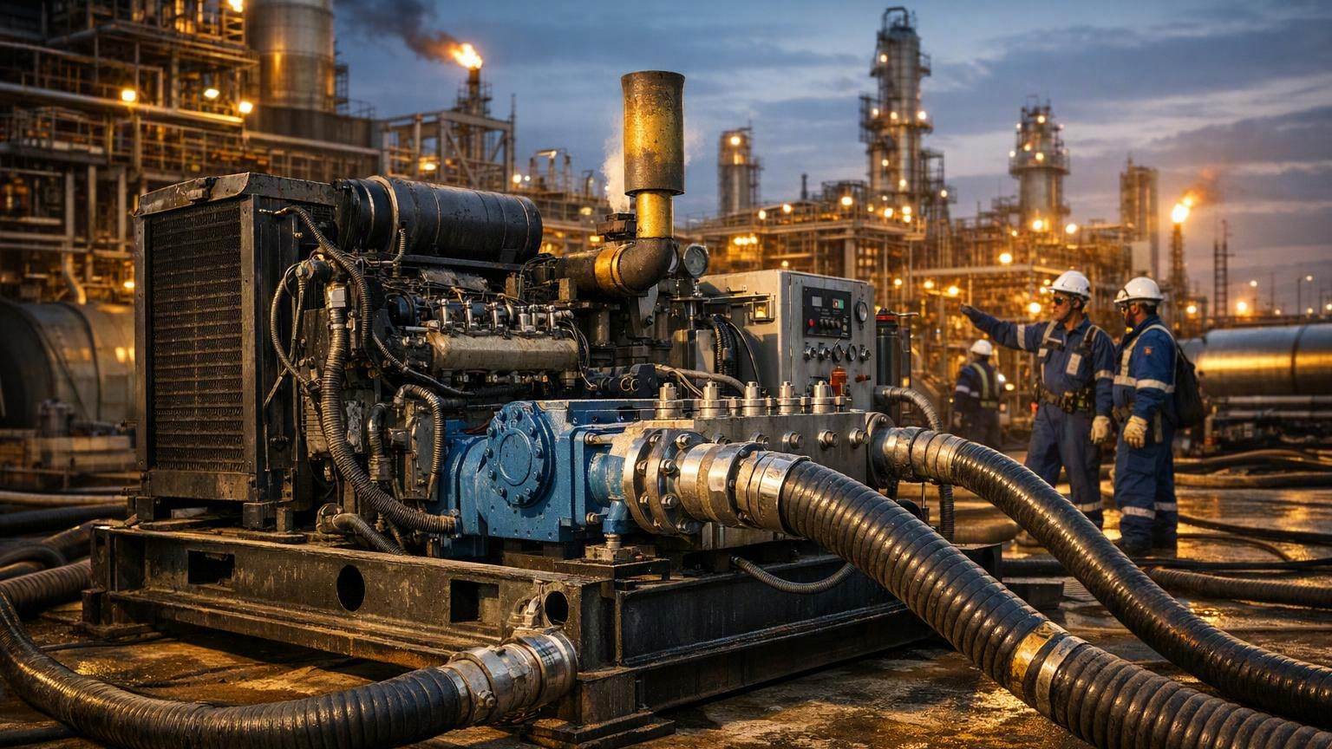
High Pressure Water Jetting
Basic Operator Training
(Awareness & Field Verification)
Day 2 – Equipment, Pre-Use Inspection, PPE & Long Barrel Gun Practical
Anabeeb HSE & Training | NEBOSH Verified Programme
END-TO-END SOLUTIONS

Slide 21
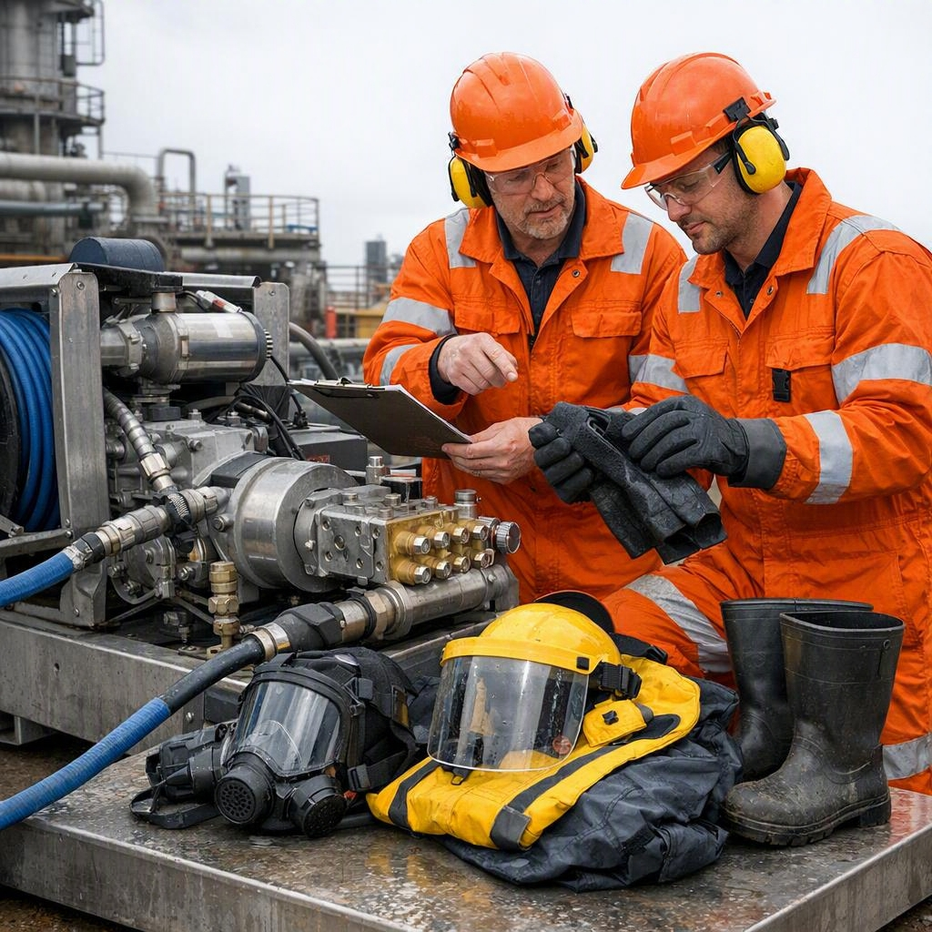
HPWJ – WATER JETTING
DAY 2 LEARNING OUTCOMES
By the end of today you will be able to:
Identify all major components of a diesel-driven triplex HP pump and the long-barrel gun system
Perform a complete pre-use inspection of pump, hoses, fittings, whip-checks, gun and PPE
Correctly line-up, air-bleed, start-up and shut-down the system following the approved sequence
Demonstrate safe long-barrel gun stance, trigger control, reaction-force management and hand-signal communication
Complete the Day 2 practical competency checklist to the required standard

Slide 22
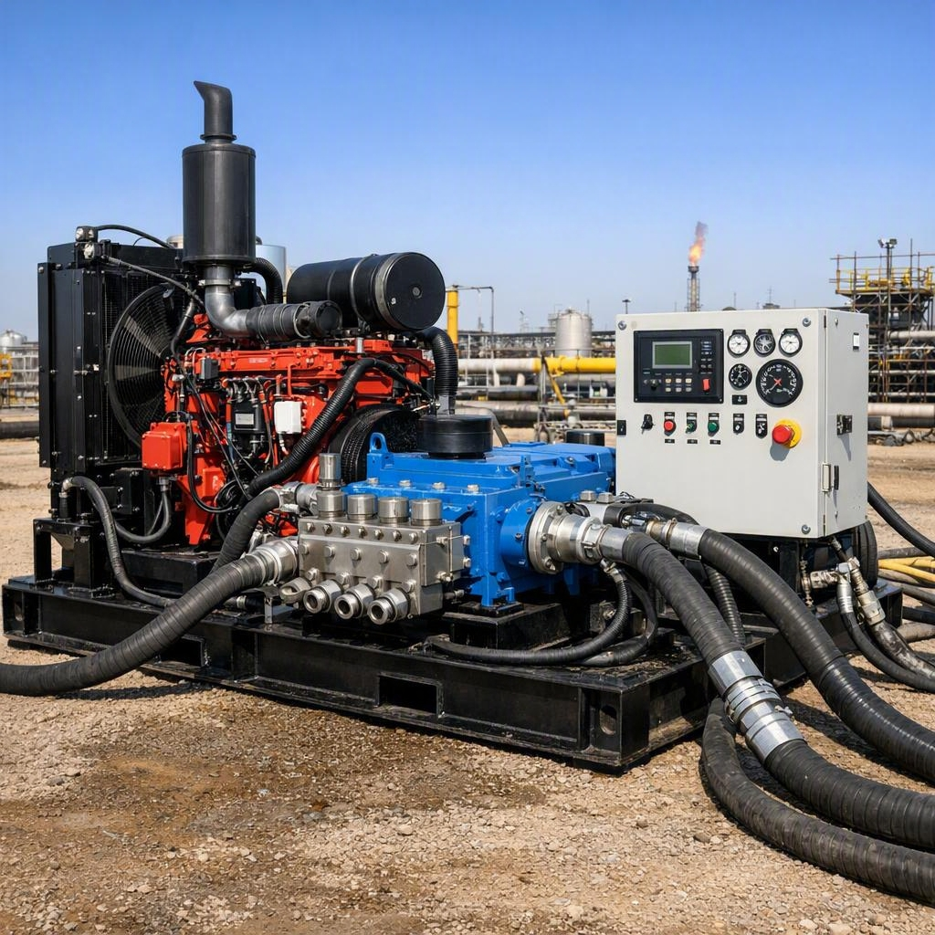
HPWJ – WATER JETTING
INTRODUCTION TO THE HIGH-PRESSURE PUMP
A High-Pressure (HP) Pump is a positive displacement pump designed to convert mechanical energy from a diesel engine into high-pressure water.
The pump delivers water at pressures ranging from 10,000 psi (690 bar) to 20,000 psi (1,379 bar) or higher.
It is used for industrial cleaning applications during shutdowns and maintenance.

Slide 23
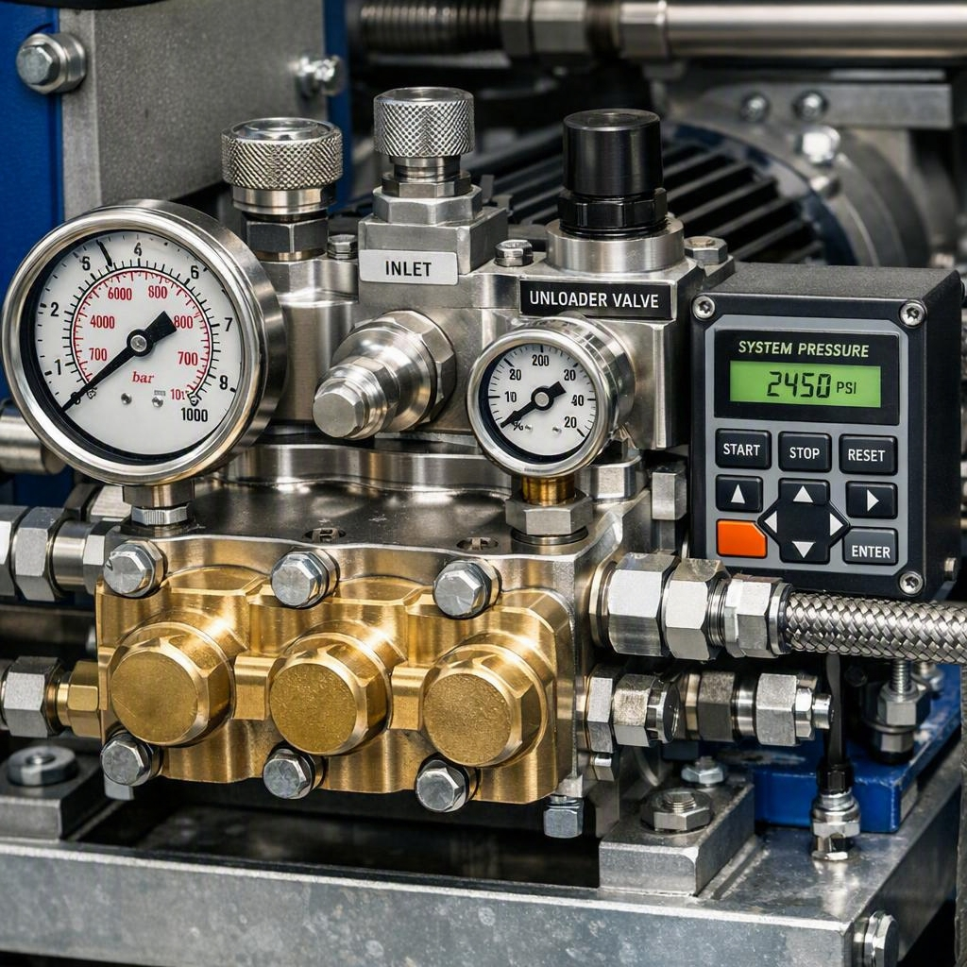
HPWJ – WATER JETTING
MAIN PARTS OF AN HP PUMP
Power Unit (Diesel Engine) – Drives the pump
Triplex Plunger Pump – Produces high-pressure water
Plungers – Compress water to high pressure
Suction & Discharge Valves – Control water flow
Pressure Regulator / Unloader Valve – Controls operating pressure
Pressure Relief Valve – Prevents over-pressure
Pressure Gauge – Displays operating pressure
Emergency Stop Button – Immediately shuts down the system

Slide 24
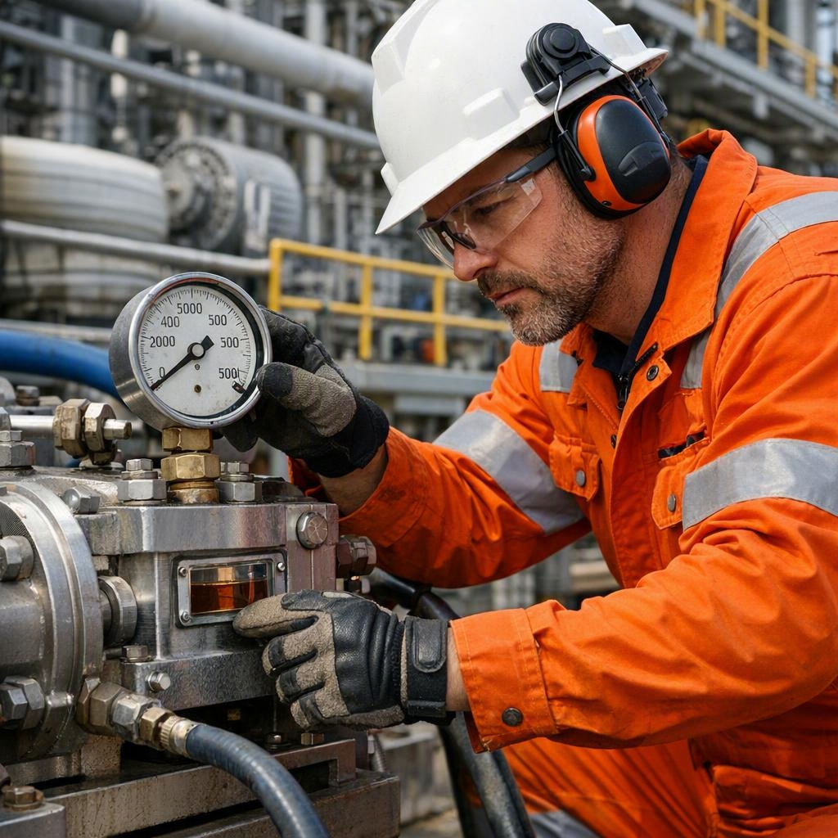
HPWJ – WATER JETTING
PRE-START INSPECTION OF THE HP PUMP
Before operating the HP pump, perform the following inspections:
Barricades installed and signage in place
Engine oil level correct
Pump oil level correct
Fuel level adequate
Cooling system condition good
Battery condition good
Belts and couplings in good condition
No oil or water leaks
Pressure gauge calibrated
Emergency stop button functional
Safety relief valve installed and operational
Never start the pump until all pre-start checks are complete and satisfactory.

Slide 25
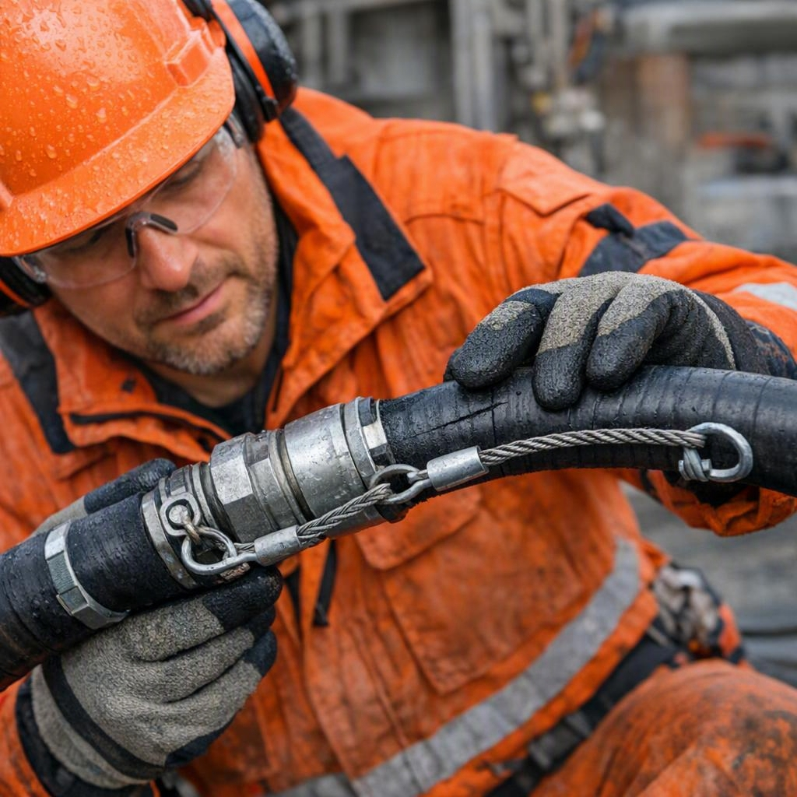
HPWJ – WATER JETTING
HP HOSE INSPECTION
Before use, inspect all high-pressure hoses:
Correct pressure rating for the job
No cuts, abrasions or damage to the outer cover
No bulges or soft spots
No damaged or leaking fittings
Safety whip checks installed and in good condition
Hose restraints installed where required
Hose routed safely with no kinks or sharp bends
Never use a damaged or suspect hose. Replace immediately.

Slide 26
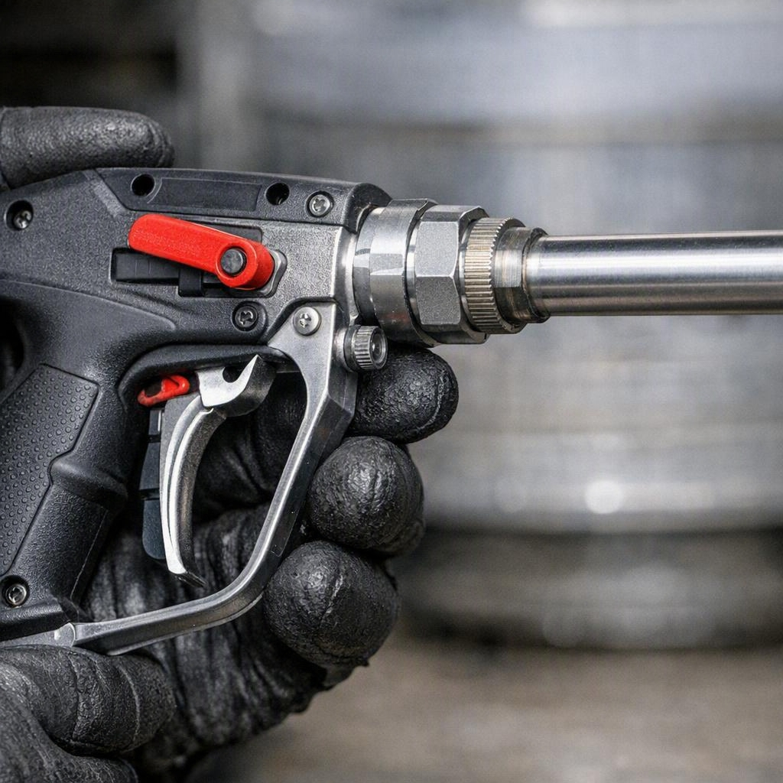
HPWJ – WATER JETTING
GUN / TOOL INSPECTION
Before use, inspect the gun and accessories:
Trigger functioning smoothly
Trigger guard in place and undamaged
Safety latch / lock working correctly
Correct nozzle fitted and secure
Lance straight and undamaged
All connections tight

Slide 27
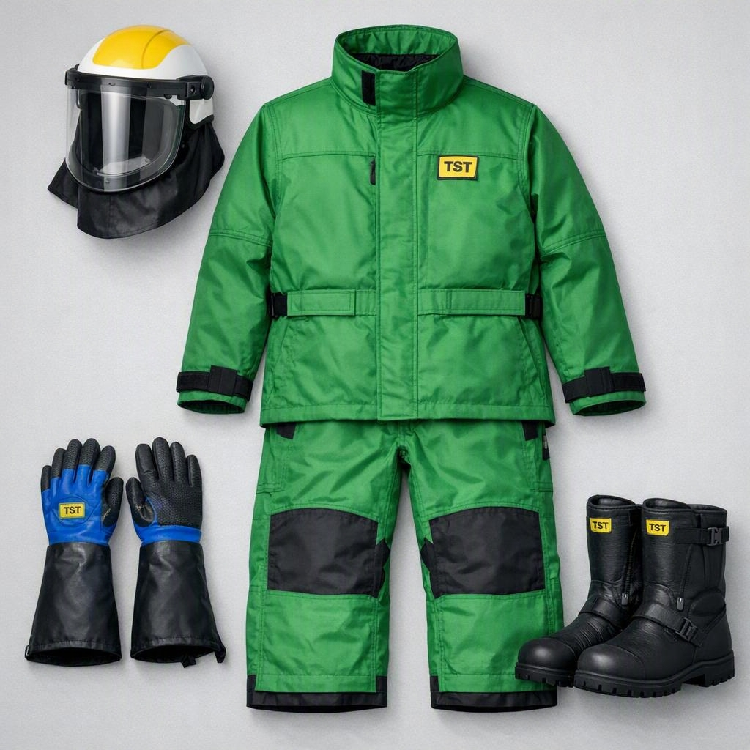
HPWJ – WATER JETTING
REQUIRED PPE FOR HPWJ
The following PPE is mandatory for high pressure water jetting work:
Safety helmet with face shield
Safety goggles
Hearing protection
TST water jetting suit (correct rating)
Cut-resistant gloves
Steel-toe safety boots
Waterproof clothing where required
TST suits are the primary protection against high-pressure water jet injuries.

Slide 28
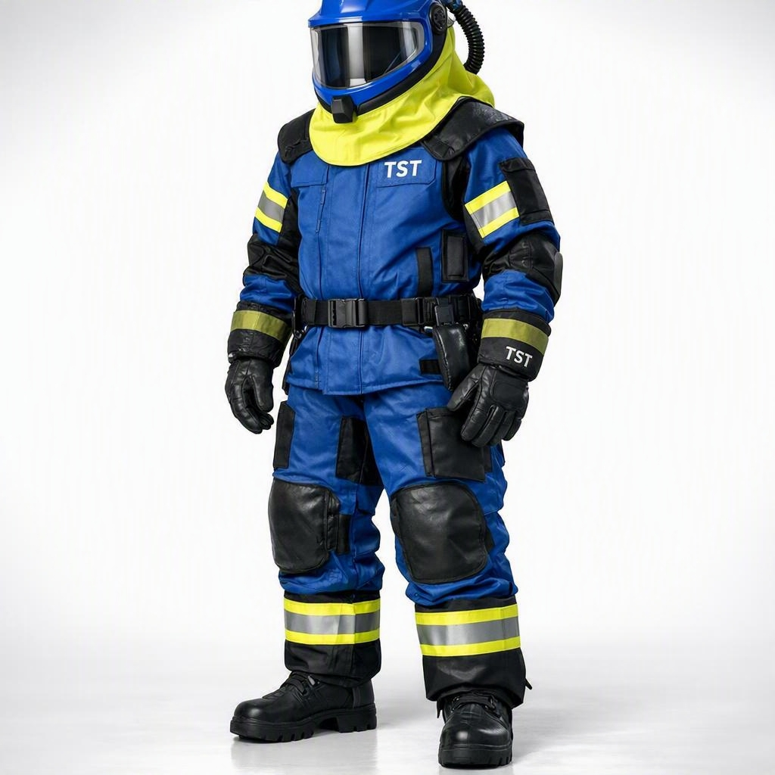
HPWJ – WATER JETTING
WHAT IS A TST SUIT?
TST suits are specially designed multi-layer protective suits for high-pressure water jetting.
They are engineered to protect against water jet penetration up to the rated pressure.
The suit consists of an outer protective layer and inner protective layers that work together to deflect and absorb high-pressure water.
TST suits are the most important piece of PPE when working with high-pressure water jetting equipment.
A TST suit is your last line of defence against serious injury.

Slide 29
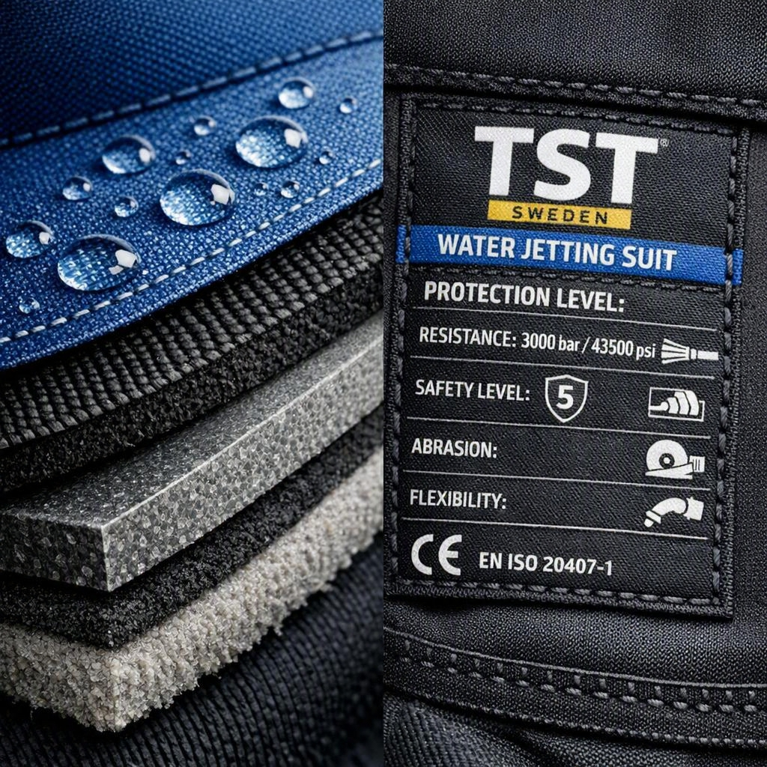
HPWJ – WATER JETTING
COMPONENTS & PROTECTION LEVELS OF TST SUITS
TST suits typically include:
Outer protective layer (high-strength fabric)
Inner protective layers (designed to deflect water jets)
Reinforced areas at high-risk zones (arms, torso, legs)
Sealed cuffs and neck protection
Different protection ratings (e.g. 500 bar, 1000 bar, 2000 bar)
Always use a suit with the correct pressure rating for the equipment being used.
Never use a TST suit below the required pressure rating for the job.

