Slide 1

Liquidity integration project

Slide 2
Strategic Request on Liquidity
Increase liquidity quality for the client
Increase our sovereignty
and control over our operation
Increase robustness/resilience
Monetize the book
Decrease liquidity mobilization

Slide 3
The initial situaton
Liquidity management is externalized to one provider only
  Fully dependant to one provider causing robustness and performance risk
  No flexibility in terms of business leveraging/performance
    All trades are sent to him
    No possibility regarding book shaping
  Lack of competition in the quotes, conditions are not optimum (ToB, spread, depth)
  Limited available products
Whereas we do have now the tehcnology and know how (API/back and front) to do it ourself:
  matching engine for trade management
  API, back end , front end tech expandable to a liquidity pipeline and book creation

Slide 4
The plan
Create a liquidity and a BI platform allowing to
  Integrate several liquidity providers offering
  Pipeline and shape it (ETL)
  to optimize liquidity quality for th client (TOB, spread, and depth)
  Integrate them with internal resting order to form the trading book
  Optimize revenue in relation with the book/liquidity
  Ensure robustness of the system (alerting, switch system)
  Decrease mobilized margin (cross margin model to be used)
  Monitor realtime the liquidity (operation and margin management)
  Monitor the liquidity long term performance

Slide 5
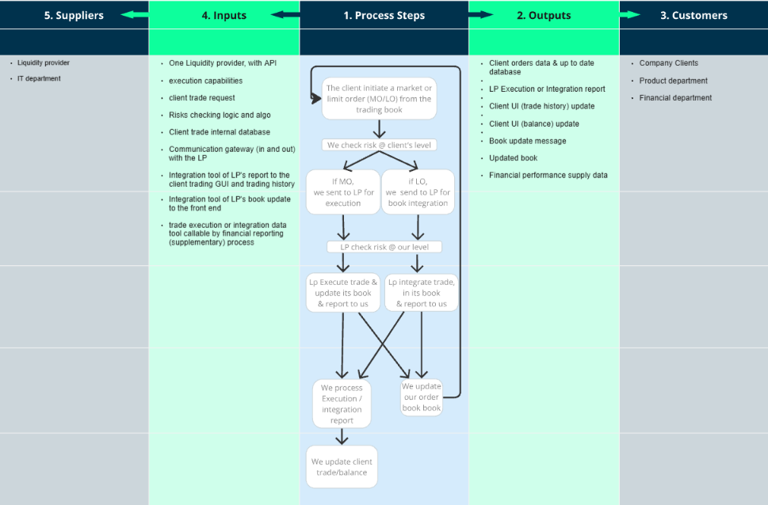
Process SIPOC Modelling AS-IS

Slide 6
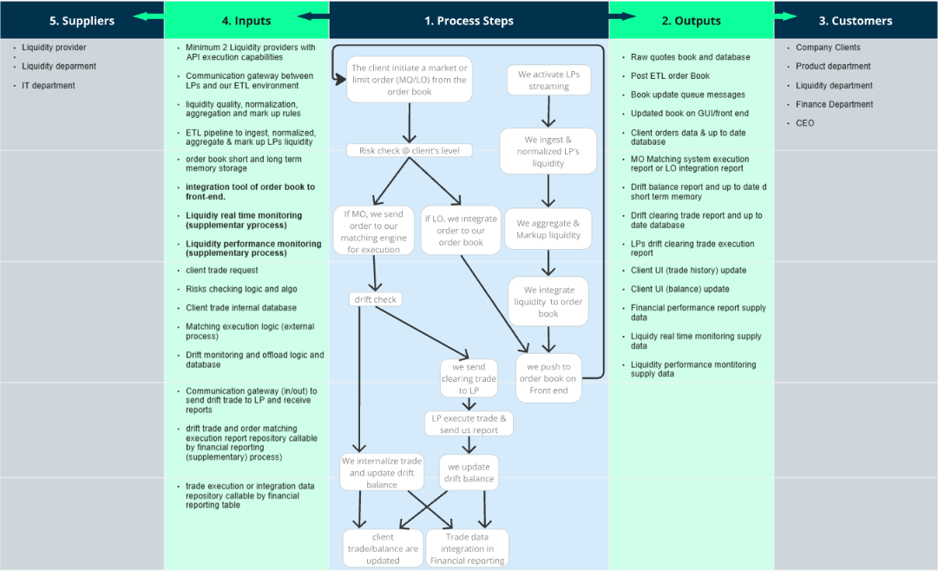
Process SIPOC Modelling TO-BE

Slide 7
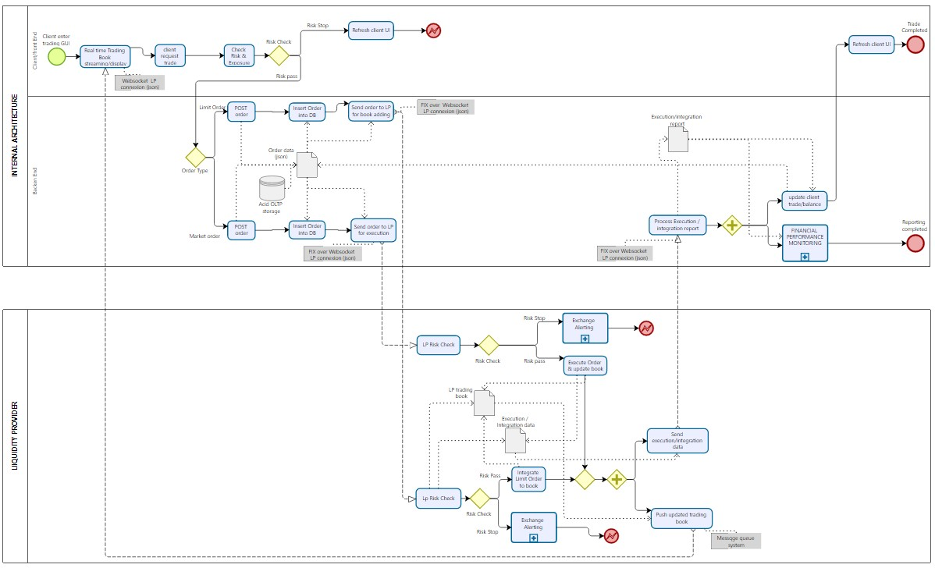
Process BPMN Modelling AS-IS

Slide 8
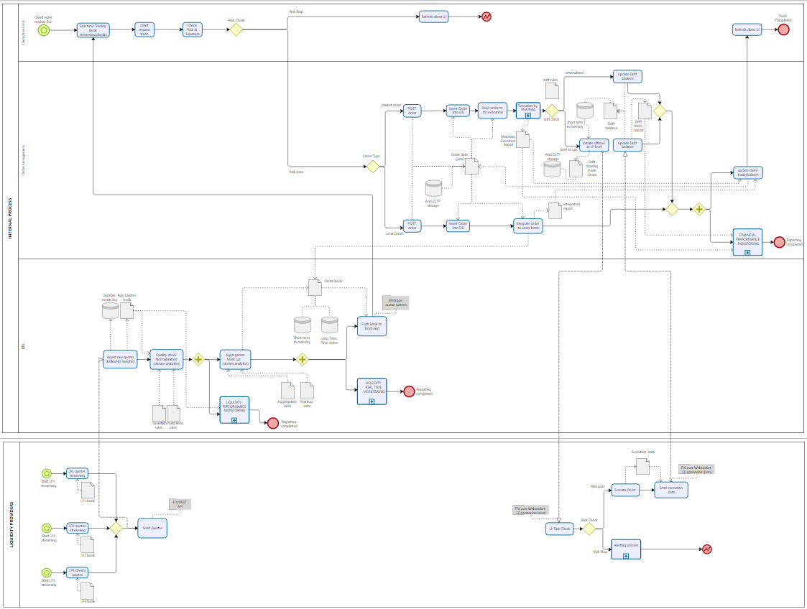
Process BPMN
Modelling
TO-BE

