Slide 1





by MERMADE
Real Estate Price Prediction API
PRESENTATION
Get Started

Slide 2
AGENDA
01
02
03
04
The target :
Our Project objectives
Getting there :
The 4 project sprints
The end line :
Our Minimal Viable Product
Future Prospects
Next Page

Slide 3
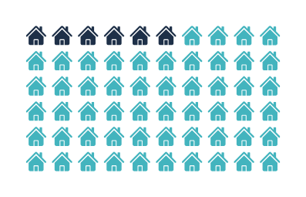
TARGET
WHAT DO WE WANT TO SOLVE
HOW DO WE SOLVE IT
Sellers want to be able to evaluate their property price:
independently from any intermediaries
in a precise and reliable manner
instantly
on a user-friendly environment
An application providing a reliable price estimation :
based on the most impactful property features
identified through data collection and analysis
used to train the machine learning model powering it
Further evolutions will integrate statistical
information on the real estate market
Next Page

Slide 4
PROJECT PHASING
4 WEEKS TO DELIVER = 4 SPRINTS
1 - DATA COLLECTION / PRE -PROCESSING
2 - DATA ANALYSIS
3 - MACHINE LEARNING MODEL DEVELOPMENT
4 - DEPLOYMENT
Next Page

Slide 5
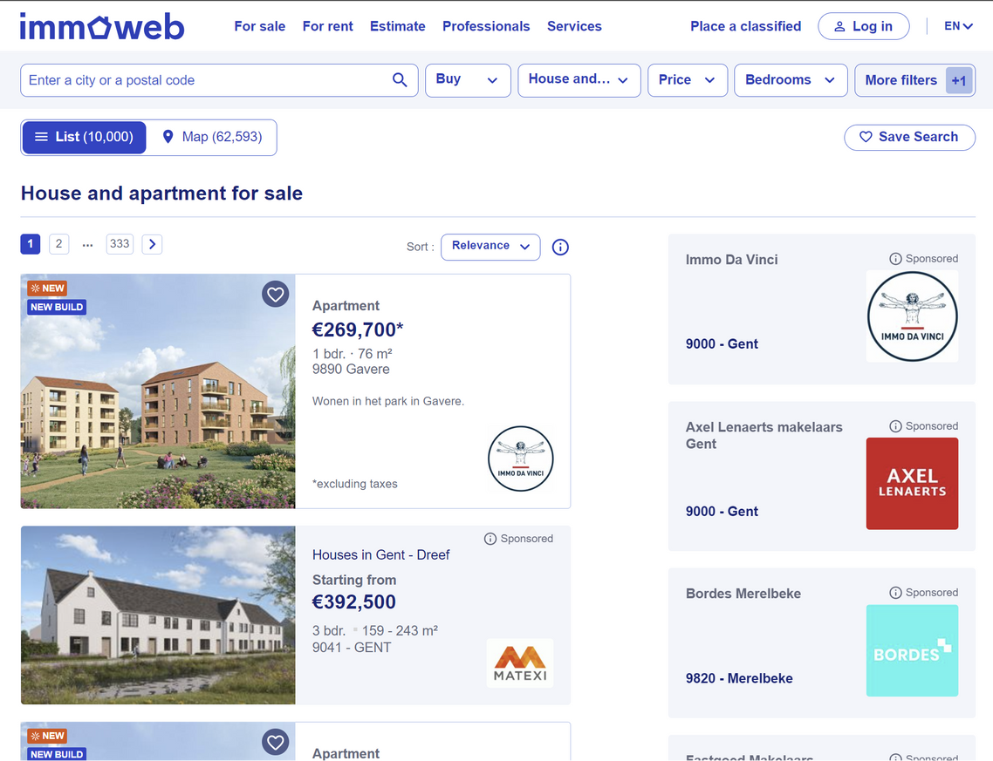
Scraping ImmoWeb
DATA COLLECTION
IMMOWEB as a resource - Thanks !
Around 5M housing units in Belgium
75K entries in the base dataset
+50 features
Representative across geography, type...
Sufficient for Machine Learning Model
Next Page
Notes:
Immoweb - shows listings from existing houses as well as new realestate projects

Slide 6
Leading to 26 parameters in final dataset
PRE-PROCESSING
Price
Geoloc
locality
zip code
Latitude
Longitude
region
province
flood zone
General
type
subtype
year
condition
frontage
cadastral income
Energy
energy class
heating
double glazing
nrj consumption
Interior
living surface
furnished
bedrooms
kitchen
open fire
Exterior
plot surface
garden
terrace
pool
Next Page

Slide 7
Leading to 26 parameters in final dataset
PRE-PROCESSING
+75K listings
Feature selection:
Prior knowledge
Location/Regions
Building Condition (Rennovated etc.)
Energy Efficiency
Size etc..
Features best represented
+50 Features
26 Features
Next Page

Slide 8
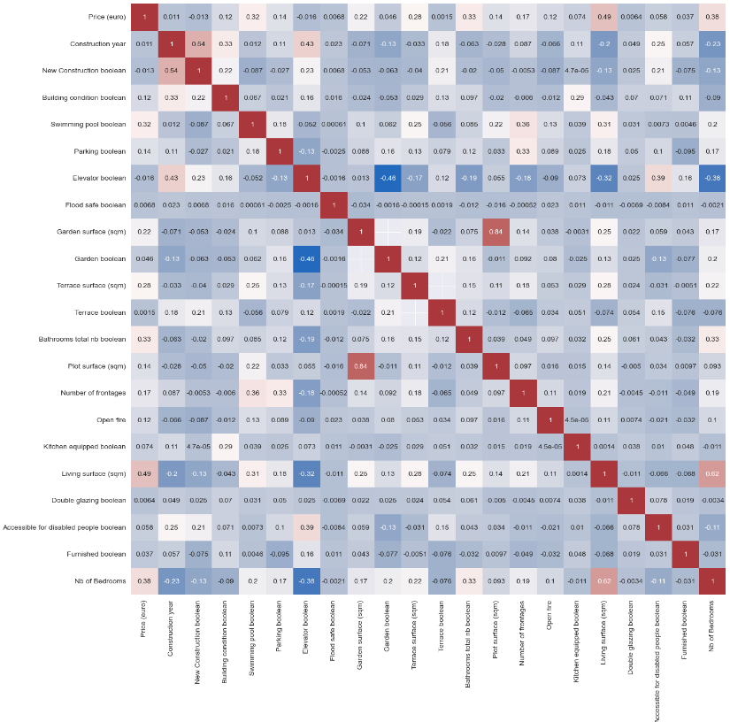
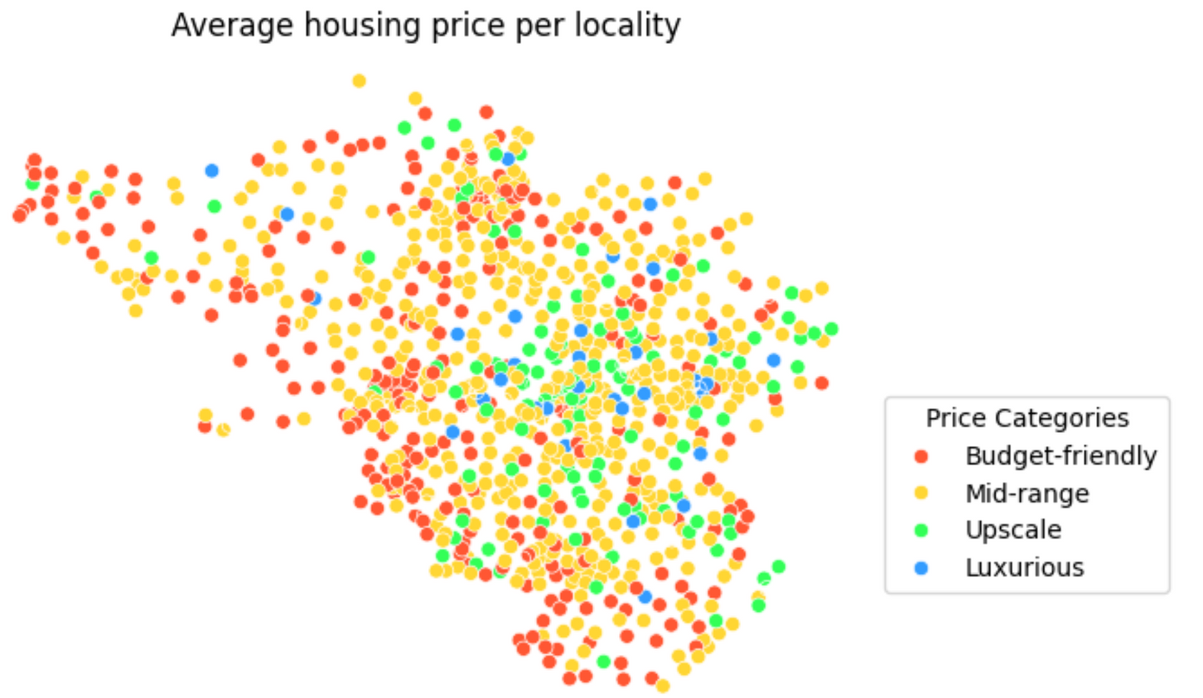
Correlation matrix and important features
DATA ANALYSIS
Correlation matrix
Descriptive data analysis
Outliers
Specific features i.e.
Swimming Pool
Furnished (y/n)
Correlation analysis
Next Page

Slide 9
Carefuly analyzed
DATA ANALYSIS
Other analysed features
Regional differences (Wallonia, Flanders, Brussels)
Price - EPC
Price - Building Condition
Next Page

Slide 10
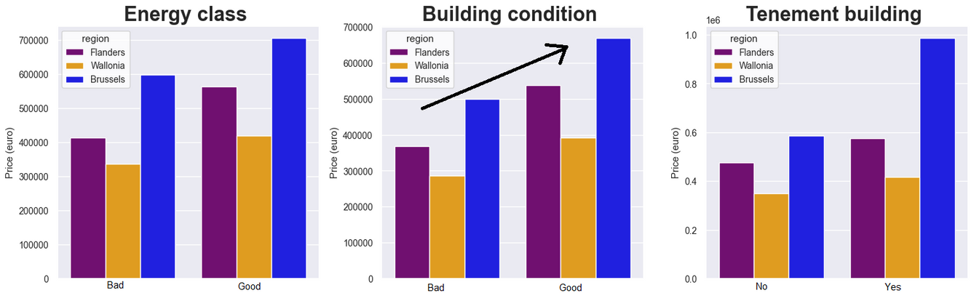
Carefuly analized
DATA ANALYSIS
Next Page

Slide 11
5 KEY FEATURES IDENTIFIED
DATA ANALYSIS
Cultural, economical and density factors are key influencers.
Houses still 25% more expensive than appartement in average
Increasing global and political significance.
Influence on housing quality and renovation costs.
Property dimensions and layout crucial for market value.
Geographical location
Type of property
Energy Efficiency
Building conditions
Size of the living surface
Next Page

Slide 12

AND 5 ADDITIONAL IMPACTING FEATURES
DATA ANALYSIS
Terrace
Modelization and app to include those 10 features at minima
Garden
Kitchen Equipement
Swimming pool
Follow the Mermade
Open Fire
Next Page

Slide 13
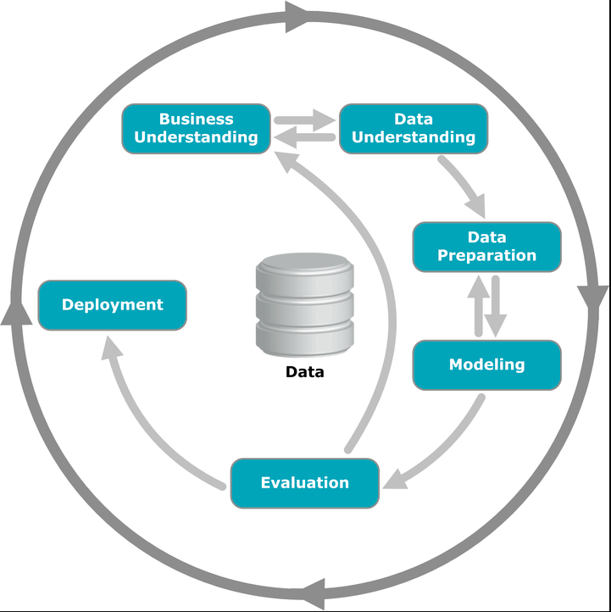
MODELIZATION : THE BASE MODEL
MODELIZATION PROCESS
4 models evaluated concurrently :
Linear Regression
Gradient Boosting Regressor
Random Forest
XG Boost
Gradient Boosting best performer on external data set :
R2 for test set : 75.4%
MAE test set : 75.2 KEUR
Next Page
MAE external set : 80.7 KEUR

Slide 14
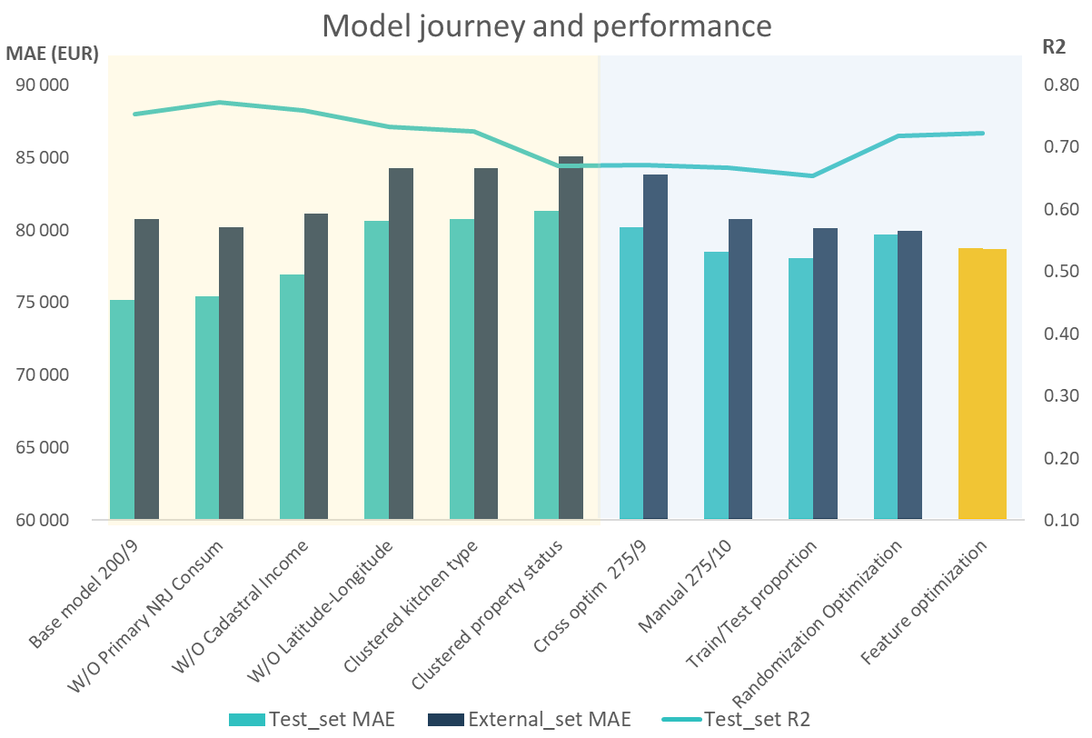


MODELIZATION : A TUMULTUOUS JOURNEY
MACHINE LEARNING
Usability improvement
Performance catch up

Slide 15
WHAT DO WE HAVE AT THIS STAGE
GETTING THERE
Pre-processed to offer 75K entries and 26 features
Determined as a must have for the modelization and the App
Predicting pricing with an R2 of 72% and sub 80K€ MAE
A Clean Data Set
10 major Features
An optimized Model
Next Page

Slide 16







DEPLOYMENT
03 - Render
02 - Docker
Online access
Container
04 - Streamlit
User interface
01 - Fast API
API
Project Done

Slide 17
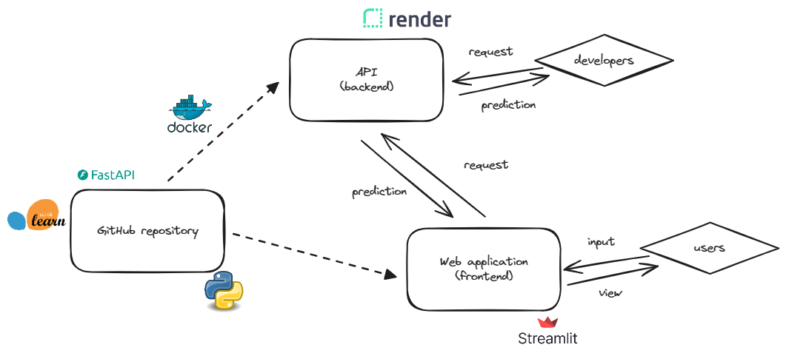
API SCHEME

Slide 18
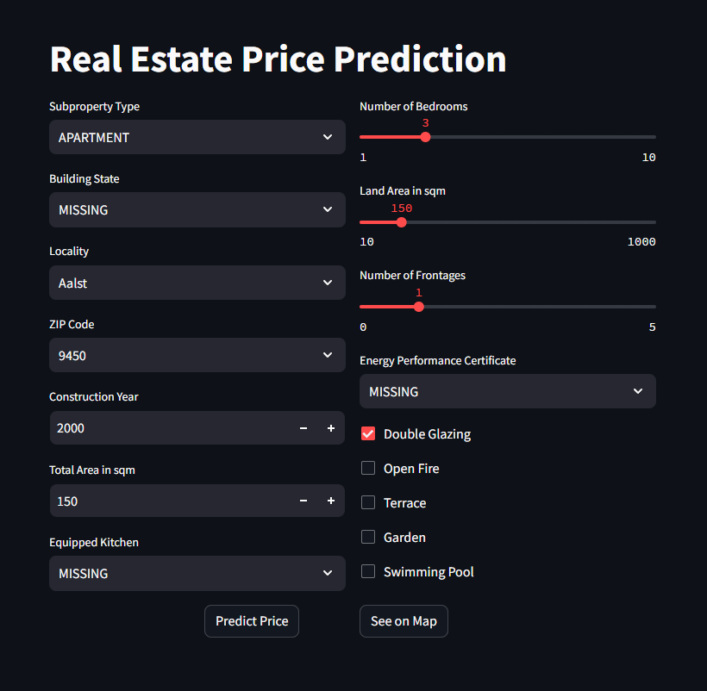
THE APP
Follow the Mermade
Next Page

Slide 19



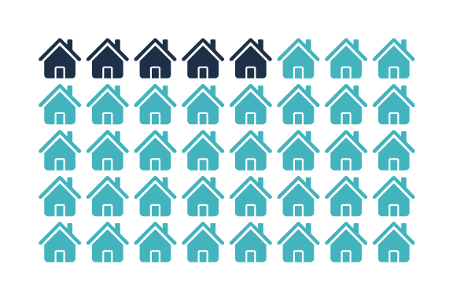

CONCLUSION
Did we achieve our target?
Accurate price prediction
User-friendly interface
Next Page

Slide 20



TECHNICAL PROSPECTS
Scraping output can be leveraged even more to allow more accurate model
Additional data
Features analysis can be refined
Additional or combination of models to be tested
FUTURE
DEVELOPMENT
Improved Modelization
More functionnalities
Add statistical & economical data on the real estate market
Next Page

Slide 21




BUSINESS PROSPECTS
Survey Users Needs
Survey users to evaluate their needs for GUI integration
along with additionnal functionnalities and users needs evaluation
Enlarge Audience
FUTURE
DEVELOPMENT
Define collaboration structure with market place / data providers
Refine business model
Strike deal with leading real estate market place / data provider in others territory
Collaboration type
Updating frequency
Add Territories
Next Page

Slide 22
by MERMADE
TEAM MERMADE
Sylvain
Julio
Omar
Polina
Brian

Slide 23
by MERMADE
A BIG THANK YOU FROM
TEAM MERMADE
Sylvain
Modelization
Julio
Front end
Omar
Front end
Polina
back end
Brian
Git Lead
QUESTIONS?

