Slide 1
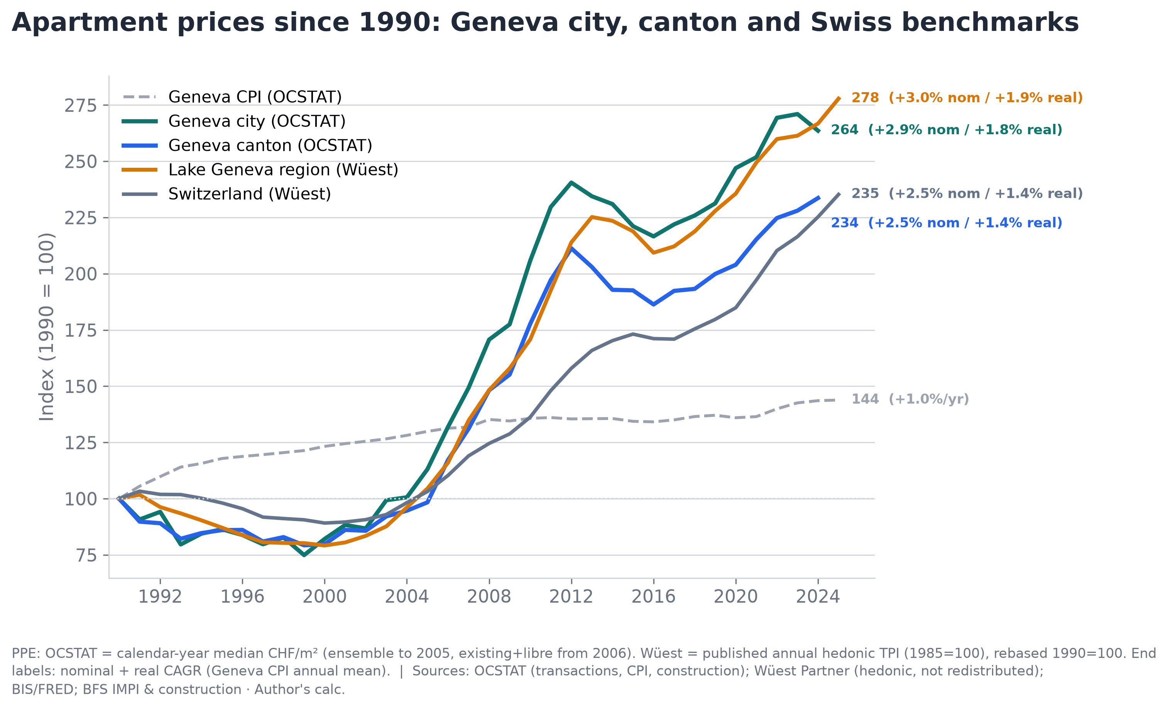
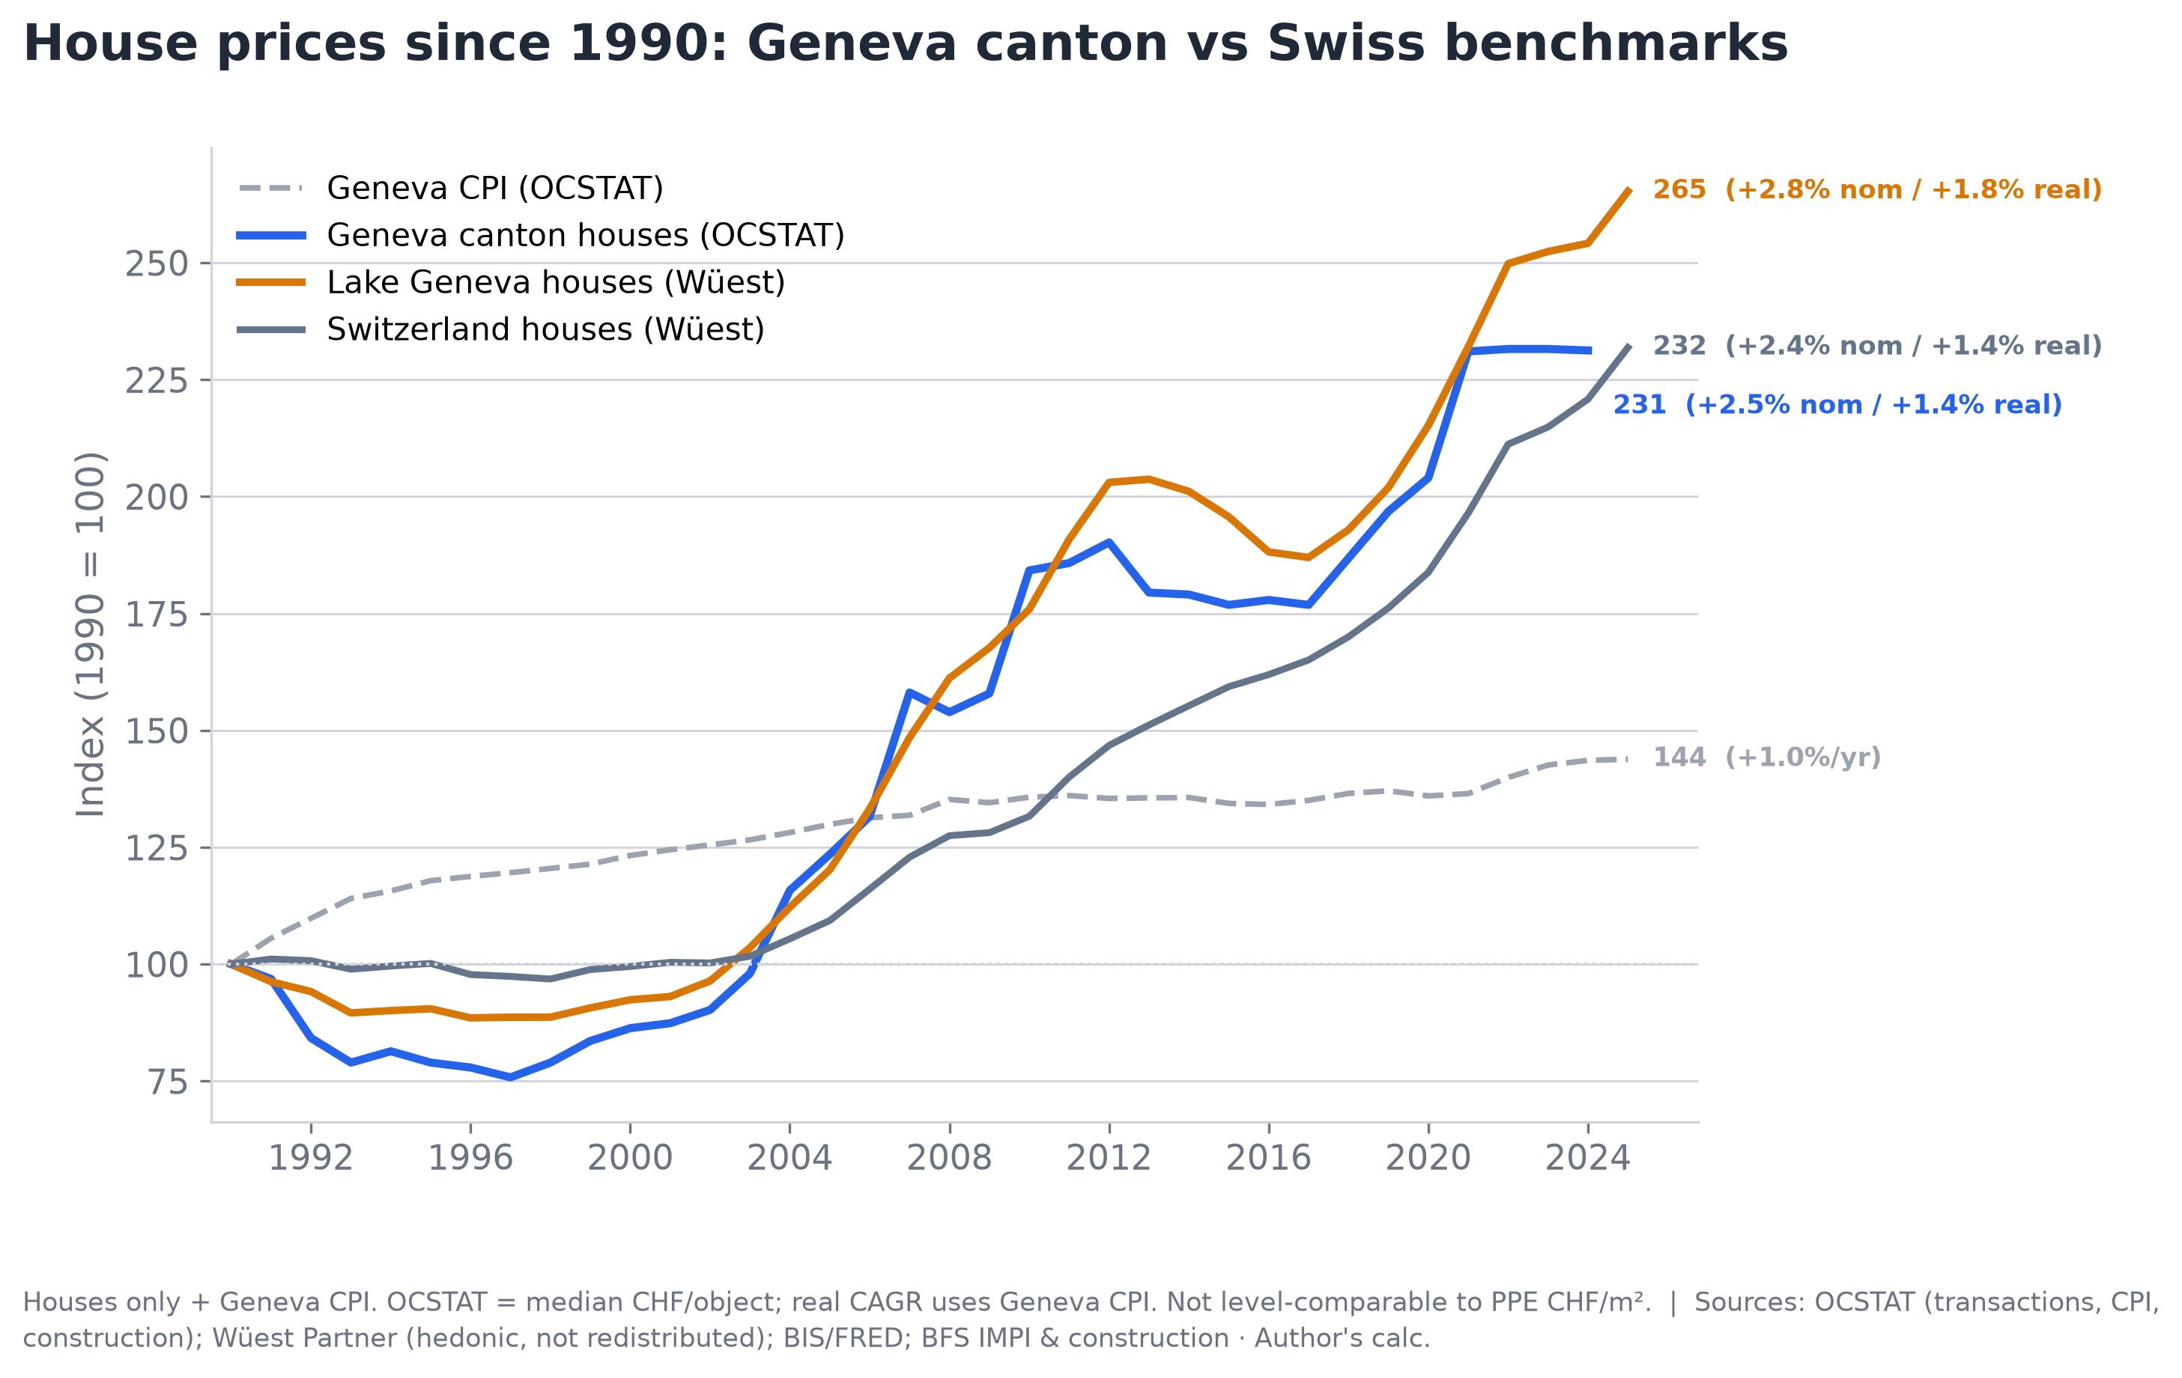
Geneva · Long-Term Price Dynamics · 1990–2025
All indices: 1990 = 100
Three independent sources, one conclusion: Geneva real estate roughly tripled since 1990.
▸ Apartments: city +2.9%/yr nominal (+1.8% real), canton +2.5%/yr (+1.4% real) over 34 years. Houses: canton +2.5%/yr, Lake Geneva region +2.8%/yr. Prices roughly double every 25–28 years in nominal terms.
▸ Official OCSTAT transactions and Wüest hedonic index show the same trajectory (correlation 0.99 on levels, 74–90% direction agreement). The trend is not an artifact of one measurement method.
▸ Geneva follows the Swiss cycle but amplifies it: deeper corrections, steeper rises. CPI grew just +1.0%/yr — real estate outpaced inflation by +1.4–2.0 percentage points annually.
Sources: OCSTAT (notarial transactions, Canton of Geneva); Wüest Partner (hedonic index, not redistributed); BIS/FRED; BFS IMPI · Author’s calculations

Slide 2
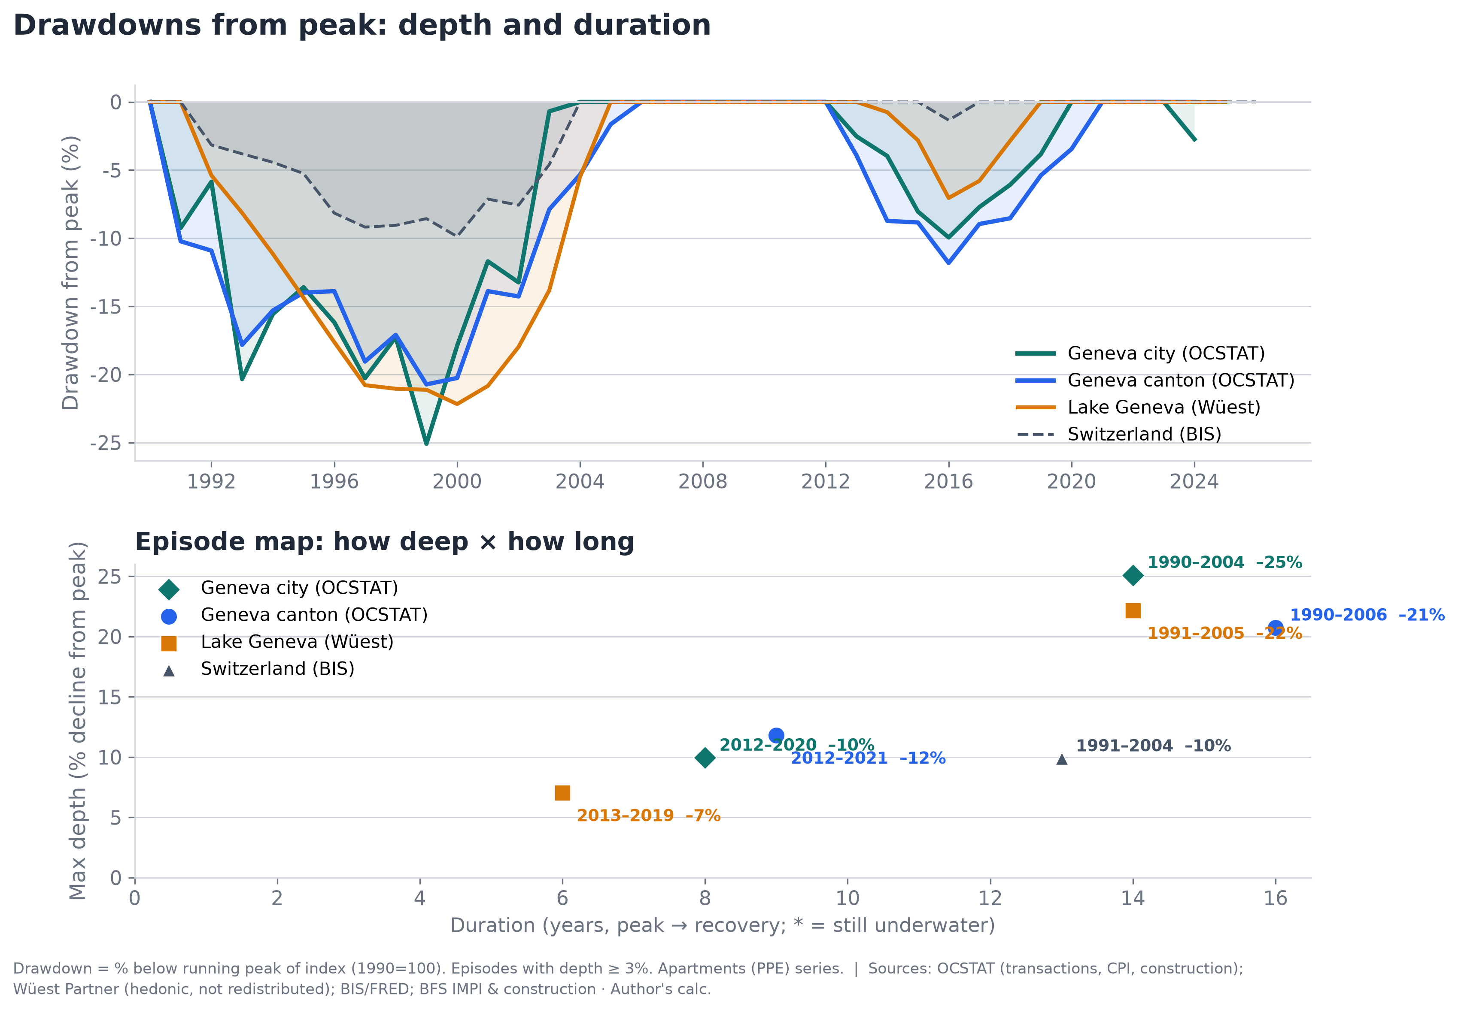
Historical Drawdowns · What Happens After a Peak?
Apartments (PPE)
▸ Worst case: Geneva city fell −25% from peak and took 14 years to recover (1990–2004). Canton: −21%, 16 years. Switzerland nationally: only −10% — Geneva amplifies the cycle 2×.
▸ The second cycle (2012–2021) was milder: −10 to −12%, recovery in 6–9 years. Shorter, shallower — potentially a more resilient market or different rate environment.
▸ After every drawdown, the new peak substantially exceeded the previous one. Long-term holders were always rewarded — but the holding period matters.
Sources: OCSTAT (notarial transactions, Canton of Geneva); Wüest Partner (hedonic index, not redistributed); BIS/FRED; BFS IMPI · Author’s calculations

Slide 3
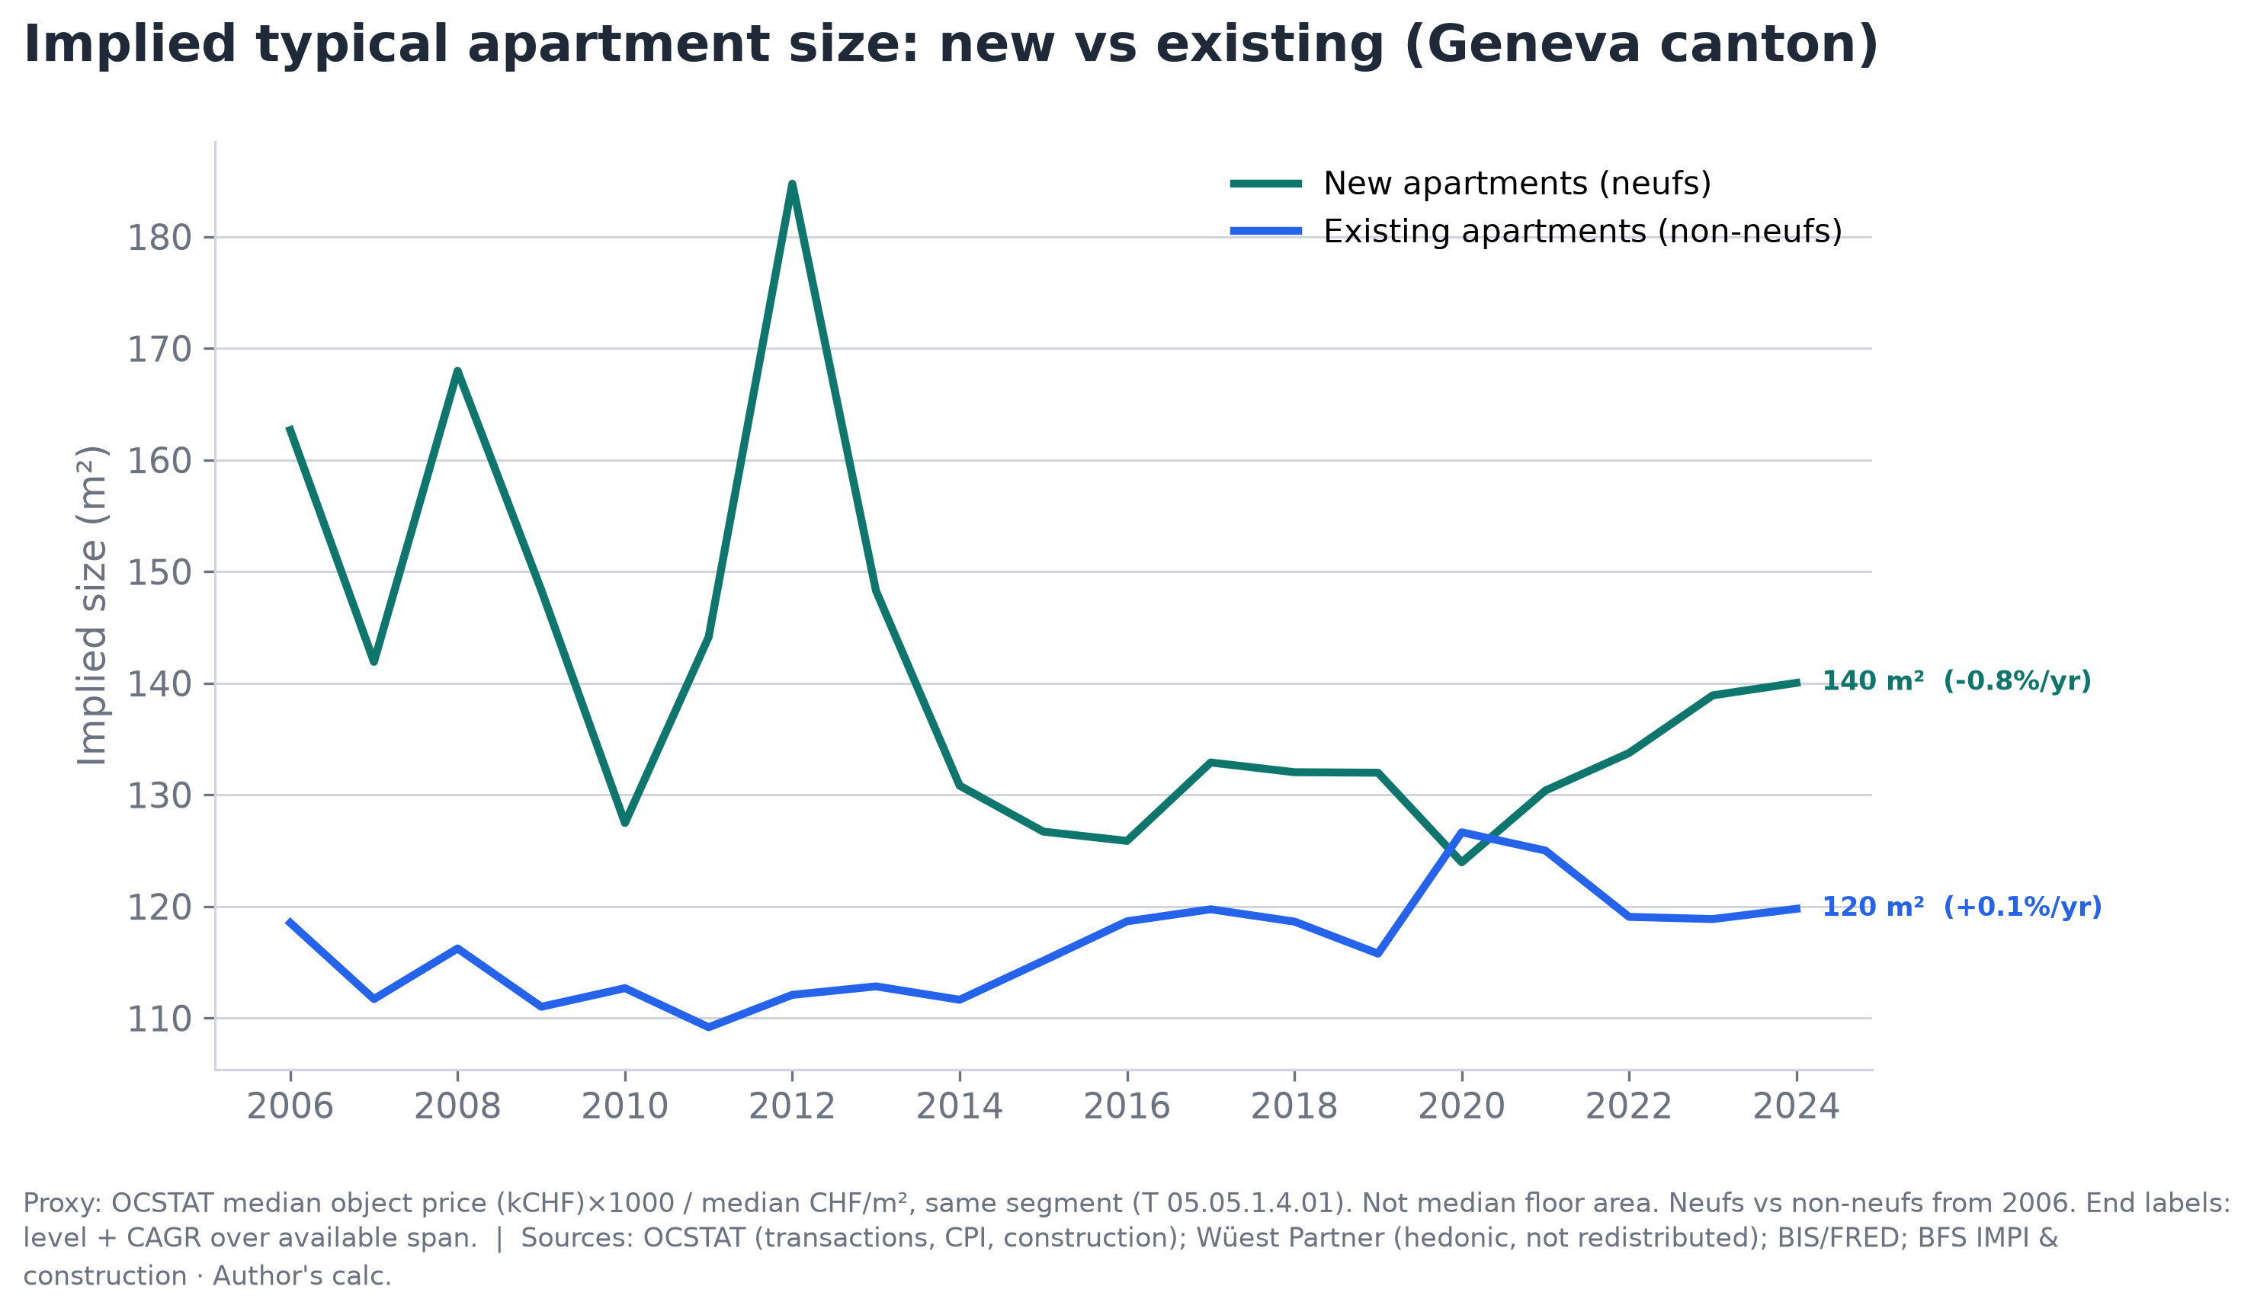
What Size Apartment Is Actually Selling?
Geneva canton · 2006–2024
Proxy: median object price ÷ median CHF/m² — the implied typical floor area of a sold apartment.
▸ Existing apartments: ~120 m², remarkably stable (+0.1%/yr over 18 years). The composition of what sells has barely changed — a consistent market for 3–4 room flats.
▸ New apartments: ~140 m² in 2024, trending upward since 2014 (from ~125 m²). Developers are building larger, higher-value units. Early years (2006–2012) show high volatility due to small sample sizes.
▸ New apartments are ~17% larger than existing. This is a proxy (ratio of two medians, not median floor area directly), but the direction is consistent with market observations.
Sources: OCSTAT (notarial transactions, Canton of Geneva); Wüest Partner (hedonic index, not redistributed); BIS/FRED; BFS IMPI · Author’s calculations

Slide 4
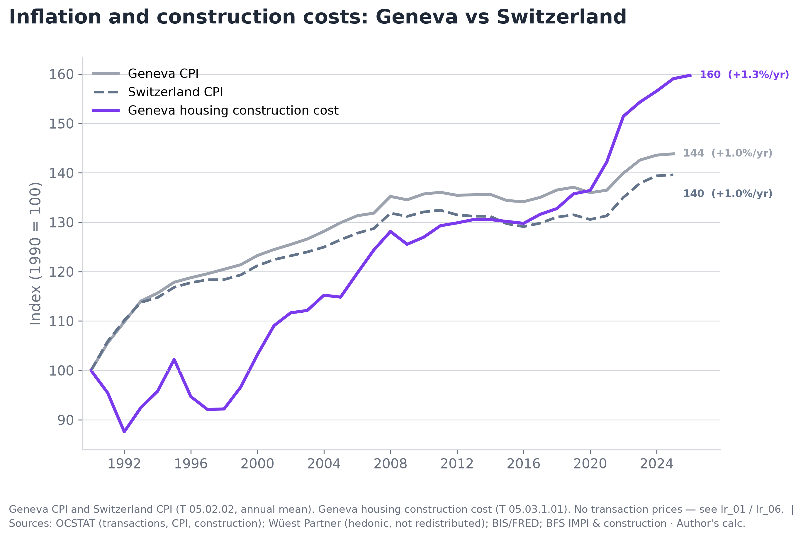
Inflation, Construction Costs & Growth Summary
All indices: 1990 = 100
Real estate outpaced inflation by +1.4–2.0 p.p./year. Construction costs surged after 2020.
Geography | Source | Index (1990=100) | Nominal /year | Real /year
APARTMENTS (PPE, CHF/m²)
Geneva city | OCSTAT | 264 | +2.9% | +1.8%
Geneva canton | OCSTAT | 234 | +2.5% | +1.4%
Lake Geneva region | Wüest | 278 | +3.0% | +1.9%
Switzerland | Wüest | 235 | +2.5% | +1.4%
HOUSES (CHF/object)
Geneva canton | OCSTAT | 232 | +2.4% | +1.4%
Lake Geneva region | Wüest | 265 | +2.8% | +1.8%
Switzerland | Wüest | 231 | +2.5% | +1.4%
INFLATION & COSTS
Geneva CPI | OCSTAT | 144 | +1.0% | —
Switzerland CPI | BFS | 140 | +1.0% | —
Geneva construction cost | OCSTAT | 160 | +1.3% | —
▸ Geneva CPI +1.0%/yr, construction costs +1.3%/yr (with a sharp acceleration after 2020). Real estate nominal growth of +2.5–3.1%/yr translates to +1.4–2.0%/yr above inflation.
▸ Construction cost surge (+18% in 4 years) supports the new-build price premium and limits future supply growth — a structural tailwind for existing property values.
▸ Data: OCSTAT (official notarial transactions), Wüest Partner (hedonic quality-adjusted index), BIS/FRED, BFS IMPI. Full methodology and code: GitHub.
Sources: OCSTAT (notarial transactions, Canton of Geneva); Wüest Partner (hedonic index, not redistributed); BIS/FRED; BFS IMPI · Author’s calculations

