Slide 1
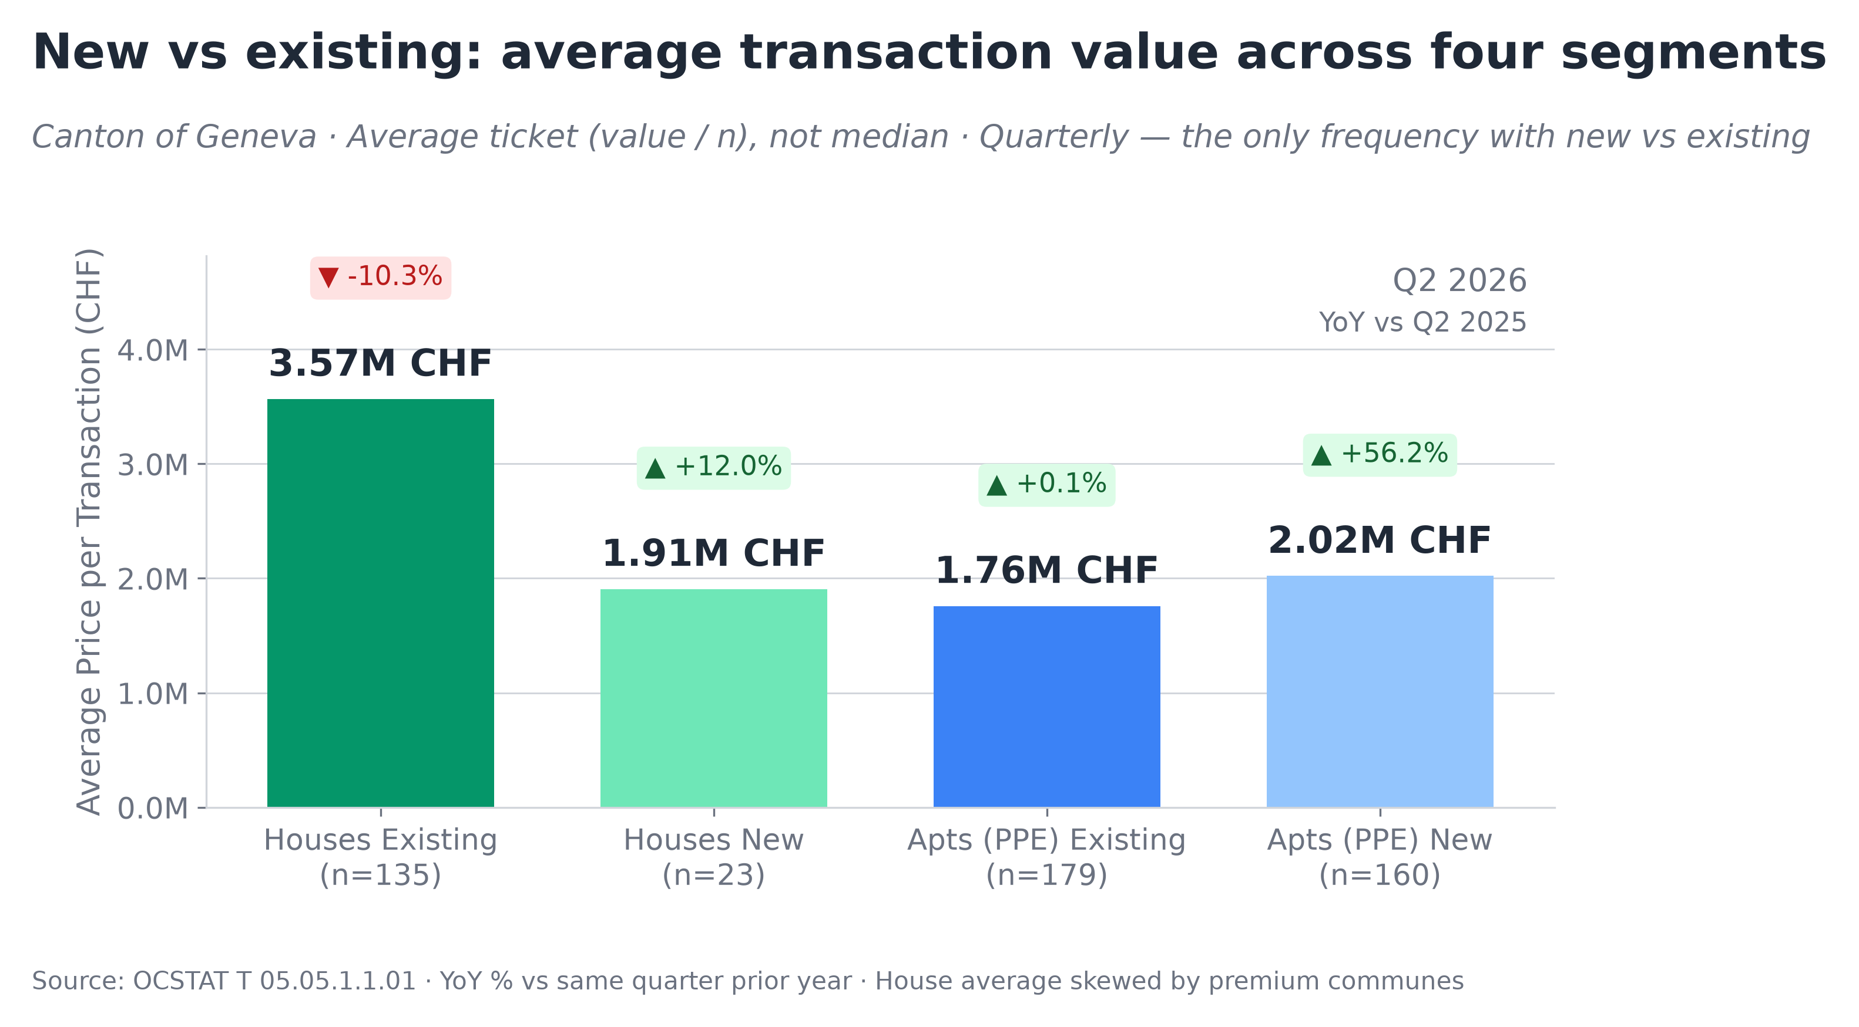
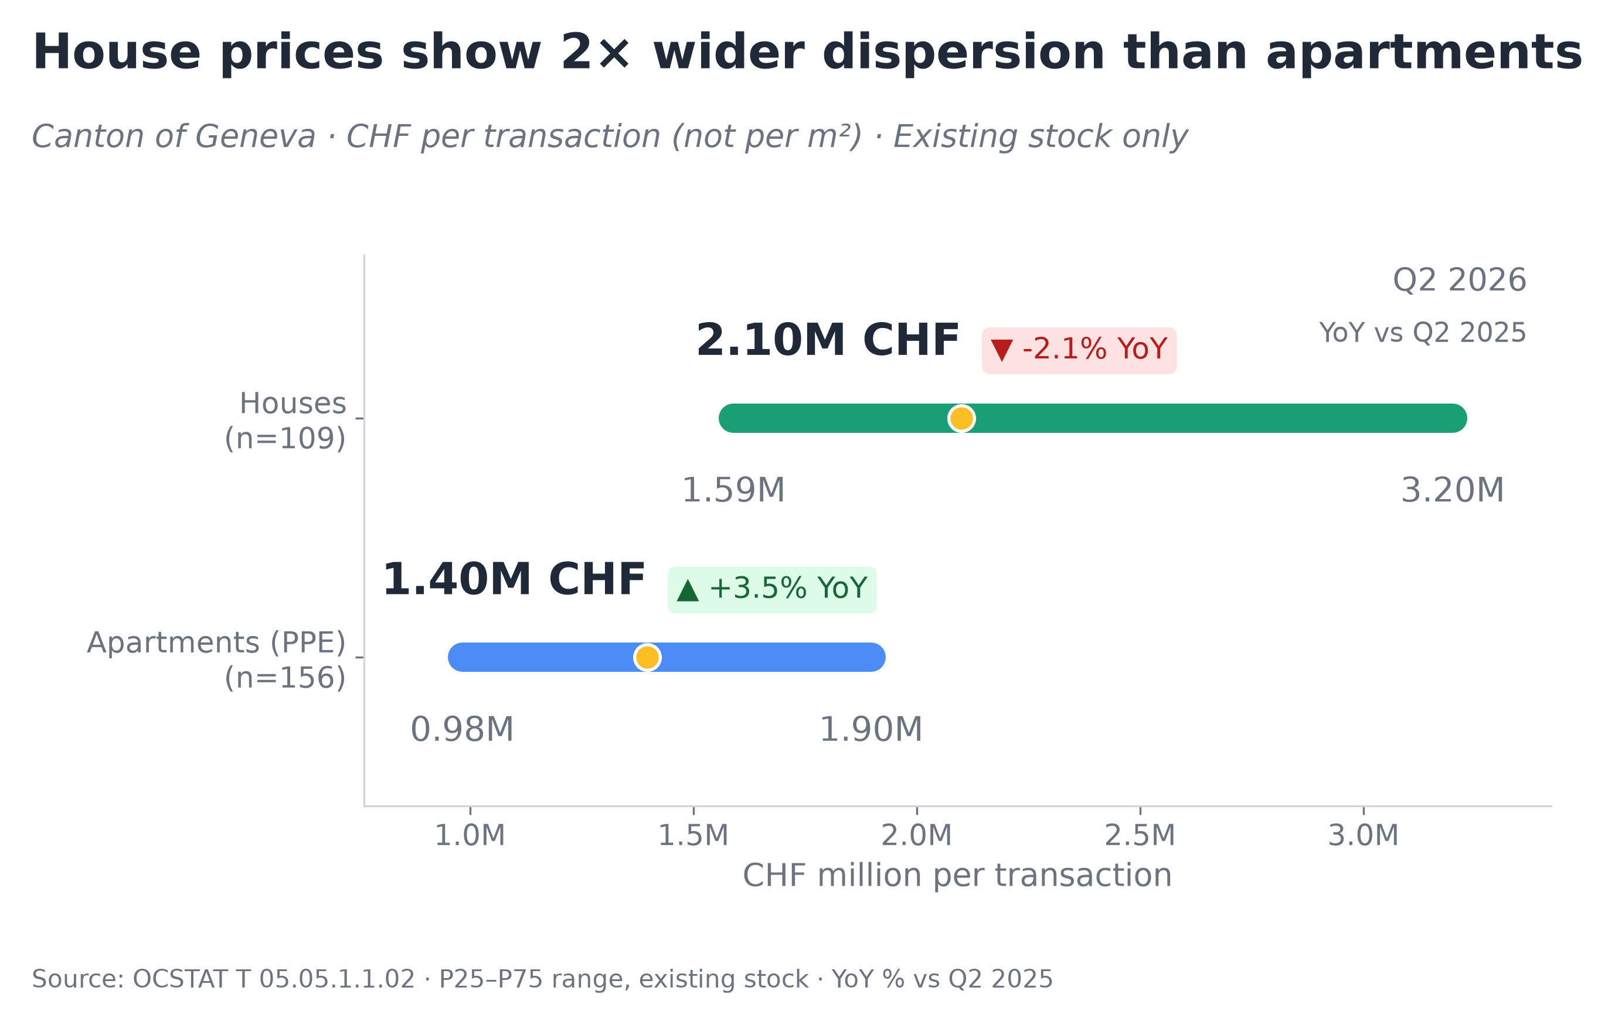
Geneva Canton · Residential Market
Official OCSTAT transactions · Q2 2026
This review answers three practical questions about the Geneva residential market: what prices look like today, how we got here, and where the value differs by commune. All figures are derived from official notarial transaction records published by the Canton of Geneva (OCSTAT). These are completed sales registered with a notary — not listing prices, bank appraisals, or survey estimates. The dataset covers condominium apartments (PPE) and detached houses across all 45 communes.
Annual data through 2024 · Quarterly data through Q2 2026
Key observations
Key observations
Key observations
Key observations
▸ A house costs on average 2× more than an apartment (3.6M vs 1.8M CHF).
▸ New apartment average rose +56% YoY — driven by several large projects closing, not a broad market-wide price increase.
▸ Existing house average (3.6M) is pushed up by luxury transactions in premium communes (Cologny, Vandoeuvres).
▸ New and existing apartment prices are similar (~1.8–2.0M per transaction).
▸ Half of house buyers pay between 1.6M and 3.2M CHF — prices vary significantly by commune and property type.
▸ Apartments are more predictable: 75% of transactions fall within 1.0–1.9M.
▸ Apartment P75 (~1.9M) meets house P25 (~1.6M) — at this price, a buyer chooses between a large apartment or a modest house.
▸ House median stable at 2.10M (−2.1% YoY), apartment median 1.40M (+3.5% YoY).
Source: OCSTAT T 05.05 · Canton of Geneva · YoY vs Q2 2025 · Chart 1: average ticket (value/n), not median · Chart 2: official OCSTAT medians + P25–P75
Author's analysis · Raw data: OCSTAT T 05.05 series · Methodology and code: https://github.com/slviktor/geneva-real-estate-market-analysis

Slide 2
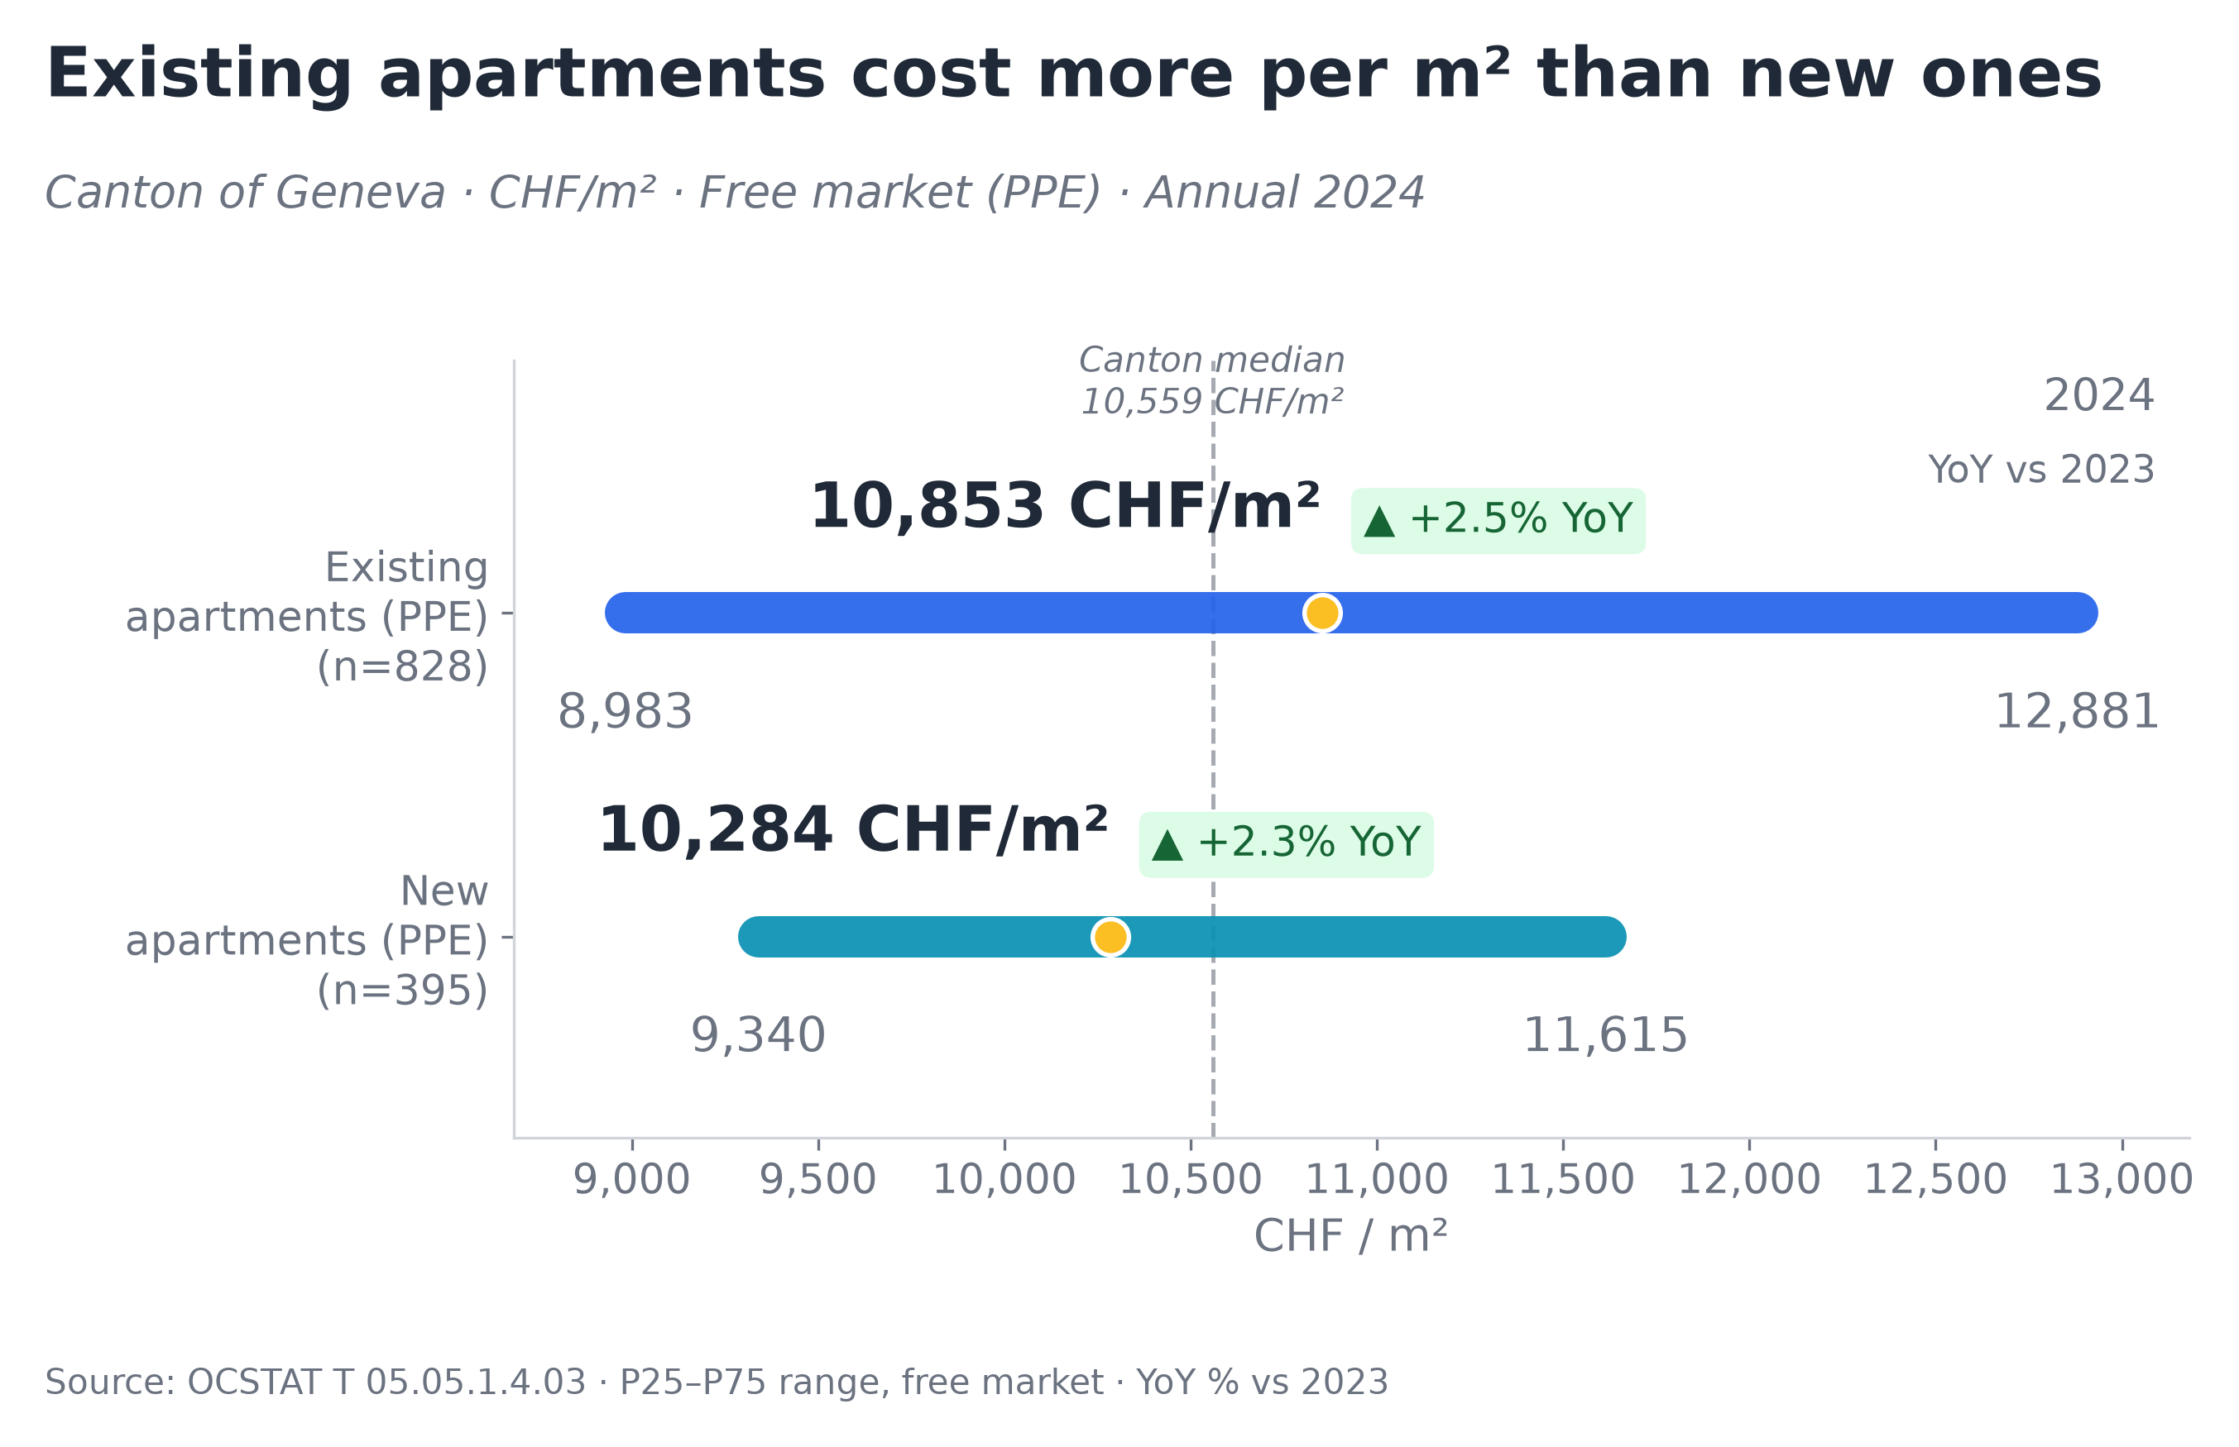
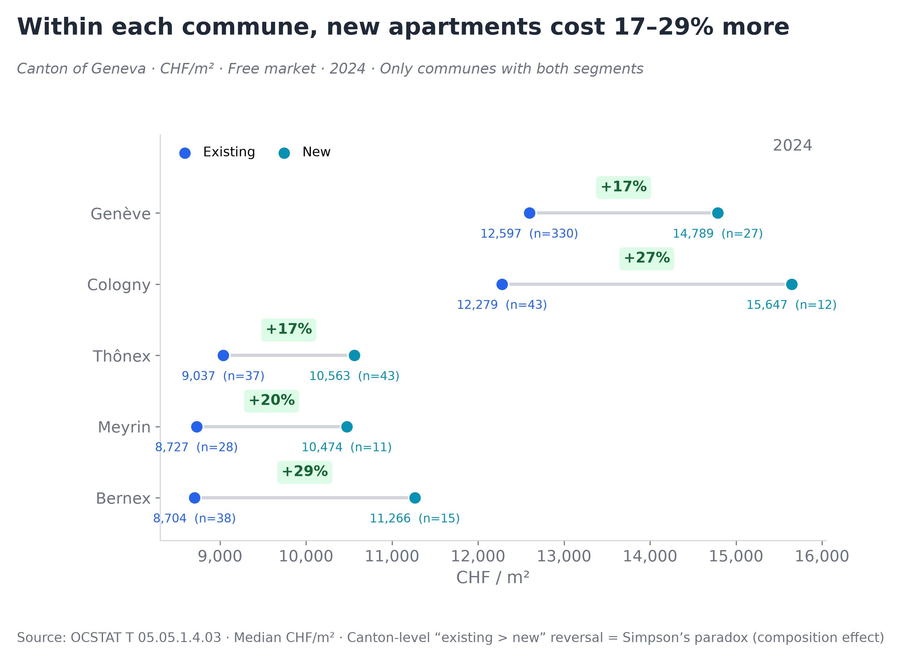
Price per m² · Canton Overview
OCSTAT · Notarial transactions · Annual 2024
Key observations
▸ Existing apartments (10,853 CHF/m²) are 5.5% more expensive than new (10,284) at canton level — counterintuitive.
▸ Secondary market is 2.1× larger: 828 existing vs 395 new transactions.
▸ Both grew ~2.4% YoY — market moves uniformly, not by segment.
▸ Existing P25–P75 range (8.9–12.9K) is 1.7× wider than new (9.3–11.6K) — more diverse locations.
Key observations
▸ Within each commune, new costs 17–29% MORE than existing — the opposite of the canton-level picture.
▸ This is a composition effect: new builds concentrate in affordable communes (Thônex, Meyrin, Bernex), while existing stock trades everywhere including premium locations.
▸ Bernex has the highest new-build premium (+29%), likely single large project at n=15.
▸ Practical: “new is cheaper” is a geographic illusion — same neighborhood, same m², new always costs more.
Source: OCSTAT T 05.05.1.4.03 · Canton of Geneva · All prices = completed notarial transactions, not listings or appraisals · CHF per square meter, free-market apartments (PPE)
Author's analysis · Raw data: OCSTAT T 05.05 series · Methodology and code: https://github.com/slviktor/geneva-real-estate-market-analysis

Slide 3
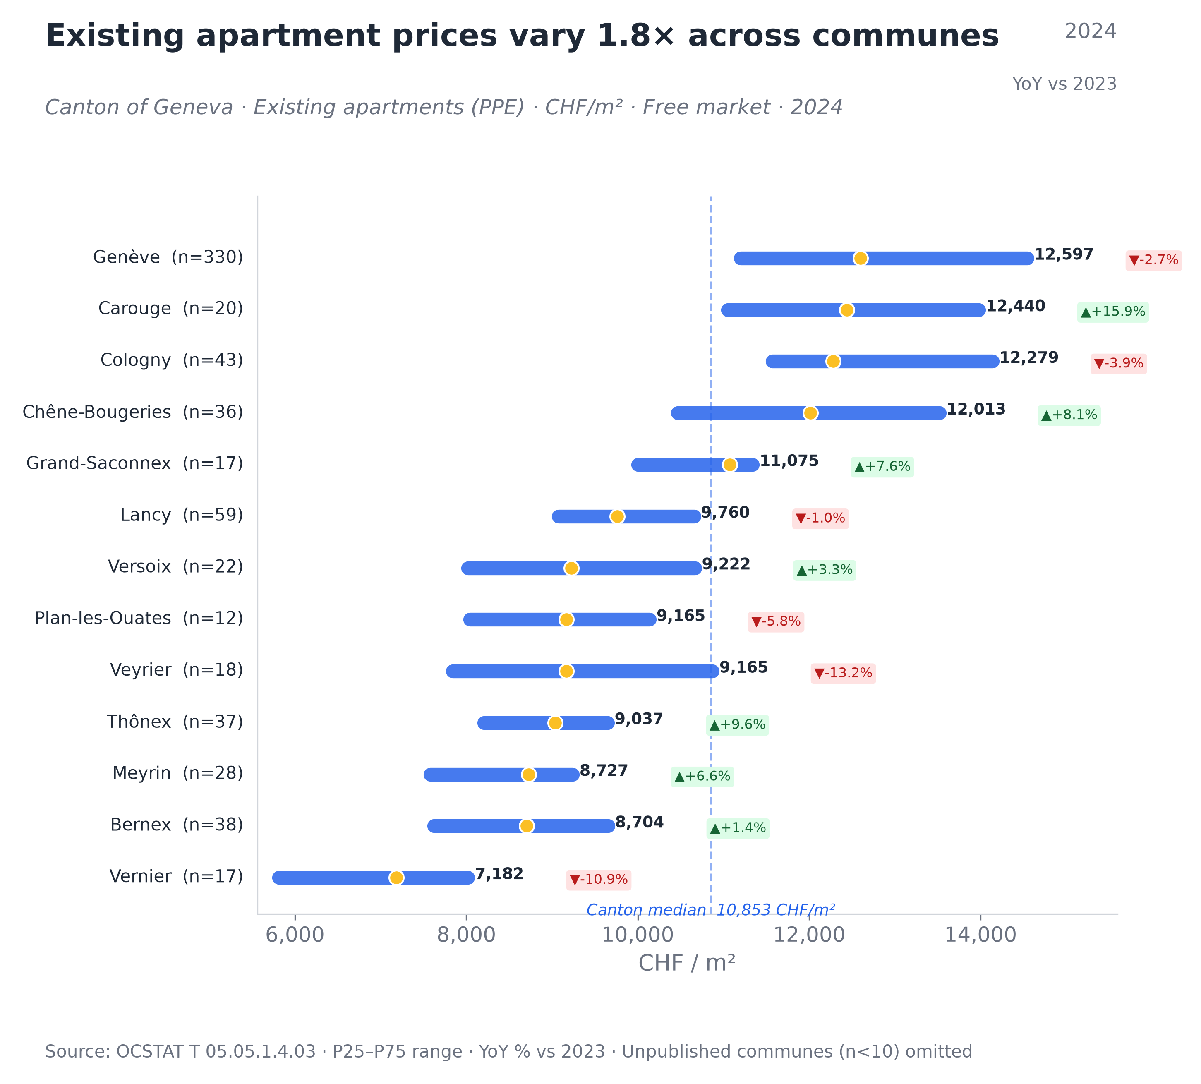
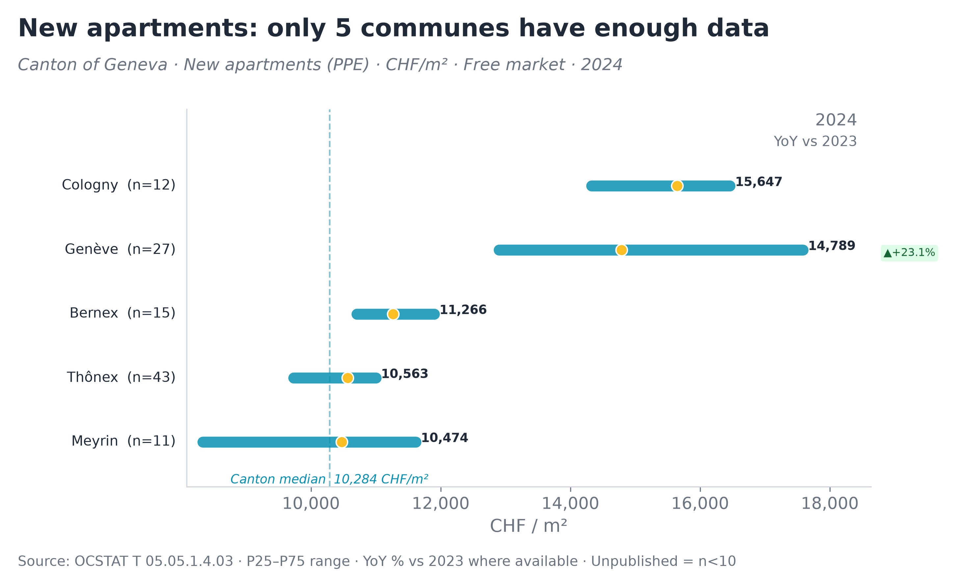
Price per m² · Communes
OCSTAT · Notarial transactions · Annual 2024
Key observations
▸ Only 5 of 45 communes have enough new-apartment data (n≥10) in 2024 — market is extremely concentrated.
▸ Two tiers: affordable (Meyrin, Thônex, Bernex at 10–11K) vs premium (Genève, Cologny at 15–16K).
▸ Genève new +23.1% YoY — not market growth but a few luxury project closings (n=27).
▸ Communes appear and disappear from the statistics each year — new-build market is structurally volatile.
Key observations
▸ 1.8× price gap: Vernier (7,182 CHF/m²) vs Genève (12,597). Same canton, 75% more living space for same budget.
▸ Only 4 communes above canton median (10,853): Genève, Carouge, Cologny, Chêne-Bougeries.
▸ Carouge: strongest growth (+15.9% YoY) among premium communes.
▸ Veyrier (−13.2%) and Plan-les-Ouates (−5.8%) declined — but at n=18 and n=12, this may be statistical noise.
Source: OCSTAT T 05.05.1.4.03 · Canton of Geneva · Unpublished communes (n<10) omitted, not zero · YoY vs 2023
Author's analysis · Raw data: OCSTAT T 05.05 series · Methodology and code: https://github.com/slviktor/geneva-real-estate-market-analysis

Slide 4
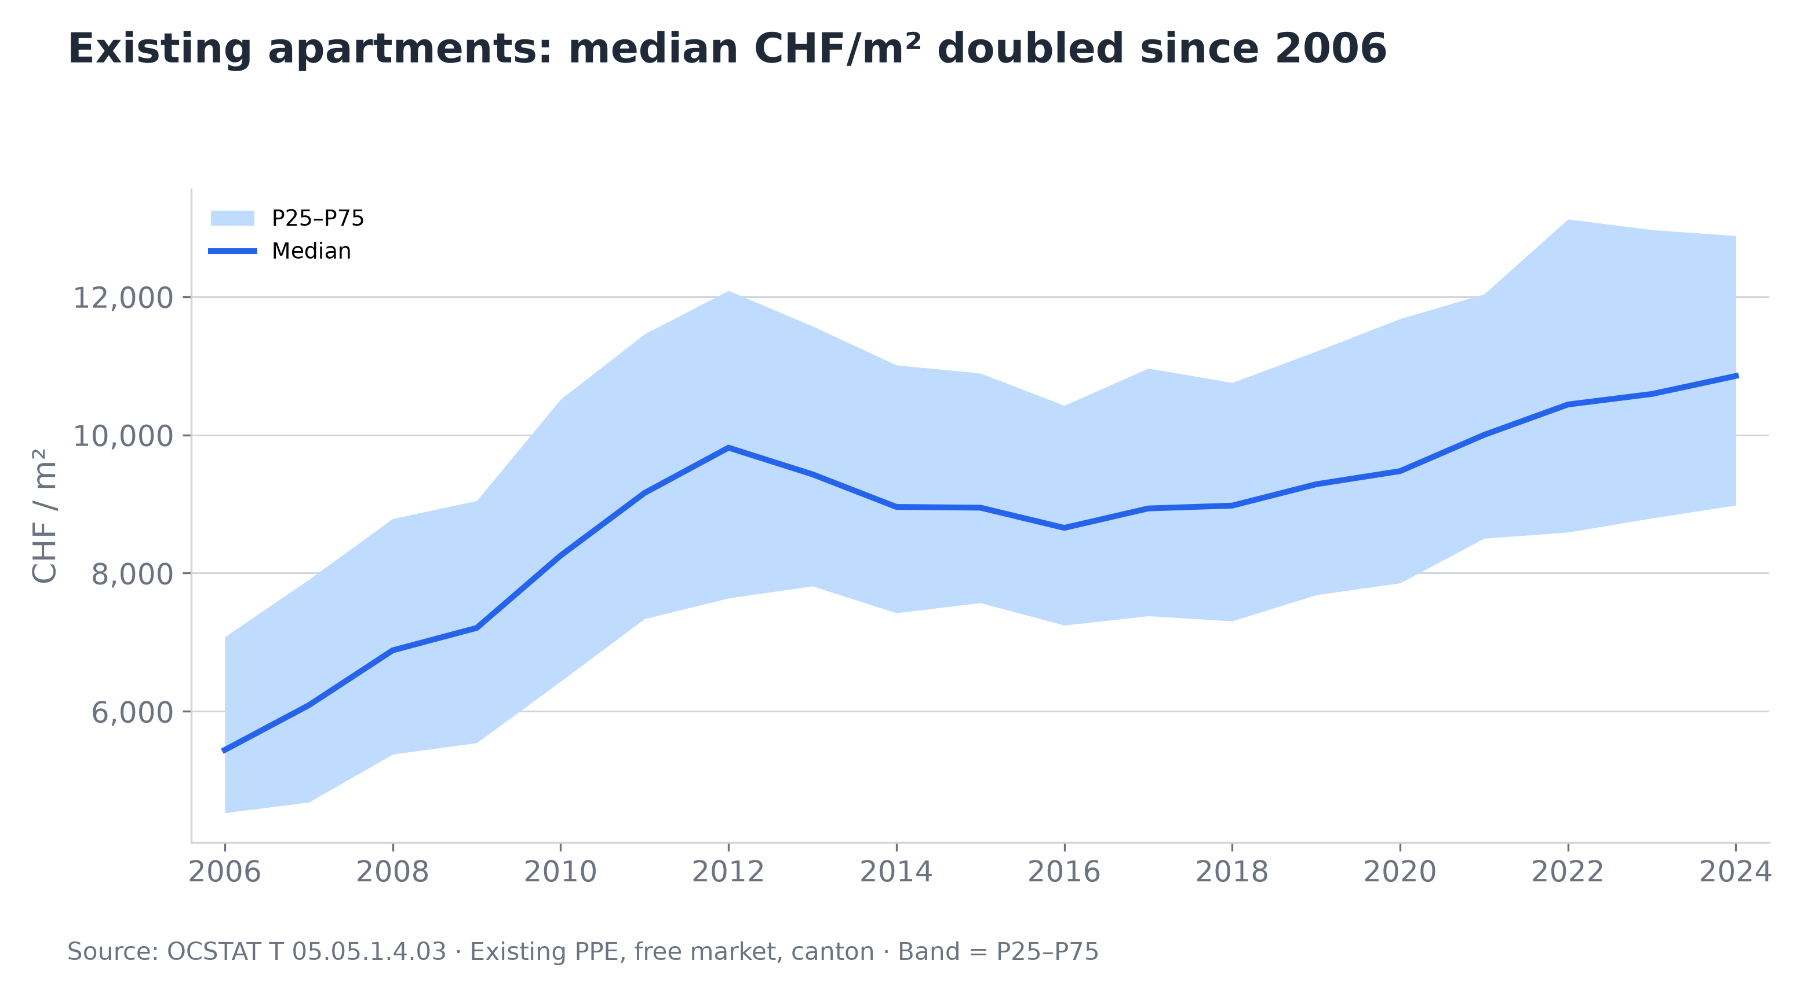
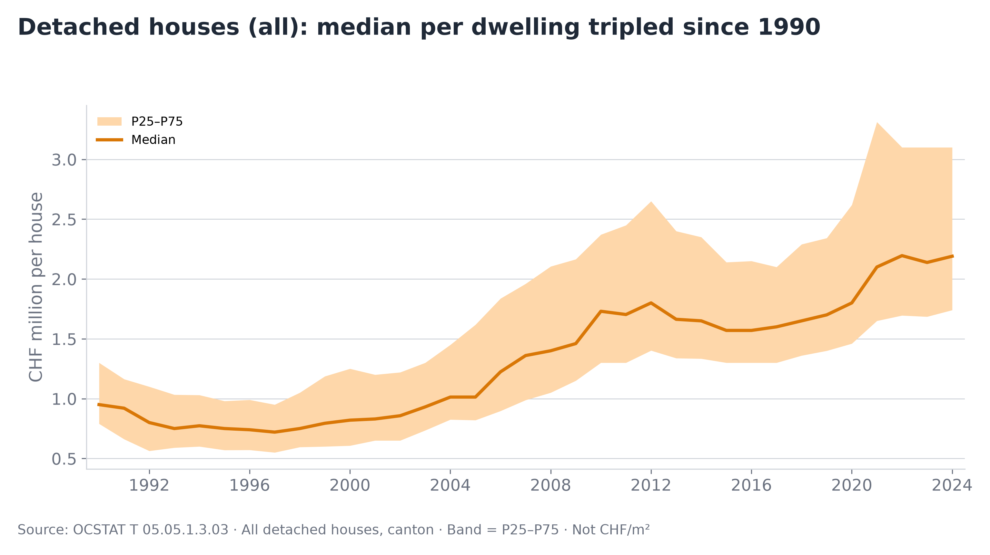
Long-term Trends · How We Got Here
OCSTAT · Canton of Geneva · Annual
Apartments (CHF/m²)
Houses (CHF per dwelling)
▸ Median roughly doubled since 2006: from ~5,300 to ~10,900 CHF/m².
▸ Fast growth 2006–2012 (+80%), then a 8-year plateau (2012–2020), followed by renewed acceleration.
▸ P25–P75 band has remained relatively stable in width — the entire distribution shifted upward, not just the top.
▸ Even during the 2012–2020 plateau, prices never fell below 2012 levels — no sustained downward correction.
▸ Median house tripled since the mid-1990s: from ~0.75M to ~2.2M CHF.
▸ 1990–2004: decade of stagnation (flat at ~0.8–1.0M). 2004–2012: sharp rally to ~1.8M.
▸ Post-2020: P25–P75 band has widened dramatically — growing divergence between affordable and premium houses.
▸ Note: OCSTAT publishes house prices per dwelling (not per m²) — not directly comparable to apartment data.
Source: OCSTAT T 05.05 · Canton of Geneva · Left: existing PPE, free market, CHF/m² · Right: detached houses, CHF per dwelling · Band = P25–P75 of transactions
Author's analysis · Raw data: OCSTAT T 05.05 series · Methodology and code: https://github.com/slviktor/geneva-real-estate-market-analysis

Slide 5
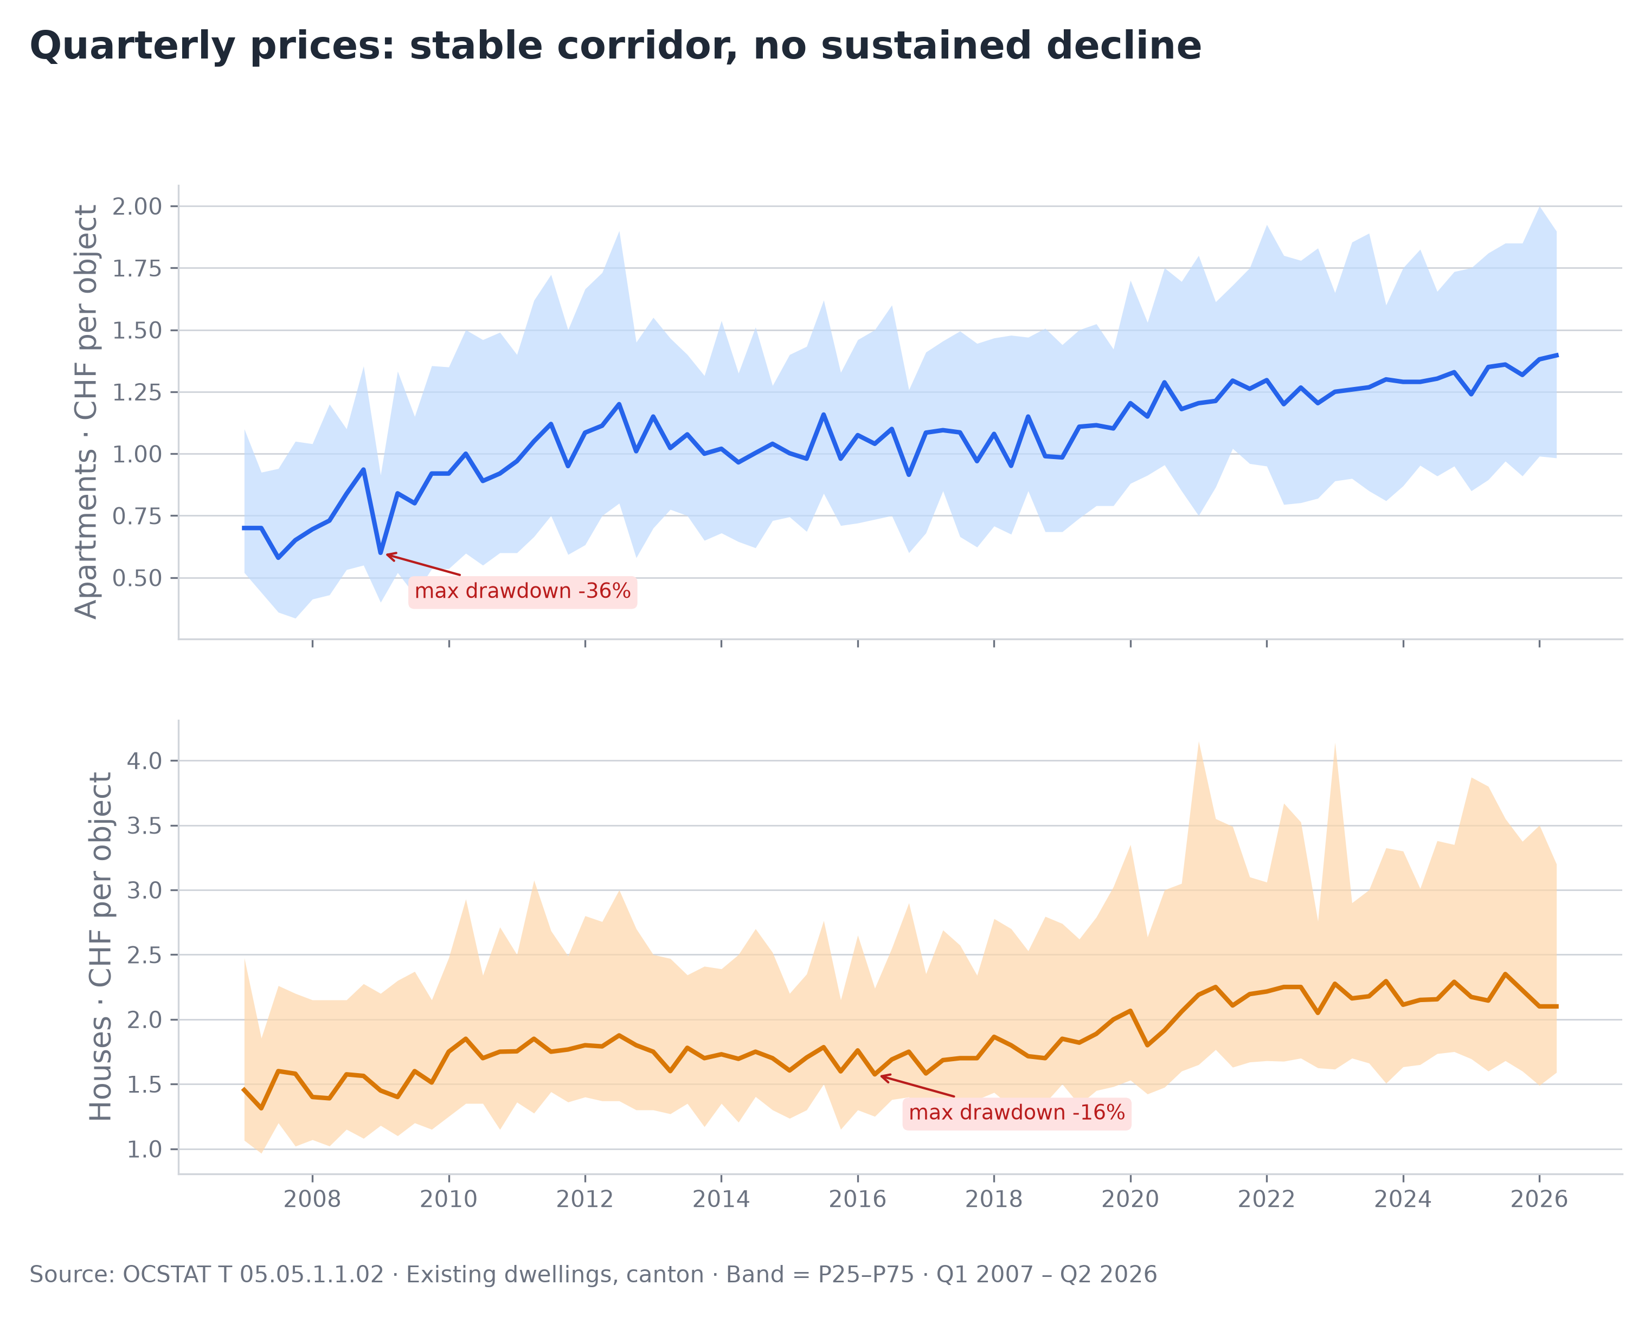
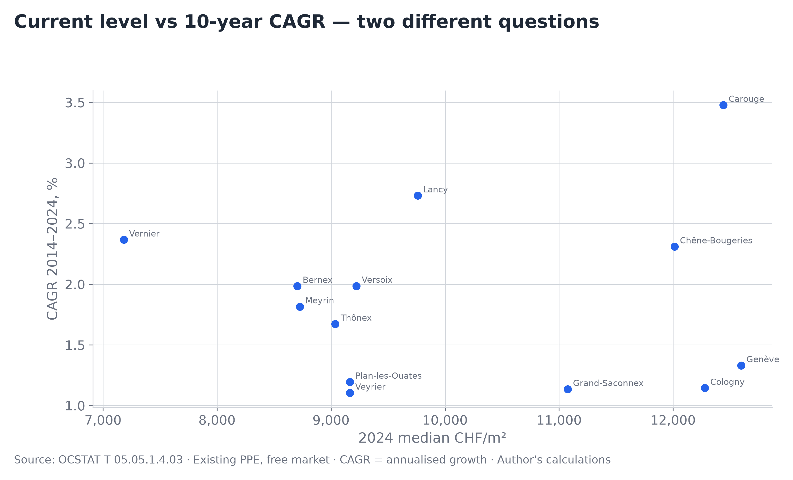
Market Resilience · Shocks & Growth by Commune
OCSTAT · Canton of Geneva · Annual
Key observations
▸ Expensive ≠ fast-growing. Cologny: 12.3K/m² but only 1.1% CAGR. Carouge: similar price, 3.5% CAGR.
▸ Vernier: cheapest (7.2K/m²) yet 2.4% CAGR over 10 years — catch-up growth from a low base.
▸ Genève city: highest absolute price (12.6K) but lowest CAGR (1.2%) — already mature, limited upside.
▸ Practical: for long-term value, look at Lancy, Vernier — not the most expensive communes.
Key observations
▸ Apartment median keeps climbing (+13% over 6 quarters to 1.40M); house median is plateauing at ~2.1M — two markets are diverging.
▸ Three macro shocks (2008, COVID, 2022 rate hikes) produced no sustained median decline — 1–2 quarters of correction at most.
▸ House P75 surged +64% in 2021–2023 (2.5M → 4.1M), then retreated — premium segment reacts, median absorbs.
▸ Apartment P75 grew modestly (+18%) — houses have a higher and more volatile ceiling.
P25 barely moves: apartments ~0.9–1.0M, houses ~1.5–1.7M — a structural price floor.
▸ House corridor (P75–P25) widened 33% since 2019; apartment corridor is stable — house market is polarizing.
Note: –36% drawdown is a composition shift (which apartments sold), not a real price drop. Annual CHF/m² shows max –12% over 4 years.
Source: OCSTAT T 05.05 · Canton of Geneva · Left: YoY % changes, annual · Right: 10-year CAGR 2014–2024, existing PPE, free market · Author’s calculations
Author's analysis · Raw data: OCSTAT T 05.05 series · Methodology and code: https://github.com/slviktor/geneva-real-estate-market-analysis

Slide 6
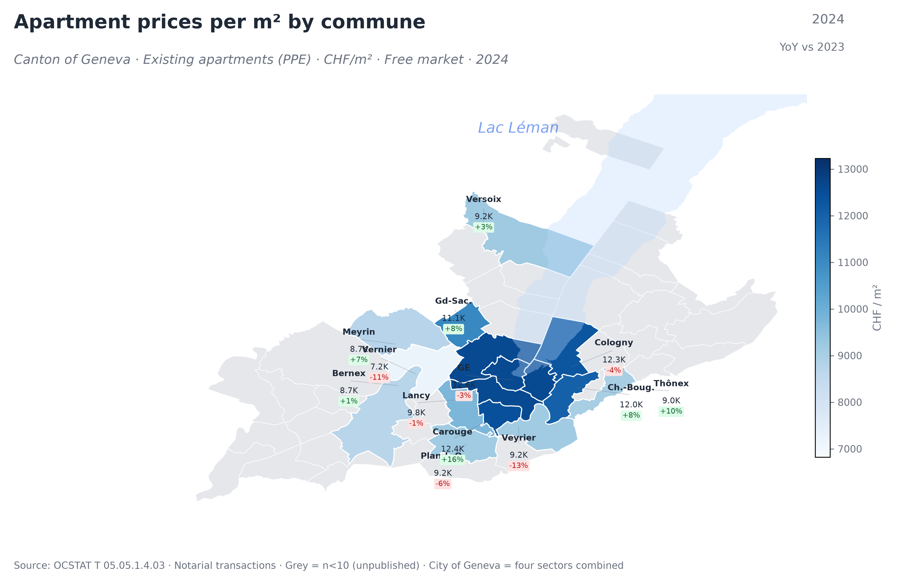
Geography · Apartment Prices per m²
OCSTAT · Existing PPE · Free market · 2024
Key observations
▸ The price gradient runs east-west: premium communes (Genève, Cologny, Chêne-Bougeries) cluster along the lake shore at 12–12.5K CHF/m².
▸ Western suburbs (Vernier, Bernex, Meyrin) offer 30–40% lower prices per m² — same canton, very different value proposition.
▸ Carouge stands out: +16% YoY with 12.4K/m² — catching up to the premium lakeside communes.
▸ Veyrier (−13%) and Vernier (−11%) declined YoY, but small sample sizes (n=18 and n=73) may explain the drop.
▸ Grey communes have fewer than 10 transactions — OCSTAT does not publish a median for them.
▸ 1.8× price range across the canton: same 60m² apartment costs 430K in Vernier vs 750K in Cologny.
Source: OCSTAT T 05.05.1.4.03 · Canton of Geneva · Notarial transactions, not listings · Grey = n<10 (unpublished) · YoY vs 2023
Author's analysis · Raw data: OCSTAT T 05.05 series · Methodology and code: https://github.com/slviktor/geneva-real-estate-market-analysis

Slide 7
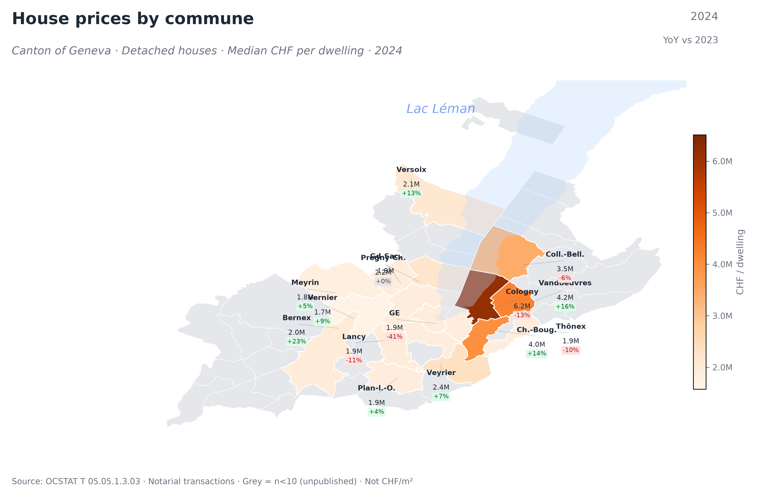
Geography · House Prices per Dwelling
OCSTAT · Detached houses · 2024
Key observations
▸ Cologny dominates at 6.2M CHF/house — 3.7× more than Vernier (1.7M). A single canton, two different markets.
▸ The premium belt along the lake (Cologny, Ch.-Bougeries, Vandoeuvres, Collonge-Bellerive) = 3.5–6.2M.
▸ Genève city: −41% YoY (1.9M) — misleading, as only n=18 transactions in the city proper. House market is suburban.
▸ Bernex: +23% YoY at 2.0M — the strongest grower among affordable suburbs.
▸ More communes publish house data (15) than apartment CHF/m² (13) — houses trade in more communes.
▸ Note: prices are per dwelling, not per m². Larger houses cost more regardless of the location premium
Source: OCSTAT T 05.05.1.3.03 · Canton of Geneva · Notarial transactions · Median CHF per dwelling (not per m²) · YoY vs 2023
Author's analysis · Raw data: OCSTAT T 05.05 series · Methodology and code: https://github.com/slviktor/geneva-real-estate-market-analysis

