Slide 1
Opinion Mining
A Short Tutorial
Kavita Ganesan
Hyun Duk Kim
Text Information Management Group
University of Illinois @ Urbana Champaign

Slide 2
Agenda
Introduction
Application Areas
Sub-fields of Opinion Mining
Some Basics
Opinion Mining Work
  Sentiment Classification
  Opinion Retrieval

Slide 3
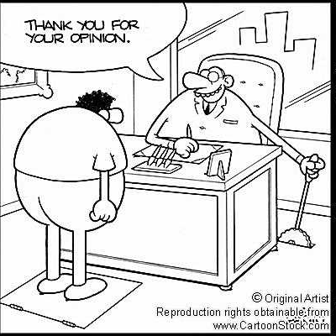
“What people think?”
What others think has always been an important piece of information
“Which car should I buy?”
“Which schools should I
apply to?”
“Which Professor to work for?”
“Whom should I vote for?”

Slide 4


“So whom shall I ask?”
Pre Web
  Friends and relatives
  Acquaintances
  Consumer Reports
Post Web
“…I don’t know who..but apparently it’s a good phone. It has good battery life and…”
  Blogs (google blogs, livejournal)
  E-commerce sites (amazon, ebay)
  Review sites (CNET, PC Magazine)
  Discussion forums (forums.craigslist.org,
  forums.macrumors.com)
  Friends and Relatives (occasionally)

Slide 5
“Whoala! I have the reviews I need”
Now that I have “too much” information on one
topic…I could easily form my opinion and make
decisions…
  Is this true?

Slide 6


…Not Quite
Searching for reviews may be difficult
  Can you search for opinions as conveniently
  as general Web search?
  eg: is it easy to search for “iPhone vs Google Phone”?
Overwhelming amounts of information on one topic
  Difficult to analyze each and every review
  Reviews are expressed in different ways
    “the google phone is a disappointment….”
    “don’t waste your money on the g-phone….”
    “google phone is great but I expected more in terms of…”
    “…bought google phone thinking that it would be useful but…”

Slide 7

“Let me look at reviews on one site only…”
Problems?
  Biased views
    all reviewers on one site may have the same opinion
  Fake reviews/Spam (sites like YellowPages, CitySearch are prone to this)
    people post good reviews about their own product OR services
    some posts are plain spams

Slide 8

Coincidence or Fake?
Reviews for a moving
company from YellowPages
# of merchants
reviewed by the each of
these reviewers ➔ 1
Review dates close
to one another
All rated 5 star
Reviewers seem to know
exact names of people
working in the company and
TOO many positive mentions

Slide 9
So where does all of this lead to?

Slide 10
Heard of these terms?
Subjectivity Analysis
Review Mining
Appraisal Extraction
Sentiment Analysis
Opinion Mining
Synonymous
&
Interchangeably Used!

Slide 11
So, what is Subjectivity?
The linguistic expression of somebody’s opinions, sentiments, emotions…..(private states)
private state: state that is not open to objective verification (Quirk, Greenbaum, Leech, Svartvik (1985). A Comprehensive Grammar of the English Language.)
Subjectivity analysis - is the computational study of affect, opinions, and sentiments expressed in text
  blogs
  editorials
  reviews (of products, movies, books, etc.)
  newspaper articles

Slide 12
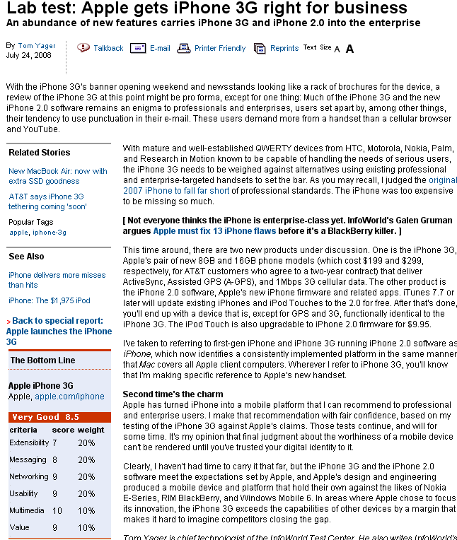
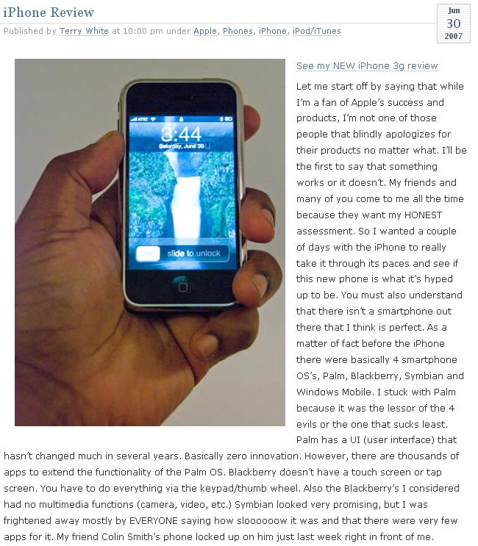
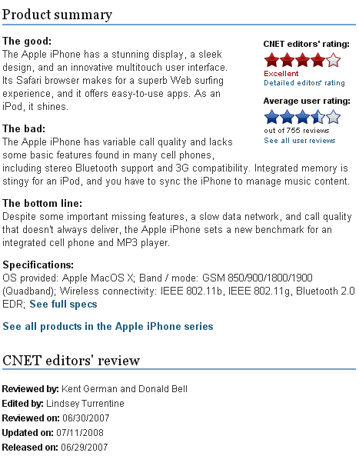
Example: iPhone review
Review posted on a tech blog
InfoWorld
-summary is structured
-everything else is plain text
-mixture of objective and
subjective information
-no separation between
positives and negatives
CNET
-nice structure
-positives and negatives
separated
Tech BLOG
-everything is plain text
-no separation between
positives and negatives
Review on InfoWorld - tech news site
CNET review

Slide 13
Example: iPhone review
Review posted on a tech blog
Review on InfoWorld - tech news site
CNET review

Slide 14
Subjectivity Analysis on iPhone Reviews
Individual’s Perspective
Highlight of what is good and bad about iPhone
  Ex. Tech blog may contain mixture of information
Combination of good and bad from the different sites (tech blog, InfoWorld and CNET)
  Complementing information
  Contrasting opinions
  Ex.
    CNET: The iPhone lacks some basic features
    Tech Blog: The iPhone has a complete set of features

Slide 15

Subjectivity Analysis on iPhone Reviews
Business’ Perspective
Apple: What do consumers think about iPhone?
  Do they like it?
  What do they dislike?
  What are the major complaints?
  What features should we add?
Apple’s competitor:
  What are iPhone’s weaknesses?
  How can we compete with them?
  Do people like everything about it?
Known as Business
Intelligence

Slide 16
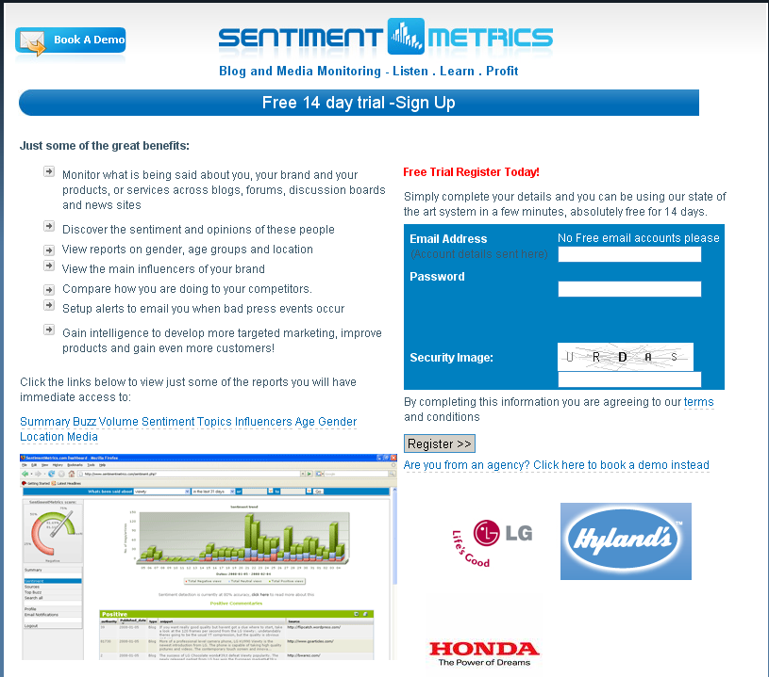
Business Intelligence Software
Opinion Trend (temporal) ?
Sentiments for a given product/brand/services

Slide 17
Other examples
Blog Search http://www.blogsearchengine.com/blog-search/?q=obama&action=Search
Forum Search
http://www.boardtracker.com/

Slide 18
Application Areas Summarized
Businesses and organizations: interested in opinions
  product and service benchmarking
  market intelligence
  survey on a topic
Individuals: interested in other’s opinions when
  Purchasing a product
  Using a service
  Tracking political topics
  Other decision making tasks
Ads placements: Placing ads in user-generated content
  Place an ad when one praises an product
  Place an ad from a competitor if one criticizes a product
Opinion search: providing general search for opinions

Slide 19
Opinion Mining – The Big Picture
Opinion Mining
Opinion Retrieval
Opinion Question Answering
IR
IR
use one or combination
Sentence Level
Sentiment Classification
Document Level
Comparative mining
Feature Level
Opinion Integration
Direct Opinions
Opinion Spam/Trustworthiness

Slide 20

Some basics…
Basic components of an opinion
  1. Opinion holder: The person or organization that holds a specific opinion on a particular object
  2. Object: item on which an opinion is expressed
  3. Opinion: a view, attitude, or appraisal on an object from an opinion holder.
This is a great
book
Opinion
Opinion Holder
Object

Slide 21
Some basics…
Two types of evaluations
Direct opinions
    “This car has poor mileage”
  Comparisons
      “The Toyota Corolla is not as good as Honda Civic”
  They use different language constructs
  Direct opinions are easier to work with but comparisons may be more insightful

Slide 22
An Overview of the Sub Fields
Classify sentence/document/feature
based on sentiments expressed by
authors
➔positive, negative, neutral
Sentiment Classification
Identify comparative sentences & extract
comparative relations
Comparative sentence:
“Canon’s picture quality is better than that of
Sony and Nikon”
Comparative relation:
(better, [picture quality], [Canon], [Sony, Nikon])
Comparative mining
relation
feature
entity1
entity2

Slide 23
An Overview of the Sub Fields
Automatically integrate opinions
from different sources such as
expert review sites, blogs and
forums
Opinion Integration
Try to determine likelihood of spam in
opinion and also determine authority
of opinion
Ex. of Untrustworthy opinions:
  Repetition of reviews
  Misleading “positive” opinion
  High concentration of certain words
Opinion Spam/Trustworthiness
Analogous to document retrieval process
Requires documents to be retrieved and ranked according to opinions about a topic
A relevant document must satisfy the following criteria:
  relevant to the query topic
  contains opinions about the query
Opinion Retrieval

Slide 24
An Overview of the Sub Fields
Similar to opinion retrieval task, only that
instead of returning a set of opinions,
answers have to be a summary of those
opinions and format has to be in “natural
language” form
Ex.
Q: What is the international reaction to the reelection of Robert Mugabe as president of Zimbabwe?
A: African observers generally approved of
his victory while Western Governments
strongly denounced it.
Opinion Question Answering

Slide 25
Agenda
Introduction
Application Areas
Sub-fields of Opinion Mining
Some Basics
Opinion Mining Work
  Sentiment Classification
  Opinion Retrieval

Slide 26
Where to find details of previous work?
  “Web Data Mining” Book, Bing Liu, 2007
  “Opinion Mining and Sentiment Analysis” Book, Bo Pang and Lillian Lee, 2008

Slide 27
What is Sentiment Classification?
Classify sentences/documents (e.g. reviews)/features based on the overall sentiments expressed by authors
  positive, negative and (possibly) neutral
Similar to topic-based text classification
  Topic-based classification: topic words are important
  Sentiment classification: sentiment words are more important (e.g: great, excellent, horrible, bad, worst)

Slide 28
Sentiment Classification
A. Sentence Level Classification
  Assumption: a sentence contains only one opinion (not true in many cases)
  Task 1: identify if sentence is opinionated
  classes: objective and subjective (opinionated)
  Task 2: determine polarity of sentence
classes: positive, negative and neutral
Quiz:
“This is a beautiful bracelet..”
Is this sentence subjective/objective?
Is it positive, negative or neutral?

Slide 29
Sentiment Classification
B. Document(post/review) Level Classification
  Assumption:
    each document focuses on a single object (not true in many cases)
    contains opinion from a single opinion holder (not true in many cases)
  Task: determine overall sentiment orientation in document
    classes: positive, negative and neutral

Slide 30
Sentiment Classification
C. Feature Level Classification
Goal: produce a feature-based opinion summary of multiple reviews
  Task 1: Identify and extract object features that have been commented on by an opinion holder (e.g. “picture”,“battery life”).
  Task 2: Determine polarity of opinions on features
  classes: positive, negative and neutral
  Task 3: Group feature synonyms

Slide 31
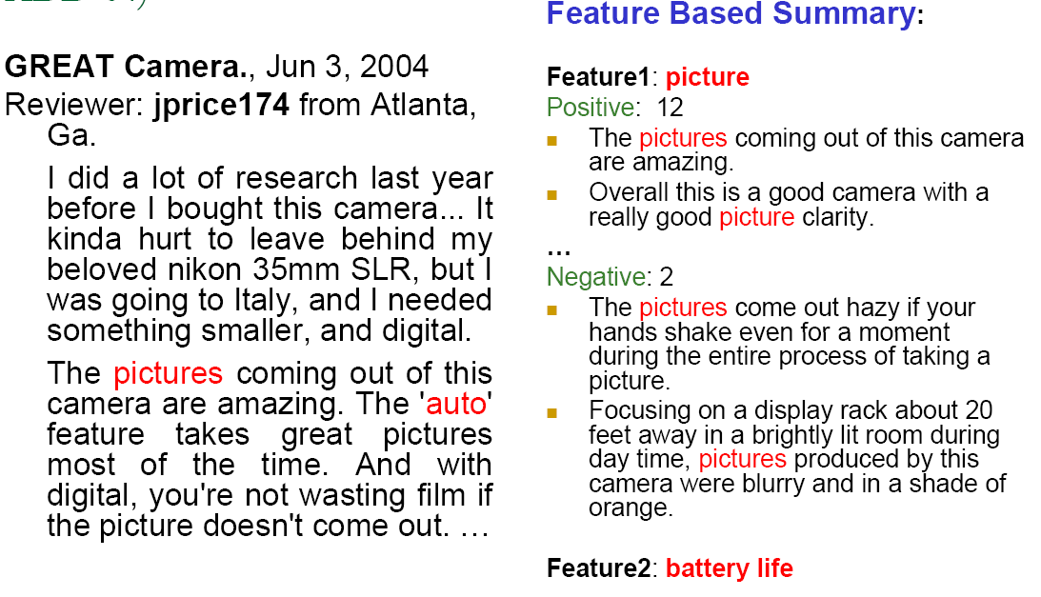
Example: Feature Level Classification – Camera Review

Slide 32
Sentiment Classification
In summary, approaches used in sentiment classification
  Unsupervised – eg: NLP pattern @ NLP patterns with lexicon
  Supervised – eg: SVM, Naive Bayes..etc (with varying features like POS tags, word phrases)
  Semi Supervised – eg: lexicon+classifier
Based on previous work, four features generally used
  a. Syntactic features
  b. Semantic features
  c. Link-based features
  d. Stylistic features
Semantic & Syntactic features are most commonly used

Slide 33
Sentiment Classification
Features Usually Considered
A. Syntatic Features
What is syntactic feature? - Usage of principles and rules for constructing sentences in natural languages [wikipedia]
Different usage of syntactic features:
POS+punctuation [Pang et al. 2002; Gamon 2004] | POS Pattern [Nasukawa and Yi 2003; Yi et al. 2003; Fei et al. 2004; Wiebe et al 2004] | Modifiers Whitelaw et al. [2005]
>> POS (part-of-speech) tags & punctuation ➔eg: a sentence containing an adjective and “!” could indicate existence of an opinion “the book is great !” | >>POS n-gram patterns ➔patterns like “n+aj” (noun followed by +ve adjective) - represents positive sentiment ➔patterns like “n+dj” (noun followed by -ve adjective) - express negative sentiment | >> Used a set of modifier features (e.g., very, mostly, not) ➔ the presence of these features indicate the presence of appraisal “the book is not great” “..this camera is very handy”

Slide 34
Sentiment Classification
Features Usually Considered
B. Semantic Features
Leverage meaning of words
Can be done manually/semi/fully automatically
Score Based - Turney [2002] | Lexicon Based - Whitelaw et al. [2005]
Use PMI calculation to compute the SO score for each word/phrase Idea: If a phrase has better association with the word “Excellent” than with “Poor” it is positively oriented and vice versa Score computation: PMI (phrase ^ “excellent”) – PMI (phrase ^ “poor”) PMI- is a measure of association used in information theory. The PMI of a pair of x and y belonging to discrete random variables quantifies the discrepancy between the probability of their coincidence given their joint distribution versus the probability of their coincidence given only their individual distributions and assuming independence. | Use appraisal groups for assigning semantics to words/phrases Each phrase/word is manually classified into various appraisal classes (eg: deny, endorse, affirm)

Slide 35
Sentiment Classification
Features Usually Considered
C. Link-Based Features
  Use link/citation analysis to determine sentiments of documents
  Efron [2004] found that opinion Web pages heavily linking to each other often share similar sentiments
  Not a popular approach
D. Stylistic Features
  Incorporate stylometric/authorship studies into sentiment classification
  Style markers have been shown highly prevalent in Web discourse [Abbasi and Chen 2005; Zheng et al. 2006; Schler et al. 2006]
  Ex. Study the blog authorship style of “Students vs Professors”
Authorship Style of Students | Authorship Style of Professors
Colloquial@spoken style of writing | Formal way of writing
Improper punctuation | Proper punctuation
More usage of curse words & abbreviations | Limited curse words & abbreviation

Slide 36
Sentiment Classification – Recent Work
Abbasi, Chen & Salem (TOIS-08)
Propose:
  sentiment analysis of web forum opinions in multiple languages (English and Arabic)
Motivation:
  Limited work on sentiment analysis on Web forums
  Most studies have focused on sentiment classification of a single language
  Almost no usage of stylistic feature categories
  Little emphasis has been placed on feature reduction/selection techniques
New:
  Usage of stylistic and syntactic features of English and Arabic
  Introduced new feature selection algorithm: entropy weighted genetic algorithm (EWGA)
    EWGA outperforms no feature selection baseline, GA and Information Gain
Results, using SVM indicate a high level of classification accuracy

Slide 37
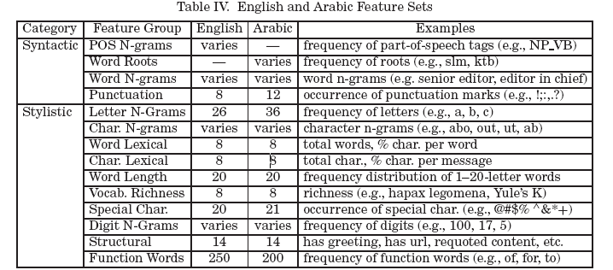
Sentiment Classification – Recent Work
Abbasi, Chen & Salem (TOIS-08)

Slide 38
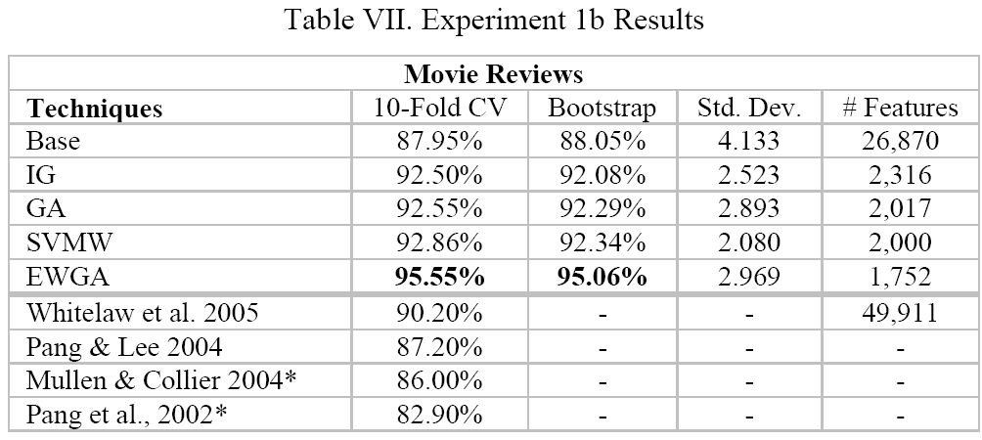
Sentiment Classification – Recent Work
Abbasi, Chen & Salem (TOIS-08)

Slide 39
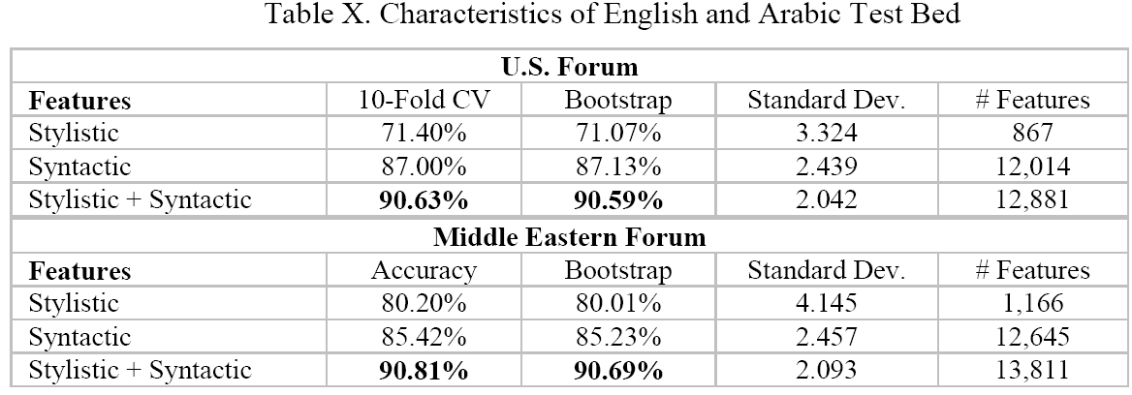
Sentiment Classification – Recent Work
Abbasi, Chen & Salem (TOIS-08)

Slide 40
Sentiment Classification – Recent Work
Blitzer et al. (ACL 2007)
Propose:
  Method for domain adaptation for sentiment classifiers (ML based) focusing on online reviews for different types of products
Motivation:
  Sentiments are expressed differently in different domains - annotating corpora for every domain is impractical
  If you train on the “kitchen” domain and classify on “book” domain ➔ error increases
New:
  Extend structural correspondence learning algorithm (SCL) to sentiment classification area
Key Idea:
  If two topics/sentences from different domains have high correlation on unlabeled data, then we can tentatively align them
Achieved 46% improvement over a supervised baseline for sentiment classification

Slide 41
Sentiment Classification – Recent Work
Blitzer et al. (ACL 2007)
Unlabeled kitchen contexts
Unlabeled books contexts
Do not buy the Shark portable steamer …. Trigger mechanism is defective.
the very nice lady assured me that I must have a defective set …. What a disappointment!
Maybe mine was defective …. The directions were unclear
The book is so repetitive that I found myself yelling …. I will definitely not buy another.
A disappointment …. Ender was talked about for <#> pages altogether.
it’s unclear …. It’s repetitive and boring
Aligning sentiments from different domains

Slide 42

Sentiment Classification - Summary
Relatively focused & widely researched area
  NLP groups
  IR groups
  Machine Learning groups (e.g., domain adaptation)
Important because:
  With the wealth of information out on the web, we need an easy way to know what people think about a certain “topic” – e.g., products, political issues, etc
Heuristics generally used:
  Occurrences of words
  Phrase patterns
  Punctuation
  POS tags/POS n-gram patterns
  Popularity of opinion pages
  Authorship style

Slide 43
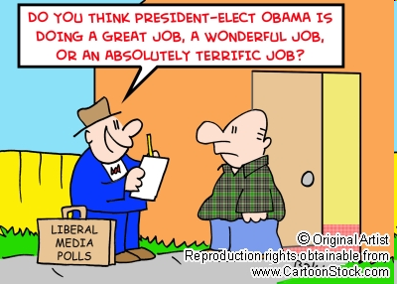
Quiz
Can you think of other heuristics to
determine the polarity of subjective
(opinionated) sentences?

Slide 44

Opinion Retrieval
Is the task of retrieving documents according to topic and ranking them according to opinions about the topic
Important when you need people’s opinion on certain topic or need to make a decision, based on opinions from others
General Search | Opinion Search
search for facts | search for opinions/opinionated topics
rank pages according to some authority and relevance scores | Rank is based on relevance to topic and content of opinion

Slide 45
Opinion Retrieval
“Opinion retrieval” started with the work of Hurst and Nigam (2004)
  Key Idea: Fuse together topicality and polarity judgment ➔ “opinion retrieval”
  Motivation: To enable IR systems to select content based on a certain opinion about a certain topic
  Method:
    Topicality judgment: statistical machine learning classifier (Winnow)
    Polarity judgment: shallow NLP techniques (lexicon based)
  No notion of ranking strategy

Slide 46
Opinion Retrieval
Summary of TREC Blog Track (2006 – 2008)
TREC 2006 Blog Track | TREC 2007 Blog Track | TREC 2008 Blog Track
Opinion Retrieval | Same as 2006 with 2 new tasks: -blog distillation (feed search) -polarity determination | Same as 2006 and 2007 with 1 new task: -Baseline blog post retrieval task (i.e. “Find me blog posts about X.”)

Slide 47
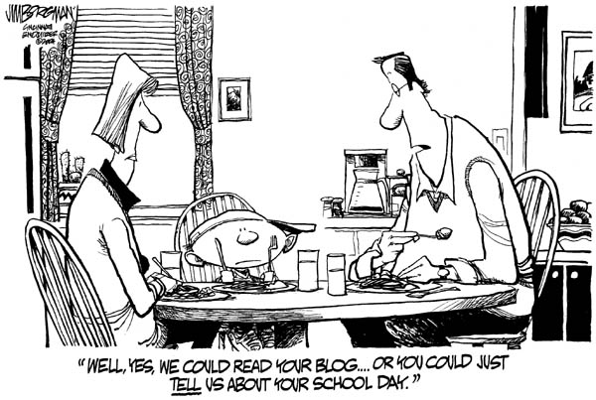
Notes:
Lets give this a slight twist… lets say the kid finished dinner and has gone to watch some TV..
My editing skills at work..

Slide 48
Opinion Retrieval
Summary of TREC-2006 Blog Track [6]
TREC-2006 Blog Track – Focus is on Opinion Retrieval
  14 participants
  Baseline System
    A standard IR system without any opinion finding layer
  Most participants use a 2 stage approach
Query
standard retrieval &
ranking scheme
Ranked
documents
STAGE 1
    -tf*idf
    -language model
    -probabilistic
opinion related
re-ranking/filter
Ranked
opinionated
documents
STAGE 2
  -dictionary based
  -text classification
  -linguistics

Slide 49

Opinion Retrieval
Summary of TREC-2006 Blog Track [6]
TREC-2006 Blog Track
  The two stage approach
    First stage
    documents are ranked based on topical relevance
    mostly off-the-shelf retrieval systems and weighting models
      TF*IDF ranking scheme
      language modeling approaches
      probabilistic approaches.
    Second stage
    results re-ranked or filtered by applying one or more heuristics for detecting opinions
    Most approaches use linear combination of relevance score and opinion score to rank documents. eg:
      α and β are combination parameters

Slide 50
Opinion Retrieval
Summary of TREC-2006 Blog Track [6]
Opinion detection approaches used:
  Lexicon-based approach [2,3,4,5]:
    (a) Some used frequency of certain terms to rank documents
    (b) Some combined terms from (a) with information about the
      distance between sentiment words &
      occurrence of query words in the document
      Ex:
      Query: “Barack Obama”
      Sentiment Terms: great, good, perfect, terrific…
      Document: “Obama is a great leader….”
    success of lexicon based approach varied
..of greatest quality………… ……nice…….
wonderful………good battery life…

Slide 51
Opinion Retrieval
Summary of TREC-2006 Blog Track [6]
Opinion detection approaches used:
  Text classification approach:
    training data:
      sources known to contain opinionated content (eg: product reviews)
      sources assumed to contain little opinionated content (eg:news, encyclopedia)
    classifier preference: Support Vector Machines
    Features (discussed in sentiment classification section):
      n-grams of words– eg: beautiful/<ww>, the/worst, love/it
      part-of-speech tags
    Success of this approach was limited
      Due to differences between training data and actual opinionated content in blog posts
  Shallow linguistic approach:
    frequency of pronouns (eg: I, you, she) or adjectives (eg: great, tall, nice) as indicators of opinionated content
    success of this approach was also limited

Slide 52
Opinion Retrieval
Highlight: Gilad Mishne (TREC 2006)
Gilad Mishne (TREC 2006)
  Propose: multiple ranking strategies for opinion retrieval in blogs
  Introduced 3 aspects to opinion retrieval
    topical relevance
      degree to which the post deals with the given topic
    opinion expression
      given a “topically-relevant” blog post, to what degree it contains subjective (opinionated) information about it
    post quality
      estimate of the quality of a “blog post”
      assumption - higher-quality posts are likely to contain meaningful opinions

Slide 53
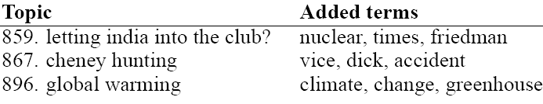
Opinion Retrieval
Highlight: Gilad Mishne (TREC 2006)
Step 1: Is blog post Relevant to Topic?
add terms to original query by comparing language model of top-retrieved docs ➔ entire collection
limited to 3 terms
blind relevance
feedback [9]
Query
language
modeling
based retrieval
Topic relevance
improvements
term proximity
[10,11]
every word n-gram from the query treated as a phrase
Ranked
documents
temporal
properties
determine if query is looking for recent posts
boost scores of posts published close to time of the query date

Slide 54



Opinion Retrieval
Highlight: Gilad Mishne (TREC 2006)
Step 2: Is blog post Opinionated?
Lexicon-based method- using GeneralInquirer
GeneralInquirer
  large-scale, manually-constructed lexicon
  assigns a wide range of categories to more than 10,000 English words
Example of word categories :
  emotional category: pleasure, pain, feel, arousal, regret
  pronoun category: self, our, and you;
“The meaning of a word is its use in the language” - Ludwig Wittgenstein (1958)

Slide 55
Opinion Retrieval
Highlight: Gilad Mishne (TREC 2006)
Step 2: Is blog post Opinionated?
For each post calculate two sentiment related values known as
“opinion level”
Extract “topical sentences” from post to count the opinion-bearing words in it
Topical sentences:
>sentences relevant to topic
>sentences immediately
surrounding them
“post opinion” level
Blog post
Calculate opinion
level
“feed opinion” level
Idea:
Feeds containing a fair amount of opinions are more likely to express an opinion in any of its posts
Method:
> use entire feed to which the post
belongs
> topic-independent score per feed estimates the degree to which it contains opinions (about any topic)
(# of occurrences of
words from any of “opinion indicating” categories )
total # of words

Slide 56
Opinion Retrieval
Highlight: Gilad Mishne (TREC 2006)
Step 3: Is the blog post of good quality?
  A. Authority of blog post: Link-based Authority
    Estimates authority of documents using analysis of the link structure
    Key Idea:
      placing a link to a page other than your own is like “recommending” that page
      similar to document citation in the academic world
    Follow Upstill et al (ADCS 2003) - inbound link
    degree (indegree) as an approximation
      captures how many links there are to a page
    Post’s authority estimation is based on:
      Indegree of a post p & indegree of post p’s feed
Site A
Site B
Blog
Post P
Site C
Authority=Log(indegree=3)

Slide 57
Opinion Retrieval
Highlight: Gilad Mishne (TREC 2006)]
Step 3: Is the blog post of good quality?
  B. Spam Likelihood
    Method 1: machine-learning approach - SVM
    Method 2: text-level compressibility - Ntoulas et al (WWW 2006)
      Determine: How likely is post P from feed F a SPAM entry?
      Intuition: Many spam blogs use “keyword stuffing”
        High concentration of certain words
        Words are repeated hundreds of times in the same post and across feed
        When you detect spam post and compress them ➔ high compression ratios for these feeds
        Higher the compression ratio for feed F, more likely that post P is splog (Spam Blog)
      comp. ratio=(size of uncompressed pg.) / (size of compressed pg.)
  Final spam likelihood estimate:
(SVM prediction) * (compressibility prediction)

Slide 58
Opinion Retrieval
Highlight: Gilad Mishne (TREC 2006)
term proximity
query [10,11]
Step 4: Linear Model
Combination
1.Topic relevance
language model
blind relevance
feedback [9]
top
1000
posts
temporal
properties
link based
authority [12]
“post opinion”
level
3.Post Quality
2.Opinion level
spam likelihood
[13]
“feed opinion”
level
partial “post quality”
scores
partial “opinion level”
scores
4. Weighted linear
combination
of scores
final scores
ranked
opinionated
posts

Slide 59
Opinion Retrieval
Summary of TREC-2008 Blog Track
Opinion Retrieval & Sentiment Classification
  Basic techniques are similar – classification vs. lexicon
  More use of external information source
    Traditional source: WordNet, SentiWordNet
    New source: Wikipedia, Google search result, Amazon, Opinion web sites (Epinions.com, Rateitall.com)

Slide 60
Opinion Retrieval
Summary of TREC-2008 Blog Track
Retrieve ‘good’ blog posts
  Expert search techniques
    Limit search space by joining data by criteria
    Used characteristics: number of comments, post length, the posting time
    -> estimate strength of association between a post and a blog.
  Use of folksonomies
    Folksonomy: collaborative tagging, social indexing.
      User generating taxonomy
      Creating and managing tagging.
    Showed limited performance improvement

Slide 61
Opinion Retrieval
Summary of TREC-2008 Blog Track
Retrieve ‘good’ blog posts
  Temporal evidence
    Some investigated use of temporal span and temporal dispersion.
    Recurring interest, new post.
  Blog relevancy approach
    Assumption:
      A blog that has many relevant posts is more relevant.
      The top N posts best represent the topic of the blog
    Compute two scores to score a given blog.
      The first score is the average score of all posts in the blog
      The second score is the average score of the top N posts that have the highest relevance scores.
    Topic relevance score of each post is calculated using a language modeling approach.

Slide 62
Opinion Retrieval – Recent Work
He et al (CIKM-08)
Motivation:
  Current methods require manual effort or external resources for opinion detection
Propose:
  Dictionary based statistical approach - automatically derive evidence of subjectivity
    Automatic dictionary generation – remove too frequent or few terms with skewed query model
    assign weights – how opinionated. divergence from randomness (DFR)
      For term w, divergence D(opREl) from D(Rel)
      ( Retrieved Doc = Rel + nonRel. Rel = opRel + nonOpRel )
    assign opinion score to each document using top weighted terms
    Linear combine opinion score with initial relevance score
Results:
  Significant improvement over best TREC baseline
  Computationally inexpensive compared to NLP techniques

Slide 63
Opinion Retrieval – Recent Work
Zhang and Ye (SIGIR 08)
Motivation:
  Current ranking uses only linear combination of scores
  Lack theoretical foundation and careful analysis
  Too specific (like restricted to domain of blogs)
Propose:
  Generation model that unifies topic-relevance and opinion generation by a quadratic combination
    Relevance ranking serves as weighting factor to lexicon based sentiment ranking function
Different than the popular linear combination

Slide 64

Opinion Retrieval – Recent Work
Zhang and Ye (SIGIR 08)
Key Idea:
  Traditional document generation model:
    Given a query q, how well the document d “fits” the query q
      estimate posterior probability p(d|q)
  In this opinion retrieval model, new sentiment parameter, S (latent variable) is introduced
    Iop(d,q,s): given query q, what is the probability that document d
    generates a sentiment expression s
Tested on TREC Blog datasets – observed significant improvement
Opinion Generation Model
Document Generation Model

Slide 65
Challenges in opinion mining
Summary of TREC Blog Track focus (2006 – 2008)
TREC 2006 Blog Track | TREC 2007 Blog Track | TREC 2008 Blog Track
Opinion Retrieval | Same as 2006 with 2 new tasks: -blog distillation (feed search) -polarity determination | Same as 2006 and 2007 with 1 new task: -Baseline blog post retrieval task (i.e. “Find me blog posts about X.”)
Main Lessons Learnt from TREC 2006, 2007 & 2008:
Good performance in opinion-finding is strongly dependent on finding as many relevant documents as possible regardless of their opinionated nature

Slide 66
Challenges in opinion mining
Summary of TREC Blog Track focus (2006 – 2008)
  Many Opinion classification and retrieval system could not make improvements.
  Used same relevant document retrieval model.
  Evaluate the performance of opinion module.
  ΔMAP = Opinion finding MAP score with only retrieval system – Opinion finding MAP score with opinion module.
  A lot of margins to research!!!
Group | ΔMAP of Mix | ΔMAP of Positive | ΔMAP of Negative
KLE | 4.86% | 6.08% | 3.51%
UoGTr | -3.77% | -4.62% | -2.76%
UWaterlooEng | -6.70% | -1.69% | -12.33%
UIC_IR_Group | -22.10% | 2.12% | -49.60%
UTD_SLP_Lab | -22.96% | -17.51% | -29.23%
Fub | -55.26% | -59.81% | -50.18%
Tno | -76.42% | -75.93% | -77.02%
UniNE | -43.68 | -39.41% | -48.49%

Slide 67
Challenges in opinion mining
Highlight of TREC-2008 Blog Track
Lee et al. Jia et al. (TREC 2008)
Propose:
  Method for query dependent opinion retrieval and sentiment classification
Motivation:
  Sentiments are expressed differently in different query. Similar to the Blitzer’s idea.
New:
  Use external web source to obtain positive and negative opinionated lexicons.
Key Idea:
  Objective words: Wikipedia, product specification part of Amazon.com
  Subjective words: Reviews from Amazon.com, Rateitall.com and Epinions.com
    Reviews rated 4 or 5 out of 5: positive words
    Reviews rated 1 or 2 out of 5: negative words
Top ranked in Text Retrieval Conference.

Slide 68
Challenges in opinion mining
Polarity terms are context sensitive.
  Ex. Small can be good for ipod size, but can be bad for LCD monitor size.
  Even in the same domain, use different words depending on target feature.
    Ex. Long ‘ipod’ battery life vs. long ‘ipod’ loading time
  Partially solved (query dependent sentiment classification)
Implicit and complex opinion expressions
  Rhetoric expression, metaphor, double negation.
  Ex. The food was like a stone.
  Need both good IR and NLP techniques for opinion mining.
Cannot divide into pos/neg clearly
  Not all opinions can be classified into two categories
  Interpretation can be changed based on conditions.
  Ex. 1) The battery life is ‘long’ if you do not use LCD a lot. (pos)
  2) The battery life is ‘short’ if you use LCD a lot. (neg)
  Current system classify the first one as positive and second one as negative.
  However, actually both are saying the same fact.

Slide 69
Opinion Retrieval – Summary
Opinion Retrieval is a fairly broad area (IR, sentiment classification, spam detection, opinion authority…etc)
Important:
  Opinion search is different than general web search
Opinion retrieval techniques
  Traditional IR model + Opinion filter/ranking layer (TREC 2006,2007,2008)
    Some approaches in opinion ranking layer:
      Sentiment: lexicon based, ML based, linguistics
      Opinion authority - trustworthiness
      Opinion spam likelihood
      Expert search technique
      Folksonomies
  Opinion generation model
    Unify topic-relevance and opinion generation into one model
  Future approach:
    Use opinion as a feature or a dimension of more refined and complex search tasks

Slide 70
Agenda
Introduction
Application Areas
Sub-fields of Opinion Mining
Some Basics
Opinion Mining Work
  Sentiment Classification
  Opinion Retrieval

Slide 71
Thank You
Thank You

Slide 72
People in the Field
TO BE ADDED LATER
Peter D. Turney
Eduard Hovy
Nitin Jindal
Bing Liu
Jeonghee Yi
ChengXiang Zhai
Ounis
Bo Pang
Lillian Lee

Slide 73
References
[1] M. Hurst and K. Nigam, “Retrieving topical sentiments from online document collections,” in Document Recognition and Retrieval XI, pp. 27–34, 2004.
[2] Liao, X., Cao, D., Tan, S., Liu, Y., Ding, G., and Cheng X.Combining Language Model with Sentiment Analysis for Opinion Retrieval of Blog-Post. Online Proceedings of Text Retrieval Conference (TREC) 2006. http://trec.nist.gov/
[3] Mishne, G. Multiple Ranking Strategies for Opinion Retrieval in Blogs. Online Proceedings of TREC, 2006.
[4] Oard, D., Elsayed, T., Wang, J., and Wu, Y. TREC-2006 at Maryland: Blog, Enterprise, Legal and QA Tracks. OnlineProceedings of TREC, 2006. http://trec.nist.gov/
[5] Yang, K., Yu, N., Valerio, A., Zhang, H. WIDIT in TREC-2006 Blog track. Online Proceedings of TREC, 2006. http://trec.nist.gov/
[6] Ounis, I., de Rijke, M., Macdonald, C., Mishne, G., and Soboroff, I. Overview of the TREC 2006 Blog Track. In Proceedings of TREC 2006, 15–27. http://trec.nist.gov/
[7] Min Zhang, Xingyao Ye: A generation model to unify topic relevance and lexicon-based sentiment for opinion retrieval. SIGIR 2008: 411-418
[9] J. M. Ponte. Language models for relevance feedback. In Advances in Information Retrieval: Recent Research from the Center for Intelligent Information Retrieval, 2000.
[10] D. Metzler and W. B. Croft. A markov random field model for term dependencies. In SIGIR ’05, 2005.
[11] G. Mishne and M. de Rijke. BoostingWeb Retrieval through Query Operations. In ECIR 2005, 2005.
[12] T. Upstill, N. Craswell, and D. Hawking. Predicting fame and fortune: Pagerank or indegree? In ADCS2003, 2003.
[13] A. Ntoulas, M. Najork, M. Manasse, and D. Fetterly. Detecting spam web pages through content analysis. In WWW 2006, 2006.
[14] An Effective Statistical Approach to Blog Post Opinion Retrieval.
Ben He, Craig Macdonald Jiyin He, and Iadh Ounis. In Proceedings of CIKM 2008.

Slide 74
References
[15] I. Ounis, C. Macdonald and I. Soboroff, Overview of the TREC 2008 Blog Track (notebook paper), TREC, 2008.
[16] Y. Lee, S.-H. Na, J. Kim, S.-H. Nam, H.-Y. Jung and J.-H. Lee , KLE at TREC 2008 Blog Track: Blog Post and Feed Retrieval (notebook paper), TREC, 2008.
[17] L. Jia, C. Yu and W. Zhang, UIC at TREC 208 Blog Track (notebook paper), TREC, 2008.

