Slide 1

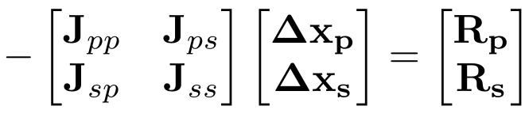
Constrained Pressure Residual In UTCOMP
Brief introduction to CPR preconditioner.
Overview of different implementations in different simulators.
Propsed plan for the implementation in UTCOMP.

Slide 2
Brief Introduction
Linear systems produced by reservoir simulators are usually solved using a Krylov-Based method (GMRES, CG, CGS, Bi-CGStab, ...).
These iterative methods require a preconditioner to converge in a reasonable time.
The Constrained Pressure Residual is a preconditioner designed specifically to handle the linear systems produced by reservoir simulators.
The equations of the multiphase fluid flow in porous media are of mixed character (elliptic-hyperbolic).
The PDE system is nearly-elliptic with respect to pressure and hyperbolic with respect to saturation.
CPR was invented in 1985 by Wallis, J etal… .
Originaly it was used to accelerate Generalized Conjugate Residual (GCR) method.
Now it is mostly used with GMRES.
CPR is the industry standard preconditioner for compositional flows.

Slide 3
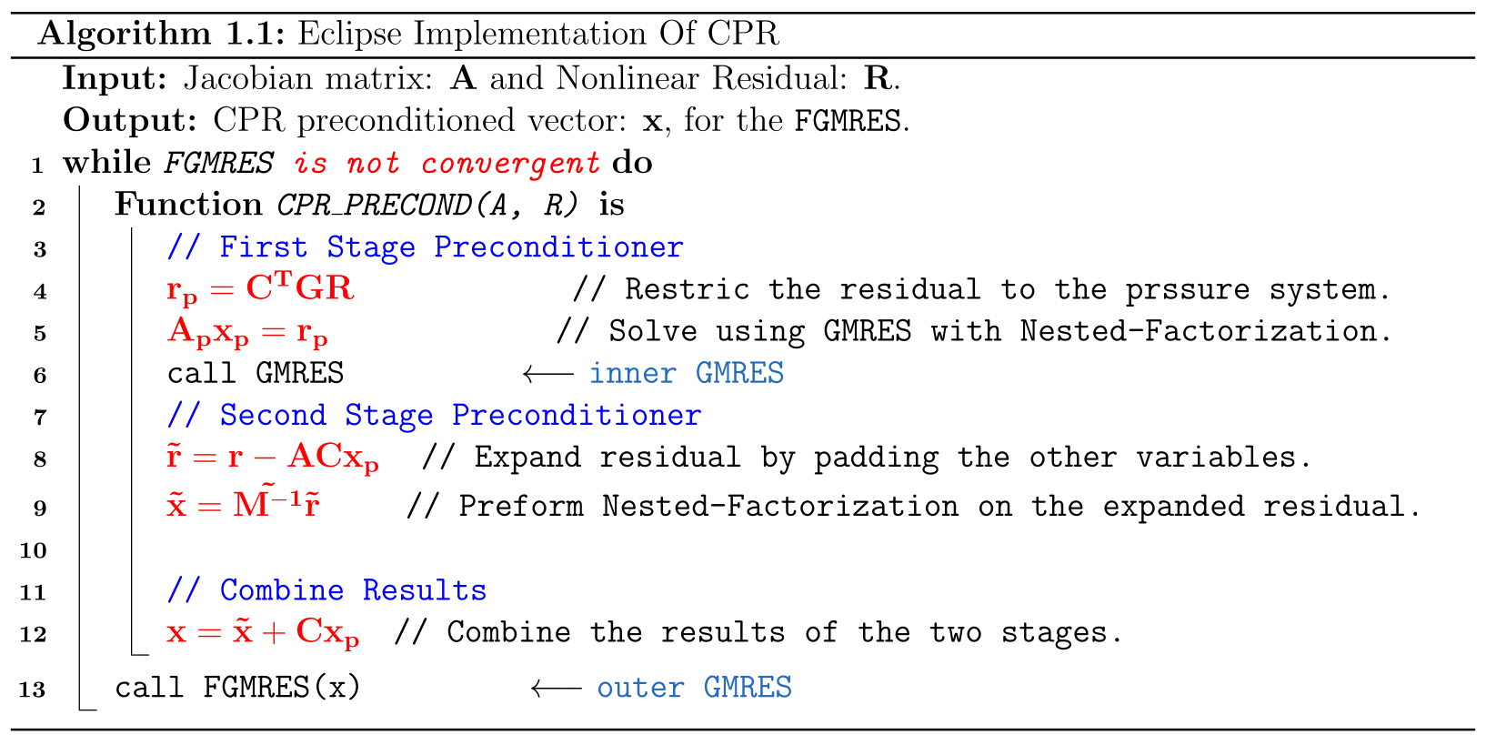
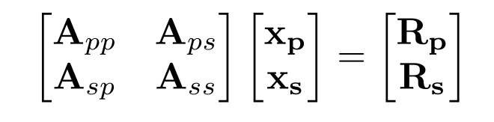
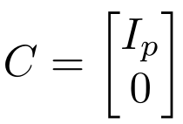


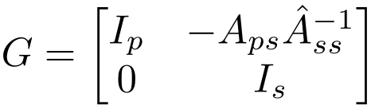
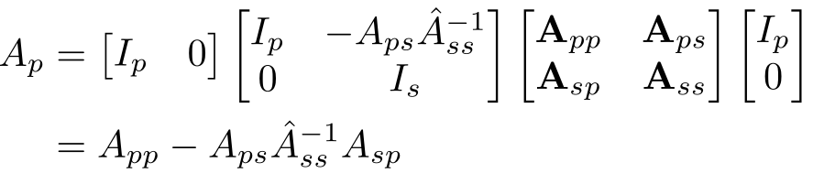
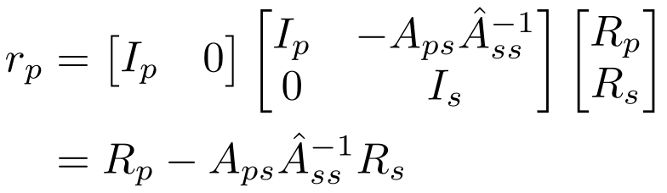
ECLIPSE Implementation

Slide 4
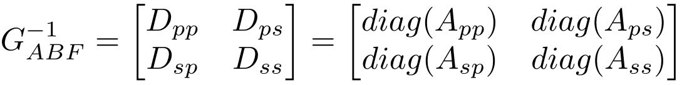
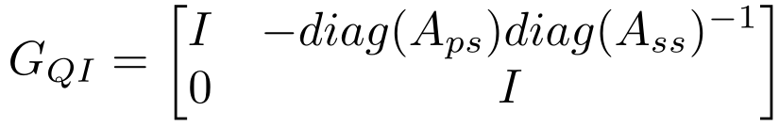
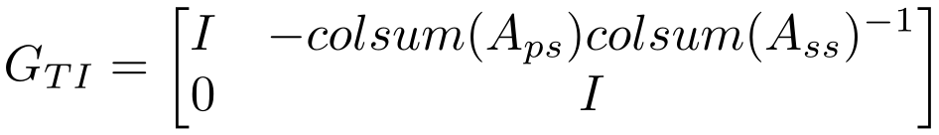
Decoupling Techniques
Decoupling approaches (Different values of G):
  Alternate-Block Factorization (ABF).
  Quasi-IMPES (QI).
  True-IMPES (TI).

Slide 5
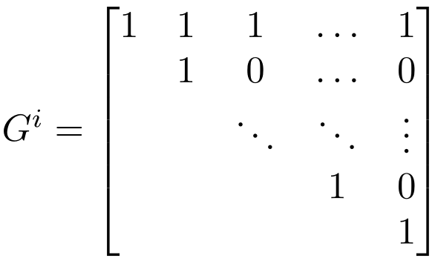
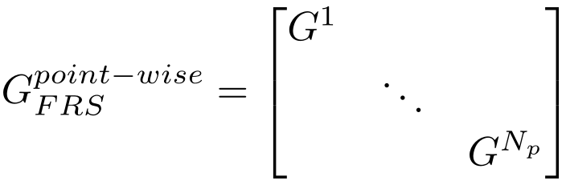
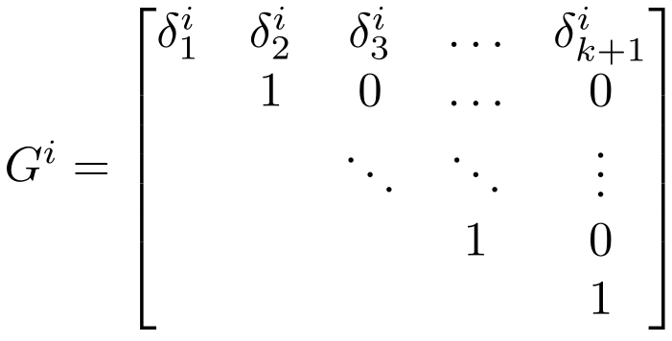
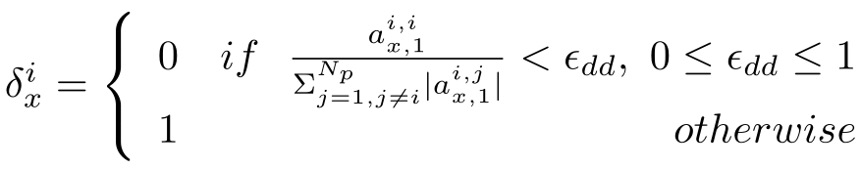
Decoupling Techniques
Full Row Sum (FRS).
Dynamic Row Sum (DRS).
Least-squares Decopupling Operator (LSQ).

Slide 6
CMG Implementation
CMG uses the DRS decoupling operator to accelerate the AMG solver.

Slide 7
PFLOTRAN Implementation
There are two main methods:
  Alternate-Block-Factorization(ABF).
  Quasi-Implicit-Pressure-Explicit-Saturation (QIMPES).

Slide 8
MRST Implementation
uses the DRS decoupling operator to accelerate the AMGCL solver.

Slide 9
OPM Flow Implementation
Heavly templated C++ code, requires more time to understand.
Few points can be said:
  Uses OpenCL “GPU programming”.
  Implements CPR but uses DUNE library for Krylov solvers.
  Runs ECLIPSE format model files.
  Most advanced open source reservoir simulator.

Slide 10
Plan For UTCOMP
PGE 398R MASTER'S REPORT.
Initialy implement DRS with (GMRES from PETSC).
If time permits implement other dcoupling operators and compare with DRS.

Slide 11
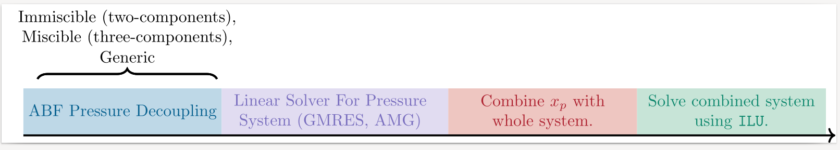
Timeline For Implementation
If time permits:
  Run configure PETSC with CUDA and run UTCOMP on GPU machine.
  Implement other decoupling strategies and compare performance with current one.

Slide 12

Unconventional 200,000 gridblocks
Fully Implicit run of 200,000 gridblocks.
Comparison of CPR with standard UTCOMP solver:

Slide 13
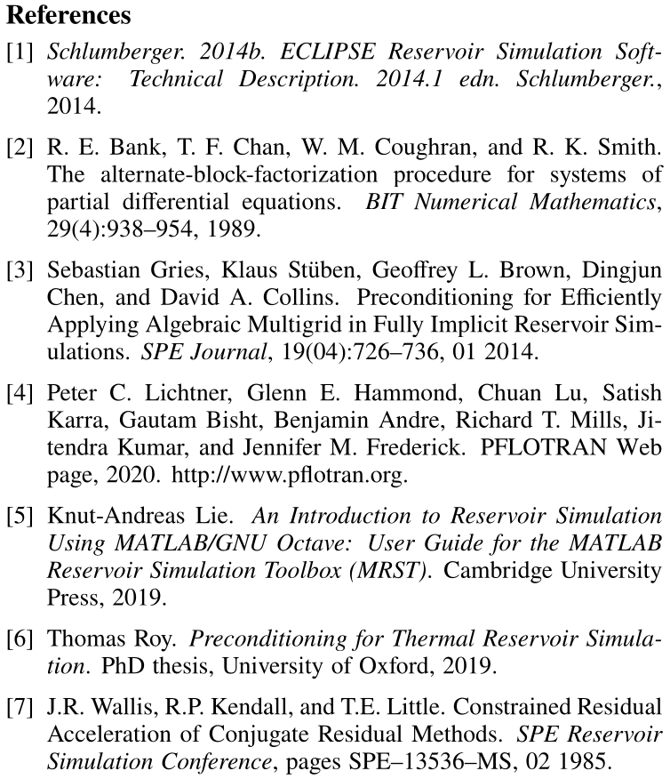
References

