Slide 1
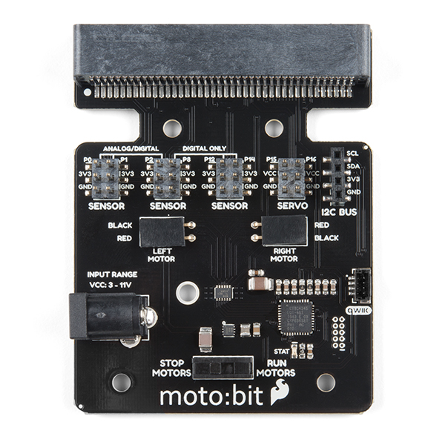
4-digit
display
Rotary sensor
Line follower sensor
Left motor
Right motor
Power

