Slide 1
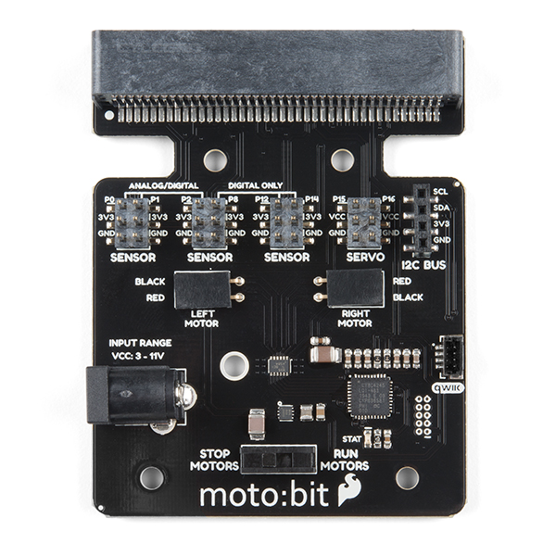
Line follower sensor
Left motor
Right motor
Power

