Slide 1
VetClinic RestApi Project
Süleyman KARACA - github.com/slymnkrc

Slide 2
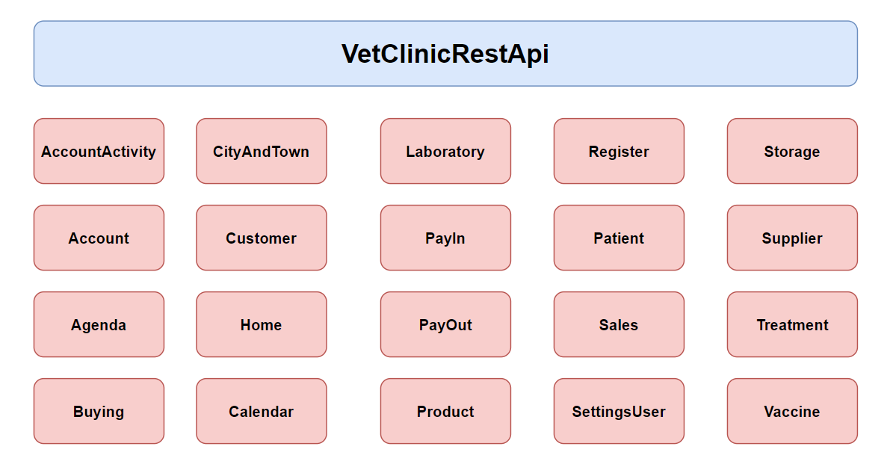
Project Information

Slide 3

Project Information

Slide 4
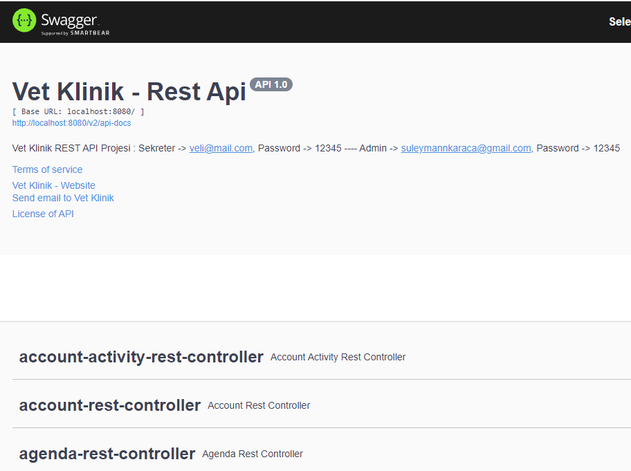
Login Page

Slide 5
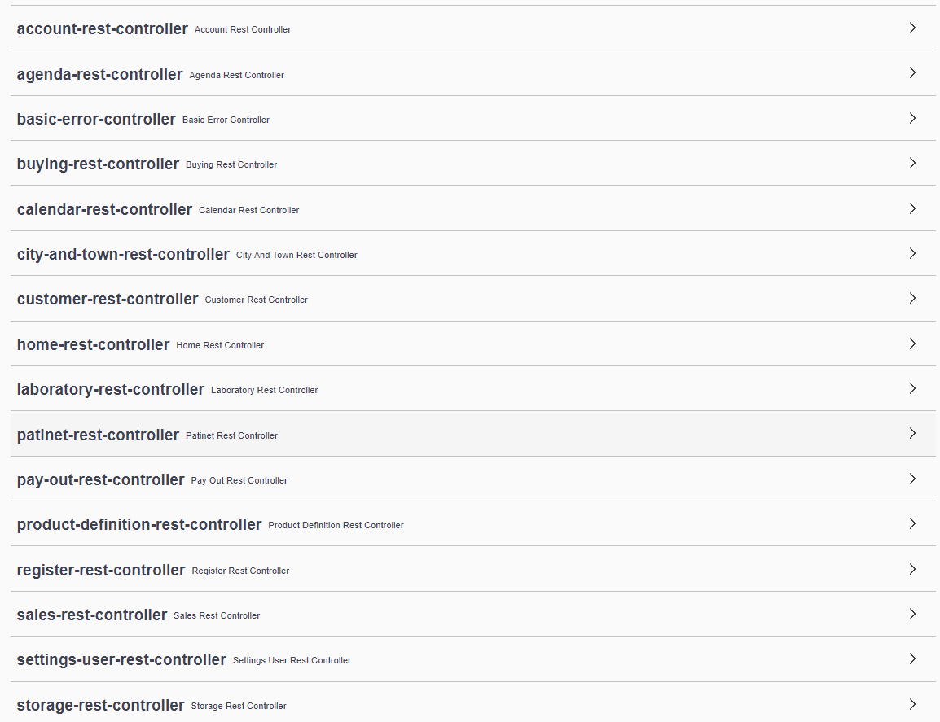

Slide 6
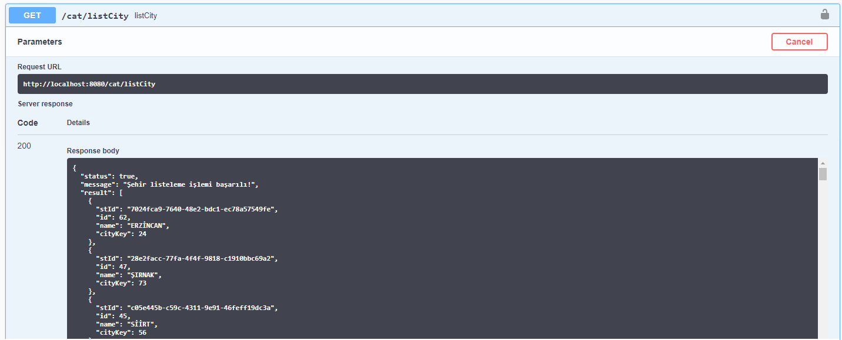
Redis

Slide 7
