Slide 1
HSMC Computing Cup
lam kin long
Pui ching middle school

Slide 2
Outline
Approach to arrange activities
Human-centred design concept

Slide 3

Task simplification
Convert the activities’ duration and available period(s) to basic numbers, in minutes
Easier to process later on
For example, if the duration is $2:15’$ (2 hours and 15 minutes), then convert it to $2×60+15=135$
Treat minutes as an array, and each day has $60\left(24−9\right)=900$ units
9:00 9:01 9:02 9:03 9:04
If one of the available periods is $Z x:y↔X:Y$, for example $Wed 11:30↔14:00$, then convert it to $900Z+60\left(x−9\right)+y↔900Z+60\left(X−9\right)+Y−1$, which the example will be converted to $2850↔2999$ (inclusive)

Slide 4

Task modification
We now have an empty array with length $900×7=6300$
We also have $N$ (number of activities) segments (activities’ duration), e.g. $135$
Each segment has a score (priority), and positions which it can be placed. E.g. the segment with length $135$ must be placed between $2850↔2999$ (inclusive) (I give $2850↔2999$ a name called slot)
Fill the array with segments
Maximize the total score
* For now, let’s ignore the prerequisite(s) of the activities

Slide 5

Task modification
After the modification, I don’t think that I have the ability to find an algorithm with sub-quadratic time complexity, i.e. $O(N^{2})$ (since $N=1000$), which give an optimal score
So let’s focus on sub-optimal greedy algorithms, which will be faster in terms of time complexity, but the score is not guaranteed to be maximized

Slide 6
Before being greedy
We don’t know how to generate a valid timetable even if we have infinity amount of runtime
We don’t know which part of the algorithm we can apply greedy strategy in
Therefore let’s find out how to generate a valid timetable first, using brute force

Slide 7
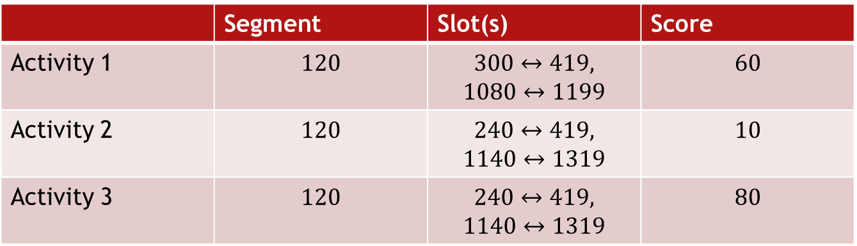

Before being greedy
 | Segment | Slot(s) | Score
Activity 1 | $$120$$ | $$300↔419,$$ $$1080↔1199$$ | $$60$$
Activity 2 | $$120$$ | $$240↔419,$$ $$1140↔1319$$ | $$10$$
Activity 3 | $$120$$ | $$240↔419,$$ $$1140↔1319$$ | $$80$$
One of the possible timetables is this:
Activity 2 in $240↔359 (359=240+120−1)$
Activity 1 in $1080↔1199$
Activity 3 in $1200↔1319$
(In fact this is the optimal timetable possible, with total score of $150$)

Slide 8
Before being greedy
What can we get with this example?
The most important element in the timetable (seed) is the order of the planned activities
So we get a brute force algorithm like this:
int[] P = {index of all activities}
for all permutations of P:
clear the timetable
for all i in [1..N]:
assign activity P[i] to the timetable as early as possible,
if even possible
This algorithm will give us an optimal timetable with maximized score
Why? Each of the valid timetables can be identified with its order of activity

Slide 9

Brute force: Time complexity
What is the time complexity of brute force?
1. Brute force all permutations of P: $O(N!)$
2. For each activities, find its earliest available slot
Separately: $O(M)$, where $M$ is the maximum number of available slots
Total: $O(NM)$
Overall time complexity: $O\left(N!NM\right)$
When $N=1000 \& M=100$, the execution of the algorithm certainly exceeds 1 second (Time limit exceeded, TLE)
(Fun fact: The maximum $N$ we can handle with this algorithm within 1 second is about $8$)

Slide 10

Brute force: Optimization
How can we optimize this algorithm?
* $log$ is in base $2$
0. Pre-sort the slots of each activities in increasing order: $O\left(NM\log{M}\right)$, because we need to do binary searching on the slots
1. Brute force all permutations of P: $O(N!)$
2. For each activities, binary search its earliest available slot: $O\left(N\log{M}\right)$
Overall time complexity: $O\left(NM\log{M}+N!N\log{M}\right)$
Still too slow! ☹

Slide 11
Brute force: Optimization
We notice that the bottleneck of this algorithm is part 1, which it enumerates all permutations of P, and so much time is wasted on trying “bad permutations” (permutations which give poor results)
So again, how can we optimize?
Weapon: Greedy
Instead of wasting time trying bad permutations, we can design greedy strategies, and focus on those better permutations

Slide 12

Greedy strategies: Order of activities
One of the most intuitive strategies is the one we use in the famous knapsack problem
Basic intro to the knapsack problem
A bag with a weight limit
Items with a weight and a value
Put some items into the bag, such that $\sum_{i∈items_in_the_bag}{{Weight}_{i}}≤{Weight}_{bag}$
Maximize the total value
Greedy strategy: Value to weight ratio
The greater the ratio is, the better the item is
Similarly, in this problem we can use “Score to duration (segment) ratio” (SSR)
We want to prioritized activities with greater SSR

Slide 13

SSR: Time complexity
Let’s analyse the time complexity of the new algorithm which uses this strategy
0. Pre-sort the slots of each activities in increasing order: $O\left(NM\log{M}\right)$, because we need to do binary searching on the slots
1. Apply SSR (sorting in decreasing order) to get the permutation of P: $O(N\log{N})$
2. For each activities, binary search its earliest available slot: $O\left(N\log{M}\right)$
Overall time complexity: $O\left(NM\log{M}+N\log{N}+N\log{M}\right)$
$=O(NM\log{M}+N\log{(NM)})$
Lightening fast! Fairly good result! ☺!
Stop here?

Slide 14

SSR: Observation
We notice that the later part of the time complexity, $O(N\log{(NM)})$ uses little if no time when maximum value of $N$ is just $1000$
How can we make use of this observation?
Actually, since we only try one permutation, the result won’t be that good
Design 999 more strategies / X to Y ratios?
Think backward: what are the flaws of the value to weight ratio strategy in the knapsack problem?
Maybe there is an item with enormous weight but still better value to weight ratio than later items, and after we put it into the bag, no space is left. But instead we can just give up this item, and put all remaining items into the bag, such that sum of values of remaining items is greater than the one with big weight

Slide 15
SSR: Improvement
Back to the problem, maybe there is an activity with good SSR but not worth doing
How to deal with it?
Modify our SSR algorithm:
// P = {SSR-applied permutation}
int_vector V = empty int_vector // dynamic-sized array
for all i in [1..N]:
clear the timetable
push P[i] into V
reorder V // in some way
for all j in V:
assign activity j to the timetable as early as possible, if even possible
backup the timetable if it is better than our best record
The basic idea is that for all prefixes of P, we reorder them each time, to avoid situations discussed last page

Slide 16
New SSR: Step by step
P[] = {1, 3, 5, 4, 2}
Before reordering: V = {1}
After reordering: V = {1}
Assign activities as early as possible
Before reordering: V = {1, 3}
After reordering: V = {3, 1} (just for example)
Assign activities as early as possible
Before reordering: V = {3, 1, 5}
After reordering: V = {3, 5, 1}
...

Slide 17

New SSR: Time complexity
Old one: $O(NM\log{M}+N\log{N}+N\log{M})$
For each prefixes of P we reorder it: extra $N\log{N}$ in the last part of the time complexity
New one: $O\left(NM\log{M}+N\log{N}+N^{2}\log{N}\log{M}\right)$
$=O\left(NM\log{M}+N\log{N}\left(1+N\log{M}\right)\right)$
$=O(NM\log{M}+N^{2}\log{N}\log{M})$
Still pretty fast! The result is better than the last one!
Stop here? Yes :P

Slide 18
New SSR: How to reorder?
But how to reorder activities in V?
By using our slots’ information again!
To summarize:
Use SSR to get the permutation P
Use slot’s information to reorder V, which is some prefix of P
For each activity i in V, assign it to the timetable as early as possible, if even possible

Slide 19

New SSR: How to reorder?
I use 4 strategies to reorder V (basically choose 1 slot from each activities, and when reordering, smaller activities’ slot’s left go first. If tie, smaller right go first)
Minimum frequencies slot
Precompute: for all slots from all activities, add 1 to a frequency array. E.g. $300↔419$: freq[300]++; freq[301]++; freq[302]++; ...; freq[419]++. Data structures such as Partial Sum can speed up the process
For all activities, find the slot which sum of frequencies inside is minimum (impact on other activities is minimum)
Minimum minimum segment frequencies slot: Way more complex (Monotone Queue)
Minimum segment frequencies mean slot
Minimum segment frequencies median slot

Slide 20
Prerequisite(s)...
Slightly modified SSR
If an activity has prerequisites, score and segment of its prerequisites (parents) will be accumulated
Before assigning an activity to the timetable, we need to do some sort of Depth first search (DFS) to check if ALL of its parents have been assigned already

Slide 21

At last
Boundary cases
Prerequisite relationships form a cycle in the graph (will throw warning to user)
Activity 1 requires activity 2 to be finished first, but activity 2 also treats activity 1 as a prerequisite
Simple DFS to find out these activities, and ignore them later on
Slots that are impossible to be used (will throw warning if an activity has no usable slots)
Segment $=50$, but slot $=100↔129$ ($50>30$)
Mix random into the algorithm, and keep repeating it until 1 second has passed
Initial P or V = {1, 2, 3, 4, 5}, may be shuffled to {2, 1, 3, 5, 4}, but will never be {5, 4, 3, 2, 1}
Hugely improve the overall result (can try a lot more good permutations / prefixes)
Multithreaded optimization (don’t have time to implement unfortunately)
373 lines of code

Slide 22
Human-centred design concept
Easy to use and user friendly, even for people who don’t have any computing knowledge
No confusing icons
No long-press actions required
All buttons and text boxes are big and clearly labelled
Whole app visible in 1 window
Button to open the user manual
What our team can improve:
More beautiful UI (our current one is quite dull and boring)
Buttons for user to add activities, instead of text input (though the input format has been demonstrated in the user manual)
112 lines of code

Slide 23
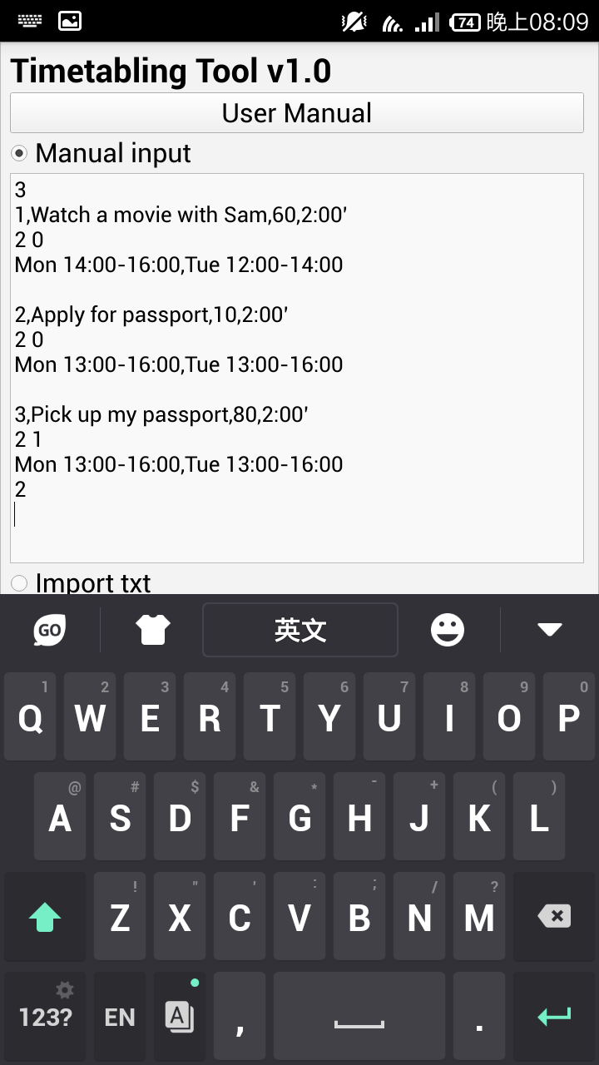
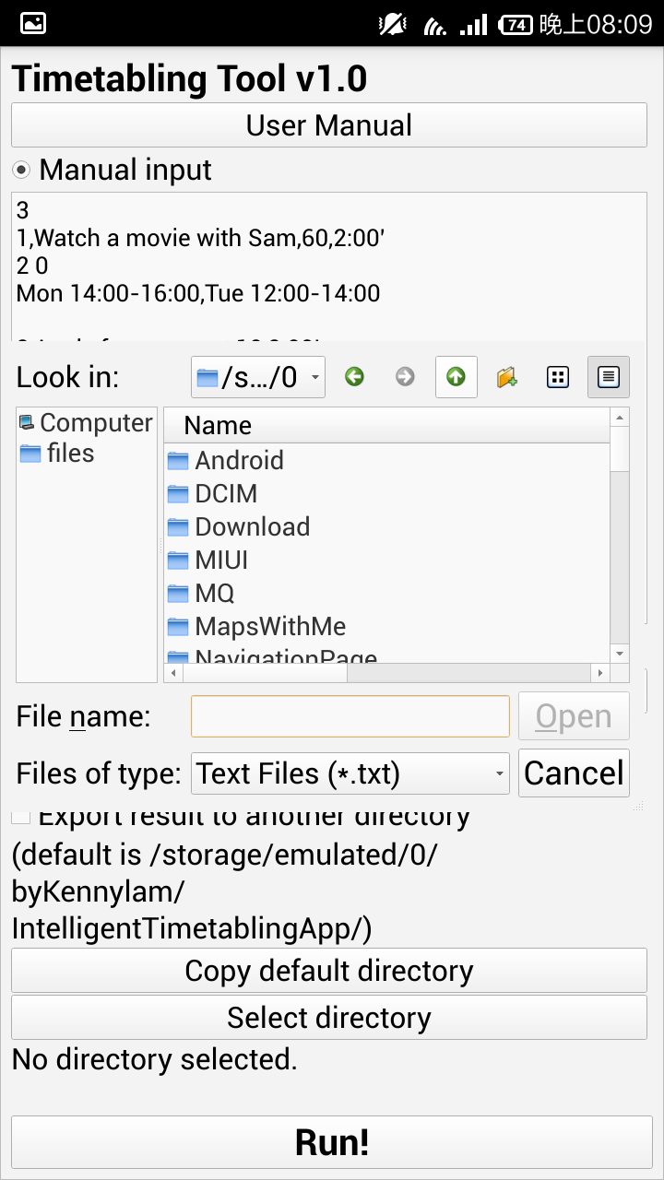
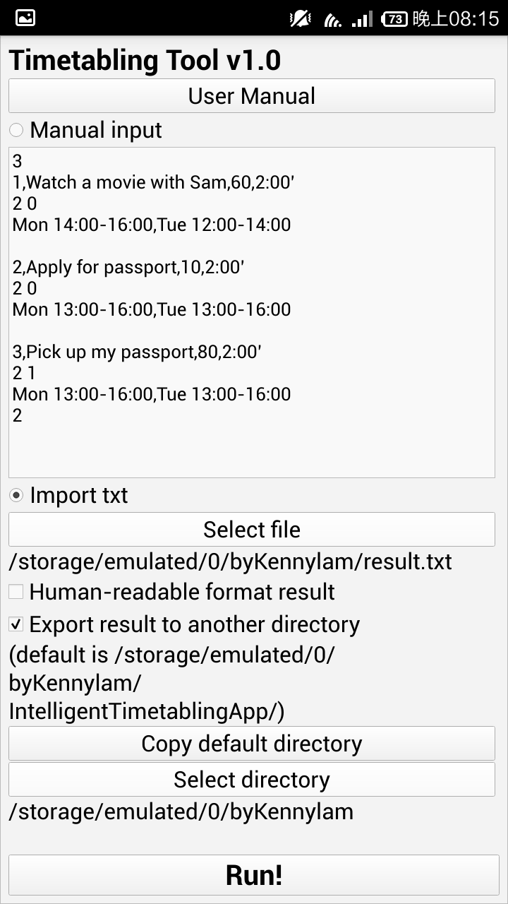
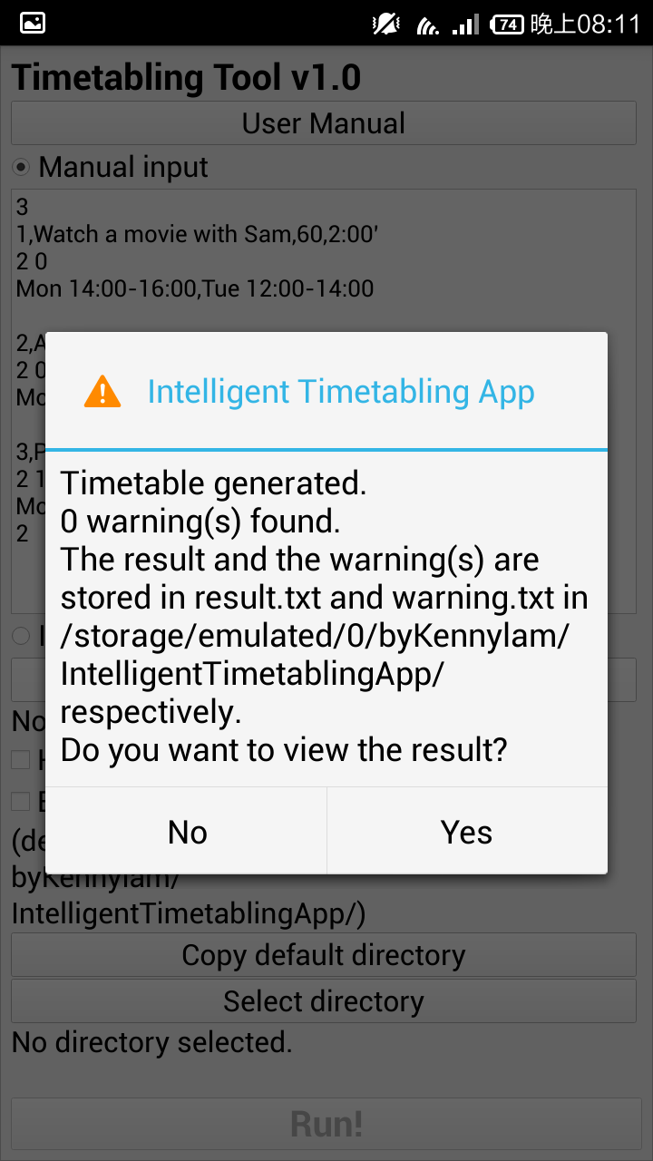
Screenshots

Slide 24
Thank you, Q&A time

