Slide 1







PHARMACY MANAGEMENT SYSTEM
STEP FOUR
Screenshots of some important features & Limitations and Future Works.
STEP TWO
STEP THREE
Features(Only completed features should be listed here) & Technologies Used.
STEP FIVE
Methodology (Includes different diagrams such as ER, USE CASE, ACTIVITY, DATAFLOW)
STEP ONE
Conclusion
&
References
Introduction & Motivation (Why did we choose this specific project?)

Slide 2
PMS is application to help pharmacist to manage pharmacy in the systematic ways.
It can make the work easier by giving the details of medicine when its name is entered.
This application has more benefits, Easy to find medicine because we use strong search option .
And It has more option such as, easy to add medicine, medicine type, medicine deadline and also delete and modify option.
It’s help to both of customer and pharmacist.
We use four different types of users here : ADMIN, CUSTOMER, SUPPLIER .
STEP ONE
Introduction

Slide 3
Currently, the number of pharmacies is increasing day by day with the increase in population in the world.
So I think these pharmacies need proper management to benefit the public health.
So I have selected this project for myself.
STEP ONE
Motivation (Why did we choose this specific project?)

Slide 4
Completed Featurres Should be listed here :
Efficiency and accuracy
Frame work
Availability of Both Computer and Android Version
STEP TWO
Features(Only completed features should be listed here) &Technologies Used.
Software Technology tools Used :
Sublime Text
Microsoft Edge
Visual Studio
MySQL Database
XAMM Server

Slide 5
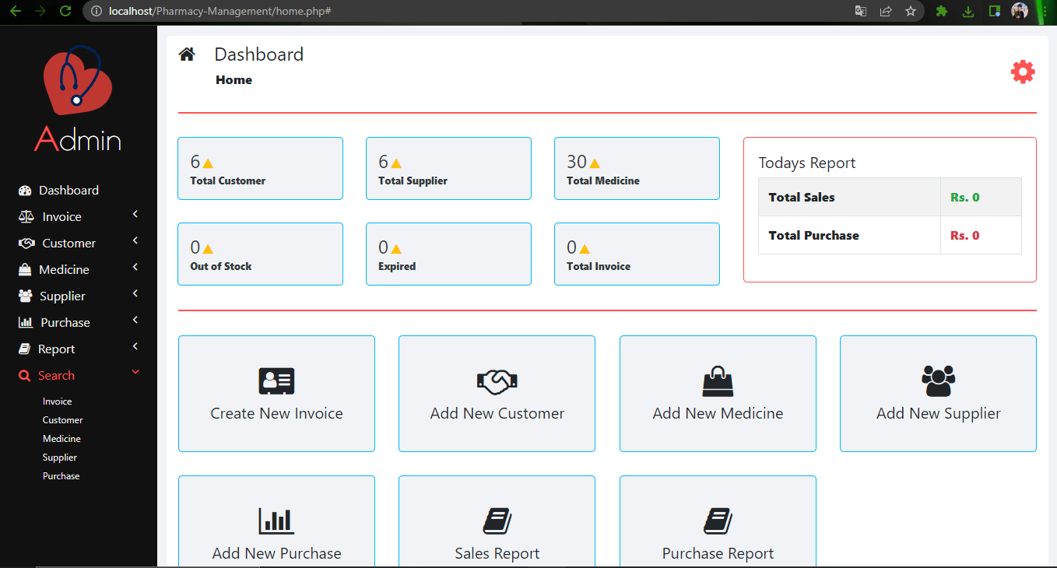

Some important features of my project :
1
A standard searching system :
STEP THREE
Screenshots of some important features & Limitations and Future Works.

Slide 6
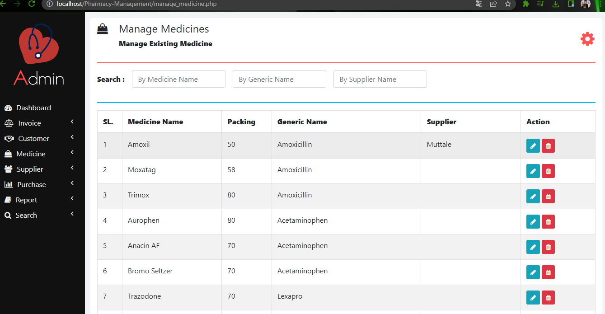
2
Medicine Stock :
STEP THREE
Screenshots of some important features & Limitations and Future Works.

Slide 7
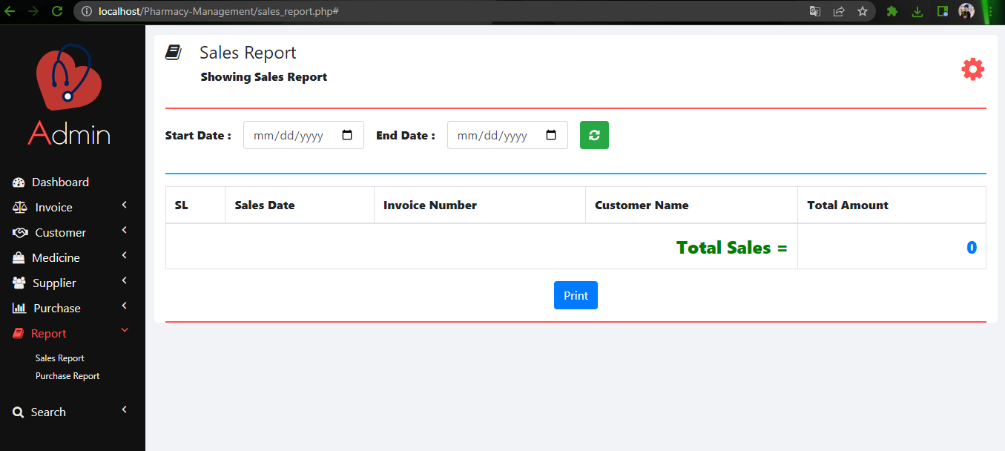

3
Printing Sales report :
STEP THREE
Screenshots of some important features & Limitations and Future Works.

Slide 8
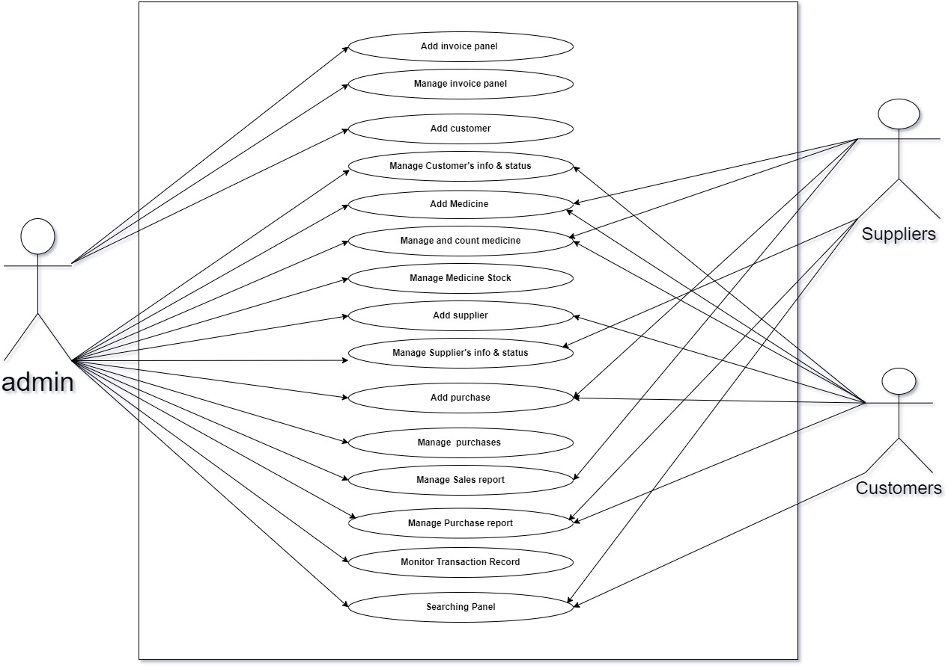

Use case Diagram :
STEP FOUR
Methodology (Includes different diagrams such as ER, USE CASE, ACTIVITY, DATAFLOW)

Slide 9
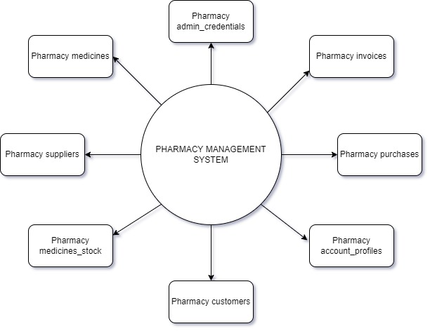

Data Flow Diagram :
STEP FOUR
Methodology (Includes different diagrams such as USE CASE, ACTIVITY, DATAFLOW)

Slide 10
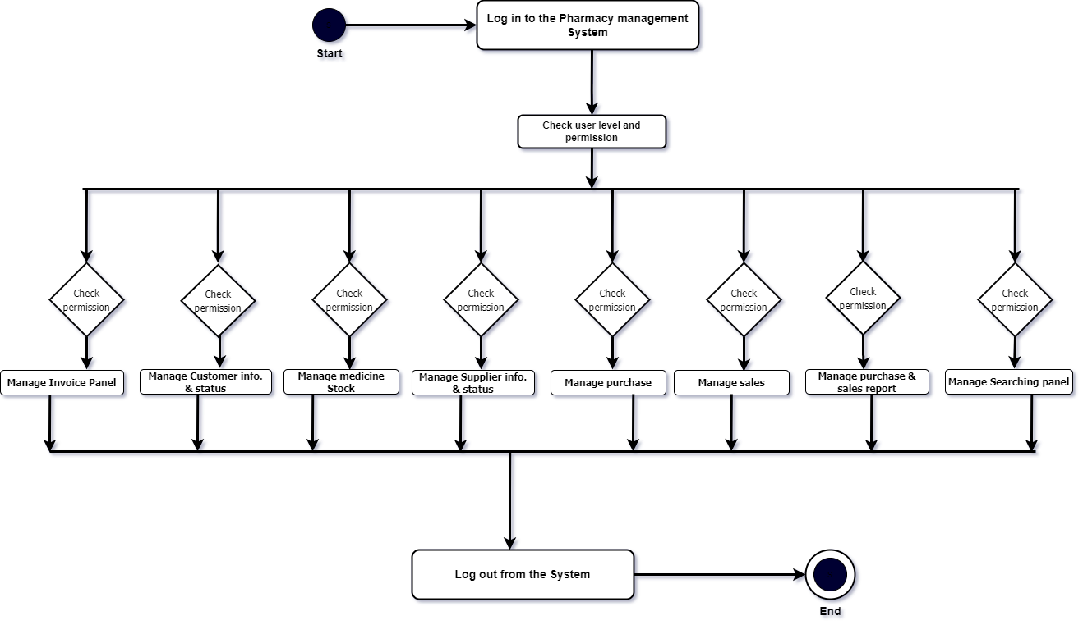

Activity Diagram :
STEP FOUR
Methodology (Includes different diagrams such as ER, USE CASE, ACTIVITY, DATAFLOW)

Slide 11

Conclusion :
Apparently in our today world things cannot be done organized, accurately and efficiently using file-based system so making things globally in a digitized way is a tremendous advantage in especially this type of Pharmacy management system program.
STEP FIVE
Conclusion
&
References

Slide 12
Especially, previous semester Database management system lab final report helps me properly. Another guideline are given bellow which is help me a lot :
https://www.arogga.com/
http://www.pcb.gov.bd/
https://www.coursehero.com/file/105156270/SRS-PHARMACY-MANAGEMENT-SYSTEMdocx/
https://www.w3schools.com/js/
https://getbootstrap.com/
https://www.w3schools.com/php/
https://en.wikipedia.org/wiki/Pharmacy_management_system
https://lingojam.com/FontChanger
https://onlinepngtools.com/create-transparent-png
https://www.free-css.com/free-css-templates
Those websites are helps me for develop this web application.
STEP FIVE
Conclusion
&
References

Slide 13
THANKS FOR
YOUR VALUABLE
TIME
💚💙🧡💖

