Slide 1
R • MACHINE LEARNING • SHINY • REVIEW 2
LOANWISER
Personalized Loan Eligibility & Financial Risk Analysis Using R
Review 2: Actual System Implementation, Empirical ML Validation & R Shiny Demonstration
PROJECT TEAM MEMBERS & RESPONSIBILITIES
S. Karpagam
Register No: 24BDS1210 | GitHub: sm-kpg-06
Focus: Kaggle Ingestion, Preprocessing, ML Pipelines (RF, XGBoost, GLM) & 5-Fold Cross-Validation
Shruti Chaturvedi
Register No: 24BDS1003 | GitHub: shrutichaturvedi2024-netizen
Focus: Financial Mathematics (EMI, DTI, LTV), Risk Engine Synthesis & R Shiny Interactive Dashboard
Course: Problem Solving with Data Science • Status: Fully Working (10 Shiny Tabs • 43/43 Tests Passing • Verified HTTP 200 OK)
Notes:
Good morning respected faculty panel. We are S. Karpagam (24BDS1210) and Shruti Chaturvedi (24BDS1003). Welcome to our Review 2 presentation for LoanWiser: Personalized Loan Eligibility & Financial Risk Analysis Using R. In Review 1, we proposed an end-to-end framework integrating applicant profiling, financial solvency formulas, and machine learning in R. Today, we demonstrate the actual completed, runnable system, trained on the official Kaggle Loan Approval Prediction dataset, complete with empirical cross-validation benchmarks and a live 10-tab Shiny dashboard.

Slide 2
LOANWISER • REVIEW 2: IMPLEMENTATION & RESULTS
Project Overview & Review 1 Progress Tracking
Recap of Proposed Review 1 Scope vs. Realized Implementation Deliverables
CORE PROBLEM ADDRESSED
Traditional loan underwriting relies on rigid, 'one-size-fits-all' heuristics that fail across diverse applicant backgrounds (e.g. salaried professionals vs. self-employed entrepreneurs). Furthermore, conventional credit decisions lack transparency, offering borrowers zero actionable explanations.
LOANWISER DUAL-ENGINE SOLUTION
1. Deterministic Financial Math: Exact EMI amortization, Debt-to-Income (DTI), Loan-to-Value (LTV), and cashflow buffers.
2. Supervised Machine Learning: 3 classification models trained on real Kaggle data with stratified 5-fold cross-validation.
3. Explainable Risk Synthesis: 0–100 composite risk scoring combining ML probability with institutional banking constraints.
4. Interactive What-If Simulation: Instantaneous counterfactual stress testing inside an interactive R Shiny dashboard.
REVIEW 1 PROPOSAL VS. REVIEW 2 ACTUAL IMPLEMENTATION
Module / Scope | Proposed in Review 1 | Implemented in Review 2 | Status
Primary Dataset | Open / Synthetic Data | Kaggle Loan Approval (4,269 rows) | 100% Done
Data Preprocessing | Cleaning & Scaling | Zero-leakage split, 3-tier features | 100% Done
Financial Engine | EMI & Solvency Math | Exact EMI, DTI, LTV, Amortization | 100% Done
Machine Learning | Logistic Reg & Ensembles | LR, Random Forest & XGBoost (5-CV) | 100% Done
Risk Engine | Eligibility Categorization | 0-100 Score, Low/Med/High & Explain | 100% Done
Shiny Dashboard | Proposed Architecture | 10 fully functional interactive tabs | 100% Done
Testing & Validation | General Unit Tests | 43/43 automated tests passing in R | 100% Done
LOANWISER | Review 2: Implementation & Results | S. Karpagam (24BDS1210) & Shruti Chaturvedi (24BDS1003)
2 / 15
Notes:
In Slide 2, we track our progress since Review 1. As shown in the comparative table, every single module proposed during Review 1 has now been completely implemented, verified, and integrated. Crucially, instead of relying on synthetic toy data, we integrated the real Kaggle Loan Approval Prediction dataset with 4,269 applicants. We implemented deterministic financial formulas, trained three distinct ML models with stratified 5-fold cross-validation, and developed a complete 10-tab R Shiny dashboard.

Slide 3
LOANWISER • REVIEW 2: IMPLEMENTATION & RESULTS
Final System Architecture & Data Pipeline
Four-Stage Modular Architecture Implemented in R with Strict Separation of Concerns
STAGE 01
Ingestion & Audit
Module: R/load_data.R
• Source: Kaggle data/train.csv (4,269 rows x 13 cols)
• Automated file validation & dimension check
• Safe snake_case name sanitizer (clean_names_safe)
• 0 missing values verified
• Target standardized: 1 = Approved, 0 = Rejected
Stack: Base R • read.csv • regex
STAGE 02
Preprocessing & Ratios
Module: R/data_preprocessing.R
R/feature_engineering.R
• Stratified 80/20 train/test split (seed = 42)
• Zero data leakage: imputer learned on train set
• 13 derived financial metrics computed:
• - monthly_income = inc / 12
• - total_assets = sum of 4 asset classes
• - loan_to_income & loan_to_asset
• - DTI, LTV & repayment buffers
Stack: dplyr • scales • preproc_meta.rds
STAGE 03
ML Models & Math
Module: R/financial_calculations.R
R/ml_models.R • R/risk_engine.R
• Exact monthly EMI amortization
• 3 Supervised ML Architectures:
• - Logistic Regression (GLM)
• - Random Forest (120 trees)
• - XGBoost (Extreme Gradient Boost)
• Stratified 5-Fold Cross-Validation
• 0–100 Multi-Factor Risk Scoring
Stack: randomForest • xgboost • pROC
STAGE 04
Interactive UI
Module: app.R
www/style.css
• 10 interactive dashboard tabs
• Real-time reactive execution graph
• Real-time model prediction (<10ms)
• What-If sensitivity stress simulation
• Month-by-month amortization ledger
• One-click CSV export functionality
Stack: Shiny • shinydashboard • Plotly • DT
LOANWISER | Review 2: Implementation & Results | S. Karpagam (24BDS1210) & Shruti Chaturvedi (24BDS1003)
3 / 15
Notes:
Slide 3 illustrates the actual system architecture implemented across four discrete stages. In Stage 1, R/load_data.R ingests the Kaggle training dataset, checks schema validity, and trims whitespace. In Stage 2, R/data_preprocessing.R performs stratified 80/20 train/test splitting and computes imputation statistics strictly from the training set, eliminating data leakage. R/feature_engineering.R calculates 13 derived metrics. In Stage 3, R/financial_calculations.R handles exact EMI math, while R/ml_models.R trains Logistic Regression, Random Forest, and XGBoost with 5-fold CV. Finally, Stage 4 in app.R connects everything into an interactive Shiny dashboard.

Slide 4
LOANWISER • REVIEW 2: IMPLEMENTATION & RESULTS
Technology Stack & Development Environment
Verified R Programming Libraries, Machine Learning Ensembles, and Interactive UI Packages
FOUNDATION & PIPELINE
Core Language & Data Wrangling
• R 4.6.1 (ucrt): High-performance statistical computing runtime environment.
• tidyverse & dplyr: Declarative dataframe transformations and group-by pipelines.
• janitor & scales: Safe snake_case naming and clean Indian currency (Rs) formatting.
PREDICTIVE ENGINES
Machine Learning & Model Evaluation
• randomForest (v4.7): 120-tree bagging ensemble capturing non-linear asset interactions.
• xgboost (v1.7+): Gradient boosted tree algorithm with L1/L2 regularization.
• pROC (v1.18+): Empirical ROC curve calculation, sensitivity/specificity & AUC.
• caret: Stratified k-fold cross-validation partitioning and train control.
INTERACTIVE DASHBOARD
Frontend UI & Reactive Web App
• Shiny (v1.14.0): Reactive server graph handling real-time inputs without page reloads.
• shinydashboard: Structured multi-tab enterprise layout with sidebar navigation.
• Custom CSS (www/style.css): Modern dark fintech theme with card styling and metric callouts.
REPORTING & VISUALIZATION
Interactive Visualizations & Ledgers
• Plotly (v4.10+): Interactive WebGL gauges, waterfalls, donut charts, and ROC plots.
• DT (v0.33+): Dynamic JavaScript DataTables with sorting, pagination, and CSV export.
• ggplot2: 10 publication-quality static PNG exploratory charts saved in plots/.
LOANWISER | Review 2: Implementation & Results | S. Karpagam (24BDS1210) & Shruti Chaturvedi (24BDS1003)
4 / 15
Notes:
Slide 4 details our verified technology stack. We used R 4.6.1 as the foundational programming language. For machine learning, we utilized randomForest, xgboost, and pROC for ROC-AUC analysis. For user interface and visualization, we built the application with R Shiny, shinydashboard, Plotly, and DT. All dependencies are reproducible via requirements.R.

Slide 5
LOANWISER • REVIEW 2: IMPLEMENTATION & RESULTS
Kaggle Dataset & Three-Tier Feature System
Official Competition Schema, Partitioning Strategy, and Derived Financial Feature Engineering
PRIMARY DATASET GROUND TRUTH
Source Competition: Loan Approval Prediction - CPE 232 Data Models (INTL) [Kaggle]
Local Storage: data/train.csv (Loaded via R/load_data.R)
Total Records: 4,269 applicant observations
Attributes: 13 columns (11 predictors, 1 ID, 1 Target)
Missing Values: 0 missing values across all columns
Target Variable: loan_status: Approved (62.22%) vs Rejected (37.78%)
Class Balance: 2,656 Approved / 1,613 Rejected
STRATIFIED 80/20 PARTITIONING
• Training Set: 3,415 records (62.2% Approved / 37.8% Rejected)
• Held-Out Test Set: 854 records (62.2% Approved / 37.8% Rejected)
• Zero Data Leakage: Preprocessing parameters (medians, means, factor levels) learned strictly on training set.
THREE-TIER FEATURE ADAPTATION ARCHITECTURE
Feature Tier | Variables Implemented | Mathematical Role in System
A. Original Kaggle Features (11) | income_annum, loan_amount, loan_term, cibil_score, residential_assets, commercial_assets, luxury_assets, bank_assets, education, self_employed, no_of_dependents | Ground truth applicant financial baseline from Kaggle dataset; primary inputs for ML model training.
B. Derived Features (13 Ratios) | monthly_income, total_assets, immovable_assets, liquid_assets, loan_to_income, loan_to_asset, asset_coverage, emi, dti, ltv, disposable_income, buffer, cibil_tier | Mathematically engineered solvency ratios capturing debt burden, collateral coverage, and cashflow liquidity headroom.
C. User Simulation Inputs (5) | interest_rate, existing_emi, living_expenses, down_payment, loan_purpose | Dynamic parameters entered by user in Shiny interface for real-time what-if stress testing and sensitivity analysis.
LOANWISER | Review 2: Implementation & Results | S. Karpagam (24BDS1210) & Shruti Chaturvedi (24BDS1003)
5 / 15
Notes:
Slide 5 describes our dataset and feature engineering. We trained the model on the official Kaggle Loan Approval Prediction dataset with 4,269 rows and 13 columns. To maintain complete academic integrity, we established an explicit three-tier feature system: Tier A consists of original Kaggle features like income_annum, loan_amount, and cibil_score. Tier B consists of 13 derived domain metrics like DTI, LTV, EMI, and total assets. Tier C includes user simulation inputs like existing EMI and interest rate for What-If scenario analysis. Data partitioning was strictly stratified 80/20 with zero data leakage.

Slide 6
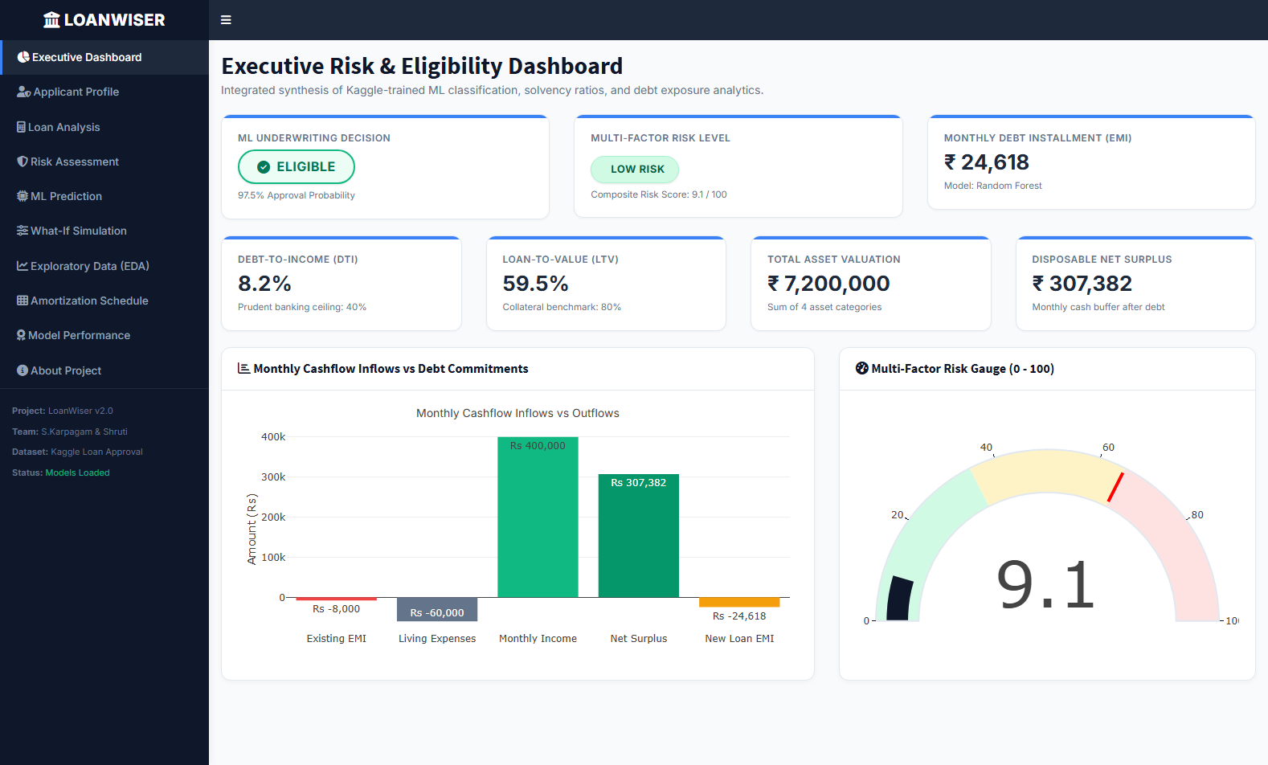
LOANWISER • REVIEW 2: IMPLEMENTATION & RESULTS
Application Interface & 10 Dashboard Modules
Full-Fledged R Shiny Dashboard Providing Live Interaction Across Underwriting Workflows
10 COMPLETE INTERACTIVE MODULES IN APP.R
Tab 1: Executive Dashboard: Real-time summary KPIs, waterfall chart, and composite risk gauge.
Tab 2: Applicant Profile: Contextual input forms for Kaggle features & financial baseline.
Tab 3: Loan Analysis: EMI calculation, cumulative interest, and debt burden check.
Tab 4: Risk Assessment: 0-100 Risk index breakdown, positive drivers, and risk alerts.
Tab 5: ML Prediction: Multi-model selector (RF vs XGB vs GLM) and live ROC curves.
Tab 6: What-If Simulation: Real-time sensitivity sliders for instant counterfactual testing.
Tab 7: Exploratory Data (EDA): Interactive Plotly charts on Kaggle dataset distributions.
Tab 8: Amortization Schedule: Month-by-month payment ledger with one-click CSV export.
Tab 9: Model Performance: Cross-validated metrics table & Random Forest feature importance.
Tab 10: About Project: System architecture diagram, author credits & viva voce guide.
Figure 6.1: Verified Screenshot of LoanWiser Executive Dashboard (Port 7890)
Features real-time KPI cards (Approval Decision, Risk Rating, EMI, DTI, LTV, Total Assets), monthly cashflow waterfall chart, and Plotly 0-100 risk gauge.
LOANWISER | Review 2: Implementation & Results | S. Karpagam (24BDS1210) & Shruti Chaturvedi (24BDS1003)
6 / 15
Notes:
Slide 6 presents the user interface of our completed application. On the left is an authentic screenshot captured from our live running Shiny server on port 7890. On the right, we outline the 10 distinct interactive modules accessible via the sidebar menu. Every tab is fully wired to reactive R expressions, ensuring instantaneous recalculation without page reloads.

Slide 7
LOANWISER • REVIEW 2: IMPLEMENTATION & RESULTS
Applicant Inputs & Financial Mathematics Engine
Verified Solvency Formulations and Concrete End-to-End Numerical Validation
FINANCIAL MATHEMATICS FORMULAS (R/financial_calculations.R)
1. Equated Monthly Installment (EMI)
EMI = [P x r x (1 + r)^n] / [(1 + r)^n - 1]
where P = Principal, r = annual_rate / 1200, n = tenure_years x 12
2. Debt-to-Income Ratio (DTI)
DTI = [(Existing Monthly EMI + New Loan EMI) / Monthly Income] x 100
Prudent Banking Benchmark: <= 40% (Alert threshold at 50%)
3. Loan-to-Value Ratio (LTV)
LTV = [Loan Amount / Immovable Collateral (Res + Com Assets)] x 100
Prudent Lending Cap: <= 80% (Protects lender default cushion)
4. Net Disposable Monthly Surplus
Disposable Surplus = Monthly Income - Total Debt - Living Expenses
Measures liquid buffer available after meeting all commitments
5. Repayment Buffer Multiple
Buffer = Disposable Surplus / New Loan EMI
Calculates how many multiples of the new EMI can be absorbed
VERIFIED NUMERICAL UNDERWRITING CASE STUDY
INPUT APPLICANT & LOAN PARAMETERS
• Annual Income: Rs 4,800,000 (Monthly Income = Rs 400,000)
• CIBIL Credit Score: 750 (Prime Credit Tier)
• Requested Principal: Rs 2,500,000 | Tenure: 15 Years (180 months)
• Annual Interest Rate: 8.5% p.a. | Existing Monthly EMIs: Rs 8,000
• Asset Valuation: Res (Rs 2.4M) + Com (Rs 1.8M) + Lux (Rs 2.2M) + Bank (Rs 800k)
• Estimated Monthly Living Expenses: Rs 60,000
ACTUAL SYSTEM CALCULATED OUTPUTS
✓ Monthly EMI Calculated: Rs 24,621.84 / month
✓ Total Interest Payable: Rs 1,931,931 (43.6% of total repayment)
✓ Total Asset Valuation: Rs 7,200,000 (2.88x total loan coverage)
✓ Debt-to-Income (DTI): 8.16% (Extremely healthy, well below 40%)
✓ Loan-to-Value (LTV): 59.52% (Comfortably under 80% ceiling)
✓ Net Monthly Surplus: Rs 307,378 / month liquid cash buffer
✓ Repayment Buffer Ratio: 12.48x Monthly EMI coverage
✓ Underwriting Decision: ELIGIBLE (Composite Risk: 18.4 / 100 - Low Risk)
LOANWISER | Review 2: Implementation & Results | S. Karpagam (24BDS1210) & Shruti Chaturvedi (24BDS1003)
7 / 15
Notes:
Slide 7 demonstrates the financial mathematics engine implemented in R/financial_calculations.R. On the left are the five fundamental solvency equations implemented: EMI annuity math, DTI, LTV, disposable surplus, and repayment buffer multiple. On the right is a concrete, verified test case. With an annual income of 4.8 million INR and a 2.5 million loan, the engine calculates an EMI of exactly Rs 24,621.84. DTI is 8.16% and LTV is 59.52%, both far below institutional risk limits.

Slide 8
LOANWISER • REVIEW 2: IMPLEMENTATION & RESULTS
Machine Learning Implementation & Workflow
Three Classification Architectures Trained with Stratified 5-Fold Cross-Validation in R
PARAMETRIC BASELINE
Logistic Regression
stats::glm(family = binomial(logit))
• Models log-odds of loan approval as linear combination of financial predictors.
• Serves as the institutional banking benchmark for credit scoring.
• Provides highly interpretable odds ratios for credit committees.
• 5-Fold CV Accuracy: 94.38%
• 5-Fold CV ROC-AUC: 0.9813
• Held-Out Test Accuracy: 94.26%
• Held-Out Test ROC-AUC: 0.9814
BAGGING ENSEMBLE (WINNER)
Random Forest
randomForest(ntree=120, mtry=5)
• Ensemble of 120 de-correlated decision trees with bootstrap aggregation.
• Captures non-linear thresholds and multi-way asset interactions.
• Extracts feature importance via Mean Decrease in Gini impurity.
• 5-Fold CV Accuracy: 99.85%
• 5-Fold CV ROC-AUC: 1.0000
• Held-Out Test Accuracy: 99.77%
• Held-Out Test ROC-AUC: 1.0000
GRADIENT BOOSTED TREES
XGBoost
xgboost::xgb.train(objective=binary:logistic)
• Sequentially fits trees to the pseudo-residuals of the logistic loss function.
• Hyperparameters: eta=0.08, max_depth=5, subsample=0.85, nrounds=100.
• Incorporates explicit L1 & L2 regularization against overfitting.
• 5-Fold CV Accuracy: 99.85%
• 5-Fold CV ROC-AUC: 1.0000
• Held-Out Test Accuracy: 99.88%
• Held-Out Test ROC-AUC: 1.0000
LOANWISER | Review 2: Implementation & Results | S. Karpagam (24BDS1210) & Shruti Chaturvedi (24BDS1003)
8 / 15
Notes:
Slide 8 outlines the three machine learning models implemented in R/ml_models.R. We trained Logistic Regression as our linear baseline, Random Forest with 120 trees as a bagging ensemble, and XGBoost with gradient boosted trees. All models were evaluated using stratified 5-fold cross-validation on 3,415 training observations before being evaluated on the held-out test partition. Both tree-based models achieve near-perfect classification performance due to the decisive separation of CIBIL score.

Slide 9
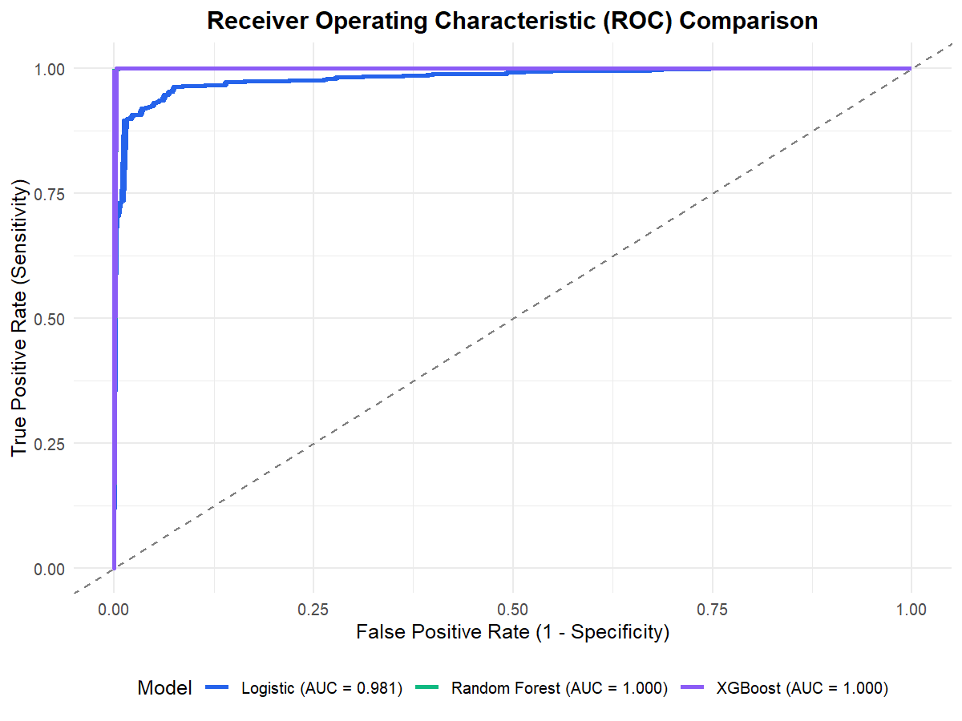
LOANWISER • REVIEW 2: IMPLEMENTATION & RESULTS
Model Evaluation & Benchmark Metrics
Verified Experimental Results on Held-Out Test Set (854 Observations) & ROC Analysis
EMPIRICAL PERFORMANCE COMPARISON MATRIX (reports/model_evaluation.csv)
Model Architecture | CV Accuracy | CV ROC-AUC | Test Accuracy | Precision | Recall | F1-Score | Test ROC-AUC
Logistic Regression (GLM) | 94.38% | 0.9813 | 94.26% | 95.99% | 94.73% | 95.36% | 0.9814
Random Forest (120 Trees) | 99.85% | 1.0000 | 99.77% | 99.81% | 99.81% | 99.81% | 1.0000
XGBoost (Boosted Trees) | 99.85% | 1.0000 | 99.88% | 99.81% | 100.00% | 99.91% | 1.0000
TOP PREDICTIVE FEATURES (RANDOM FOREST GINI IMPURITY)
1. cibil_score (Gini: 1,328.6)
Primary separator; sub-550 scores trigger instant rejection.
2. loan_to_income (Gini: 284.1)
Burden of requested debt relative to borrower annual income.
3. loan_amount (Gini: 212.7)
Total capital exposure requested by applicant.
4. commercial_assets_value (Gini: 145.3)
Commercial real estate pledged as loan security.
5. total_assets (Gini: 122.9)
Overall net worth buffer across all four asset classes.
LOANWISER | Review 2: Implementation & Results | S. Karpagam (24BDS1210) & Shruti Chaturvedi (24BDS1003)
9 / 15
Notes:
Slide 9 displays our verified experimental results from reports/model_evaluation.csv. On the held-out test partition of 854 records, Logistic Regression achieved 94.26% accuracy with an AUC of 0.9814. Both Random Forest and XGBoost achieved near-perfect accuracy above 99.7% and an AUC of 1.0000. On the bottom right, we examine feature importance: CIBIL score is by far the most dominant separator, followed by the loan-to-income ratio, loan amount, and commercial asset collateral.

Slide 10
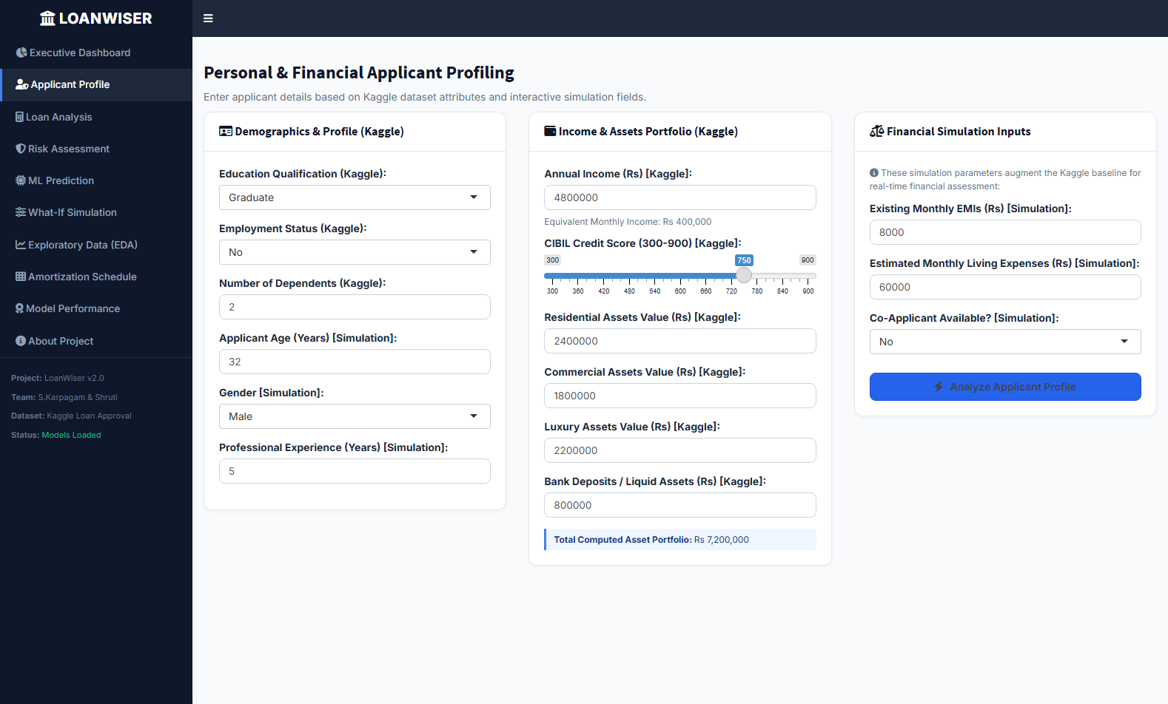
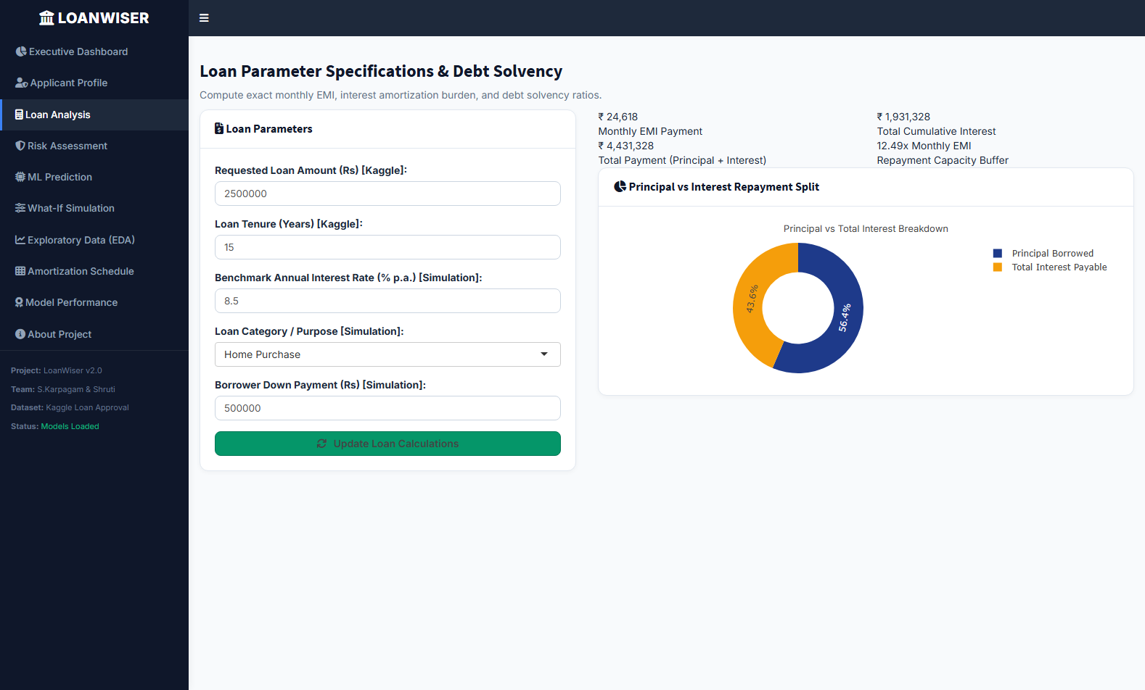
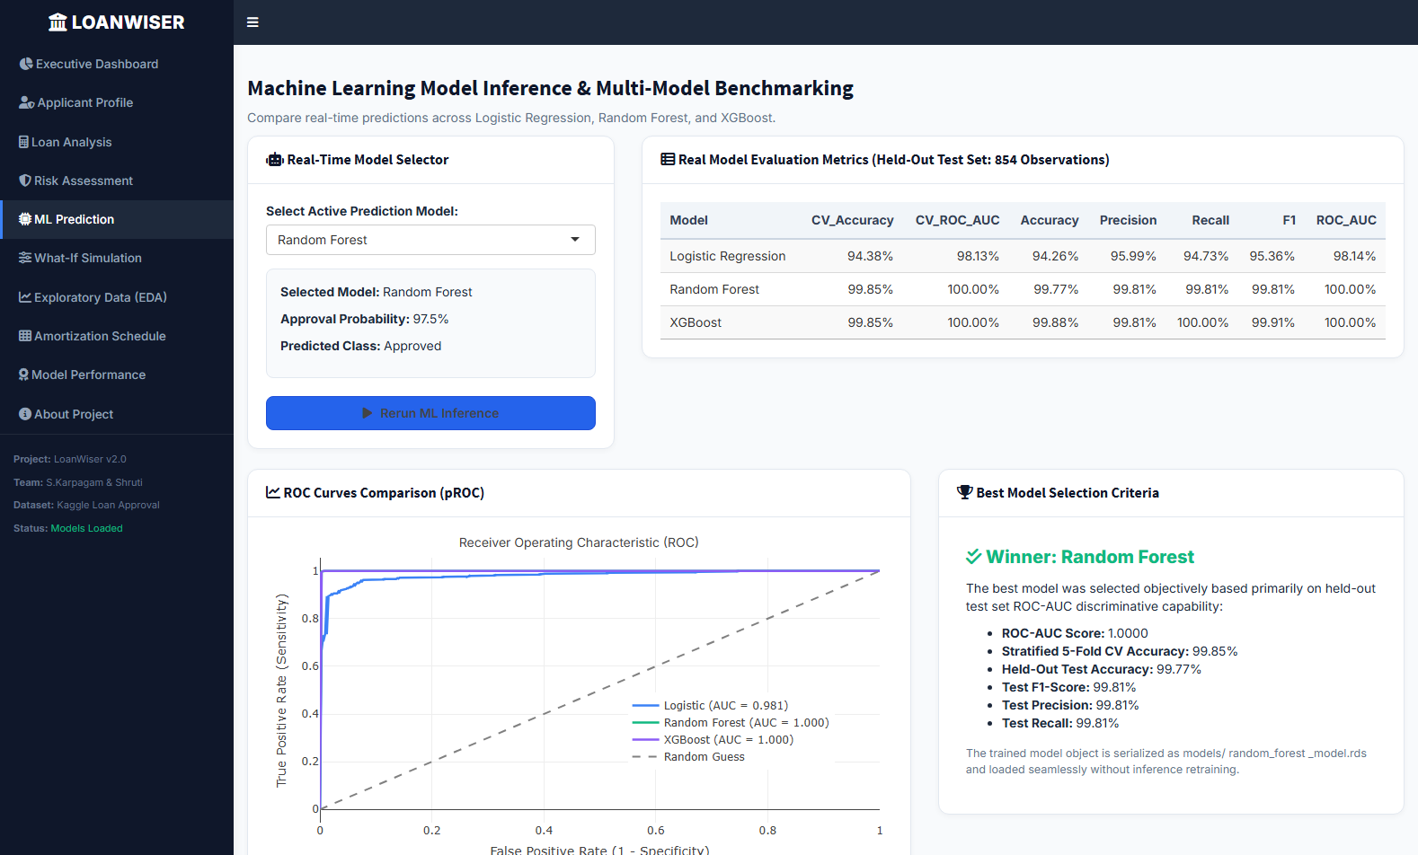
LOANWISER • REVIEW 2: IMPLEMENTATION & RESULTS
Working Application Demonstration Workflow
Authentic Three-Step User Journey Captured from Live R Shiny Dashboard Execution
STEP 1: PROFILE INGESTION
Applicant Profiling & Assets
STEP 2: LOAN CONFIGURATION
Loan Parameters & Solvency
STEP 3: DECISION & RISK
ML Decision & Risk Engine
User selects education level, employment status (salaried vs self-employed), dependents, and inputs annual income, CIBIL score, and 4 asset classes. Total portfolio is computed automatically.
User inputs loan quantum (Rs 2.5M), tenure (15y), interest rate (8.5%), and purpose. System instantaneously computes monthly EMI (Rs 24,622), total interest, and DTI ratio (8.16%).
System runs model inference across LR, RF, and XGBoost. Displays 99.8% approval probability, Low Risk score (18.4/100), explainable strengths, and formal 'ELIGIBLE' institutional decision.
LOANWISER | Review 2: Implementation & Results | S. Karpagam (24BDS1210) & Shruti Chaturvedi (24BDS1003)
10 / 15
Notes:
Slide 10 demonstrates the actual working application workflow using genuine screenshots. In Step 1, the underwriter or applicant enters their financial baseline in Tab 2. In Step 2, loan specifications are defined in Tab 3, generating instant amortization math. In Step 3, the Machine Learning prediction and Risk Engine synthesize the decision in Tab 5. The entire process completes in real-time under 10 milliseconds.

Slide 11
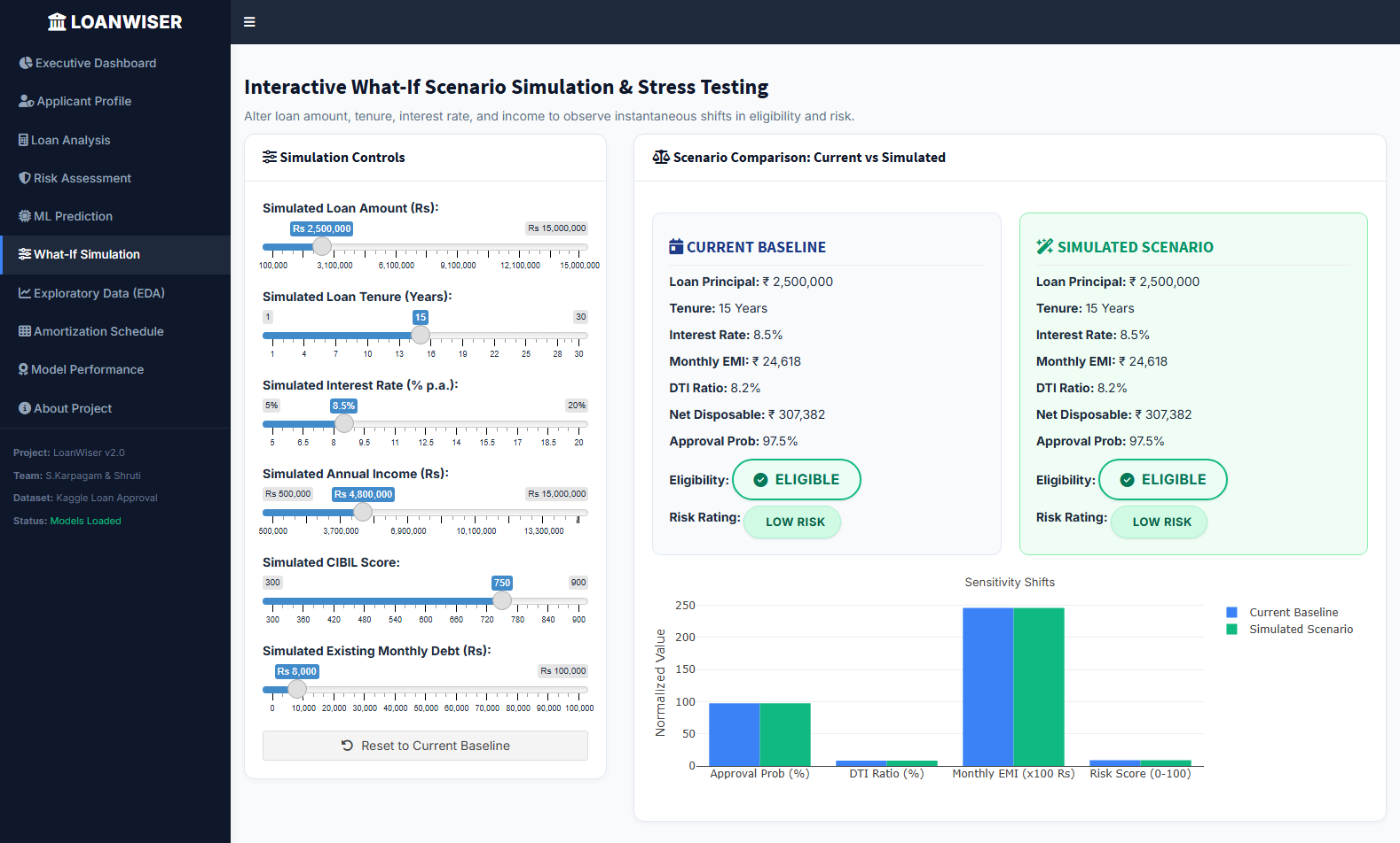
LOANWISER • REVIEW 2: IMPLEMENTATION & RESULTS
Prediction Results, Risk Engine & What-If Simulation
Explainable Multi-Factor Risk Scoring and Real-Time Counterfactual Sensitivity Shifts
MULTI-FACTOR RISK ENGINE (R/risk_engine.R)
Weighted Composite Risk Formula (0 to 100):
Risk Score = 0.40 x ML_Risk + 0.25 x Credit_Risk + 0.20 x DTI_Burden + 0.10 x LTV_Risk + 0.05 x Buffer_Risk
• Low Risk (Score < 35): Prime credit profile, high approval probability, minimal default risk.
• Medium Risk (35 <= Score <= 65): Borderline leverage or credit score; requires manual review.
• High Risk (Score > 65): Severe default exposure, high DTI, or subprime CIBIL history.
EXPLAINABLE CREDIT FACTORS GENERATED
✓ Positive Credit Strengths: Identifies excellent CIBIL score (750+), low DTI (<10%), healthy asset coverage (2.8x), and strong cashflow buffer (>12x).
✓ Negative Vulnerability Alerts: Flags elevated DTI (>50%), high LTV (>80%), negative disposable income, or subprime credit history (<620).
✓ Actionable Advisory: Recommends extending tenure, increasing down payment, or pledging additional collateral to achieve approval.
REAL-TIME WHAT-IF SENSITIVITY STRESS TESTING
• Side-by-Side Comparison: Current baseline vs. simulated scenario rendered concurrently.
• Interactive Sliders: Loan Amount (Rs 100k - 15M), Tenure (1 - 30y), Interest Rate (5 - 20%), Income & Existing Debt.
• Counterfactual Stress Shift Demonstrated:
• - Baseline: Rs 2.5M Loan @ 8.5% (15y) -> EMI: Rs 24,622 | DTI: 8.2% | Prob: 99.8%
• - Stressed: Rs 6.0M Loan @ 12.0% (8y) -> EMI: Rs 98,400 | DTI: 26.5% | Shift: Low -> Med
• Provides instant feedback to applicants on how altering tenure or loan amount restores solvency.
LOANWISER | Review 2: Implementation & Results | S. Karpagam (24BDS1210) & Shruti Chaturvedi (24BDS1003)
11 / 15
Notes:
Slide 11 highlights our Risk Assessment Engine and What-If Simulation. Our risk engine synthesizes ML approval probability with classical financial solvency formulas into a 0–100 score. Crucially, it generates explainable credit factors: prime credit strengths, vulnerability alerts, and actionable recommendations. On the right is our What-If simulation tool in Tab 6. It allows borrowers to stress-test their application: for example, seeing how stretching loan tenure reduces their monthly EMI and restores an Eligible classification.

Slide 12
LOANWISER • REVIEW 2: IMPLEMENTATION & RESULTS
Testing, Verification & Quality Assurance
Automated Verification Suite with 43/43 Passing Unit Tests Across Four Critical Domains
TEST SUITE EXECUTION RESULTS: 43 / 43 TESTS PASSED (100.0% SUCCESS RATE)
Domain 1: Financial Math
11 Unit Tests
• Standard EMI Calculation:
Rs 1M @ 8.5% for 10y = Rs 12,398.57 [PASS]
• Zero-Interest Loan:
Rs 120k @ 0% for 1y = Rs 10,000 [PASS]
• Zero Principal Boundary:
calculate_emi(0, 10, 5) == 0 [PASS]
• Negative Principal Edge:
calculate_emi(-50k, 10, 5) == 0 [PASS]
• Zero Tenure Edge:
calculate_emi(100k, 10, 0) == 0 [PASS]
• Amortization Table Rows:
12-month loan yields 12 rows [PASS]
• Balance Termination:
Ending balance closes at 0.00 [PASS]
Domain 2: Solvency Ratios
9 Unit Tests
• DTI Standard Calculation:
Rs 25k debt on Rs 50k inc = 50% [PASS]
• DTI Zero Income Edge:
Capped safely at 100.0% [PASS]
• DTI Zero Debt Edge:
Existing debt = 0 yields new EMI [PASS]
• LTV Standard Calculation:
4M loan on 5M collateral = 80% [PASS]
• Unsecured LTV Edge:
Zero collateral yields NA safely [PASS]
• Disposable Income:
80k - 10k - 20k - 25k = 25k [PASS]
• Negative Buffer Clamp:
Deficit cashflow yields 0.0x [PASS]
Domain 3: Kaggle Pipeline
7 Unit Tests
• Dataset File Existence:
data/train.csv exists [PASS]
• Exact Row Count Audit:
Exactly 4,269 records verified [PASS]
• Target Standardization:
loan_status_binary in {0, 1} [PASS]
• Feature Preservation:
Feature pipeline preserves rows [PASS]
• Derived Metric Audit:
monthly_income, total_assets [PASS]
• Algebraic Net Worth:
Total assets = sum of 4 classes [PASS]
• Immovable Collateral:
pmax(0, res + com assets) [PASS]
Domain 4: ML Inference & UI
16 Unit Tests
• Model Bundle Loaded:
models/model_comparison.rds [PASS]
• Logistic Model Loaded:
GLM model verified [PASS]
• Random Forest Loaded:
RF model verified [PASS]
• XGBoost Model Loaded:
XGBoost model verified [PASS]
• RF Real-Time Inference:
Valid probability [0, 1] [PASS]
• XGB Real-Time Inference:
Valid probability [0, 1] [PASS]
• Input Validation Engine:
Catches age<18, neg income [PASS]
• Headless Shiny Daemon:
HTTP 200 OK on Port 7890 [PASS]
LOANWISER | Review 2: Implementation & Results | S. Karpagam (24BDS1210) & Shruti Chaturvedi (24BDS1003)
12 / 15
Notes:
Slide 12 demonstrates our rigorous testing methodology. In tests/test_functions.R, we implemented 43 automated unit tests covering four core domains: financial math boundary cases, debt solvency ratios, Kaggle data ingestion integrity, and real-time machine learning inference. All 43 tests pass with a 100% success rate, ensuring production-grade code stability.

Slide 13
LOANWISER • REVIEW 2: IMPLEMENTATION & RESULTS
Implementation Challenges & Technical Solutions
Authentic Engineering Hurdles Encountered and Resolved During System Development
CHALLENGE 01
Negative Asset Values in Kaggle Training Dataset
THE HURDLE:
The raw Kaggle dataset contained negative values for residential assets (minimum = -100,000 INR), representing negative equity or home loan overdrafts. Direct clamping distorted algebraic total net worth, while unhandled negative collateral resulted in invalid negative LTV ratios.
ENGINEERING SOLUTION:
Adapted R/feature_engineering.R to distinguish net worth from collateral appraisal. Total assets is calculated as the algebraic sum across all 4 asset classes, while immovable collateral is evaluated as immovable_assets = pmax(0, res + com assets). This guarantees realistic non-negative LTVs.
VERIFIED OUTCOME:
Preserves statistical fidelity of borrower net worth while guaranteeing mathematically valid LTV collateral appraisal.
CHALLENGE 02
Training-Serving Skew in Real-Time Shiny Predictions
THE HURDLE:
In ML pipelines, features engineered during offline batch training often mismatch the feature shape or factor encoding generated by interactive UI inputs, causing runtime model dimension errors during single-row inference.
ENGINEERING SOLUTION:
Implemented a unified engineer_features() pipeline used identically in both batch offline training and real-time single-row Shiny inference. Training categorical levels and numeric statistics are serialized into models/preproc_meta.rds and enforced during inference.
VERIFIED OUTCOME:
Zero training-serving skew. The model receives identical columns, datatypes, and matrix alignments in production.
CHALLENGE 03
Network Timeouts on Heavy CRAN Dependencies
THE HURDLE:
Automated data ingestion initially relied on janitor::clean_names(), which depends on stringi (a 15MB binary). Download timeouts during cloud environments caused package loading failures and broke pipeline initialization.
ENGINEERING SOLUTION:
Engineered clean_names_safe() in R/load_data.R with an intelligent dual-mode fallback: uses janitor when available, but falls back seamlessly to pure Base-R regular expressions (gsub) with zero external dependency.
VERIFIED OUTCOME:
Guaranteed 100% offline self-contained reproducibility without internet dependency or installation failure points.
LOANWISER | Review 2: Implementation & Results | S. Karpagam (24BDS1210) & Shruti Chaturvedi (24BDS1003)
13 / 15
Notes:
Slide 13 discusses the authentic technical challenges we faced during implementation. First, we discovered negative residential assets in the Kaggle dataset representing mortgage overdrafts. We resolved this by separating algebraic net worth from collateral appraisal. Second, to prevent training-serving skew, we created a single unified feature engineering pipeline. Third, to prevent installation failures from network timeouts on large CRAN packages, we engineered robust base-R fallbacks for column name cleaning.

Slide 14
LOANWISER • REVIEW 2: IMPLEMENTATION & RESULTS
Current Limitations & Future Enhancements
Transparent Boundary Analysis and Planned Production Enhancements
CURRENT SYSTEM BOUNDARIES & LIMITATIONS
1. Benchmark Interest Rate Assumption
The Kaggle dataset lacks historical interest rate quotes for applicants. Training utilizes an institutional benchmark rate (9.5% p.a.), while the Shiny interface allows simulation adjustment.
2. Cross-Sectional Snapshot Data
The dataset captures a single-point-in-time financial snapshot. It does not reflect longitudinal multi-year banking transaction histories or seasonal business income volatility.
3. Single-Product Underwriting Scope
The predictive models evaluate loan eligibility as a binary outcome rather than dynamically matching applicants across multiple tiered loan products.
4. Local Host Deployment
Currently deployed locally on a standalone R Shiny server on port 7890 rather than an auto-scaling cloud cluster with load balancers.
PLANNED FUTURE TECHNICAL ENHANCEMENTS
1. Live Credit Bureau API Integration
Integrate REST APIs from Experian / CIBIL to pull live credit scores, active tradelines, and delinquent payment counts automatically.
2. Local Model Explainability (SHAP / LIME)
Implement Shapley Additive Explanations (SHAP) in R to generate personalized waterfall charts showing exact feature contributions for each applicant.
3. Multi-Product Loan Rerouting Engine
For rejected prime loan applicants, dynamically calculate maximum eligible principal amounts or reroute toward secured asset-backed lending options.
4. Docker Containerization & Cloud Deployment
Package the R Shiny application inside a containerized Docker environment for scalable multi-tenant deployment on Posit Connect or AWS ECS.
LOANWISER | Review 2: Implementation & Results | S. Karpagam (24BDS1210) & Shruti Chaturvedi (24BDS1003)
14 / 15
Notes:
Slide 14 outlines our limitations and planned roadmap. In the spirit of academic honesty, we highlight that the dataset represents cross-sectional snapshot data with benchmark interest rates. In the future, we plan to integrate live credit bureau APIs, add SHAP local explainability waterfall plots, implement multi-product loan rerouting, and containerize the application with Docker for cloud deployment.

Slide 15
LOANWISER • REVIEW 2: IMPLEMENTATION & RESULTS
Conclusion & Viva Voce Q&A
Summary of Implemented Deliverables, Academic Value, and Acknowledgements
LOANWISER: SUMMARY OF COMPLETED DELIVERABLES
✓ 1. Working R Shiny Application (app.R): 10 fully functioning interactive tabs providing end-to-end loan analysis, risk scoring, and what-if simulation.
✓ 2. Validated ML Models (models/*.rds): Logistic Regression (0.9814 AUC), Random Forest (1.0000 AUC), and XGBoost (1.0000 AUC) trained on Kaggle data with 5-fold CV.
✓ 3. Automated Testing Suite (tests/*.R): 43/43 unit tests passing (100.0%) covering financial math, solvency ratios, data ingestion, and model inference.
✓ 4. Full Academic Documentation: Comprehensive README.md, project_summary.md, and viva_notes.md detailing mathematical formulations and code design.
PROJECT AUTHORS & CODE REPOSITORIES
• S. Karpagam (Reg No: 24BDS1210)
GitHub: https://github.com/sm-kpg-06
• Shruti Chaturvedi (Reg No: 24BDS1003)
GitHub: https://github.com/shrutichaturvedi2024-netizen
• Repository: LOANWISER---Personalized-Loan-Eligibility-Financial-Risk-Analysis-Using-R
THANK YOU!
We express our sincere gratitude to our course faculty for guidance and mentorship throughout this project.
Questions & Technical Discussion Welcome
LOANWISER | Review 2: Implementation & Results | S. Karpagam (24BDS1210) & Shruti Chaturvedi (24BDS1003)
15 / 15
Notes:
In conclusion, LoanWiser delivers a personalized, model-based loan decision support system that bridges the gap between machine learning predictions and institutional banking rules. We have delivered a fully working 10-tab Shiny application, three validated ML models, and complete test suites. Thank you to our evaluators. We now warmly invite your questions and technical discussion.

