Slide 1
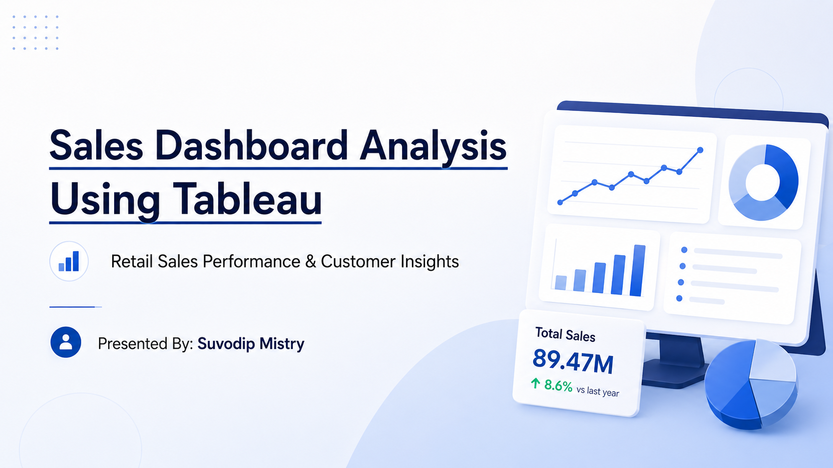

Slide 2
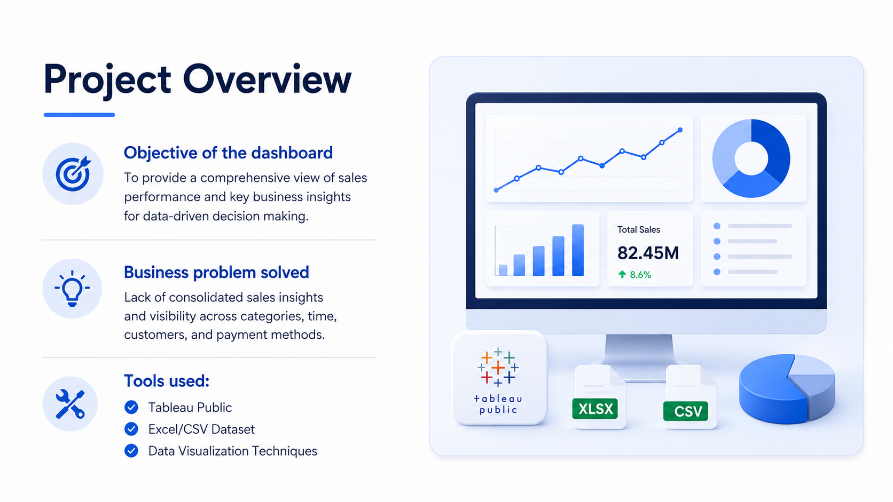

Slide 3
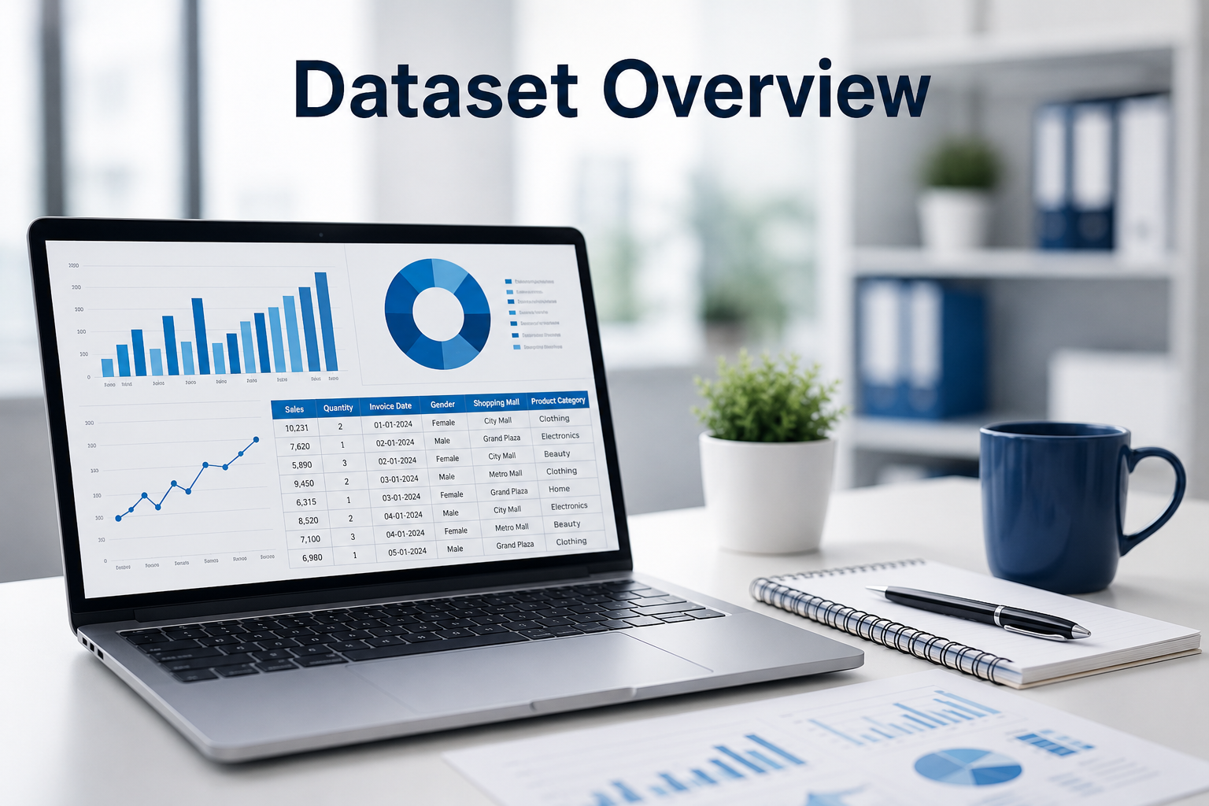
Dataset Overview
Dataset source
Key fields:
Sales
Quantity
Invoice Date
Gender
Shopping Mall
Product Category
Data preparation steps

Slide 4
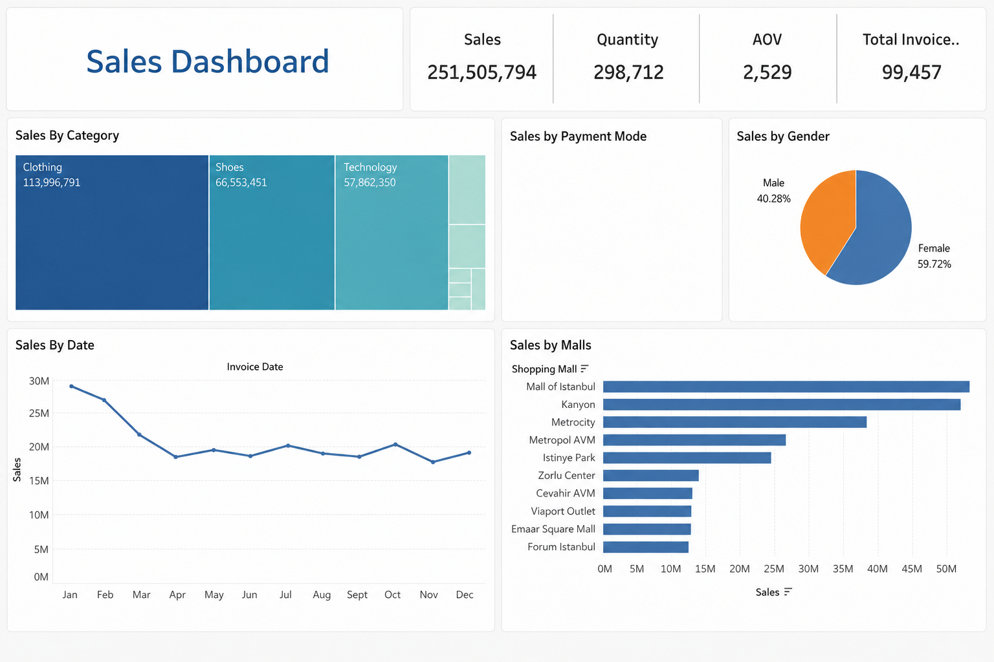
Dashboard Overview
Topics:
Dashboard Components
Filters & Interactivity
KPI Cards
Charts & Visualizations Used

Slide 5
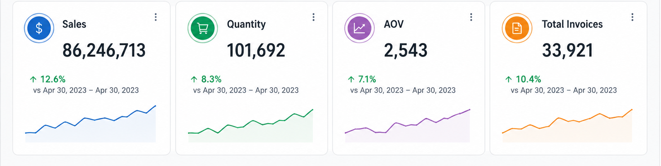
KPI Performance Analysis
Topics:
Total Sales
Total Quantity Sold
Average Order Value (AOV)
Total Invoices
Business Performance Summary

Slide 6
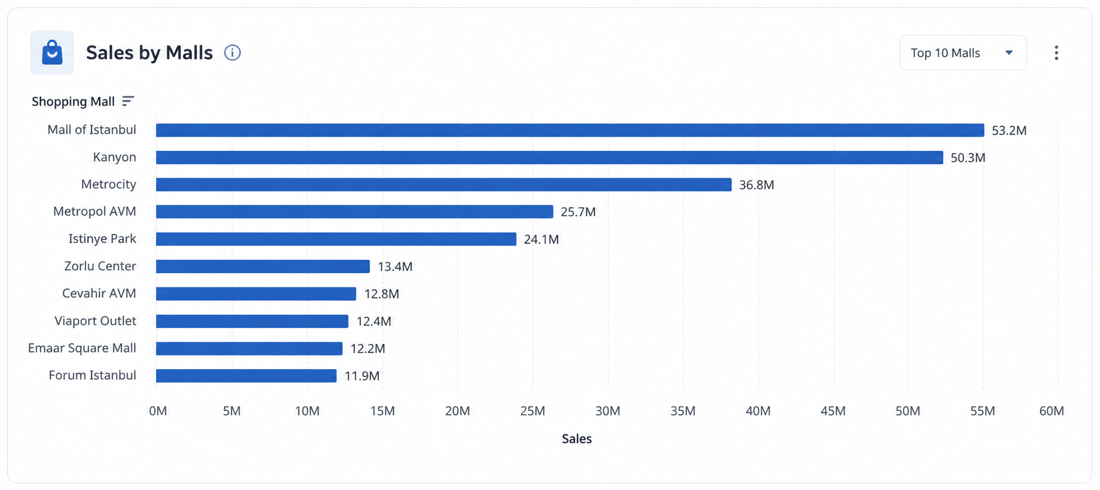
Sales by Category Analysis
Topics:
Highest Revenue Category
Product Category Comparison
Tree map Visualization Insights
Business Impact of Product Categories

Slide 7
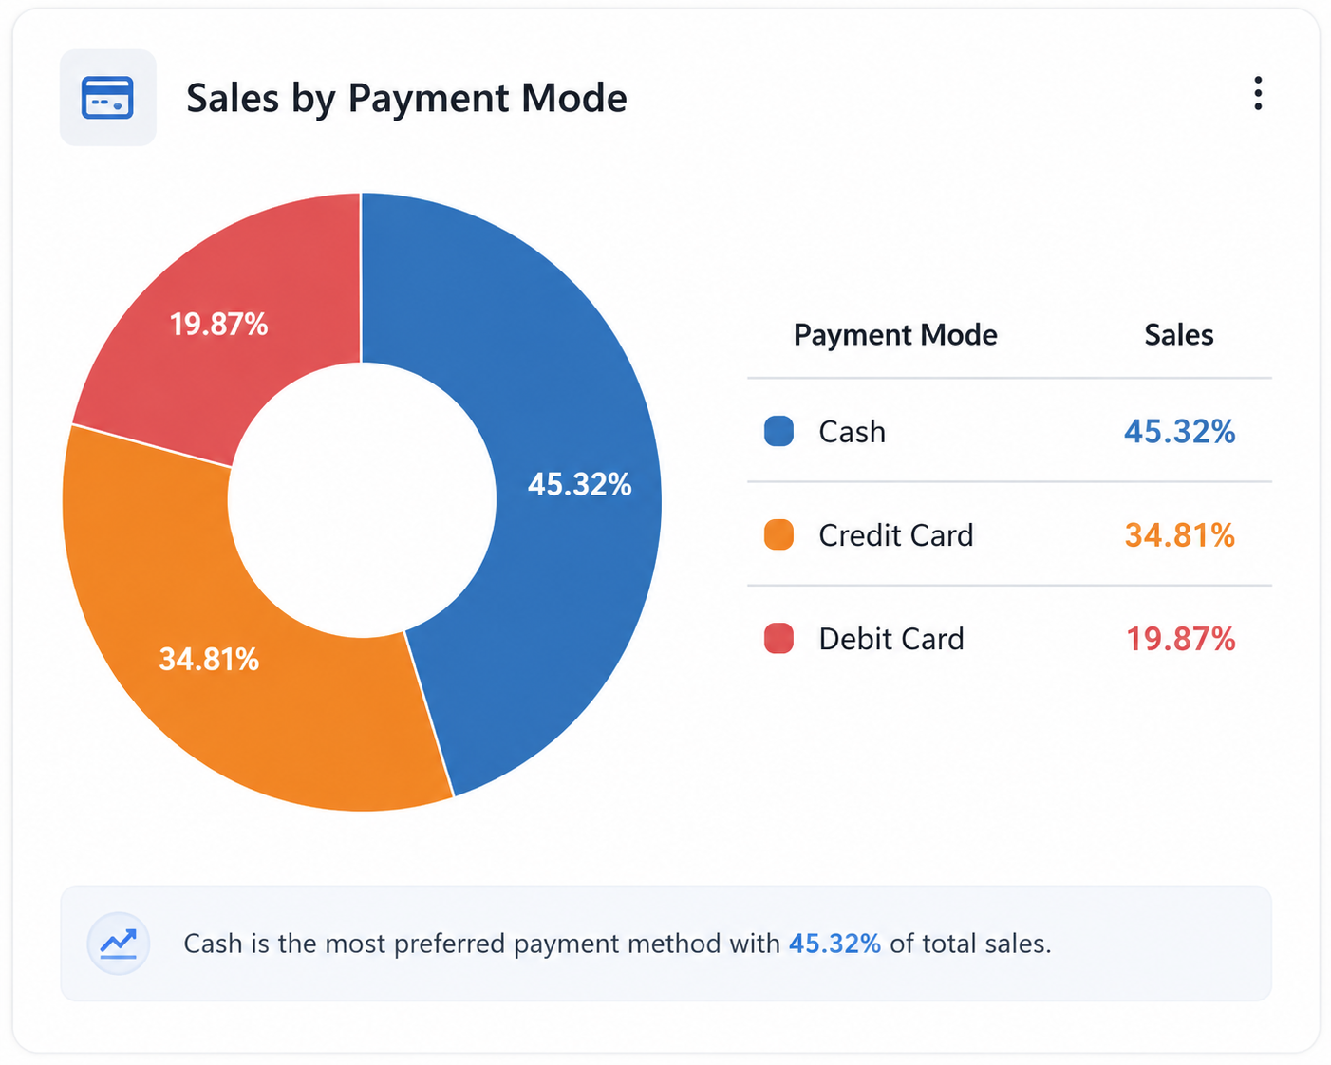
Sales by Payment Mode
Topics:
Cash vs Credit Card vs Debit Card
Most Preferred Payment Method
Payment Distribution Insights
Customer Transaction Patterns

Slide 8
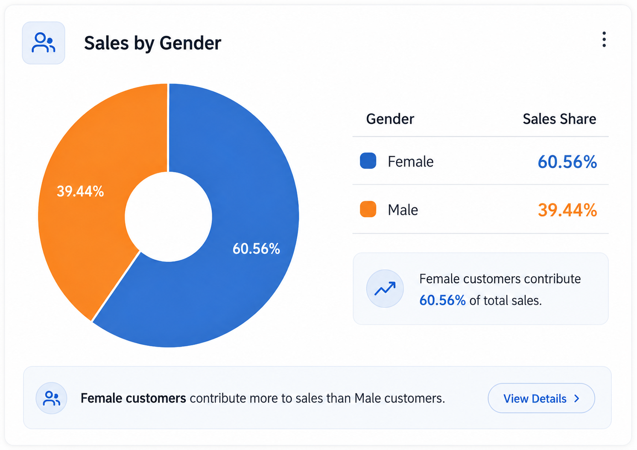
Sales by Gender
Topics:
Male vs Female Contribution
Purchase Behavior Analysis
Customer Segmentation Insights
Marketing Opportunities

Slide 9
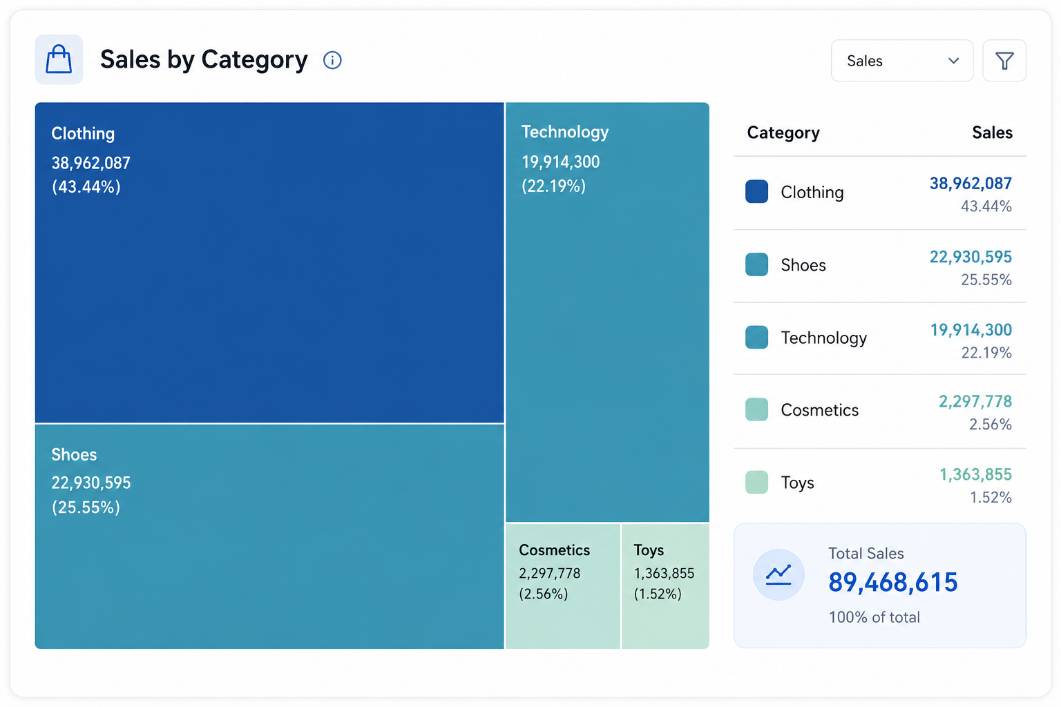
Monthly Sales Trend Analysis
Topics:
Monthly Sales Performance
Seasonal Trends
Peak & Low Sales Periods
Time-Series Insights

Slide 10
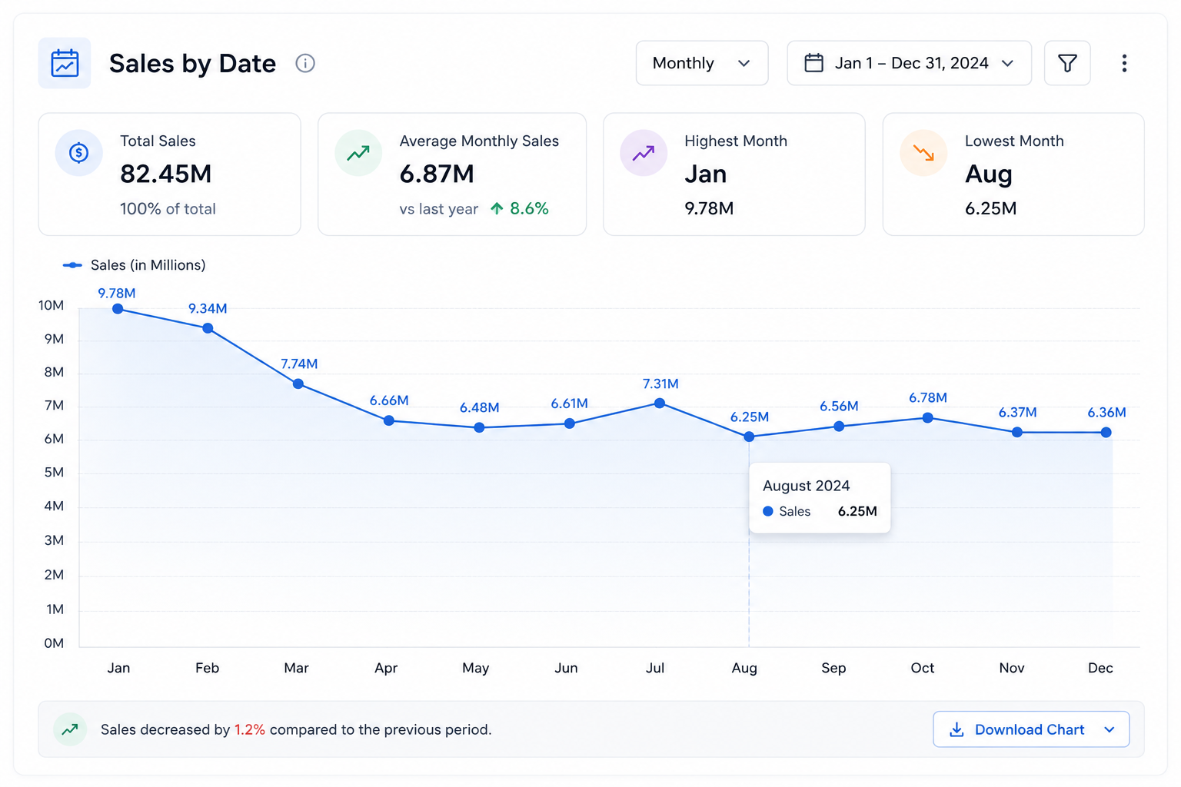
Shopping Mall Performance
Topics:
Top Performing Malls
Revenue Comparison
Customer Traffic Insights
Location-Based Business Analysis

Slide 11
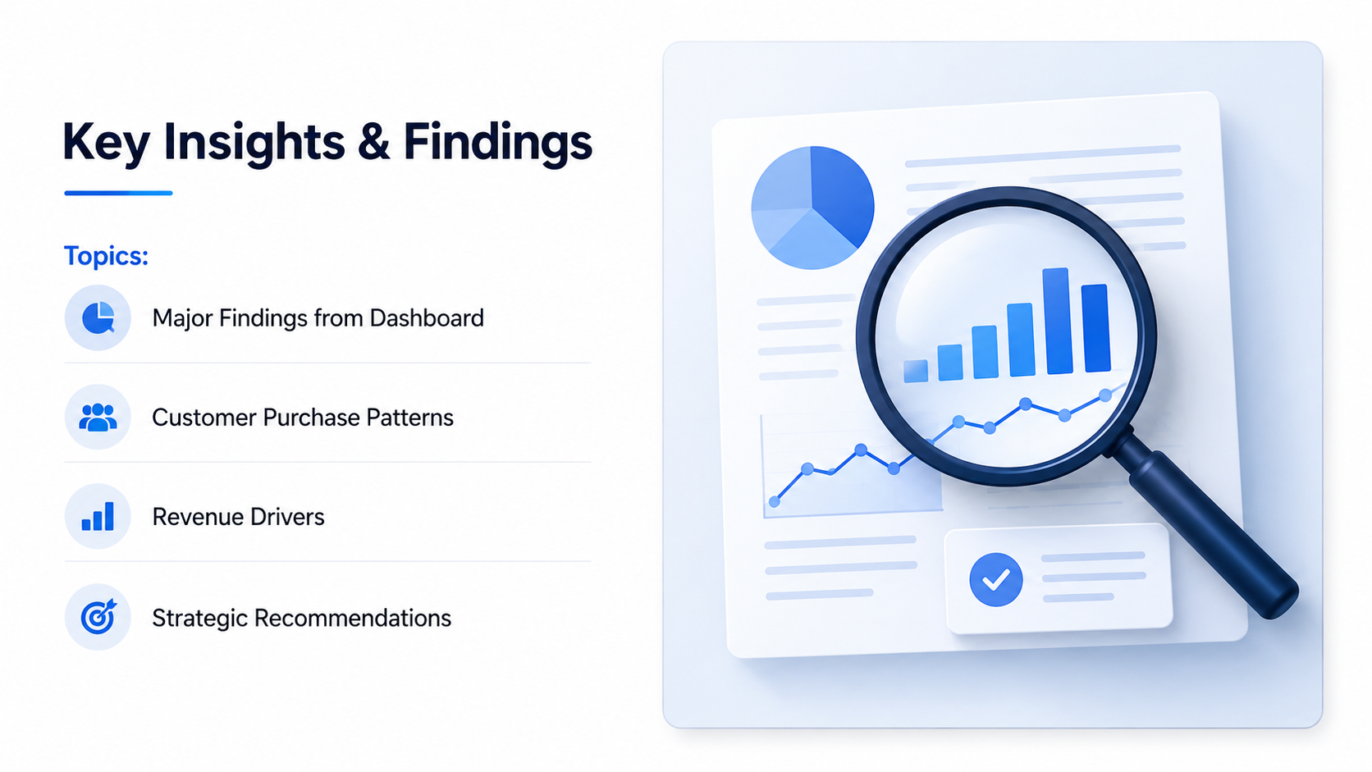

Slide 12
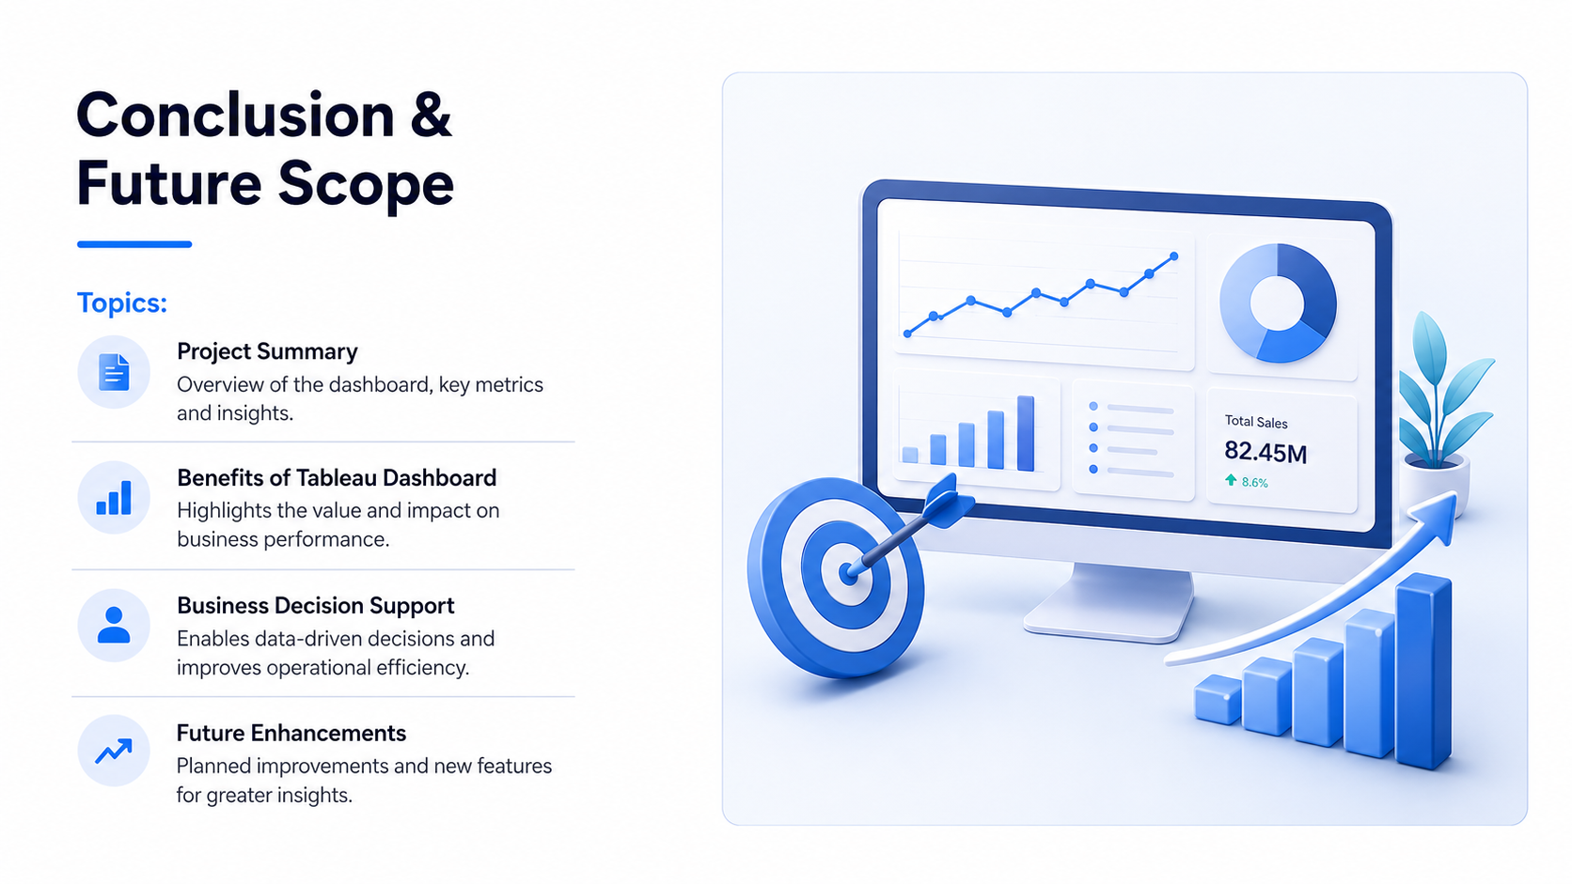

Slide 13


