Slide 1
Tampines Street 83 Precinct
Structural Layout & Architectural Directory — Tampines Parkview (HDB)
Unit types · Floor layouts · Floor size · Window size & orientation
Blocks: 857, 863, 857A, 857B, 863A, 863B, 862, 862A, 864, 864A · Est. 1987
Source: HDB block signage (857B, 862A, 864A), Tampines Parkview master report (est. 1987). Verify with official HDB floor plans.

Slide 2
1. Precinct Master Specification Table
All 10 blocks along Tampines Street 83
Block | Typology | Model | Storeys | 4-Rm | 5-Rm | EM | Total | Floor Size | Orientation | Windows
857 | Exec Maisonette Slab | Maisonette (Duplex) | Up to 11 | 0 | 0 | 80 | 80 | 146-154 m2 | N-S Axis | Dbl-height + casement
863 | Exec Maisonette Slab | Maisonette (Duplex) | Up to 11 | 0 | 0 | 80 | 80 | 146-154 m2 | N-S Axis | Dbl-height + casement
857A | Low-Rise Point | Model A / Improved | 4 | 10 | 6 | 0 | 16 | 104-122 m2 | N-S Vector | 4-6 / 5-7 panes
857B | Low-Rise Point | Model A / Improved | 4 | 10 | 6 | 0 | 16 | 104-122 m2 | N-S Vector | 4-6 / 5-7 panes
863A | Low-Rise Point | Model A / Improved | 4 | 10 | 6 | 0 | 16 | 104-122 m2 | N-S Vector | 4-6 / 5-7 panes
863B | Low-Rise Point | Model A / Improved | 4 | 10 | 6 | 0 | 16 | 104-122 m2 | N-S Vector | 4-6 / 5-7 panes
862 | High-Rise Slab | Model A / Improved | Up to 13 | 54 | 42 | 0 | 96 | 104-122 m2 | N-S Vector | 4-6 / 5-7 panes
862A | High-Rise Slab | Model A / Improved | Up to 13 | 54 | 42 | 0 | 96 | 104-122 m2 | N-S Vector | 4-6 / 5-7 panes
864 | High-Rise Slab | Model A / Improved | Up to 13 | 54 | 42 | 0 | 96 | 104-122 m2 | N-S Vector | 4-6 / 5-7 panes
864A | High-Rise Slab | Model A / Improved | Up to 13 | 54 | 42 | 0 | 96 | 104-122 m2 | N-S Vector | 4-6 / 5-7 panes
Total | Precinct Aggregate |  |  | 246 | 192 | 160 | 598 |  | All N-S
Source: HDB block signage (857B, 862A, 864A), Tampines Parkview master report (est. 1987). Verify with official HDB floor plans.

Slide 3
2. Grouped Summary — 3 Typology Groups
GROUP 1 · Executive Maisonette Slab
Blocks 857, 863
GROUP 2 · Low-Rise 4-Storey Point
Blocks 857A, 857B, 863A, 863B
GROUP 3 · High-Rise Slab
Blocks 862, 862A, 864, 864A
• Long linear double-storey (duplex) slab
• Up to 11 storeys
• 80 units/block = 80 Exec Maisonette
• Floor size: 146-154 m2
• Orientation: North-South Axis
• Windows: double-height glazing +
casement (upper quarters)
• 2 lift/stair cores + common deck
• L-shaped point block, 4 units/floor
• 4 storeys
• 16 units/block = 10x4-Rm + 6x5-Rm
• Floor size: 104-122 m2
• Orientation: North-South Vector
• Windows: 4-6 (4Rm) / 5-7 (5Rm) panes
• Stacks 390,392 = 5-Rm; 394,396 = 4-Rm
• 1 stair/lift entry lobby
• Slab: 5-Rm end wings + 4-Rm core run
• Up to 13 storeys
• 96 units/block = 54x4-Rm + 42x5-Rm
• Floor size: 104-122 m2
• Orientation: North-South Vector
• Windows: 4-6 (4Rm) / 5-7 (5Rm) panes
• 862/862A dog-leg; 864/864A I-slab
• 2 lift/stair cores + dry riser
Precinct aggregate: 246 x 4-Room + 192 x 5-Room + 160 Exec Maisonette = 598 units.

Slide 4
3A. Blocks 857 & 863 — Executive Maisonette Long Slab
8 maisonette stacks in two segments · 2 lift/stair cores · continuous common-access deck
Segment 1 — West Half (Stacks 1-4)
Stack 01
Maisonette
Stack 02
Maisonette
LIFT A
+ STAIR
LIFT A
+ STAIR
Stack 03
Maisonette
Stack 04
Maisonette
===== Continuous Common Access Deck (West) =====
Segment 2 — East Half (Stacks 5-8)
Stack 05
Maisonette
Stack 06
Maisonette
LIFT B
+ STAIR
LIFT B
+ STAIR
Stack 07
Maisonette
Stack 08
Maisonette
===== Continuous Common Access Deck (East) =====
4-Room Model A
5-Room Improved
Exec Maisonette
Lift / Stair core
All 80 units per block are Executive Maisonette duplexes (146-154 m2), oriented on the North-South axis. Lower balcony: double-height structural glazing; upper private quarters: heavy-frame casement windows.

Slide 5
3B. Blocks 857A, 857B, 863A, 863B — Low-Rise 4-Storey Point Block
4 units per floor around one stair/lift lobby (per Block 857B signage)
STAIR / LIFT
ENTRY LOBBY
(ES)
392
5-Room
390
5-Room
394
4-Room
396
4-Room
4-Room Model A
5-Room Improved
Exec Maisonette
Lift / Stair core
L-shaped, high-privacy point block · 4 storeys · 16 units/block (10 x 4-Room + 6 x 5-Room) · 104-122 m2 · North-South vector.
Corridor-facing rooms use high sill lines and sandblasted privacy glass louvres; living rooms face N-S for cross-ventilation.

Slide 6
3C. Blocks 862 & 862A — High-Rise Dog-Leg Slab
5-Room end wings + central 4-Room run · 2 cores (per Block 862A signage)
414
5-Room
426
5-Room
416
5-Room
LIFT A
+ ES
418
4-Room
420
4-Room
422
4-Room
424
4-Room
LIFT B
+ ES/DR
428
5-Room
4-Room Model A
5-Room Improved
Exec Maisonette
Lift / Stair core
High-rise slab · up to 13 storeys · 96 units/block (54 x 4-Room + 42 x 5-Room) · 104-122 m2 · North-South vector.
5-Room Improved units occupy the end wings for corner exposure; 4-Room Model A units line the central corridor.

Slide 7
3D. Blocks 864 & 864A — High-Rise Linear I-Slab
4-Room corridor run · 5-Room units isolated at both ends (per Block 864A signage)
LIFT A
+ ES/DR
458 4-Room
460 5-Room
456 4-Room
454 4-Room
Straight linear I-slab. The 4-Room Model A units form a single corridor run (450-458). The 5-Room Improved units (446, 448, 460) are isolated at the bottom-left projection and the top-right end for privacy and corner exposure.
Up to 13 storeys · 96 units/block · 104-122 m2 · North-South vector.
452 4-Room
LIFT B
+ ES/DR
450 4-Room
446 5-Room
448 5-Room
4-Room Model A
5-Room Improved
Exec Maisonette
Lift / Stair core

Slide 8
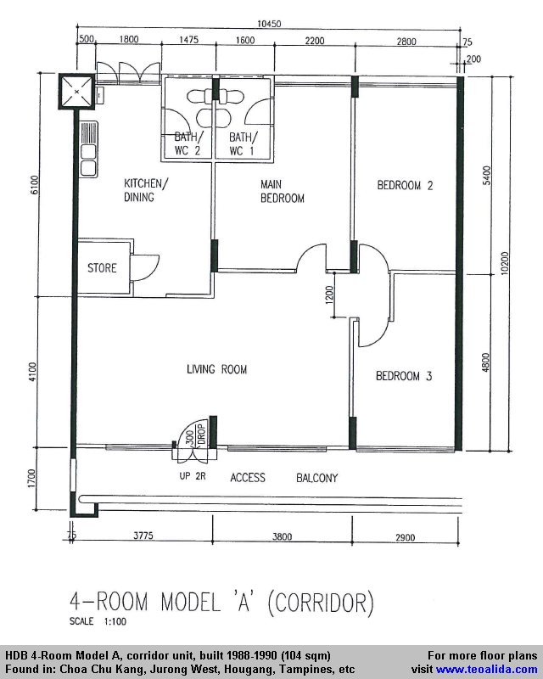
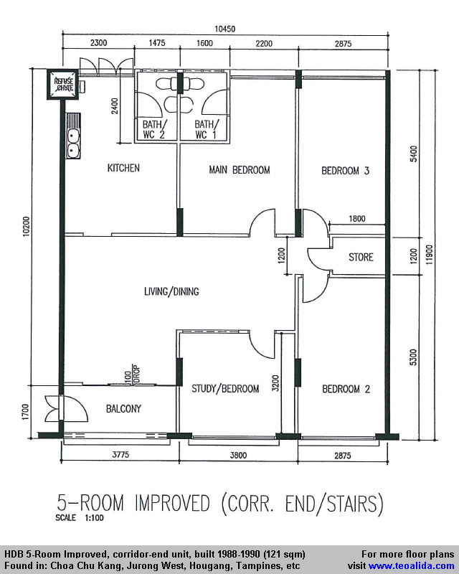
4. Reference Floor Plans — 4-Room & 5-Room (dimensioned)
Standard HDB plans for the unit type · scale 1:100 · indicative for 857-864A
4-Room Model A (~104 m²)
5-Room Improved (~121 m²)
Reference plans are DIMENSIONED standard HDB plans for the unit type (scale 1:100), indicative for blocks 857-864A - not the exact block drawings. Source: housingmap.sg / teoalida.com. Verify via HDB InfoWEB.

Slide 9
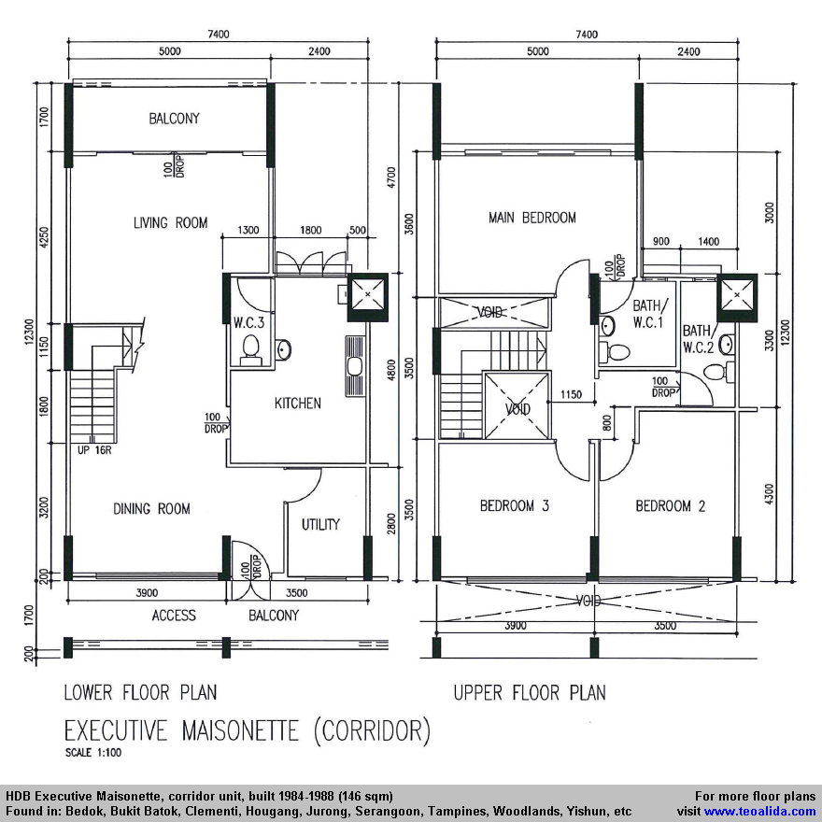
5. Reference Floor Plan — Executive Maisonette (dimensioned)
Two-storey standard HDB plan · scale 1:100 · indicative for blocks 857 & 863
Executive Maisonette (Duplex, 146–154 m²)
• Lower floor: living + dining + kitchen + utility + guest WC, balconies.
• Upper floor: master bedroom (en-suite) + bedrooms 2 & 3 + 2 baths.
• Internal staircase links the two levels.
• Double-height glazing at balcony; casement windows upstairs.
• North–South axis orientation (blocks 857 & 863).
This standard 1983–1987 corridor Maisonette (147 m²) matches the era and size of blocks 857/863; the plan is dimensioned at 1:100 but is indicative for the type, not the exact block drawing.
Reference plans are DIMENSIONED standard HDB plans for the unit type (scale 1:100), indicative for blocks 857-864A - not the exact block drawings. Source: housingmap.sg / teoalida.com. Verify via HDB InfoWEB.

