Slide 1
Introduction to Linux Shell
15-213/18-213/15-513/14-513/18-613: Introduction to Computer Systems

Slide 2
Linux Shell
The shell is a program that takes commands from the keyboard and gives them to the operating system to perform
Computers “think” in text commands
Write commands using a “Command Line Interface” (CLI), often called a “terminal”
Say the basics of being in a directory, include slide
What is linux?
On most Linux systems a program called bash acts as the shell
Other shell programs which include: sh, ksh, tcsh and zsh.

Slide 3
The Basics: Directories
Two commands commonly used to work with the current working directory:
pwd - print working directory
This tells you what directory you are currently in
cd - change directory
This lets you change into a different directory
Important Directory Names:
~ – the home directory
~andrewid – the home directory of user “andrewid”
. – the current directory
.. – the parent directory (the directory right above the current one)
/ – the root directory (the main directory that has no parent)

Slide 4
Manual pages (man pages)
If you are ever unsure about a command one helpful resource is to utilize man pages
$ man <command>
Gives information on what a command does and what options you can give it.
You can search through a man page by typing: /thing_i_want_to_find
Advance from one match to the next by pressing n
Most commands have a --help or -h option that will print out a help message
For more information about the man command, enter:
$ man man

Slide 5
Managing your files

Slide 6
Managing files: Moving, creating & deleting files
cp <source> <destination> - copy files
mv <source> <destination> - move and rename files
rm <filename> - PERMANENTLY delete files
rmdir <filename> - PERMANENTLY delete empty directory
mkdir <directory> - make directories
touch <file> - create an empty file
List the files in the current directory:
ls [path] - listing files
tree [path] - recursively listing files

Slide 7
WHAT NOT TO DO [BAD]
$ rm -rf /
$ rm -rf *
$ rm -rf .
$ mv /home/user/* /dev/null
What Not to Do Part 1
What Not to Do Part 2
THESE ARE
BAD! NEVER
TRY THIS!

Slide 8
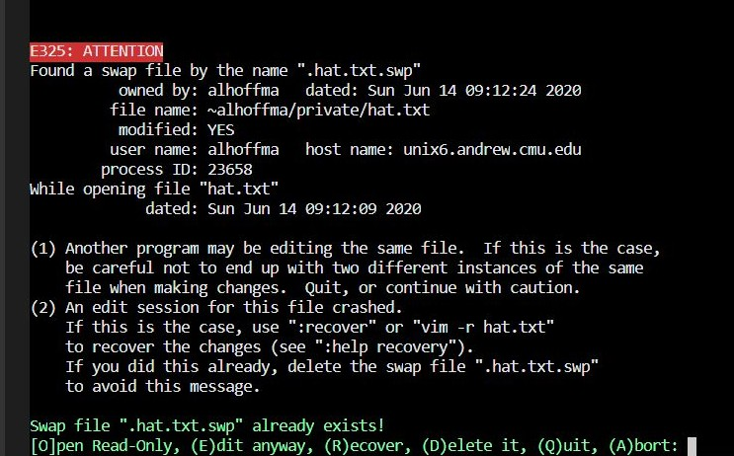
Hidden & Temporary Files
Hidden files begin with a . and are hidden unless you specify a command for -a (all)
Swap Files **applies to vim**
malloc.c .malloc.c.swp
A copy of an old version of a file that was not properly saved
Solution:
Delete swap file from command line
Open Read Only
Useful for when you only want to view contents
Edit anyway
Be careful! If the file is being edited in another vim session, you will have 2 versions
Recover
Delete it
Quit
Useful to not edit the current file but want to keep other vim sessions open
Abort
Useful to close any open vim sessions
Useful for when Useful for when you know the swap you no longer
file contains the changes you want to recover
need the file

Slide 9
Text Processing
$ sort sort lines of text file
-d: dictionary order
-f: ignore case
-n: numeric sort
-r: reverse
$ cat concatenates inputs and prints on the screen
$ uniq reports or omits repeated lines
$ head/tail prints first (or last) lines of a file
-bx: print out first (or last) x bytes
-nx: print out first (or last) x lines

Slide 10
Other helpful aspects of a shell

Slide 11
File Redirection
Syntax
command < file.txt command > file.txt command >> file.txt command 2> file.txt
command 2>> file.txt
Meaning
Read the stdin of “command” from “file.txt”
Send the stdout of “command” to “file.txt”, overwriting its contents Append the stdout of “command” to the end of “file.txt”
Send the stderr of “command” to “file.txt”, overwriting its contents Append the stderr of “command” to the end of “file.txt”
Example*:
# 'hello.txt' doesn't exist, so it will be created
$ echo "Hello" > hello.txt
$ cat hello.txt Hello
*more on echo at the end :)

Slide 12
Grep (Global Regular Expression Print)
grep searches for patterns in a file [if no file is provided, all files are recursively searched]
$ grep [OPTION...] PATTERNS [FILE...]
Standard Flags
-c: prints count of matching lines
-h: display matches without filenames
-i: ignores case for matching; scanning stops after first match
-l: displays list of only filenames
Examples
$ grep “test” *
$ grep -r “test”
$ grep -rc “test”
-n: display matches and line numbers
-e exp: specificies expression with this option
-f file: takes pattern from file
-o: print only matching parts of lines
-r: read all files under each directory, recursively

Slide 13
Pipes (|)
Pipes are a way to chain together the output from one command with the input to another.
To create a pipe, we use the Unix pipe character: |
Lets use grep to find words in the computer’s dictionary that contain the string “compute”
$ grep compute /usr/share/dict/words
>> compute
computer
… Uncomputed
# Pipe output of grep (on stdout) to the input of wc (on stdin)
$ grep “compute” /usr/share/dict/words | wc -l
>> 34 # Thus, 34 words have the word 'compute' in them
Using pipes effectively can reduce some incredibly hard problems down to one line of code

Slide 14
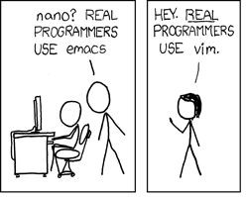
Option 1: VIM
Can be run on pretty much any terminal.
To make vim *spicy* or to add extra functionality you can modify your ~/.vimrc!
Use vim by SSH-ing into a shark machine
According to legend, if you learn all the keyboard shortcuts, the rate at which your fingers travel approach lightspeed, to the point of being a potential hazard to those in your general vicinity.

Slide 15
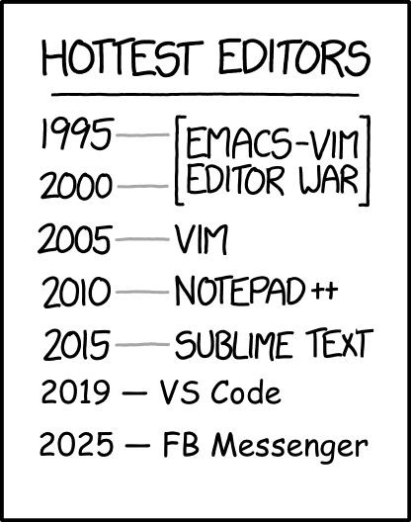
Option 2: VS Code + SFTP
Text editor with lots of traditional functionality.
Tabs, easy window split, built-in terminal, tree view, etc.
Cool plugins to make code prettier + life easier.
People won’t make fun of you for using the mouse.
(Except for VIM purists)
(Don’t let the haters get to you)

Slide 16
Other Notable Editors
Emacs
Command line editor like Vim
Lots of powerful features, but can be very complicated at times
Sublime Text
Editing application with an SFTP Plugin, like VS Code
Simpler and more lightweight than VS code

Slide 17
Vim!
Vim is a terminal-based text editor that is highly customizable
$ vim ~/.vimrc
Three big modes:
Normal mode: press the “esc” key.
-- INSERT -- mode: press the “i” key in normal mode (make sure you see the --INSERT--)
Then type that into the text buffer
-- VISUAL -- mode: press the “v” key in normal mode.
Use arrow keys to highlight a selection
“Copy and paste”:
Highlight text, press “y” to yank (copy) and “p” to paste
Press “d” twice will delete the selection, which also makes it available to paste with “p”

Slide 18
Closing Vim :(
When done, press “esc” and then type in “:w” to save
Type in “:q” to quit VIM
This can be combined into “:wq” to save and quit in one command
Try $ vimtutor for more tips and tricks for VIM that we might not have covered!

Slide 19
Echo & sed commands
echo is used to display line of text/string that are passed as an argument
$ echo ls -l | sh
#Passes the output of "echo ls -l " to the shell, with the same result as a simple ls -l
sed can do insertion, deletion, search and replace (substitution)
$ sed 's/old_word/new_word/' file.txt
s → substitution
Substitutes ‘old_word ’ with ‘new_word ’ in file.txt

