Slide 1
Forecasting Credit Card Spending for Personalized Customer Relationship Management
A Predictive Analysis
Jessenth Ebenezer (15154)

Slide 2
The problem
Context
Data
Problem statement
Accurate predictions of consumer spending patterns are vital for banks, enabling them to tailor their services and marketing strategies effectively.
To achieve this, we will explore customer demographics, financial information, and past transaction history to build a predictive model.
Build a suitable Machine Learning model that predicts the average credit card spend of a customer over the next 3 months based on parameters listed in the dataset.

Slide 3
Challenges deep-dive
Data Quality
Feature Complexity
Model Selection
Missing Values and Irrelevant Features
As with any data of a significant size, there is a lot of information that may prove to be unwanted for the task at hand, implementing the right strategies to impute these values and taking decisions based on domain expertise is vital
Selecting and Engineering the right parameters
The complexity of financial data requires careful feature engineering to capture meaningful information. Deciding how to approach certain values require studying correlation and pattern recognition to ensure nothing of importance is lost and maintain accuracy throughout.
Going beyond thresholds
Going through a plethora of regression models and evaluating each model’s performance and tuning them to make sure the expected performance criteria is met successfully, with various methods of ensemble learning, hyperparameter tuning, etc.

Slide 4
Solution
Combining predictions from multiple base models such as Ridge, Lasso, Random Forest, Linear Regression, XGBoost, etc.
Scores well below threshold (~111 on validation set, 116-118 on evaluation dataset)
Can be easily deployed as a web application using gradio/streamlit
A robust model that follows the ensemble approach to provide reliable results

Slide 5
Implementation

Slide 6
Understanding the features and descriptions from provided dictionary, dataset and planning the forthcoming stages of analysis and prediction
Selecting features, combining and aggregating less correlated features, simplifying and cleaning data
Comparing model efficiency and stacking to produce the ultimate meta model for prediction
Data Exploration
EDA
Feature Engineering
Model Training
Evaluation
Visualizing and analyzing the dataset, detecting outliers, handling missing values, preprocessing
Initializing and training the dataset on various regression models and validating through the entire dataset.

Slide 7
The Features
Features
32,820 rows, 44 columns
Numerical
Categorical
Demographic and Financial
Binary Descriptors
Expenditure
Loan Info
Investments
Account Type
Gender of Holder
Credit and Debit Cards
Personal, Vehicle
Demat, FD, Insurance
Current / Savings
Male / Female

Slide 8
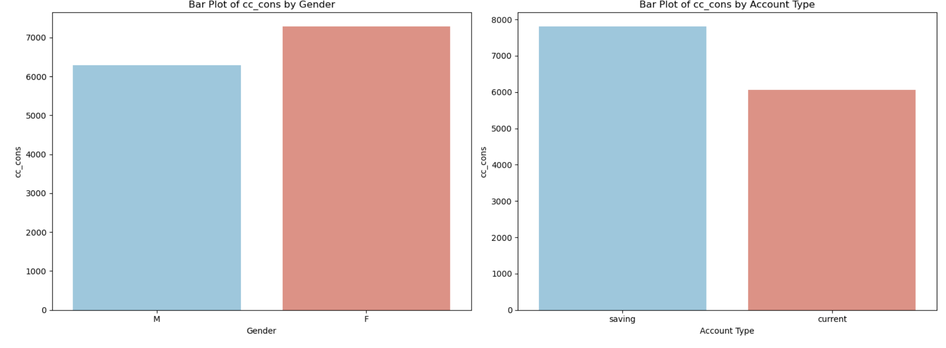
Visuals
Target variable analysis on categorical features

Slide 9
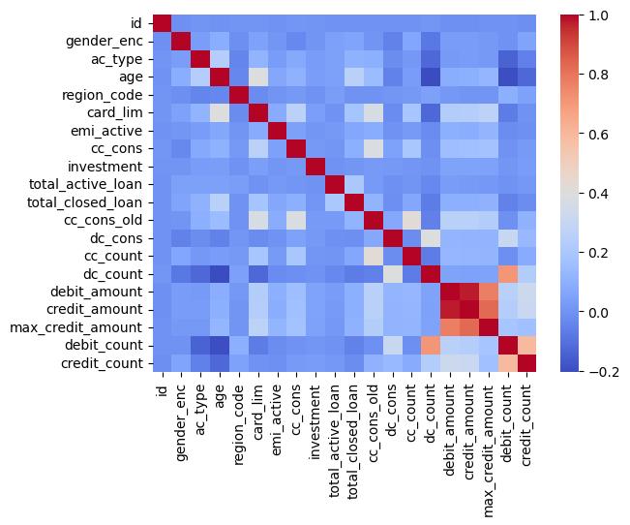
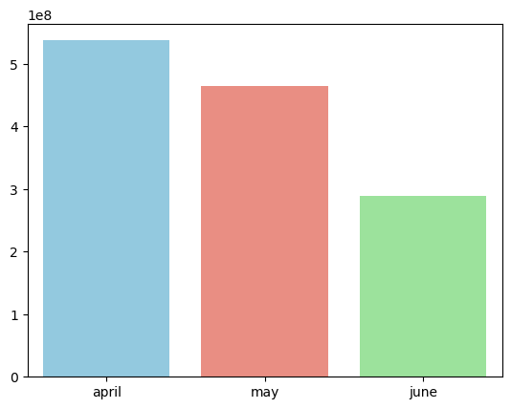
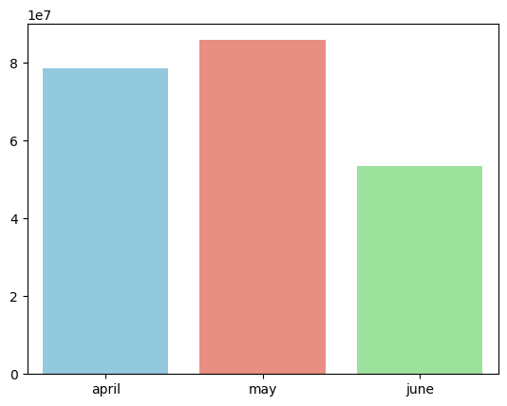
Visuals
(L) Seasonal Expenditure Trends, Credit and Debit Card
(R) Correlation Heatmap of features after preprocessing

Slide 10
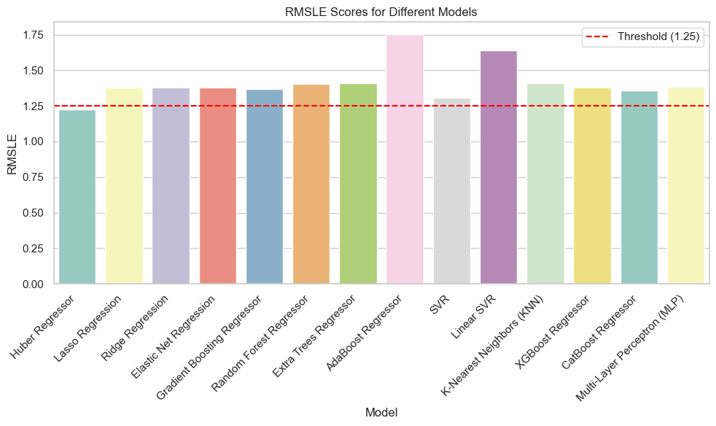
Visuals
Base model performances - 14 regressor models with different computation algorithms
Evaluation metric - root mean squared logarithmic error

Slide 11
Impact
Stacked Model Metrics:
Mean Squared Error: 106869096.3068
Mean Absolute Error:4651.9976192
R2 Score: 0.160097
RMSLE: 1.11760446
RMSLE*100 on Validation Online:
116.1218436

Slide 12
Thank You

