Slide 1
EDA- Facebook Data Analysis
Date: 28th March, 2022

Slide 2
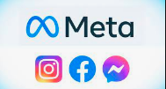
HELLO!
I AM SMITHA ABRAHAM
I am here to take you through my first journey doing an Exploratory Data Analysis on Facebook Utilization Dataset.
INSAID Program: PGP-DS & AI

Slide 3
Lets begin our story…
1

Slide 4
9 Step EDA Workflow
Introduction
Problem Statement
Installing & Importing Libraries
Data Acquisition & Description
Data Pre-Profiling
Data Pre-Processing
Data Post-Profiling
Exploratory Data Analysis
Conclusion & Actionable Insights

Slide 5
Introduction
Staying connected is what Facebook has offered it’s users across the globe.
Most of the time social applications fail to stay up to date, resulting in great loss to the company.
This method revolves around a deep interest in developing an understanding of the people for whom we’re designing the products or services.
.

Slide 6
Problem Statement
Here we are working on a Facebook dataset collected in the year 2013.
Trying to analyse what the dataset can offer in improving the business goals of Facebook.
We are trying to analyse the user’s likes and dislikes to understand the mistakes that can cause disengagement.
This will also help us observe and develop empathy with the target user.

Slide 7
Installing & Importing Libraries
Pandas library for Panel Data Analysis and Pandas Profiling to generate Univariate Analysis.
Numpy library for Numerical Analysis.
Matplotlib library for Plotting charts and graphs.
Seaborn library for Interactive Visualisation.

Slide 8
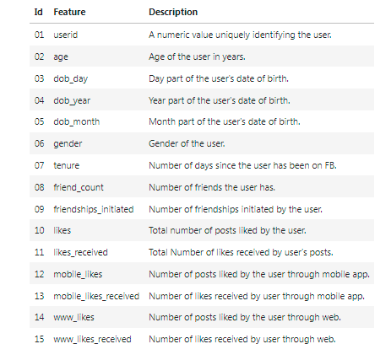
Data Acquisition & Description
The are total 99003
rows with 15 columns.
Column: "tenure" is of float64 datatype.
Column: "gender" is of object datatype.
Remaining columns are of int64 datatype.

Slide 9
Data Pre-Profiling & Data Pre-processing
Generated an HTML report using Pandas Profiling library.
According to the report, the following details were found:-
There were NO Duplicate records in the dataset.
Column : ‘gender’ had total 175 missing values. These missing values were replaced with new category name as “Not Specified”.
Column : ‘tenure’ had only 2 missing values hence they were replaced with the “median” value. On checking further it was observed that this column only had int64 values. Hence the datatype of this column was changed from float64 to int64 datatype.

Slide 10
Data Post-Profiling
During this phase, the following details were verified to check if the data is ready for further analysis:-
There were NO Duplicate records in the dataset.
Column : ‘gender’ now had NO missing values.
Column : ‘tenure’
This column has NO missing values.
The datatype of this column was changed from float64 to int64 datatype.

Slide 11
Exploratory Data Analysis (EDA)

Slide 12
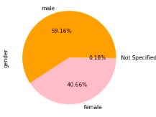
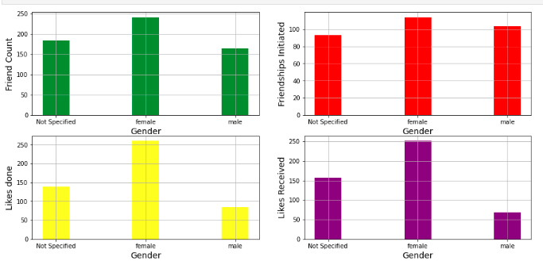
Analysis based on User’s Gender
Maximum number of the Facebook users are Males who constitute 59.16 % of the total.
Most of the female users are more Active Facebook users as compared to the male users, who have comparatively more accounts.

Slide 13


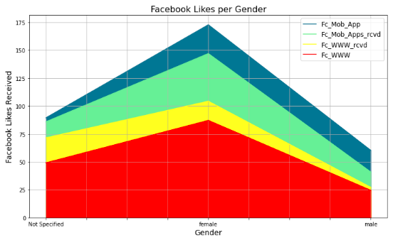
Facebook Mobile App vs Facebook Website
As per dataset, it is found that users prefer to use the mobile app version more as compared to web version.
The plot shows that female users are more Active as compared to other categories.

Slide 14
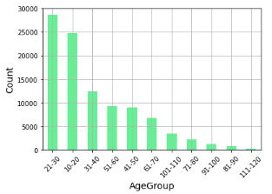
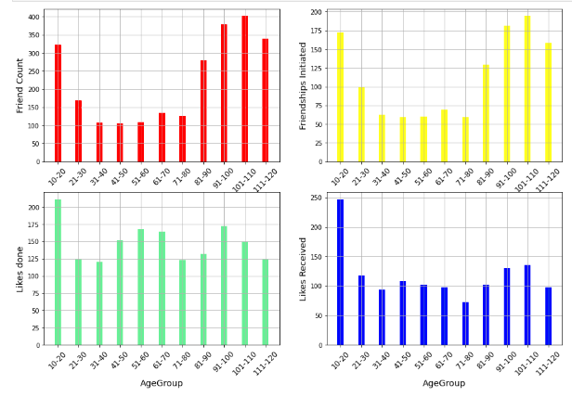
New columns for extensive analysis
(A) Column: AgeGroup- This column was created based on ‘age’ column to create age range.
Maximum Facebook users were aged between 21-30 years.
Most active Facebook users aged between 13-20 years. Since 13 years is permissible age limit for creating Facebook account.

Slide 15
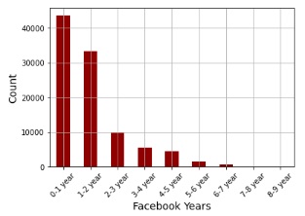
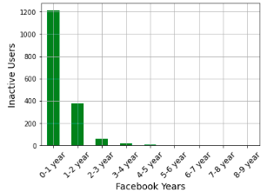
New columns for extensive analysis
(B) Column: Fc-Years- This column was created based on ‘tenure’ column to analyse the time period for which users had been using Facebook.
Maximum users had been using Facebook since 2012 or had just joined in 2013.
Most of them are Inactive users since they have recently joined
There are only 9 senior citizens aged between 91-113 years, who have been associated with Facebook since 2004-2005.

Slide 16
Conclusion & Actionable Insights
Steps should be taken to control creation of Fake Facebook Accounts. This will help in building a sense of safety among its users.
Senior citizens aged 91 years and above have had a long association with Facebook since 2004-2005. Hence this platform should be made more user friendly for them as most of them find it hard to stay up to date with the emerging technologies.
The Male users seem to be keeping a low profile as compared to other users. Some steps should be taken in order to understand their likes and dislikes and provide them with more options to stay connected.

Slide 17
THANK YOU !!

