Slide 1











Tekton Pipelines As Code
An opinionated CI based on Tekton Pipelines
Shivam Mukhade

Slide 2
Agenda
CI/CD Pipeline?
Tekton Pipelines Overview
Introduction to Pipelines As Code?
Why Pipelines As Code?
Demo :)
‹#›

Slide 3
What is a CI/CD pipeline?
A continuous integration and continuous deployment (CI/CD) pipeline is a series of steps that must be performed in order to deliver a new version of software. Ref.
By automating CI/CD throughout development, testing, production, and monitoring phases of the software development lifecycle, organizations are able to develop higher quality code, faster.
Examples:
When someone create a pull request, run unit test, e2e, build test and deploy
When a commit is merged, deploy the code
‹#›

Slide 4


An open-source project for providing a set of shared and standard components for building Kubernetes-style CI/CD systems
Governed by the Continuous Delivery Foundation
Contributions from Google, Red Hat, Cloudbees, IBM, Pivotal and many more

Slide 5
Example
If we do it manually for a go project..
git clone
go test..
golangci-lint run...
…
Done!
Now, let’s see how to define using Tekton resources...
git clone Task
go test Task
golanglint Task
(Go)
git clone Task
npm test Task
npm lint Task
(NodeJs)

Slide 6
Tekton Concepts
Pipeline
Task
Task
step
Task
step
Task
step
step
step
step
step
step

Slide 7
Tekton Concepts: Pipeline
kind: Pipeline
metadata:
name: deploy-dev
spec:
params:
- name: IMAGE_TAG
tasks:
- name: git
taskRef:
name: git-clone
params: [...]
- name: build
taskRef:
name: buildah
params: [...]
runAfter: ["git"]
- name: deploy
taskRef:
name: oc-deploy
params: [...]
runAfter: ["build"]
A graph of Tasks: concurrent & sequential
Tasks run on different nodes
Task execution logic
Conditional
Retries
Share data between tasks
git
build
deploy

Slide 8
Task, Pipeline & PipelineRun
kind: PipelineRun
metadata:
name: deploy-dev-run-1
spec:
pipelineRef:
name: deploy-dev
kind: Task
metadata:
name: git-clone
spec:
….
kind: Pipeline
metadata:
name: deploy-dev
spec:
params:
- name: IMAGE_TAG
tasks:
- name: git
taskRef:
name: git-clone
params: [...]
- name: build
taskRef:
name: buildah
params: [...]
runAfter: ["git"]
- name: deploy
taskRef:
name: oc-deploy
params: [...]
runAfter: ["build"]
git
kind: Task
metadata:
name: buildah
spec:
….
kind: PipelineRun
metadata:
name: deploy-dev-run-2
spec:
pipelineRef:
name: deploy-dev
build
deploy
kind: Task
metadata:
name: oc-deploy
spec:
….
kind: PipelineRun
metadata:
name: deploy-dev-run-3
spec:
pipelineRef:
name: deploy-dev

Slide 9
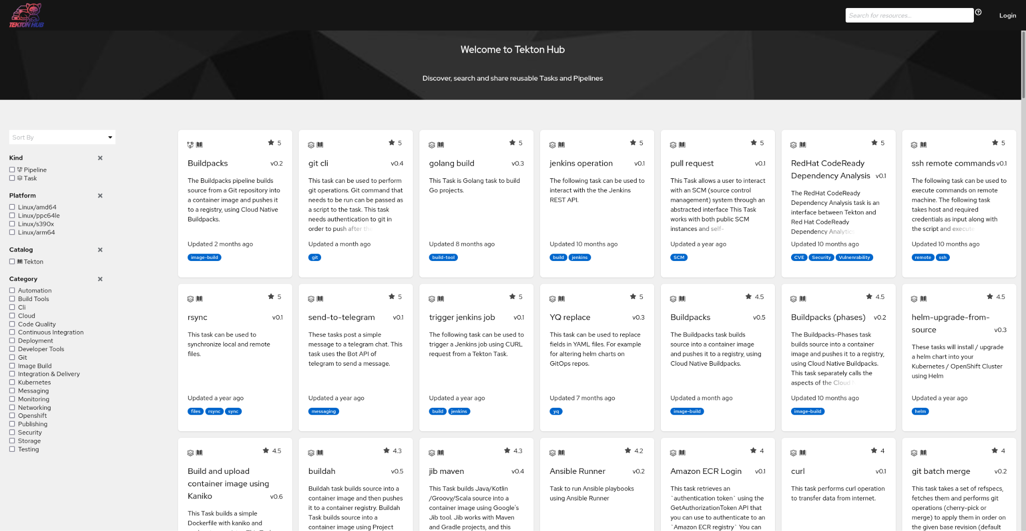
Tekton Hub (hub.tekton.dev)

Slide 10
Tekton Triggers
Event triggering with Tekton!
Triggers will execute pipeline but won’t report
Git Platform
(eg. GitHub)
Tekton Triggers
Start PipelineRun

Slide 11
Pipelines As Code

Slide 12
Overview
When a Pull Request is created, platform sends the Event
Execute the PipelineRun on behalf of User
Git Platform
(eg. GitHub)
Pipelines As Code
PipelineRun
Report the status back on the Pull Request
Kubernetes Cluster

Slide 13
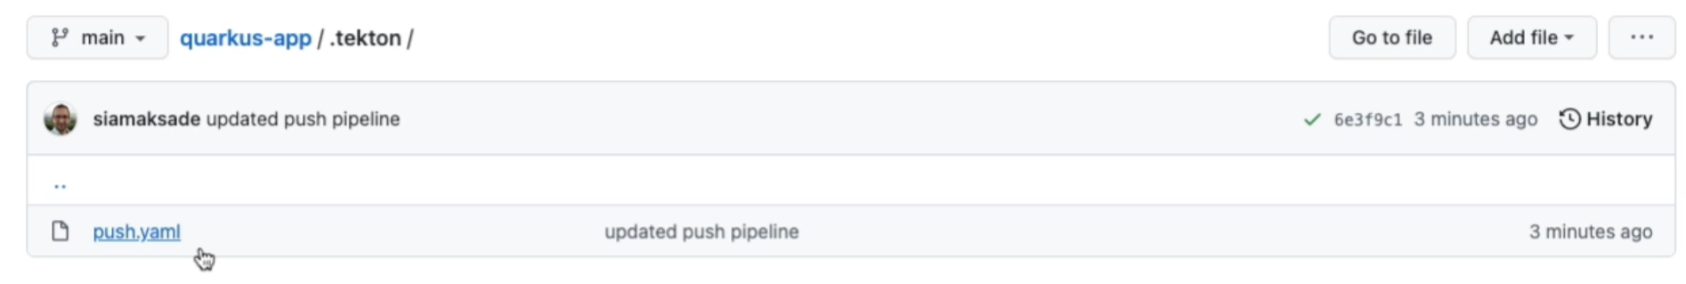
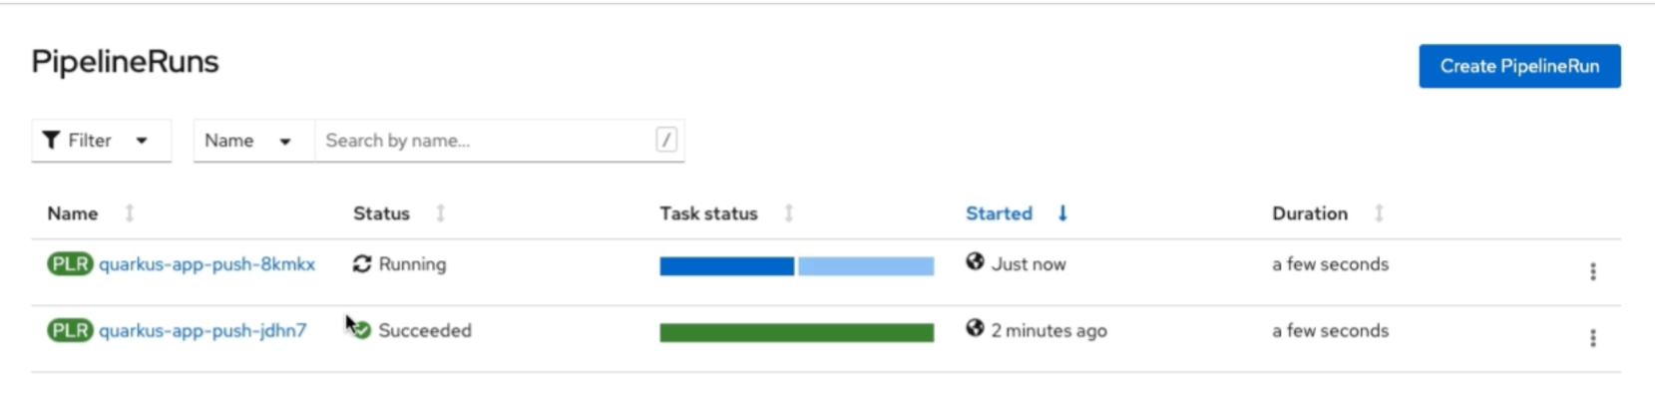
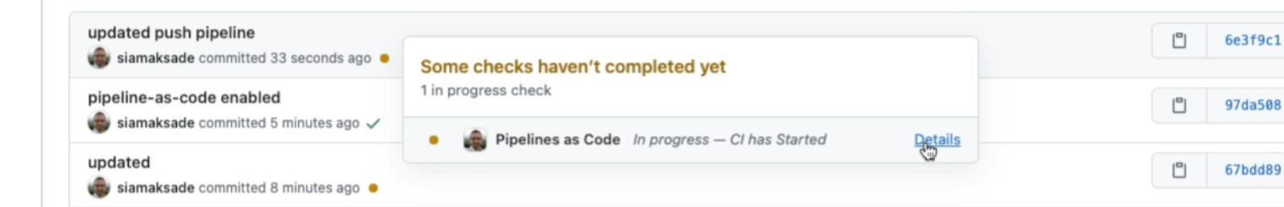
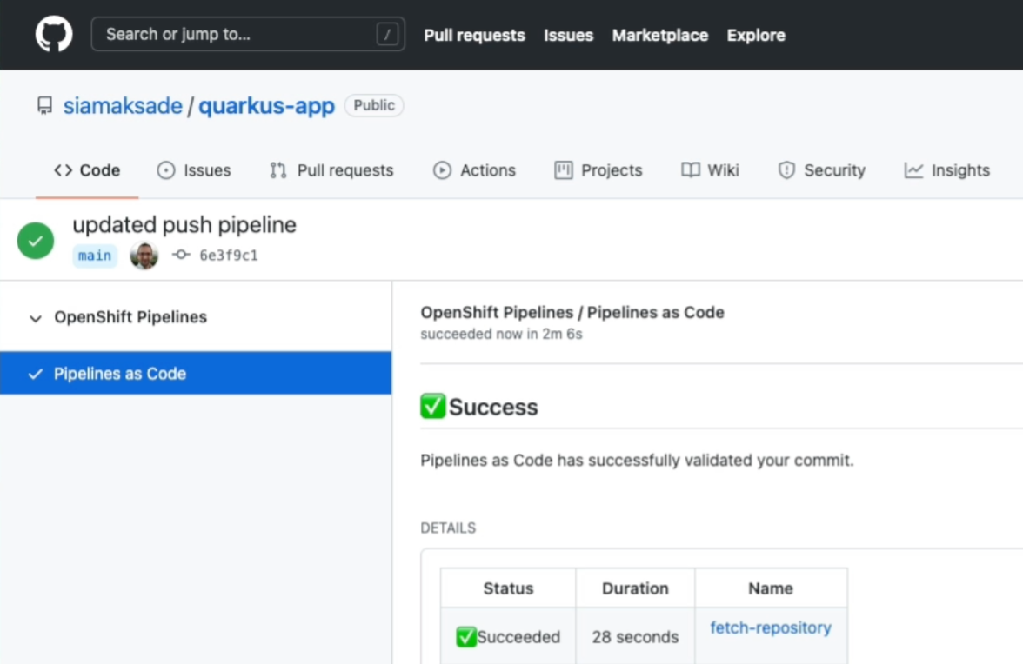
Pipelines as Code
Git as the source of pipeline definition
Pipelines retrieved and run from Git
Pipeline per Git event (push, pull-request)
Pipeline status on GitHub commit and pr
Integrated with GitHub Checks
Restart pipelines via pull-request comments
‹#›

Slide 14
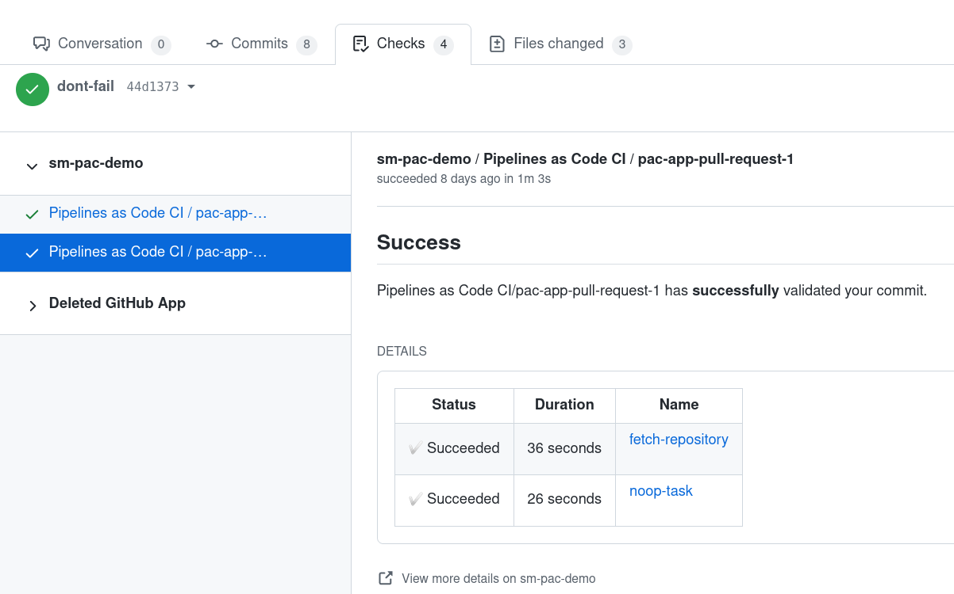
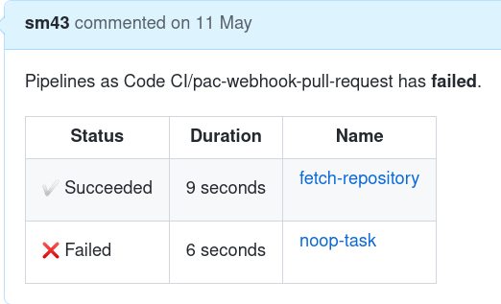
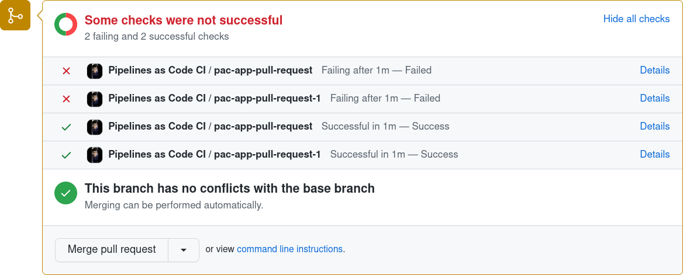
Pipelines as Code
Support using
GitHub App
Webhook
GitHub
GitLab
Bitbucket Cloud/Server
‹#›

Slide 15
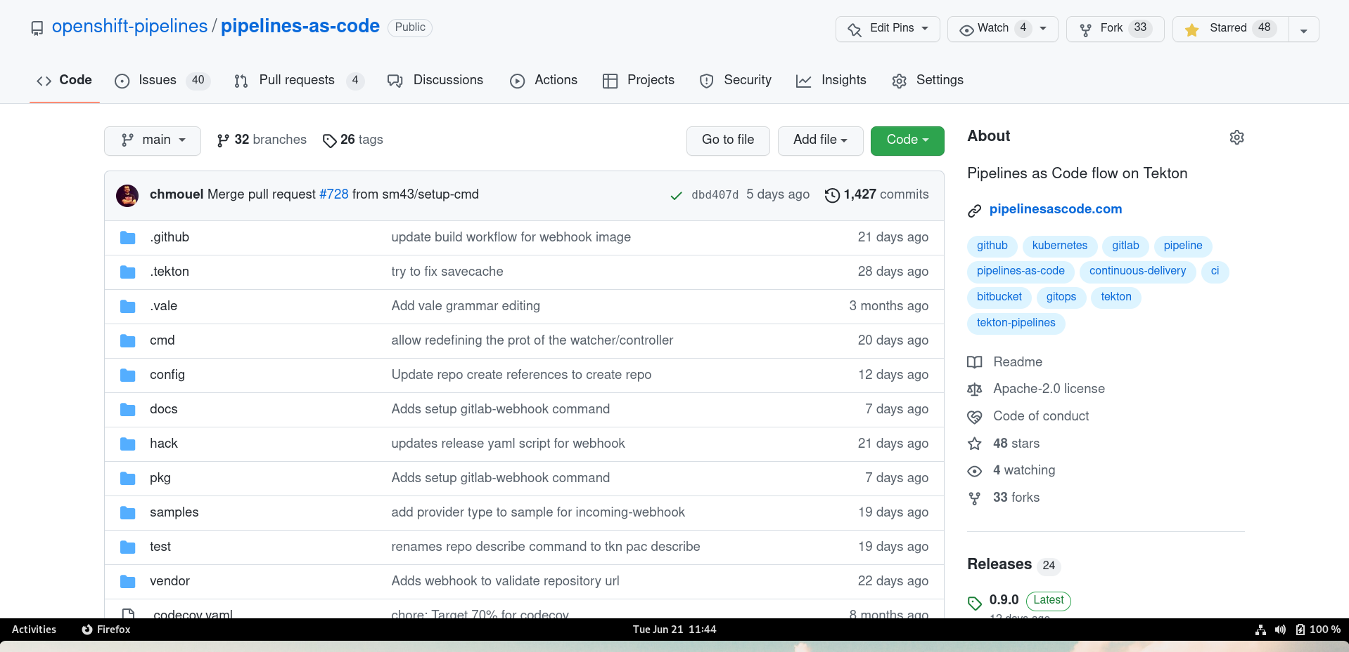
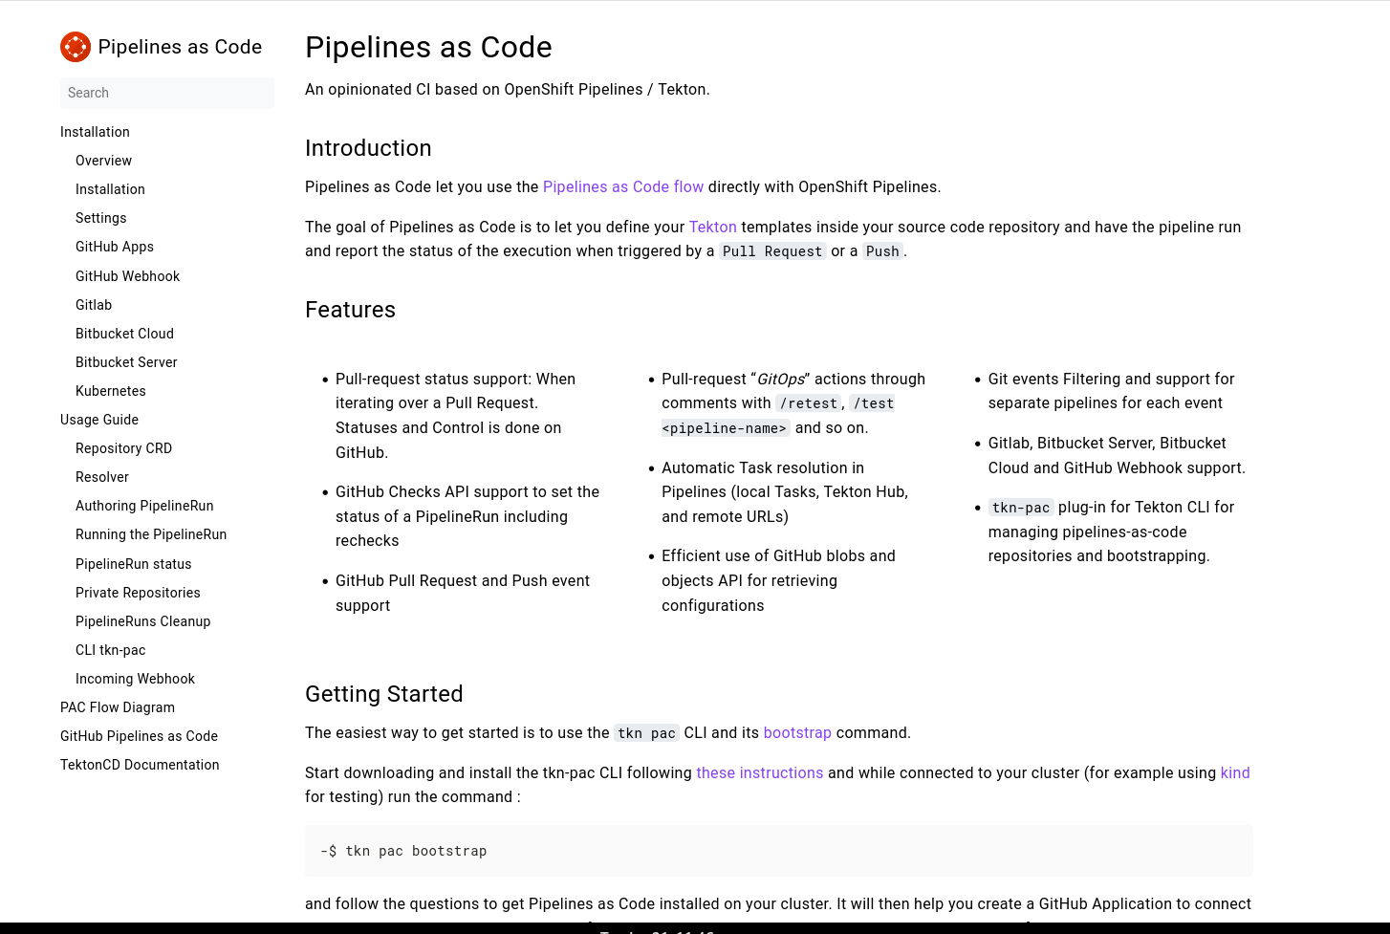
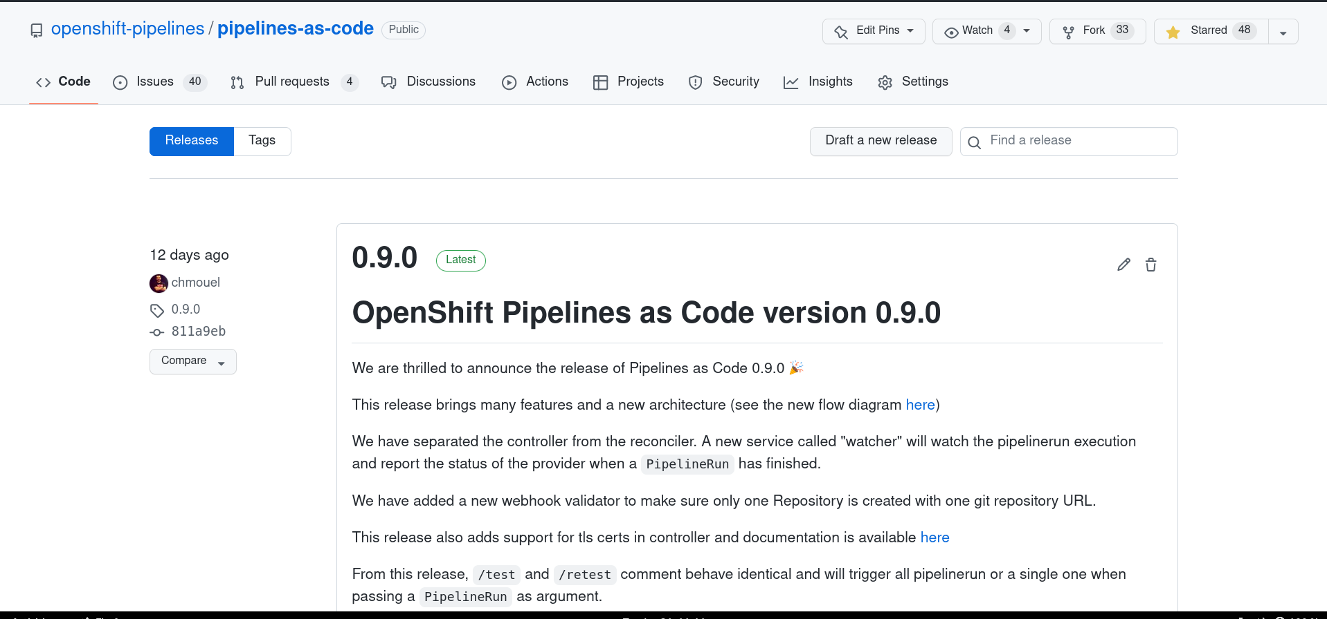
What’s Next?
openshift-pipelines/pipelines-as-code
https://pipelinesascode.com/
‹#›

Slide 16
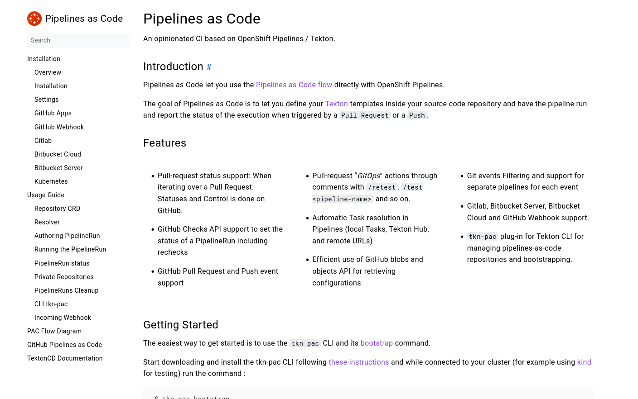
References
Pipelines As Code
https://pipelinesascode.com/
Blogs: (sm43.medium.com)
World of Tekton
OpenShift/Tekton Pipelines As Code
‹#›

Slide 17
Thank you
Pipelines As Code

