Slide 1
Modeling human working memory’s involvement in Bayesian inference
Sarah L. Master
Bayesian Modeling
Spring 2021

Slide 2
Introduction: Multiple systems for learning from reward
Reinforcement learning (RL)
Based in the basal ganglia
Reliant on dopaminergic reward prediction errors (RPE)
Learning from discrepancy between observed and expected outcomes (incremental)
Long-term, robust storage of values of actions
Working memory (WM)
Reliant primarily on prefrontal cortex
Instant, accurate storage of information
Capacity limited
Representations decay with time
Humans can use WM as storage in deterministic reward learning tasks to improve the speed of their learning (Collins & Frank, 2012)
Can we quantify the involvement of WM in a probabilistic RL task?

Slide 3
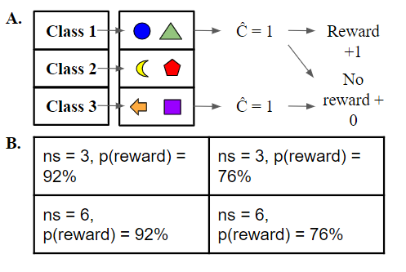
Methods: The Task
Subjects complete 14 independent learning blocks with varying set sizes (ns) and varying probabilities of reward.
There are three possible classes, which correspond to the correct action to take to get rewarded (1, 2, or 3)
Subjects must classify each stimulus through trial and error. They press one of three buttons and then receive +1 or +0 reward for their choice.

Slide 4
Methods: The Bayesian inference (BI) model
Subjects learn p(c|x,stim), where x is reward history.
Class learning is independent across stimuli, and I assume a flat prior over classes, so p(c|x,stim) simplifies to a function of evidence accumulated for one stimulus at a time:
p(c|x) = ∑^{T} p(x_{t}|c) where x is r = 1 or r = 0.
To receive feedback, subjects must make a choice (ĉ). The feedback from this choice is incorporated into the posterior over classes according to the following likelihoods:
p( r = 1 | ĉ = c ) = p_{reward}
p( r = 0 | ĉ = c ) = 1 - p_{reward}
p( r = 0 | ĉ ≠ c ) = 1
p( r = 1 | ĉ ≠ c ) = 0
Where p_{reward} is 0.92 or 0.76, depending on the block.
ĉ = 2
r = 1 r = 0
p(c|x_{t})

Slide 5
Methods: The Bayesian inference (BI) model
Evidence is stored in working memory as it comes in. Older evidence, capacity K trials ago or more, has 50% chance of decay.
1 | 1 | 1
0 | 1 | 0
1 | 1 | 1
1 | 1 | 1
0 | 1 | 0
1 | 1 | 1
1 | 1 | 1
0 | 1 | 0
1 | 1 | 1
All pieces of evidence are put into storage in the order they come in, preserving stimulus & action information, but lining all information up together in temporal order.
1 | 1 | 1
0 | 1 | 0
1 | 1 | 1
K = 5
1 | 1 | 1
0 | 1 | 0
1 | 1 | 1
1 | 1 | 1
0 | 1 | 0
1 | 1 | 1
1 | 1 | 1
0 | 1 | 0
1 | 1 | 1
0.4 | 0.2 | 0.4
1 | 1 | 1
1 | 1 | 1

Slide 6
Methods: The reinforcement learning (RL) model
Q (value) learner, with forgetting & incremental updates:
Q_{t}(s,c) = Q_{t}(s,c) + α*(r - Q_{t-1}(s,c))
where s is the stimulus at hand, c is the button response (classification), α is the RL learning rate, and r is the reward just seen (0 or 1).
Q values also decay back to their initial values (Q_{init}) with time through a forget parameter:
Q = Q - forget*(Q - Q_{init})
In both RL and BI models, choices are made with a softmax procedure, with inverse temperature parameter ꞵ.

Slide 7
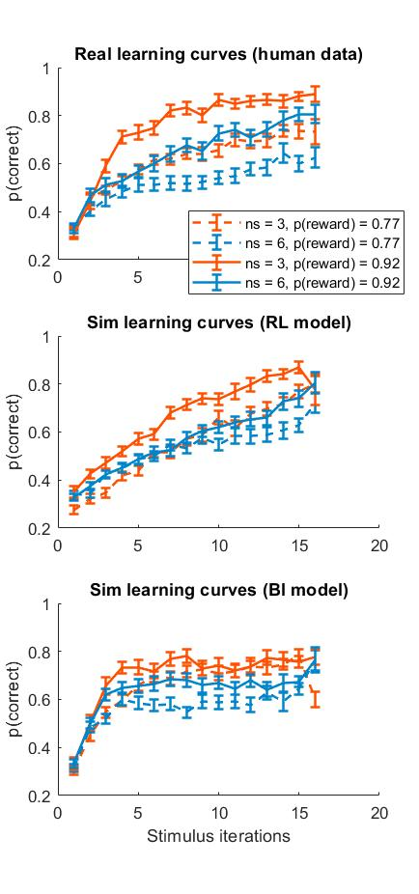
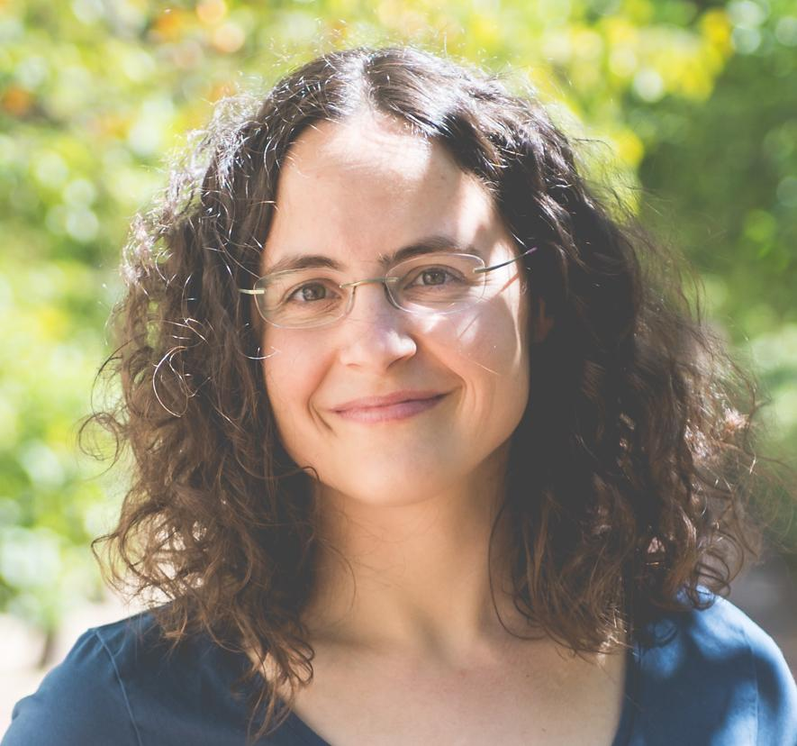
Results: Human learning curves
N = 35
Subjects learn correct actions very quickly in blocks with more reliable feedback and small set size.
There are clear effects of both set size and uncertainty in asymptotic accuracy, as well as speed of learning.
Thanks to Prof Anne Collins for these data

Slide 8
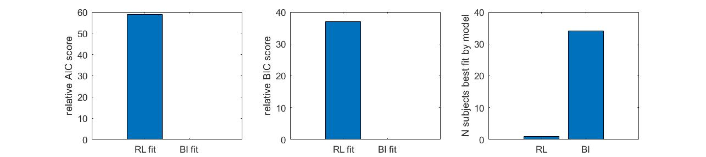
Results: Model comparison

Slide 9
Results: Simulated learning curves

Slide 10
Discussion: Seems WM is involved to some degree in Bayesian inference in this task
The BI model with capacity limitations & temporal decay is the winning model in terms of AIC & BIC, and it nicely reproduces many aspects of human learning curves.
...but not perfectly!
Future directions:
Test a hybrid model which involves both systems
Play around with other free parameters in the BI model, like the probability of decay past capacity
Fix the recovery of the ꞵ parameter in both models (will help clarify the set size & uncertainty effects in simulated behavior)

Slide 11
Acknowledgements
Thank you to Professor Anne Collins and William Ryan for use of the data.
Thank you to Wei Ji and to Hormet for the helpful feedback on my BI model.
And thanks to my classmates for a fun semester of Bayesian Modeling :)

