Slide 1
Typology Analysis
There are two sets of Typologies:
Archive – Typologies that have been archived – we have no visibility of how many times these have be observed within the data
Latest – Typologies extracted from the latest batch of data – we have counts on the number of times each typology is observed
By analysing the Archive and latest typologies found there are 2 large distinct clusters of typologies that cover a large proportion of the typologies
There are a number of other clusters, some large and some small
The largest captures different permutations of 5 red flag indicators
The second largest has the same 2 red flag indicators repeated with a number of individual red flag indicators
Once these two clusters have been processed other clusters would need only a small number of other red flag indicators to get a full coverage of typologies
Assumption: All red flag indicators can be processed

Slide 2
Archived Typology Clustering
18, 19
4, 6, 7, 14
(9)
Numbers in brackets show number of typologies described by each cluster
16, 22
(10)
17, 19
(11)
2, 19
(2)
2, 18
(2)
21, 18, 16,
15, 6
(7)
16, 18
(2)
15, 18
(3)
12, 15
(2)
15, 20
(2)
2 A single client depositing multiple cheques for the prevailing monthly minimum domestic worker wage.
4 Cash deposits made at multiple locations
6 Change of the Name / Surname on an account of a female customer such as to suggest a sham marriage
7 Customer is making frequent ATM cash withdrawals at unusual time such as middle of the night (2200-0600) with no apparent legitimate reason
12 Frequent payments for travel related expenses to/from high-risk countries
14 High volume of credit card authorisations for accommodation/ vehicles with no subsequent charge, suggesting payment was made in cash
15 Income of the personal account owner is significantly higher than expected
16 Living expenses that suggest sustenance of many individuals
17 Payments made to advertisers of illicit services
18 Payments made to/received from blacklisted recruitment agencies
19 Phone number/ email address associated with a customer is also found on escort/ sex/ adult service advertisements.
20 Unexplained payments to high-risk jurisdictions for modern slavery
21 Unusually high number of unrelated individuals residing at the same address
22 When making F2F payments individual customer is repeatedly avoiding ID threshold, indicating an individual’s ID documents may have been taken from him/her

Slide 3
Latest Typology Clustering
18, 19
4, 6, 7, 14
(0)
Numbers in brackets show number of instances found in latest set
16, 22
(42)
17, 19
(426)
2, 19
(0)
2, 18
(1)
21, 18, 16,
15, 6
(521)
16, 18
(4)
15, 18
(0)
12, 15
(0)
15, 20
(13)
Red Circles in latest and archive
Blue Circles only in archive
2 A single client depositing multiple cheques for the prevailing monthly minimum domestic worker wage.
4 Cash deposits made at multiple locations
6 Change of the Name / Surname on an account of a female customer such as to suggest a sham marriage
7 Customer is making frequent ATM cash withdrawals at unusual time such as middle of the night (2200-0600) with no apparent legitimate reason
12 Frequent payments for travel related expenses to/from high-risk countries
14 High volume of credit card authorisations for accommodation/ vehicles with no subsequent charge, suggesting payment was made in cash
15 Income of the personal account owner is significantly higher than expected
16 Living expenses that suggest sustenance of many individuals
17 Payments made to advertisers of illicit services
18 Payments made to/received from blacklisted recruitment agencies
19 Phone number/ email address associated with a customer is also found on escort/ sex/ adult service advertisements.
20 Unexplained payments to high-risk jurisdictions for modern slavery
21 Unusually high number of unrelated individuals residing at the same address
22 When making F2F payments individual customer is repeatedly avoiding ID threshold, indicating an individual’s ID documents may have been taken from him/her

Slide 4
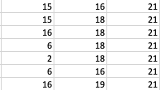
CLUSTER 1
Focusing on the largest cluster (based on instances)
There are multiple permutations of the 5 key red flag indicators (shown in the table to the left) which allow 6 Typologies to be covered by processing 5 red flag indicators
21, 18, 16,
15, 6
(521)
Key (6 Typologies covered)
RF number | Description
21 | Unusually high number of unrelated individuals residing at the same address
18 | Payments made to/received from blacklisted recruitment agencies
16 | Living expenses that suggest sustenance of many individuals
15 | Income of the personal account owner is significantly higher than expected
6 | Change of the Name / Surname on an account of a female customer such as to suggest a sham marriage
Auxiliary (4 Typologies covered)
RF number | Description
2 | A single client depositing multiple cheques for the prevailing monthly minimum domestic worker wage
19 | Phone number/ email address associated with a customer is also found on escort/ sex/ adult service advertisements

Slide 5
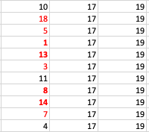
CLUSTER 2
Red indicates the red flag indicator appears in a previous cluster
17, 19
(426)
Now look at the second largest cluster
This one has two of the same indicators repeated throughout
(17 and 19)
Key (1 Typologies covered)
RF number | Description
17 | Payments made to advertisers of illicit services
19 | Phone number/ email address associated with a customer is also found on escort/ sex/ adult service advertisements
Auxiliary (22 Typologies covered)
RF number | Description | No Observations
13 | High frequency of beauty related payments that do not relate to the nature of business/ expected account activity | 194
14 | High volume of credit card authorisations for accommodation/ vehicles with no subsequent charge, suggesting payment was made in cash | 94
1 | An individual customer’s account is showing an unusual pattern of frequently changing a location, evident from everyday spending (such as food), especially if in high-risk countries, that is inconsistent with customer’s profile with no apparent legitimate reason | 77
Continued on next page

Slide 6
Auxiliary - continued
RF number | Description | No Observations
8 | Customer is making frequent cash deposits via multiple ATMs and deposits are shortly followed by ATM cash withdrawals in different locations | 34
7 | Customer is making frequent ATM cash withdrawals at unusual time such as middle of the night (2200-0600) with no apparent legitimate reason | 14
5 | Cash deposits made outside usual industry business hours | 10
18 | Payments made to/received from blacklisted recruitment agencies | 2
3 | Business customer providing beauty services (such as nail bars, massage salons or spas) with high frequency of payments made by male customers | 1
10 | Customers with business types such as massage salons, spas, nightclubs, and adult entertainment establishments etc. show frequent double-charge patterns, where two transactions for the same card account are submitted within one hour of each other | 0
11 | Customer withdraws very large amount of cash prior to foreign travel, that can be accompanied by foreign exchange transactions in large amounts, inconsistent with customer’s profile and stated income | 0
4 | Cash deposits made at multiple locations | 0

Slide 7
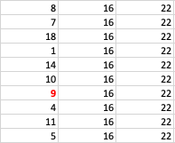
CLUSTER 3
Red indicates the red flag indicator appears in a previous cluster
16, 22
(42)
Now look at the third largest cluster
By processing the key red flag indicator 22 we add 9 typologies
Key (9 Typologies covered)
RF number | Description
16 | Living expenses that suggest sustenance of many individuals
22 | When making F2F payments individual customer is repeatedly avoiding ID threshold, indicating an individual’s ID documents may have been taken from him/her
Auxiliary (2 Typologies covered)
RF number | Description | No Observations
9 | Customer’s personal account is showing a pattern where received payments appear to be state benefits that is inconsistent with customer’s profile. Account shows no personal spending after that would indicate normal activity | 32
7 | Customer is making frequent ATM cash withdrawals at unusual time such as middle of the night (2200-0600) with no apparent legitimate reason | 4
11 | Customer withdraws very large amount of cash prior to foreign travel, that can be accompanied by foreign exchange transactions in large amounts, inconsistent with customer’s profile and stated income | 2
Continued on next page

Slide 8
Auxiliary - continued
RF number | Description | No Observations
8 | Customer is making frequent cash deposits via multiple ATMs and deposits are shortly followed by ATM cash withdrawals in different locations | 2
1 | An individual customer’s account is showing an unusual pattern of frequently changing a location, evident from everyday spending (such as food), especially if in high-risk countries, that is inconsistent with customer’s profile with no apparent legitimate reason | 1
14 | High volume of credit card authorisations for accommodation/ vehicles with no subsequent charge, suggesting payment was made in cash | 1
5 | Cash deposits made outside usual industry business hours | 0
18 | Payments made to/received from blacklisted recruitment agencies | 0
10 | Customers with business types such as massage salons, spas, nightclubs, and adult entertainment establishments etc. show frequent double-charge patterns, where two transactions for the same card account are submitted within one hour of each other | 0
4 | Cash deposits made at multiple locations | 0

Slide 9

CLUSTER 4
Red indicates the red flag indicator appears in a previous cluster
Now look at the fourth largest cluster
By processing the fourth cluster all red flags and typologies are processed
15, 20
(13)
Key (1 Typologies covered)
RF number | Description
15 | Income of the personal account owner is significantly higher than expected
20 | Unexplained payments to high-risk jurisdictions for modern slavery
Auxiliary (4 Typologies covered)
RF number | Description | No Observations
12 | Frequent payments for travel related expenses to/from high-risk countries | 13
11 | Customer withdraws very large amount of cash prior to foreign travel, that can be accompanied by foreign exchange transactions in large amounts, inconsistent with customer’s profile and stated income | 0
All red flag indicators and typologies have now been covered

Slide 10
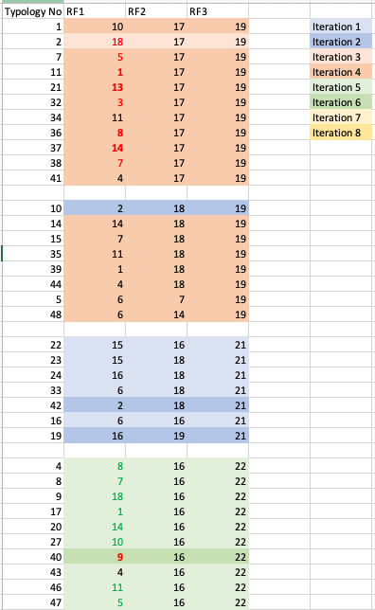
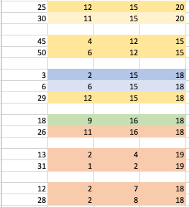
Typology Clustering
Cluster 2
The light orange shows the typologies supported by processing the key indicators, the dark orange is when the auxiliary indicators are processed. There are 10 auxiliaries that need to be processed
Automatic
No extra work is required for this cluster – automatically completed once cluster 1 and cluster 2 have been processed
Cluster 1
The light blue shows the typologies supported by processing the key indicators, the dark blue is when the auxiliary indicators are processed
Cluster 3
Processing the one key indicator (light green) supports a further 9 typologies
Cluster 4
Processing the one key indicator (light orange) and the remaining auxiliary indicator provides a full coverage of all typologies
Automatic
Automatic
Automatic
No extra work is required for these clusters
Automatic
Automatic

