Slide 1

BADRUKA | SCHOOL OF MANAGEMENT
Coca-Cola
HOW CAN COCA-COLA
OPTIMIZE INVENTORY &
DISTRIBUTION?
Across markets • Evidence-based business analytics
Dataset-led PGDM case study | MySQL · Python · Databricks · Power BI
PGDM | BIG DATA ANALYTICS & DBMS
01

Slide 2
Coca-Cola | BIG DATA & DBMS
Our project workflow: from data to decisions
Sequence of tools, purpose, and current verification status
01
Kaggle → CSV
02
Excel / CSV
03
MySQL + DBeaver SQL
Data acquisition
Data audit
Store & query
Coca-Cola dataset supplied; Kaggle origin stated by student, source URL not yet verified.
50,000 rows and 31 fields; checks for missing values, duplicates and consistency.
Schema and 16 analytical queries prepared for market, demand, inventory and transport.
SOURCE TO VERIFY
ANALYZED
EXECUTION PENDING
04
Python
05
Tableau / Power BI
06
Report
Analyze & visualize
Dashboard layer
Optimization plan
pandas profiling, aggregations and four dataset-based analytical charts.
Interactive charts and KPI monitoring; Tableau usage and Power BI execution not evidenced.
Review overstock, reorder levels, forecast gaps and distribution costs.
ANALYZED
TO BE COMPLETED
RECOMMENDATIONS
Important: Kaggle is a student-reported source; no listing URL has been verified. Tableau and Power BI are not presented as executed outputs.
PGDM | BIG DATA ANALYTICS & DBMS
WORKFLOW | 13

Slide 3
BADRUKA | SCHOOL OF MANAGEMENT
Coca-Cola
The business challenge
Right product. Right market. Right quantity. Right time.
Demand varies by market
Excess stock ties up cash
Distribution adds cost
A single inventory rule risks mismatching different market needs.
Overstock indicators are widespread in the sample.
Transportation lead time and expense vary by mode.
Decision to solve
How should replenishment, inventory allocation, and transport selection differ across markets?
PGDM | BIG DATA ANALYTICS & DBMS
02

Slide 4
BADRUKA | SCHOOL OF MANAGEMENT
Coca-Cola
What did we actually analyze?
One supplied inventory and distribution CSV; figures are dataset-level, not corporate disclosures.
50,000
8
10
31
Records
Markets
Products
Original fields
Method
CSV quality checks → MySQL-ready design → Python analysis → recommendations → proposed BI validation
Caution: this is an analytical project dataset; its provenance and operational definitions still need confirmation.
PGDM | BIG DATA ANALYTICS & DBMS
03

Slide 5
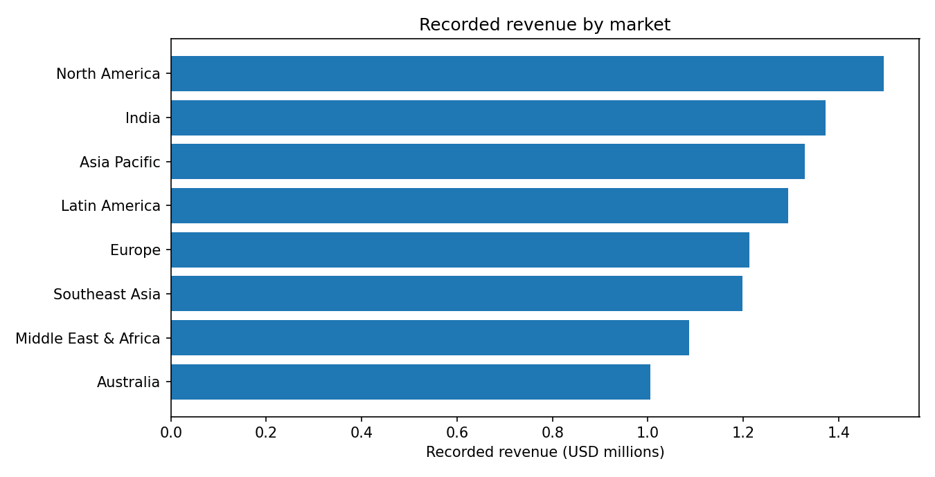
BADRUKA | SCHOOL OF MANAGEMENT
Coca-Cola
Market-level revenue tells us where to focus
Recorded revenue by market in the supplied dataset.
Key insight
North America
Highest recorded revenue: $1.49M
Allocation should reflect demand and service risk—not revenue alone.
PGDM | BIG DATA ANALYTICS & DBMS
04

Slide 6
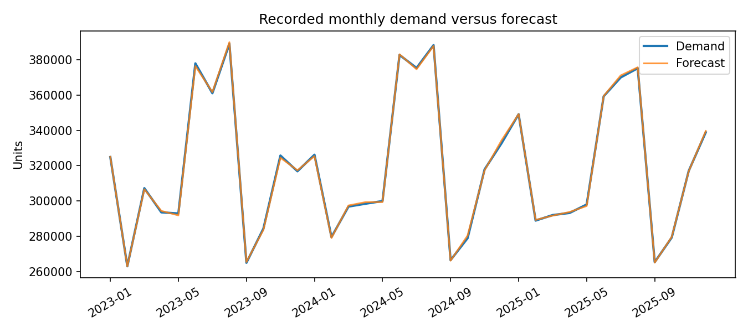
BADRUKA | SCHOOL OF MANAGEMENT
Coca-Cola
Seasonality changes replenishment needs
Demand across monthly records; spikes merit investigation before changing policy.
Planning implication
Use rolling demand forecasts by market and product, with seasonal overrides.
Verify seasonal labels and date granularity first.
PGDM | BIG DATA ANALYTICS & DBMS
05

Slide 7
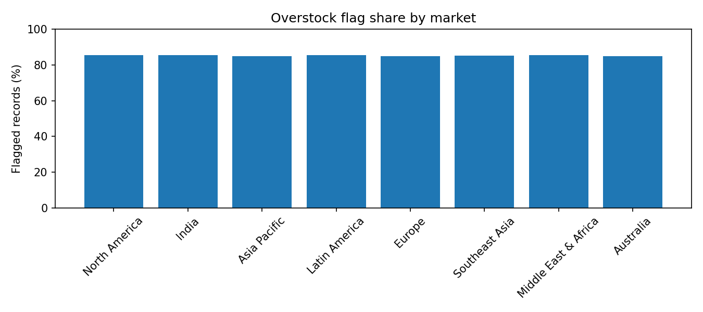
BADRUKA | SCHOOL OF MANAGEMENT
Coca-Cola
The clearest warning sign: potential excess stock
Overstock is a source-data flag, not a validated cash-savings estimate.
85.2%
42,598 records flagged overstock
Recommendation: diagnose product × market combinations, then test lower order quantities.
PGDM | BIG DATA ANALYTICS & DBMS
06

Slide 8
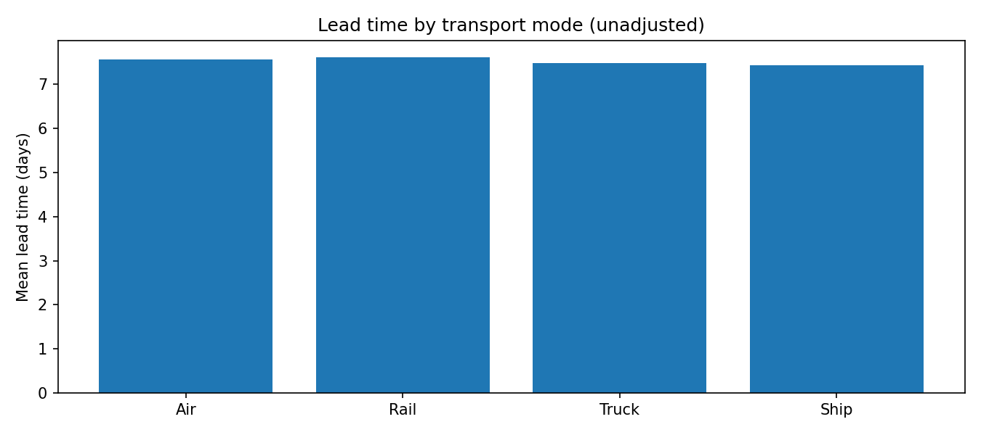
BADRUKA | SCHOOL OF MANAGEMENT
Coca-Cola
Transport choices require more than cost
Average recorded lead time by transport mode; observational differences are not causal.
Transport spend
$478,330
Recorded across all modes
Compare unit cost, distance, urgency and route before mode switching.
PGDM | BIG DATA ANALYTICS & DBMS
07

Slide 9
BADRUKA | SCHOOL OF MANAGEMENT
Coca-Cola
Proposed solution: smarter inventory allocation
A testable policy—not a claimed implemented optimization.
1 Segment demand
2 Set stock rules
3 Review replenishment
Rank market × product demand, variability and cost-to-serve.
Estimate safety stock and reorder points using demand and lead time.
Flag overstock and below-reorder cases for planner action.
Illustrative policy
Reorder point = expected demand during lead time + safety stock
Before deployment: check units, time intervals, forecast bias and missing stock-movement definitions.
PGDM | BIG DATA ANALYTICS & DBMS
08

Slide 10
BADRUKA | SCHOOL OF MANAGEMENT
Coca-Cola
Practical examples: what other companies teach us
External case studies; these are not results from the Coca-Cola dataset.
Walmart — shared demand visibility
Zara — analytics-led allocation
Retail Link illustrates the value of coordinated replenishment and supplier data sharing.
Operations research has been used to improve store-level distribution decisions.
Transferable lesson
Combine reliable demand signals, allocation rules, and frequent performance review.
References: INFORMS Zara case study; Walmart Retail Link case study (full URLs in speaker notes).
PGDM | BIG DATA ANALYTICS & DBMS
09
Notes:
[Sources]
https://www.informs.org/Impact/O.R.-Analytics-Success-Stories/Zara-Uses-Operations-Research-to-Reengineeer-Its-Global-Distribution-Process
https://iprjb.org/journals/IJSCM/article/view/3311

Slide 11
BADRUKA | SCHOOL OF MANAGEMENT
Coca-Cola
What would success look like?
Pilot the recommendations; measure results before asserting impact.
Inventory
Forecasting
Distribution
Lower overstock rate and holding cost with no service deterioration.
Lower forecast WAPE by market, product and season.
Lower adjusted cost per delivered unit and lead-time variation.
Pilot design
Select high-overstock product–market pairs → compare baseline vs pilot → assess service, cost and waste.
PGDM | BIG DATA ANALYTICS & DBMS
10

Slide 12
BADRUKA | SCHOOL OF MANAGEMENT
Coca-Cola
What the evidence cannot yet prove
Academic integrity: limitations matter as much as dashboards.
No recorded stock-out variation
Inventory reconciliation gaps
Stockout_Flag is zero and Fill_Rate_Percent is 100% throughout.
3,841 records differ under an assumed stock-flow equation.
Origin and definitions
Tool evidence pending
Dataset source, sampling and metric semantics need verification.
No DBeaver, Databricks or Power BI execution is claimed here.
Conclusion: optimize through a verified, measured pilot—not unsupported promises of cost savings.
PGDM | BIG DATA ANALYTICS & DBMS
11

Slide 13
BADRUKA | SCHOOL OF MANAGEMENT
Coca-Cola
Thank you
Inventory intelligence becomes business value when measured decisions improve service and cost.
Coca-Cola Inventory & Distribution Across Markets
Questions & Discussion
Prepared for Badruka School of Management | PGDM Big Data Analytics & DBMS
PGDM | BIG DATA ANALYTICS & DBMS
12

